Slide 1
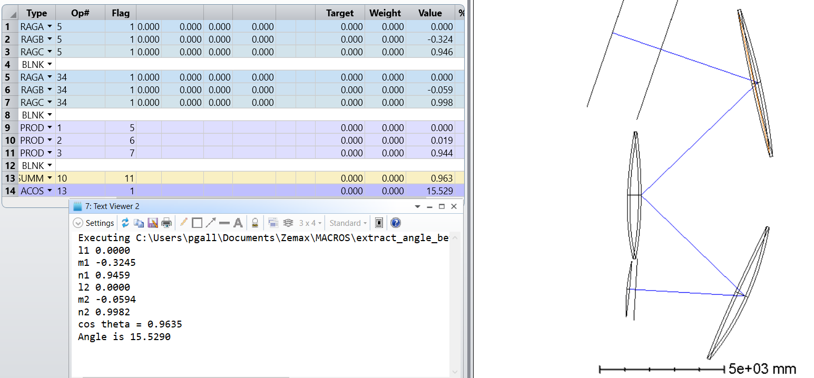
Chief ray boresight-focal plane angle
For the boresight, take chief ray direction in global coordinates before primary (u)
Take chief direction ray at focal plane (v)
Angle=arccos(u dot v)
Test with merit function, script it for future use (see github).
Angle between

Slide 2
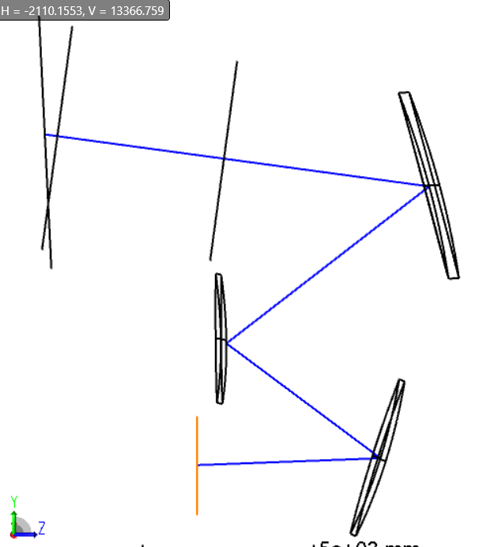
SP TMA
Special case, off axis fields
Evaluate explicitly
Angle is 9.95 degrees

Slide 3
F/# options
f/# | Boresight-focal plane angle [deg]
3.7 SP TMA | 9.95
2.5 | 15.5
2.8 | 13.6
3.1 | 16.5
3.3 | 20.4
3.6 | 15.5
3.25 | 14.4
3.0 | 17.5
3.15 | 12.9

