Slide 1

China’s National Disability Prevention Action Plan
(2026 to 2030)
--Implications for the newborn-related IVD industry in China
Yvette Yao 10/15/2026

Slide 2
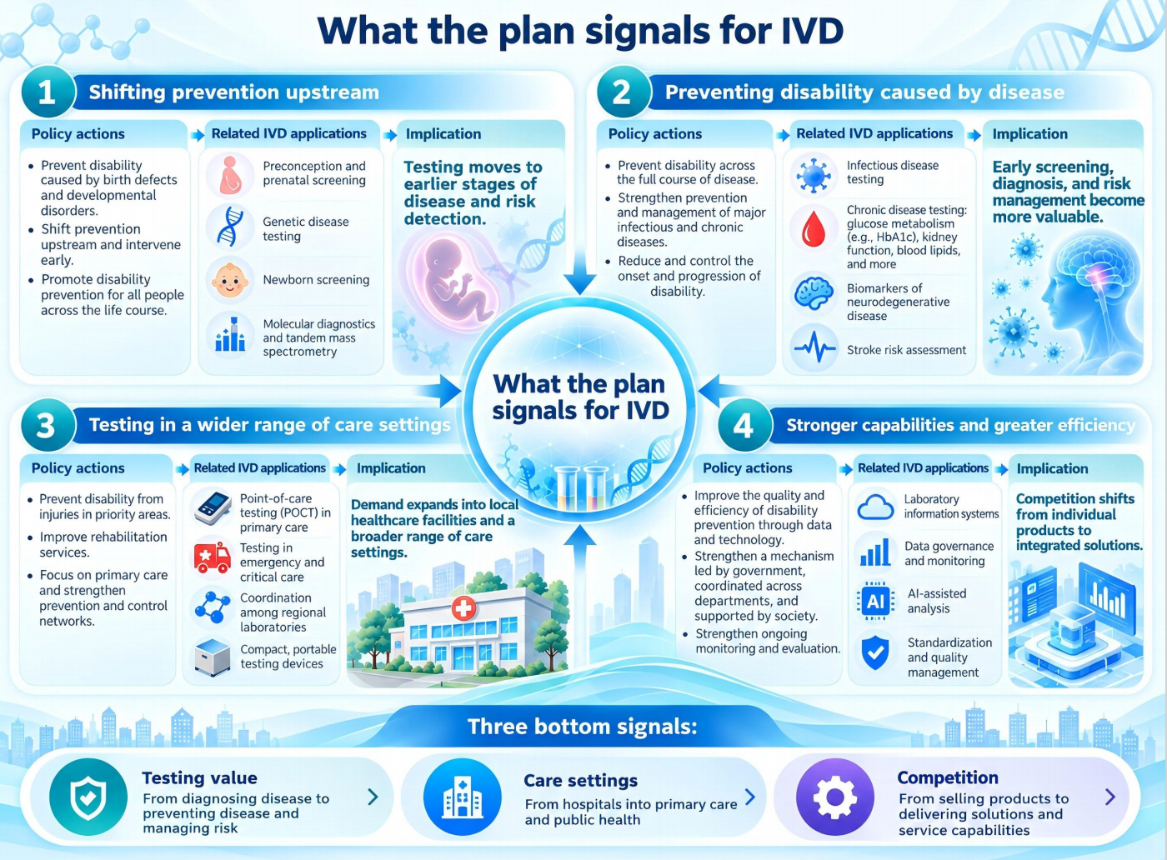
01
A new round of IVD
competition
The National Disability Prevention Action Plan for 2026 to 2030 (hereinafter referred to as the “plan”) release signals a nationwide effort to strengthen the healthcare system through prevention, early detection, and targeted intervention.
A new round of competition is taking shape in the IVD industry.
Companies that can detect disease earlier, assess risk more accurately, and connect patients more effectively with clinical intervention will be better positioned to succeed.

Slide 3
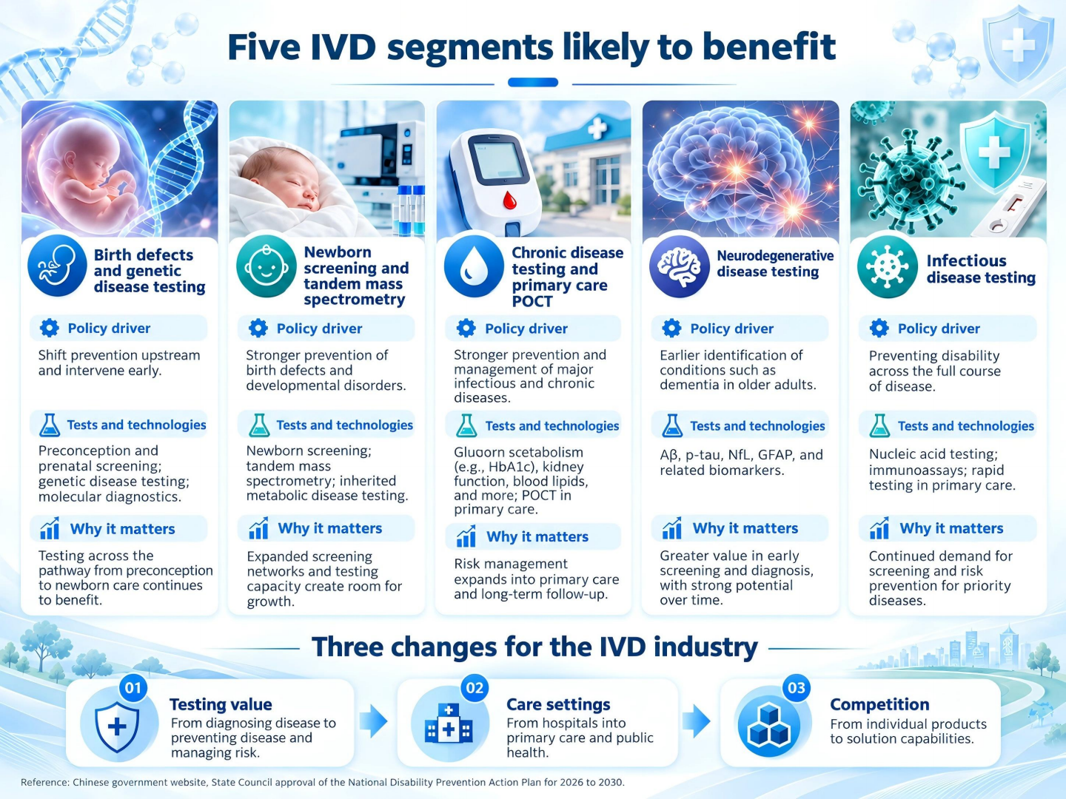
02
Clear Opportunities in Newborn and Genetic Disease Screening
The plan sets out six actions. Their implications for IVD span five key areas, two of which are directly relevant to newborn and genetic disease screening.
1) Newborn screening and clinical mass spectrometry.
The focus on children ages 0 to 6 and coordinated support across the care pathway creates favorable conditions for disorders like LSDs, for which timely detection and treatment are important.
2) Testing for birth defects and genetic diseases.
From preconception carrier screening and NIPT to chromosomal testing and molecular diagnosis of genetic diseases. China strengthens its system for preventing and managing birth defects.
MS/MS is already widely used to screen newborns for certain disorders. As local screening networks become more established and testing capacity improves, demand for related instruments, reagents, and technical services may increase.
“Further advance newborn screening for inherited metabolic disorders and hearing impairment, adjust the conditions included in newborn screening as needed, and strengthen timely diagnosis and intervention.”

Slide 4
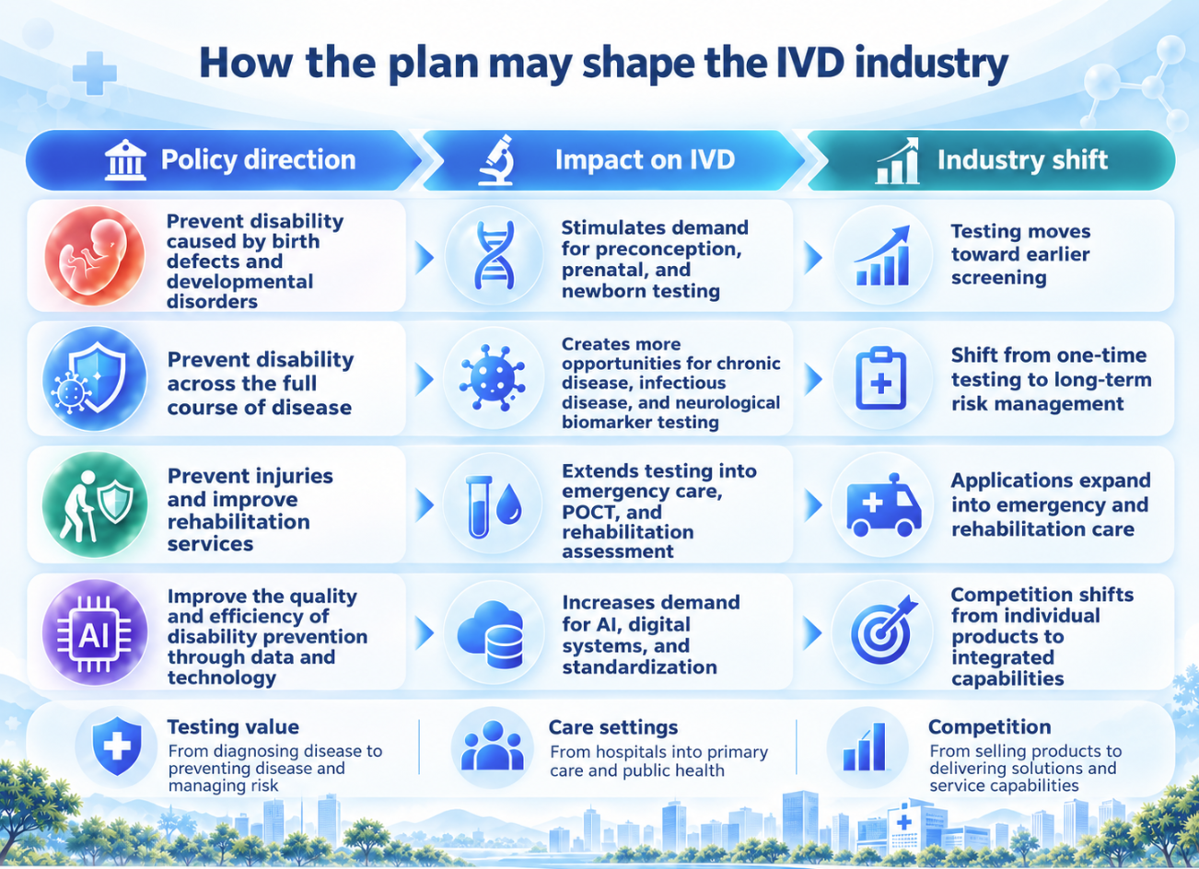
03
How Competition in the IVD Industry Is Changing
Three changes stand out as the IVD industry shifts toward early detection and prevention.
1) Demand for testing is moving toward earlier stages of disease.
Preventing birth defects, inherited metabolic disorders, chronic diseases, and neurodegenerative diseases requires timely identification of clinically meaningful risks.
2) Competition is increasingly centered on clinical value.
The value for a test is wether it changes clinical decisions, helps patients receive timely intervention, and improves health outcomes over time. Simply adding more tests can not create a competitive advantage now.
3) Testing services are expanding into local healthcare settings.
As China continues to strengthen healthcare services at the local level, county hospitals, maternal and child health institutions, and community health centers will become important settings for adoption.
Once a product gains adoption across these settings, it can reach an exceptionally large patient population.

Slide 5
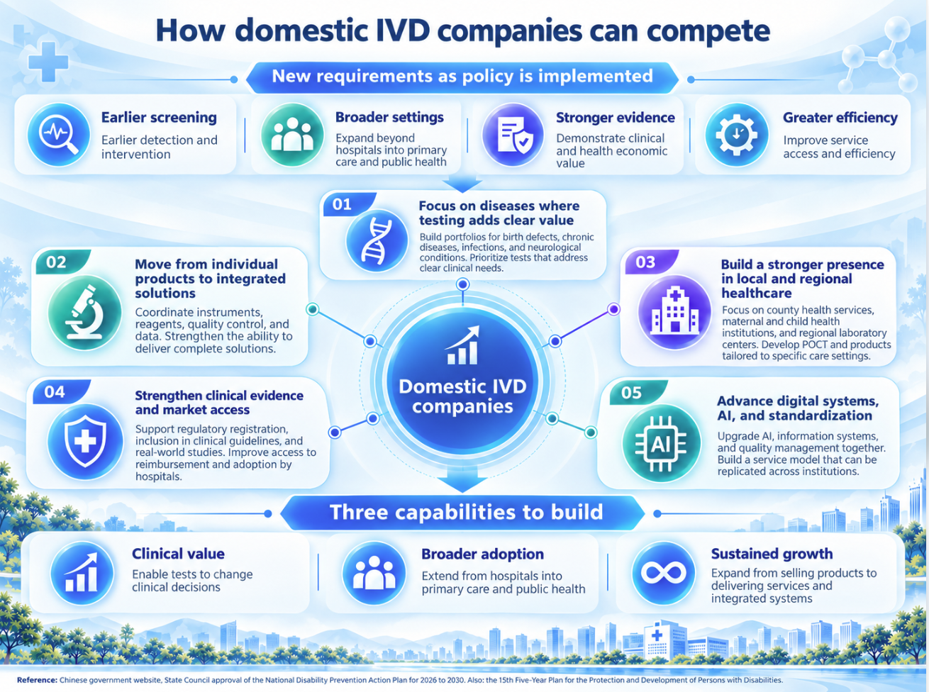
04
The Strategic Shift Among Domestic IVD Companies
Domestic companies are now focused on building clinical evidence, securing reimbursement, controlling product costs, and developing comprehensive service capabilities. Four capabilities they are developing now is:
1) Build technology portfolios around priority diseases.
Focus on areas with clear clinical needs, including birth defects, inherited metabolic disorders, and so on. Invest in tests that can meaningfully improve diagnostic and treatment decisions.
2) Develop integrated solutions.
Connect instruments, reagents, quality management, data analysis, and clinical services to help hospitals establish more efficient testing and care management processes.
3) Strengthen service capabilities in local healthcare markets.
Provide reliable products and services with manageable costs and straightforward operation and maintenance for Tier I institutions.
4) Closely track local implementation.
Watch for changes to screening panels, allocations of public health funding, investment in healthcare capacity, authorization to offer and bill for laboratory tests, and actual tenders and procurement.

