Slide 1


Slide 2

Job Application Tracker

Slide 3
Group Members Introduction
Zara Ahmed BC220409531

Slide 4

INTRODUCTION OF PROJECT
The Job Tracking Application is designed to simplify and streamline the job application process. It provides a centralized platform accessible across mobile phones, laptops, and desktop computers. Users can record unlimited job applications with essential details such as company name, address, contact information, HR/contact person, email, and LinkedIn profile.
Each application can be tracked for status like applied, response received, interview/test date, rejected, or offer accepted. Users can upload resumes, cover letters, and appointment letters, keeping all documents organized in one place. The application allows email or in-app reminders for deadlines, interviews, and tests, while a visual dashboard presents job statuses in graphs or tables for easy monitoring.

Slide 5
The adopted methodology in this project is “VU process Model” which is a combination of Waterfall Model and Spiral Model.

Slide 6
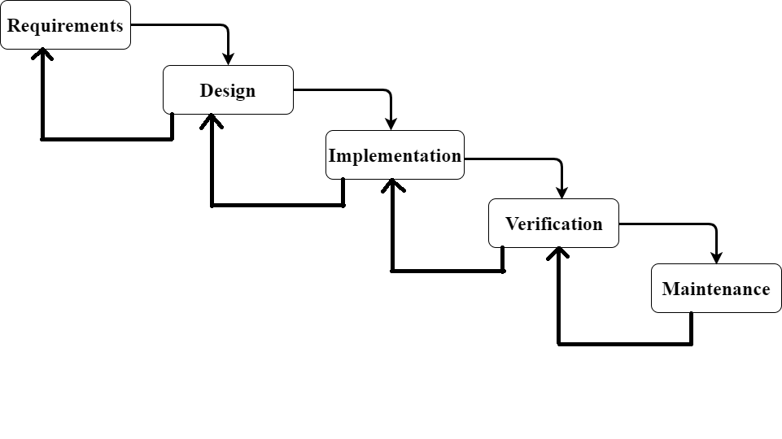
VU Process Model

Slide 7
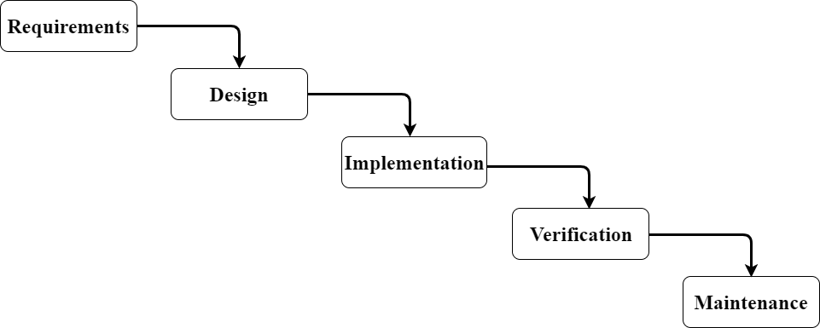
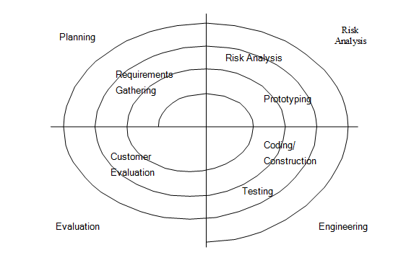
Process Model Diagram
Waterfall Model Spiral Model

Slide 8
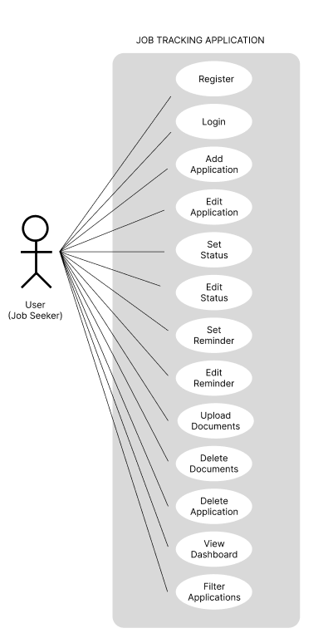
Use Case Diagram

Slide 9
Business Rules Catalog
User can add, view, edit, and delete job applications with details such as company name, contact, email, and application status.
App will track application progress with statuses like Applied, Interview Scheduled, Rejected, or Offer Accepted.
User can upload and manage related documents such as resumes, cover letters, and appointment letters.
App will send reminders and notifications for interviews, tests, deadlines, and follow-ups.
User can view dashboards with graphs or tables to monitor job application progress.

Slide 10
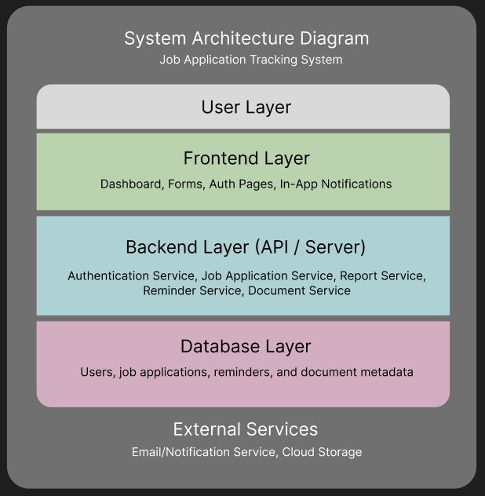
Architectural Design

Slide 11
Team Structure
Gathering and Analyzing the Info
Designing the Project
Development
Zara Ahmed
Database
Business & Logical work
Documentation

Slide 12
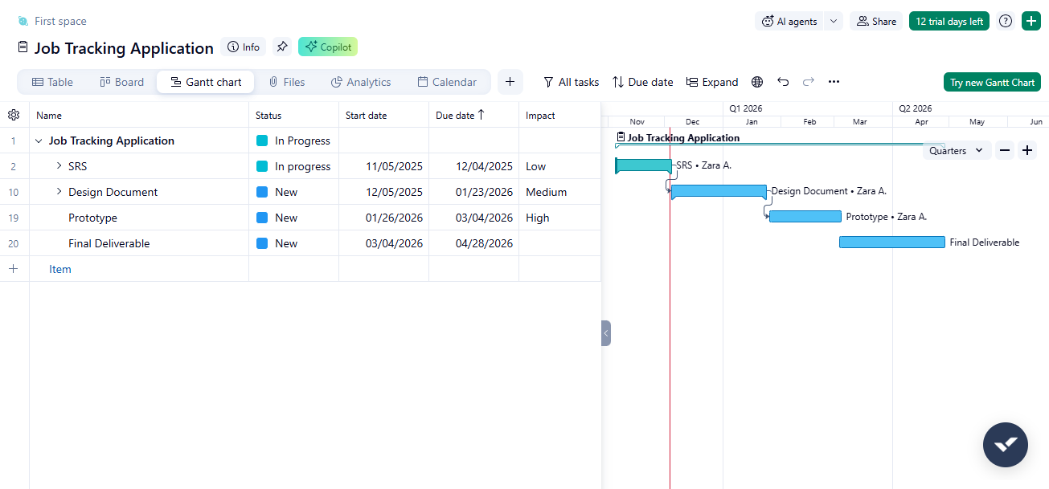
Project Schedule

Slide 13
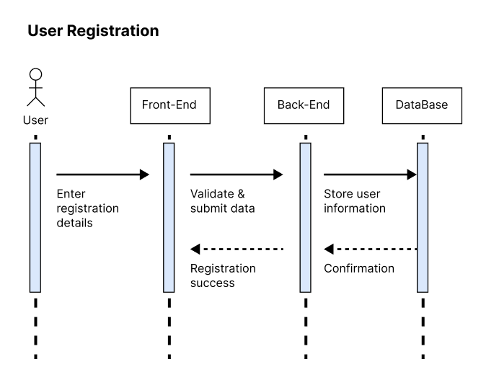
Sequence Diagrams

Slide 14
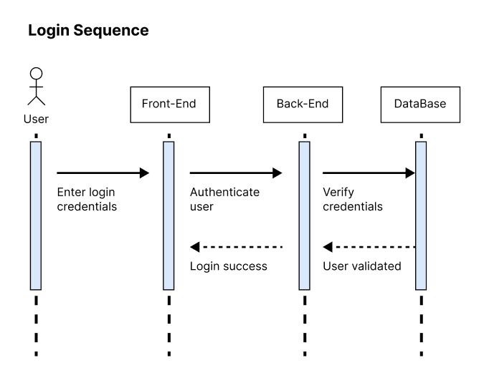

Slide 15
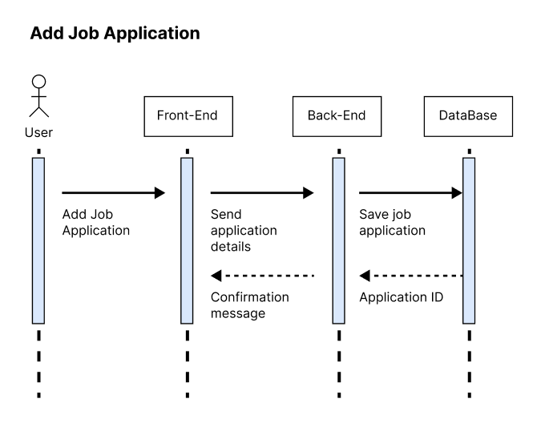

Slide 16
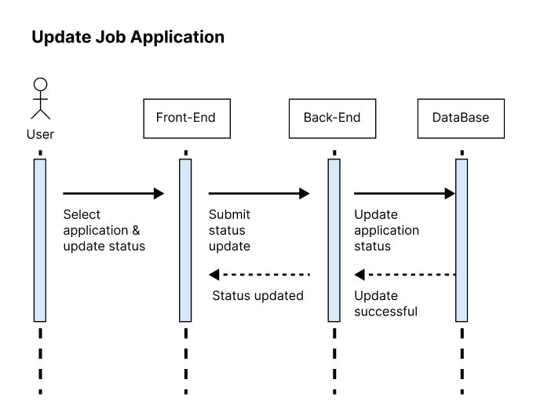

Slide 17
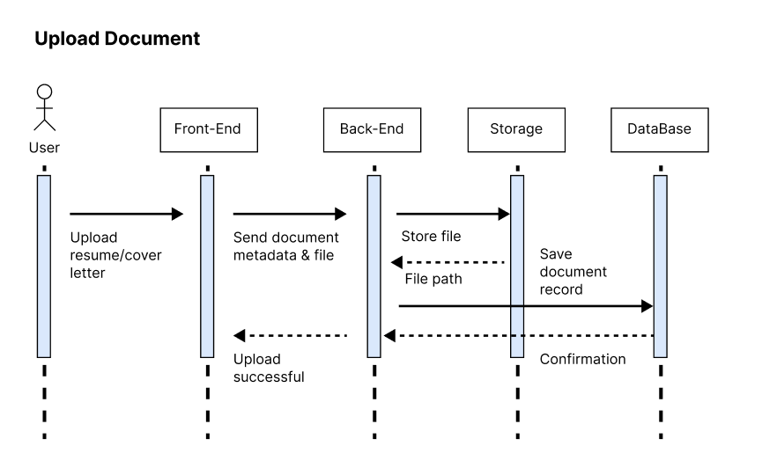

Slide 18
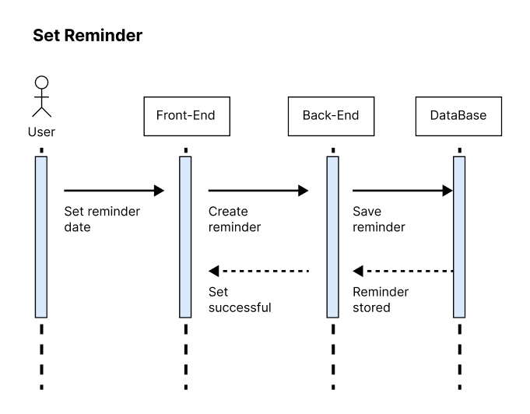

Slide 19
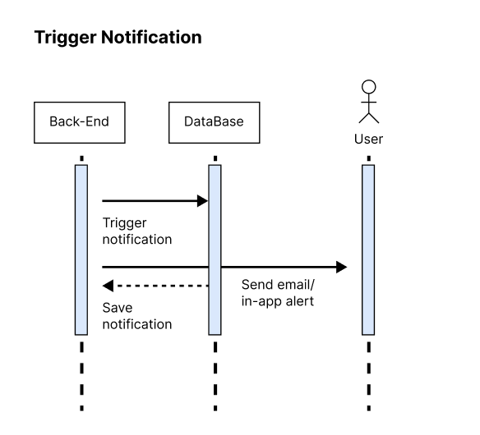

Slide 20
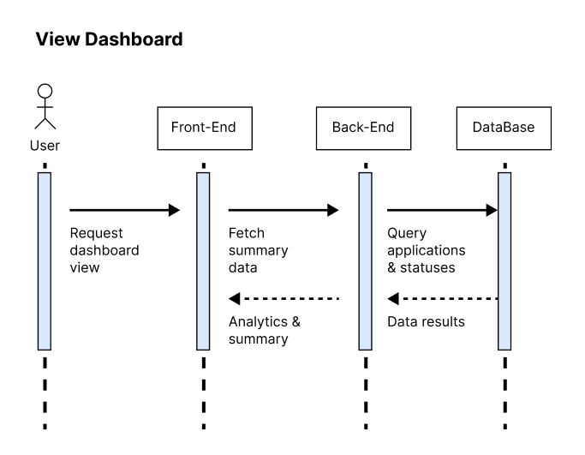

Slide 21
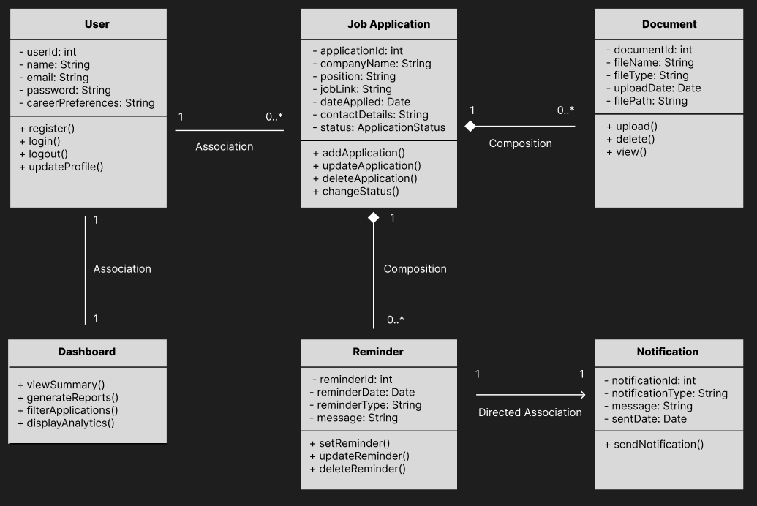
Class Diagram

Slide 22
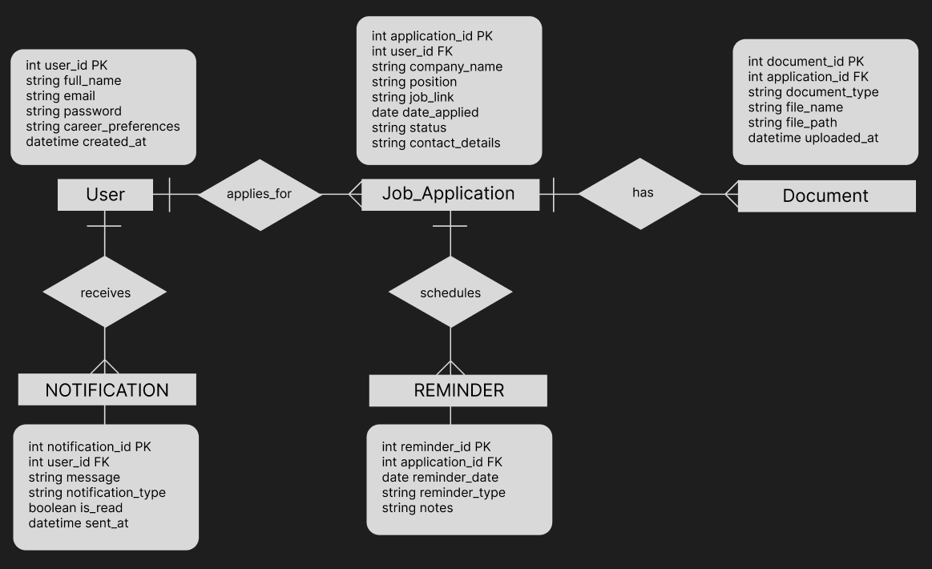
Entity-Relationship Diagram

Slide 23
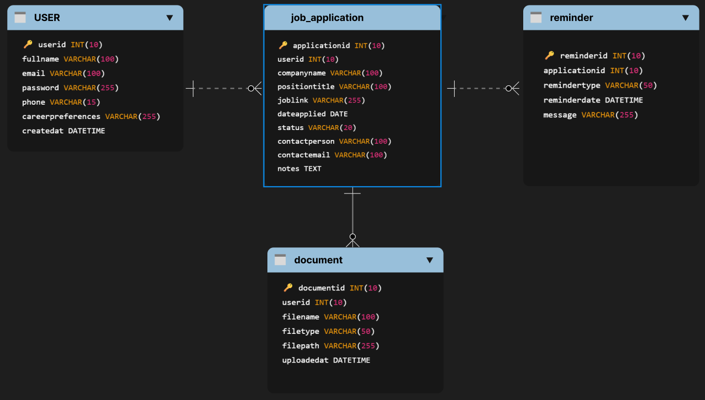
Database Diagram

Slide 24
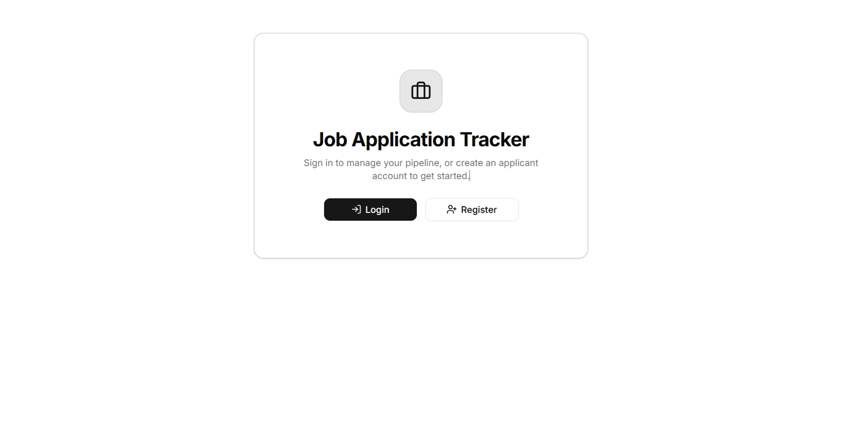
User Interfaces
Landing

Slide 25
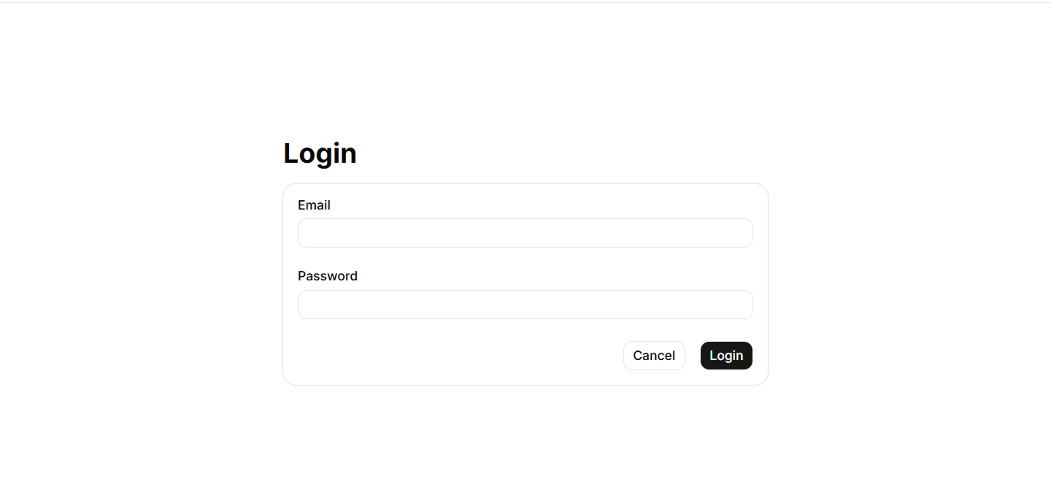
User Interfaces
Login

Slide 26
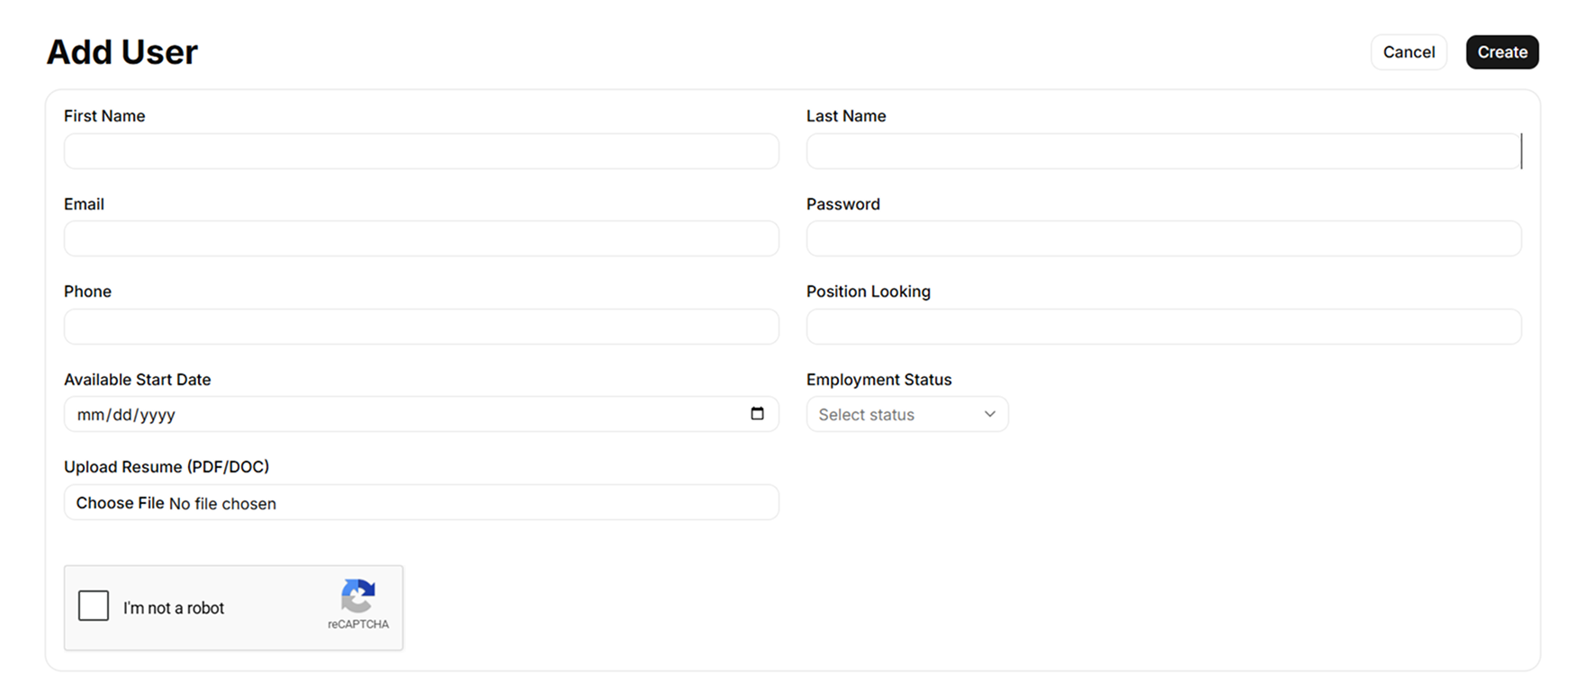
User Interfaces
Register Screen

Slide 27
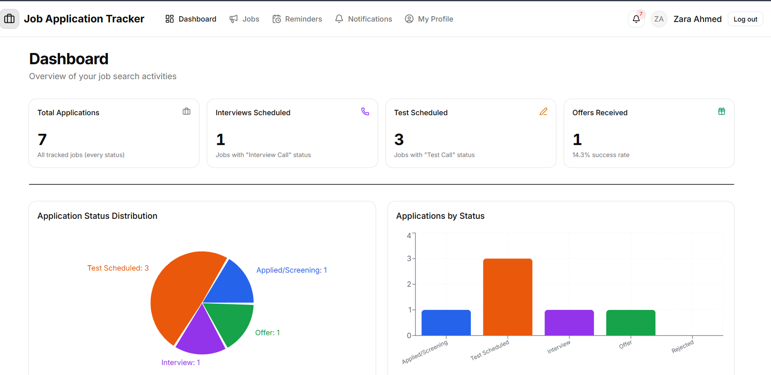
User Interfaces
Dashboard

Slide 28
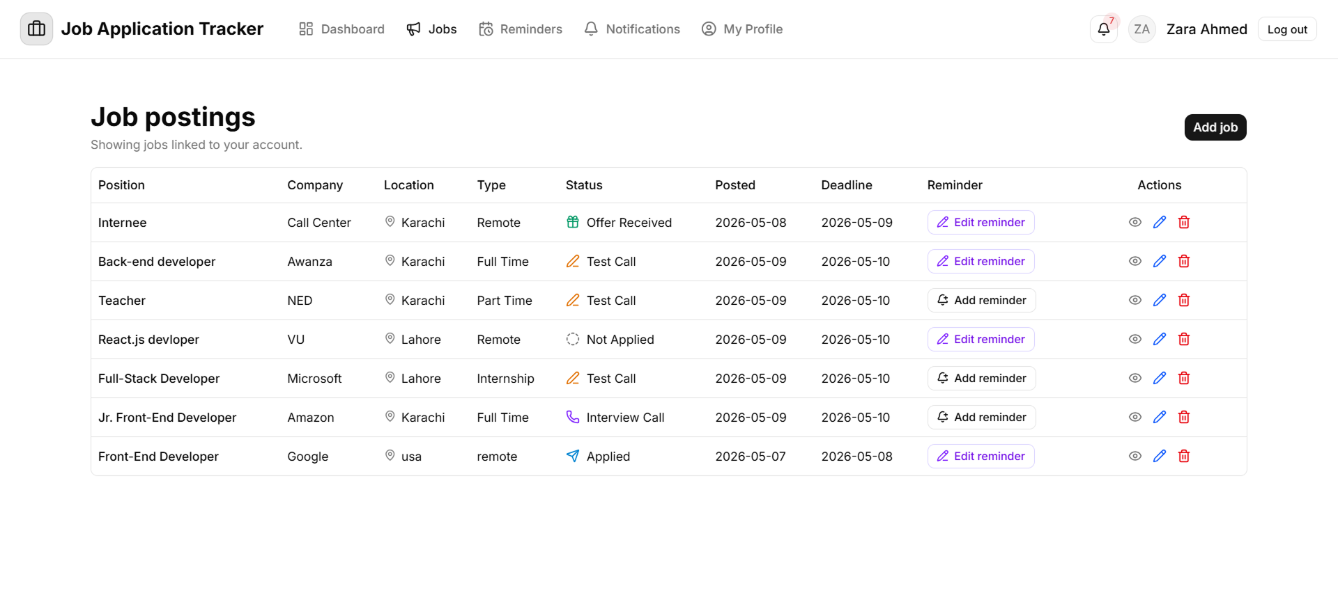
User Interfaces
Job Application List Page

Slide 29
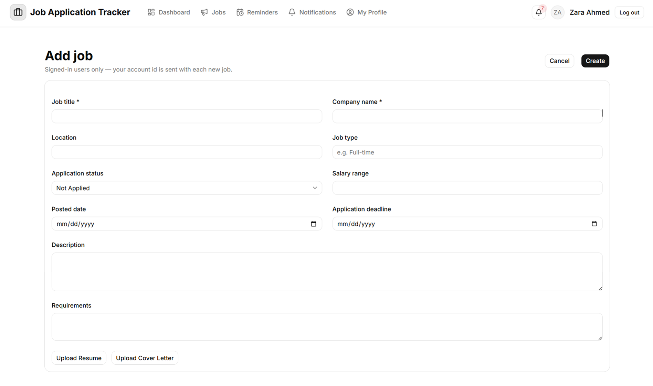
User Interfaces
Add Job Application

Slide 30
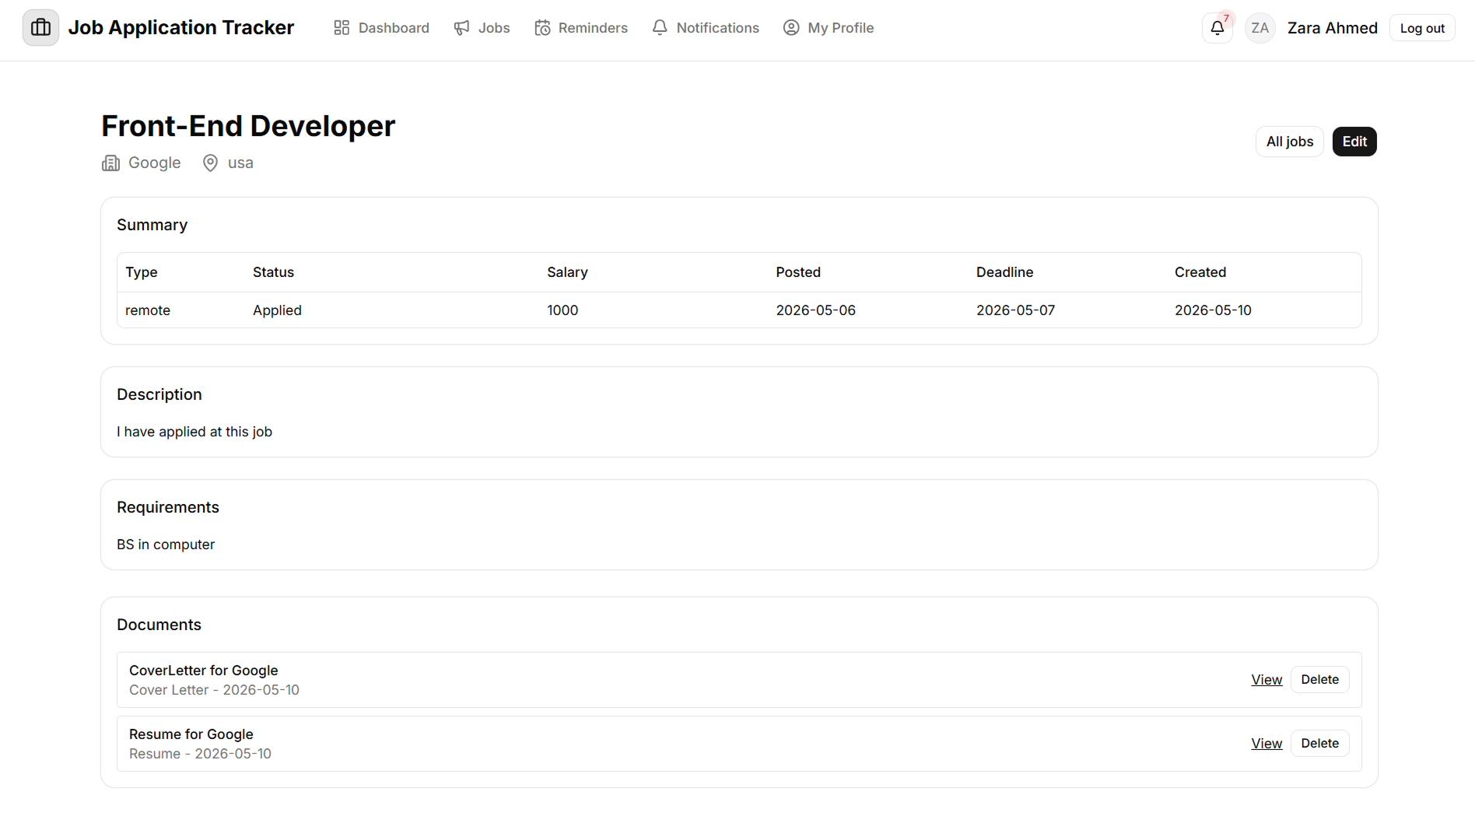
User Interfaces
Application Detail

Slide 31
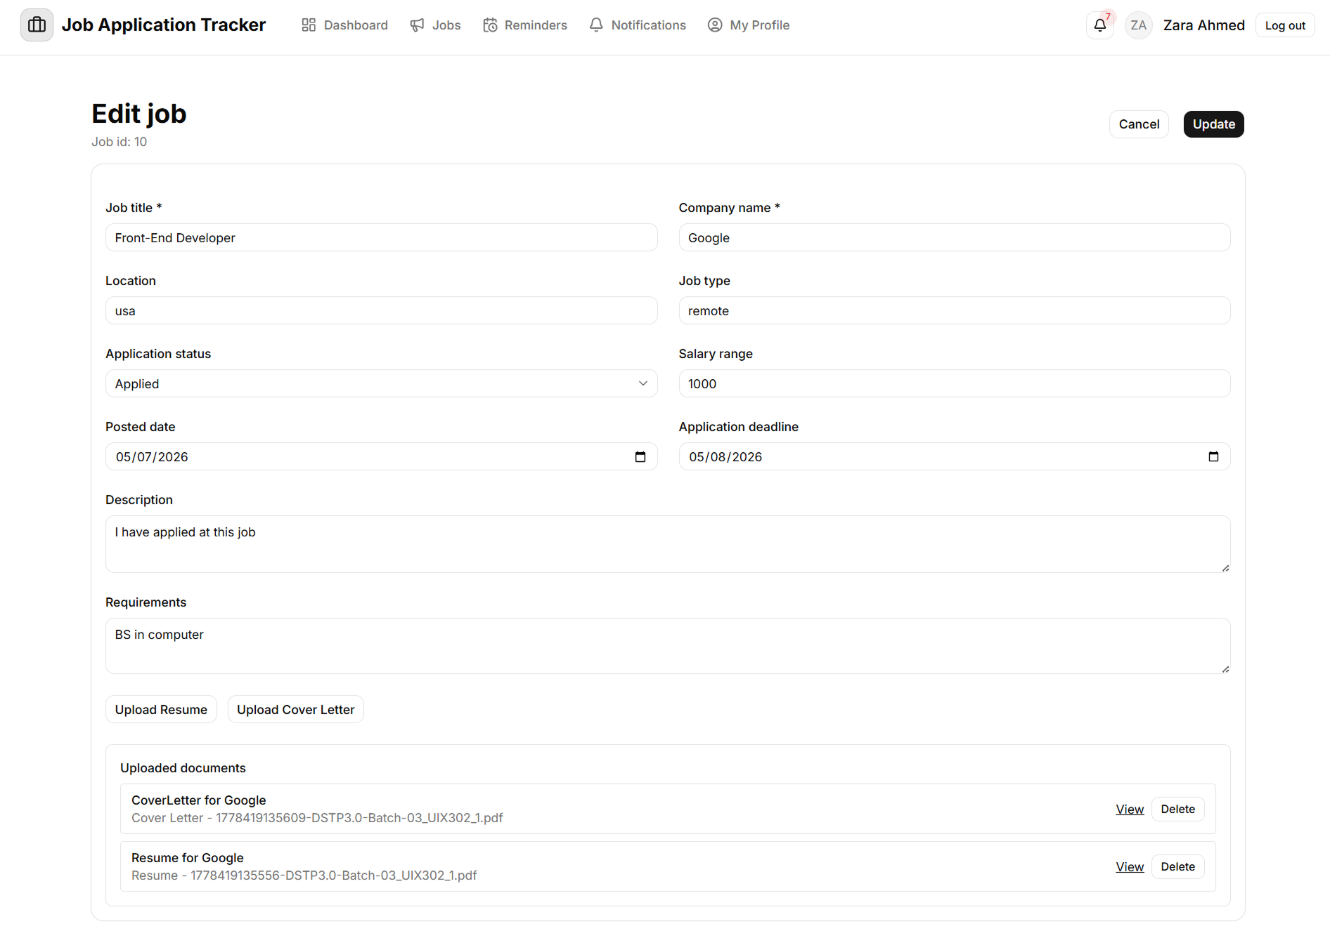
User Interfaces
Edit Application

Slide 32
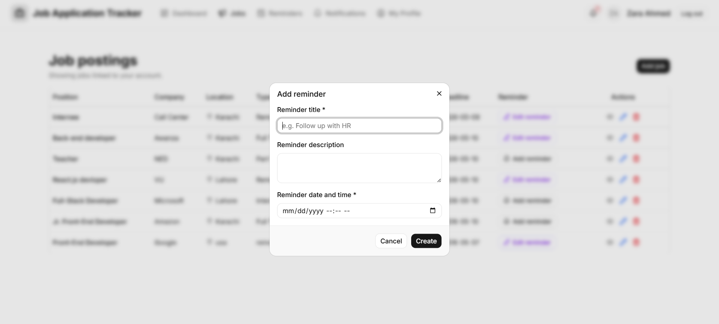
User Interfaces
Add Reminder

Slide 33
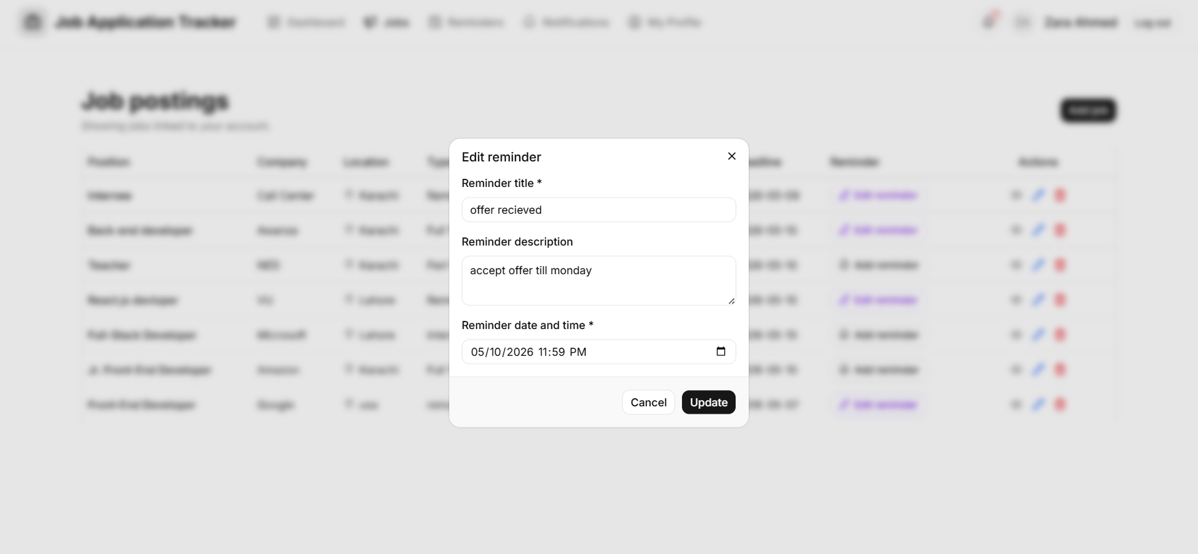
User Interfaces
Edit Reminder

Slide 34
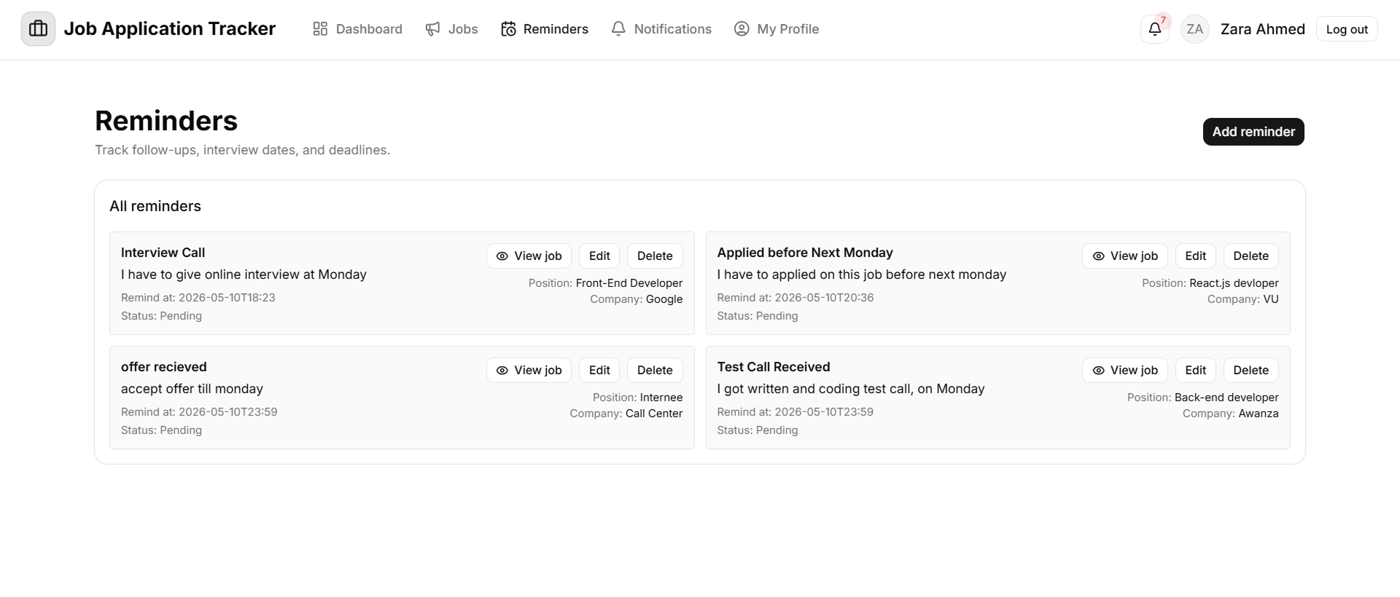
User Interfaces
Reminder List page

Slide 35
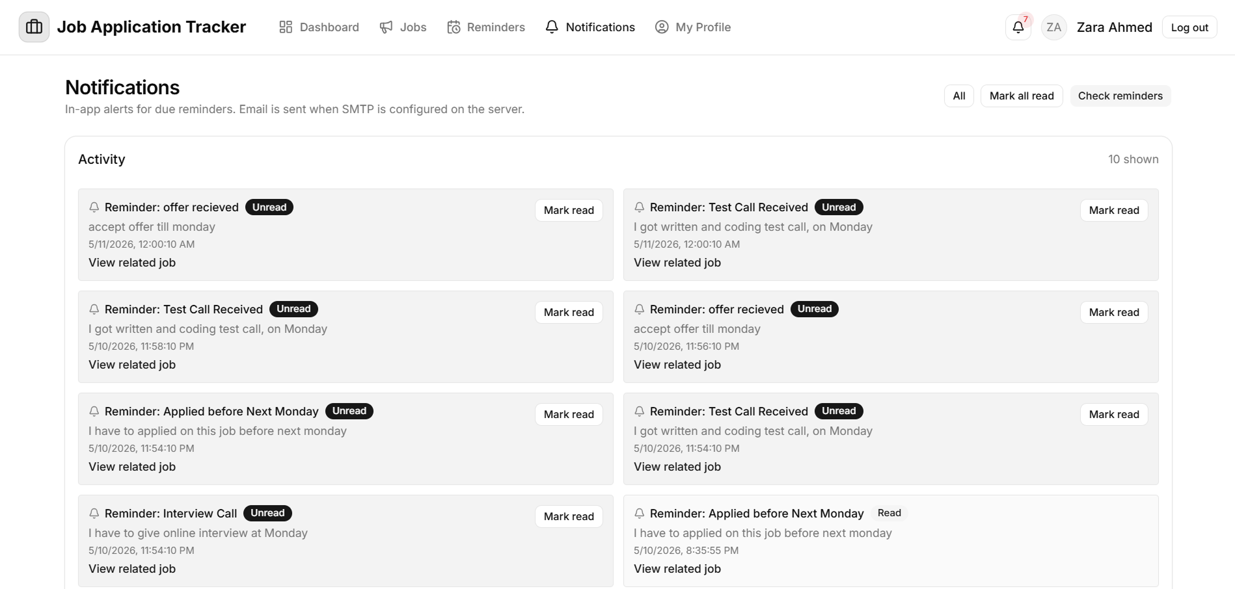
User Interfaces
Notification List page

Slide 36
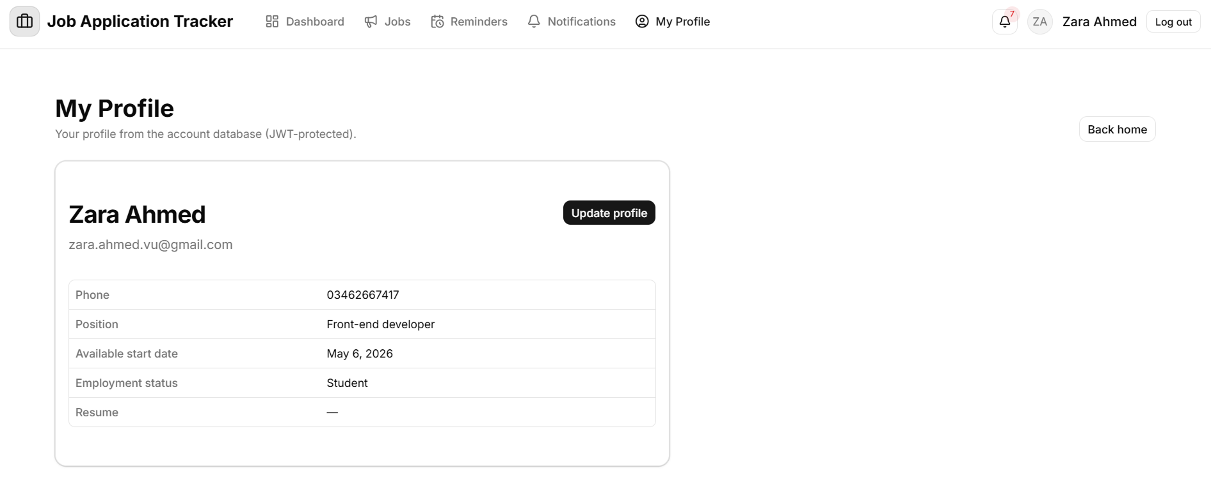
User Interfaces
Profile page

Slide 37
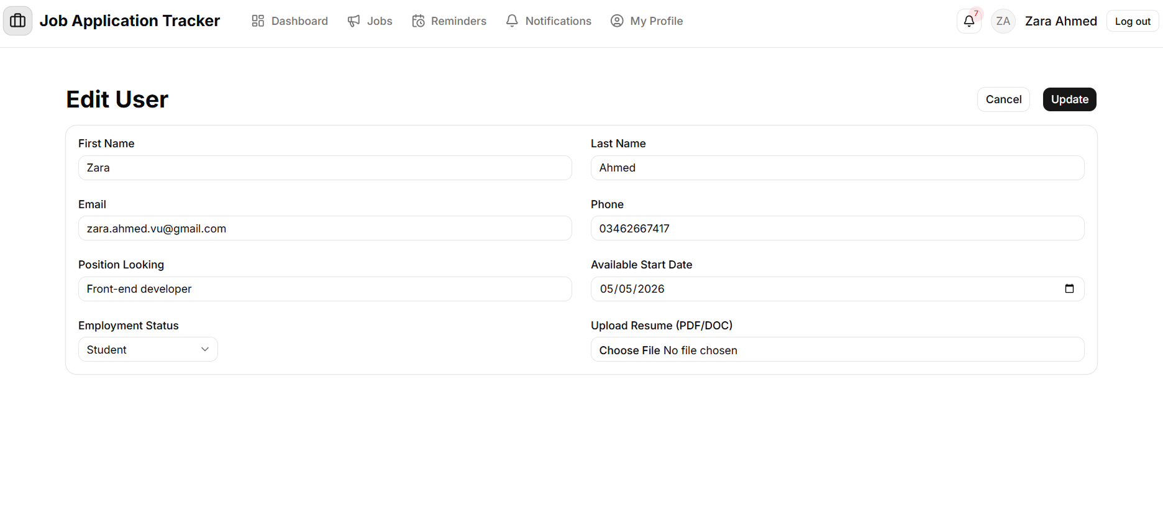
User Interfaces
Edit Profile page

Slide 38
Tools
Following tools have been used during the development of this application .
Tool
Microsoft VS Code and Cursor
Database
MySql and Workbench
Development language
JavaScript
Server
Node.JS and Express

Slide 39
Thank You!
Zara Ahmed - BC220409531

