Slide 1
Vue.js
Beyond the Basics

Slide 2
Laravel Integration
Framework for building user interfaces
Focused on the view layer
Easily integrate with other libraries
Current version: 2.4.1

Slide 3
Routing
Simple(low barrier of entry)
Lightweight (~24kb min+gzip)
Fast
Reactive
Component based

Slide 4

Authentication
Evan You - ex employee of Google, and Meteor Dev Group
Creator:
First commit: First release:
Discovered by Laravel
Release of second(current) version:
Jul 2013
Feb 2014
Apr 2015
Sep 2016

Slide 5

How it relates to Vue.js?

Slide 6
State Management
Vuex
Vuex is a state management pattern + library for Vue.js applications. It serves as a centralized store for all the components in an application, with rules ensuring that the state can only be mutated in a predictable fashion

Slide 7
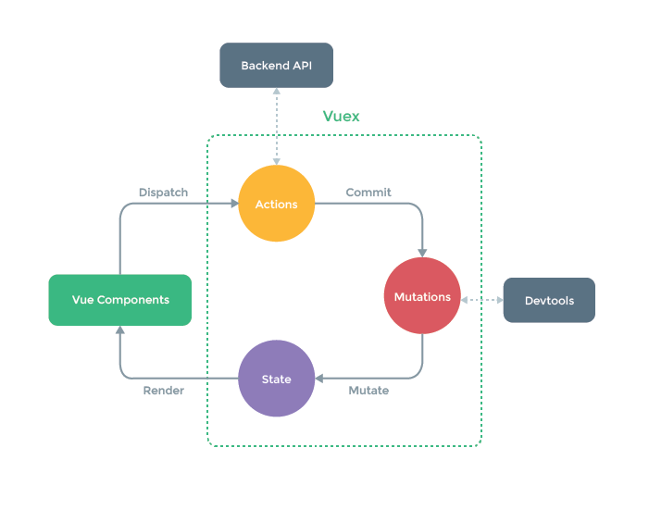
State Management

Slide 8
ACL Roles & Permissions
CDN
NPM
Bower
CLI

Slide 9
Global Ajax Configuration

Slide 10
Code Splitting

Slide 11
Laravel Mix Configuration

Slide 12

Babel
Babel is a JavaScript compiler
Babel is a toolchain that is mainly used to convert ECMAScript 2015+ code into a backwards compatible version of JavaScript in current and older browsers or environments. Here are the main things Babel can do for you:

Slide 13
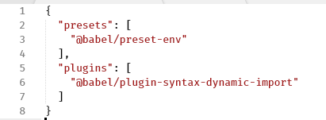
Babel Configuration
Babel configuration can be set using .babelrc file in project root.

Slide 14
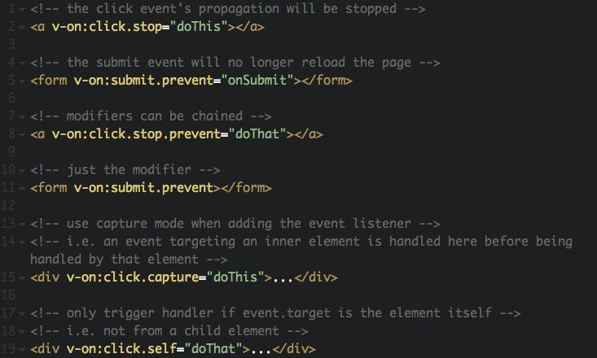
Event modifiers
.stop
.prevent
.capture
.self
.once
https://vuejs.org/v2/guide/events.html#Event-Modifiers

Slide 15
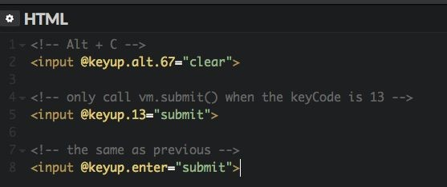
Keys modifiers
.enter
.tab
.delete (captures both “Delete” and “Backspace” keys)
.esc
.space
.up
.down
.left
.right
.ctrl
.alt
.shift
.meta
Mouse modifiers
.left
.right
.middle
https://vuejs.org/v2/guide/events.html#Modifier-Keys

Slide 16
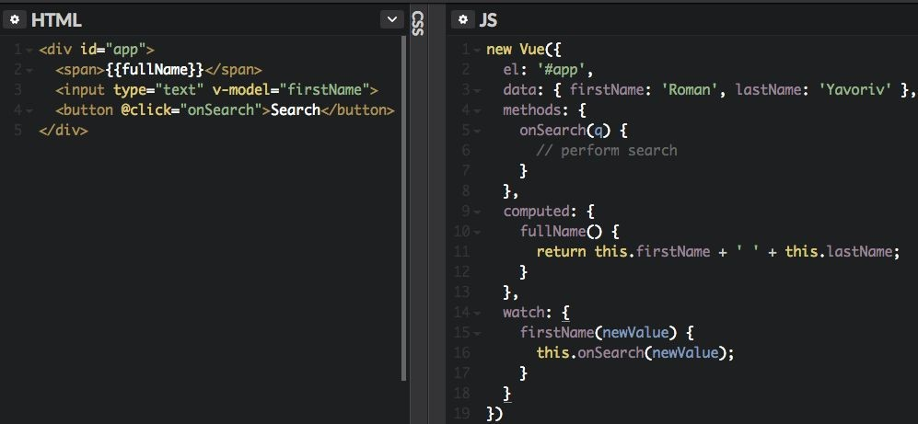
Vue instance properties
https://vuejs.org/v2/api/#Options-Data

Slide 17
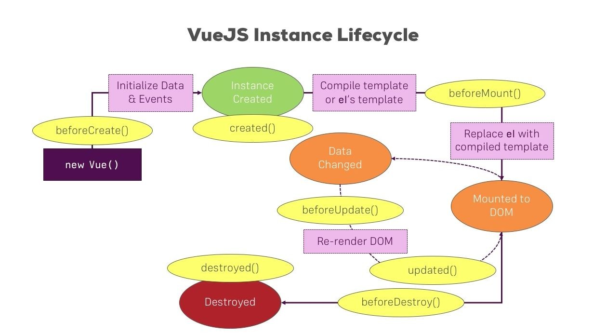
Lifecycle hooks

Slide 18
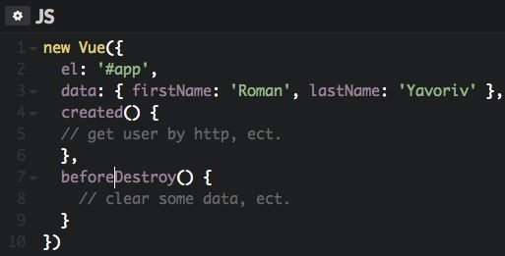
Example of using hooks
https://vuejs.org/v2/api/#Options-Lifecycle-Hooks

Slide 19
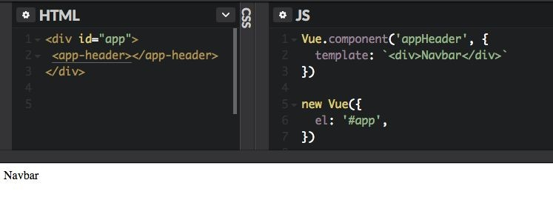
Components

Slide 20
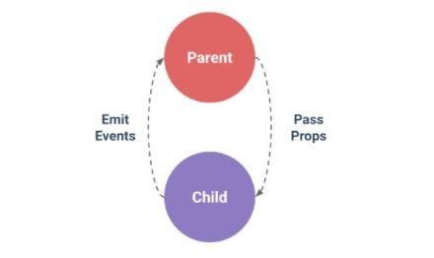
Components communication

Slide 21
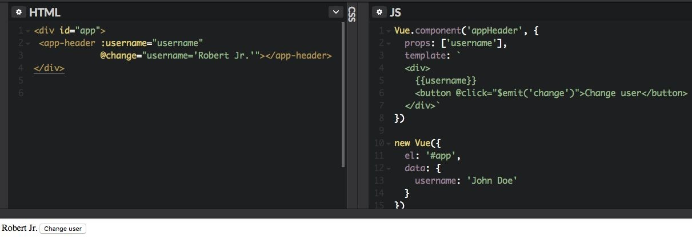
Component communication example

Slide 22
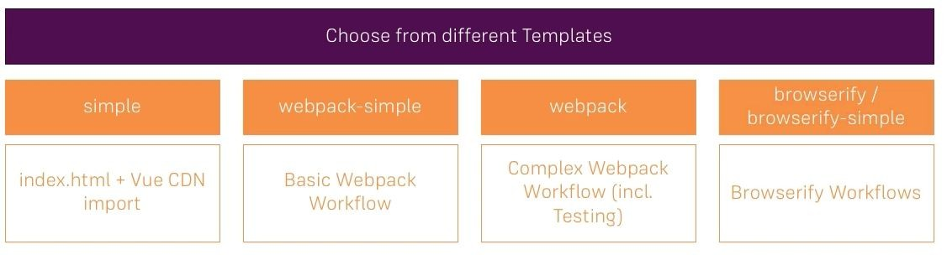
Fast start with CLI
$ npm install -g vue-cli
$ vue init <template-name> <project-name>

Slide 23
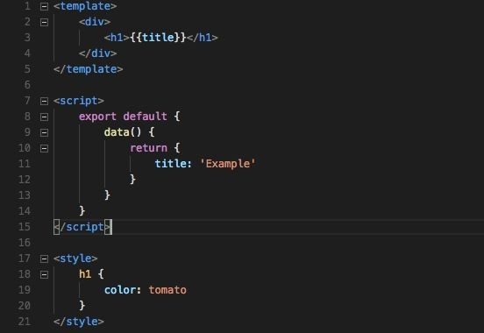
Single file component

Slide 24
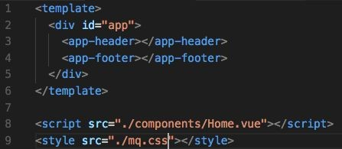
What About Separation of Concerns?

Slide 25
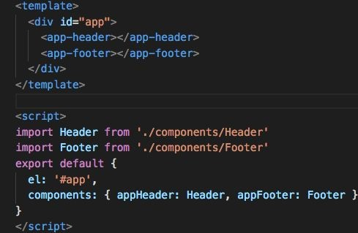
Declare components locally

Slide 26
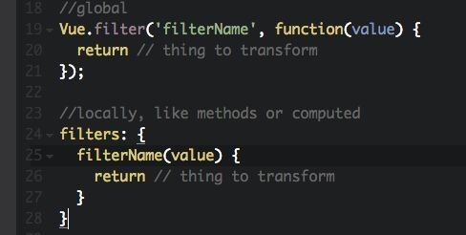
Filters

Slide 27


Slide 28



Contacts
graniron roman.yavoriv@techmagic.co
graniron

