Slide 1


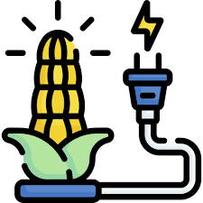



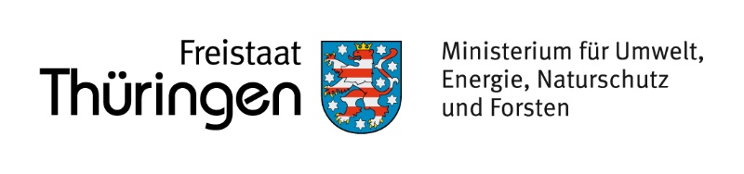
Energy System Modeling
for Thuringia
We create a digital representation of Thuringia's future energy system in order to assess pathways toward a
secure,
affordable and
climate-neutral energy supply.
Renewable Generation
Wind energy, photovoltaics, and other renewable sources form the basis of future energy supply.
Energy Conversion
Systems for converting biomass to electricity or electricity into heat or hydrogen for various sectors.
Storage
Batteries, thermal storage, and hydrogen storage ensure a flexible, demand-based supply.
Consumption Sectors
The provision of energy for industry, buildings (heat), and mobility (transport).
Model built based on sector-coupled modeling with the open-source Open-energy Modelling Framework (oemof)
Notes:
We build a virtual version of the regional energy system and test future scenarios before decisions are made in reality.

Slide 2



Why is energy system modeling
needed?
Energy systems are becoming increasingly interconnected and complex — electricity, heat, mobility, and industry are strongly interdependent. Modeling makes these interactions visible.
Reliable energy supply
Assessment of how energy demand can be securely met under changing conditions.
Efficient investments
Identification of infrastructure and storage investments with the greatest added value for the region.
Policy decision support
Evidence-based scenarios as a foundation for regional planning and transformation.
Future energy systems become increasingly interconnected and complex.
Notes:
Instead of isolated sectors, electricity, heat, mobility and industry interact strongly. Modelling helps understand these interactions.

Slide 3



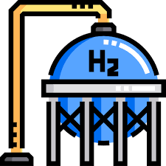



Opportunities for Thuringia:
Storage and Future Scenarios
Scenario Analysis
Battery Storage
For grid flexibility and rapid load shifting
Expansion Pathways
Different expansion pathways for renewable energy
Thermal Storage
For capturing and time-shifting heat
Sector Coupling
Linking electricity, heat, mobility, and industry
Storage Opportunities
Hydrogen
As long-term storage for seasonal energy supply
Demand & Technology
Development of demand, technology, and system efficiency
Industrial Flexibility
Potential through controllable process and load management
Transformation Scenarios
Regional pathways for a resilient energy transition
The model helps identify future opportunities and resilient pathways for Thuringia.
Notes:
This addresses the interest in storage while positioning Thuringia as a region that can actively shape future energy infrastructure.

