Slide 1
proto.actor

Slide 2
actor model

Slide 3
cloud objects

Slide 4

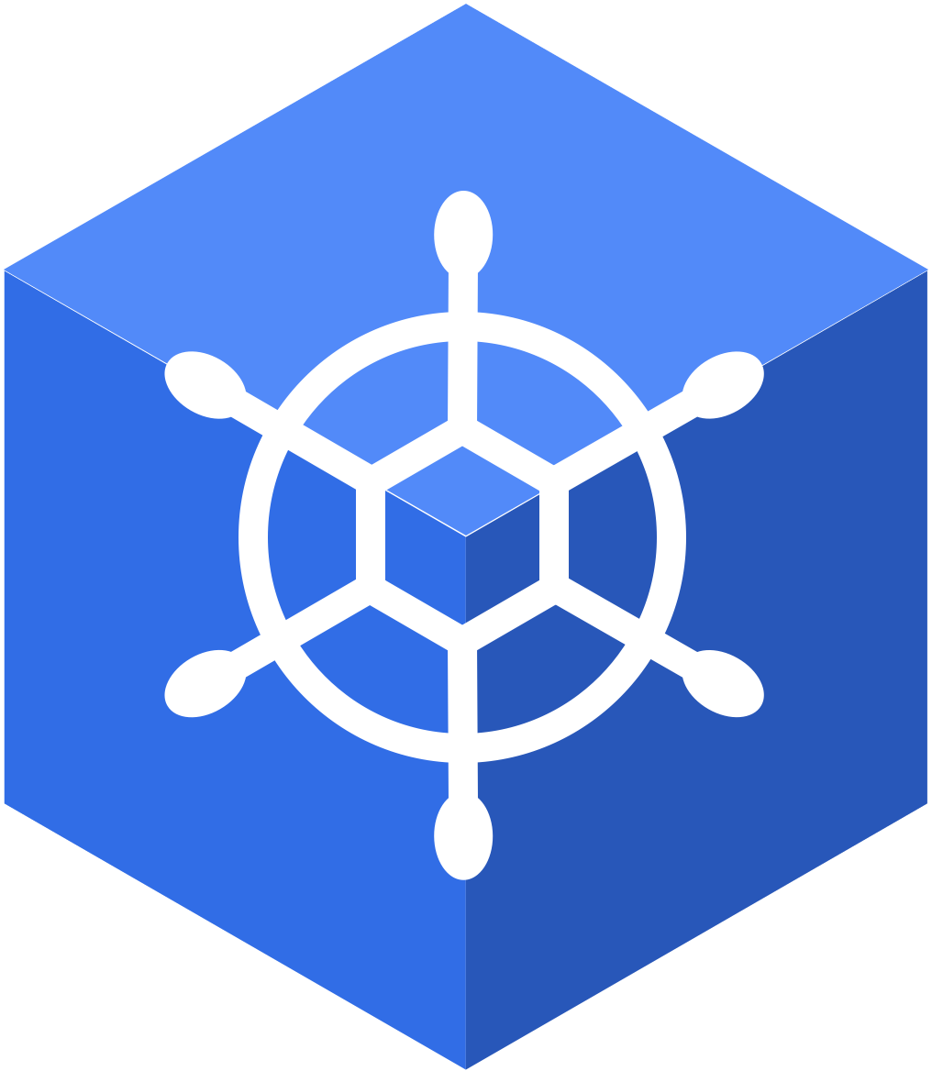
cloud native

Slide 5
microservices

Slide 6
observability

Slide 7
data streams

Slide 8
extensible

