Slide 1
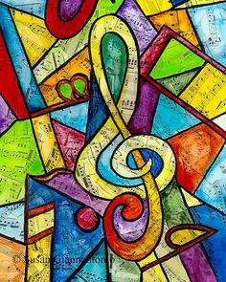

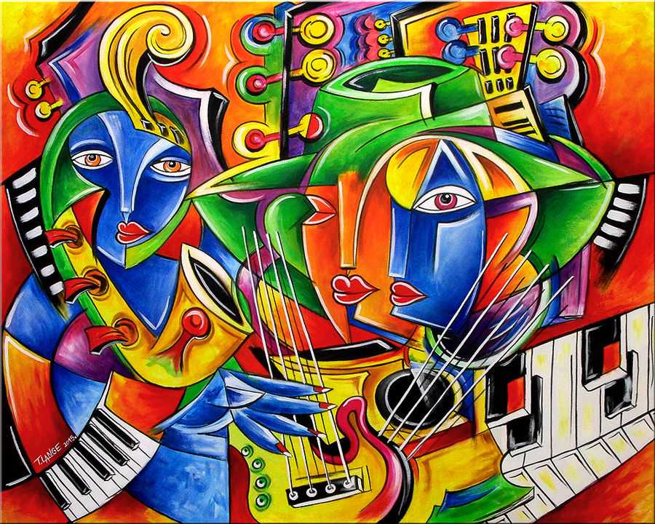
Toronto: Analysis of Culture & Community Centers

Slide 2
Toronto: Analysis of Culture & Community Centers
The city of Toronto is the provincial capital of Ontario and the most populous center of Canada
Toronto is a prominent center for music, theatre, motion picture production and television production, and is home to the headquarters of Canada's major national broadcast networks and media outlets.
Its varied cultural institutions which include numerous museums and galleries, festivals and public events, entertainment districts, national historic sites, and sports activities, attracting over 25 million tourists each year.
GOAL:
The ultimate goal of this exercise will be to ascertain the density ,variety and geographical location of cultural and community centers that the city of Toronto has to offer.
Specifically , we would like to know:
The aim for this particular exercise in data analysis is to segment different culture and community centers
We would also like to have the knowledge which particular areas in Toronto have higher concentration of community centers and which require future rebuilding
Community centers should be categorized based on their specific use e.g. library, performance center etc.
Community centers should be categorized based on ownership details as well.

Slide 3
Toronto: Analysis of Culture & Community Centers
STAKEHOLDERS/ INTENDED AUDIENCE:
This exercise is aimed /sponsored by the city council of Toronto. However the information here in will serve handy for the below groups/individuals as well:
Press: for the purposes of marketing/ information dissemination to general public
City building contractors
Current and potential future investors and patrons of the arts
Various charities/community outreach programs
Event planners/ organizers
Last but not the least, general public

Slide 4
Toronto: Analysis of Culture & Community Centers
DATA SET:
This exercise is aimed /sponsored by the city council of Toronto. However the information here in will serve handy for the below groups/individuals as well:
Press: for the purposes of marketing/ information dissemination to general public
City building contractors
Current and potential future investors and patrons of the arts
Various charities/community outreach programs
Event planners/ organizers
Last but not the least, general public

