Slide 1
What is convolution in image processing
Take pixels of the original image
Take a matrix with numbers in each box
Apply the matrix on the original image to derive a new image

Slide 2
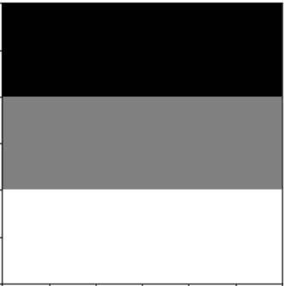
A very simplistic pixel values for the
Image on the left. For ease of viewing showing in a 3 *3 matrix
a | b | c
d | e | f
g | h | i
Say, this is the pixel representation
Of the image on the left
Pixels are obviously numbers within
0-255 range. However we are
Showing them as alphabets for ease of demonstration on later slides
Say, this is our simplest image.
A gradually lightening gray scale image
Our aim: perform an image convolution with a given image kernel

Slide 3

Given below: A sample image kernel.
We would be using this particular kernel and apply it as a convolution on the image above.
** usually image kernels are odd numbered matrix eg 3 * 3, or 5 * 5. reason explained later
** dimensions of the kernel needs to be same or lower than the dimensions of the original image
-1 | 2 | -1
-1 | 2 | -1
-1 | 2 | -1
Psst..This is a vertical edge detector kernel. But more on this later

Slide 4
-1 | 2 | -1
-1 | 2 | -1
-1 | 2 | -1
First Step
Slide the kernel matrix over each pixel of the original image.
***This has to be done in such a way such that, the center of the kernel matrix is on top of the pixel in question for the original image
This particular information also sheds light on why kernel matrices are usually odd dimension matrix
a | b | c
d | e | f
g | h | i
Our next step would be to slide the kernel matrix one step at a time over the original image
the movement of one pixel at a time is known as stride. In this example, stride = 1.
So when we move our kernel matrix in second step, the center of the kernel would be on top of box ‘b’
If stride was 2 , when we move our kernel matrix in second step, the center of the kernel would be on top of box ‘c’
We keep moving column wise and then to the next row and column wise further

Slide 5
-1 | 2 | -1
-1 | 2 | -1
-1 | 2 | -1
2nd Step
Slide the kernel matrix over each pixel of the original image by moving one pixel at a time.
Again we center the kernel matrix on the pixel.
a | b | c
d | e | f
g | h | i
-1 | 2 | -1
-1 | 2 | -1
-1 | 2 | -1
a | b | c
d | e | f
g | h | i
3rd Step
Slide the kernel matrix over each pixel of the original image by moving one pixel at a time.
Again we center the kernel matrix on the pixel.

Slide 6
4th Step
5th Step
6th Step
a | b | c
d | e | f
g | h | i
-1 | 2 | -1
-1 | 2 | -1
-1 | 2 | -1
-1 | 2 | -1
-1 | 2 | -1
-1 | 2 | -1
a | b | c
d | e | f
g | h | i
a | b | c
d | e | f
g | h | i
-1 | 2 | -1
-1 | 2 | -1
-1 | 2 | -1
7th Step
8th Step
9th Step
a | b | c
d | e | f
g | h | i
a | b | c
d | e | f
g | h | i
a | b | c
d | e | f
g | h | i
-1 | 2 | -1
-1 | 2 | -1
-1 | 2 | -1
-1 | 2 | -1
-1 | 2 | -1
-1 | 2 | -1
-1 | 2 | -1
-1 | 2 | -1
-1 | 2 | -1

Slide 7
Two things that we would have noticed by now.
We did not deduce the output at each of the 9 steps
How do we deal with the cases where the kernel overshoots the boundaries of the image, say step 1, 2, 3, etc
For the step 1, we would show the same in the next slides
For step 2 , we perform padding. That is we surround the original image with zeros (as shown below)
0 | 0 | 0 | 0 | 0
0 | a | b | c | 0
0 | d | e | f | 0
0 | g | h | i | 0
0 | 0 | 0 | 0 | 0
** in case our image was of larger dimension say 25*25. We may use a larger kernel say of 5 * 5 matrix. In that case, we would have to have a padding layer of thickness 2. ie, instead of one layer of zeros as shown here, we would have two layers of zeros surrounding the image

Slide 8
Calculation of output at each step
The output of a convolution is another image with possibly different pixel values.
We calculate the weighted sum of the product of the kernel value and original image pixel value
** remember, places where kernel overshoots are padded with zero.
-1 | 2 | -1
-1 | 2 | -1
-1 | 2 | -1
3
We calculate the top left pixel of the new image created
a | b | c
d | e | f
g | h | i
0 * -1 + 0 * 2 + 0 * -1 + 0 * -1 + 2*a + -1 * b + 0 * -1 +2*d + -1 * e
If we ignore the 0 values: 2*a + -1 * b +2*d + -1 * e
Eg a = 1, b = 1, c = 1
d = 2, e = 2, f = 2
g = 3, h = 3, I = 3
Value would be :
2 * 1 + -1*1+ 2*2 + -1*2 = 3
p.s ignored the 0 values

Slide 9
2nd step
-1 | 2 | -1
-1 | 2 | -1
-1 | 2 | -1
3 | 0
a | b | c
d | e | f
g | h | i
We calculate the (1,2)th pixel of the new image created
0 * -1 + 0 * 2 + 0 * -1 + -1*a + 2*b + -1 * c + -1*d +2*e + -1 * f
If we ignore the 0 values: -1*a + 2*b + -1 * c + -1*d +2*e + -1 * f
Eg a = 1, b = 1, c = 1
d = 2, e = 2, f = 2
g = 3, h = 3, I = 3
Value would be :
-1*1 + 2*1 + -1 * 1 + -1*2 +2*2 + -1 * 2 = 0
p.s ignored the 0 values

Slide 10
Final output of convolution at the end of every step
Pssst… we filled in example values for our image
1 | 1 | 1
2 | 2 | 2
3 | 3 | 3
-1 | 2 | -1
-1 | 2 | -1
-1 | 2 | -1
3 | 0 | 3
6 | 0 | 6
5 | 0 | 5
convolutions
Original
Kernel

Slide 11
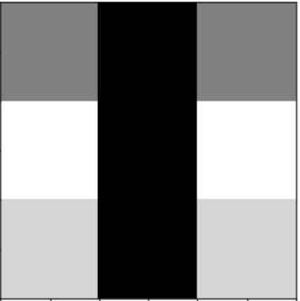
Just for Fun: this is our original image on the left and convoluted one on the right(based on example pixel values)
convolutions

Slide 12
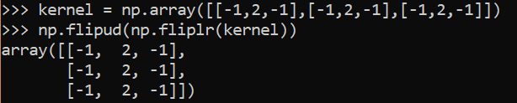
Some important theories to consider
Calculations of the convolutions involves a step where we flip the kernel matrix horizontally and vertically as well. This is the mathematical formula for convolution. However we skipped this step in our example because our kernels are symmetric. Proof below.
Given an original image of dimensions (n * k). Kernel of dimension (m * m ). Padding of value (p) and stride of value s
The size of the altered image would be a * b.
Where a = floor((n +2p – m)/s) + 1 and b = floor((k +2p –m)/2) + 1

Slide 13
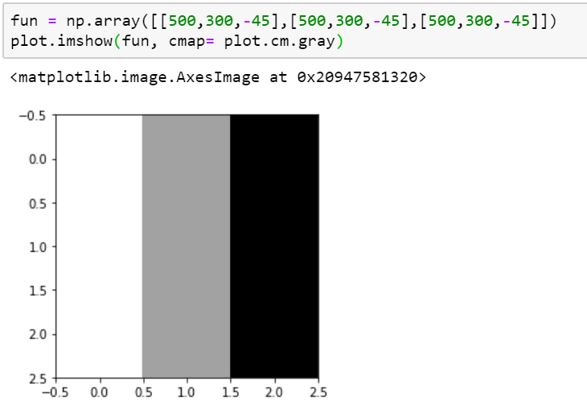
Some important theories to consider
3. When we are performing the weighted sum, it is possible that the output exceeds the range 0-255. Python libraries would take care of this issue, by having the max value as white and lowest values as black
This particular matrix exceeds 0-255 range in all boxes.
So , python performs the following :
Largest values shown as white.
Lowest values shown as black
Values within are in ranges of gray

Slide 14
Operation | Custom Function | Industry Accepted
Flip a matrix horizontally | def flip_horizontally(matrix): return matrix[:, ::-1] | np.fliplr()
Flip a matrix vertically | def flip_vertically(matrix): return matrix[::-1] | np.flipud()
Rotate a matrix | flip_vertically(flip_horizontally(m)) | np.flipud(np.fliplr(m))
Convolution | convolution() method described above | from scipy.signal import convolve2d convolve2d(image, kernel, mode = ‘same’)

Slide 15
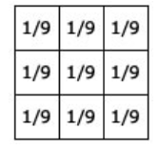
Armed with our understanding so far, lets try and develop an intuition for convolution
What do I mean by developing “intuition for convolution” ?
understand how and why convolution impacts a certain image
As a result, come up with new kernels to cause changes to an image eg blurring, sharpening, etc
In order to understand convolution in image processing, we are going to accept one example as universal truth. And develop our intuition ahead
In our example, our universal truth would be the box blur kernel.
We will accept box blur kernel does exactly as promised.. That is blurs the image
We will see the reason why it blurs
Box blur kernel:

Slide 16
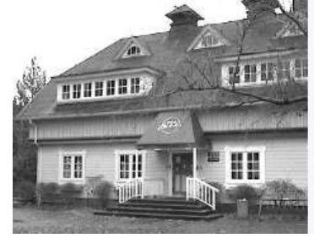
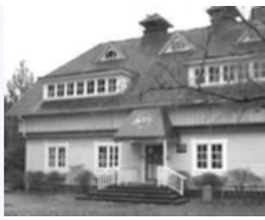
Box Blur
We see above the effect of applying a blur kernel on an image
The output image is defined less clearly
It also seems like the colors are diffusing into each other blurring the edges causing a blur result
Lets understand why the given kernel causes this effect

Slide 17
Box Blur
We will always, always, always focus on the center of the kernel
Looking at the center, we will see how the surroundings are impacting the center of original image
Why focus on the center? Because , center of the kernel is aligned with each pixel on the original image. As we have seen before
What do we see?
the center has 8 surroundings.
Each kernel box has same value.
The center is applied on each pixel of the original image.
Hence, each pixel of the original image gets changed to average value of itself and its surrounding pixels.
Every pixel is brought down the same level, which is 1/9th of its value
The above causes that particular diffusing effect which is symptomatic of blur

Slide 18
Box Blur
Why 1/9 ? Why not something else say 2/3 or 1/6?
If you see we have taken a kernel dimension of 9 boxes.
It is important that the weights are equally distributed in all boxes. This is because if they are not , a certain pixel may become darker than the rest. So some part of the image might become darker or more highlighted. Not really what we want in a blur
Why will one particular pixel become darker? Because we would end up emphasizing that particular pixel higher due to uneven weights
What will be the box blur kernel for a kernel dimension of 5*5 . It will be 1/25 in each box
Psst..We will see what happens to images when we take incorrect kernel values in our python exercises later.
Lets look at another example…

Slide 19
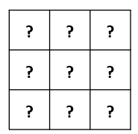
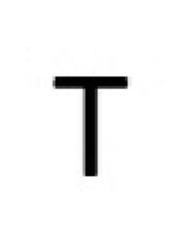
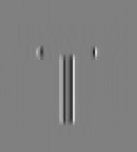
Vertical Edge Detection
We see above the effect of applying a vertical edge detector kernel on an image
The output image only highlights the vertical edges in lighter tones
Lets attempt to develop the kernel that causes this effect

Slide 20
Vertical Edge Detection
We see above the effect of applying a vertical edge detector kernel on an image
The output image only highlights the vertical edges in lighter tones
What is a vertical edge?
A pixel belongs to a vertical edge , if the pixel right on top and right below has same or similar value. The other pixels surrounding it will not have same or even nearby value.
So if we have to develop a vertical edge detector where the vertical edges are shown in lighter colours, we would have to give weights to the middle boxes and give relatively negative weights to the adjacent boxes.
Why negative weights? So that the adjacent turns darker.
The weight distribution has to be relative, so if total adjacents are brought down by 2 steps , the middle ones need to be highlighted by two steps as well

Slide 21
Vertical Edge Detection
As always, focus on the center of the kernel
Based on the definition of vertical edge, we would have to give higher weights to middle box, its top most neighbour and its bottommost neighbour.
Why higher? Because higher values are whitish in the color scheme
Similarly, the adjacent surroundings need to be darkened in equal weights.
How do we darken? We reduce the pixel values. In our case, we would give negative weights
Why do we darken in equal weights? So that the edges clearly stand out, with no chances of diffusion
What do we mean by equal weights? So, for example if the center aisle is increased by 8 points , the adjacent aisles needs to be decreased by 8 points.
Eg: In a 3 * 3 matrix, that means we give 8 weight in center aisle
Eg: -8/2 = 4. -4 weights in adjacent aisles

Slide 22
Vertical Edge Detection
Based on our previous slide, we would whiten/lighten the center aisle
Based on our previous slide, we would darken the adjacent aisles
Weights have to be provided in relative proportion
? | ? | ?
? | ? | ?
? | ? | ?
-1 | 2 | -1
-1 | 2 | -1
-1 | 2 | -1
Psst.. We will check in our python exercises , the impact of changing these values around. Will it still be able to detect edges?

Slide 23
Vertical Edge Detection
-1 | 2 | -1
-1 | 2 | -1
-1 | 2 | -1
Based on this particular vertical edge detection kernel, can we
Create a horizontal edge detector kernel?
Diagonal edge detector kernel?
Yes!! Logic would be similar, we would simply flip the values around
-1 | -1 | -1
2 | 2 | 2
-1 | -1 | -1
-1 | -1 | 2
-1 | 2 | -1
2 | -1 | -1
2 | -1 | -1
-1 | 2 | -1
-1 | -1 | 2
Horizontal Edge
Diagonal 45° Edge
Diagonal 135° Edge
Lets look at one more example…

Slide 24
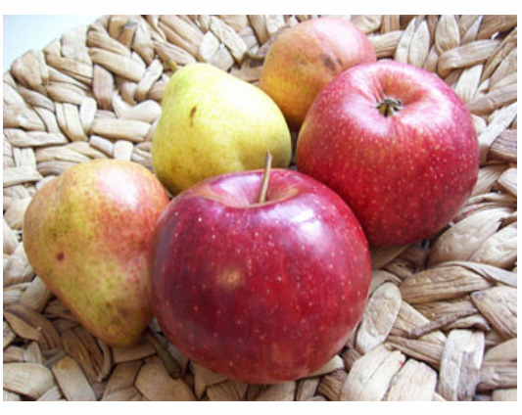
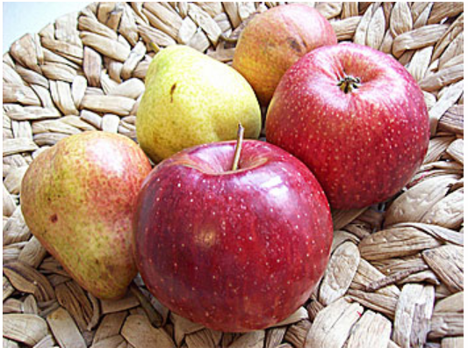
Sharpening Kernel
What happens to an image when we sharpen ?
The edges are better defined . The contrast of the edges are better. Look at image below
Look at the surface of forefront red apple. Left surface appears softer where as that is not the case in the right image. Shadows are darker and edges are more apparent

Slide 25
Sharpening Kernel
Once again, we focus on center of the kernel. Decide that and then decide on the surroundings
In sharpening, what exactly happens? Each pixel becomes better defined than its surroundings.
How do we achieve that?
We give higher weights to that pixel and lower proportional weight to surroundings

Slide 26
Sharpening Kernel
Based on previous, we give a higher positive weight to center pixel.
The surrounding pixels, i.e. the top most, bottom most, left most and right most would be given proportionally lower i.e. negative weights
We would ignore the corner pixels, hence give 0 weights to each corner
? | ? | ?
? | ? | ?
? | ? | ?
0 | -1 | 0
-1 | 5 | -1
0 | -1 | 0

