Slide 1


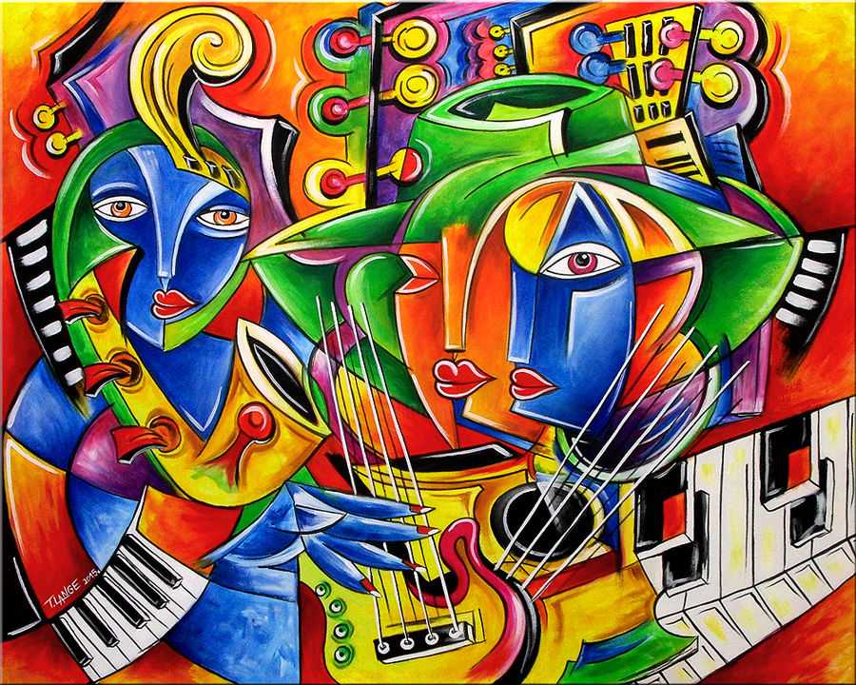
Toronto: Analysis of Culture & Community Centers

Slide 2
Toronto: Analysis of Culture & Community Centers
The city of Toronto is the provincial capital of Ontario and the most populous center of Canada
Toronto is a prominent center for music, theatre, motion picture production and television production, and is home to the headquarters of Canada's major national broadcast networks and media outlets.
Its varied cultural institutions which include numerous museums and galleries, festivals and public events, entertainment districts, national historic sites, and sports activities, attracting over 25 million tourists each year.
GOAL:
The ultimate goal of this exercise will be to ascertain the density ,variety and geographical location of cultural and community centers that the city of Toronto has to offer.
Specifically , we would like to know:
The aim for this particular exercise in data analysis is to segment different culture and community centers
We would also like to have the knowledge which particular areas in Toronto have higher concentration of community centers and which require future rebuilding
Community centers should be categorized based on their specific use e.g. library, performance center etc.
Community centers should be categorized based on ownership details as well.

Slide 3
Toronto: Analysis of Culture & Community Centers
STAKEHOLDERS/ INTENDED AUDIENCE:
This exercise is aimed /sponsored by the city council of Toronto. However the information here in will serve handy for the below groups/individuals as well:
Press: for the purposes of marketing/ information dissemination to general public
City building contractors
Current and potential future investors and patrons of the arts
Various charities/community outreach programs
Event planners/ organizers
Last but not the least, general public

Slide 4
Toronto: Analysis of Culture & Community Centers
DATA SET:
The data set used for the purposes of this exercise has been downloaded from Toronto CA City government website.
https://www.toronto.ca/city-government/data-research-maps/open-data/open-data-catalogue/culture-and-tourism/#1b3c08c4-0316-fc59-88c6-e6d7178a2cf8
File Name: MSFC_44 Wards_Complete_Final.xlsx
Data Dictionary : MSFC_Readme.xls
*** Datasets are made freely available for anyone under the City’s Open Government Licence, which is based on version 1.0 of the Open Government License – Ontario. This license allows worldwide, royalty-free, perpetual, non-exclusive license to use the City’s open datasets, for both commercial and non-commercial use.

Slide 5
Toronto: Analysis of Culture & Community Centers
OBSERVATIONS POST ANALYSIS:
By the end of following this particular notebook, how we came to the following analysis will be clear. However to intrigue the readers interest and for quick clarity , earmarking few critical observations upfront.
City of Toronto has close to 1600 culture and community centers spread across its various wards
Majority (~700) of these community centers facilitate performance
City has only ~100 public libraries
Majority (~1100) of these community centers are not owned or operated by the city
Ward 20 in Toronto – Scarborough Southwest has the highest concentration of community centers

Slide 6
Toronto: Analysis of Culture & Community Centers
CONCLUSION:
Based on our data analysis exercise we can conclude the following:
City of Toronto has close to 1600 culture and community centers spread across its various wards. Density and availability of community centers reduces the further away we are from the city center.
Majority (~700) of these community centers facilitate performance
City has only ~100 public libraries. The highest number of libraries at a particular ward is only 5.
Majority (~1100) of these community centers are not owned or operated by the city.
Ward 20 in Toronto – Scarborough Southwest has the highest concentration of community centers. This can be attributed to private sponsorship and investment as majority of private stake community centers are also in this particular ward
Wards which require work in infrastructure of community centers are Scarborough Agincourt , Danforth and Etiboke

