Slide 1
What is convolution in image processing
Take pixels of the original image
Take a matrix with numbers in each box
Apply the matrix on the original image to derive a new image

Slide 2

A very simplistic pixel values for the
Image on the left. For ease of viewing showing in a 3 *3 matrix
a | b | c
d | e | f
g | h | i
Say, this is the pixel representation
Of the image on the left
Pixels are obviously numbers within
0-255 range. However we are
Showing them as alphabets for ease of demonstration on later slides
Say, this is our simplest image.
A gradually lightening gray scale image
Our aim: perform an image convolution with a given image kernel

Slide 3

Given below: A sample image kernel.
We would be using this particular kernel and apply it as a convolution on the image above.
** usually image kernels are odd numbered matrix eg 3 * 3, or 5 * 5. reason explained later
** dimensions of the kernel needs to be same or lower than the dimensions of the original image
-1 | 2 | -1
-1 | 2 | -1
-1 | 2 | -1
Psst..This is a vertical edge detector kernel. But more on this later

Slide 4
-1 | 2 | -1
-1 | 2 | -1
-1 | 2 | -1
First Step
Slide the kernel matrix over each pixel of the original image.
***This has to be done in such a way such that, the center of the kernel matrix is on top of the pixel in question for the original image
This particular information also sheds light on why kernel matrices are usually odd dimension matrix
a | b | c
d | e | f
g | h | i
Our next step would be to slide the kernel matrix one step at a time over the original image
the movement of one pixel at a time is known as stride. In this example, stride = 1.
So when we move our kernel matrix in second step, the center of the kernel would be on top of box ‘b’
If stride was 2 , when we move our kernel matrix in second step, the center of the kernel would be on top of box ‘c’
We keep moving column wise and then to the next row and column wise further

Slide 5
-1 | 2 | -1
-1 | 2 | -1
-1 | 2 | -1
2nd Step
Slide the kernel matrix over each pixel of the original image by moving one pixel at a time.
Again we center the kernel matrix on the pixel.
a | b | c
d | e | f
g | h | i
-1 | 2 | -1
-1 | 2 | -1
-1 | 2 | -1
a | b | c
d | e | f
g | h | i
3rd Step
Slide the kernel matrix over each pixel of the original image by moving one pixel at a time.
Again we center the kernel matrix on the pixel.

Slide 6
4th Step
5th Step
6th Step
a | b | c
d | e | f
g | h | i
-1 | 2 | -1
-1 | 2 | -1
-1 | 2 | -1
-1 | 2 | -1
-1 | 2 | -1
-1 | 2 | -1
a | b | c
d | e | f
g | h | i
a | b | c
d | e | f
g | h | i
-1 | 2 | -1
-1 | 2 | -1
-1 | 2 | -1
7th Step
8th Step
9th Step
a | b | c
d | e | f
g | h | i
a | b | c
d | e | f
g | h | i
a | b | c
d | e | f
g | h | i
-1 | 2 | -1
-1 | 2 | -1
-1 | 2 | -1
-1 | 2 | -1
-1 | 2 | -1
-1 | 2 | -1
-1 | 2 | -1
-1 | 2 | -1
-1 | 2 | -1

Slide 7
Two things that we would have noticed by now.
We did not deduce the output at each of the 9 steps
How do we deal with the cases where the kernel overshoots the boundaries of the image, say step 1, 2, 3, etc
For the step 1, we would show the same in the next slides
For step 2 , we perform padding. That is we surround the original image with zeros (as shown below)
0 | 0 | 0 | 0 | 0
0 | a | b | c | 0
0 | d | e | f | 0
0 | g | h | i | 0
0 | 0 | 0 | 0 | 0
** in case our image was of larger dimension say 25*25. We may use a larger kernel say of 5 * 5 matrix. In that case, we would have to have a padding layer of thickness 2. ie, instead of one layer of zeros as shown here, we would have two layers of zeros surrounding the image

Slide 8
Calculation of output at each step
The output of a convolution is another image with possibly different pixel values.
We calculate the weighted sum of the product of the kernel value and original image pixel value
** remember, places where kernel overshoots are padded with zero.
-1 | 2 | -1
-1 | 2 | -1
-1 | 2 | -1
3
We calculate the top left pixel of the new image created
a | b | c
d | e | f
g | h | i
0 * -1 + 0 * 2 + 0 * -1 + 0 * -1 + 2*a + -1 * b + 0 * -1 +2*d + -1 * e
If we ignore the 0 values: 2*a + -1 * b +2*d + -1 * e
Eg a = 1, b = 1, c = 1
d = 2, e = 2, f = 2
g = 3, h = 3, I = 3
Value would be :
2 * 1 + -1*1+ 2*2 + -1*2 = 3
p.s ignored the 0 values

Slide 9
2nd step
-1 | 2 | -1
-1 | 2 | -1
-1 | 2 | -1
3 | 0
a | b | c
d | e | f
g | h | i
We calculate the (1,2)th pixel of the new image created
0 * -1 + 0 * 2 + 0 * -1 + -1*a + 2*b + -1 * c + -1*d +2*e + -1 * f
If we ignore the 0 values: -1*a + 2*b + -1 * c + -1*d +2*e + -1 * f
Eg a = 1, b = 1, c = 1
d = 2, e = 2, f = 2
g = 3, h = 3, I = 3
Value would be :
-1*1 + 2*1 + -1 * 1 + -1*2 +2*2 + -1 * 2 = 0
p.s ignored the 0 values

Slide 10
Final output of convolution at the end of every step
Pssst… we filled in example values for our image
1 | 1 | 1
2 | 2 | 2
3 | 3 | 3
-1 | 2 | -1
-1 | 2 | -1
-1 | 2 | -1
3 | 0 | 3
6 | 0 | 6
5 | 0 | 5
convolutions
Original
Kernel

Slide 11
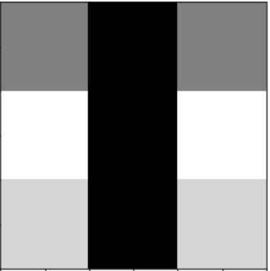
Just for Fun: this is our original image on the left and convoluted one on the right(based on example pixel values)
convolutions

Slide 12
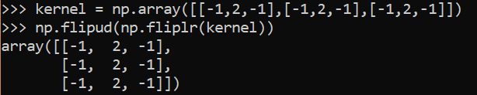
Some important theories to consider
Calculations of the convolutions involves a step where we flip the kernel matrix horizontally and vertically as well. This is the mathematical formula for convolution. However we skipped this step in our example because our kernels are symmetric. Proof below.
Given an original image of dimensions (n * k). Kernel of dimension (m * m ). Padding of value (p) and stride of value s
The size of the altered image would be a * b.
Where a = floor((n +2p – m)/s) + 1 and b = floor((k +2p –m)/2) + 1

Slide 13
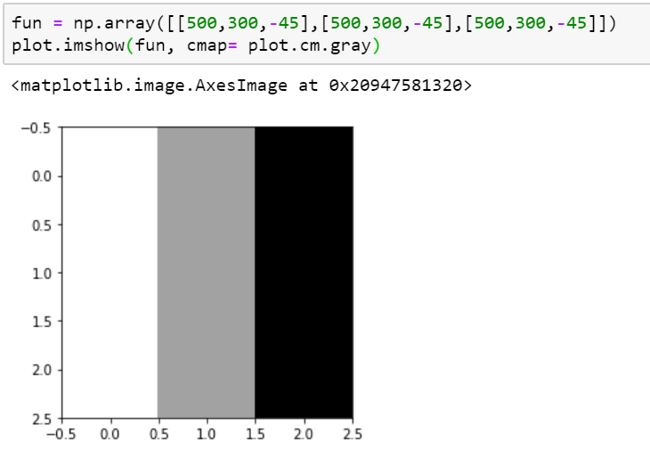
Some important theories to consider
3. When we are performing the weighted sum, it is possible that the output exceeds the range 0-255. Python libraries would take care of this issue, by having the max value as white and lowest values as black
This particular matrix exceeds 0-255 range in all boxes.
So , python performs the following :
Largest values shown as white.
Lowest values shown as black
Values within are in ranges of gray

Slide 14
Operation | Custom Function | Industry Accepted
Flip a matrix horizontally | def flip_horizontally(matrix): return matrix[:, ::-1] | np.fliplr()
Flip a matrix vertically | def flip_vertically(matrix): return matrix[::-1] | np.flipud()
Rotate a matrix | flip_vertically(flip_horizontally(m)) | np.flipud(np.fliplr(m))
Convolution | convolution() method described above | from scipy.signal import convolve2d convolve2d(image, kernel, mode = ‘same’)

