Slide 1
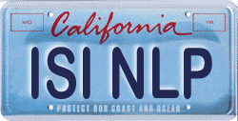
“Discussions of the Theory and Practice of Translation reach back into antiquity and show remarkable continuities.”
-- Wikipedia
kevin knight
university of southern california
ATANLP workshop, July 16, 2010

Slide 2
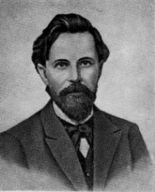
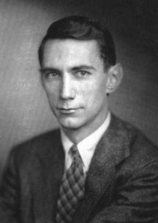

History of the World
consonant/vowel
sequences in Pushkin novels
[Markov 1913]
[Shannon 1948]
[Chomsky 1956]
[Chomsky 1957]
[Rounds 1970] & [Thatcher 1970]
[Thatcher 1973]
noisy channel model
cryptography
context free grammars
transformational
grammars
tree transducers, to
formalize
transformational
grammars
tree automata
survey article

Slide 3
Transformational Grammar (hypothesized movement)
Core
CFG
S
Transformational
Component
*
S
NP
VP
NP
VP
DT
N
V
NP
DT
N
AUX
V
PP
the
boy
saw
the
door
was
seen
P
NP
DT
N
the
door
by
DT
N
the
boy

Slide 4
History of the World
consonant/vowel
sequences in Pushkin novels
[Markov 1913]
[Shannon 1948]
[Chomsky 1956]
[Chomsky 1957]
[Rounds 1970] & [Thatcher 1970]
[Thatcher 1973]
noisy channel model
cryptography
context free grammars
transformational
grammars
tree transducers, to
formalize
transformational
grammars
tree automata
survey article

Slide 5

History of the World
“The number one priority in the area [of tree automata theory] is a careful assessment of the significant problems concerning natural language and programming language semantics and translation. If such problems can be found and formulated, I am convinced that the approach informally surveyed here can provide a unifying framework within which to study them.”
consonant/vowel
sequences in Pushkin novels
[Markov 1913]
[Shannon 1948]
[Chomsky 1956]
[Chomsky 1957]
[Rounds 1970] & [Thatcher 1970]
[Thatcher 1973]
noisy channel model
cryptography
context free grammars
transformational
grammars
tree transducers, to
formalize
transformational
grammars
tree automata
survey article

Slide 6
Natural Language Translation (real movement!)
S
S
*
NP
VP
CONJ
S’
wa-
[and]
DT
N
V
NP
V
NP
NP
the
boy
saw
ra’aa
[saw]
N
N
DT
N
the
door
atefl
[the boy]
albab
[the door]

Slide 7
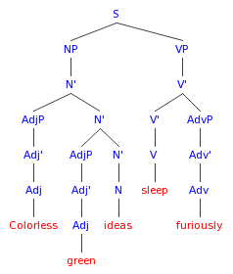


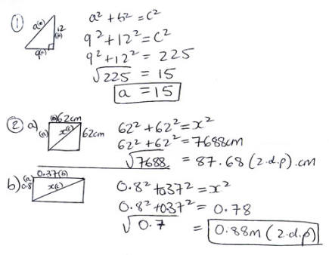
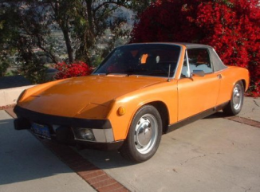


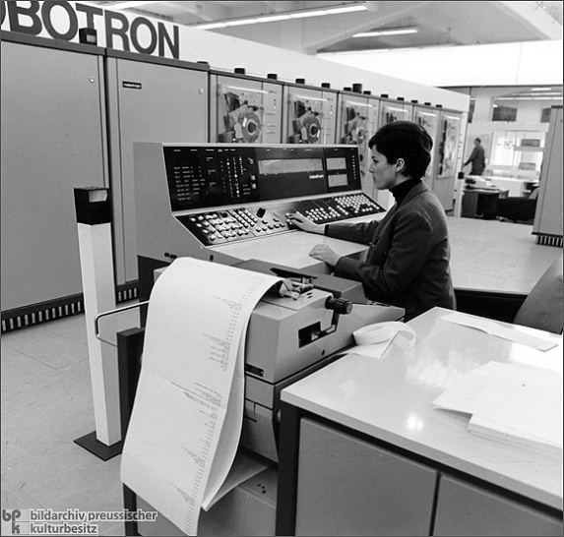
History of the World
Tree
Automata
Theory
Linguistics
Computers

Slide 8
Machine Translation is Hard!
Each word has tons of meanings
I’ll get a cup of coffee ?
I didn’t get that joke ?
I get up at 8am ?
I get nervous ?
Yeah, I get around … ?
Each word has zillions of contexts
Word order is very different
Machine must produce good sentences, not just consume them

Slide 9
Machine Translation is Hard!
English | The plane is faster than the train.
Chinese | 飞机 比 火车 快 (plane) (compared-to) (train) (fast)
English | When did you arrive?
Chinese | 你 是 什么时候 到 的 ？ (you) 是 (when) (arrive) 的
English | Where is the train?
Chinese | 火车 在 那儿 ？ (train) (at) (where)
English | Who wrote this letter?
Chinese | 这封 信 是 谁 写 来 的 ？ (this) (letter) 是 (who) (write) (come) 的

Slide 10

History of the World
THEORY
Let’s prove theorems!
LINGUISTICS
Let’s eschew
formalism!
NATURAL LANGUAGE PROCESSING
Let’s build demo systems!

Slide 11
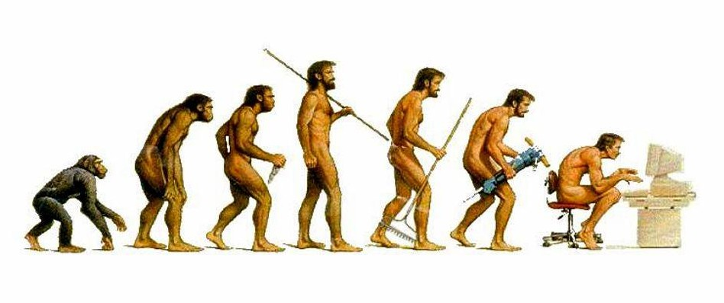
Natural Language Processing
FSA
CFG
Unification Grammar
CFG
FSA

Slide 12
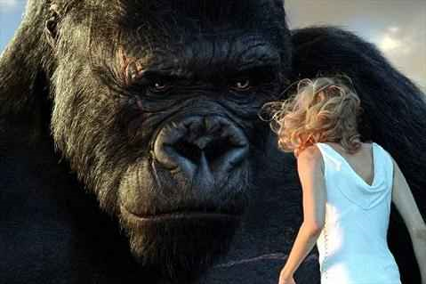
Natural Language Processing
FSA
CFG
Unification Grammar
CFG
FSA
gosh!
Tree Adjoining
Grammar

Slide 13
Linguistic Data
We have a lot!
Can train an English FSA on one trillion words.
The cup is on the table >> Cup the table on is the
The player is on the field >> The player is in the field
Translation data is especially tantalizing:
Billions of words, for some language pairs
Let’s explain translation data,
search for models that fit the data,
use those models to translate new data …

Slide 14
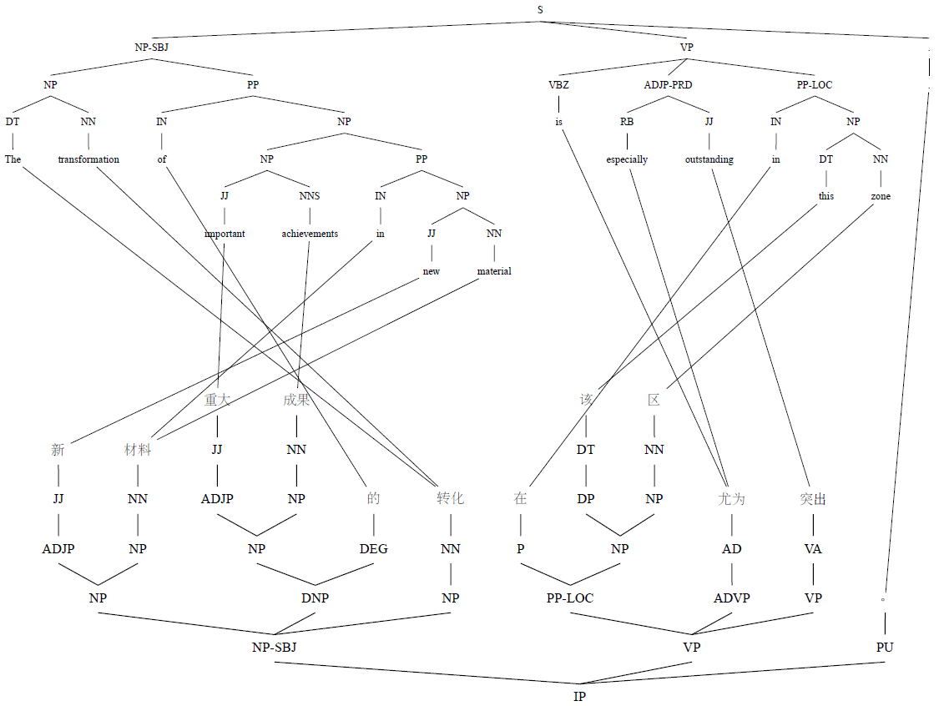

Slide 15
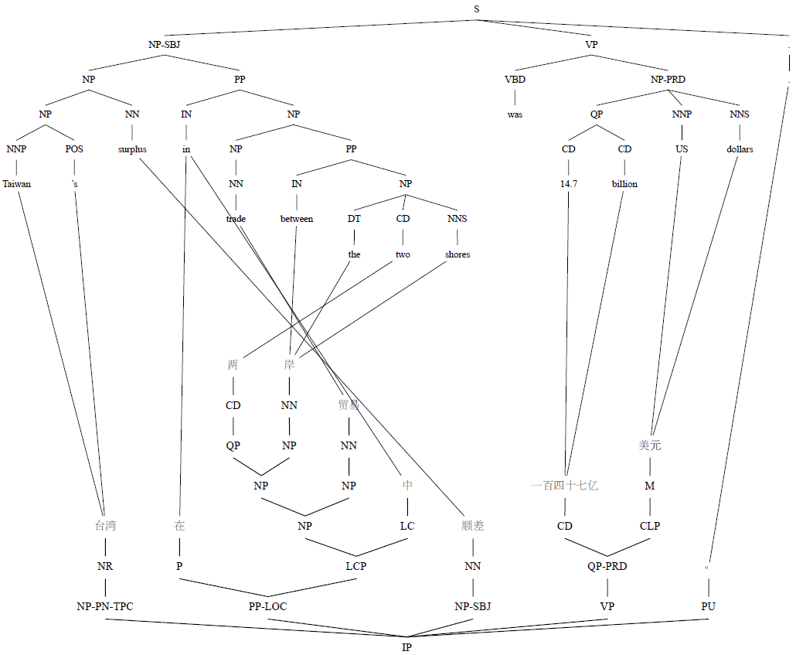

Slide 16
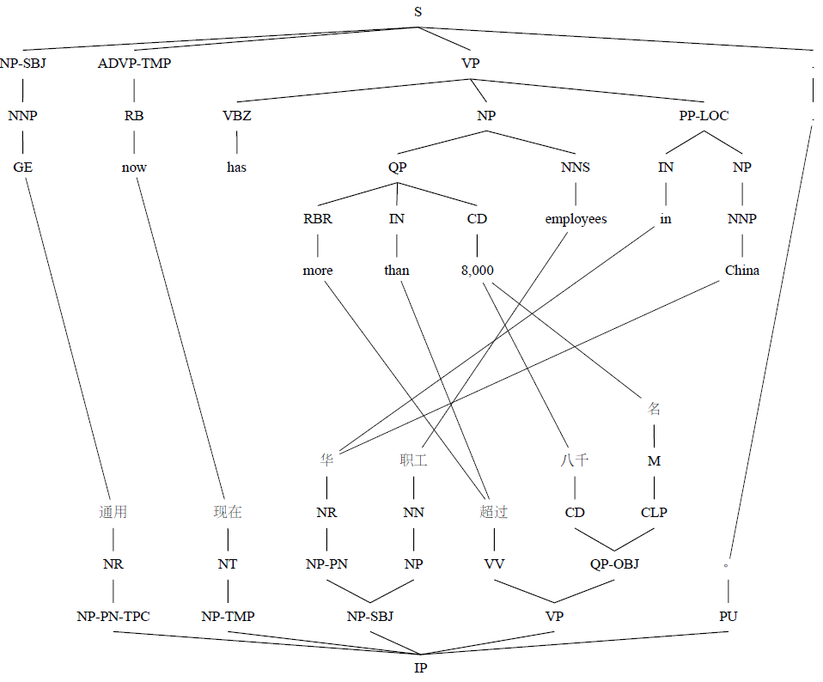

Slide 17
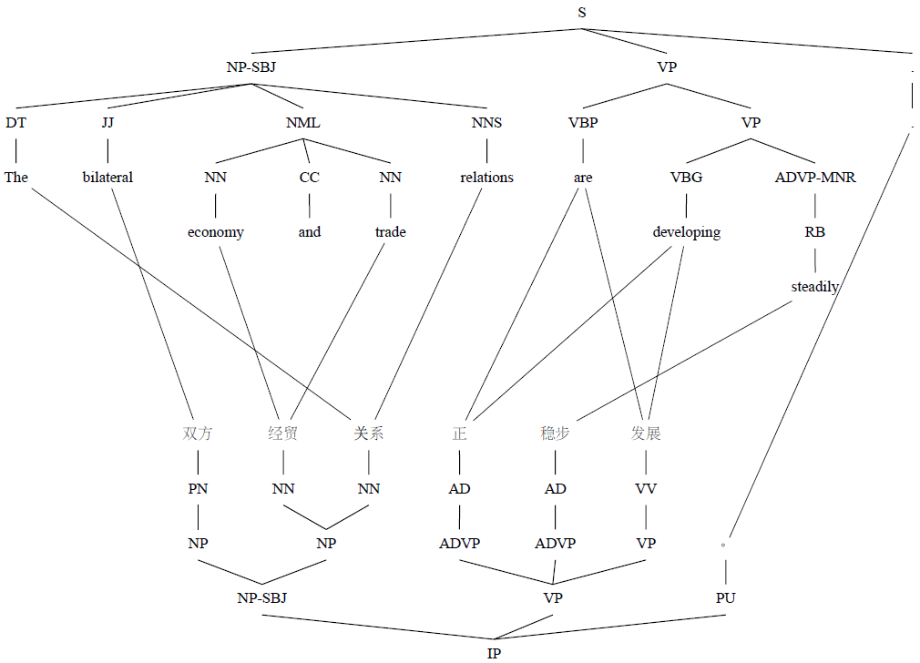

Slide 18
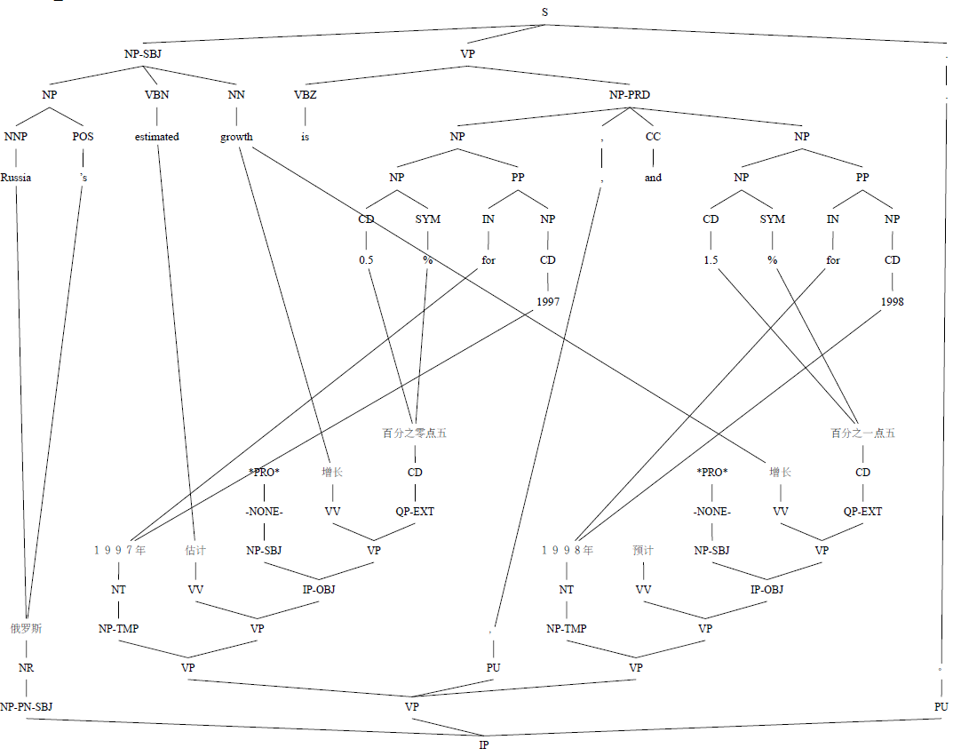

Slide 19
Fit to Data
What does it mean for a translation model to fit the observed translation data?
#1 Theory approach
#2 Linguistics approach
#3 Statistical approach
#4 Heroic approach

Slide 20
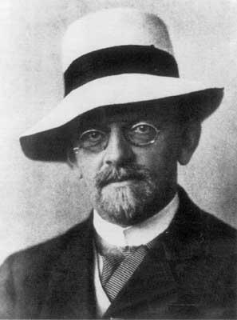
Fit to Data #1: Theory Approach
Goal: Create an underlying formalism and prove that it has certain formal properties necessary to explain data.

Slide 21
Desirable Properties for a Transducer Formalism for NLP [Knight 07]
Expressiveness
Can express the knowledge needed to capture the transformation & solve the linguistic problem
Modularity
Can integrate smaller components into bigger systems, co-ordinate search
Inclusiveness
Encompasses simpler formalisms
Teachability
Can learn from input/output examples

Slide 22
Expressiveness
some necessary things for machine translation
Phrasal Translation
Non-constituent Phrases
Non-contiguous Phrases
VP
S
hay X
VP
poner X
está cantando
VBZ
VBG
PRO
VP
VB
X
PRT
is
singing
there
VB
X
put
on
are
Context-Sensitive
Word Insertion/Deletion
Re-Ordering
Lexicalized Re-Ordering
S
NP
NPB
X
PP
的
X
VP
Y X Z
X
Y X
DT
X
P
Y
the
Y
Z
of

Slide 23
Local Rotation
S
S
*
NP
VP
CONJ
S’
wa-
[and]
DT
N
V
NP
V
NP
NP
the
boy
saw
ra’aa
[saw]
N
N
DT
N
the
door
atefl
[the boy]
albab
[the door]

Slide 24
Desirable Formal Properties [Knight 07]
Expressiveness | Do local rotation
Modularity | Be closed under composition
Inclusiveness | Capture any transformation that a string-based FST can
Teachability | Given input/output pairs, find rule probabilities to maximize likelihood

Slide 25
Top-down Tree Transducers
every rule has this form
one-level LHS
multilevel RHS
T – top-down
L – linear (non-copying)
N – non-deleting
S
S
x0
x1
x2
x1
VP
arabic verb
x0
x2
arabic subject
arabic object
LNT

Slide 26
Top-down Tree Transducers
one-level LHS
multilevel RHS
T – top-down
L – linear (non-copying)
N – non-deleting
S
S
x0
x1
x2
VP
arabic verb
x0
x2
arabic subject
arabic object
LT
can delete subtrees

Slide 27
Top-down Tree Transducers
one-level LHS
multilevel RHS
T – top-down
L – linear (non-copying)
N – non-deleting
S
S
x0
x1
x2
x0
VP
arabic verb
x0
x0
x2
arabic subject
arabic object
T
can copy & delete subtrees

Slide 28
Top-down Tree Transducers
one-level LHS
multilevel RHS
T – top-down
L – linear (non-copying)
N – non-deleting
q S
S
x0
x1
x2
r x1
VP
arabic verb
s x0
q x0
s x2
arabic subject
arabic object
T
LT
LNT
all employ states

Slide 29
T – top-down
L – linear (non-copying)
N – non-deleting
T
copying
non-copying
LT
deleting
non-deleting
LNT

Slide 30
T – top-down
L – linear (non-copying)
N – non-deleting
T
copying
non-copying
LT
deleting
non-deleting
Expressiveness:
S
*
S
PRO
VP
V
PRO
NP
q S
?
V
NP
LNT
x0
x1

Slide 31
T – top-down
L – linear (non-copying)
N – non-deleting
q S
S
T
x0
x1
r x1
q x0
s x1
copying
r VP
q x0
non-copying
LT
x0
x1
deleting
non-deleting
s VP
q x1
Expressiveness:
x0
x1
S
*
S
PRO
VP
V
PRO
NP
q S
?
V
NP
LNT
x0
x1

Slide 32
Extended (x-) Transducers
multilevel LHS
multilevel RHS
T – top-down
L – linear (non-copying)
N – non-deleting
x – extended LHS
S
S
x0
VP
x1
x0
x2
xLNT
x1
x2
can grab more structure
english
subject
english object
english verb
possibility mentioned in [Rounds 70]
variant defined in [Dauchet 76]
used for practical MT by [Galley et al 04, 06]
studied formally by [Maletti et al 09]

Slide 33
T
copying
GS’84
non-copying
deleting
LT
non-deleting
LNT
GS’84

Slide 34
xT_{R}=T_{R}
xT
+ finite-check
before delete
M’09
T
copying
GS’84
non-copying
xLT
deleting
LT
non-deleting
xLNT
M’09
+ local rotation
LNT
GS’84

Slide 35
xT_{R}=T_{R}
Expressive enough for local rotation
xT
M’09
T
copying
GS’84
non-copying
xLT
deleting
LT
non-deleting
Expressiveness:
xLNT
S
*
S
M’09
PRO
VP
V
PRO
NP
LNT
V
NP
GS’84
Expressive power theorems in [Maletti, Graehl, Hopkins, Knight, SIAM J. Comput]

Slide 36
xT_{R}=T_{R}
Expressive enough for local rotation
xT
bottom up
transducers
M’09
T
B
copying
GS’84
non-copying
xLT
LB=LT_{R}
deleting
LT
non-deleting
xLNT
M’09
LNT
GS’84

Slide 37
xT_{R}=T_{R}
Expressive enough for local rotation
Closed under composition
xT
bottom up
transducers
M’09
T
B
copying
GS’84
non-copying
xLT
LB=LT_{R}
deleting
LT
non-deleting
xLNT
M’09
LNT
GS’84

Slide 38
Expressive enough
Closed under composition
xT_{R}=T_{R}
Generalizes FST
xT
T
B
copying
non-copying
MBOT
xLT
LB=LT_{R}
deleting
LT
non-deleting
xLNT
(xRHS, input-e,
output-e)
xLNT
(xRHS, output-e)
xLNT
(xRHS, input-e)
LNT
(xRHS, input-e,
output-e)
FST
xLNT
(xRHS, e-free)
LNT
(xRHS, input-e)
LNT
(xRHS, output-e)
GSM
LNT
(xRHS, e-free)

Slide 39
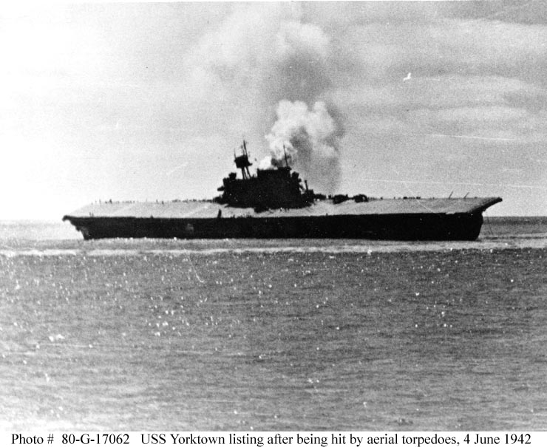
Fit to Data #2: Linguistics Approach
Goal: Destroy enemy theory by torpedo
Whose blue dog does Mary
think Bill believes John said
he saw?
Mary thinks Bill believes
John said he saw
whose blue dog?
your favorite theory

Slide 40
Fit to Data #2: Linguistics Approach
S
S
*
NP
VP
WhNP
VP
AUX
S
Mary
V
S
DT ADJ N
Whose blue dog
does
NP
VP
thinks
NP
VP
Mary
V
S
Bill
V
S
think
NP
VP
believes
NP
VP
Bill
V
S
I
V
WhNP
believes
NP
VP
DT ADJ N
whose blue dog
saw
I
V
saw

Slide 41

Fit to Data #2: Linguistics Approach
Goal: Find generalizations in data
Summer project at ISI (2010):
What is the smallest xLNTs tree transducer (rule book)
that explains a given tree/string corpus?
Smallest, in bytes.
No word-to-word alignments provided.
Difficult search problem!
your favorite theory

Slide 42
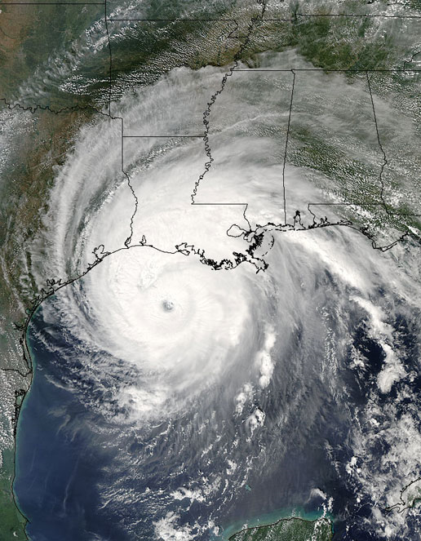
Fit to Data #3: Statistical Approach
Goal: Predict translation behavior
Model will always be wrong
Key: how to manage ignorance
Use past to predict future
Worry about the frequent stuff
If we could really predict
human translator behavior well,
we would be able to build
good automatic translators
(“do as a human would”)
my home
town

Slide 43
Shannon Hangman
Hangman

Slide 44
Shannon Hangman
Hangman
e

Slide 45
Shannon Hangman
Hangman
t
t
e

Slide 46
Shannon Hangman
Hangman
n
t
t
e

Slide 47
Shannon Hangman
Hangman
n i
t
t
e

Slide 48
Shannon Hangman
Hangman
n i a
t
t
e

Slide 49
Shannon Hangman
Hangman
n i a
s
t
s
t
e

Slide 50
Shannon Hangman
Hangman
n i a
s
t
s
h
t
e

Slide 51
Shannon Hangman
Hangman
n i a b
s
t
s
h
t
e

Slide 52
Shannon Hangman
Hangman
n i a b r
s
t
s
h
t
e

Slide 53
Shannon Hangman
Hangman
n i a b r q
s
t
s
h
t
e

Slide 54
Shannon Hangman
Hangman
Shannon Game is like hangman, except:
it’s not fun
you go left to right
a correct guess only lights up one letter
they never hang you
you wish they would hang you
n i a b r q
s
t
s
h
t
e

Slide 55
Shannon Hangman
Hangman
Shannon Game is like hangman, except:
it’s not fun
you go left to right
a correct guess only lights up one letter
they never hang you
you wish they would hang you
n i a b r q
j
u
s
t
s
h
o
o
t
m
e

Slide 56
Shannon Hangman
Estimates how good we can predict language.
Guess sequence:
1 4 16 1 1 1 74 …
P_{human}(guess) ~ P(1)·P(4)·P(16)·P(1)·P(1)·P(1)·P(74) …
H(guess) = - log₂P(guess) / N
Shannon’s wife: 0.8-1.6

Slide 57
Shannon Hangman
English
model |  | H(guess)
human |  | 1.9
char | 1-gram | 4.4
 | 2-gram | 3.7
 | 3-gram | 3.1
word | 1-gram | 2.8
 | 3-gram | 1.8
Spain qualified for the World Cup Final, and will p_
?
Experiments at ISI by Kyle Gorman and Kevin Knight

Slide 58
Shannon Hangman for Translation
English
English given French
model |  | H(guess) | H(guess | f)
human |  | 1.9 | 1.2
char | 1-gram | 4.4
 | 2-gram | 3.7
 | 3-gram | 3.1
word | 1-gram | 2.8 | 2.2
 | 3-gram | 1.8
l'Espagne se qualifie pour la finale de la Coupe du monde,
et affrontera dimanche les Pays-Bas.
Spain qualified for the World Cup Final, and will p_
?
Experiments at ISI by Kyle Gorman and Kevin Knight

Slide 59
Statistical Approach to MT
Build a probabilistic generative story, e.g.
from English tree
to Chinese string
involving steps not directly observed
Discover hidden steps by maximizing likelihood
Extract probabilistic dictionaries, rules, etc
Use rules to translate new sentences
Employ target language model for fluency

Slide 60
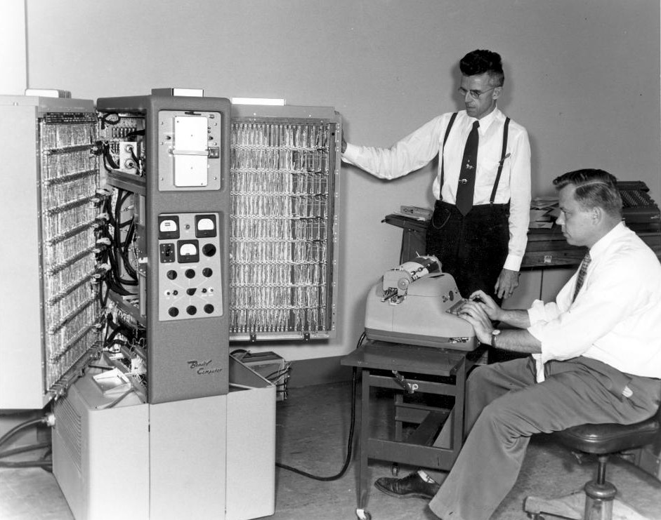
Fit to Data #4: Heroic Approach (aka Engineering Approach)
Goal: Improve machine translation quality
Pick idea
Write program!
Get bugs out
Get more bugs out!
Evaluate!!
Add a feature
Clean the data
Evaluate
Iterate!
Bakeoff #9:

Slide 61
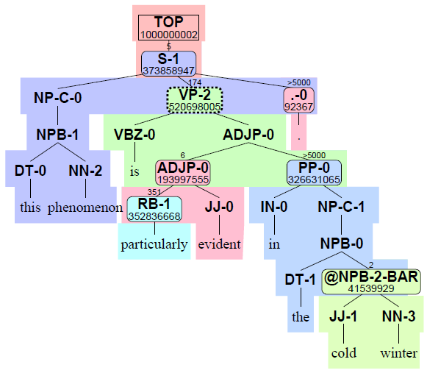
It works…

Slide 62
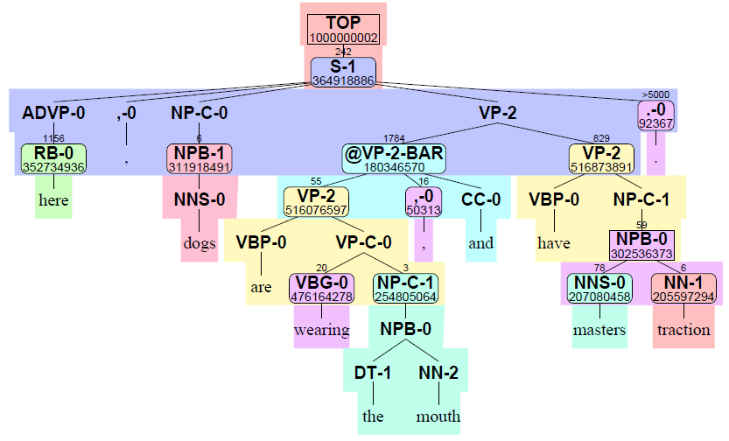
…except when
it doesn’t.

Slide 63
…except when
it doesn’t.
The verb discuss doesn’t
take an S argument (like
believe and realize do)!
An idea can’t
visit a place!

Slide 64
Rest of This Talk
Connections between MT and automata
Review previous open issues
“Overview of Probabilistic Tree Transducers for NLP” [Knight & Graehl 05]
Goal of that paper: make connections between fields
Thank God for Mexico!
Raise new open issues

Slide 65

Open Issues from [Knight & Graehl 05]
[Huang & Chiang 05] Very popular in MT & parsing
[Pauls & Klein 09] K-best A* Parsing (best paper ACL 2009)
Still no separation of k and n, as in [Eppstein 94] for FSA, as implemented in Carmel.
[May, Knight, Vogler 10] Cascades of non-composable transducers.
Compares pipeline vs integrated search.
No heuristics.

Slide 66
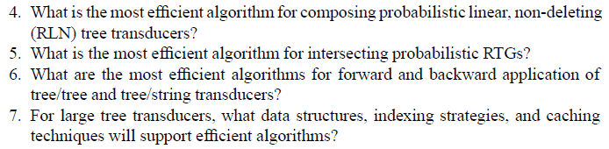

Open Issues from [Knight & Graehl 05]
[May, Vogler, Knight 10] Explicit algorithms and asymptotic complexities.
[Maletti 09] Minimization algorithms.
etc
Engineering work is being done within context of large, 500m-rule MT systems.
Unclear. Tree adjoining remains tantalizing.

Slide 67

Open Issues from [Knight & Graehl 05]
Unclear. Existing P(tree) models forget too much, then need to remember later.
[Maletti, Graehl, Hopkins & Knight 09]
[Shieber 06] Though more the opposite direction…
I’ll come back to this.

Slide 68

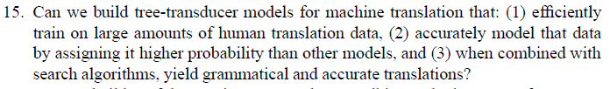
Open Issues from [Knight & Graehl 05]
Unclear. Must be symmetrical, moving stuff both up and down.
Unclear. For practical MT, we binarize trees in advance.
This introduces problems with ungrammatical outputs.
Making good progress, but need next quantum jump.
[May & Knight 06, May 10] More practicality = more scale.

Slide 69
New Open Issues

Slide 70
Closure under Composition: Is it Necessary?
Forward and backward application through a cascade of xLNT tree transducers [May, Knight, and Vogler 10]
Pipeline style
Integrated style (all transducers working simultaneously)
Training transducer cascades on end-to-end data
[Graehl & Knight 04] shows how to train one machine
[May 10] looks at training a whole cascade

Slide 71
New Desirable Properties?
Preserve regularity

Slide 72
Other NLP Areas
Summarization
Question answering
etc.
More fundamentally:
Natural Language Understanding (NLU)
Natural Language Generation (NLG)
NLU + NLG = Meaning-based MT

Slide 73
Natural Language Understanding
;; An animated character named "Pluto" appears at intervals in the
;; actual film, explaining the peaceful uses and safety of plutonium.
(a / and
:op1 (a2 / |appear>pop up|
:agent (c / |fictional character|
:mod (a3 / |animated<moving|)
:name "Pluto")
:temporal-locating (i / |time interval|)
:spatial-locating (f / |movie|
:mod (a4 / |existent,actual|)))
:op2 (e / |explain<inform|
:agent c
:patient (a5 / and
:op1 (u / |utilize|
:mod (p / |peace<order|))
:op2 (s / |safety<status|)
:gpi (p / |Pu|))))
Mnemonic names
for WordNet concepts
Standard “Davidsonian”
semantics.
Labeled directed
acyclic graph (DAG).
Manually-developed
relations (70 unique)

Slide 74
Natural Language Understanding
;;-----------------------------------------------------------------
;; I know people who can approach the president.
(h / |know|
:agent i
:patient (s / PERSON
:quant plural
:agent-of (c / |draw near|
:destination (p / |president<head of state|)
:domain-of (p2 / |possible<latent|))))
;;-----------------------------------------------------------------
;; She accused him of stealing the car.
(A / |accuse|
:agent she
:patient (S / |glom|
:agent he
:patient (C / |auto|)))
;;-----------------------------------------------------------------
;; I cannot abuse their trust.
(A / |possible>workable|
:domain (A2 / |sell<cozen|
:agent i
:patient (T / |reliance,trust|
:gpi they))
:polarity negative)
Some concepts
trigger special
grammatical
constructions

Slide 75
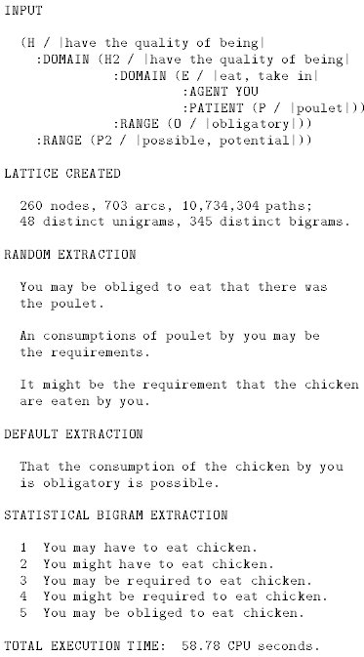
Natural Language Generation
[Knight & Hatzi 05]
[Langkilde & Knight 98]
Semantic representation
Transformation system
Lattice/Forest of
English realizations
Language model
Best English sentence

Slide 76
thanks
and many thanks to the organizers of this workshop!

Slide 77
The Beautiful World of Composable Transducers
English phoneme
sequence
Foreign phoneme
sequence
P(r|e)
P(r)
P(p|e)
P(f|r)
P(e)
English word
sequence
P(f|e)
Foreign word
sequence
P(e|f)
English word
sequence
P(l|e)
P(p|e)
Long English
word sequence
English phoneme
sequence
P(e|p)
English word
sequence

Slide 78
The Beautiful World of Composable Transducers
English phoneme
sequence
Foreign phoneme
sequence
P(r|e)
P(r)
P(p|e)
P(f|r)
P(e)
English word
sequence
P(f|e)
Foreign word
sequence
P(e|f)
English word
sequence
P(l|e)
P(p|e)
Long English
word sequence
English phoneme
sequence
P(e|p)
English word
sequence

Slide 79
The Beautiful World of Composable Transducers
English phoneme
sequence
Foreign phoneme
sequence
P(r|e)
P(r)
P(p|e)
P(f|r)
P(e)
English word
sequence
P(f|e)
Foreign word
sequence
P(e|f)
English word
sequence
P(l|e)
P(p|e)
Long English
word sequence
English phoneme
sequence
P(e|p)
English word
sequence

Slide 80
The Beautiful World of Composable Transducers
English phoneme
sequence
Foreign phoneme
sequence
P(r|e)
P(r)
P(p|e)
P(f|r)
P(e)
English word
sequence
P(f|e)
Foreign word
sequence
P(e|f)
English word
sequence
P(l|e)
P(p|e)
Long English
word sequence
English phoneme
sequence
P(e|p)
English word
sequence

Slide 81
The Beautiful World of Composable Transducers
English phoneme
sequence
Foreign phoneme
sequence
P(r|e)
P(r)
P(p|e)
P(f|r)
P(e)
English word
sequence
P(f|e)
Foreign word
sequence
P(e|f)
English word
sequence
P(l|e)
P(p|e)
Long English
word sequence
English phoneme
sequence
P(e|p)
English word
sequence

Slide 82
The Beautiful World of Composable Transducers
English phoneme
sequence
Foreign phoneme
sequence
P(r|e)
P(r)
P(p|e)
P(f|r)
P(e)
English word
sequence
P(f|e)
Foreign word
sequence
P(e|f)
English word
sequence
P(l|e)
P(p|e)
Long English
word sequence
English phoneme
sequence
P(e|p)
English word
sequence

