Slide 1
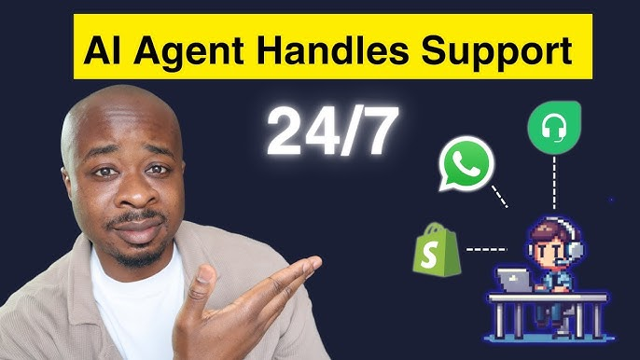

Slide 2
AI Receptionist for the Textile Industry
WhatsApp Price Quotation System

Slide 3
Real-World Scenario and Limitations
Customers frequently request price info based on material, color, quality
Manual replies are slow, inconsistent, and depend on receptionist availability
Time-limited service (9 a.m. – 6 p.m.) creates response gaps
Language barriers complicate communication

Slide 4
AI-Powered Customer Support for the Textile Industry
Automated WhatsApp Price Quotation System using Python and AI Agents

Slide 5
Why Implement an AI-Powered Support System?
Provide 24/7 customer response via WhatsApp
Ensure consistent and accurate answers regardless of staff availability
Automatically understand and process queries in multiple languages
Improve customer satisfaction and reduce manual workload

Slide 6
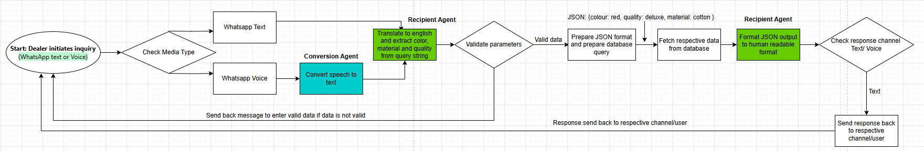
Data flow diagram

Slide 7
Technical Details
Python is used for efficient, fast development
GROK AI API used for natural language understanding
AI Agents handle tasks like translation, DB querying, and response generation
WhatsApp integration to capture and reply to real-time customer queries

Slide 8
Future Enhancements
Add voice message support: convert voice to text using speech recognition
Use same AI agent system to process and respond to audio queries
Enable dynamic price updates via real-time databases
Integrate with CRM for customer-specific pricing and history

