Slide 1
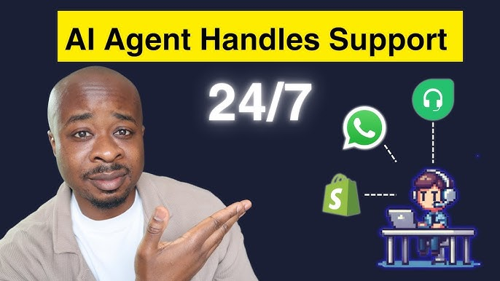

Slide 2
AI Receptionist for the Textile Industry

Slide 3
Agenda
Limitations
Solutions
Benefit of AI Receptionist
How we work
Future vision

Slide 4
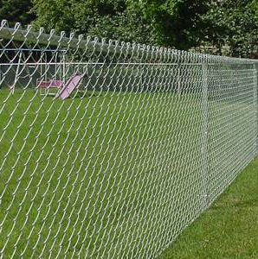
Real World Scenario & Limitations

Slide 5
Real World Scenario & Limitations
Limitations in the current system:
For example, IndiaMart, Alibaba.
Fixed Working Hours: Support is only available between 9:00 AM to 7:00 PM.
Staff Availability: Receptionist may be busy, on leave, or unavailable during high query volumes.
Language Barriers: Customers from diverse regions may not speak the same language as the receptionist.
Delayed Responses: Human error or workload can lead to slow replies, impacting customer satisfaction.
These bottlenecks affect customer experience and potentially result in lost opportunities.

Slide 6
Reason to Implement AI-Based Receptionist

Slide 7
Effective delivery techniques
24x7 Availability: Always active, no holidays.
Multilingual Understanding: Can interpret queries in multiple languages.
Fast Response Time: Instant replies, even during high demand.
Consistent Accuracy: No human error in understanding or replying.
Customer Engagement: Enhanced interaction quality with smart understanding of customer needs.

Slide 8
Are we limited for specific business?

Slide 9

No, We’re versatile
It’s not just limited to textile business. Our product support multiple business at minimum effort.

Slide 10
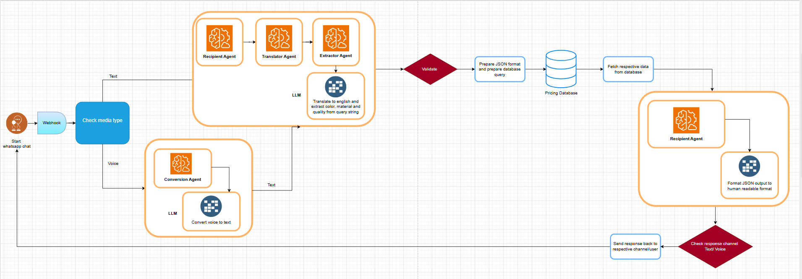
Technical Overview for Interested Audiences

Slide 11

Core Technologies Used
Python: Chosen for its readability, speed of development, and large ecosystem.
AI Agents (LLM-based):
Understand user messages
Translate languages if needed
Extract key data (material, color, quality)
Query pricing database
Format and send reply
WhatsApp Integration: Using APIs like Twilio/Gupshup to send/receive messages
Structured Prompting: To enhance agent understanding and ensure accurate query parsing

Slide 12
Benefits of Python & AI Agents
Rapid prototyping and flexible integration
Easy to scale and maintain
Leverage cutting-edge language models without deep AI knowledge

Slide 13

Future Enhancements
Our roadmap includes the following upgrades to make the assistant even more intelligent and versatile:
Generic question and Price question: We will try to answer generic questions as well for customer satisfaction.
Voice-to-Text Integration: Customers can send voice messages which will be transcribed and processed by the AI agent.
Voice-to-Voice Response: AI can reply in audio format for easier communication.
Product Image Understanding: AI can process product photos to understand customer intent.
CRM Integration: Automatically log interactions and customer data to a CRM system.
Marketing Purpose: Based on previous queries we can encourage customer to buy related products.

Slide 14
Thank you

