Slide 1
SNS News Recommendation
Progress Update
May 1st 2013
임베디드 시스템 연구실
김상모, 김형준, 한인규

Slide 2



System Architecture
News
Recommendation
User
News Recommendation
Server
Liked News
User 1
User 2
User n
User News Subscriptions
News Link Sources

Slide 3
Project Scope
User Liked News
Trainer
Daemon
Document Vector
Personalized
Document Vector List
(Per User)
Subscribed News
Evaluation
Daemon
Similarity
Score
Recommendation
Naïve Bayesian

Slide 4
Trainer Daemon Design
Trainer
Daemon
Plain Text
User ID
D2V: Document to Vector
Reference and Update
Whenever Users Like News
Document Vector
PDVL
GTT
PDVL
(Personalized Document Vector List)
GTT
(Global Term ID Table)

Slide 5
Evaluation Daemon Design
Naïve Bayesian
Evaluation
Daemon
Plain Text
User ID
Document Vector
D2V
NVE
News from Subscriptions
PDVL
PDVL
(Personalized Document Vector List)
Similarity
Score

Slide 6
Development Progress
Design
Design
Design
Implementation
Implementation
Implementation
Integration
Integration
Integration
GTT
PDVL
D2V
Lexical Analysis
Design
Design
Design
Design
Implementation
Implementation
Implementation
Implementation
Integration
Integration
Integration
Integration
Optimization
NVE
Trainer Daemon
Evaluation Daemon
NVE CUDA
Document Similarity Evaluation
Service Daemons

Slide 7
NVE CUDA Acceleration Module
float nvmuldiv( float d1[], float d2[], int len)
Performs the primitive Naive Bayesian Probability Calculation
Return: (d1[0] / d2[0]) x (d1[1] / d2[1]) x ... x (d1[len-1] x d2[len-1] )

Slide 8
Reduction
Implementation:
float reduce_mul ( thrust::device_vector<float> &d1 )
{
return thrust::reduce(
d1.begin(),
d1.end(),
(float) 1,
thrust::multiplies<float>()
);
}
Generalization of Summation
Excel: Sum(A1-A10)
Thrust
Open Source Parallel Algorithms Library
Supports CUDA
thrust::reduce( first, last, init, binary_op)
v₁ | v₂ | v₃ | v₄ | Op. | Result
1 | 3 | 2 | 4 | Σ | 10
1 | 3 | 2 | 4 | Π | 24

Slide 9
Limitation of Thrust
thrust::reduce() runs Synchronously
No Bulk Synchronous Data Parallel (Only on Roadmap)
1, 2, 3, 4, 5, 6, 7, 8, …
Result:
1, 2, 3, 4, 5, 6, 7, 8, …
Result:
One by one
1, 2, 3, 4, 5, 6, 7, 8, …
Result:
1, 2, 3, 4, 5, 6, 7, 8, …
Result:
How do we parallelize?

Slide 10
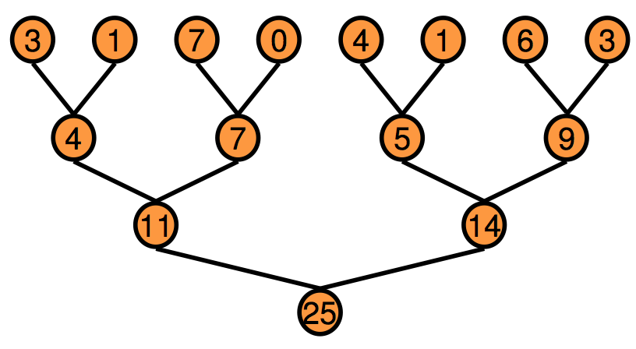
Our Strategy
Implement Optimized CUDA Kernel for Reduction Handles One Dataset
Launch Multiple Kernels for Multiple Datasets Asynchronously
A Kernel Launch is Asynchronous by Default
Reduction: Tree-based approach

Slide 11
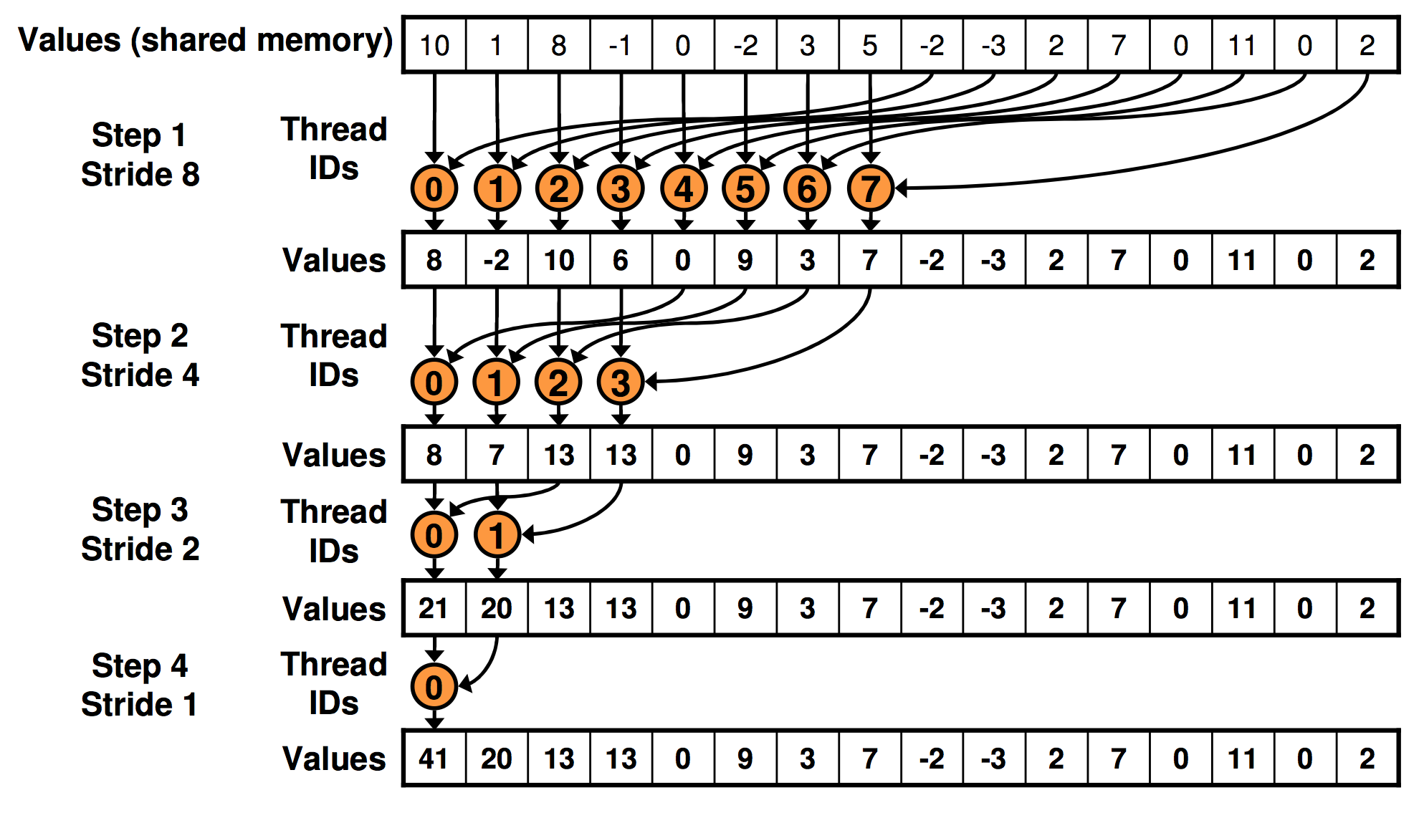
How to optimize Reduce?
A Good Work at NVIDIA
Optimizing Parallel Reduction in CUDA, Mark Harris
http://developer.download.nvidia.com/compute/cuda/1.1-Beta/x86_website/projects/reduction/doc/reduction.pdf
Thanks

