Slide 2
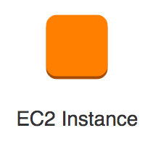
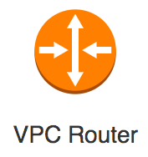
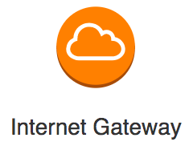
Public SN
Network ACL
Route Table
Security Group
Private SN
Network ACL
Route Table
Security Group
VPC
Region

