Slide 1
YOLO v3 (1)
YOLOv3: An Incremental Improvement
2024-09-09
2115686 최세인

Slide 2
Index
1. Abstract
2. Bounding Box Prediction
3. Class Prediction
4. Predictions Across Scales
5. Feature Extractor
6. Result
7. mAP

Slide 3
Abstract
Experiment with good findings from other object detection research to improve learning accuracy:
1. Bounding Box Prediction
2. Class Prediction
3. Predictions Across Scales
4. Feature Extractor

Slide 4
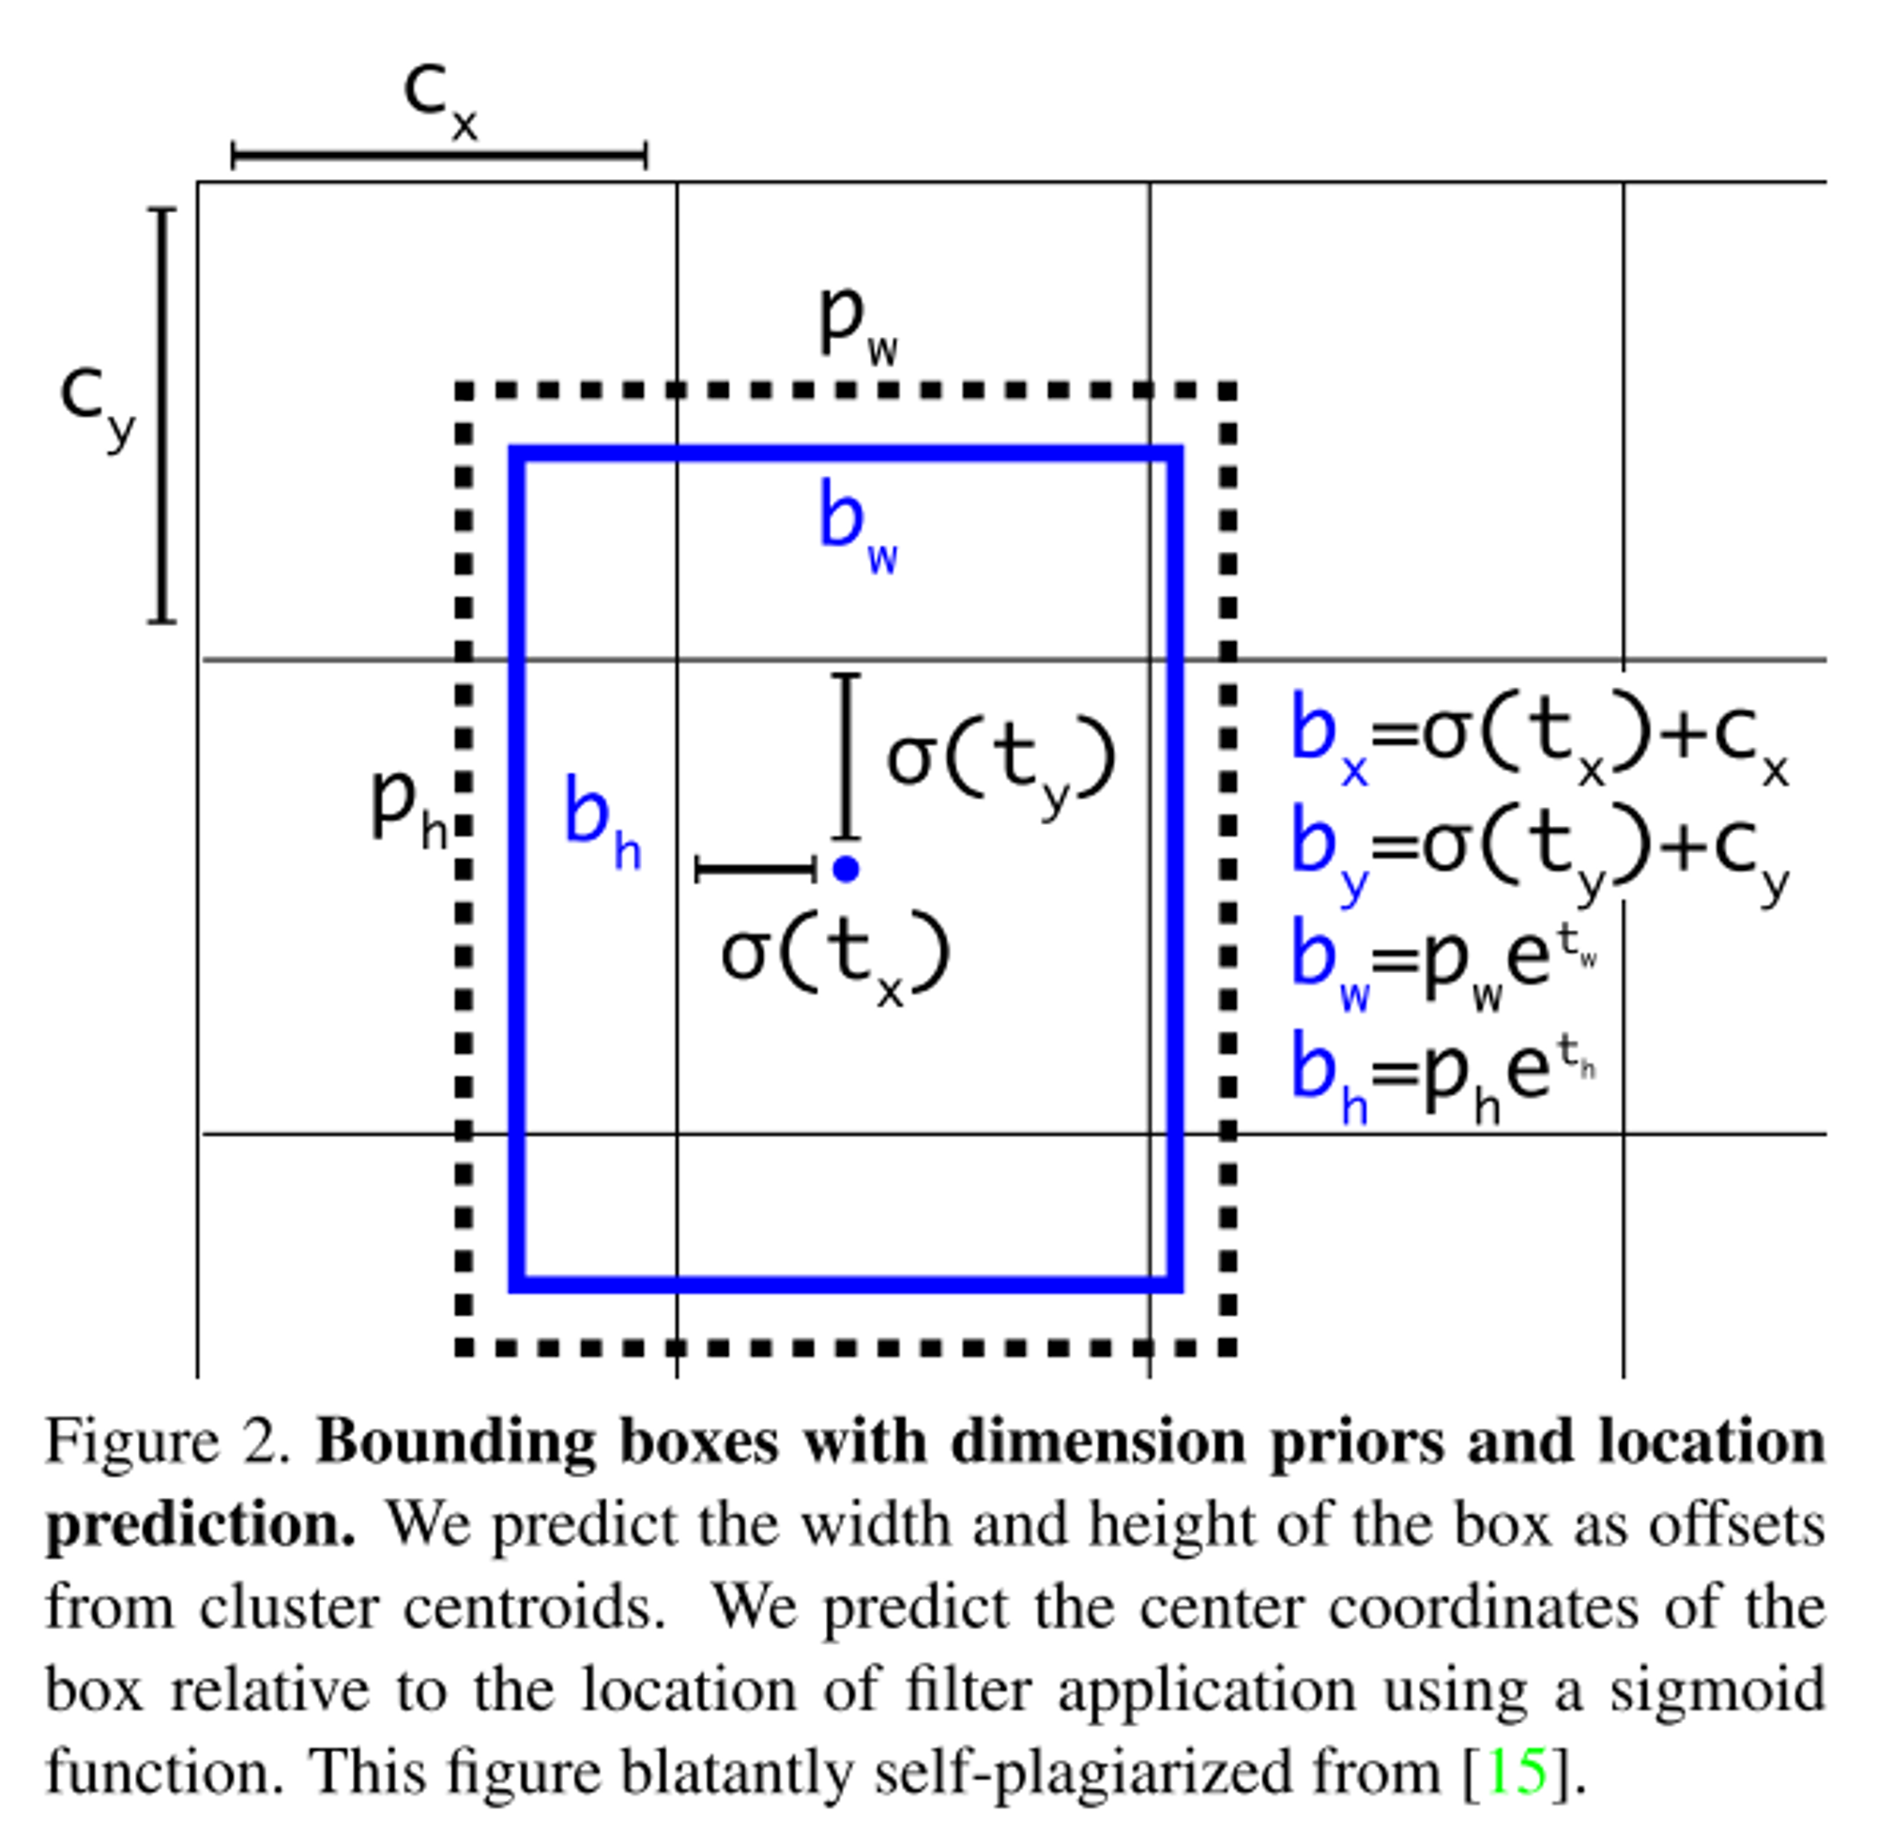
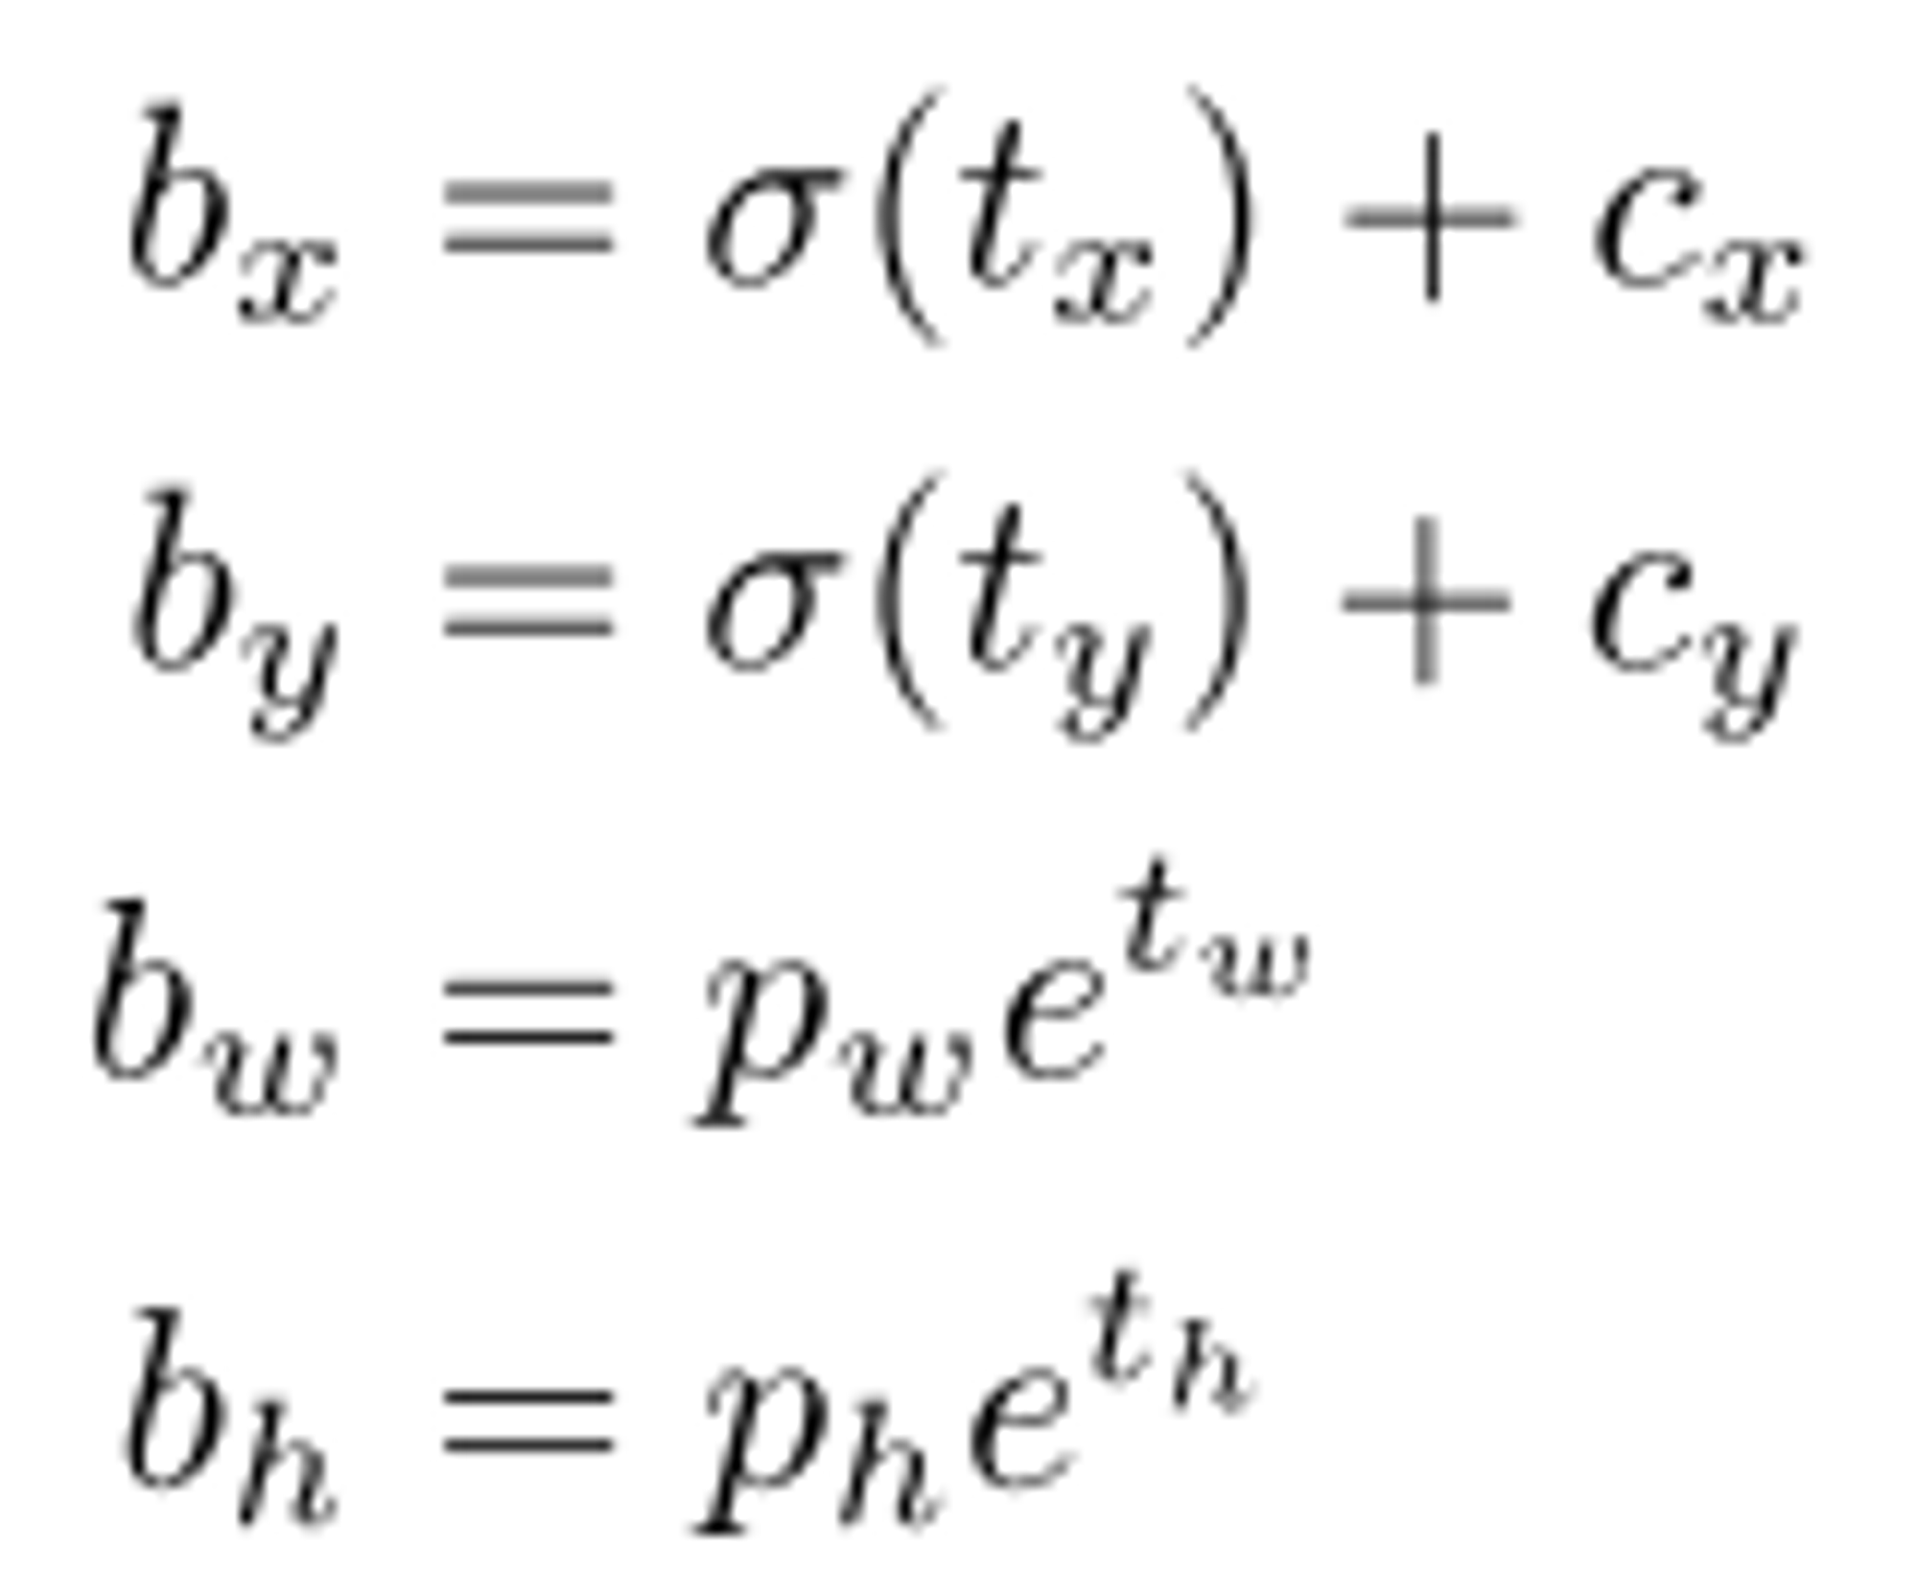
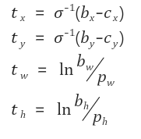
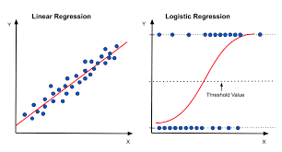
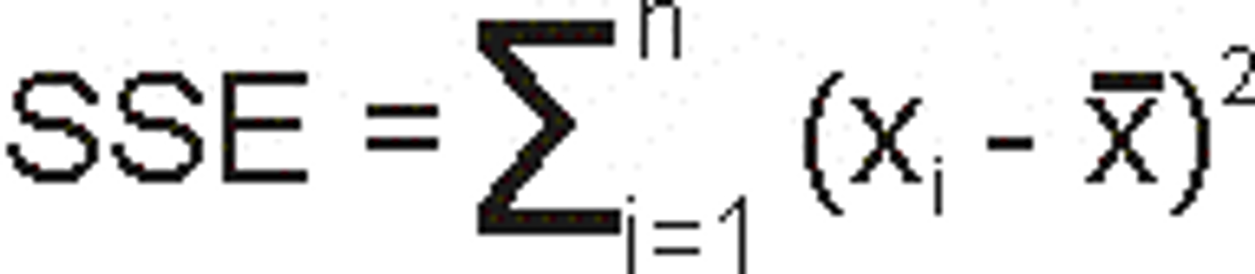
Bounding Box Prediction
Introduce anchor boxes of the initially set size in YOLO v2 to stabilize the initial regression training -> This concept is also used in YOLO v3
Prediction Goal
inverse
->
During training, use SSE (sum of squared error loss).
Predict the objectness score of each bounding box using logistic regression.
Difference from previous methods: Assign only one bounding box prior for each actual object.
If not assigned to an actual object, only the loss related to objectness occurs.

Slide 5
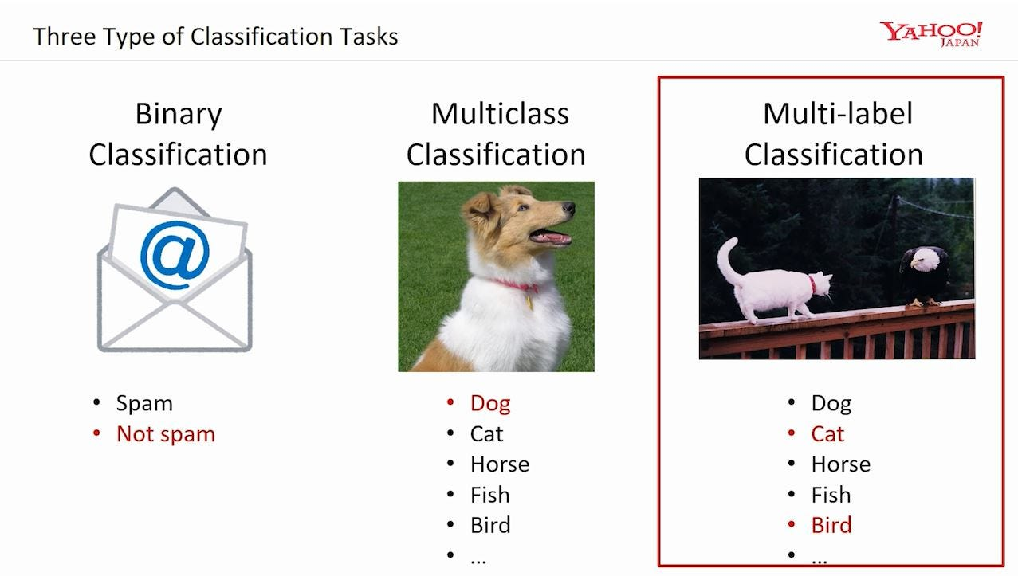
Class Prediction
Use multilabel classification to predict the classes that can be included in the corresponding bounding box.
A multi-labeled approach with similar characteristics, such as 'woman' and 'human,' is beneficial for data modeling
softmax , independent logistic classifier Usage
During training, use binary cross-entropy loss for class prediction

Slide 6
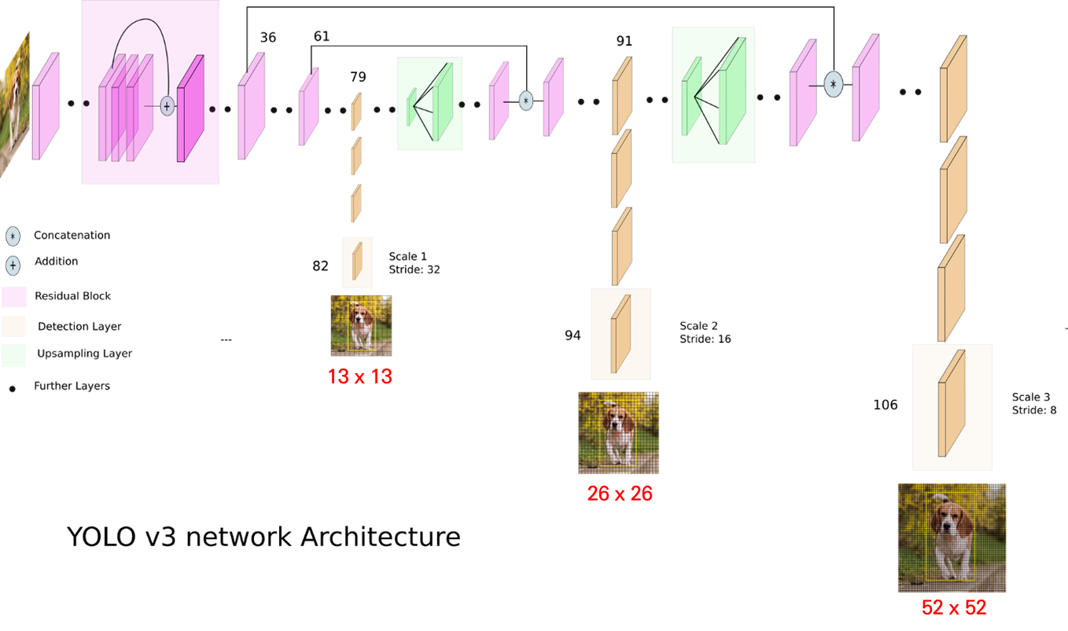
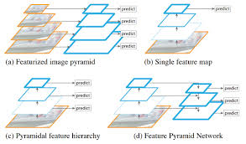

Predictions Across Scales
upscaling -> concatenation
Extract feature maps at three different scales, similar to the concept of FPN (Feature Pyramid Network)
At the end of the extracted convolutional layer, predict a 3D tensor that includes bounding box, objectness, and class predictions information
3d tensor map: N*N*[3*(4+1+80)]

Slide 7
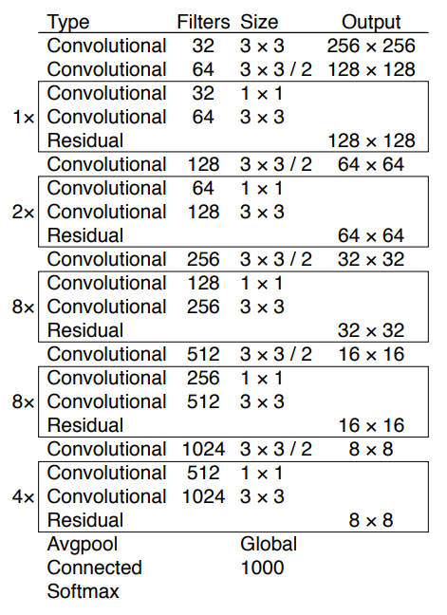
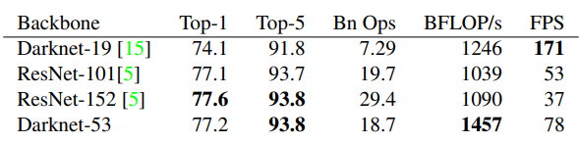
Feature Extractor

Slide 8
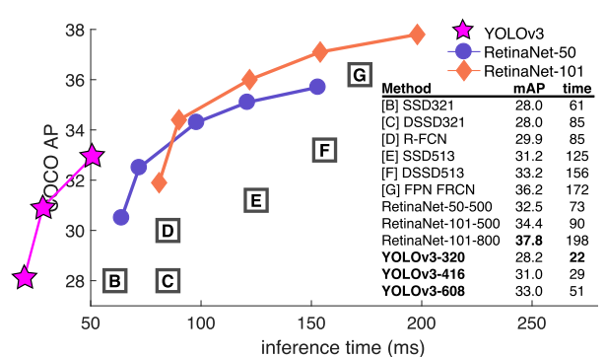
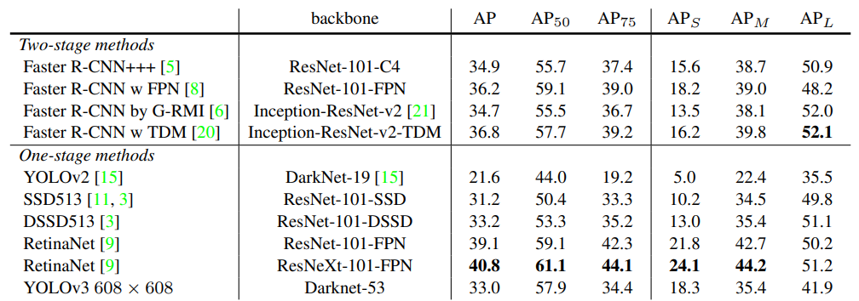
Result

Slide 9
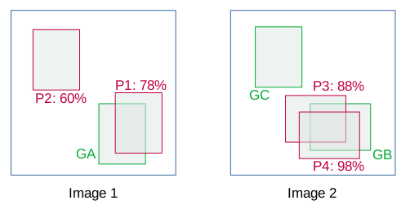
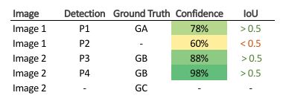
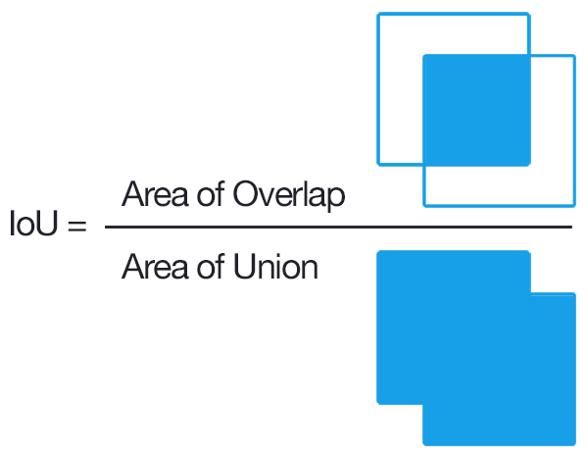
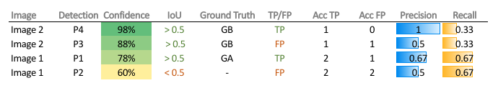
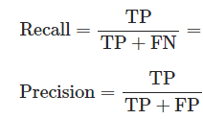
mAP

Slide 10
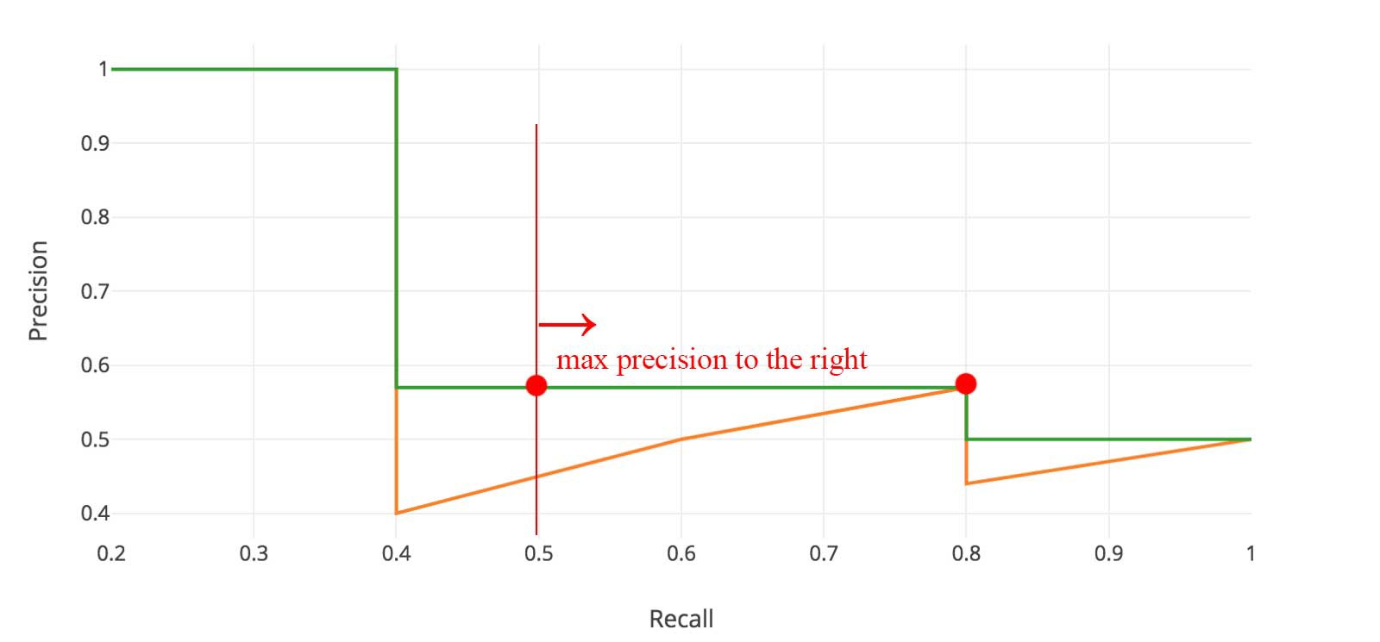
mAP
PR Curve
Change the graph to a descending shape
-> Calculate the area below and find the AP
AP: The average of the Precision values calculated from the Precision-Recall graph.
mAP: The average of the Average Precision for each class.
AP50: The AP when the IoU threshold is 0.5.

