Slide 1
YOLO v1 (3)
You Only Look Once: Uniﬁed, Real-Time Object Detection
2024-10-14
2115686 최세인

Slide 2
Index
1. Question resolved – Loss function
2. Darknet Imagenet Training
3. YOLO v1 Detection Training

Slide 3
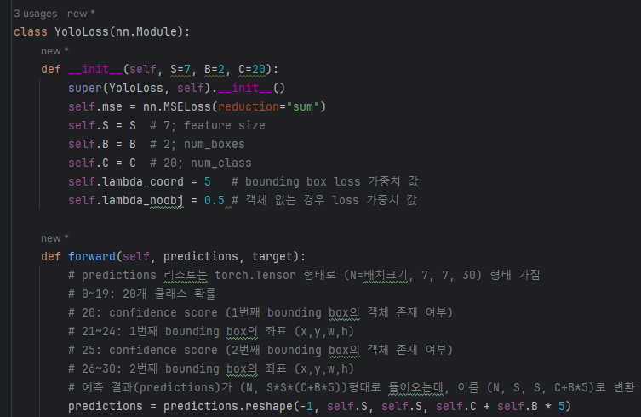
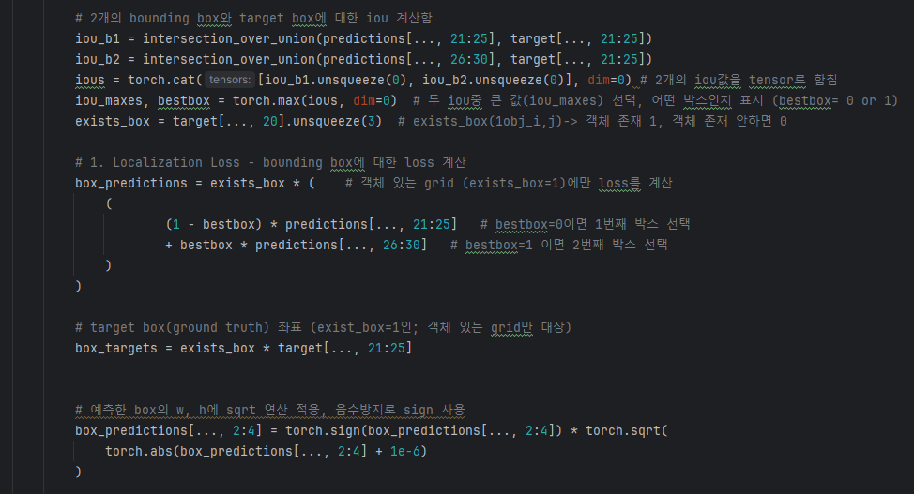
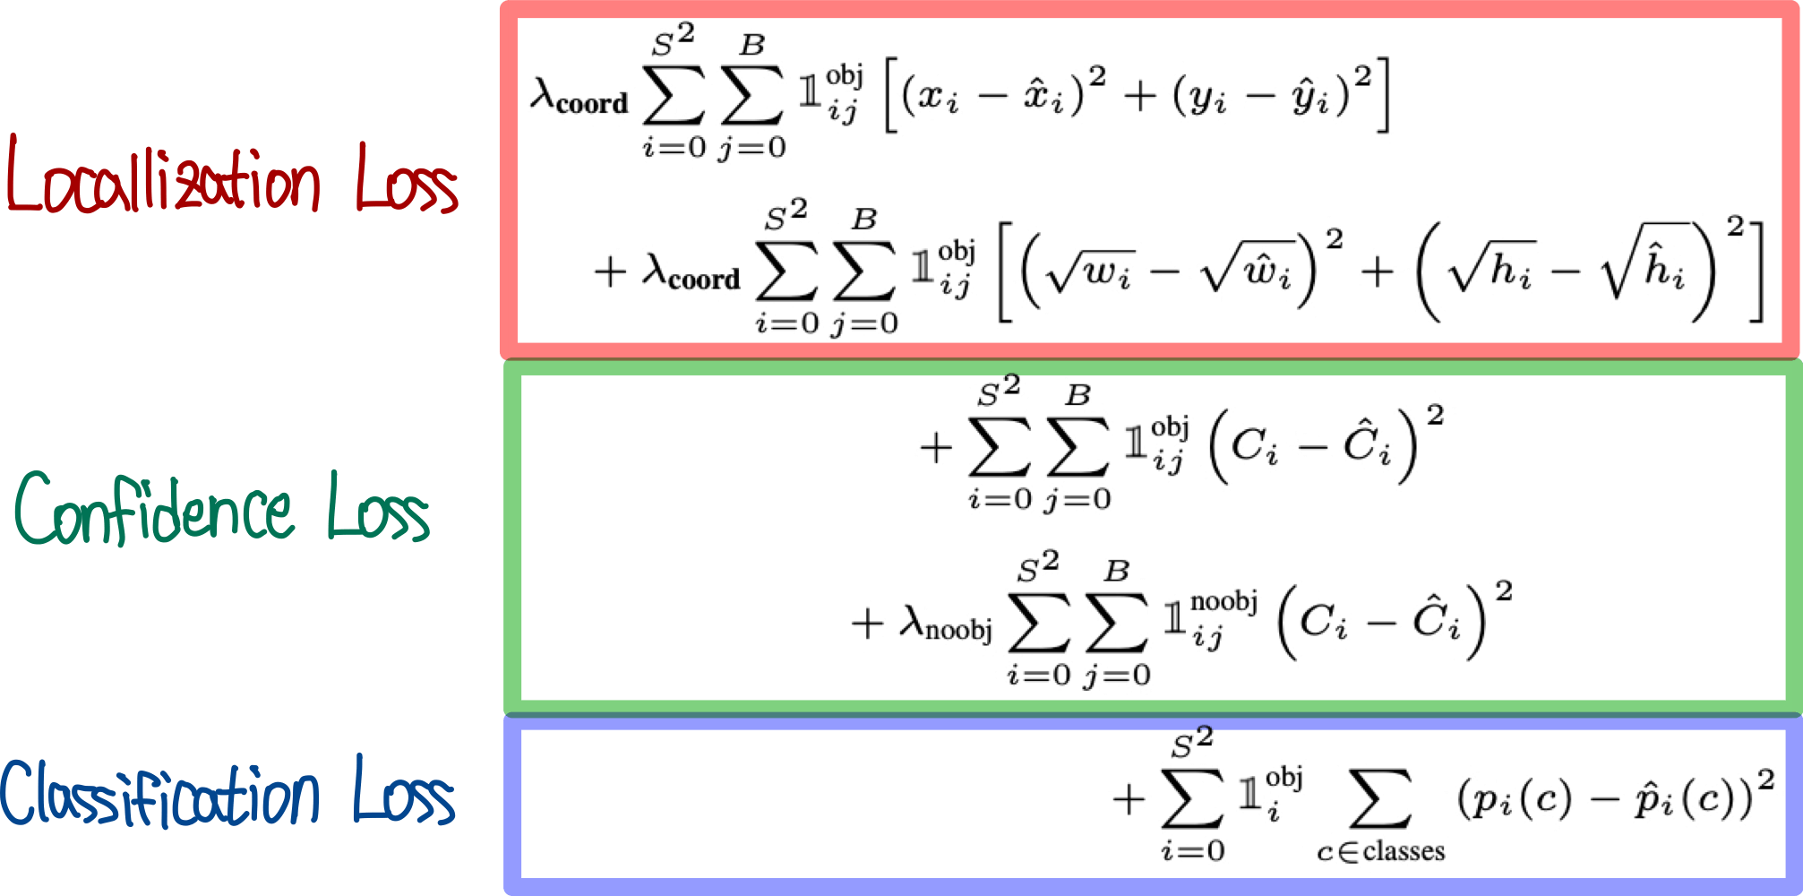
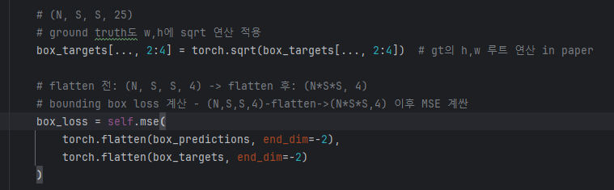
Loss Function
[21:25] and [26:30] extract only the coordinates, excluding the confidence score.
=> [2:4]: w,h
 |  |  |  |  |  |  |  |  |  |  |  |  |  |  |  |  |  |  |  |  | 0 | 1 | 2 | 3 |  | 0 | 1 | 2 | 3
0 | 1 | 2 | 3 | 4 | 5 | 6 | 7 | 8 | 9 | 10 | 11 | 12 | 13 | 14 | 15 | 16 | 17 | 18 | 19 | 20 | 21 | 22 | 23 | 24 | 25 | 26 | 27 | 28 | 29
 |  |  |  |  |  |  |  |  |  |  |  |  |  |  |  |  |  |  |  | c1 | x1 | y1 | w1 | h1 | c2 | x2 | y2 | w2 | h2
❓
1
1
1
0
1
c1 | x1 | y1 | w1 | h1 | c1 | x2 | y2 | w2 | h2

Slide 4
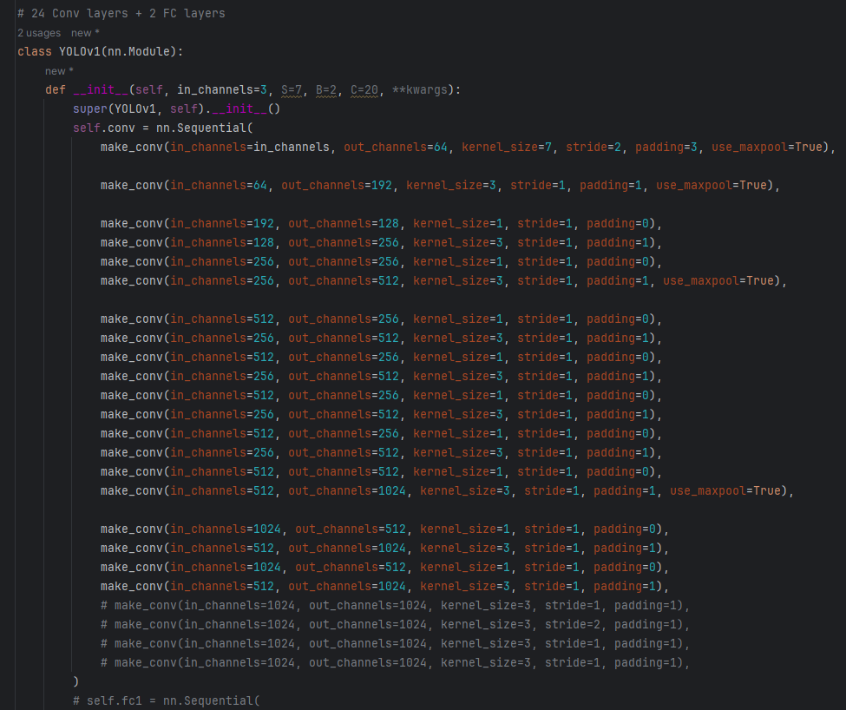
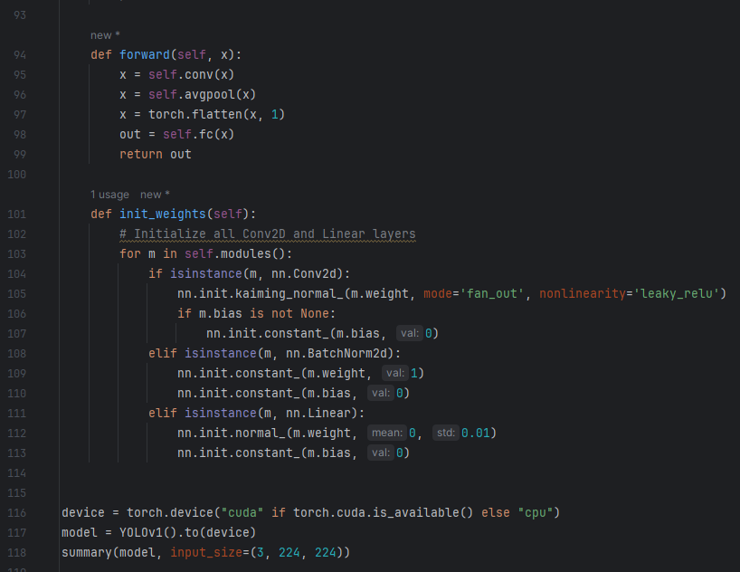
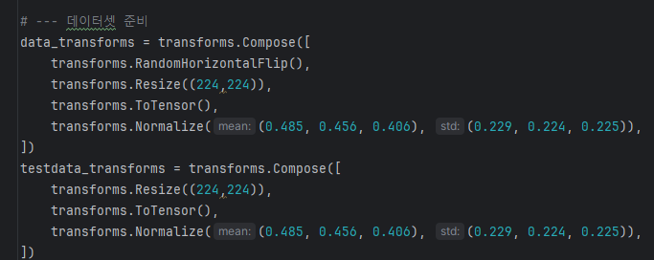
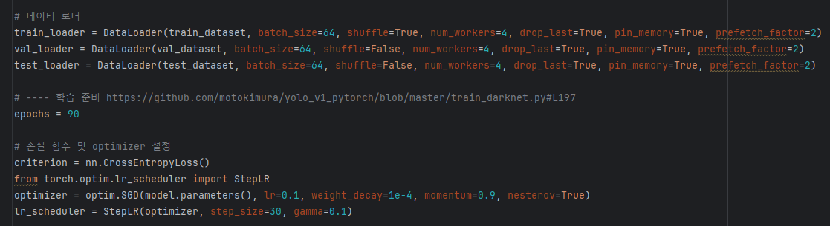
Darknet Imagenet Training

Slide 5
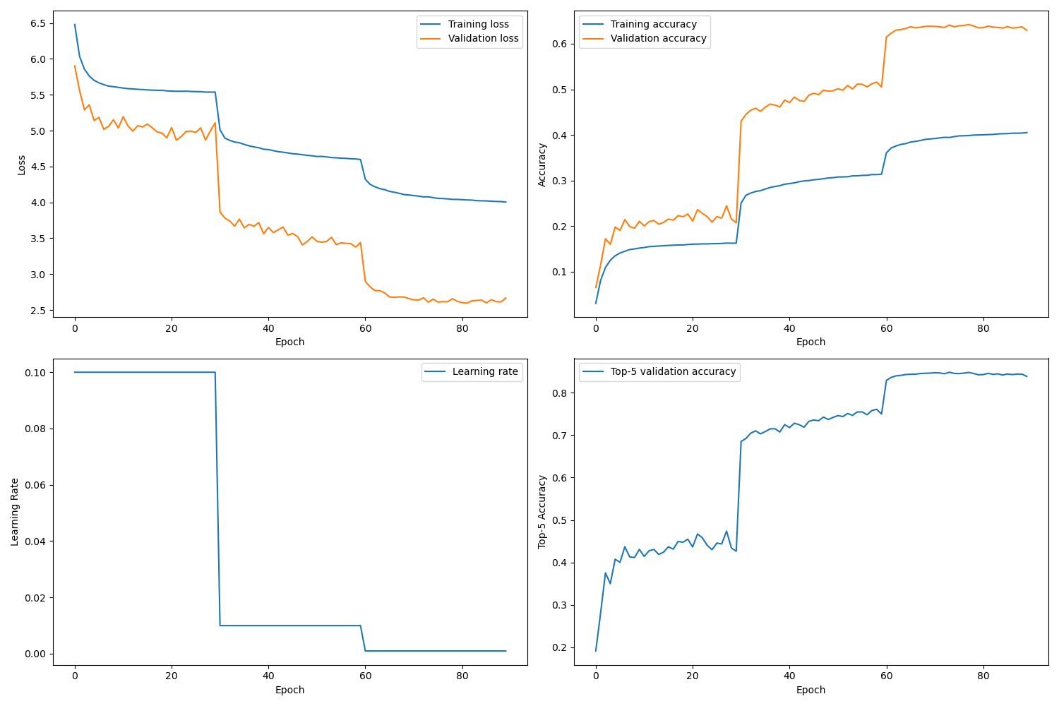
Darknet Imagenet Training

Slide 6
YOLO v1 Detection Training

Slide 9
Loss Function
❓
1
1
1
0
1
c1 | x1 | y1 | w1 | h1 | c1 | x2 | y2 | w2 | h2

Slide 10
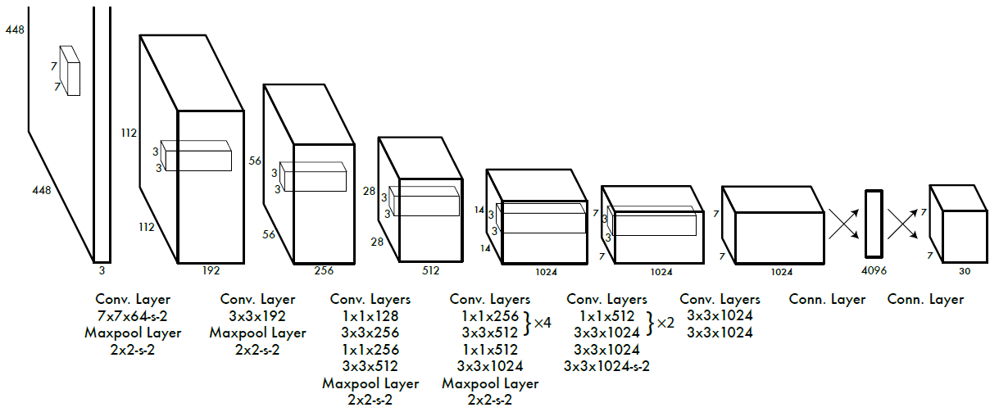
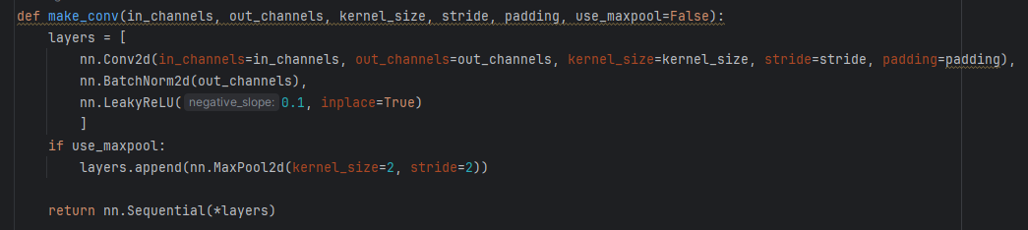
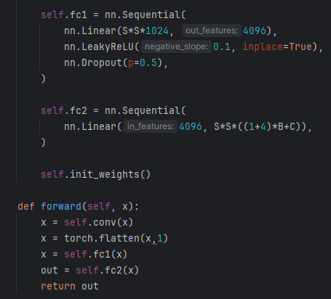
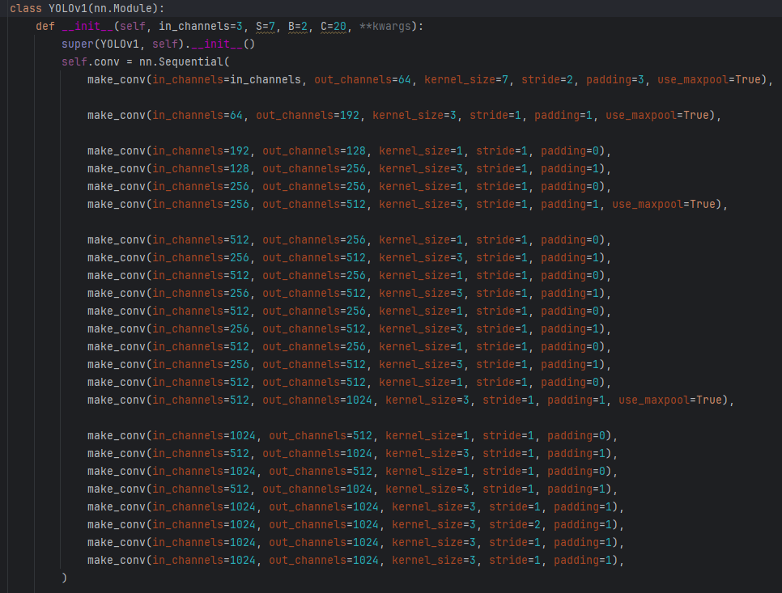
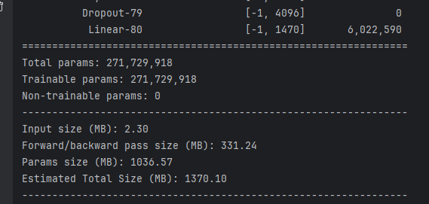
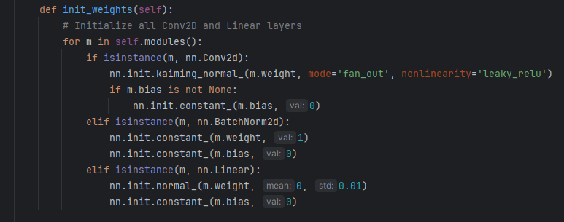
Darkent model
darknet for Detection Training
Summary Output ⬇️

Slide 11
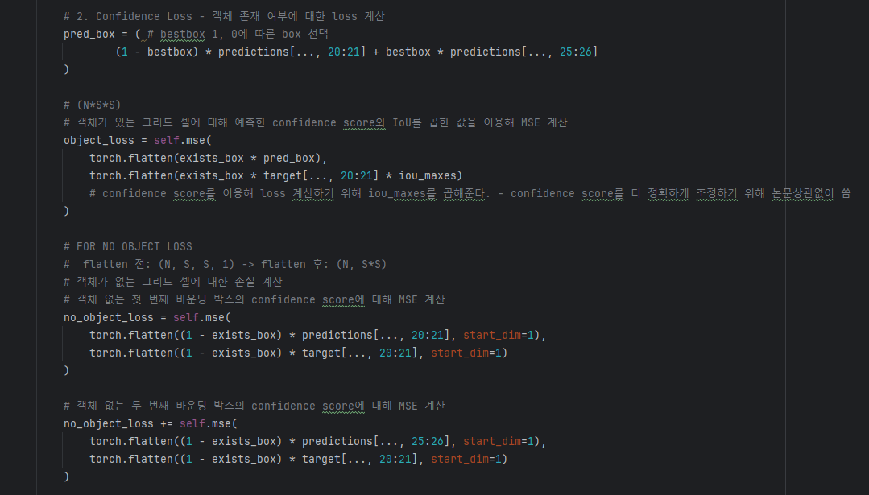
Loss Function

Slide 12
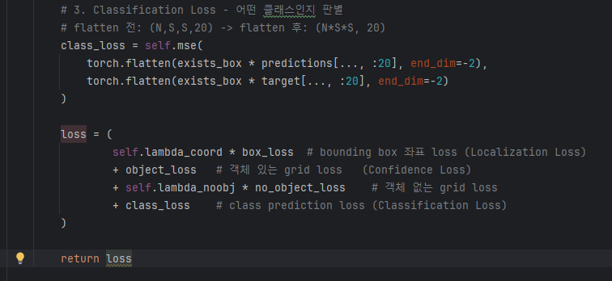
Loss Function

Slide 13
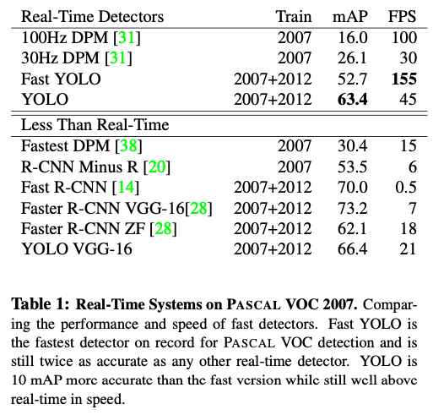
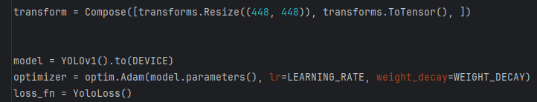
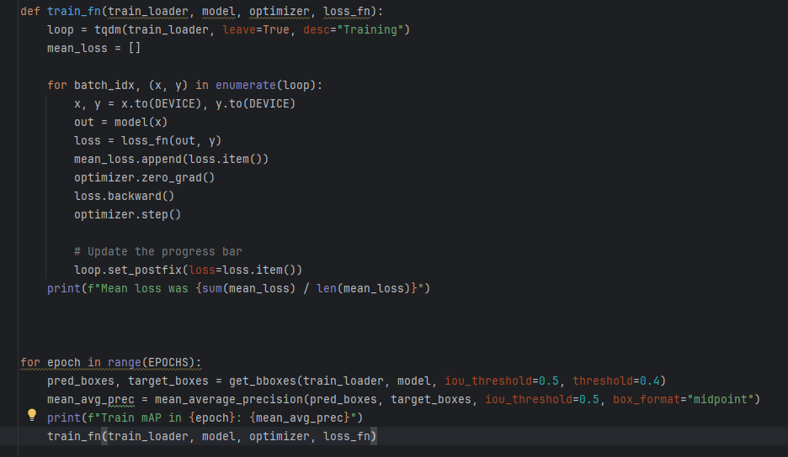
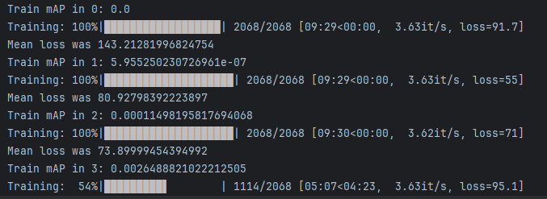
Training

Slide 14
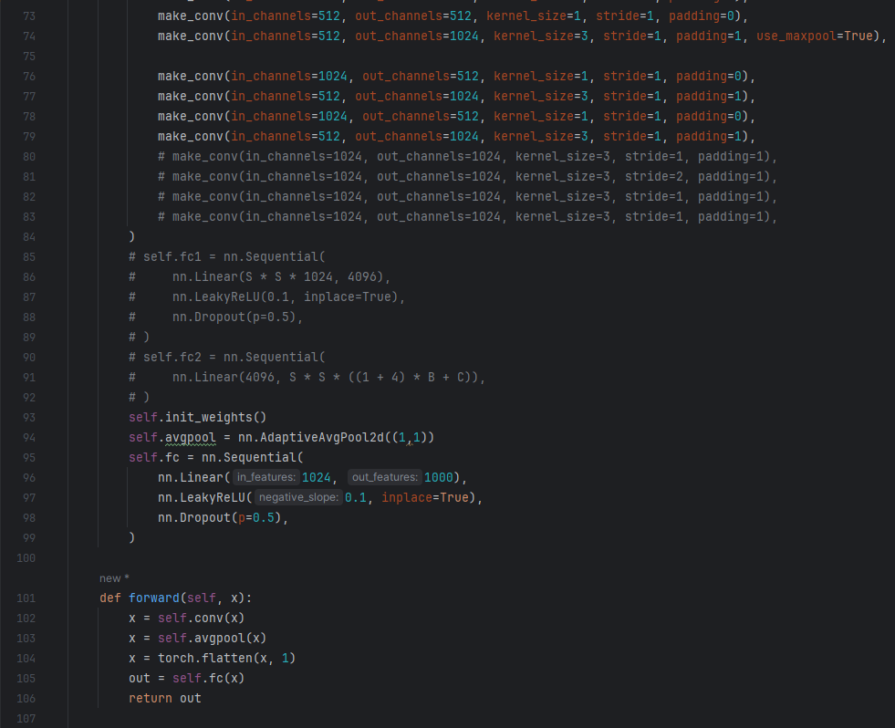
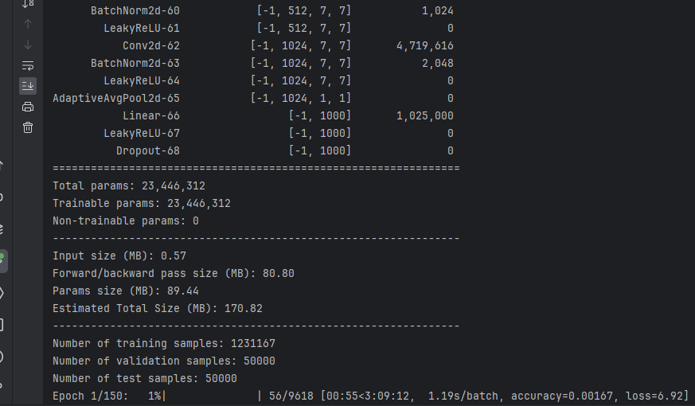
To Do
데이터셋 전처리
이전 차수에서는 x1,y1,x2,y2로 처리했는데, x,y,w,h 형식으로 바꿔서 새로 넣기
이미지넷 학습시켜서 활용 – paper val 88%

