Slide 1
YOLO v1 (5)
You Only Look Once: Uniﬁed, Real-Time Object Detection
2024-11-04
2115686 최세인

Slide 2
Index
1. Hyperparameter Fixes
2. YOLO v1 Detection Train
3. Model load & Detecting test

Slide 3

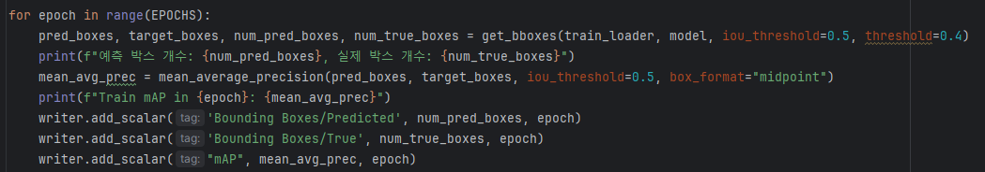
Hyperparameter Fixes
Modify optimizer hyperparameter (lr, weight_decay: 0.001, 0.0005 -> 0.00002, 0)
Delete learning rate scheduler
Modify threshold: 0.4, 0.3 -> 0.5, 0.4

Slide 4
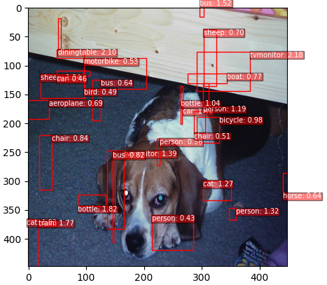
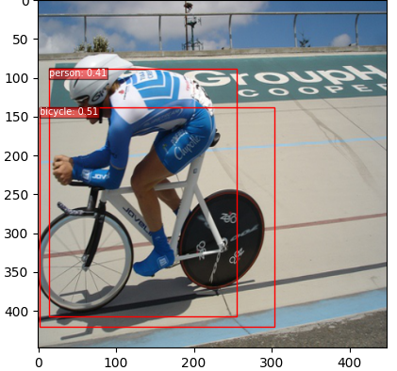
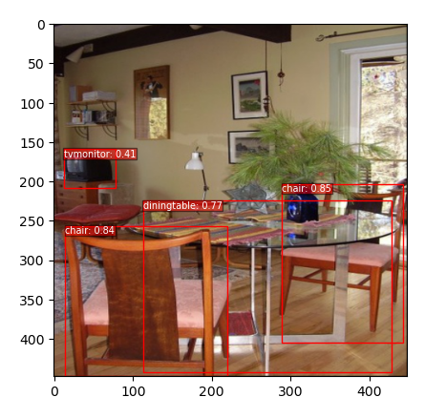
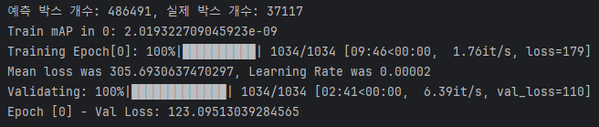

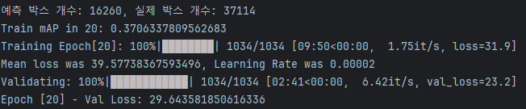
YOLO v1 Detection Train
epoch 0
epoch 20
epoch 135

Slide 5
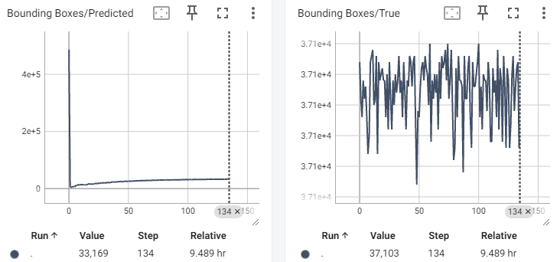
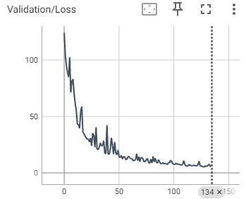
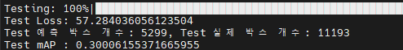
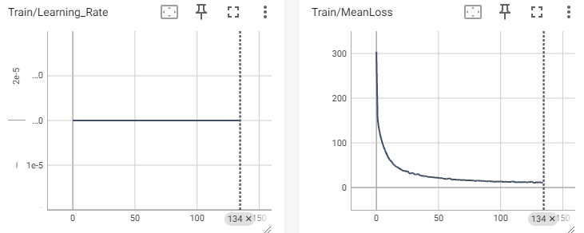
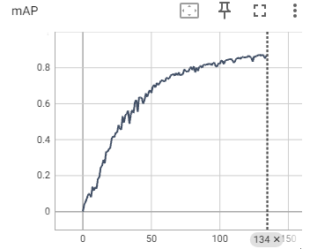
Result

Slide 6
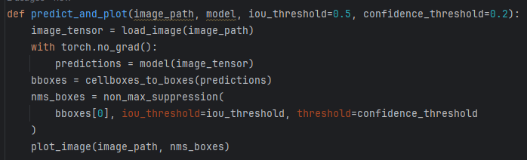
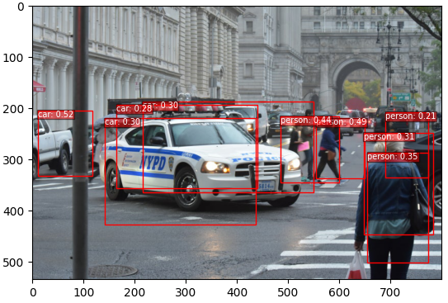
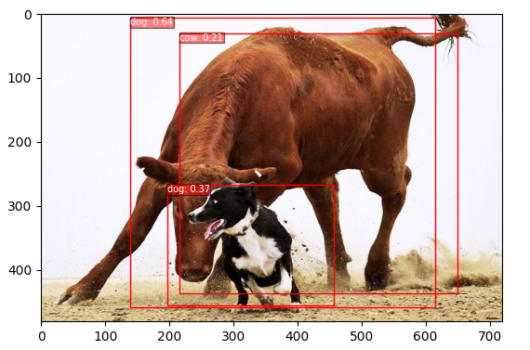
Model load & Detecting test
checkpoint = torch.load("/home/ivpl-d29/myProject/Study_Model/YOLOv1/logs/model/detect/final_model.pt")

