Slide 1
Fast R-CNN (2)
Fast R-CNN
2024-12-02
Sein Choi
Intelligent Vision Processing Lab. (IVPL)
https://ivpl.sookmyung.ac.kr
Div. of AI Engineering, Sookmyung Women’s University
E-mail: csi1806@sookmyung.ac.kr

Slide 2
Contents
R-CNN Architecture
RoI Pooling
Fine-tuning for Detection
Fast R-CNN Detection (Truncated SVD)
Conclusion
다음 스터디(12.16) 전까지 논문 개념 모자란거 정리, R-CNN 구현

Slide 3



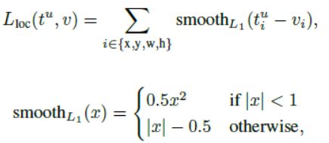

Fine-tuning for Detection
Multi-task Loss
Softmax (K+1)
Feature vectors
For each RoI
to learn both at once.
FCs
4 floats
For Bbox regressor
The background with U=0 is ignored.
T: ground truth coordinate
V: prediction coordinate
L1 loss:
Less impact on the output
Small differences are handled smoothly, while large differences are handled linearly.

Slide 4
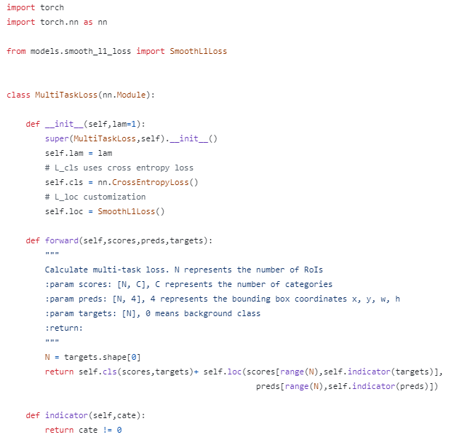
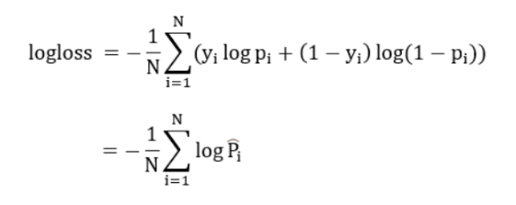
Cross Entropy Loss =
https://pytorch.org/docs/stable/generated/torch.nn.CrossEntropyLoss.html

Slide 9
Introduction
Improving Accuracy Across Various Tasks Using ConvNet
For object detection, complexity -> use multi-stage pipeline
Two Major Challenges in Addressing Complexity
Handling numerous region proposals
2. Need for precise location refinement
To address these, there is a trade-off involving speed, accuracy, and simplicity.
Solution:
Propose single-stage training algorithm
= classify object proposals + refine spacial locations
Results:
Training Speed : The proposed method is 9 times faster than R-CNN and 3 times faster than SPPnet on VGG16.
Inference Time: The inference time is 0.3 seconds per image.
mAP: Achieved 66% on Pascal VOC 2012, compared to 62% for R-CNN.

Slide 10
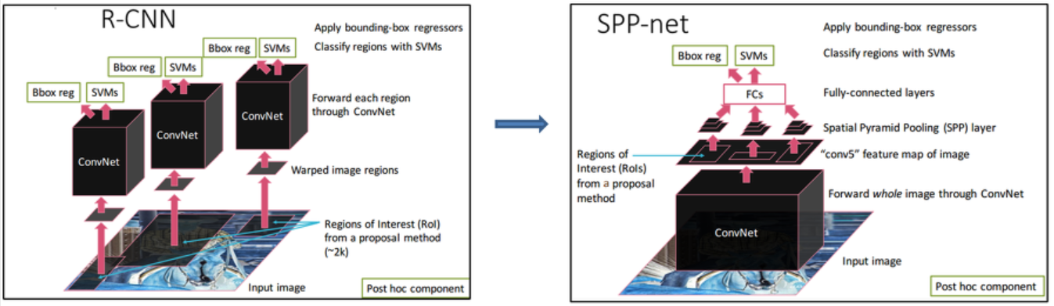
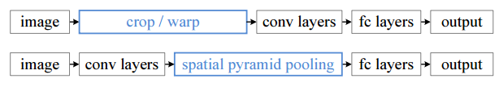
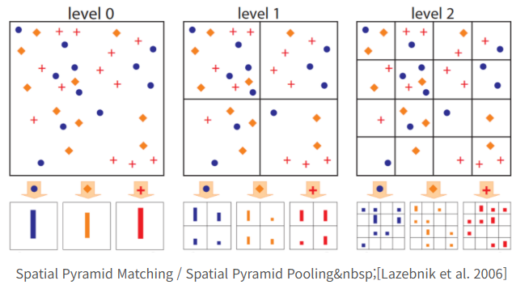
R-CNN and SPPnet
Difference of R-CNN and SPPnet
What is SPPnet?
Reason for R-CNN's slowness: without sharing computation.
SPPnet's proposal: apply computation sharing to speed up R-CNN.
Compute Conv feature map for the entire input image.
Use feature vectors extracted from the shared feature map to classify each region proposal.
Connect after pooling with multiple output sizes, similar to spatial pyramid pooling (citing SPM paper).
Advantages of SPPnet
Test time acceleration: 10-100 times faster.
Training time reduction: 3 times shorter.
Vectors: SPP, SPM
SPP : 3 (w.pooling)
SPM : 16
Disadvantages of R-CNN
Training is a multi-stage pipeline
Training is expensive in space and time
Object detection is slow
Disadvantages of SPPnet
Complex multi-stage training process.
Need to store features on disk every time.
Need to train SVM and bounding box regressor separately.
Major disadvantage: Cannot update/train layers preceding spatial pyramid pooling.

Slide 11
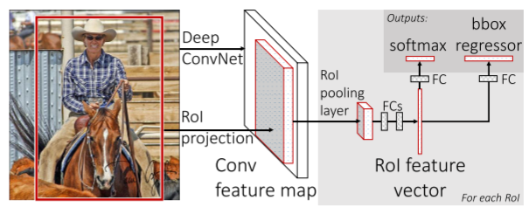
Architecture
Softmax (K+1)
Conv
Max pooling layer
Conv feature map
RoI pooling layer
Image +
Object Proposal Set
Feature vectors
For each RoI
FCs
4 floats
For Bbox regressor

Slide 12
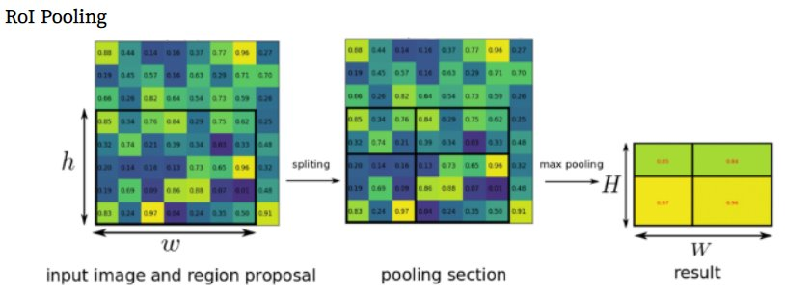
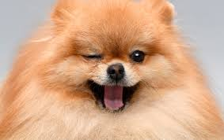
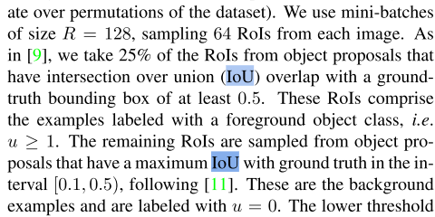

RoI Pooling
Conv feature map
RoI pooling layer
Feature vectors
For each RoI
Region of Interest Pooling
The region proposals are mapped to the CNN's feature map (given in the coordinates of the original image).
The proposal box is divided into a k×k grid
Max Pooling.
Result: The proposal box information is transformed kxk
Why? Because the FC layer of a CNN requires a fixed-size input.
Region proposals generated by Selective Search have varying sizes and aspect ratios
N=2
Mini batch imgs
7x7 RoI Pooling
R=128, 64 RoIs
Hierarchical sampling of mini-batches
1000~2000 Region Proposal
IoU >0/5 u=1(64*0.25=16)
IoU <0.5 u=0 (64*0.75=48)

Slide 13
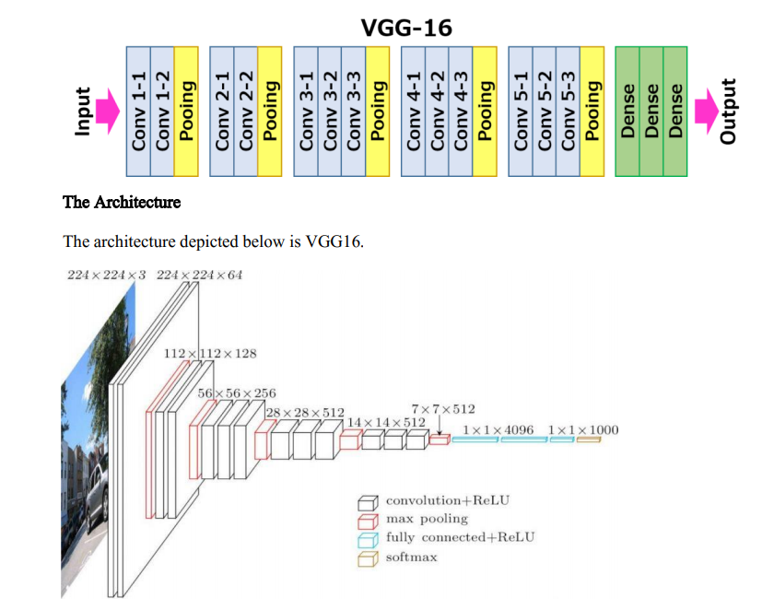
Fine-tuning for Detection
Initializing from pre-trained networks​
CafNet (Small; S)
VGG_CNNM_1024 (Medium; M)
VGG16 (Large; L)
Image + RoI lists
HxW (eg.7x7) matching
RoI Pooling Layer
K+1 Softmax,
BBox Regressor

Slide 14
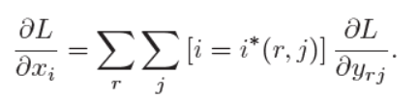
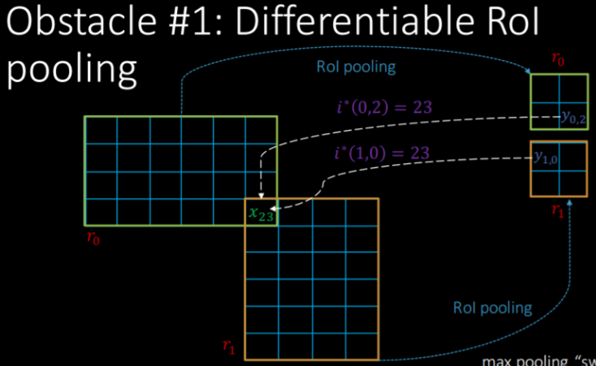


Fine-tuning for Detection
Back-propagation through RoI pooling layers
Since max pooling selects the largest value in each region, during the backpropagation process, we can track which value was selected (i.e., argmax).
Backpropagation is the process of propagating the error from the output to the input, updating the weights and biases. In networks that include RoI pooling, it is necessary to know which value was selected for each RoI region in order to compute the gradients correctly.
RoI Max pooling
Input RoI
We can track which value was selected =argmax.
A single x_i can influence multiple outputs y_rj.
The final gradient for x_i is computed by summing the gradients propagated through each RoI.

Slide 15
Fine-tuning for Detection
Multi-task Loss
Softmax (K+1)
Feature vectors
For each RoI
to learn both at once.
FCs
4 floats
For Bbox regressor
The background with U=0 is ignored.
T: ground truth coordinate
V: prediction coordinate
L1 loss:
Less impact on the output
Small differences are handled smoothly, while large differences are handled linearly.

Slide 16
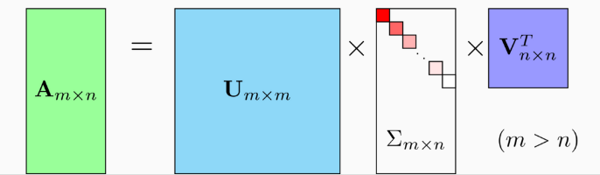

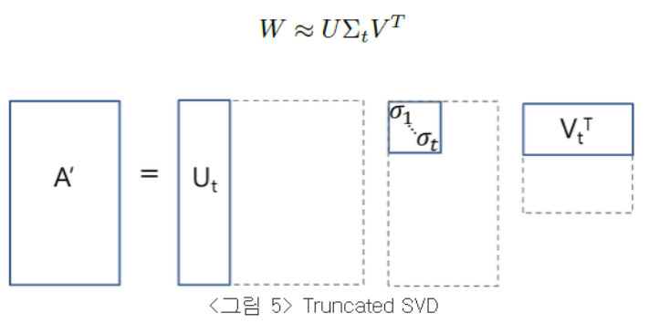
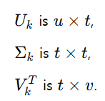


Fast R-CNN Detection
Independent NMS is performed for each class.
Truncated SVD (Singular Value Deomposition)
This approach selects only the most important singular values and their corresponding singular vectors, discarding the less important information.
W
u x v
Weight matrix W
v
t
t
v
t
t
t
u
u
Computation: u x v

Slide 17
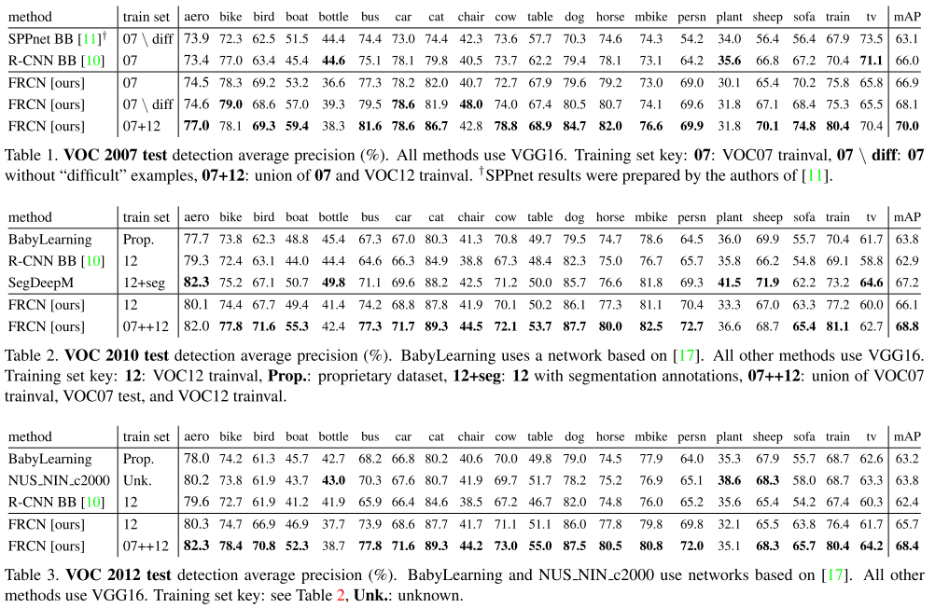
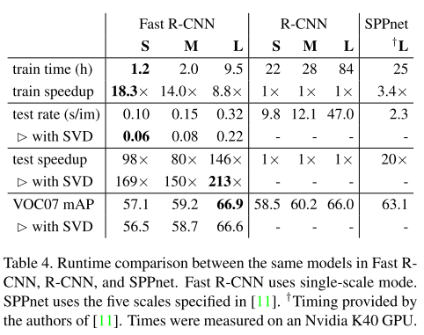
Conclusion

Slide 18
Thank you for your attention.!!!
QnA

