Slide 1
R-CNN (1)
Rich feature hierarchies for accurate object detection and semantic segmentation
2024-10-28
2115686 최세인

Slide 2
Index
0. Paper Review
1. Introduction
2. Module Design
3. Test-Time detection
4. Result – PASCAL VOC
5. Result – ILSVRC 2013 detection
6. Visualizing, ablation, and modes of error
7. Conclusion

Slide 3
1. Introduction
Issue: While there has been progress in classification using CNNs, detection has stagnated since 2014.
Main Argument: to bridge the gap between image classification and detection (using CNNs can achieve better performance than HOG)
To achieve the goal..
1. In deep network, object localizing => 2.Module Design
2. Sparse annotated detection data-> high-capacity model(CNN) train => 3.Training
Notes:
ImageNet 활용한 Classification 발전 → 그러나 의문
To what extent do the CNN classiﬁcation results on ImageNet generalize to object detection results on the PASCAL VOC Challenge? CNN 분류 결과가 ImageNet에서 PASCAL VOC 챌린지의 객체 탐지 결과에 얼마나 일반화될 수 있는가?
답변
Image Classification과 Object detection 사이의 간격을 줄임 - 논문내용
CNN으로 HOG보다 더 좋은 object detection 성능 보일 것
목표 달성 위해 2가지 문제점 해결
deep network에서 객체를 localizing
작은 양의 annotated(주석달린) detection data로 high-capacity 모델 학습시키기

Slide 4
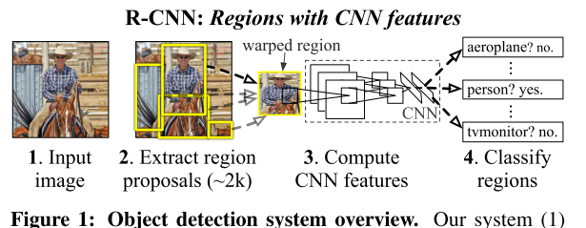
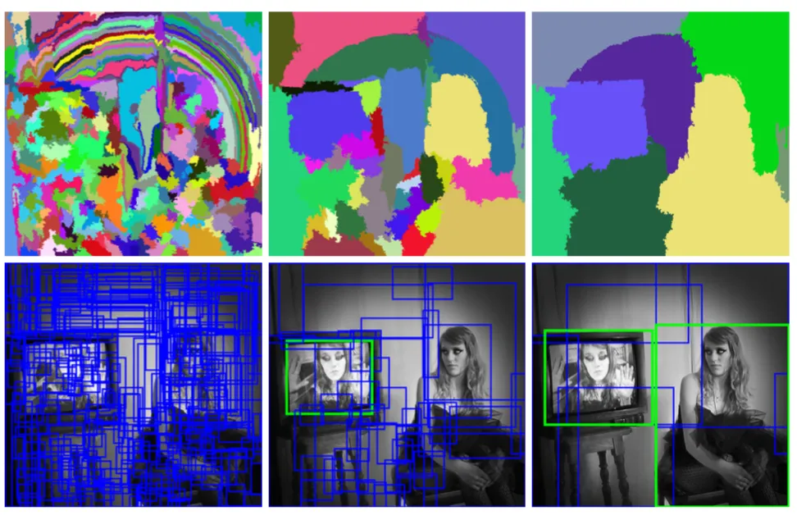
2. Module Design
1. In deep network, object localizing
Receive Input Image
Extract approximately 2000 bottom-up region proposals
Calculate features for each proposal using CNN
Classify each region using class-specific linear SVM
R-CNN: PASCAL VOC 2010 -> mAP 53.7%
Selective Search [39]: Generate region proposals to detect object
Maintain consistency in research, using Selective Search for comparison with previous detection methods.
Notes:
그림 1: Object detection system overview
입력 이미지 받기
약 2000개의 bottom-up region propals 추출
CNN 사용, 각 proposal의 feature 계산
class-specific linear SVM 사용, 각 region 분류
R-CNN은 PASCAL VOC 2010 에서 mAP 53.7% 달성
200-class ILSVRC2013 detection dataset에서는 mAP 51.4% 달성

Slide 5
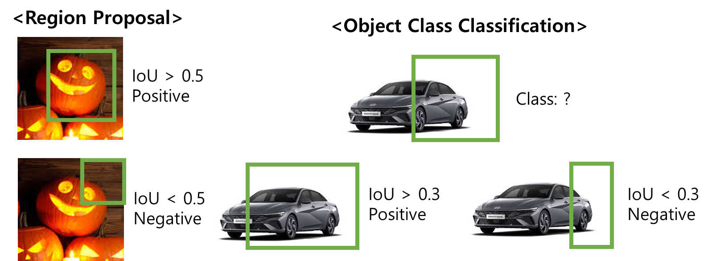

2. Module Design
1. In deep network, object localizing
Receive Input Image
Extract approximately 2000 bottom-up region proposals
Calculate features for each proposal using CNN
Classify each region using class-specific linear SVM
R-CNN: PASCAL VOC 2010 -> mAP 53.7%
Extract 4096-dimension feature vector from each region proposals(#2000)

Slide 6
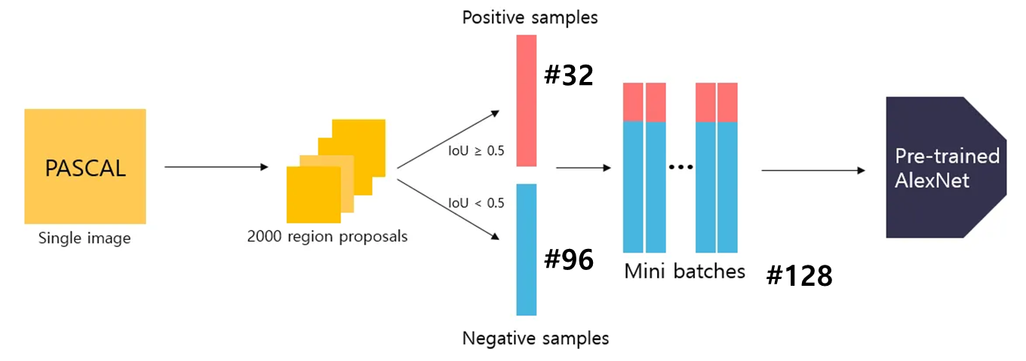
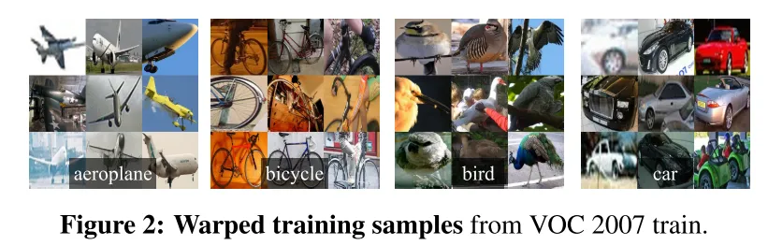
2. Module Design
2. Sparse annotated detection data-> high-capacity model(CNN) train
Model: AlexNet
Using a fine-tuned model for feature vector extraction.
Domain-specific feature vector extraction is possible
<To calculate Feature Vector>
Convert the image data of the corresponding region into a format compatible with CNN - a size of 227x227 is required 1. Expand the size of the bounding box - increase by p=16 pixels to include surrounding pixels.
2. Wrap it to 227x227 (figure 2)
Calculate features
Mean-subtract image
Forward propagation – 5 Conv+2 FC

Slide 7
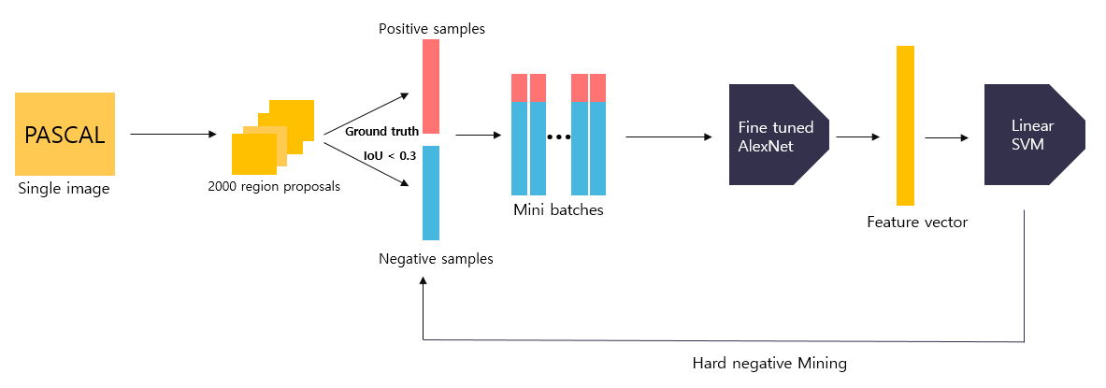
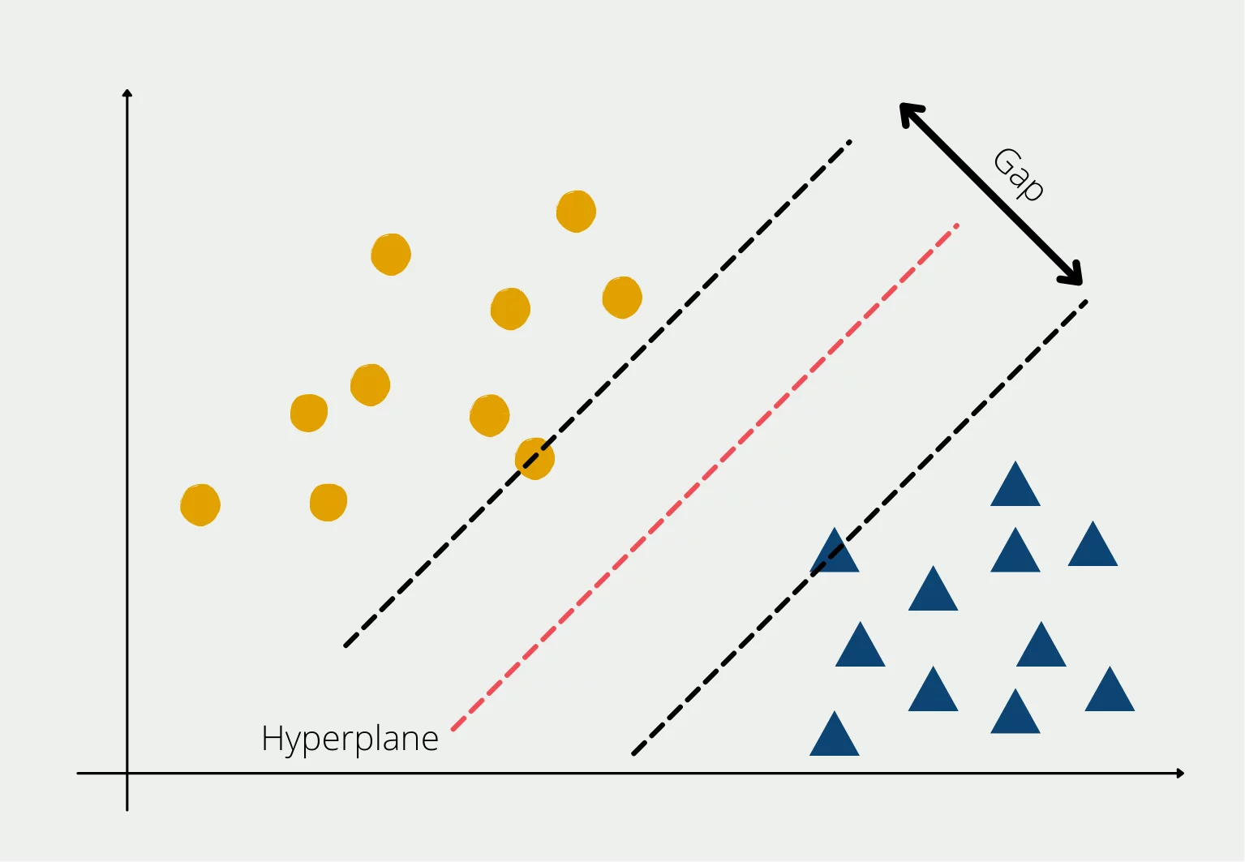
2. Module Design
1. In deep network, object localizing
Receive Input Image
Extract approximately 2000 bottom-up region proposals
Calculate features for each proposal using CNN
Classify each region using class-specific linear SVM
R-CNN: PASCAL VOC 2010 -> mAP 53.7%
Classification layer: 1000 -> N+1(class+background)
VOC: 20, ILSVRC 2013: 200
SVM (Support Vector Machine)
Find the optimal vector for classifying each class.
Memory overflow→ Using standard hard negative mining method

Slide 8
3. Test-Time detection
In Test process
The same process applies to SVM
Then, remove duplicate detections based on greedy NMS and IoU
Run-tine analysis (detection effective features)
1. Shared CNN parameters
Time effective
Time spent on calculating region proposals and features is distributed across all classes, making it efficient
2. 1.5GB lower-dimensional features

Slide 9
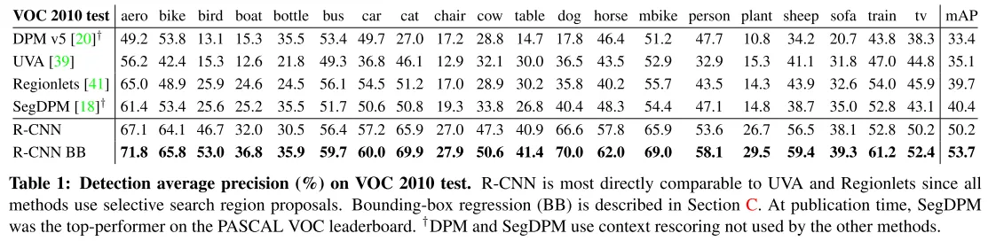
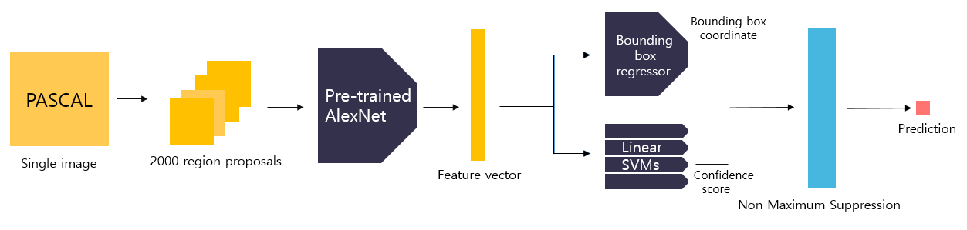
4. Result – Pascal VOC
VOC 2010: 35.1% ~ 53.7% mAP
VOC 2011/12 test: 53.3% mAP

Slide 10
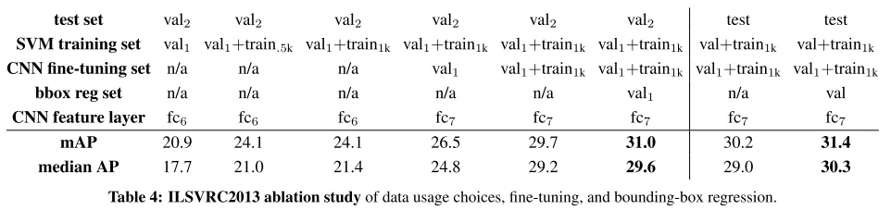
5. Result – ILSVRC 2013 detection
Train Dataset: single object-centered, variable complexity, lack of annotations, making hard negative mining impossible
Heavily reliant on the validation set+ using part of the training set as an auxiliary source of positive examples,
Val = val1 + val2
val1+train dataset train
Val2 mAP calculating

Slide 11
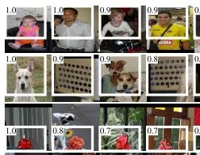
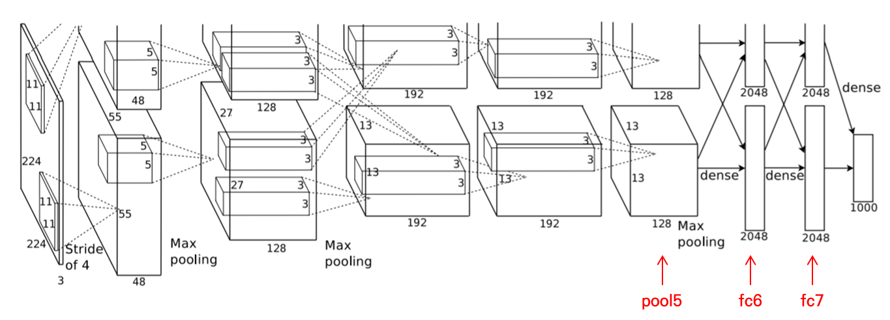
6. Visualizing, ablation, and modes of error
Visualizing Learned features
Allow the units to express which inputs they respond to.
Visualize the activations of Pool 5 units
Result
The network learns to represent class-tuned features, shapes, textures, colors, etc.
The FC layer 6 models combinations of these features.

Slide 12
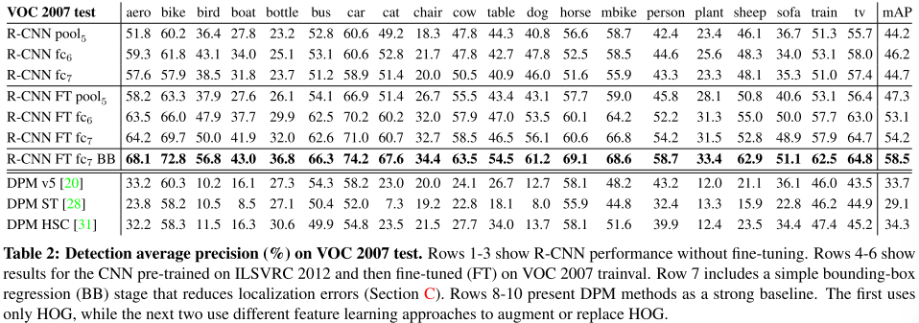
6. Visualizing, ablation, and modes of error
Ablation study
Evaluate performance by layer with and without fine-tuning
Pool 5 < fc6, fc7
Pool 5 features learned from ImageNet are useful regardless of the domain.

Slide 13
7. Conclusion
Simple and scalable 2 step object detector
2 Goals Achieve
Localization using CNN
supervised pre-training/domain-specific fine-tunning

