Slide 1
R-CNN (2)
Rich feature hierarchies for accurate object detection and semantic segmentation
2024-11-04
2115686 최세인

Slide 2
Index
1. Bounding box regression
2. Selective Search
3. Prepare Dataset
To do

Slide 3
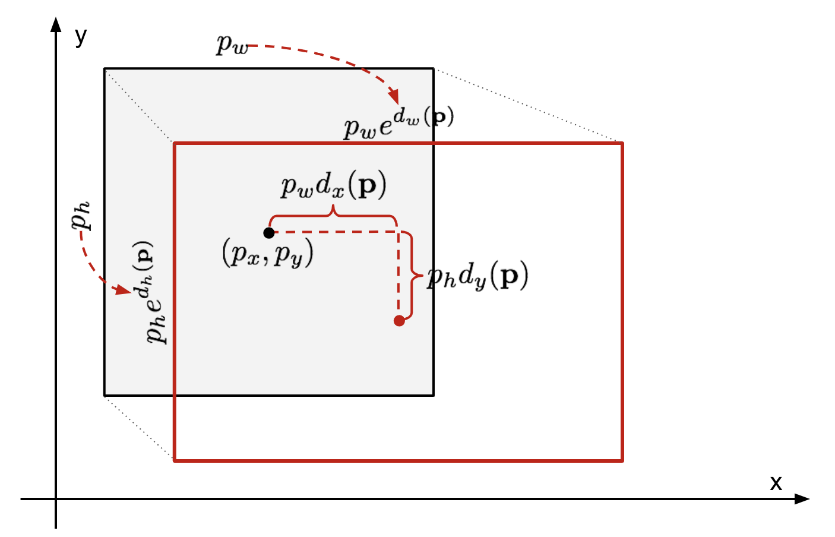
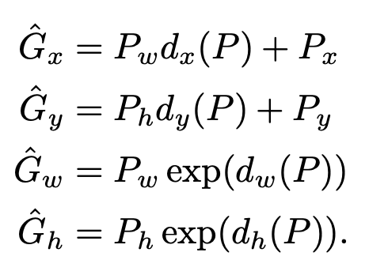

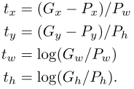
Bounding box regression
Result: mAP가 3point increase. Good for localization
Goals: To match P(proposal box)to G(ground-truth box)
Function:
x,y – move coordinates
w, h – exponential calculation (image size)
Goal: Find optimal
Goal
Trainable
wieght vector
CNN network
pool5 :
feature vector
Regulating bounding box
transformation Linear function
regularized leat squares
Training Loss
Prevent Overfitting regularization term
lambda = 1000
regression targets t
To train Weight:
Using regularized least squares
objective(ridge regression)

Slide 4



cf. Ridge regression
Basic Linear Model
Least squares
Method for finding the coefficients that minimize the error in a linear model
Ridge Regression
Incorporates the sum of the squares of each coefficient into the equation
Makes the size of the coefficients also minimized
Advantages
When the coefficient values of linear regression are very large, and the variance is very large – penalizes the coefficients themselves. Allows for smooth coefficient selection.
https://modern-manual.tistory.com/entry/Ridge-regression%EB%8A%A5%ED%98%95-%ED%9A%8C%EA%B7%80-%EA%B0%84%EB%8B%A8%ED%95%9C-%EC%84%A4%EB%AA%85%EA%B3%BC-%EC%9E%A5%EC%A0%90
ridge 회귀
Notes:
릿지 회귀: 계수 값이 매우 크고, 들쭉날쭉해서 분산 값이 클 때 이를 규wp하기 위한 방법.

Slide 5
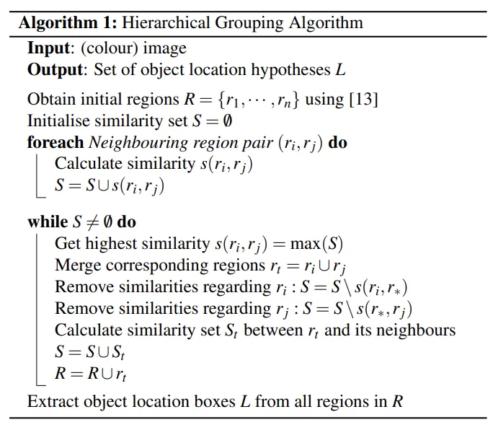
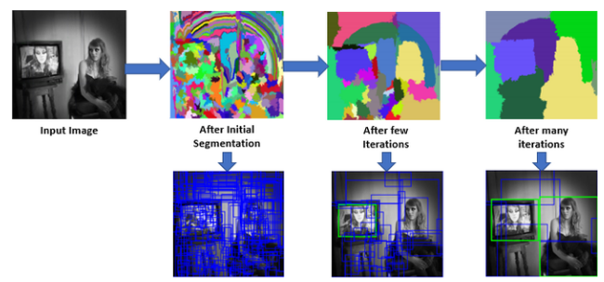
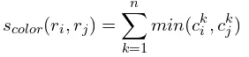
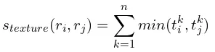
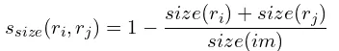
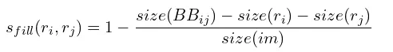
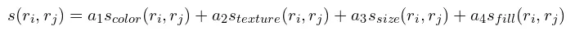
Selective Search
Capture All Scales
Diversification
Fast to Compute
Color Similarity
Texture Similarity
Size Similarity
Shape Compatibility
Final Similarity
Notes:
R : 선택된 region 후보들
S : region들의 유사도 집합
r1,r2,…rn들을 초기화
가장 유사성이 높은 s(ri, rj)을 선택
색상, 질감, 크기 및 모양 호환성을 기반으로 4가지 유사성 측정
선택된 ri, rj의 영역을 rt로 합침
유사성 집합 S에서 이미 합쳐진 s(ri, r∗), s(r∗, rj)을 제거
합쳐진 rt와 나머지 region들의 새로운 유사성 집합(St)를 계산
새로운 유사성 집합(St), 합쳐진 region( rt)을 원래 집합(S, R)에 포함시킴
하나의 region이 될때까지 반복

Slide 6
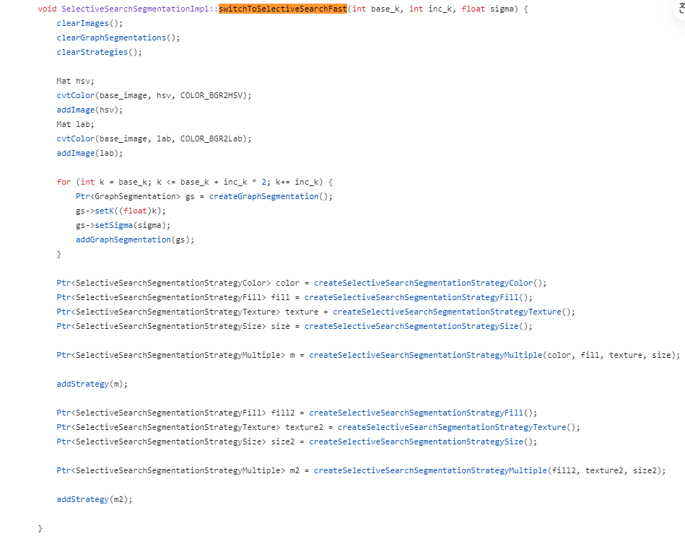
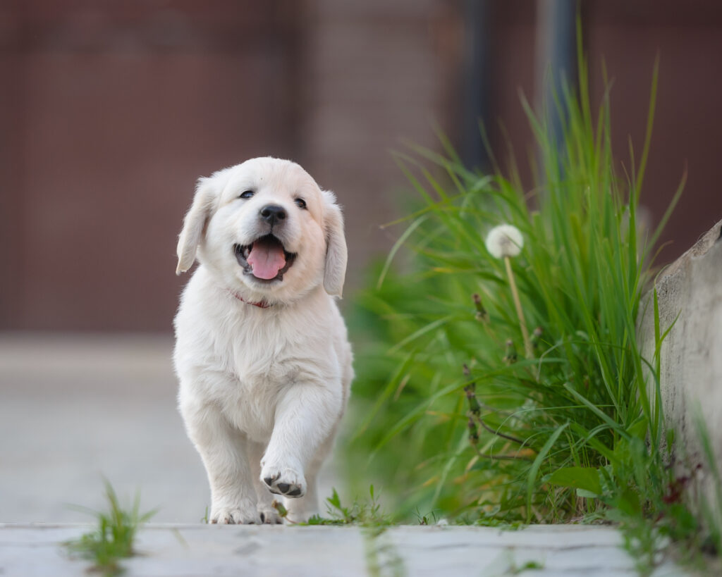
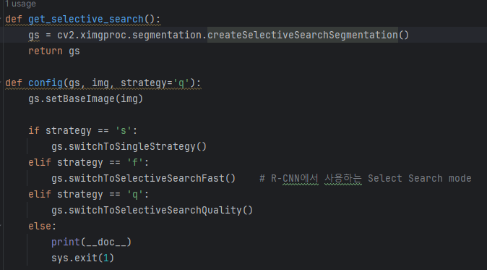
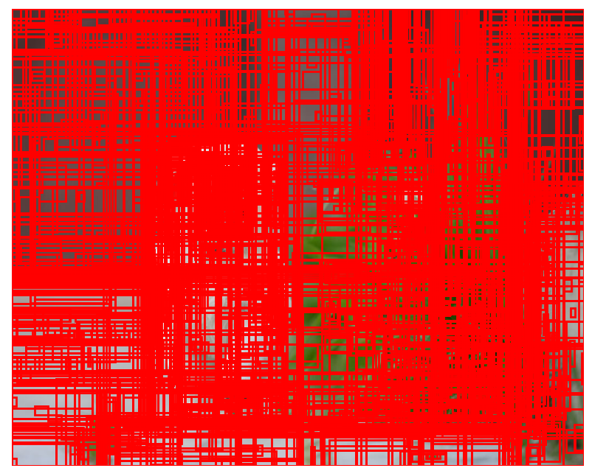
Selective Search
https://github.com/opencv/opencv_contrib/blob/4.x/modules/ximgproc/src/selectivesearchsegmentation.cpp
fast mode

Slide 7
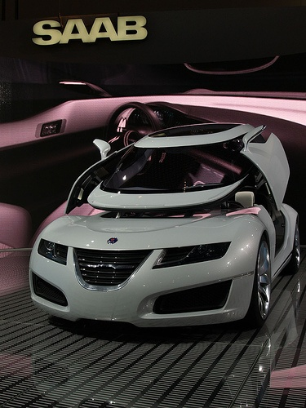
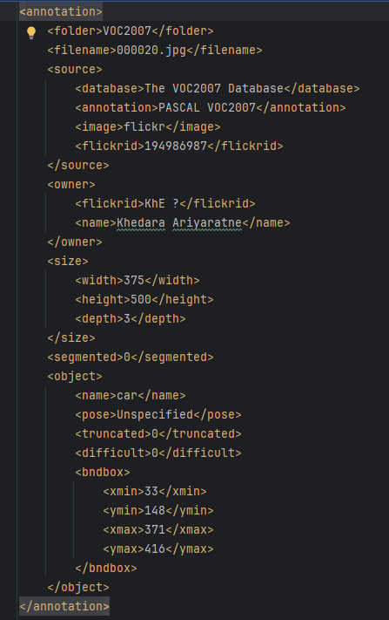
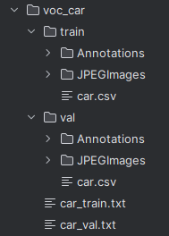
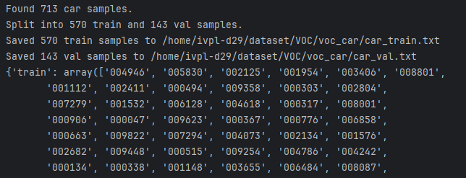
Prepare Dataset
https://herbwood.tistory.com/6
https://github.com/object-detection-algorithm/R-CNN/tree/master

Slide 8
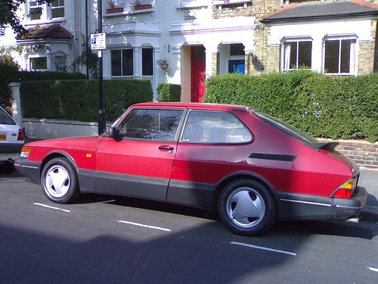
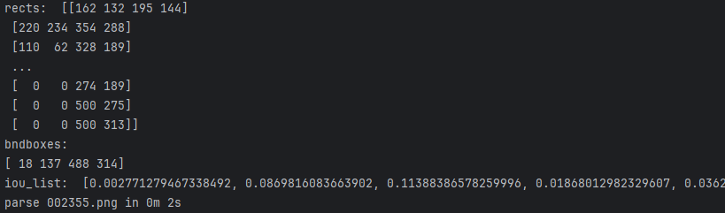
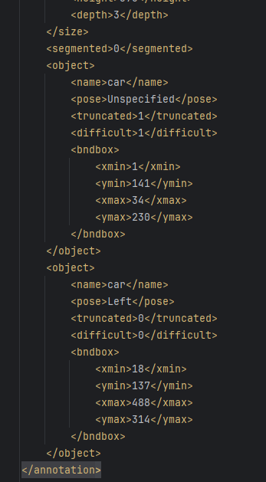
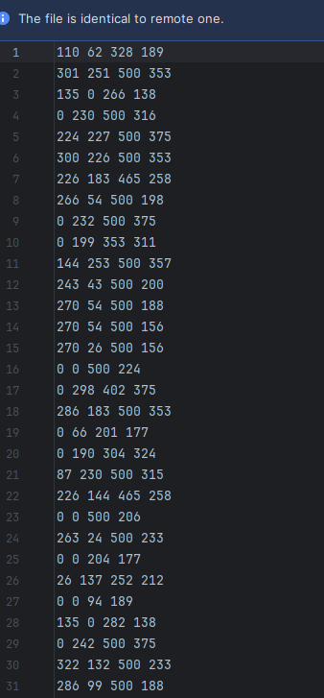
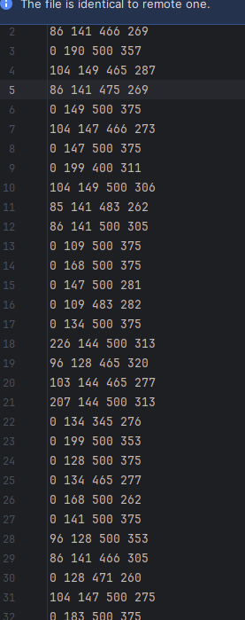
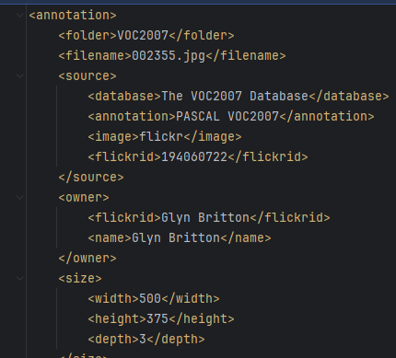
Prepare Dataset
Negative/Positive Rect Divide
002355 0/1.xml
1: positive
0: negative

Slide 9
To Do
Extract only Car data
Prepare the dataset
Fine-tune AlexNet
Train SVM, extract the model
Attach BBox regression
Final detection

