Slide 1
R-CNN (3)
Rich feature hierarchies for accurate object detection and semantic segmentation
2024-11-18
Sein Choi
Intelligent Vision Processing Lab. (IVPL)
https://ivpl.sookmyung.ac.kr
Div. of AI Engineering, Sookmyung Women’s University
E-mail: csi1806@sookmyung.ac.kr

Slide 2
Contents
R-CNN
Finetuning
SVM
Output

Slide 3
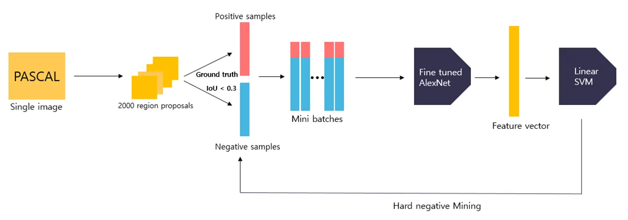
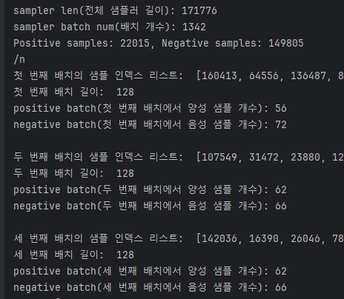
R-CNN Finetuning

Slide 4
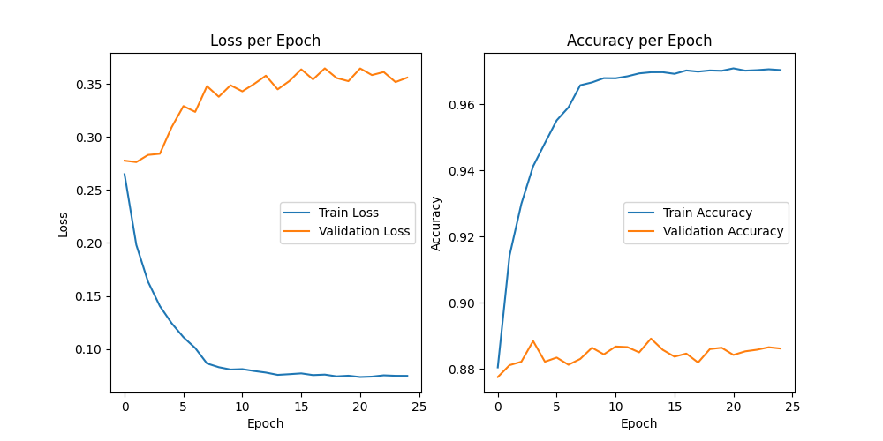
R-CNN Finetuning

Slide 5
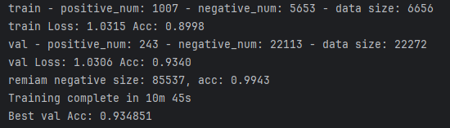
SVM

Slide 6
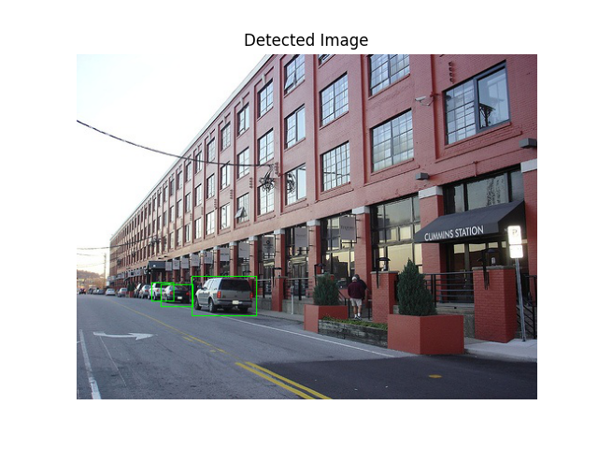
Output
000091.jpg

Slide 7
To do
Extract only Car data
Prepare the dataset
Fine-tune AlexNet
Train SVM, extract the model
Attach BBox regression
Final detection

Slide 8
Thank you for your attention.!!!
QnA

