Slide 1
Noisy Student Training (2)
Self-training with Noisy Student improves ImageNet classification
2024-08-19
2115686 최세인

Slide 2
Index
1. Expreimental plan
2. Teacher Model Train
3. Make Pseudo Label
4. Student Model Train

Slide 3
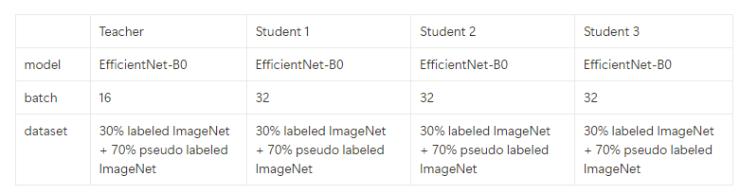
Expreimental plan
1. Teacher Model Train
2. Make Pseudo Label, filtering&balancing
3. Student Model Train
4. 3 Iterations of Student Model Train
"The reason for splitting ImageNet
To clearly know that all datasets have 1,000 classes
Allowing us to check whether the pseudo labels are predicted accurately by reviewing the class names."

Slide 4
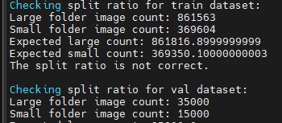
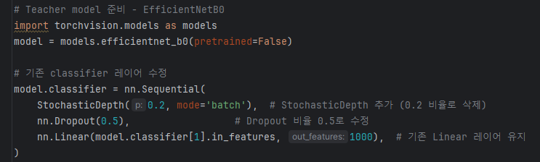
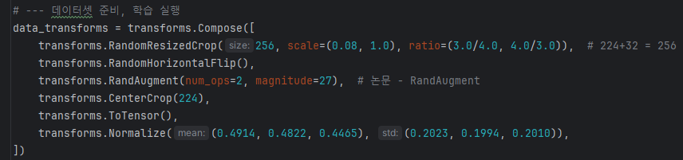
Teacher Model Train
Model : EfficientNet-B0
Dataset
Split ImageNet into 70:30, and use the 30% as labeled data.
Use ‘Small Folder’ Image
Add Noise
Add dropout and stochastic depth to the last layer of the model
Include random noise in the dataset preparation.
Epochs, optimizer Setting
100 epochs
Goal
Set the test accuracy to around 70%
(approximately 77% in the paper)

Slide 5
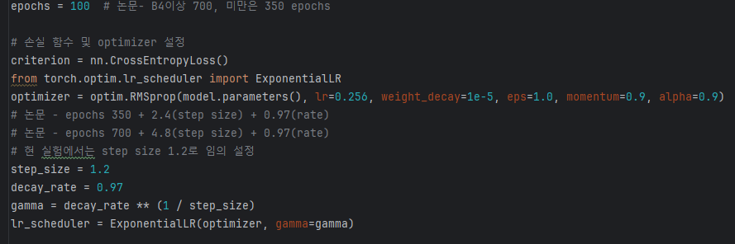

Teacher Model Train
Model : EfficientNet-B0
Dataset
Split ImageNet into 70:30, and use the 30% as labeled data.
Use ‘Small Folder’ Image
Add Noise
Add dropout and stochastic depth to the last layer of the model
Include random noise in the dataset preparation.
Epochs, optimizer Setting
100 epochs
Goal
Set the test accuracy to around 70%
(approximately 77% in the paper)
-> Table 11

Slide 6
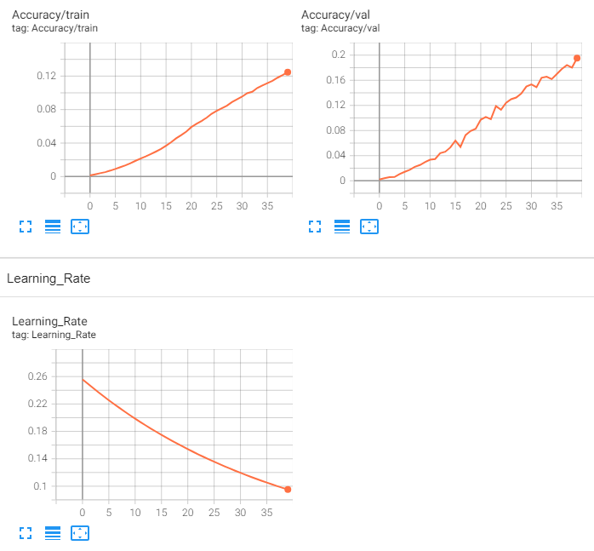
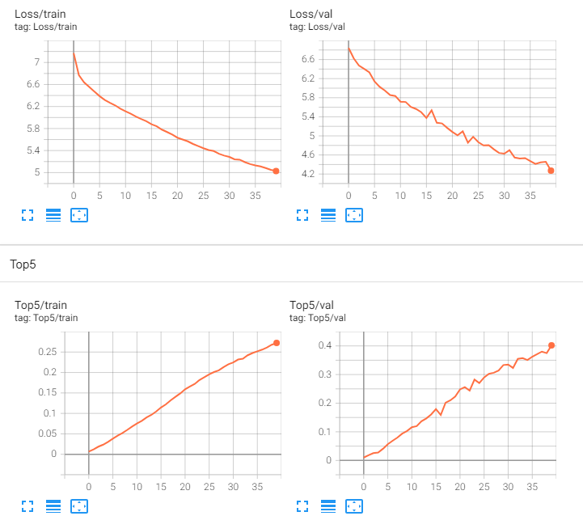
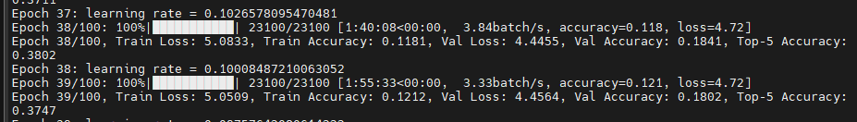
Teacher Model Train
Training
The training is progressing slowly (the paper mentions training for about 350 epochs.)

Slide 7
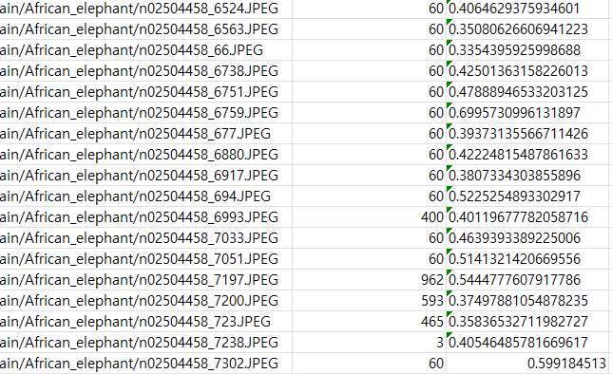
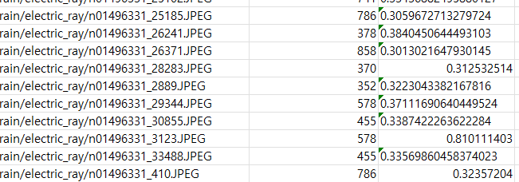
Make Pseudo Label
Load the trained model weights and perform pseudo labeling on the 70% split of the ImageNet dataset.
Filtering - Calculate the confidence for each dataset and keep only those with a confidence of 0.3 or higher.
Balancing - Ensure that each class has 800 samples (arbitrarily designated) in the dataset, creating a final pseudo labeled dataset of 1000 * 800 = 8M. If any class has fewer than 800 samples, randomly duplicate them.
The pseudo labeled data is saved in a CSV file as follows.
image_path iteration_1_pseudo label iteration_1_confidence
'African elephant': the model usually recognizes 'elephant,' but it confuses 'Indian' and 'African,' and has not yet accurately classified the class.
'Electric Ray': the accuracy is low.
The issue is likely due to using model weights with a validation accuracy of 15% temporarily.

Slide 8
Student Model Train
The number of unique images with a confidence of 0.3 or higher from the 70% split of ImageNet is 179,408
1 epochs – about 3H 40 minutes
Dataset : labeled 30%(369,604) + pseudo 1000classes*800(8M)
Total 8.36M

