Slide 1
Noisy Student Training (7)
Self-training with Noisy Student improves ImageNet classification
2024-09-23
2115686 최세인

Slide 2
Index
1. Train Teacher Model
2. Pseudo Labeling
3. Train Student Model – B3
4. Result
5. HomePage GPU Utils

Slide 3
Teacher Model Train

Slide 4
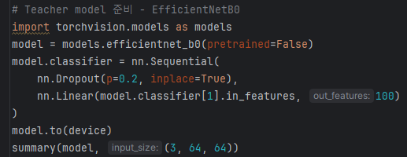
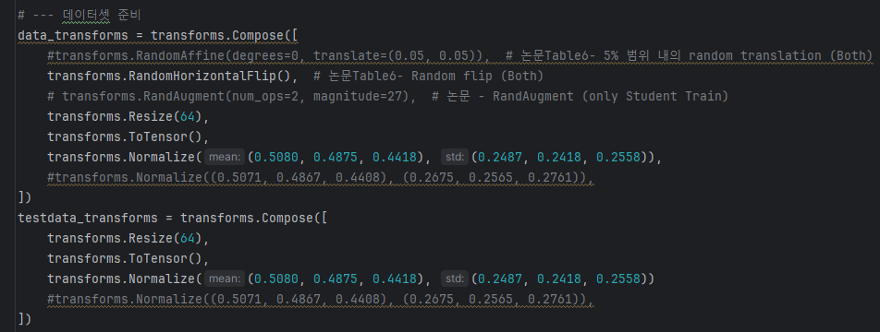
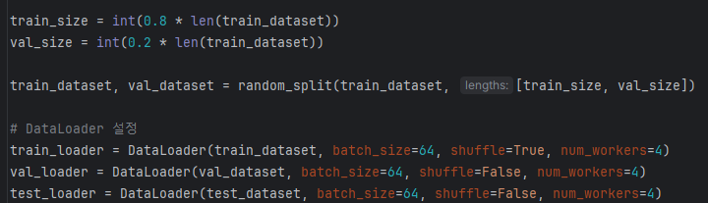
Teacher Model Train

Slide 5
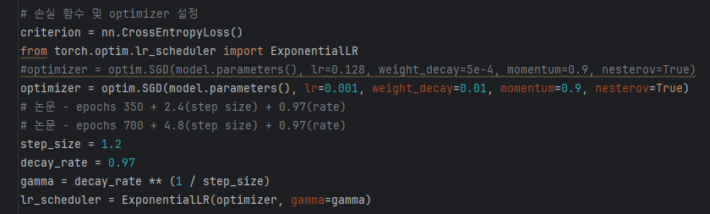
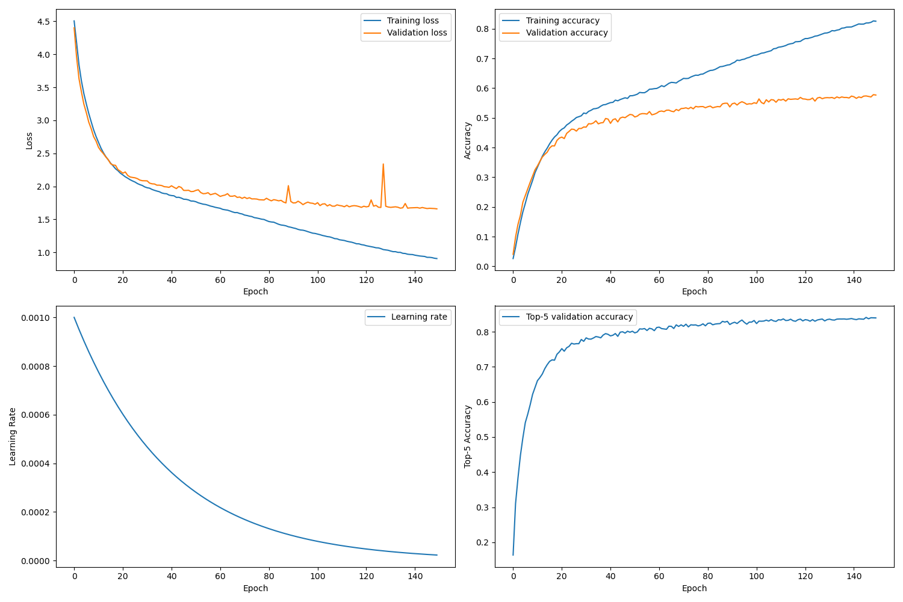
Teacher Model Train

Slide 6
Pseudo Labeling #1
After Teacher Model Training

Slide 7
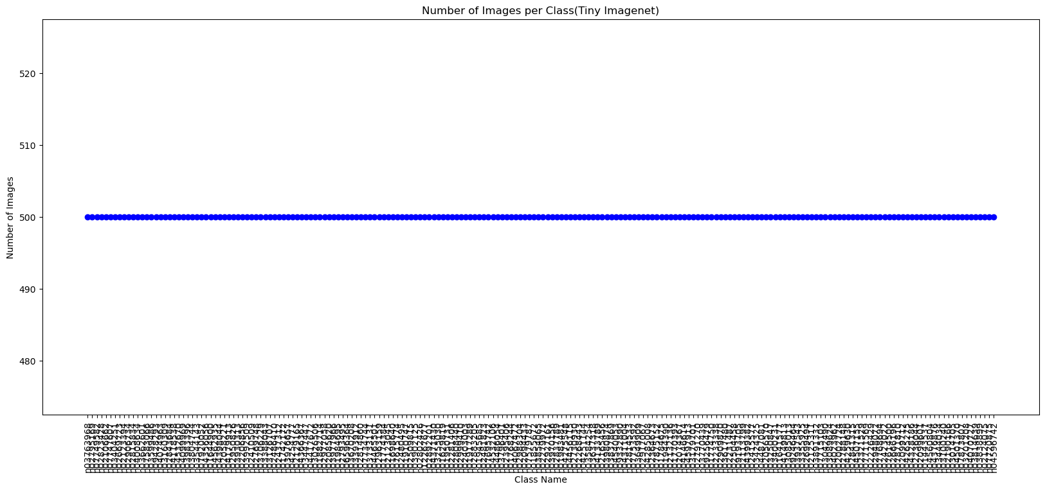
Pseudo Labeling

Slide 8
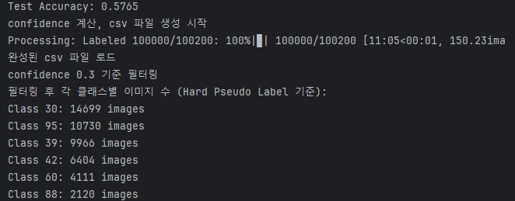
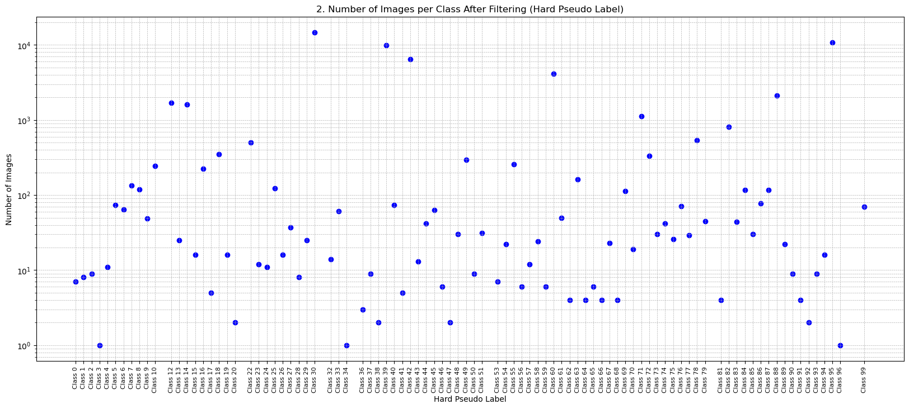
Pseudo Labeling

Slide 9
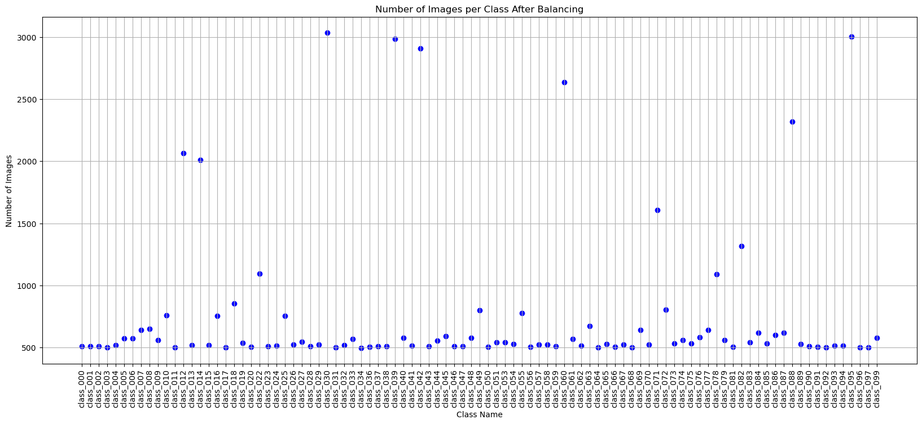
Pseudo Labeling

Slide 10
Student Training #1

Slide 11
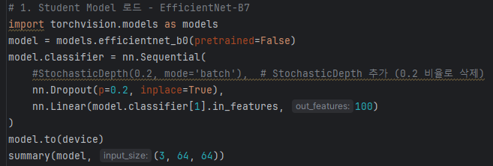
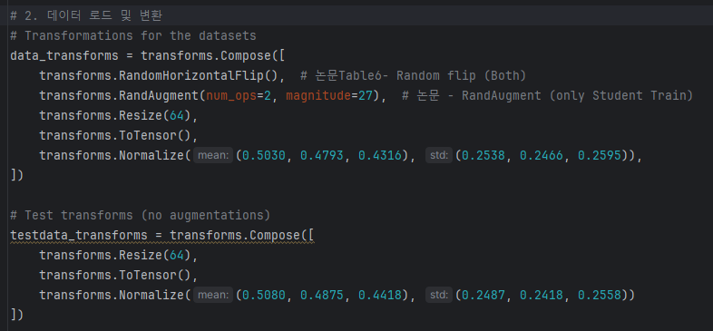
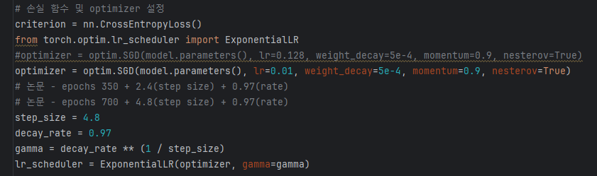
Student Model Training – B0

Slide 12
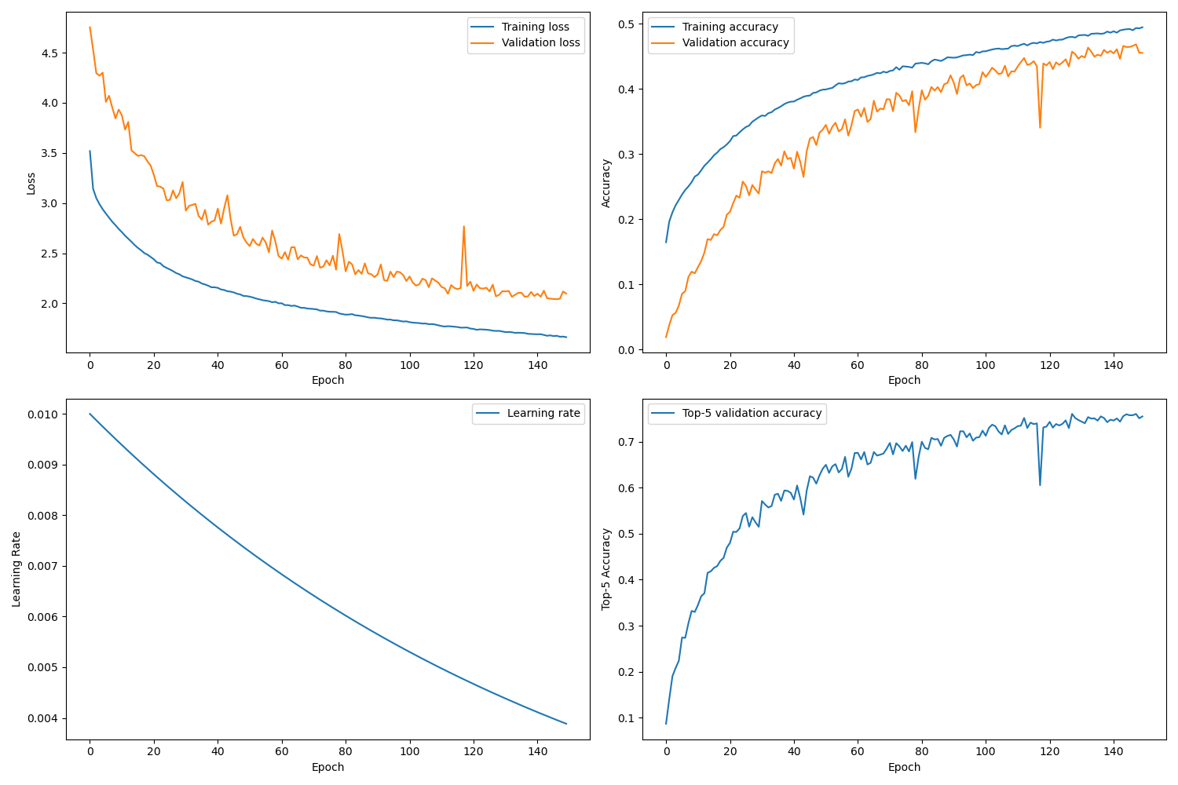

Student Model Training – B0

Slide 13
Pseudo Labeling #2
After Student Model #1 Training

Slide 14
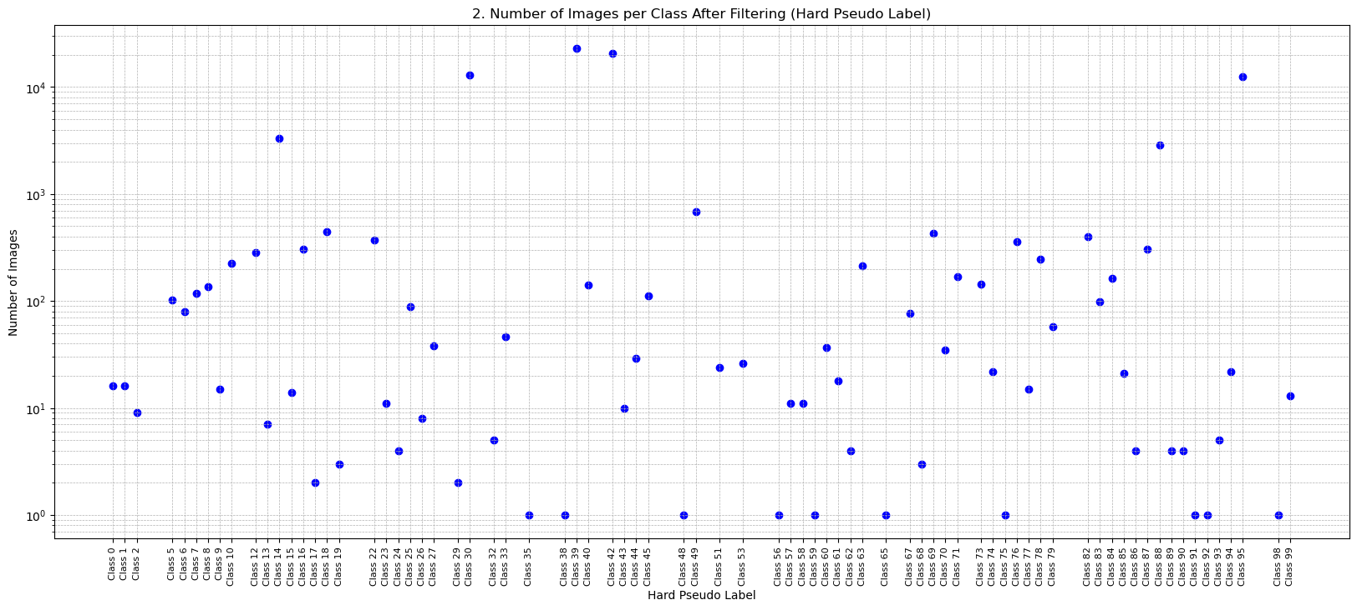
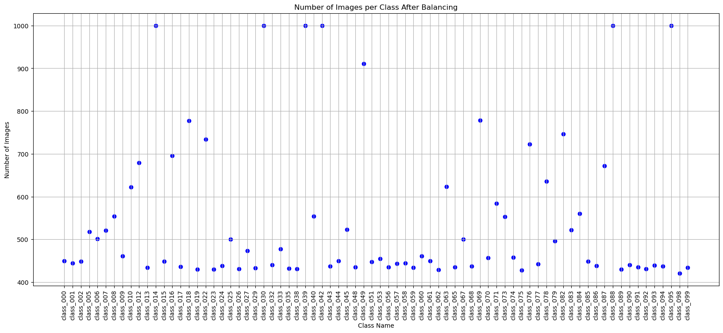
Pseudo Labeling

Slide 15
Student Training #2

Slide 16

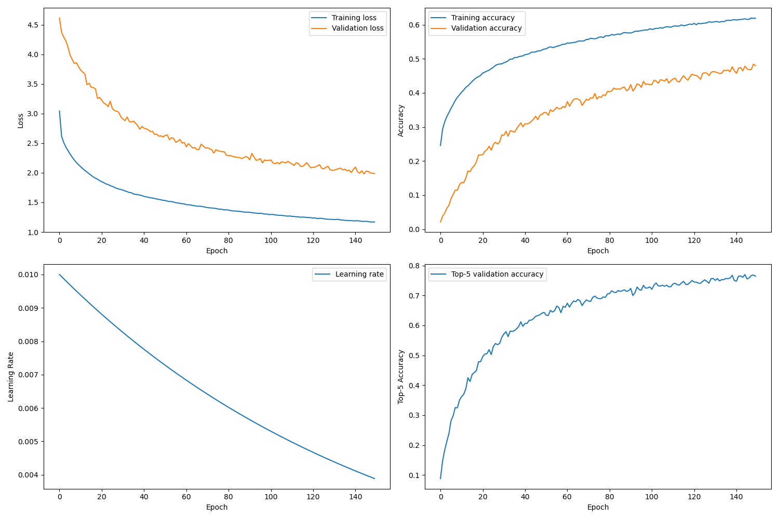
Student Training2 – B0

Slide 17
Pseudo Labeling #3
After Student Model #2 Training

Slide 18
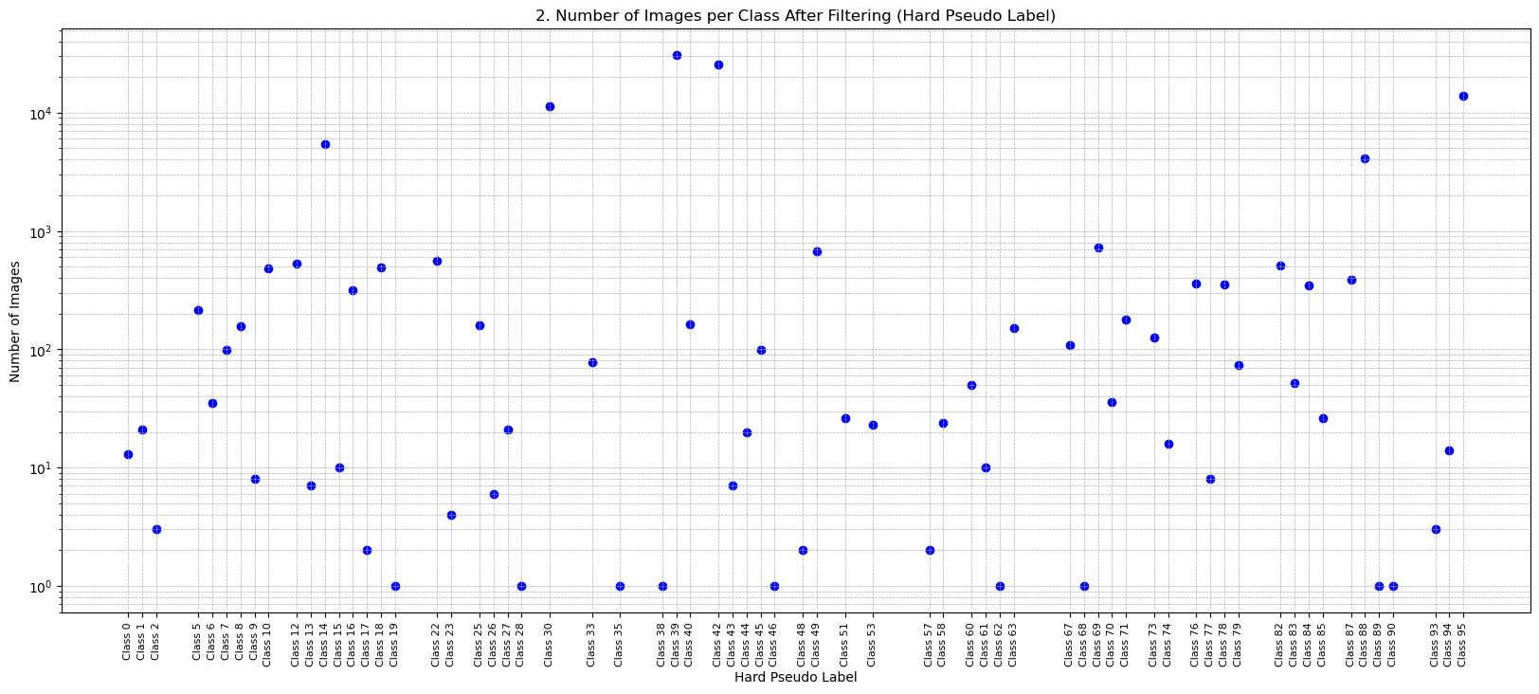
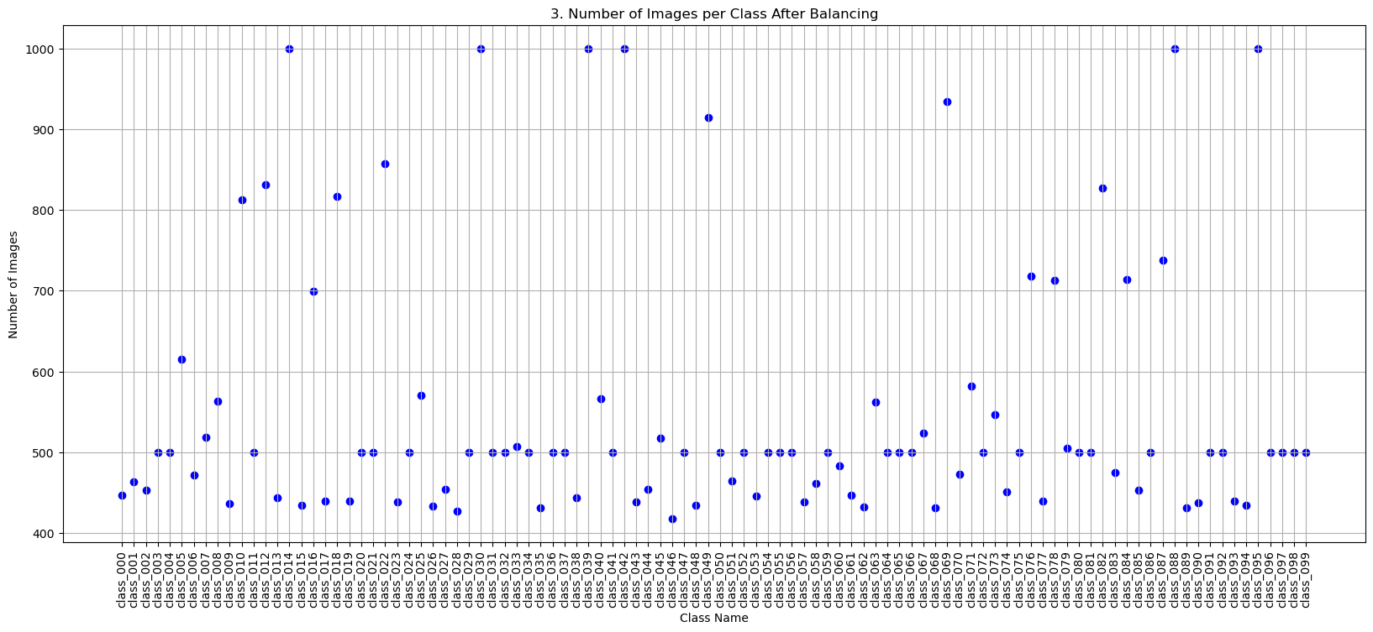
Pseudo Labeling

Slide 19
Student Training #3

Slide 20

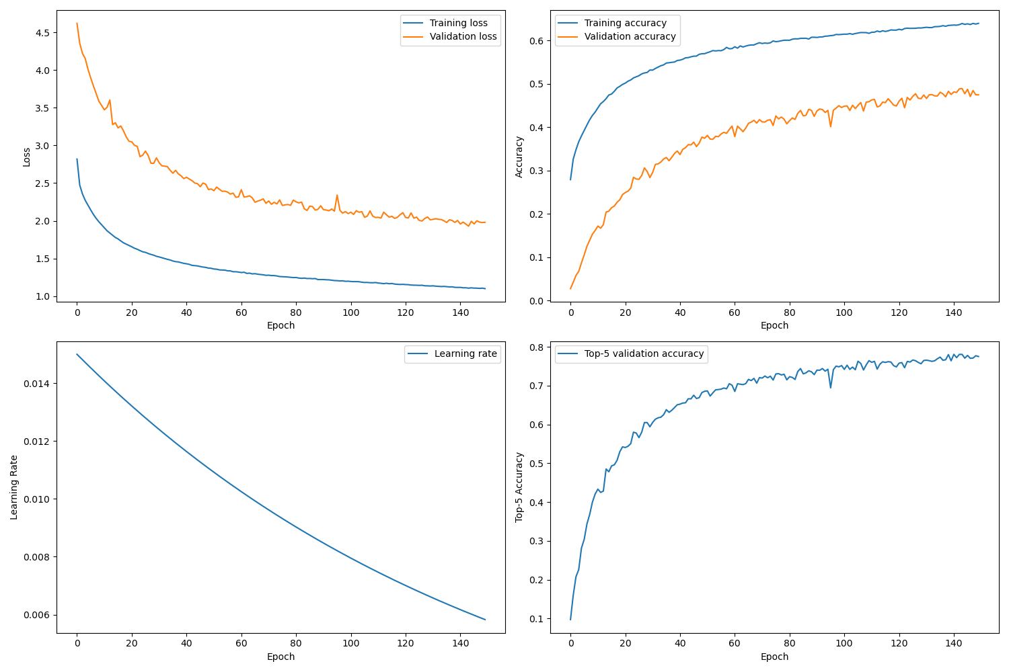
Student Training3 – B0

Slide 21
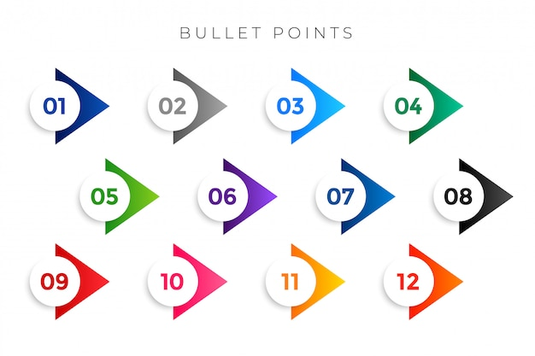
Result
Cifar100 + TinyImageNet
 | Teacher | Student1 | Student2 | Student3
Model | B0 | B0 | B0 | B0
Batch Size | 64 | 512 | 512 | 512
Epochs | 150 | 150 | 150 | 150
Train Image Count | 40,000 | 40,000 + 58,358 = 98,358 | 40,000 + 81,646 =121,646 | 40,000 + 98,688 = 138,688
Val Image Count | 10,000 | 10,000 | 10,000 | 10,000
Test Image Count | 10,000 | 10,000 | 10,000 | 10,000
Val Max Accuracy | 57% | 47.90% | 47.99% | 48.89%
Test Top-1 Accuracy | 57.65% | 60.94% | 61.47% | 60.49%
Test Top-5 Accuracy |  | 86.29% | 87.09% | 87.08%
Test Loss |  | 1.4307 | 1.3939 | 1.4120

