Slide 1
Noisy Student Training (4)
Self-training with Noisy Student improves ImageNet classification
2024-09-02
2115686 최세인

Slide 2
Index
1. Prepare Dataset
2. Revision
3. Teacher Model Train

Slide 3
Prepare Dataset
Labeled Data |  | Unlabeled Data
Cifar-100 | Name | Tiny-ImageNet
100 | Class Num | 200
32*32*3 | Resolution | 64*64*3
40,000 | Train | 100,000
10,000 | Val | 10,000
10,000 | Test | 10,000
60,000 | Total | 120,000

Slide 4
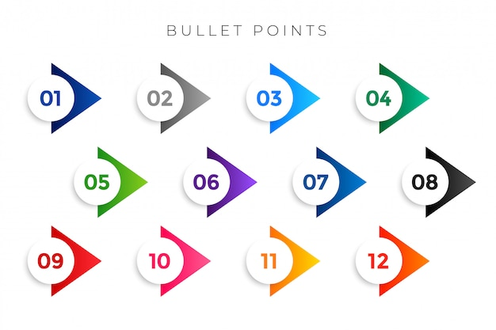
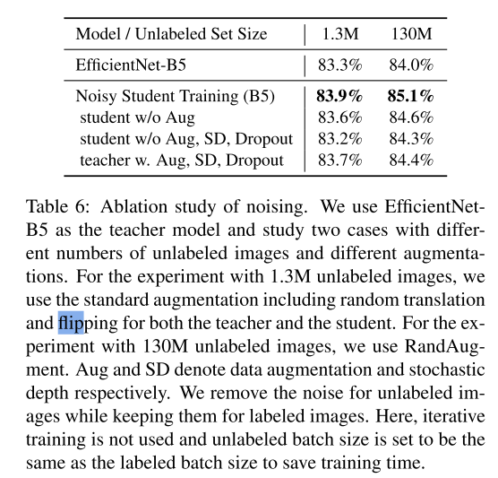

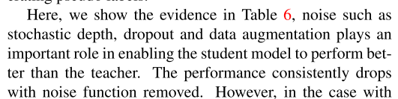
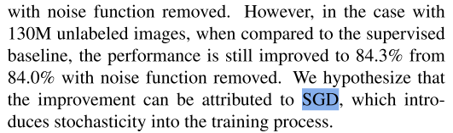
Revision
Double-check the details that were missed during implementation.
Adding noise to the Teacher Model is not beneficial for accuracy improvement.
Adding noise to the Student Model entirely is the most effective approach.
recommended to use SGD in the optimizer
For standard data augmentation excluding noise, random translation and flipping are used (both for the teacher and student as the base).

Slide 5
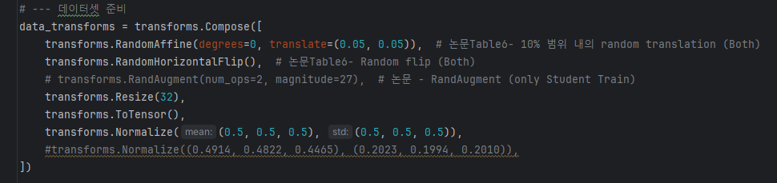
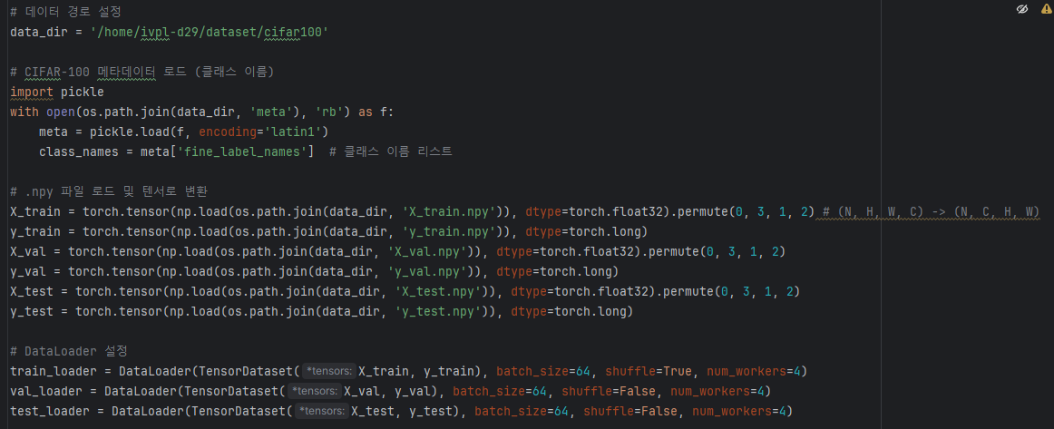

Revision Code

Slide 6
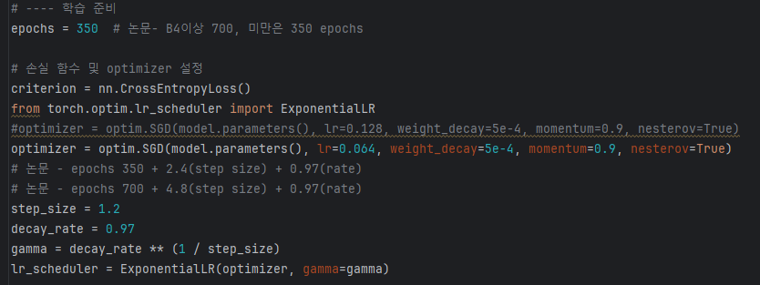
Revision Code

Slide 7
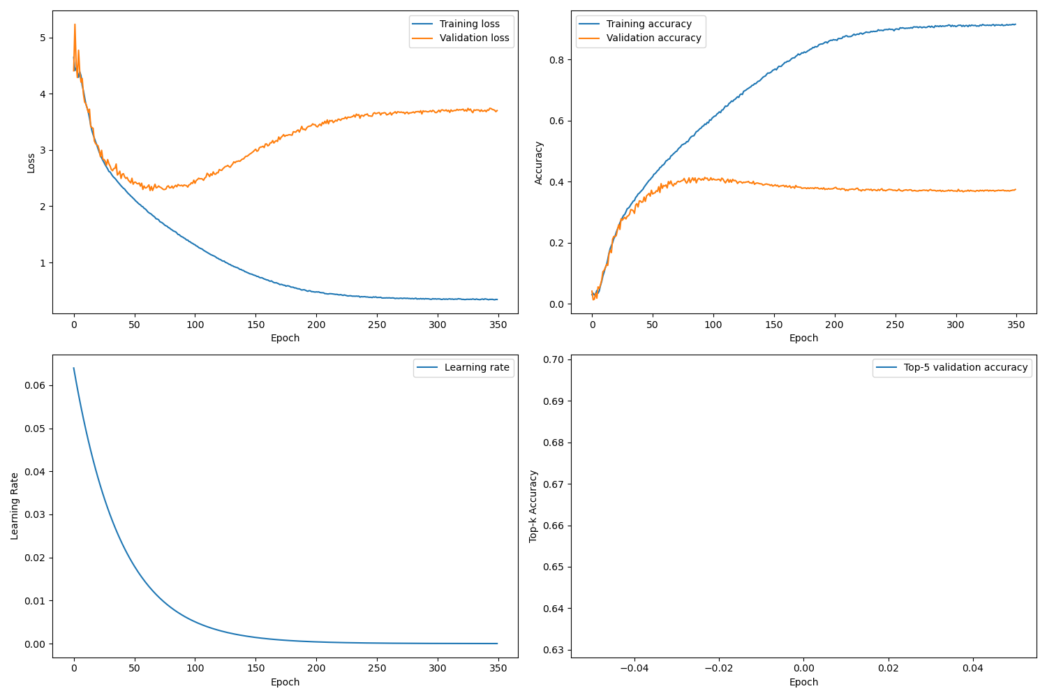
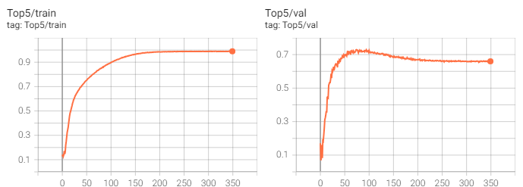
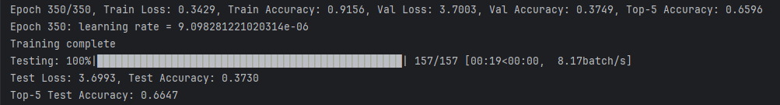
Teacher Model Training
Test Accuracy 0.3730

Slide 8
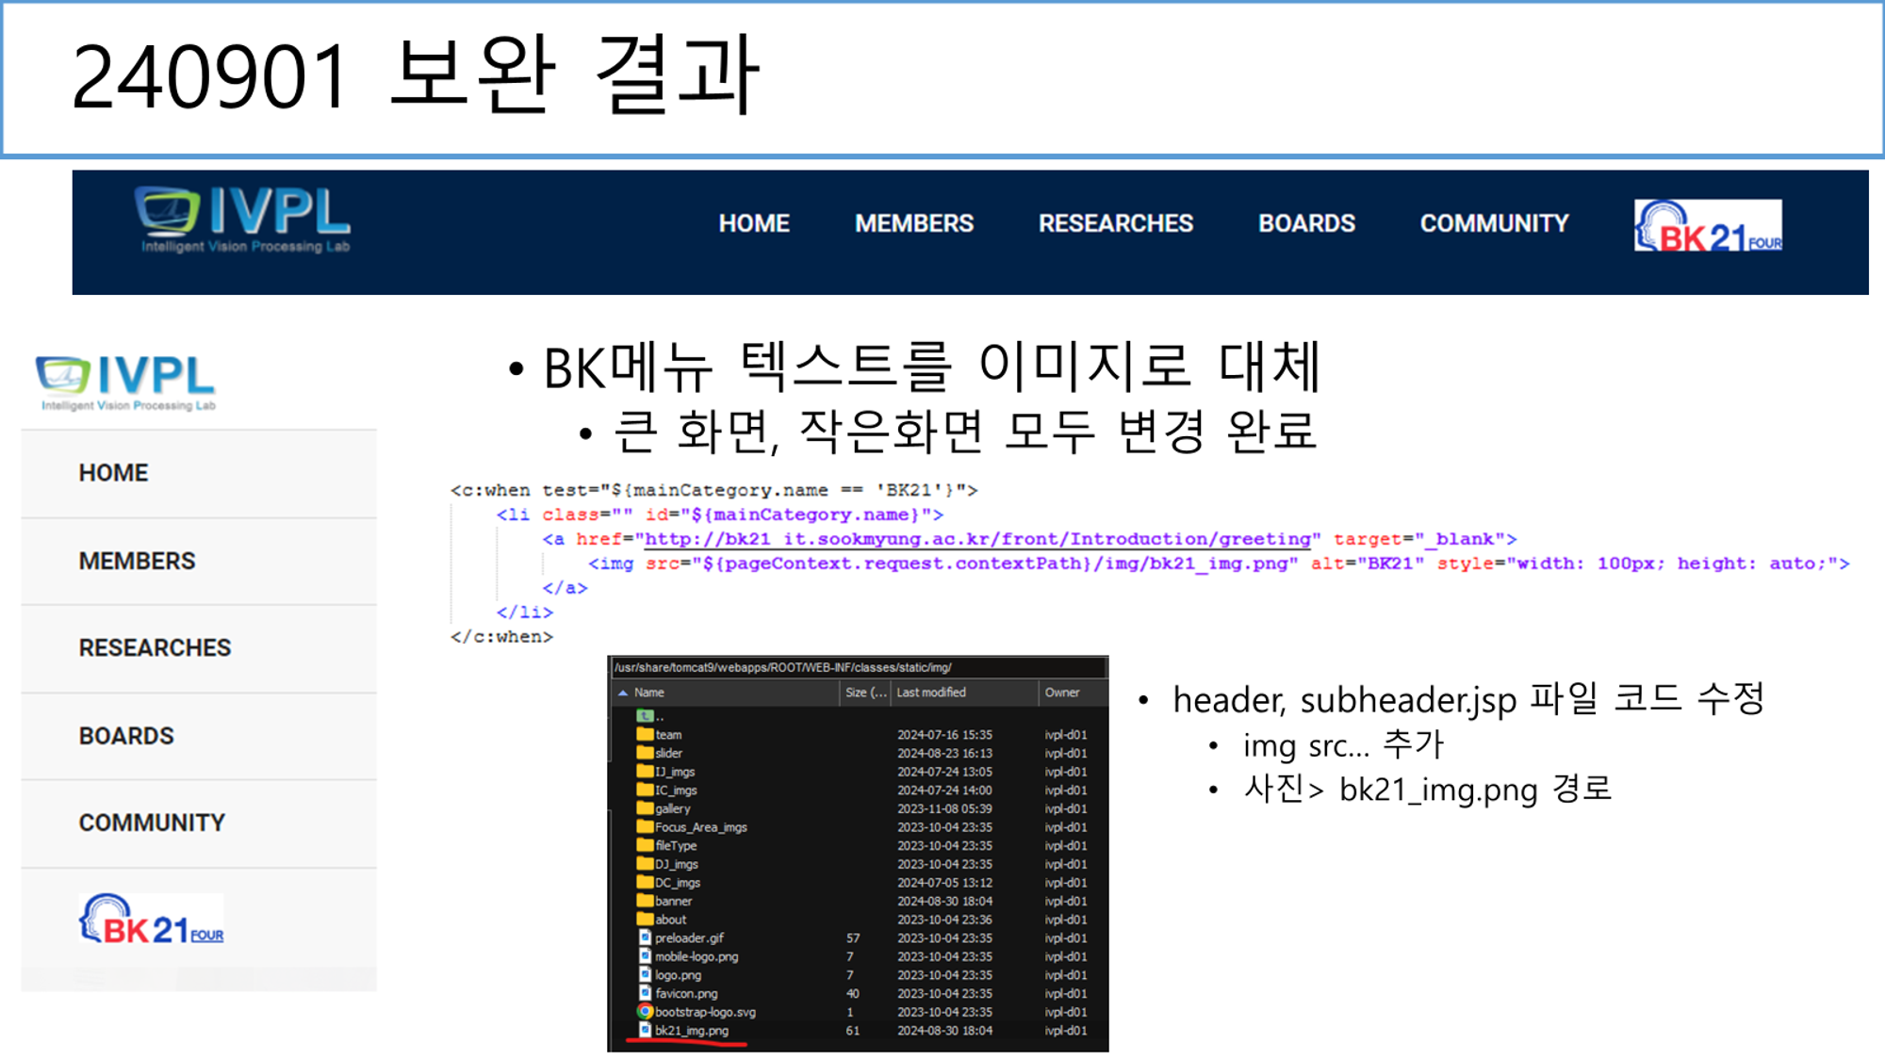

Homepage Maintenance

Slide 9
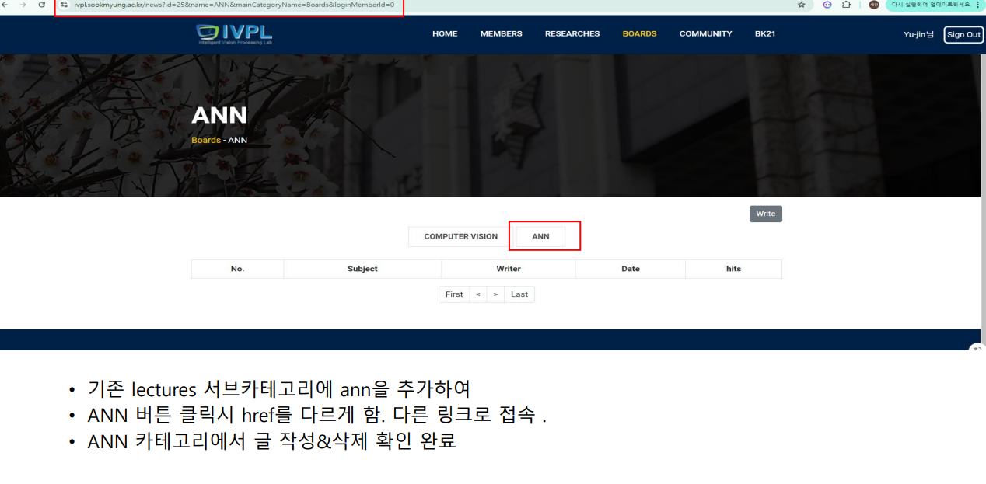
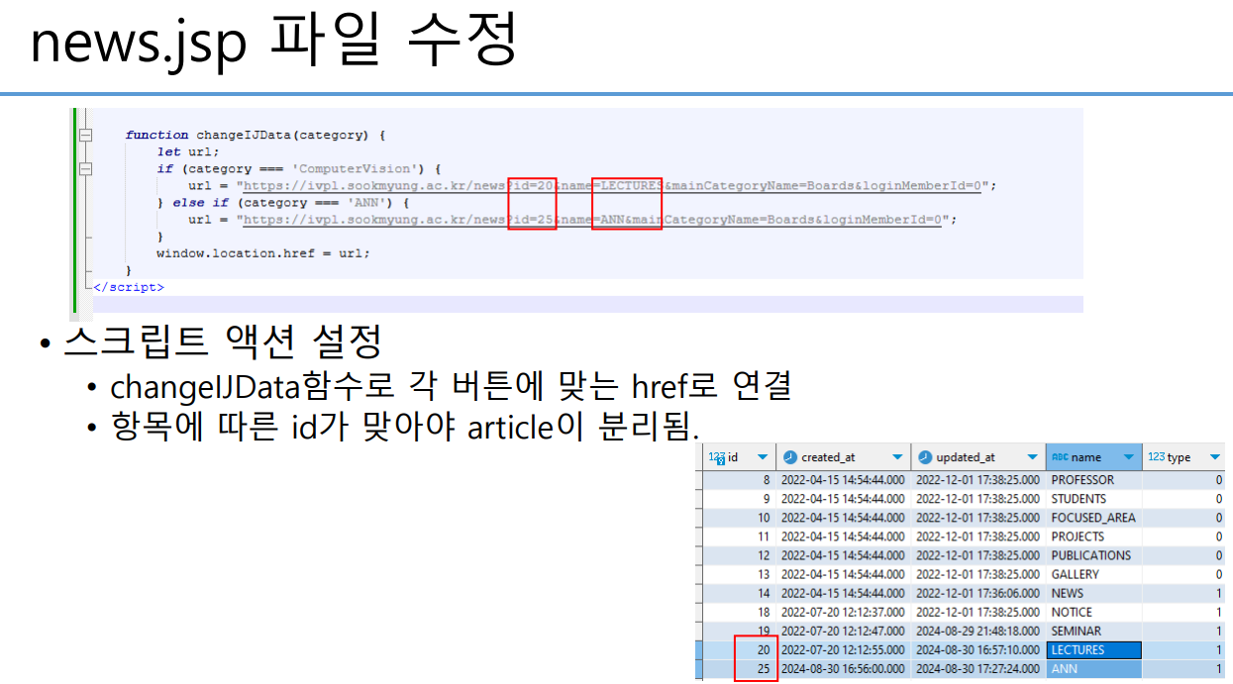
Homepage Maintenance

Slide 10
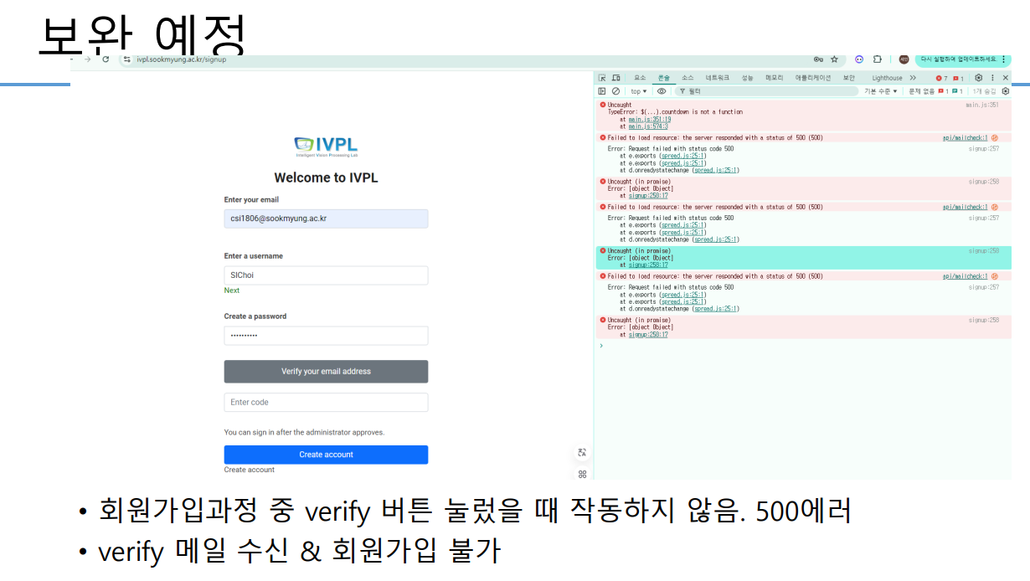
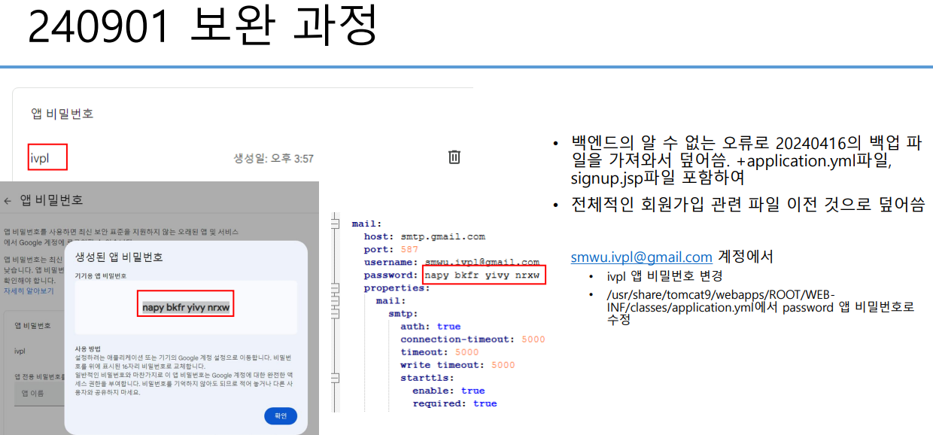
Homepage Maintenance

