Slide 1
Noisy Student Training (6)
Self-training with Noisy Student improves ImageNet classification
2024-09-09
2115686 최세인

Slide 2
Index
1. Train Teacher Model
2. Pseudo Labeling
3. Train Student Model – B7
4. Train Student Model2 – B0

Slide 3
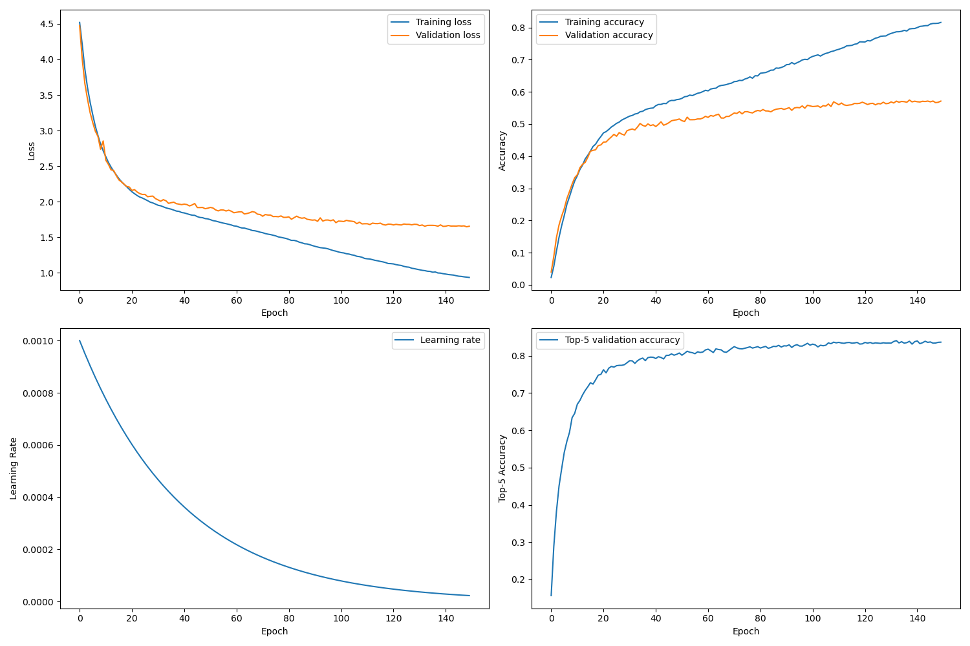
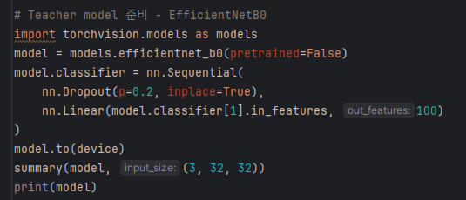
Train Teacher Model
model classifier output: 1000->100

Slide 4
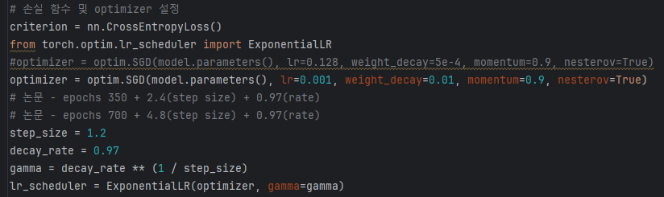
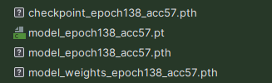

Train Teacher Model
model pth 파일 불러옴, test accuracy 측정

Slide 5
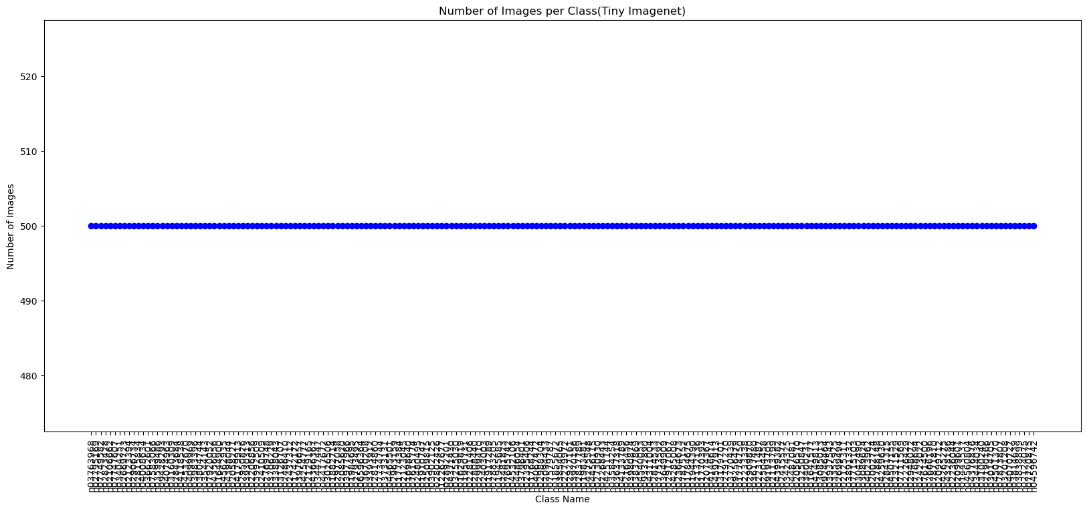
Pseudo Labeling

Slide 6
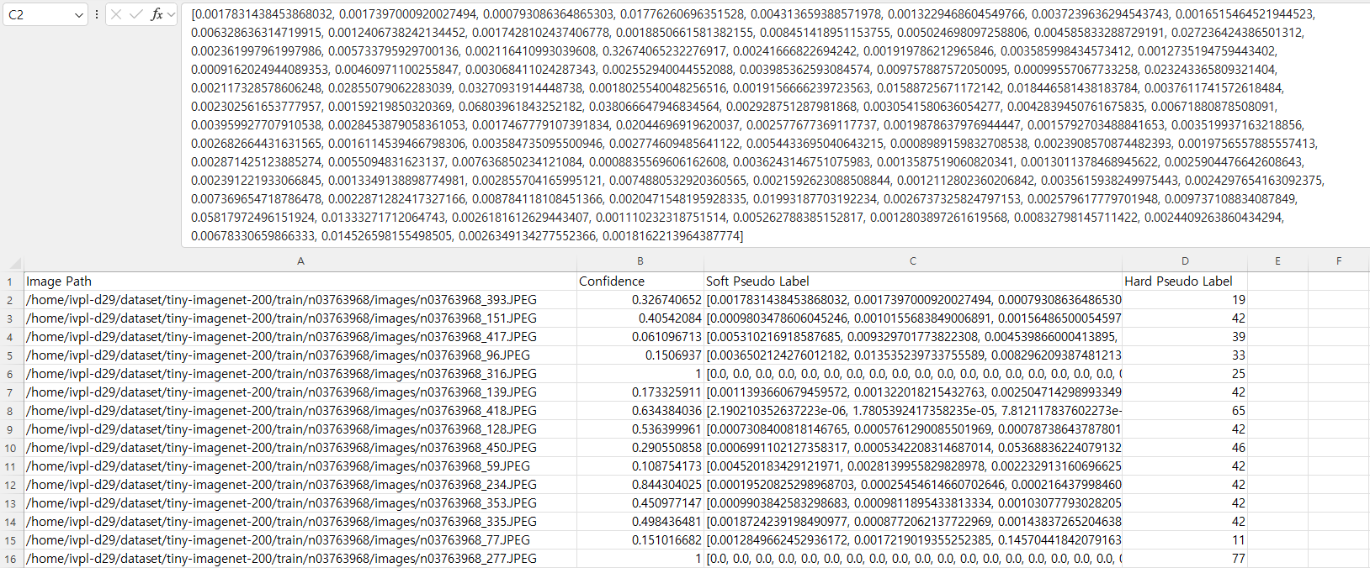
Pseudo Labeling

Slide 7
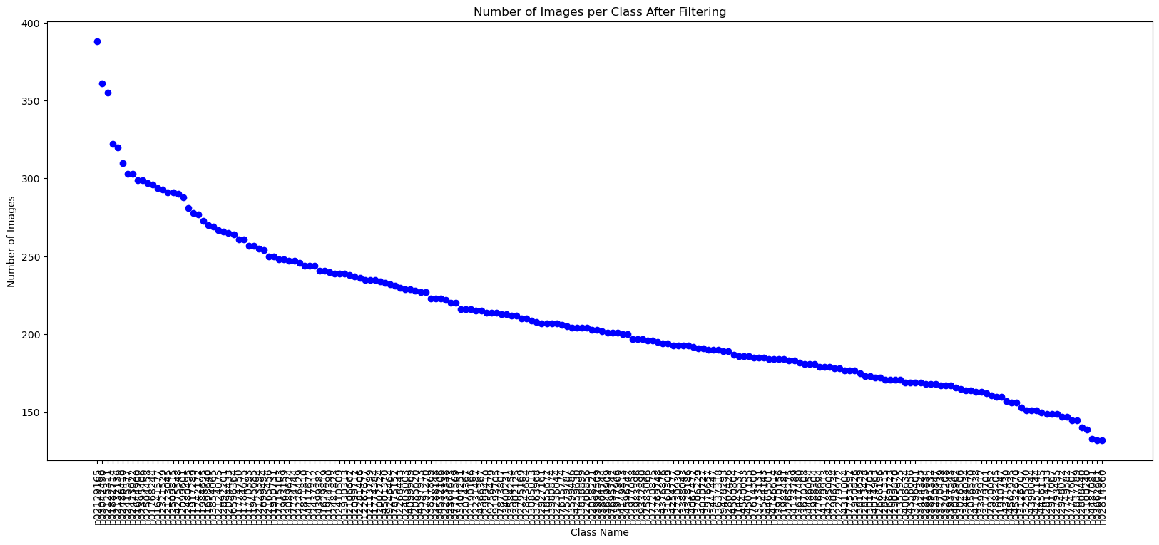
Pseudo Labeling

Slide 8
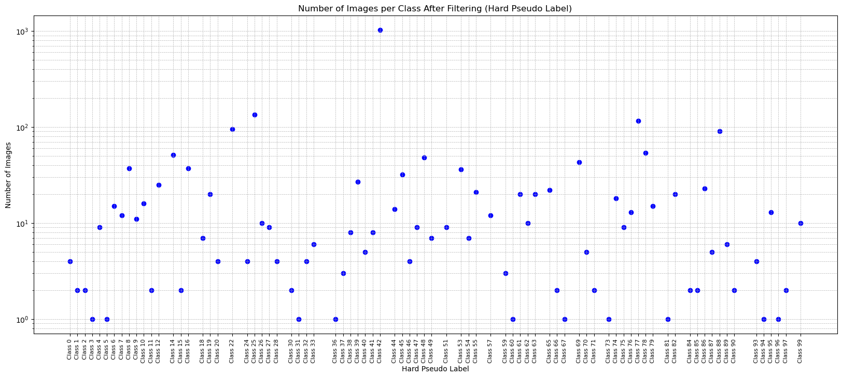
Pseudo Labeling

Slide 9
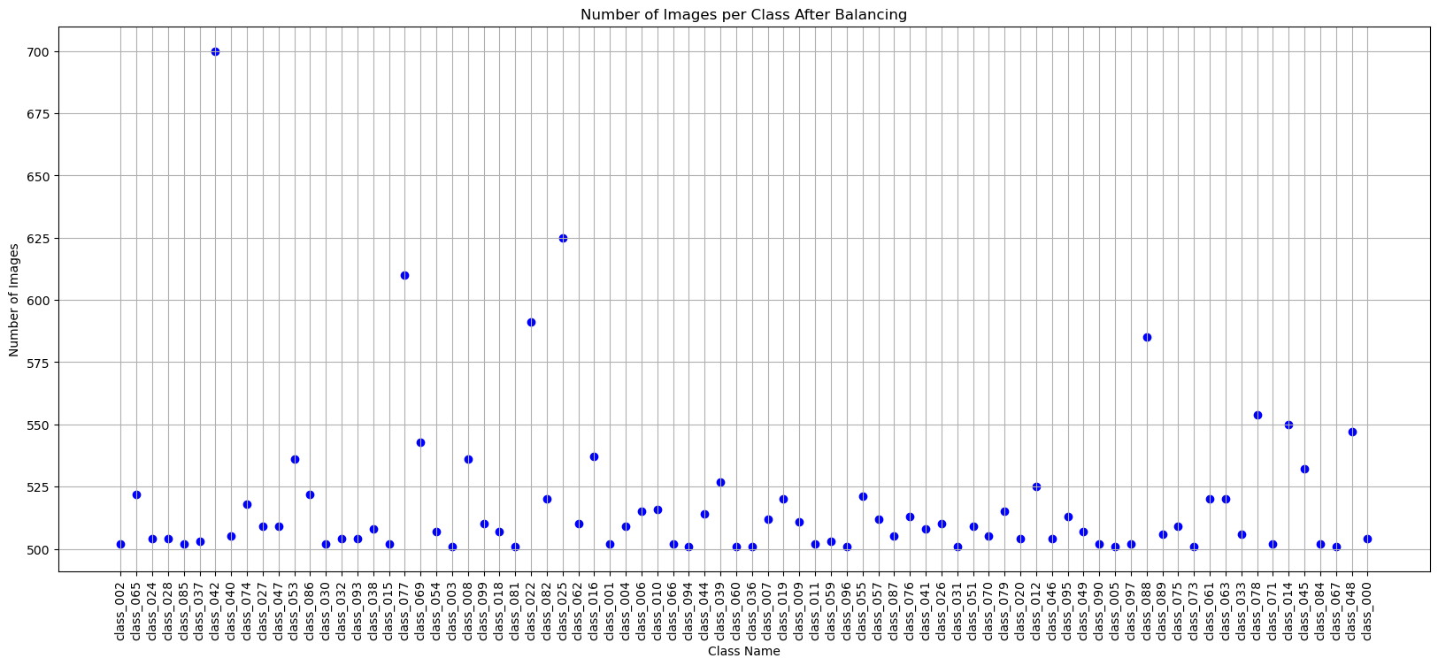
Pseudo Labeling

Slide 10

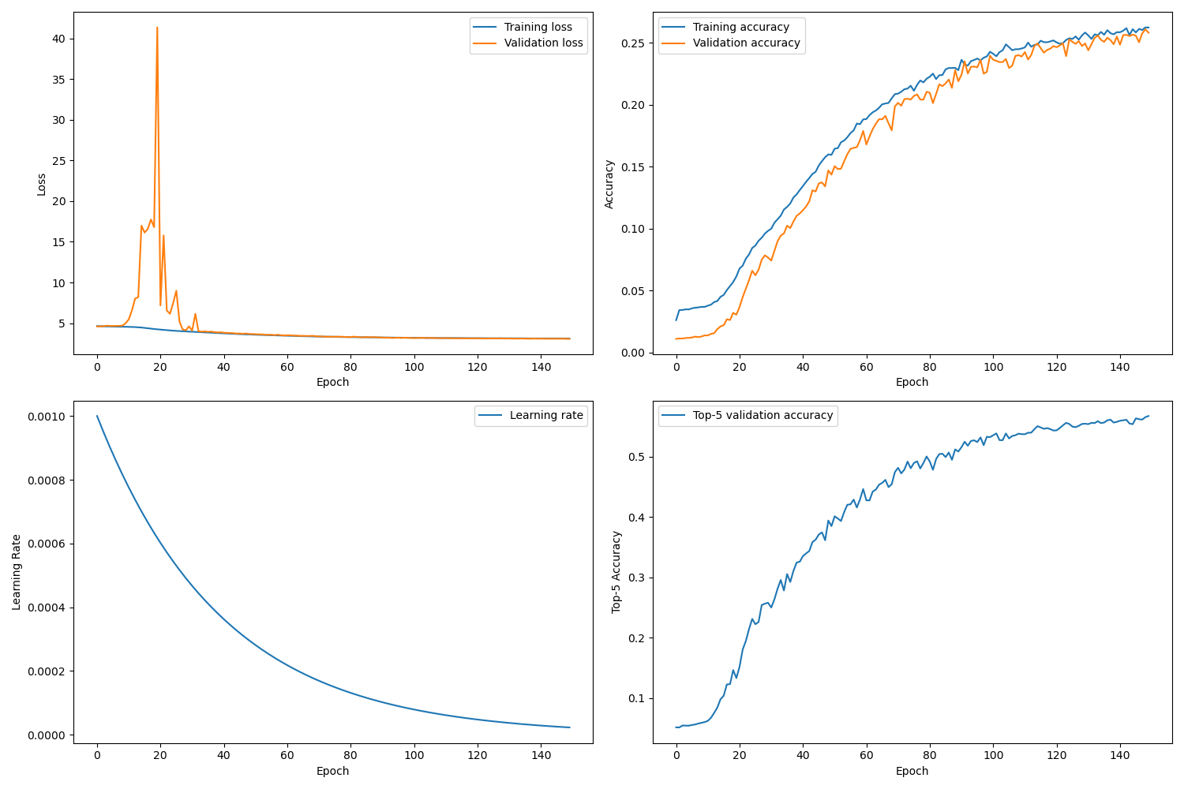
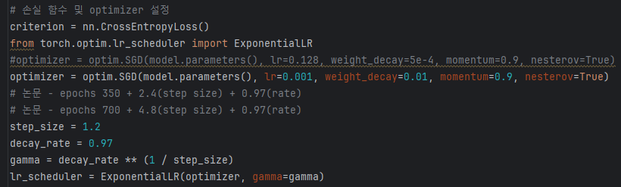
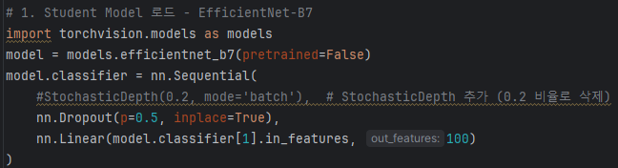
Train Student Model – B7

Slide 11
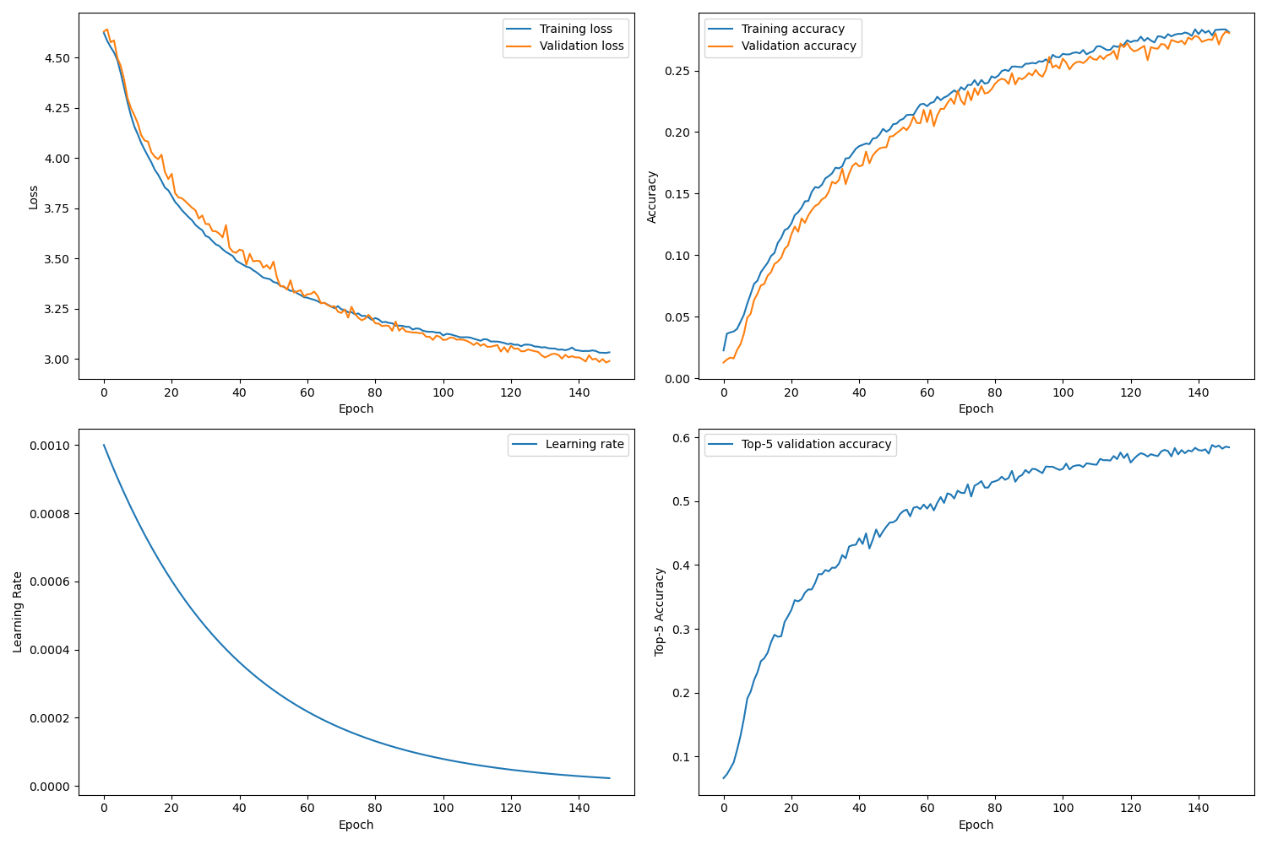
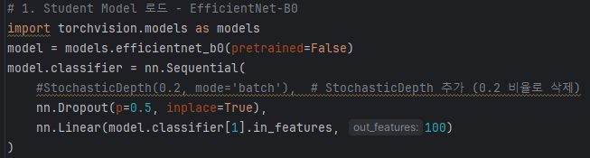
Train Student Model 2 – B0

