Slide 1
YOLO v1 (4)
You Only Look Once: Uniﬁed, Real-Time Object Detection
2024-10-28
2115686 최세인

Slide 2
Index
1. YOLO v1 Detection Train(1)
2. YOLO v1 Detection Train(2)

Slide 3
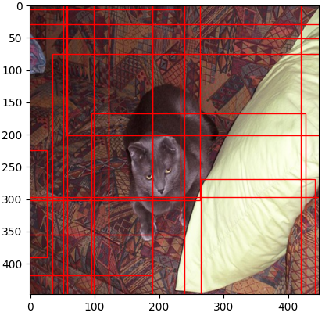
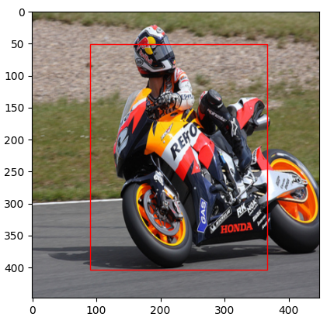
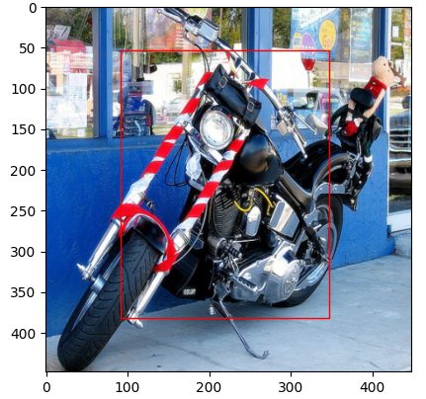
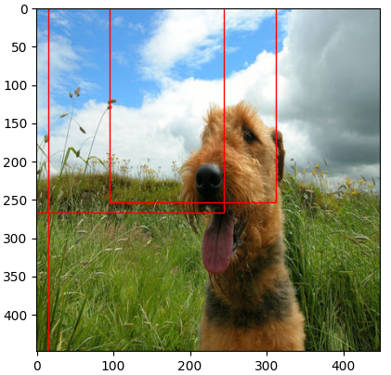
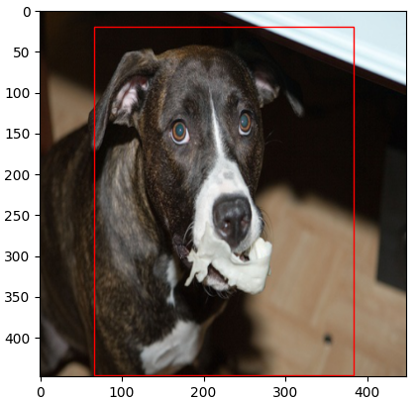
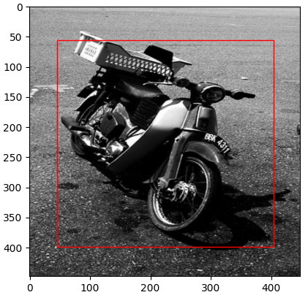

Slide 4
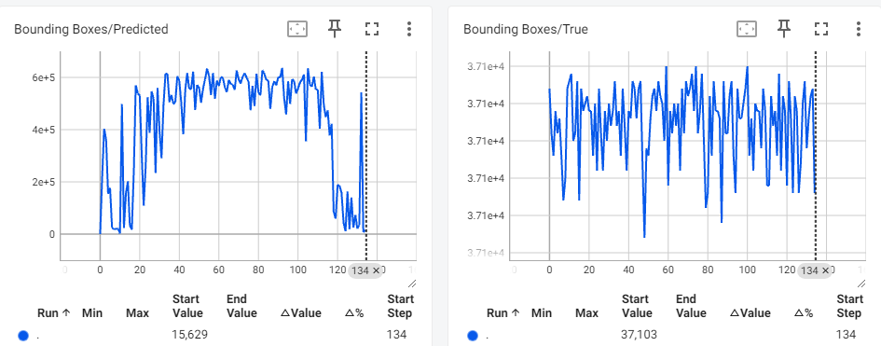
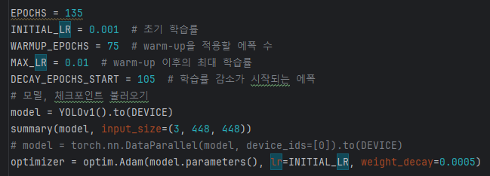
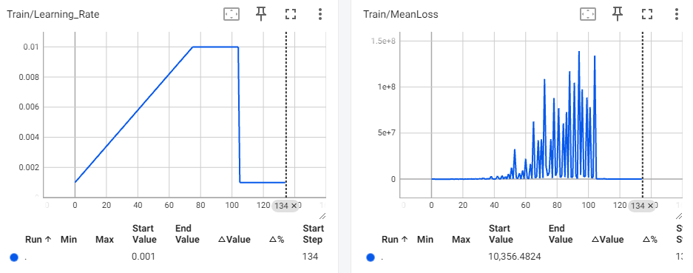
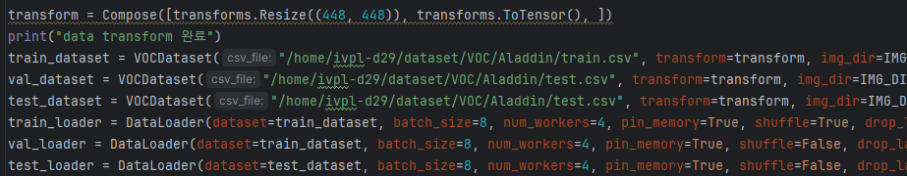
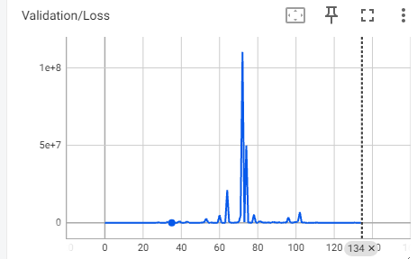
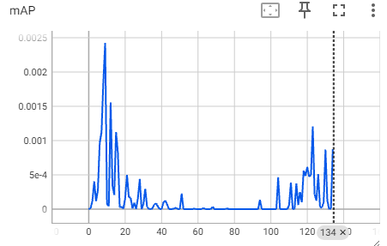
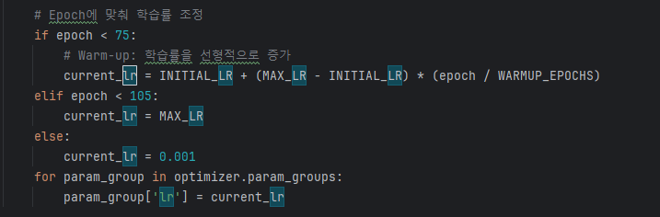
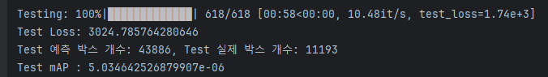
Train (1)
lr scheduler modify
Adam, warm up
{'__background__': 0,
'aeroplane': 1,
'bicycle': 2,
'bird': 3,
'boat': 4,
'bottle': 5,
'bus': 6,
'car': 7,
'cat': 8,
'chair': 9,
'cow': 10,
'diningtable': 11,
'dog': 12,
'horse': 13,
'motorbike': 14,
'person': 15,
'pottedplant': 16,
'sheep': 17,
'sofa': 18,
'train': 19,
'tvmonitor': 20}

Slide 5
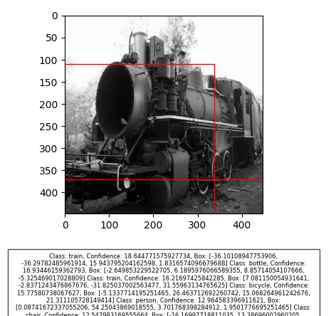
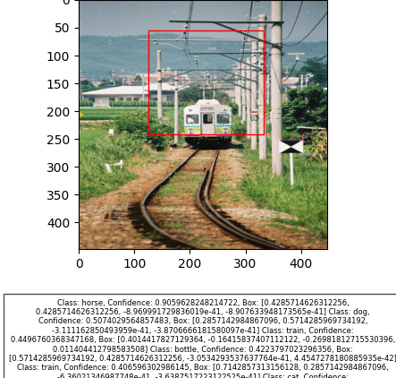
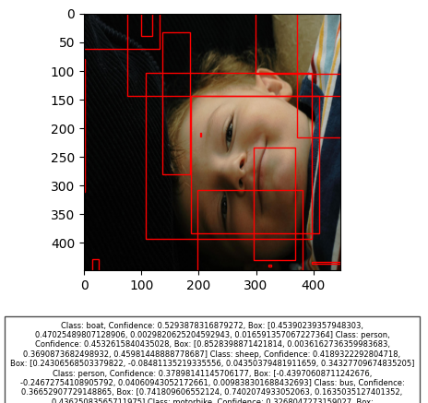

Slide 6
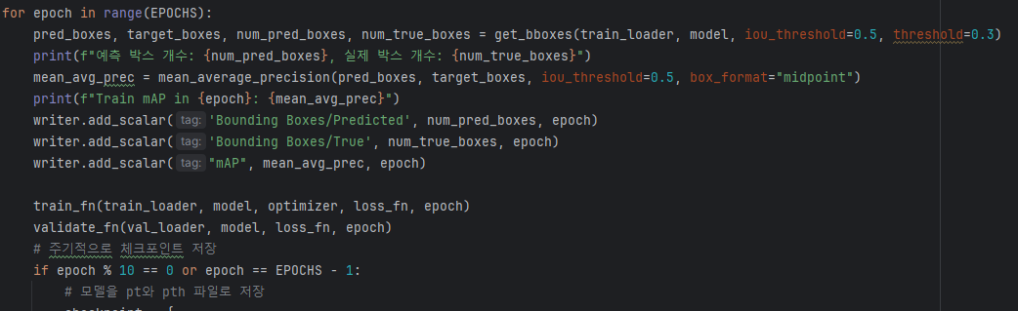
Train (2)
Darknet Classification ckpt load
lr scheduler reconstruct
optimizer : Adam -> SGD -> Adam (SGD Result: loss nan)
Batch size: 8 -> 16
Threshold(IoU/confidence) : 0.4, 0.2 -> 0.5, 0.3

Slide 7
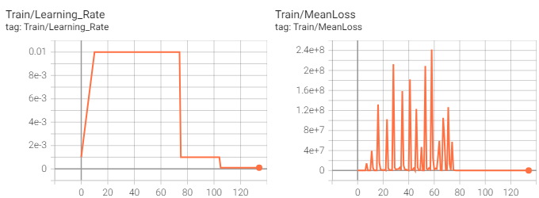
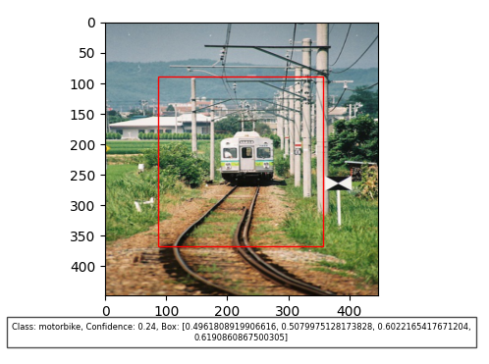
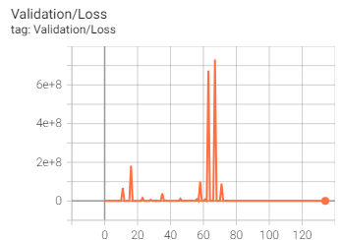
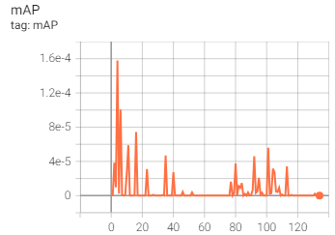
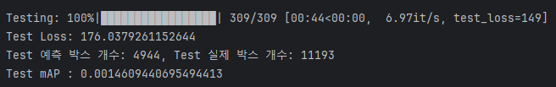
Train (2)

Slide 8
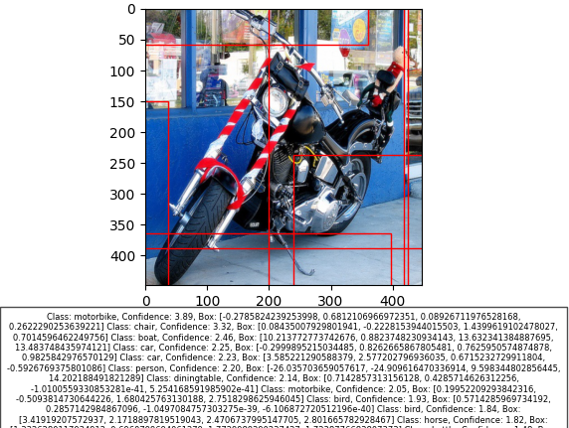
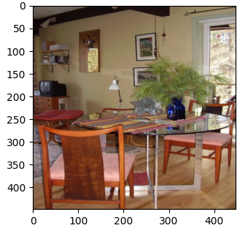
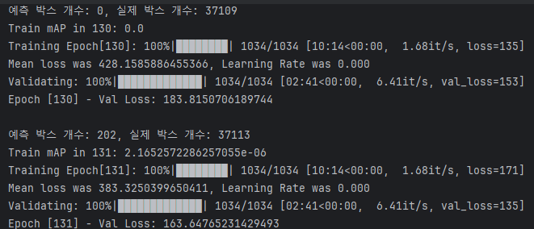
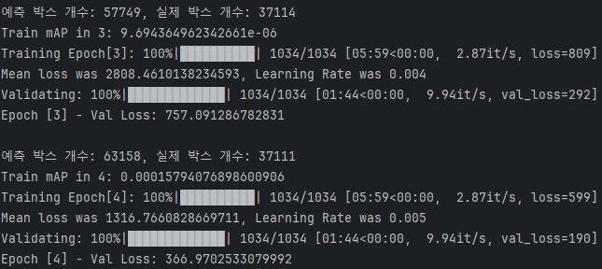
Train (2)

