Slide 1


The Ohio State AI/ML Course Project 2: Machine Learning Team 1 Wine Quality Prediction
19 March 2025

Slide 2

Executive Summary & Project Overview
In our project, we aimed to predict wine quality based on chemical properties using multiple machine learning models. by analyzing the UCI Wine Quality dataset, we trained and evaluated models such as RANDOM Forest, KNN, Decision Tree, Logistic Regression, SVM, and Naive Bayes to determined the best perfuming algorithm. The goal is to identify the key factors influencing wine quality and develop an accurate classification model.
Project Goals:
Data Preparation & Exploration – Clean, preprocess, and analyze the dataset to uncover trends in wine characteristics.
Statistical Analysis – Use ANOVA and correlation analysis to identify key relationships between chemical properties and wine quality.
Machine Learning Implementation – Train multiple models to predict wine quality and evaluate their effectiveness.
Model Selection & Optimization – Identify the best-performing model and validate it on unseen data.
Business & Scientific Insights – Provides meaningful interpretations of how chemical compositions affect wine quality for winemakers and industry professionals.
This project bridges data science and enology (wine science), demonstrating how machine learning can enhance quality control in the wine industry.
Notes:
[ ] Our team is excited to share our machine learning project, where we set out to predict wine quality based on its chemical properties.
[ ] We chose the UCI Wine Quality Dataset, which provided us with key measurements like acidity, alcohol content, and pH levels.
[ ] Our goal was to not only build a model that accurately classifies wine quality but also understand which factors have the most impact.
[ ] To achieve this, we followed a structured approach as Frank will share with you shortly, we cleaned and explored the data, ensuring it was ready bc or analysis.
[ ] As David will share, we then tested multiple machine learning models- Random forest, KNN,Decision tree, Logistic Regression,SVM.
[ ] As Micheal will share in more in depth in our conclusion, Through this process we gained insights into both the science and behind the wine quality and the strengths of different classification algorithms.
[ ] I’m going to hand it over to Frank so we can start to walk you all through our journey,share our findings, and discuss the key take aways from our evaluations.

Slide 3
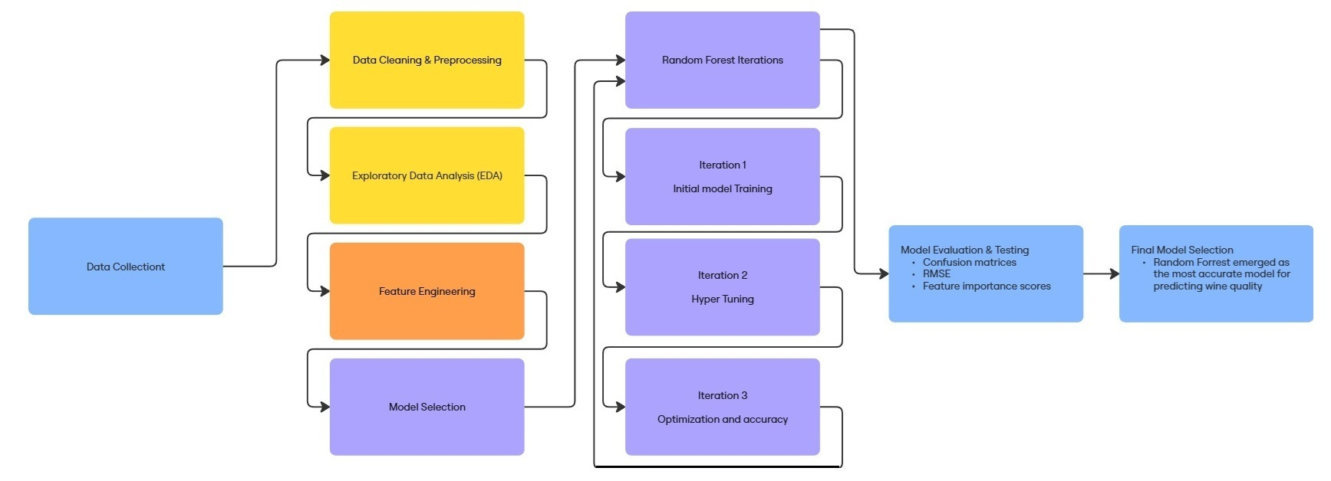
Pipeline Flowchart

Slide 4
Data Collection, Cleanup, and Exploration
The first phase of our project focused on data collection, cleaning, and exploratory analysis to ensure the dataset was structured and ready for machine learning applications. We used a wine quality dataset from the UCI Machine Learning Repository, which contains chemical properties of wines along with quality ratings assigned by wine tasters.
Data Collection & Cleanup:
The dataset was loaded from a publicly available repository.
We identified missing values and ensured all records were complete.
Column names were cleaned to remove unnecessary spaces and standardize naming conventions.
The dataset was split into red and white wine subsets to analyze each type separately.
We introduced a categorical quality label (quality_mark) to classify wines as low, medium, or high quality based on numerical quality scores.
Exploratory Data Analysis (EDA):
Box plots were used to visualize the distribution of chemical properties across different wine qualities.
Correlation heatmaps helped identify relationships between key variables (e.g., alcohol content, acidity, and residual sugar).

Slide 5
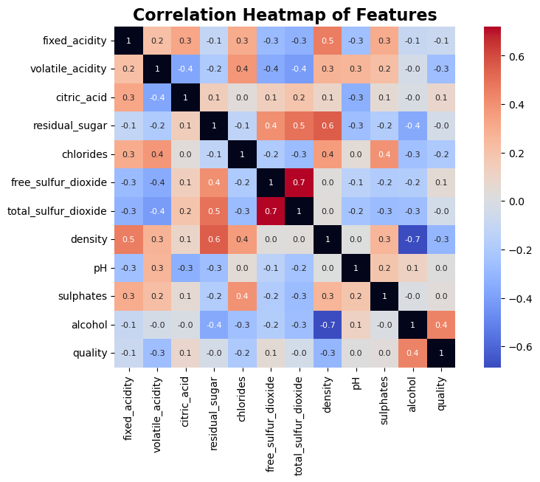
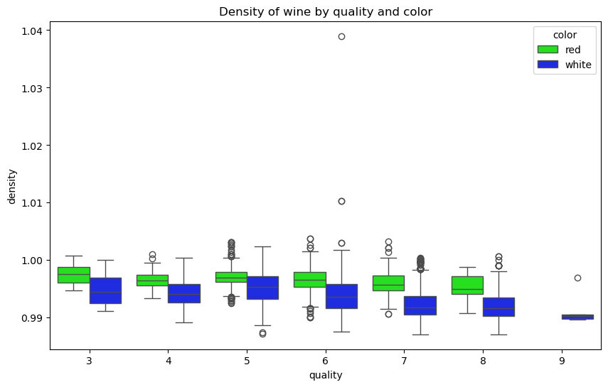
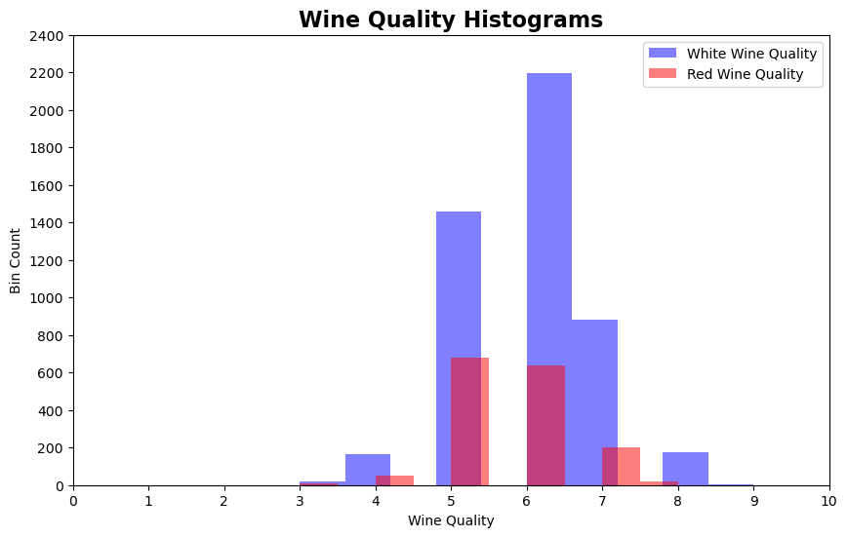
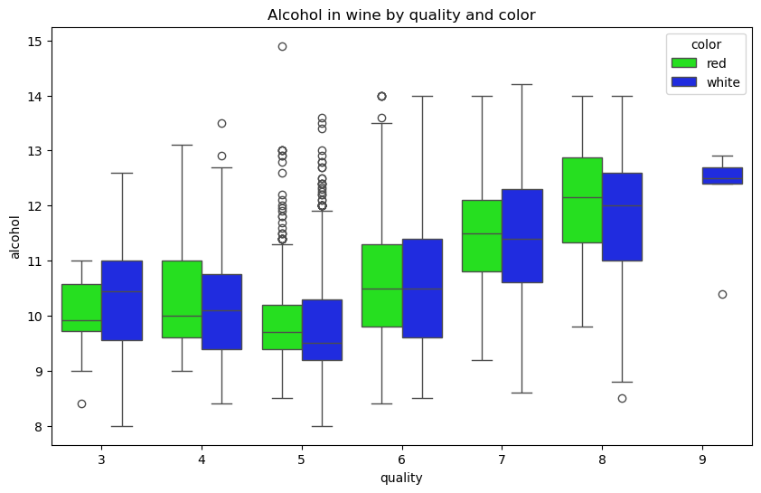
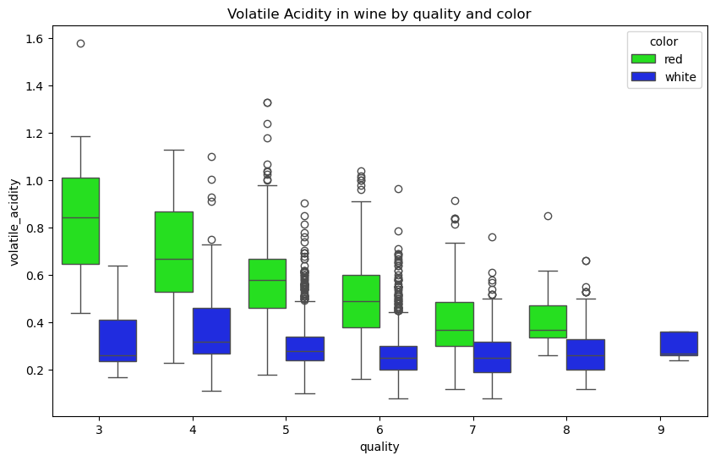
Exploratory Analysis
Analysis of the quality histograms revealed that most data was concentrated in the mid-range.
To address this imbalance, we consolidated the quality levels into three categories, ensuring a greater number of samples per level.
The correlation heatmap provided valuable insights into the key drivers of wine quality.
It also highlighted areas of collinearity, which influenced both the choice of model and feature engineering efforts.
Box plot analysis of various features demonstrated that feature trends were not consistent across wine color.
This finding prompted us to divide the dataset by color to enhance the accuracy of our analyses.

Slide 6
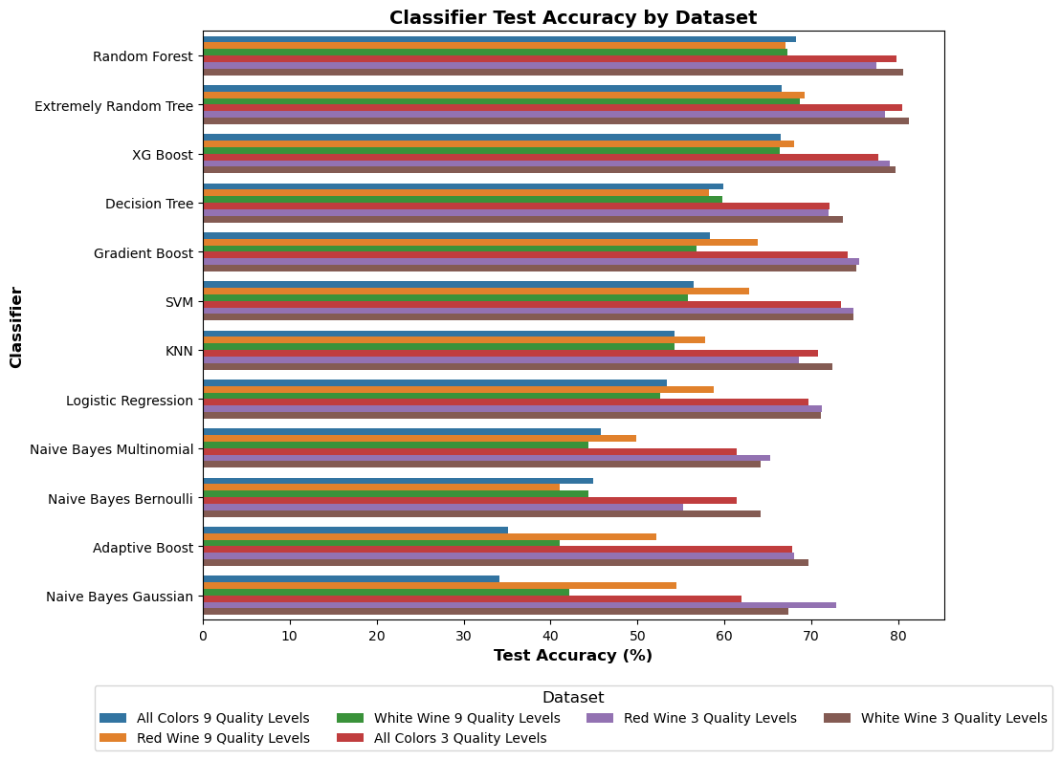
Model Selection & Best Model
After evaluating multiple models and datasets, we found:
The Random Forest model provided the best performance in predicting wine quality.
Slightly better performance on white wines can be achieved by diving the dataset on color.
Accuracy was much better with 3 quality levels as opposed to 10.
Random Forest on separate datasets and 3 quality levels was chosen for hyper tuning
Achieved the highest accuracy for both red and white wines.
Robustly handled feature interactions and collinearity.

Slide 7
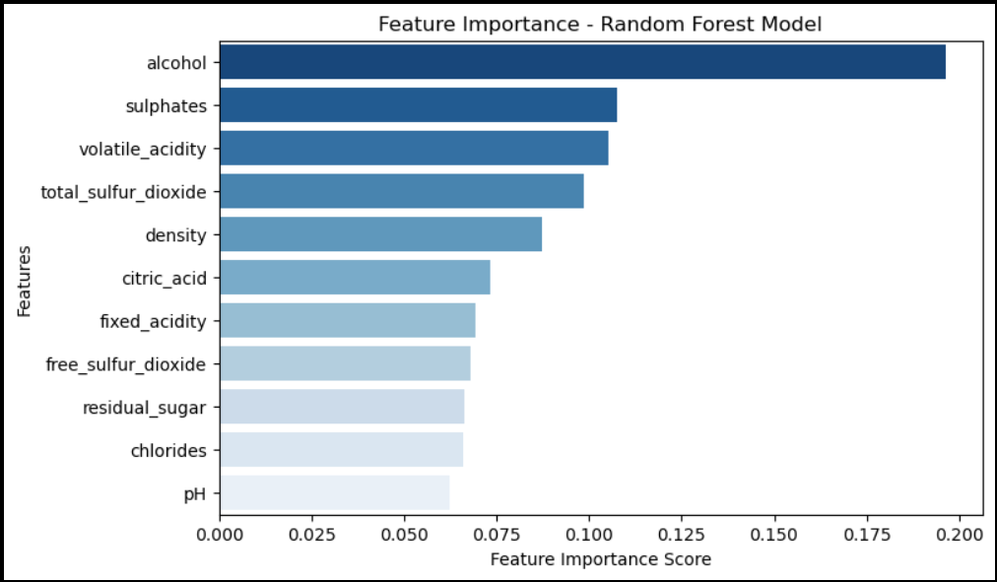
Random Forest Predictive Testing
Finally, we tested the trained Random Forest model on new, unseen data to assess its real-world predictive capabilities.
Key results:
Accuracy Results: Random Forest had the highest accuracy
Red Wine Accuracy: 84%
White Wine Accuracy: 83%
Model successfully predicted wine quality based on input features
Accuracy remained consistent with earlier evaluations.
Predictions were validated against expected wine quality levels.
Random Forest proves to be a strong and reliable model for predicting wine quality, offering high accuracy and interpretability.

Slide 8
Deep Learning Exploration: Neural networks could improve classification accuracy.
Expanding Data: Using additional datasets for better generalization.
Hyperparameter Optimization: Using Bayesian Optimization to fine-tune the model.
Deployment Plan: Implement the model as a Web API for real-world use cases.
Future Work
Team 1 identified the following points at the conclusion of our initial analysis to refine the dataset.
Explore: Deep Learning Models (Neural Networks) for better classification
Explore: Additional datasets for better generalization
Optimize hyperparameters using **Bayesian Optimization**
Deploy the best model as a **Web API** for real-world testing

Slide 9
Questions?

