Slide 1
CAD Contest D
Wirelength-Driven Detailed Macro Placement
指導教授 江介宏
B07901190 邱品誠
B08901013 曾皓晨
B08901024 邱啟翰

Slide 2
Outline
problem description
IO files and usage
data structure
main algorithm
result
discussion
future work

Slide 3
Problem D Description
Given a circuit netlist(contains both standard cells and macros) and its layout,
adjusting the position of movable macros and orientation to get minimum HPWL
Constraint:
upper bound of moving distance of each macro
possible orientation = {North, FlipNorth, South, FlipSouth}
run within 20 mins

Slide 4
IO files and usage
Input :
case.v, verilog file for knowing the connection between every components
case.lef, lef file for knowing the relative position of pins to standard cell/macro
case.def, def file for knowing the absolute position of standard cell/macro
case.mlist, def file for knowing the initial position of macros
case.txt, txt file for knowing the distance constraint
Output:
case.dmp, def file for the final position of macros

Slide 5
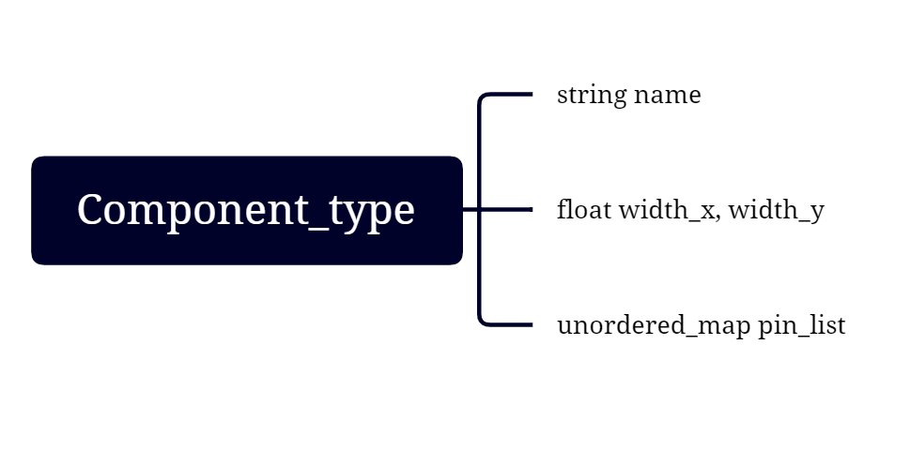
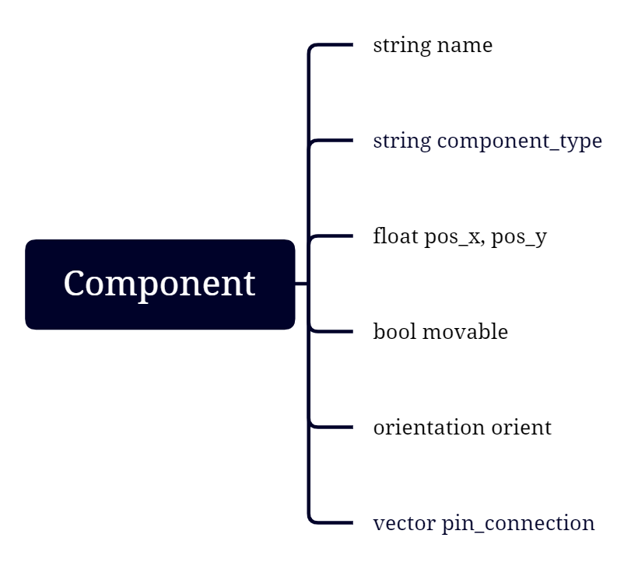
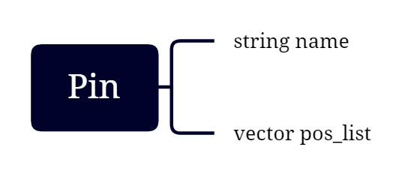
Data structure

Slide 6
Main algorithm: force-directed approach
Accumulate all pin connection of each macro in .mlist and set all wire’s weight as 1.
Get the ideal optimal position of four orientations and check which of them have the minimum HPWL.
Move the macro to a reasonable place based on moving constraint and initial position of the macro.
Boundary check: Check whether the optimal position overlaps current macros’ positions or not. If no overlap exists, move it to a new position.
Go on for several iterations.

Slide 7
Calculating zero-force target location
For each macro, we accumulate all pins to calculate zero-force target location.
A single pin of a macro might connect to multiple pins, so we traverse and accumulate all force generated by pins that is connected to a given pin of a macro.
A single pin of a macro might connect to primary input or output. Thus, if we detect the situation, we additionally accumulate the force from the primary I/O.

Slide 8
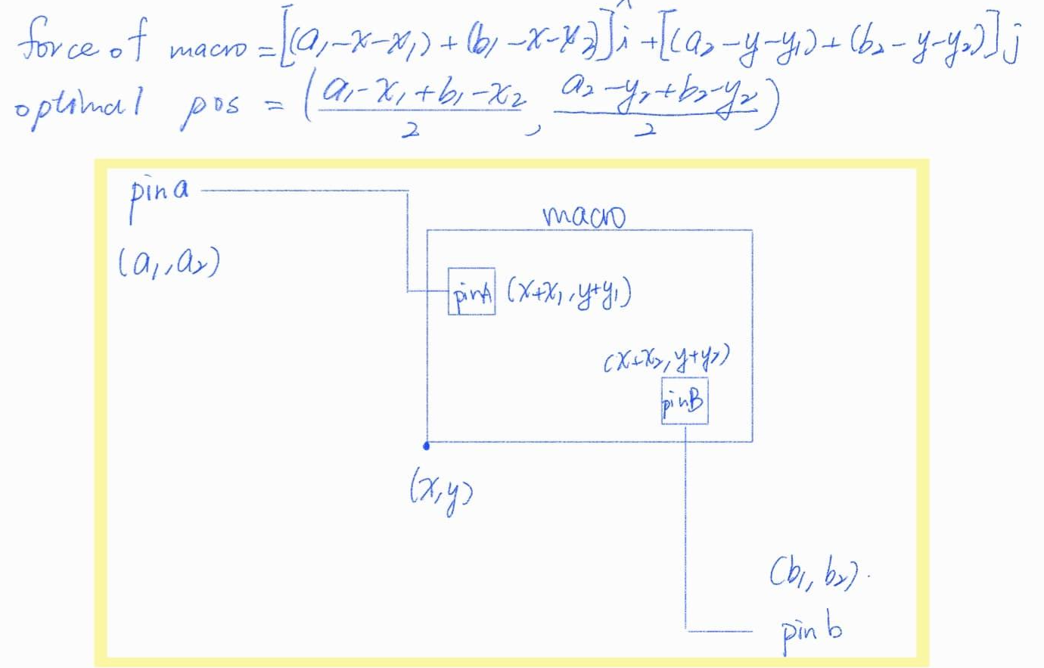
Position accumulator
= Σ (absolute connecting pin position - relative operating pin’s position)
e.g., 2 connected pins:

Slide 9
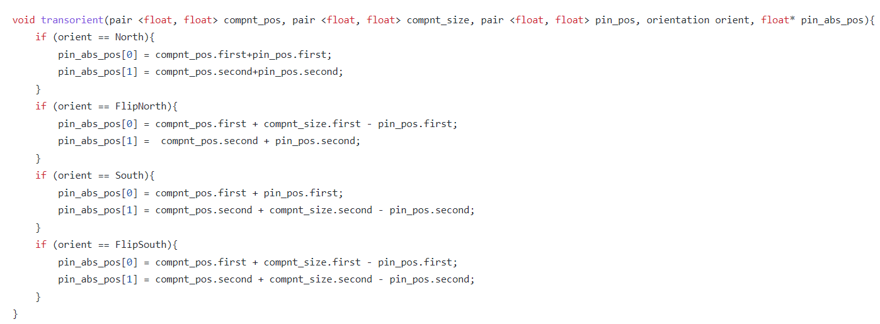
Orientation handling

Slide 10
Movement and Boundary Problem
Once we get the optimal position of a macro, if it’s Manhattan distance to its initial position is greater than the constraint, we move macro to a place with minimum force. Otherwise, we move it to the optimal position.
For fear that some macros which we will calculate later have no legitimate position, before anytime we move our macro, we check whether any overlap occurs. If it occurs, we quit that movement.

Slide 11
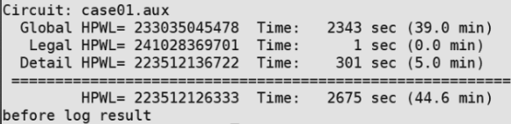
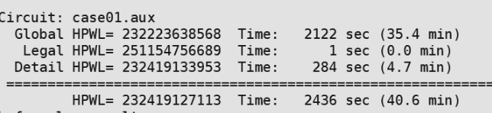
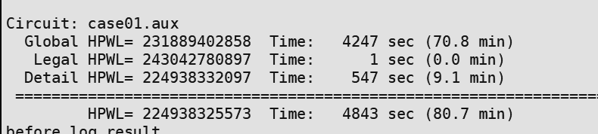
Resulting HPWL in ntuplace3 - case 1
first result
second result

Slide 12
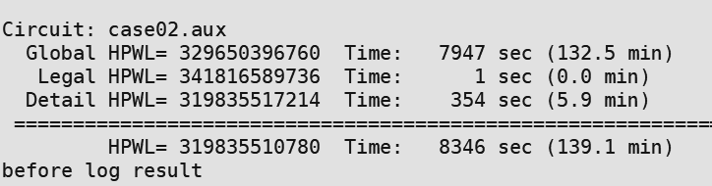
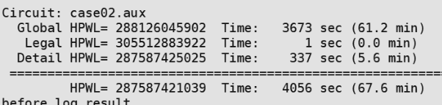
Resulting HPWL in ntuplace3 - case 2

Slide 13
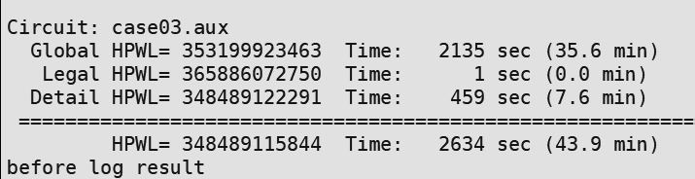
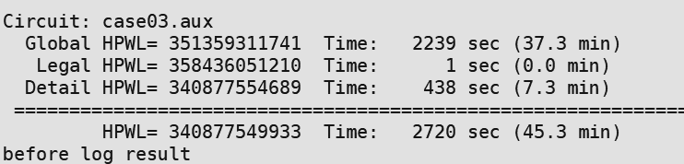
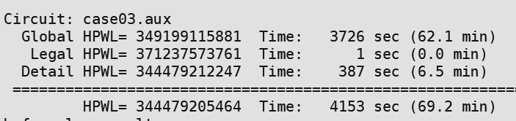
Resulting HPWL in ntuplace3 - case 3
first result
second result

Slide 14
Discussion
The positions of initial standard cells are different from those after macro placement.
Bounding box solution may not be optimal.
Calculate position of a pin by the center of its first rect.

Slide 15
Future Work
Try different method to estimate the position of components after placing.
Experiment with…
different orders of macro placement.
different ways of determine macros’ final position(e.g. SA approach).

