Slide 1
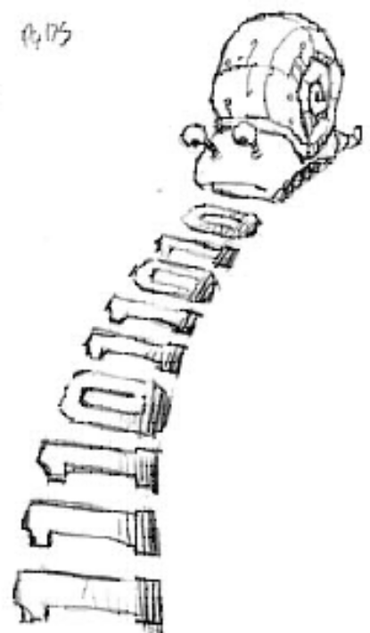
Moore vs. Mealy FSM
Alyssa P. Hacker has a snail that crawls down a paper tape with 1’s and 0’s on it. The snail smiles whenever the last four digits it has crawled over are 1101. Design Moore and Mealy FSMs of the snail’s brain.
Copyright © 2007 Elsevier
3-<<number>>

Slide 2
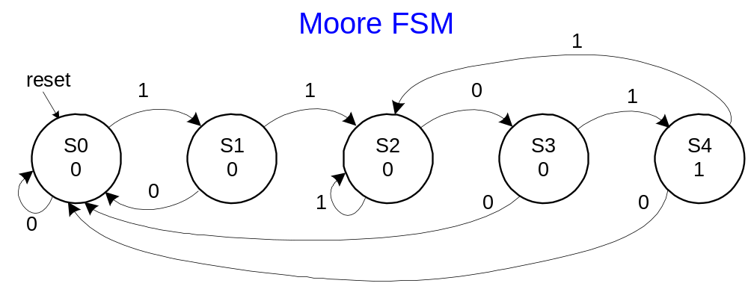
State Transition Diagrams
Copyright © 2007 Elsevier
3-<<number>>

Slide 3
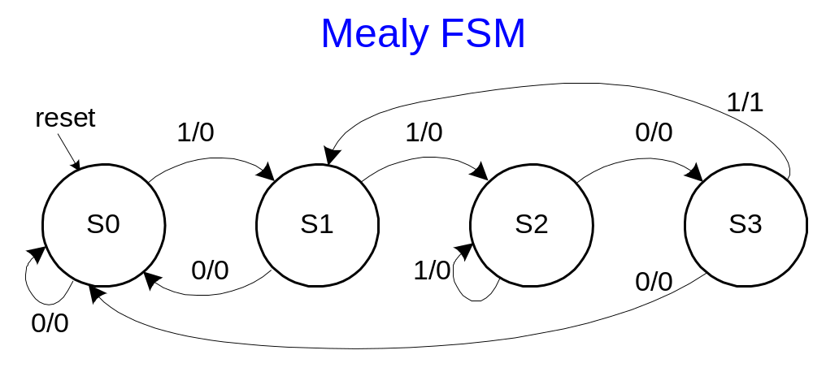
State Transition Diagrams
Mealy FSM: arcs indicate input/output
Copyright © 2007 Elsevier
3-<<number>>

Slide 4
Moore FSM State Transition Table
Current State |  |  | Inputs | Next State
S₂ | S₁ | S₀ | A | S'₂ | S'₁ | S'₀
0 | 0 | 0 | 0
0 | 0 | 0 | 1
0 | 0 | 1 | 0
0 | 0 | 1 | 1
0 | 1 | 0 | 0
0 | 1 | 0 | 1
0 | 1 | 1 | 0
0 | 1 | 1 | 1
1 | 0 | 0 | 0
1 | 0 | 0 | 1
State | Encoding
S0 | 000
S1 | 001
S2 | 010
S3 | 011
S4 | 100
Copyright © 2007 Elsevier
3-<<number>>

Slide 5
Moore FSM State Transition Table
Current State |  |  | Inputs | Next State
S₂ | S₁ | S₀ | A | S'₂ | S'₁ | S'₀
0 | 0 | 0 | 0 | 0 | 0 | 0
0 | 0 | 0 | 1 | 0 | 0 | 1
0 | 0 | 1 | 0 | 0 | 0 | 0
0 | 0 | 1 | 1 | 0 | 1 | 0
0 | 1 | 0 | 0 | 0 | 1 | 1
0 | 1 | 0 | 1 | 0 | 1 | 0
0 | 1 | 1 | 0 | 0 | 0 | 0
0 | 1 | 1 | 1 | 1 | 0 | 0
1 | 0 | 0 | 0 | 0 | 0 | 0
1 | 0 | 0 | 1 | 0 | 1 | 0
State | Encoding
S0 | 000
S1 | 001
S2 | 010
S3 | 011
S4 | 100
Copyright © 2007 Elsevier
3-<<number>>

Slide 6
Moore FSM Output Table
Current State |  |  | Output
S₂ | S₁ | S₀ | Y
0 | 0 | 0
0 | 0 | 1
0 | 1 | 0
0 | 1 | 1
1 | 0 | 0
Copyright © 2007 Elsevier
3-<<number>>

Slide 7
Moore FSM Output Table
Current State |  |  | Output
S₂ | S₁ | S₀ | Y
0 | 0 | 0 | 0
0 | 0 | 1 | 0
0 | 1 | 0 | 0
0 | 1 | 1 | 0
1 | 0 | 0 | 1
Y = S₂
Copyright © 2007 Elsevier
3-<<number>>

Slide 8
Mealy FSM State Transition and Output Table
Current State |  | Input | Next State |  | Output
S₁ | S₀ | A | S'₁ | S'₀ | Y
0 | 0 | 0
0 | 0 | 1
0 | 1 | 0
0 | 1 | 1
1 | 0 | 0
1 | 0 | 1
1 | 1 | 0
1 | 1 | 1
State | Encoding
S0 | 00
S1 | 01
S2 | 10
S3 | 11
Copyright © 2007 Elsevier
3-<<number>>

Slide 9
Mealy FSM State Transition and Output Table
Current State |  | Input | Next State |  | Output
S₁ | S₀ | A | S'₁ | S'₀ | Y
0 | 0 | 0 | 0 | 0 | 0
0 | 0 | 1 | 0 | 1 | 0
0 | 1 | 0 | 0 | 0 | 0
0 | 1 | 1 | 1 | 0 | 0
1 | 0 | 0 | 1 | 1 | 0
1 | 0 | 1 | 1 | 0 | 0
1 | 1 | 0 | 0 | 0 | 0
1 | 1 | 1 | 0 | 1 | 1
State | Encoding
S0 | 00
S1 | 01
S2 | 10
S3 | 11
Copyright © 2007 Elsevier
3-<<number>>

Slide 10
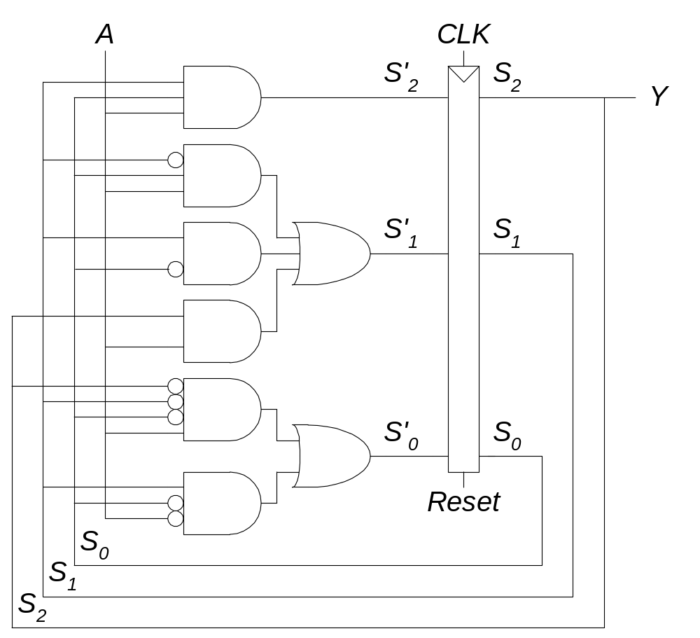
Moore FSM Schematic
Copyright © 2007 Elsevier
3-<<number>>
Notes:
化简结果考虑了不在编码范围内的state 组合，输出可以为1或0

Slide 11
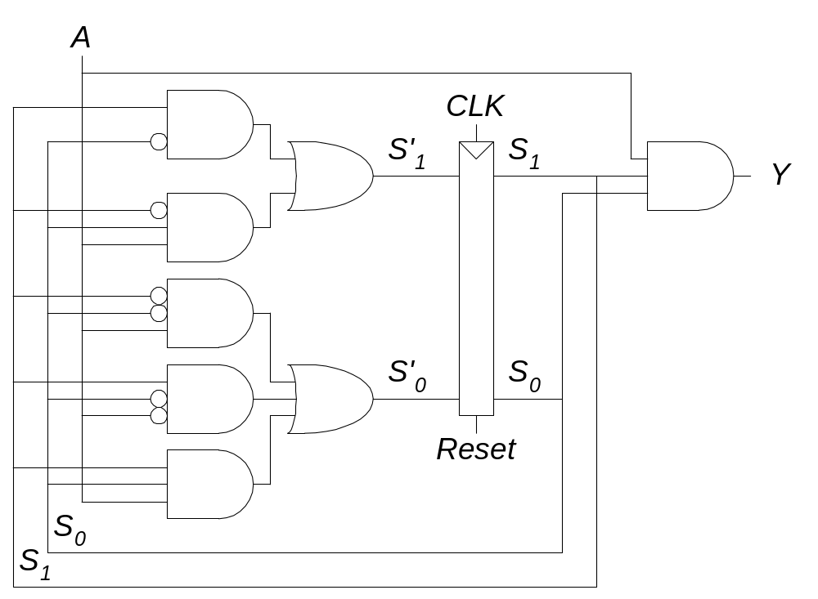
Mealy FSM Schematic
Copyright © 2007 Elsevier
3-<<number>>

Slide 12
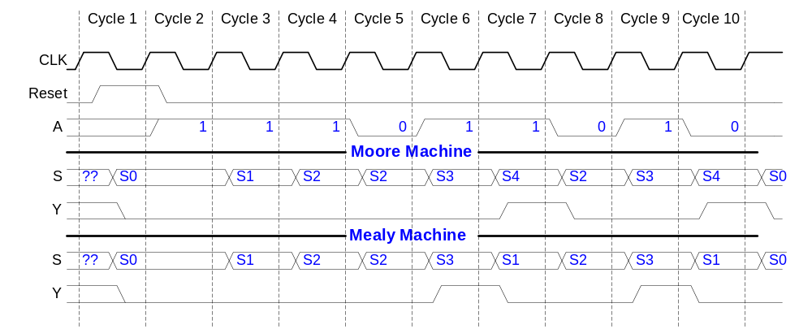
Moore and Mealy Timing Diagram
Copyright © 2007 Elsevier
3-<<number>>

Slide 13
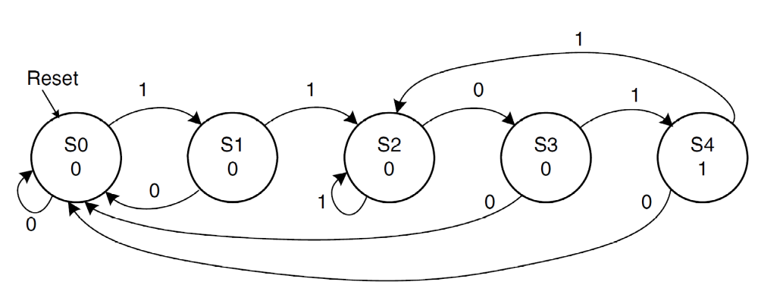
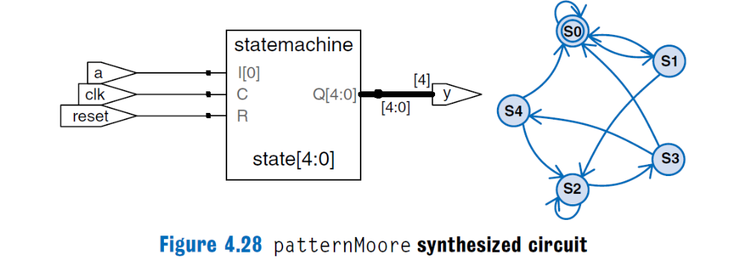
Copyright © 2007 Elsevier
3-<<number>>

Slide 14
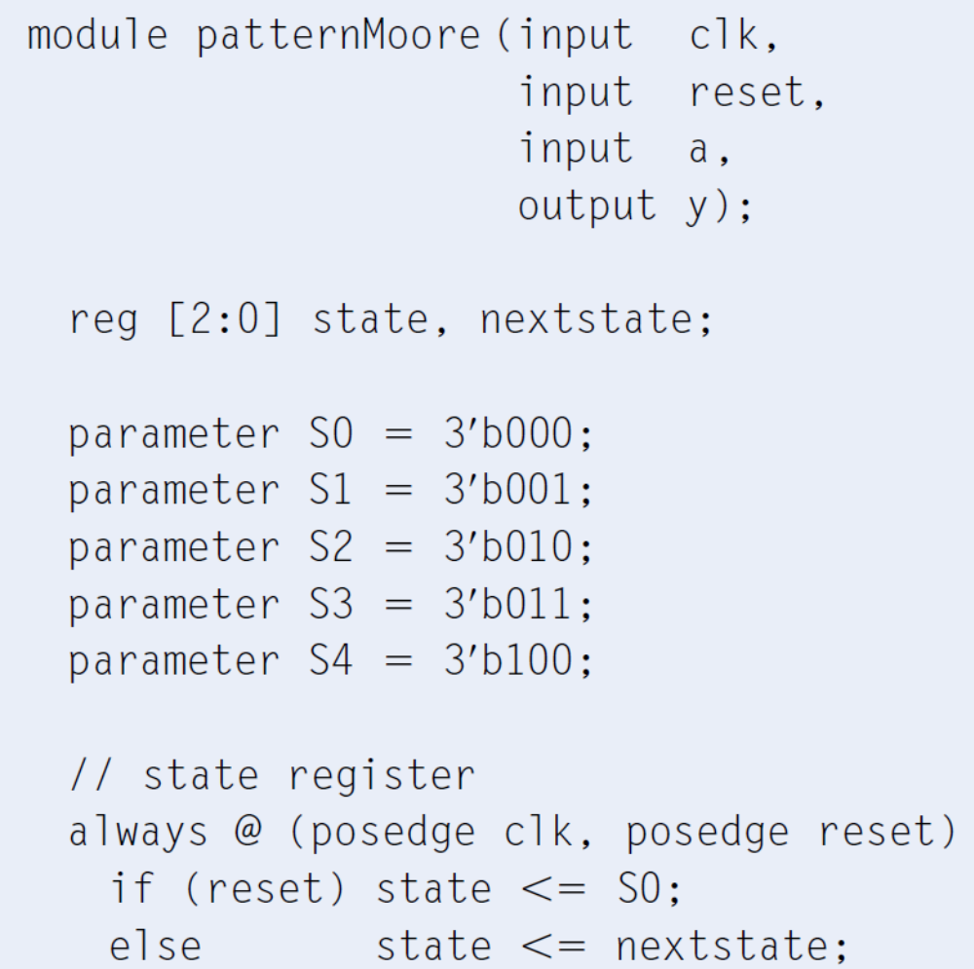
Moore FSM
Copyright © 2007 Elsevier
3-<<number>>

Slide 15
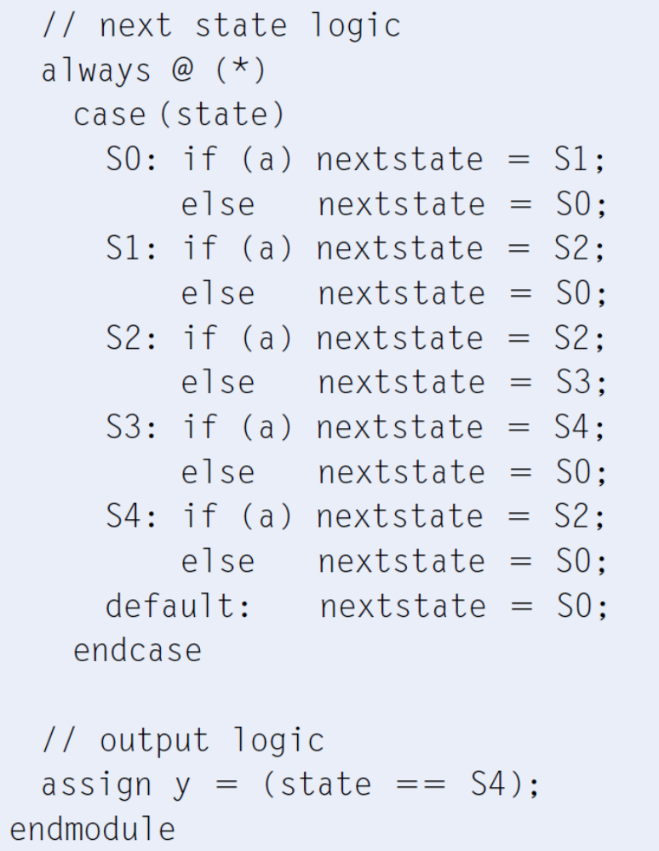
Copyright © 2007 Elsevier
3-<<number>>

Slide 16
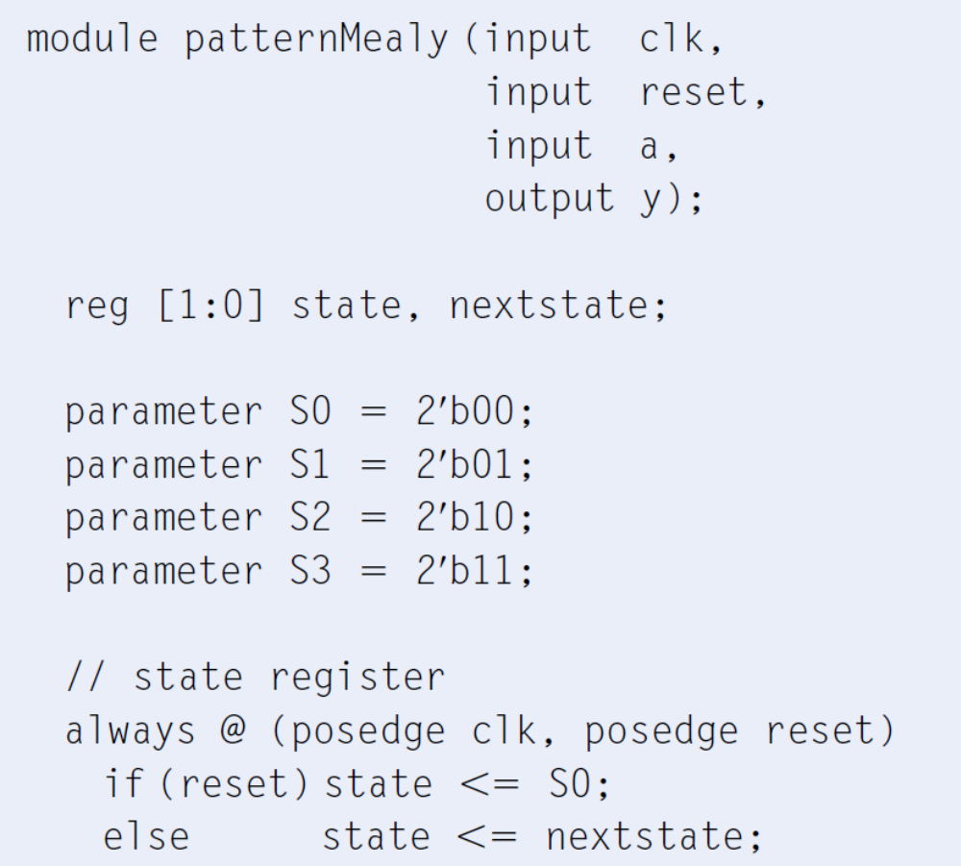
Mealy FSM
Copyright © 2007 Elsevier
3-<<number>>

Slide 17
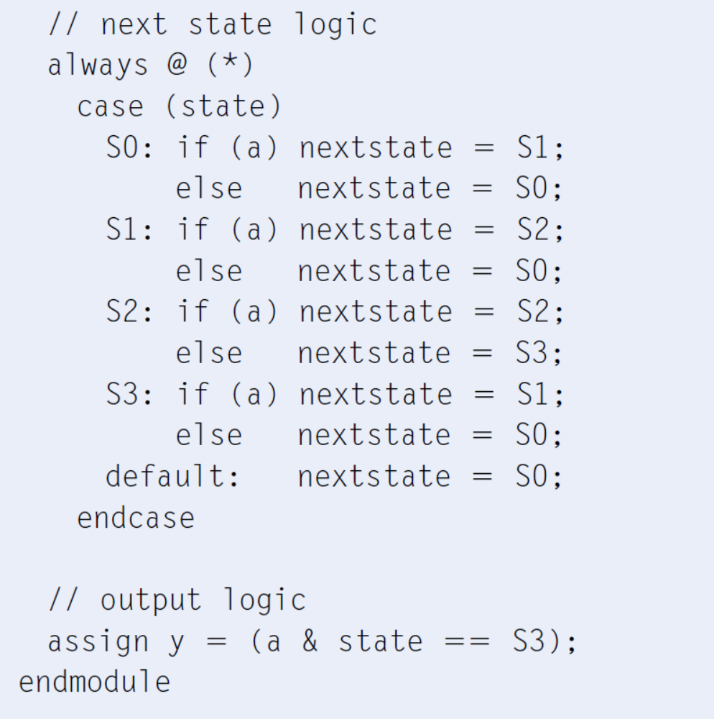
Copyright © 2007 Elsevier
3-<<number>>

Slide 18
Factoring State Machines
Break complex FSMs into smaller interacting FSMs
Example: Modify the traffic light controller to have a Parade Mode.
  The FSM receives two more inputs: P, R
  When P = 1, it enters Parade Mode and the Bravado Blvd. light stays green.
  When R = 1, it leaves Parade Mode
Copyright © 2007 Elsevier
3-<<number>>

Slide 19
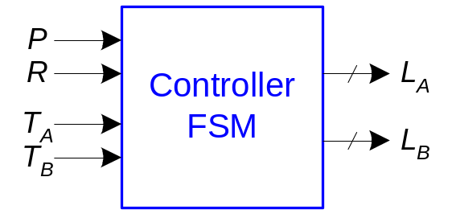
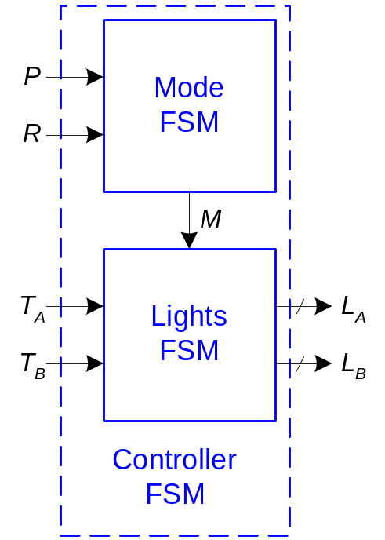
Parade FSM
Unfactored FSM
Factored FSM
Copyright © 2007 Elsevier
3-<<number>>

Slide 20
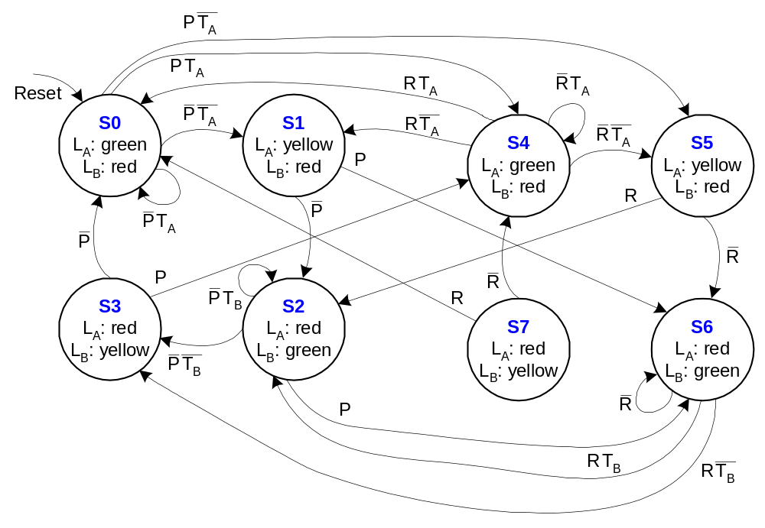
Unfactored FSM State Transition Diagram
Copyright © 2007 Elsevier
3-<<number>>

Slide 21
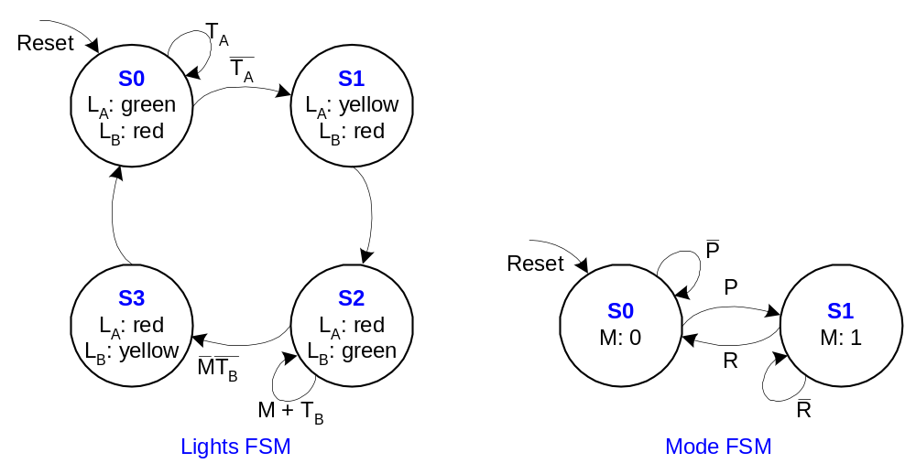
Factored FSM State Transition Diagram
Copyright © 2007 Elsevier
3-<<number>>

Slide 22
FSM Design Procedure
Identify the inputs and outputs
Sketch a state transition diagram
Write a state transition table
Select state encodings
For a Moore machine:
  Rewrite the state transition table with the selected state encodings
  Write the output table
For a Mealy machine:
  Rewrite the combined state transition and output table with the selected state encodings
Write Boolean equations for the next state and output logic
Sketch the circuit schematic
Copyright © 2007 Elsevier
3-<<number>>

