Slide 1

mOWL: Python library for machine learning with biomedical ontologies
1st Team Lecture @ eHealth Lab, INAB|CERTH
Kalliopi Kastampolidou

Slide 2
Introduction to mOWL
mOWL, a Python library for machine learning with Web Ontology Language (OWL) ontologies.
mOWL serves as:
a reference implementation for ontology embeddings and
enables the implementation of new ontology embedding methods.
Provides functionalities to manipulate ontologies and use them as data for several methods that generate embeddings of ontology entities.
provides functionality to access information in ontologies and to reason over ontologies
Notes:
mOWL, a Python library for machine learning with Web Ontology Language (OWL) ontologies.
The purpose of mOWL is to serve as a reference implementation for ontology embeddings and to enable the implementation of new ontology embedding methods.
For this purpose, mOWL provides functionality to access information in ontologies and to reason over ontologies, and it provides methods to access biomedical databases that rely on ontologies for annotation.

Slide 3
Introduction to mOWL
provides methods to access biomedical databases that rely on ontologies for annotation.
Implement ontology embedding methods that map information from formal knowledge bases and ontologies into vector spaces.
Preserve properties and relations in ontologies.
Provide methods for similarity computation, deductive inference, and zero-shot learning using these embeddings.
developed to provide a standardized framework to use the already existing methods and to ease the development of new ones.
Notes:
mOWL implements ontology embedding methods that map information contained in formal knowledge bases and ontologies into vector spaces while preserving some of the properties and relations in ontologies, as well as methods to use these embeddings for similarity computation, deductive inference and zeroshot learning

Slide 4
Introduction to mOWL
mOWL components for:
Ontology management, normalization, reasoning, and interfacing with the OWL API (Horridge and Bechhofer, 2011) and automated reasoners.
Ontology transformation, including methods for projecting ontologies into graphs, text corpora, or other formats used as precursors to machine learning.
Embedding generation by interfacing with the knowledge graph embedding library PyKEEN (Ali et al., 2021) and other approaches implemented in Python.
Embedding postprocessing, including axiom inference, node classification, evaluation, and visualization.
Notes:
mOWL has been designed to handle input in OWL format and generate embeddings that can be used to classify entities or predict new axioms
mOWL consists of components for
(ontology management, normalization and reasoning, interfacing with the OWL API (Horridge and Bechhofer, 2011) and automated reasoners;
ontology transformation, including methods for projecting ontologies into graphs, text corpora or other formats used as precursor to machine learning;
embedding generation by interfacing with the knowledge graph embedding library PyKEEN (Ali et al., 2021) and other approaches implemented in Python; and
embedding postprocessing, including axiom inference, node classification, evaluation and visualization.

Slide 5
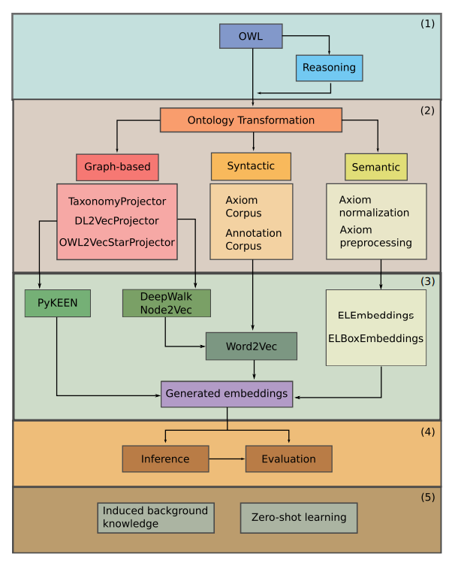
mOWL & components
Components of mOWL include:
Ontology creation, modification, and reasoning.
Graph-based and syntactic extraction functionalities, as well as preprocessing steps for semantic models.
Embedding processes utilizing graph-based, syntactic, or semantic methods.
Evaluation and inference modules for the generated embeddings.
Models that can be implemented based on how background knowledge is utilized.
Notes:
Different components existing in mOWL.
includes the ontology creation, modification and reasoning.
represent the graph-based and syntactic extraction information functionalities as well as the preprocessing steps needed for semantic models.
incorporates the embedding process that can be done with either graph-based, syntactic or semantic methods.
consists of the evaluation and inference modules for the generated embeddings.
is not a component of mOWL but shows the types of models that can be implemented based on how the background knowledge is used.

Slide 6
Implementation

Slide 7
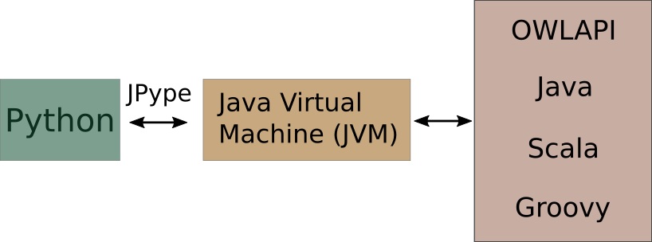
Requirements
Developed as a Python package for ease of use.
Interfaces with the OWL API for ontology processing and automated reasoning.
Utilizes JPype to bind Python and the Java Virtual Machine, facilitating access to Java classes and methods from Python.
Provides access to the entire OWL API through a Python interface.
Notes:
mOWL has been developed to be used as a Python package.
However, mOWL interfaces with the OWL API to enable ontology processing and automated reasoning.
The OWL API is implemented in Java, and we use JPype (Nelson and Scherer, 2020) to bind Python and the Java Virtual Machine, enabling access to Java classes and methods from Python.
mOWL therefore provides access to the entire OWL API through a Python interface.

Slide 8
Requirements
mOWL runs on Linux and MAC OS X systems.
It has not been tested on Windows, and compatibility issues may arise due to Java compatibility.
JDK version 17
Python version 3.8, 3.9, 3.10, 3.11
Conda version >= 4.x.x
Python requirements
Gensim >= 4.x.x
PyTorch >= 1.12.x
PyKEEN >= 1.10.1

Slide 9
Requirements
This version of documentation corresponds to mOWL-0.3.0
Python 3.10.12
JDK 11
Google colab .ipynb

Slide 10
Requirements
mOWL can be installed: from source code
or from PyPi
git clone https://github.com/bio-ontology-research-group/mowl.git
cd mowl
conda env create -f envs/environment_3_8.yml
conda activate mowl
./build_jars.sh
python setup.py install
pip install mowl-borg

Slide 11
Theoretical Background

Slide 12
Ontologies
Ontologies contain rich and structured knowledge about a specific domain of discourse.
Widely used in biology and biomedicine, with over 1000 ontologies available in BioPortal (Whetzel et al., 2011).
Facilitate various tasks such as:
Data integration across databases.
Annotation of biological entities.
Data access and analysis.
Providing background knowledge of a domain (Hoehndorf et al., 2015).
Ontologies provide machine-readable axioms to convey background knowledge.
Notes:
Ontologies include rich and structured knowledge about a domain of discourse. They are widely used in biology and biomedicine with more than 1000 ontologies available in BioPortal (Whetzel et al., 2011). Ontologies are used to facilitate tasks such as data integration across databases, annotation of biological entities, data access and analysis, and providing background knowledge of a domain (Hoehndorf et al., 2015). Background knowledge is provided by ontologies through machine-readable axioms.

Slide 13
Ontologies
Concepts:
Person
Mother
Child
Roles:
hasChild
hasSibling
hasFriend
Individuals:
Mary
John
Bob
Axioms:
Father ⊑ Person
hasChild(Bob,Mary)

Slide 14
Ontologies
Utilizing Logical Axioms in Machine Learning:
Recent machine learning methods utilize logical axioms to improve domain-specific tasks by leveraging background knowledge.
Ontology embeddings play a key role in this process.
Ontology Embeddings:
Definition: Ontology embeddings are functions that map ontology entities (classes, instances, and relations) to ℝ^{n} while preserving knowledge in the logical axioms of the ontology.
Notes:
Some recent machine learning methods can utilize logical axioms to improve domain-specific tasks by utilizing background knowledge, in particular through ontology embeddings. An ontology embedding is a function that maps ontology entities (classes, instances and relations) to the ℝ^{n} while preserving some of the knowledge in the logical axioms of the ontology. Ontology embedding methods can be divided into graph-based methods (i.e. projecting logical axioms onto a graph), syntactic methods (utilizing the axioms directly) and semantic methods (generating semantic interpretations from the axioms) (Kulmanov et al., 2021).
Ontologies provide background knowledge for a domain
in recent years, many machine learning models have been developed to embed ontologies.
Why embeddings?
● Represent entities in a compact dimension ● Visualize entities and their relations ● Cluster entities ● Compute semantic similarity

Slide 15
Ontologies
Types of Ontology Embedding Methods:
Graph-based methods: Project logical axioms onto a graph.
Syntactic methods: Utilize axioms directly.
Semantic methods: Generate semantic interpretations from axioms (Kulmanov et al., 2021).
Importance of Ontology Embeddings:
Ontologies provide background knowledge for a domain.
Many machine learning models have been developed to embed ontologies in recent years.
Advantages of Embeddings:
Represent entities in a compact dimension.
Visualize entities and their relations.
Cluster entities.
Compute semantic similarity.
Notes:
Some recent machine learning methods can utilize logical axioms to improve domain-specific tasks by utilizing background knowledge, in particular through ontology embeddings. An ontology embedding is a function that maps ontology entities (classes, instances and relations) to the ℝ^{n} while preserving some of the knowledge in the logical axioms of the ontology. Ontology embedding methods can be divided into graph-based methods (i.e. projecting logical axioms onto a graph), syntactic methods (utilizing the axioms directly) and semantic methods (generating semantic interpretations from the axioms) (Kulmanov et al., 2021).
Ontologies provide background knowledge for a domain
in recent years, many machine learning models have been developed to embed ontologies.
Why embeddings?
● Represent entities in a compact dimension ● Visualize entities and their relations ● Cluster entities ● Compute semantic similarity

Slide 16
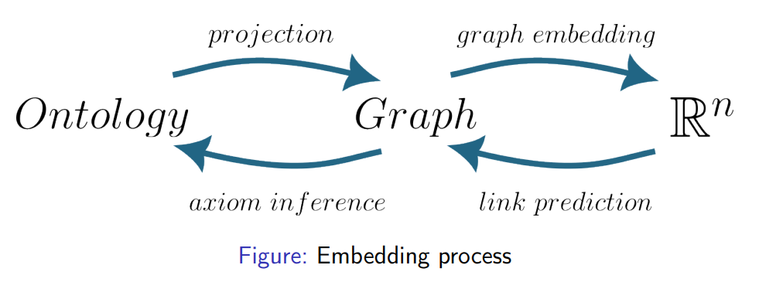
Ontologies

Slide 17
Ontologies
Utility of Ontology Embeddings:
Ontology embeddings have proven useful across various problems, particularly in biological and biomedical domains relying on ontology-represented data.
Applications of Ontology Embeddings:
Predicting associations between entities annotated with ontologies, such as gene-disease associations (GDAs) based on phenotype annotations (Smaili et al., 2019).
Providing features for larger machine learning models (Hinnerichs and Hoehndorf, 2021).
Enabling zero-shot predictions (Kulmanov and Hoehndorf, 2022).
Definition of Embedding:
An embedding is a structure-preserving mapping between a source and a target structure.
The target structure is typically more suitable for performing operations on the entities.
Notes:
An embedding is a structure-preserving mapping between a source and a target structures
Usually, the target structure is more suitable to perform operations on the entities.
Ontology embeddings have shown to be useful across different problems, and in particular in biological and biomedical problems that rely on data represented through ontologies. Ontology embeddings can be used directly to predict associations between entities annotated with ontologies, such as gene–disease associations (GDAs) based on the relations between their phenotype annotations (Smaili et al., 2019), they can be used to provide features for larger machine learning models (Hinnerichs and Hoehndorf, 2021), or they can enable zero-shot predictions (Kulmanov and Hoehndorf, 2022).

Slide 18
Ontologies
Attribute:
Definition: A piece of information about a concept.
Types: Attributes can be text, numbers, or boolean (true or false) flags.
Relationship (or Edge):
Definition: The way two things are connected.
Types:
Weighted: Indicates closeness between entities.
Named: Describes how entities are connected.
Class:
Definition: The type of thing a concept is.
Additional Concepts:
Standard Identifiers: Unique identifiers for concepts.
Axioms and Formal Definitions: Rules or formal descriptions of concepts.
Metadata:
Labels and Synonyms: Alternative names for concepts.
Database Cross References: References to external databases.
Notes:
Attribute — this is a piece of information about the concept. An example would be that “vox” is slang for “vocals”. Attributes can be text, numbers, or even a true or false flag.
Relationship, sometimes called an edge — the way we connect two things together. These can either be weighted to tell us how close they are, or a named relationship that tells us how they are connected. We might relate “recorder” to “Bach”.
Class — the type of thing a concept is. Using this we can say that a “trombone” is an instrument, and that “Chumbawamba” is a band.
Classes and relations ● Standard identifiers ● Axioms and formal definitions ● Metadata: ○ Labels, Synonyms ○ database cross references

Slide 19
Ontologies
classes represent kinds of things in the world
Arm, Apoptosis, Influenza, Homo sapiens, Drinking behavior, Membrane
instances of classes
individuals satisfying the classes’ intension
my arm, the influenza I had last year, one ethanol molecule, etc.
relations between instances
arise from interactions, configurations, etc., of individuals
my arm is part of me, the duration of my influenza was 10 days
axioms specify the conditions that instances of a class must satisfy
every instance of Hand is a part of an instance of Arm

Slide 20
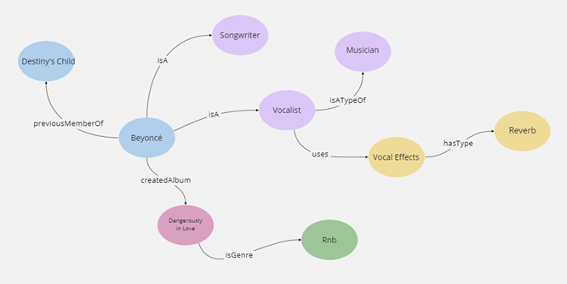
Ontologies

Slide 21
Ontology Applications in Biomedical Domain
Examples of Ontology Applications in Biomedical Domain:
Annotation and Data Integration.
Ontologies as Vocabularies.
Statistical and Predictive Data Analysis:
Enrichment Analysis.
Semantic Similarity.
Regression Analysis.
Relation Prediction.
Classification:
Supervised.
Unsupervised.
True Path Rule:
Definition:
Annotation for a class is passed to its ancestors.

Slide 22
Generating Graphs
Generating Graphs from Ontologies:
Description: The need to generate graphs from ontologies for various relationships beyond simple "is-a" relations.
Challenges with Other Relations:
Part-of, Regulates, Precedes, etc.: Exploring how to represent these complex relationships in graph form.
Handling Ontology Constructs:
Disjointness, Universal vs. Existential Quantification, Cardinality Restrictions, Intersection, Union, Negation: Considering how to handle these constructs in graph generation.
Implicit Relational Patterns:
Relational patterns are implicit in OWL axioms.
Design Patterns as Relations:
Using design patterns to represent relations between classes in ontologies.
Notes:
we may need to generate graphs from ontologies I is-a relations are easy (this is just owl:subClassOf) I how about part-of, regulates, precedes, etc.? I disjointness, universal vs. existential quantification, cardinality restrictions, intersection, union, negation? relational patterns are implicit in OWL axioms I design patterns as “relations” between classes

Slide 23
KG & Ontology projection
Knowledge Graph Construction:
ABox + RBox can be easily transformed into a Knowledge Graph.
TBox in Ontologies:
Ontologies mainly consist of the TBox.
Significance: The TBox contains concept descriptions and defines the terminology of the domain.
Graph Projection Methods:
Multiple methods exist to project an ontology into a graph.
Considerations: Some methods may result in loss of information during the projection process.
Graph Representation:
Graphs depict the hierarchy of concepts present in ontologies.
Terminology Box: TBox
Relationship Box: RBox
Assertion Box: Abox
Schema
Data
Notes:
ABox+RBox can be easily transformed into a Knowledge Graph Father(John): (John, instanceof, Father) hasChild(John, Mary): (John, hasChild, Mary)
What about the TBox? ontologies are (mostly) the TBox! Multiple methods to project an ontology into a graph Some methods could undergo loss of information
Graphs represent the hierarchy of concepts

Slide 24
mOWL: Ontology-centric-designed library
Ontology Management
Ontology Transformation
Embedding Generation
Embedding Post-processing

Slide 25
mOWL: Ontology Management
mOWL provides methods to manipulate ontologies:
creation
modification
reasoning
mOWL interfaces the OWLAPI

Slide 26
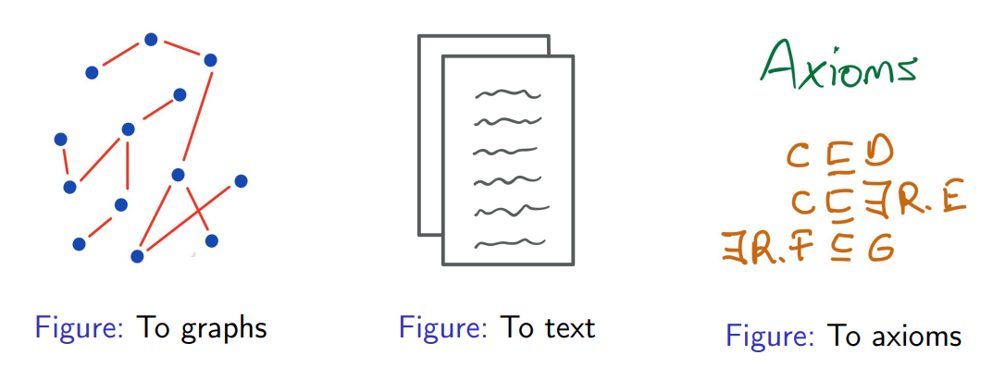
mOWL: Ontology Transformation
mOWL provides functionalities to transform ontologies and/or extract information in different ways:
Each transformation result can be used as input of a machine learning model.

Slide 27
mOWL: Ontology Transformation: Graphs
Projection refers to the process of transforming an ontology into a graph.
mOWL offers various methods for ontology projection.
Some projection methods may result in a loss of information during the transformation process.
Notes:
We call projection to the process of transforming an ontology into a graph.
There are many methods to project an ontology.
In general, some projection methods undergo some kind of loss of information

Slide 28
mOWL: Ontology Transformation: Graphs
mOWL provides several graph projection methods:
Taxonomy
Taxonomy + existential relations
DL2Vec
OWL2Vec*
Future versions: CatE projection
from mowl.projection import DL2VecProjector
projector = DL2VecProjector(bidirectional_taxonomy=True)
Notes:
Taxonomy: Basic projection method based on ontology taxonomy.
Taxonomy + Existential Relations: Extends taxonomy projection by including existential relations.
DL2Vec: Utilizes DL (Description Logic) reasoning for ontology projection.
OWL2Vec*: Projection method based on embedding ontology entities into vector space.
Future Versions: CatE Projection - A forthcoming projection method to be introduced in future versions of mOWL.

Slide 29
mOWL: Ontology Transformation: Text
Syntactic Approach in mOWL
This approach utilizes the syntactic information of axioms to generate text sentences.
Axioms are defined over syntax, including symbols and operators.
Syntactic elements can be represented as words in text sentences.
Onto2Vec
OPA2Vec
Preprocessing for Some Methods:
Preprocessing step for methods like ELEmbeddings, ELBoxEmbeddings, and Box2EL.
Preprocessing involves grouping axioms into common structural patterns, as seen in FALCON.
Notes:
This approach uses the syntactic information of the axioms and generates text sentences out of them. Axioms are defined over a syntax (symbols, operators, . . . ) Syntactic elements can be represented as words Onto2Vec, OPA2Vec
Some methods would require preprocessing of axioms: Normalization (ELEmbeddings, ELBoxEmbeddings, Box²EL) Grouping into common structural patterns (FALCON)

Slide 30
mOWL: Ontology Transformation: Text
Onto2Vec:
Utilizes syntactic information of ontologies as sentences.
Incorporates reasoning for data augmentation.
Applied to protein-protein interaction.
Input and Output:
OWL ontology.
Numerical representations in ℝ^{n} of ontology entities.
Process:
Reasoning over the ontology to generate more axioms.
Generation of sentences from the ontology axioms.
Processing the sentences using Word2Vec.
Outputting Word2Vec representations.
Notes:
Onto2Vec
Syntactic information of ontologies as sentences Use of reasoning for data augmentation Application to protein-protein interaction
Input: an OWL ontology Output: numerical representations in R n of ontology entities 1 Reasoning over the ontology to generate more axioms 2 Generation of sentences from the ontology axioms 3 Process the sentences using Word2Vec 4 Output Word2Vec representations

Slide 31
mOWL: Ontology Transformation: Axioms
Normalization:
Applied by methods such as ELEmbeddings and ELBoxEmbeddings.
Involves standardizing the axioms or ontological structures to a common format or representation.
Grouping into Common Structural Patterns:
Applied by the FALCON method.
Involves organizing axioms into groups based on shared structural patterns or characteristics.
Notes:
Some methods would require preprocessing of axioms: Normalization (ELEmbeddings, ELBoxEmbeddings) Grouping into common structural patterns (FALCON)

Slide 32
DL – Description Logics
Ontology Axioms Division:
ABox: Assertions of the world.
Example: Father(John), hasChild(John, Mary).
TBox: Concept descriptions.
Example: Mother subClassOf Person.
Description Logics Overview:
TBox: Axioms pertaining to the terminology of the domain (classes).
ABox: Axioms stating facts (assertions) about the world.
RBox: Axioms holding for relations.
Reasoning: Deriving implicitly represented knowledge (e.g., subsumption).
Note: A "knowledge graph" compises ABox + RBox.
Notes:
Ontologies axioms are divided into: ABox assertions of the world Father(John) hasChild(John, Mary)
Ontologies axioms are divided into: TBox Concept descriptions Mother subClassOf Person
Description Logics: overview TBox: axioms pertaining to the terminology of the domain (classes) ABox: axioms stating facts (assertions) about the world RBox: axioms holding for relations Reasoning: derive implicitly represented knowledge (e.g., subsumption) NB: a “knowledge graph” is an ABox + RBox

Slide 33
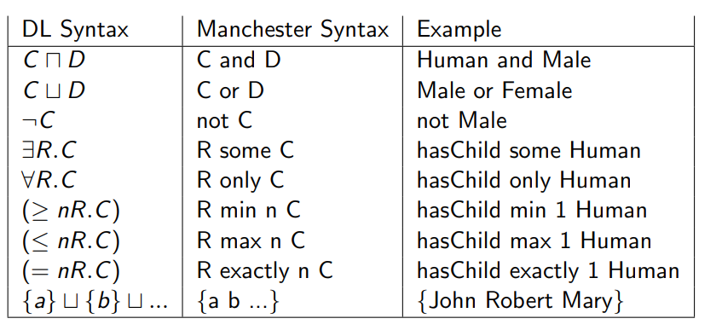
DL – Description Logics

Slide 34
Ontologies & ML
Various approaches exist for incorporating ontologies into machine learning models.
Syntactic Approach:
Treat axioms as "sentences" and utilize language models for analysis.
Graph-based Approach:
Treat ontologies as graphs, similar to semantic similarity calculations.
Model-theoretic Approach:
Encode model-theoretic semantics into optimization processes for machine learning.
Notes:
Machine learning with ontologies: approaches syntactic: treat axioms as “sentences” using language models graph-based: treat ontologies as graphs (like in semantic similarity) model-theoretic: encode model-theoretic semantics in optimization

Slide 35
Graphs & ML
Ontology Transformation into Graph:
Ontologies are transformed into graphs for machine learning applications.
Graphs as Input for Machine Learning:
Graphs serve as input data for machine learning models.
mOWL Embedding Support:
mOWL supports two methods for embedding graphs:
Random-walk based embeddings.
Knowledge Graph Embedding (KGE) models.
Notes:
Ontology has been transformed into a graph Graphs as input for a machine learning model mOWL supports two ways to embed a graph: Random-walk based embeddings Knowledge Graph Embedding (KGE) models

Slide 36
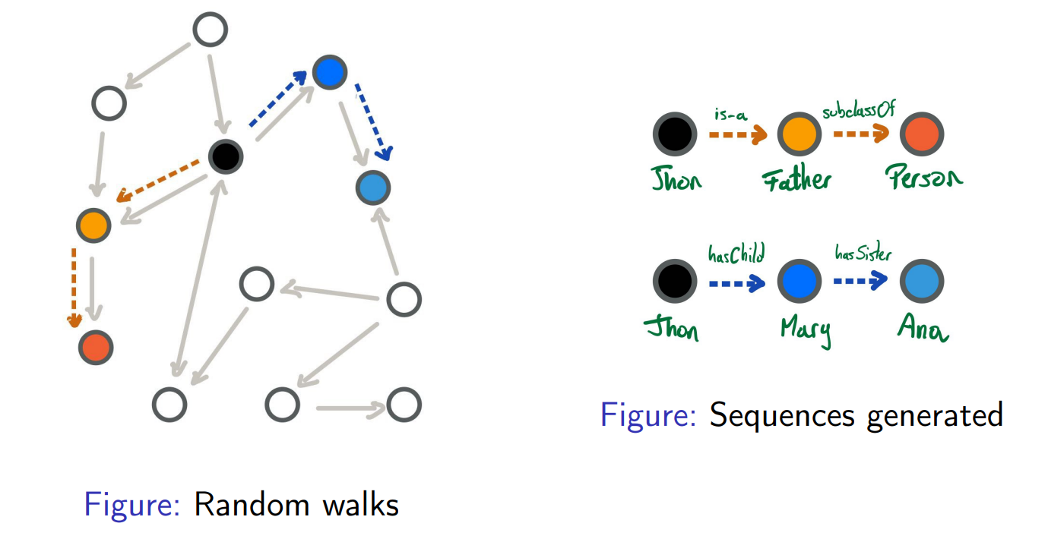
Embedding with random walks
Generated sentences become input in a language processing model:
Word2Vec
Transformers
Word2Vec embeddings preserve co-occurrence
Generated embeddings compute similarity between entities
Notes:
To capture the graph: Traverse it using walks
Generate many such walks (Many walks will give us an idea about the graph adjacency and structure)
Generated sentences become input in a language processing model such as Word2Vec Transformers
Word2Vec embeddings preserve co-occurrence Generated embeddings can be used to compute similarity between entities E1 and E2
Protein-protein interactions Gene-disease associations
Description: Generated sentences serve as input in language processing models, such as Word2Vec and Transformers.
Word2Vec Embeddings: Word2Vec embeddings are employed to preserve co-occurrence information in the generated sentences.
Computing Similarity: The generated embeddings enable computation of similarity between entities E1 and E2.
Applications:
Protein-protein Interactions.
Gene-disease Associations.

Slide 37
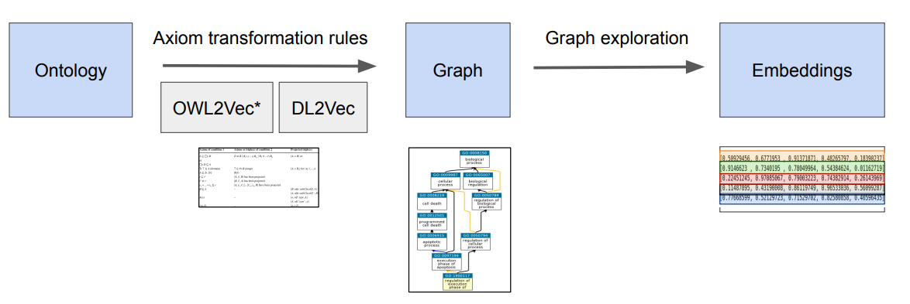
Ontology graph embedding methods

Slide 38
KGE models
Graph Structure: Graphs consist of triples composed of head, relation, and tail entities.
TransE Model: TransE is a translational Knowledge Graph Embedding (KGE) model.
Translational Models: Variations of TransE include TransH, TransR, and TransD.
Scoring: The score of a triple is determined by the distance function d(h, r, t) = ||h + r − t||, where lower scores indicate higher plausibility.
Positive and Negative Triples: d(h, r, t) represents the score of a positive triple, while d(h, r, t') represents the score of a negative triple.
Notes:
Graphs are composed by triples head, relation,tail TransE is an example of a translational KGE model. Translational models consider relation to be a translation operation between head and tail
Some variations of TransE are: TransH TransR TransD
Depending on the score
The score of a triple is given by d(h, r,t) = ||h + r − t||, where the lower d is, the more plausible the triple to hold true.
d(h,r, t) is the score of a positive triple d (h,r, t ′ ) is the score of a negative triple

Slide 39
KGE models
We can use KGE models to predict new triples.
Axiom to query: a = C ⊑ ∃R.D
Graph representation: (C, R, D)
TransE score: s = ||h + r − t||
Score s gives us the plausability of the axiom a to hold true.
Notes:
We can use KGE models to predict new triples. For example: 1 Axiom to query: a = C ⊑ ∃R.D
2 Graph representation: (C, R, D) 3 TransE score: s = ||h + r − t|| 4 Score s gives us the plausability of the axiom a to hold true.
Axiom Query: "We have an axiom represented as �=�⊆∃�.�a=C⊆∃R.D. This means that entity �a belongs to class �C and is a subset of entities related by relation �R to entities of class �D."
Graph Representation: "We represent this axiom as a triple: (�,�,�)(C,R,D), where �C is the subject, �R is the relation, and �D is the object."
TransE Score: "We calculate the score �s using the TransE model with the formula �=∣∣ℎ+�−�∣∣s=∣∣h+r−t∣∣, where ℎh is the embedding of the head entity �C, �r is the embedding of the relation �R, and �t is the embedding of the tail entity �D."
Plausibility: "The score �s gives us an indication of how plausible it is for the axiom �a to hold true. A lower score suggests higher plausibility."

Slide 40
Learning on KGE
Graph-Based Learning:
Feature learning on graphs
Iterated
edge-labeled random walk
Walks form sentences, sentences form a corpus.
Feature learning on corpus through Word2Vec or factorization of co-occurrence matrix.
RDF2Vec:
Tool for feature learning on RDF graphs.
Supports reasoning over ontologies.
GitHub Repository: https://github.com/bio-ontology-research-group/walking-rdf-and-owl
Notes:
Graph-based learning feature learning on graphs e.g., iterated, edge-labeled random walk I
walks form sentences
sentences form a corpus I
feature learning on corpus through Word2Vec (or factorization of co-occurrence matrix) I
RDF2Vec: http: //data.dws.informatik.uni-mannheim.de/rdf2vec/ I
with support for reasoning over ontologies: https://github.com/bio-ontology-research-group/ walking-rdf-and-owl Translational knowledge graph embeddings: TransE, TransR, TransE, HolE, etc. I analogy- or translation-based I
https://github.com/SmartDataAnalytics/PyKEEN Graph Convolution Neural Networks

Slide 41
Learning on KGE
Translational Knowledge Graph Embeddings:
Models include
TransE,
TransR,
HolE, etc.
Analogy- or translation-based embeddings.
GitHub Repository: https://github.com/SmartDataAnalytics/PyKEEN
Graph Convolutional Neural Networks:
Utilized for learning representations of graphs.
Notes:
Graph-based learning feature learning on graphs e.g., iterated, edge-labeled random walk I
walks form sentences
sentences form a corpus I
feature learning on corpus through Word2Vec (or factorization of co-occurrence matrix) I
RDF2Vec: http: //data.dws.informatik.uni-mannheim.de/rdf2vec/ I
with support for reasoning over ontologies: https://github.com/bio-ontology-research-group/ walking-rdf-and-owl Translational knowledge graph embeddings: TransE, TransR, TransE, HolE, etc. I analogy- or translation-based I
https://github.com/SmartDataAnalytics/PyKEEN Graph Convolution Neural Networks

Slide 42
Embeddings
Useful Applications:
Edge prediction
Similarity computation
Clustering
Feature vectors
Supervised Learning:
Edge prediction using methods like SVM or ANN.
Minimization of RMSE for a set of true labels.
Unsupervised Learning:
Clustering
Similarity computation
Visualization
Cosine similarity for L2-normalized features.
Example:
Word2Vec embeddings capture similarity between co-occurrence vectors.
Notes:
What to do with embeddings? useful for edge prediction, similarity, clustering, as feature vectors I supervised: edge prediction (e.g., SVM, ANN) I e.g.: find a function f : R n × R n 7→ [0, 1] s.t. q PT t=1( ˆyt−yt ) 2 T (RMSE) is minimized for a set of true labels yk I unsupervised: clustering, similarity, visualization I cosine similarity (for L2-normalized features) I Word2Vec embeddings capture similarity between co-occurrence vectors

Slide 43
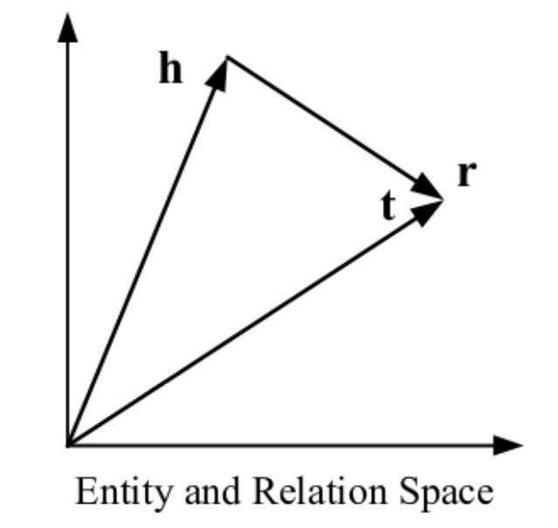
Translating embeddings - TransE
Notes:
TransE

Slide 44
Translating embeddings - TransE
Methodology:
Graph-based embedding technique.
Well-suited for RDF and ontology graphs.
Limitations:
Supports only 1:1 relations.
Not suitable for hierarchies (1-N relations).
Not suitable for N-N relations.
Does not handle transitive, symmetric, or reflexive relations.
Notes:
TransE graph-based I
works well on RDF graphs and ontology graphs
1:1 relations only I
not suitable for hierarchies (1-N relations) I
not suitable for N-N relations I
no transitive, symmetric, reflexive relations

Slide 45
Similarity in KG
Shortest Path:
Applicable to arbitrary knowledge graphs.
Limitations: Does not capture similarity well over all edge types (e.g., disjointWith, differentFrom, opposite-of, etc.).
Random Walk:
With or without restart.
Iterated approach.
Limitations: Does not consider edge labels, capturing only adjacency of nodes.
Scores the whole graph based on the probability of being in a state.
Can take multiple seed nodes.
Application: Can be used to find disease genes.
Notes:
How to measure similarity? Shortest Path I applicable to arbitrary “knowledge graphs” I does not capture similarity well over all edge types, e.g., disjointWith, differentFrom, opposite-of, etc. Random Walk I with or without restart I iterated I does not consider edge labels ⇒ captures only adjacency of nodes I scores whole graph with probability of being in a state I can take multiple seed nodes I can be used to find disease genes

Slide 46
Word2Vec
Popular Methods:
Word2Vec
BERT
Methodology:
Both methods utilize embeddings to represent text.
Word2Vec:
Generates embeddings capturing co-occurrences based on a corpus.
Embeddings are n-dimensional vectors.
Limitations:
Fixed representations
Limited context
Limited beyond co-occurrences
Notes:
● Limitations? ○ Fixed representations ○ Context ○ Beyond co-occurrences
Numerical representation and analysis of text Popular methods: ● Word2Vec ● BERT Both methods use embeddings to represent text
Well-known method ● Generates embeddings that capture co-occurrences based on a corpus ● Embeddings are in the form of n-dimensional vectors

Slide 47
Word2Vec
Random Walks:
Flatten a graph structure.
Capture node neighborhoods to generate a corpus.
Capture graph structure in ABox and TBox.
Identify hub-nodes, communities, etc., determining node importance.
Word2Vec Embeddings:
Capture co-occurrence in the graph.
Similar graph neighborhoods lead to similar co-occurrences and vector embeddings.
Feature Vectors:
Generate feature vectors mapping symbols (words, labels) into R^{n}.
Notes:
Word2Vec and Random Walks random walks “flatten” a graph I walks capture node neighborhood I and generate a “corpus” random walks capture graph “structure” I in ABox and TBox I hub-nodes, communities, etc. I determine “importance” of nodes embeddings capture co-occurrence I similar graph neighborhood ⇒ similar co-occurrence ⇒ similar vector embeddings generate “feature” vectors I functions from symbols (words, labels) into R n

Slide 48
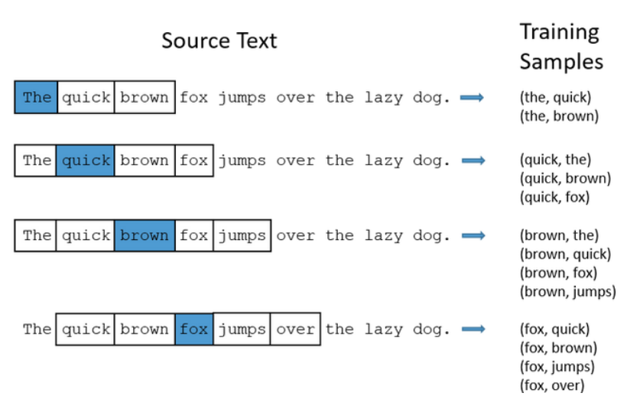
Word2Vec

Slide 49
OPA2Vec
Command Line Tool:
Input: OWL ontology, set of entities with annotations/associations.
Output: Vectors for each class and entity.
Features:
Extends Onto2Vec by incorporating annotations to entities.
Annotations can originate from various sources such as the ontology itself or external text corpora.
Usage:
Open the notebook OPA2Vec.ipynb.
Run the entire notebook for fast execution on a modern laptop.
Exploration:
Experiment with prediction methods like cosine similarity.
Notes:
https: //github.com/bio-ontology-research-group/opa2vec command line tool I input: OWL ontology, set of entities with annotations/associations I output: vectors for each class and entity includes Elk and HermiT limitations: word-based I still ignores semantics!
open the notebook OPA2Vec.ipynb run the whole notebook I this should be relatively fast and not take too much time on a modern laptop play with the prediction methods (cosine similarity
OPA2Vec extends Onto2Vec by adding annotations to entities. Annotations can come from several sources Annotations in the ontology Text corpora from other sources

Slide 50
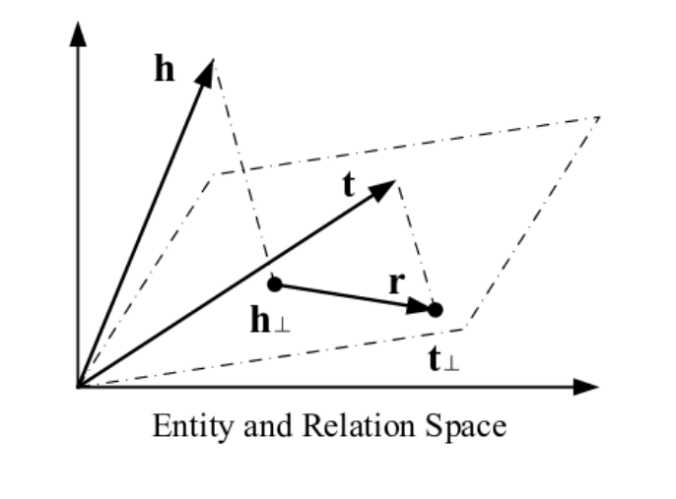
Translating embeddings
Notes:
Figure: TransH representation

Slide 51
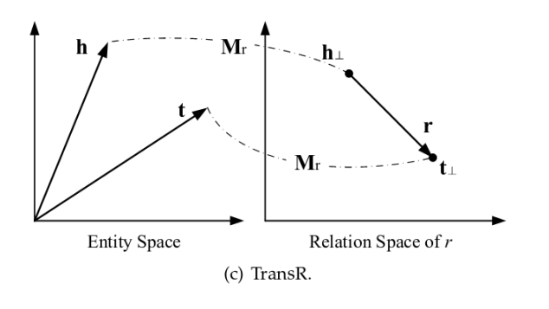
Translating embeddings
Notes:
each relation has its own semantic space

Slide 52
PyKEEN & mOWL
Python package for generating knowledge graph embeddings.
Supports various embedding types including TransE, TransR, TransD, RESCAL, etc.
Hyperparameter optimization (HPO) and evaluation are included.
Access PyKEEN at: GitHub - SmartDataAnalytics/PyKEEN
Integration with mOWL for enhanced ontology processing and embedding generation.
Notes:
PyKEEN Python package to generate knowledge graph embeddings supports many different graph embedding types: TransE, TransR, TransD, RESCAL, etc. hyperparameter optimization (“HPO”) and evaluation included https://github.com/SmartDataAnalytics/PyKEEN
mOWL integration

Slide 53
Training KGEs
Negative Sampling:
Common approach for training Knowledge Graph Embeddings (KE).
Involves corrupting triplets (h, r, t) by sampling from sets of head or tail entities.
Corrupted triplets can take forms like (h', r, t) or (h, r, t').
Loss Functions:
Logistic loss and pairwise ranking loss are commonly employed.
Logistic loss assigns -1 for negative samples and +1 for positive samples.
Notes:
Negative Sampling
Generally to train a KE, all the models we have investigated apply a variation of negative sampling by corrupting triplets (h,r,t).
They corrupt either h, or t by by sampling from set of head or tail entities for heads and tails respectively.
The corrupted triples can be of wither forms (h’,r,t)(or (h,r,t’)
Loss functions
Most commonly logistic loss and pairwise ranking loss are employed.
The logistic loss returns -1 for negative samples and +1 for the positive samples.
So if D+ and D− are negative and positive data, y=±1 is the label for positive and negative triplets and f is the ranking function,
then the logistic loss is computed as:

Slide 54
supervised learning
Feature Vectors:
Represent the graph neighborhood of nodes, including adjacent nodes and edges.
Encode ontology classes, including both asserted and inferred relationships.
Relation Prediction:
Input: Two feature vectors obtained from the embedding function.
Output: Binary classification (0 or 1) indicating the presence or absence of a relation.
Training Data: Positive and negative cases, representing both R(x, y) and ¬R(x, y) scenarios.
Positive case: R(x, y) exists.
Negative case: R(x, y) does not exist or is not provable.
Notes:
feature vectors represent graph neighborhood of nodes I
adjacent nodes and edges I
ontology classes (asserted & inferred) useful in supervised prediction tasks relation prediction: I
input: two features vectors (from embedding function) I
output: 0 or 1 (relation or not) I
training data: positive and negative cases I R(x, y) and ¬R(x, y) I R(x, y) and not provable R(x, y)

Slide 55
Limitations
Graph-Based Methods:
Often used in ontology processing, similar to random walks.
Ontologies are not inherently graphs.
Converting ontologies to graphs may lead to information loss.
Graph representations may lack axioms and definitions present in ontologies.
Absence of axioms and definitions can impact the performance of graph-based methods.
Graph Convolutional Networks (GCNs) may also face similar challenges in ontology processing.
Notes:
graph-based (same as random walks): I
ontologies are not graphs! I
converting ontologies to graphs loses information I
no axioms, no definitions (this also holds for Graph Convolutional Networks, which are not covered here)

Slide 56
Ontology processing with mOWL
mOWL facilitates two primary model types:
Ontology Embeddings: Inducing background knowledge in machine learning methods.
Successfully applied to predicting protein-protein interactions and GDAs.
Graph-based methods exhibit superior performance in most evaluation metrics.
Structured Learning: Leveraging ontology background knowledge to impose structure on machine learning representations.
Example: DeepGOZero for zero-shot predictions of protein functions.
Notes:
semantic similarity measures are mostly hand-crafted
machine learning methods are mostly data-driven
Also possible to use the RDF syntax of OWL to generate a graph
mOWL can be used to implement at least two types of models.
The first relies on generating ontology embeddings to induce background knowledge in machine learning methods.
we tested the methods implemented in mOWL on the tasks of predicting protein–protein interactions and GDAs. For both tasks, we used three types of methods: graph-based, syntactic and semantic. In most evaluation metrics and across both tasks, we find that graph-based ontology embedding methods perform better than other methods.
3 TABLES
The second type of model for which mOWL can be used consists of using the background knowledge in ontologies to constrain the learning objective and imposing a structure on representations generated by a machine learning method. In these applications, it becomes possible to perform some kind of logical operations on representations of machine learning methods, and use these, for example, for zero-shot predictions. An example of such a method can be found in mOWL where we provide an implementation of DeepGOZero (Kulmanov and Hoehndorf, 2022), a model that performs zero-shot predictions of protein functions.
In addition to the use cases enabled by mOWL, through the direct interfacing with the OWL API and JPype, mOWL is also very fast in comparison to some other implementations of ontology embedding methods. TABLE 4

Slide 57
Ontology processing with mOWL
Performance and Speed:
mOWL offers fast processing compared to alternative ontology embedding implementations.
Direct interfacing with OWL API and JPype enhances efficiency.
Semantic Similarity and Machine Learning:
Semantic similarity measures are often manually crafted.
Machine learning methods predominantly rely on data-driven approaches.
RDF Syntax Utilization:
Possibility to utilize RDF syntax of OWL for graph generation, expanding flexibility in modeling.
Notes:
semantic similarity measures are mostly hand-crafted
machine learning methods are mostly data-driven
Also possible to use the RDF syntax of OWL to generate a graph
mOWL can be used to implement at least two types of models.
The first relies on generating ontology embeddings to induce background knowledge in machine learning methods.
we tested the methods implemented in mOWL on the tasks of predicting protein–protein interactions and GDAs. For both tasks, we used three types of methods: graph-based, syntactic and semantic. In most evaluation metrics and across both tasks, we find that graph-based ontology embedding methods perform better than other methods.
3 TABLES
The second type of model for which mOWL can be used consists of using the background knowledge in ontologies to constrain the learning objective and imposing a structure on representations generated by a machine learning method. In these applications, it becomes possible to perform some kind of logical operations on representations of machine learning methods, and use these, for example, for zero-shot predictions. An example of such a method can be found in mOWL where we provide an implementation of DeepGOZero (Kulmanov and Hoehndorf, 2022), a model that performs zero-shot predictions of protein functions.
In addition to the use cases enabled by mOWL, through the direct interfacing with the OWL API and JPype, mOWL is also very fast in comparison to some other implementations of ontology embedding methods. TABLE 4

Slide 58
Getting started

Slide 59
Getting started
Importing mOWL: Use the import statement to include the mOWL library in your Python code.
Initializing JVM: Call the init_jvm() function to start the Java Virtual Machine (JVM).
Memory Allocation: Specify the amount of memory allocated to the JVM, such as "2g" in the example.
import mowl
mowl.init_jvm("2g")
Notes:
In order to use mOWL with all its functionalities, the Java Virtual Machine must be started. We can do that in the following way:
import mowl
mowl.init_jvm("2g")
In the above piece of code, we specify the amount of memory given to the JVM. The memory parameter (2g in the example) corresponds to the parameter “-Xmx” for the JVM initialization step. For more information about the JVM memory management please follow this link.

Slide 60
Built-in Datasets Classes
PPIYeastDataset([url]) | Dataset containing protein-protein interactions in yeast.
PPIYeastSlimDataset() | Reduced version of PPIYeastDataset.
GDADataset([url]) | Abstract class for gene-disease association datasets.
GDAHumanDataset() | Dataset containing gene-disease associations in human.
GDAHumanELDataset() | This dataset is a reduced version of GDAHumanDataset.
GDAMouseDataset() | Dataset containing gene-disease associations in mouse.
GDAMouseELDataset() | This dataset is a reduced version of GDAMouseDataset.
FamilyDataset([url]) | This dataset represents a family domain.

Slide 61
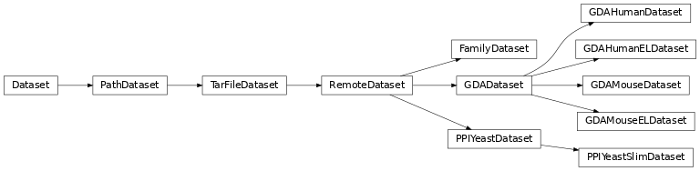
Built-in Datasets Class Inheritance Diagram

Slide 62
Datasets
Dataset Composition: mOWL datasets consist of three ontologies: training, validation, and testing.
Supported Format: mOWL is designed to handle input in OWL format, allowing for the input of OWL ontologies.
Accessing Datasets: To access any of these datasets, use the provided method:
from mowl.datasets.builtin import PPIYeastSlimDataset
ds = PPIYeastSlimDataset()
train_ontology = ds.ontology
valid_ontology = ds.validation
test_ontology = ds.testing
Notes:
mOWL is designed to handle input in OWL format. That is, you can input OWL ontologies. A mOWL dataset contains 3 ontologies: training, validation and testing.
To access any of these datasets you can use:

Slide 63
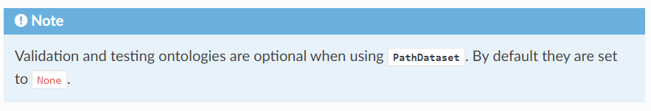
Datasets
In case you have your own training, validation and testing ontologies, you can turn them easily to a mOWL dataset as follows:
from mowl.datasets.base import PathDataset
ds = PathDataset("training_ontology.owl",
validation_path="validation_ontology.owl",
testing_path="testing_ontology.owl")
training_axioms = ds.ontology.getAxioms()
validation_axiom = ds.validation.getAxioms()
testing_axioms = ds.testing.getAxioms()

Slide 64
OWLAPI & Reasoners

Slide 65
Guidelines
Load ontology
Extract corpus (axioms or assertions)
Create a graph model using the corpus using Word2Vec
Project the ontology to edges (one for a training data set and for evaluation)
Apply the created model to the training dataset
Show accuracy metrics
Notes:
Load Ontology:
Import the ontology into the mOWL environment.
Extract Corpus:
Extract axioms or assertions from the ontology to form a corpus.
Create Graph Model:
Utilize Word2Vec to create a graph model using the extracted corpus.
Project Ontology to Edges:
Project the ontology onto edges, dividing the dataset into a training set and an evaluation set.
Apply Model to Training Dataset:
Apply the created Word2Vec model to the training dataset.
Evaluate Accuracy:
Calculate accuracy metrics to evaluate the performance of the model.

Slide 66
EL embeddings
Run the elembeddings notebook

Slide 67
mOWL & Use Cases

Slide 68
Use Cases
mOWL Demonstrations:
Knowledge-based prediction of protein-protein interactions using the Gene Ontology.
Gene-disease associations prediction using phenotype ontologies.
Practical Example:
Predicting gene-disease associations based on phenotypic similarity.
Utilizes available data sources to learn and infer associations.
Example: Diagnosis of diseases based on phenotypic similarity.
Other Applications:
Predicting protein-protein interactions based on functional similarity.
Predicting causative variants.
Predicting drug-target interactions, etc.
Notes:
We demonstrate mOWL on the knowledge-based prediction of protein–protein interactions using the gene ontology and gene–disease associations using phenotype ontologies.
Predicting gene-disease associations based on phenotypic similarity is one practical examples using the library. § Use the available data sources to learn and infer associations
Diagnosis of disease based on phenotypic similarity
q Other applications: § predict protein-protein interactions based on their functional similarity, predict the causative variants, predict the drug-targets...etc
This slide outlines the diverse applications of mOWL in knowledge-based predictions, highlighting its versatility in various domains such as protein-protein interactions, gene-disease associations, and beyond. It also emphasizes the practical examples and potential applications of the library in predicting various biological phenomena.

Slide 69
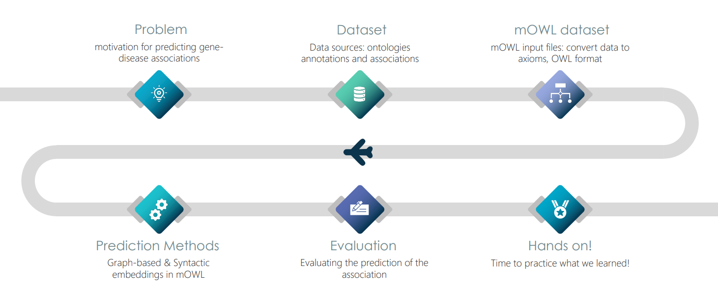
Use Cases

Slide 70
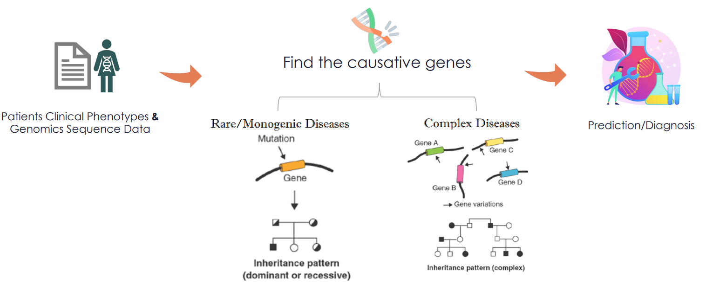
Use Cases
Notes:
Disease Gene Prediction:
Process of identifying genes from Whole-genome sequencing (WGS) likely to contribute to disease phenotype.
Utilizes disease phenotype to aid in gene prioritization.
Predicting Gene-Disease Associations:
Based on phenotypic similarity.
Enables diagnosis of diseases using phenotypic similarity.
Utilizing Phenotypes:
Leveraging phenotypes of model organism genes and diseases.
Facilitates understanding of gene-disease associations and disease diagnosis.
This slide provides an overview of disease gene prediction and the utilization of phenotypic similarity in predicting gene-disease associations and diagnosing diseases. It underscores the importance of phenotypic data in understanding genetic diseases and prioritizing genes for further investigation.

Slide 71
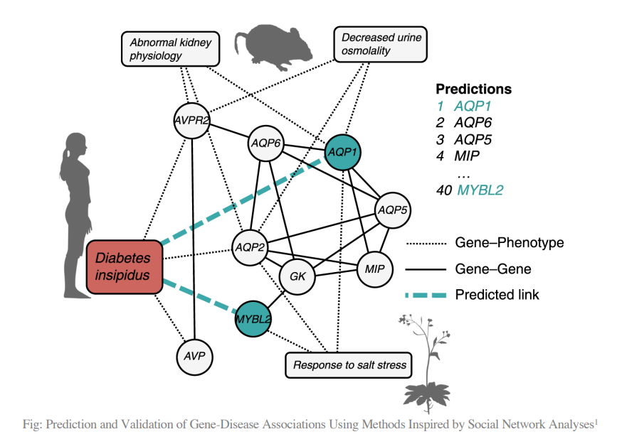
Use Cases – Phenotypic similarity

Slide 72
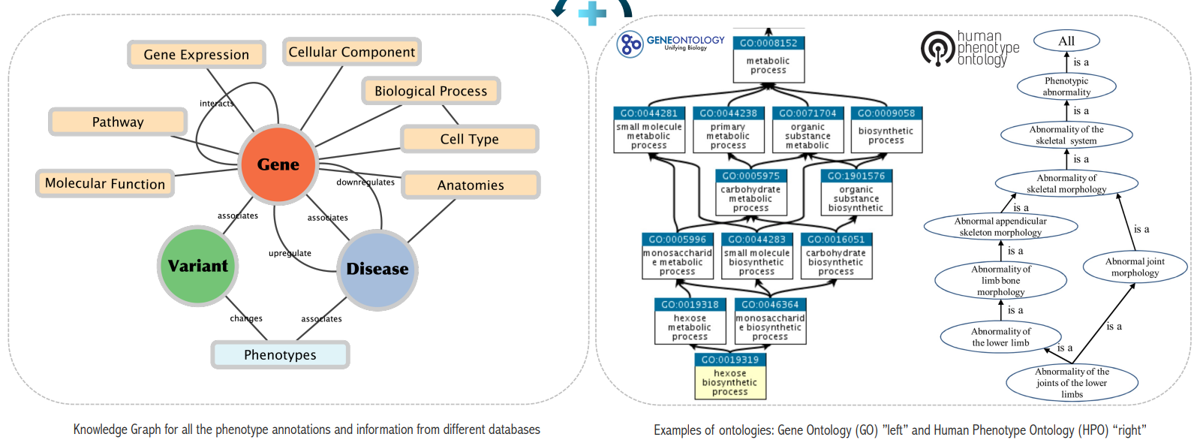
Use Cases – Phenotypic similarity
Converting knowledge axioms in phenotype ontologies to knowledge graph

Slide 73
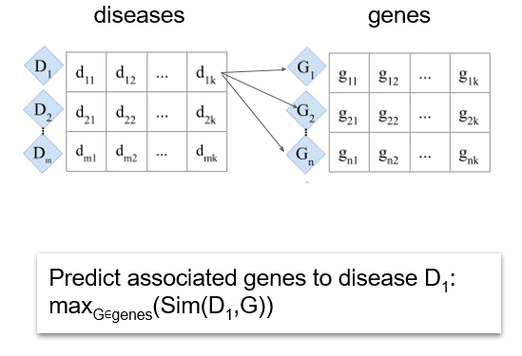
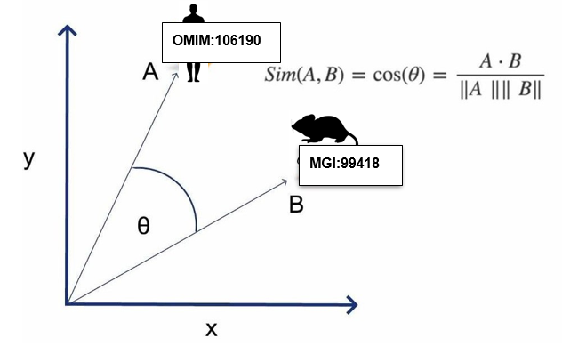
Use Cases – Calculating Phenotypic Similarity Approaches
Unsupervised Approach
Cosine similarity

Slide 74
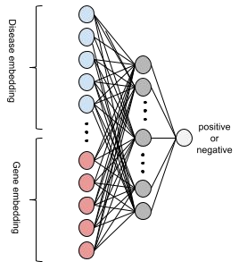
Use Cases – Calculating Phenotypic Similarity Approaches
Supervised Approach: MLP
Train/Test split
10-fold cross validation
Stratified by disease

Slide 75
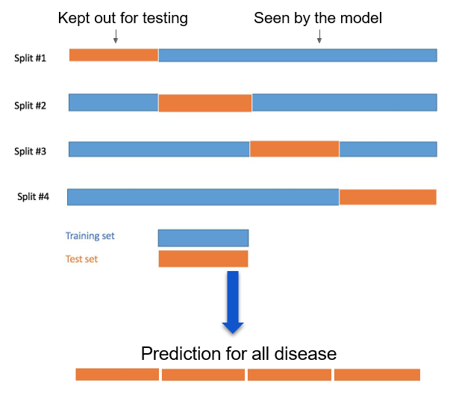
Use Cases – Calculating Phenotypic Similarity Approaches

Slide 76
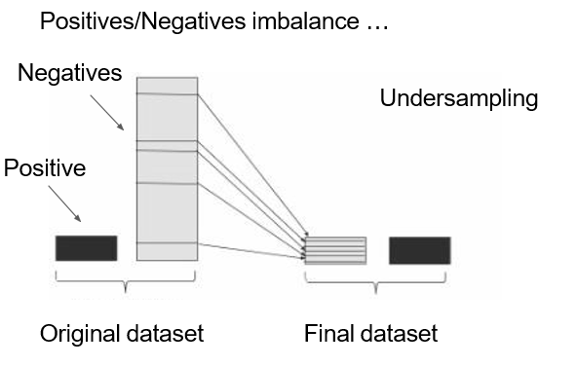
Use Cases – Calculating Phenotypic Similarity Approaches
Supervised Approach
MLP
Positives
Negatives

Slide 77
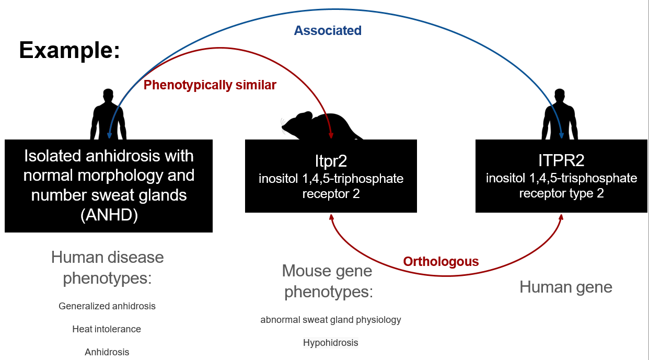
Use Cases – Calculating Phenotypic Similarity Approaches

Slide 78
Use Cases – Dataset
Diseases Phenotypes:
Obtained from HPO annotations for rare diseases document (phenotype.hpoa).
Genes Phenotypes:
Downloaded from Mouse/Human Ortholog with Phenotype Annotations from HPO database (HMD_HumanPhenotype.rpt).
Gene-Disease Associations:
Retrieved from Associations of Mouse Genes with DO Diseases file (MGI_DO.rpt).
Objective:
Allowing similar phenotypes from the same or different organism ontologies to be logically defined in similar form.
Utilization of Cross-Species Phenotype Ontologies:
PhenomeNet-Extension (Pheno-e) and uPheno.
Aim to logically define similar phenotypes across different organism ontologies.
Notes:
Using functional and phenotypic characteristics for genes
Diseases phenotypes: § Obtained from the HPO annotations for rare diseases document (phenotype.hpoa).
Genes phenotypes: § Download Mouse/Human Ortholog with Phenotype Annotations from HPO database (HMD_HumanPhenotype.rpt)
Gene-Disease associations: § Gene-disease associations were obtained from the Associations of Mouse Genes with DO Diseases file downloaded from (MGI_DO.rpt).
Both with the objective of allowing similar phenotypes from the same or different organisms ontologies to be logically defined in similar form
PhenomeNet-Extension (Pheno-e) and uPheno are cross-species phenotype ontologies that can be utilized here.
Both with the objective of allowing similar phenotypes from the same or different organisms ontologies to be logically defined in similar form.

Slide 79
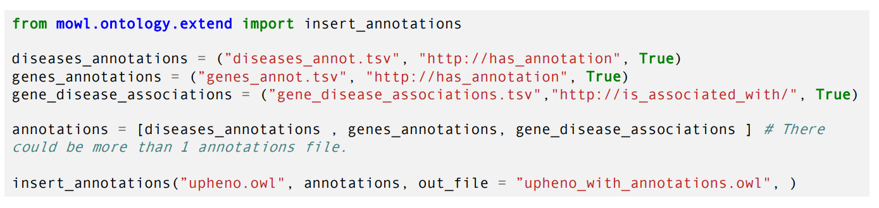
Use Cases – mOWL
mOWL is designed to handle input in OWL format
allows input of OWL ontologies
mOWL dataset contains 3 ontologies: training, validation and testing.
Associations for human and mouse extracted
randomly split 80:10:10, added to the training ontology and created the validation and testing ontologies
Notes:
How to add the annotations to mOWL to generate the Gene and disease embedding? v
mOWL is designed to handle input in OWL format Ø
you can input OWL ontologies. Ø
A mOWL dataset contains 3 ontologies: training, validation and testing.
Associations for human and mouse extracted and randomly split 80:10:10, added to the training ontology and created the validation and testing ontologies

Slide 80
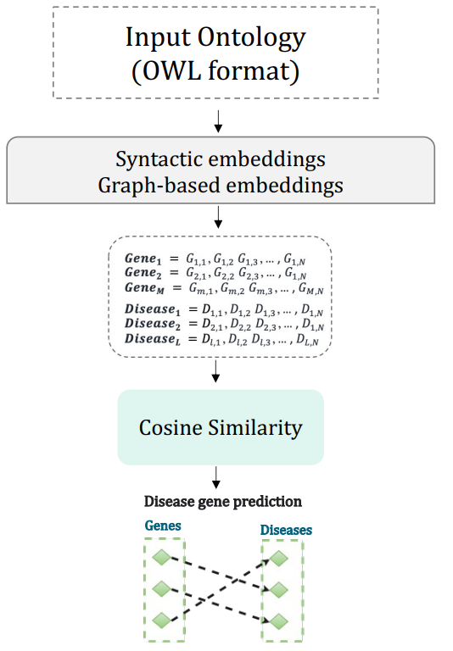
Use Cases – mOWL prediction methods
Utilize mOWL to generate representation from the ontology graph.
Obtain embeddings for genes and diseases using various methods:Syntactic Embeddings:
Onto2Vec
OPA2Vec
Graph-based Embeddings:
DL2Vec
OWL2Vec
Notes:
Generate the representation from the ontology graph (using mOWL). § Collect features (embeddings) for the gene and disease using different method. Syntactic embeddings Onto2vec OPA2Vec Graph-based embeddings DL2vec OWL2Vec
Τhis slide outlines the process of generating ontology graph representations using mOWL and collecting features (embeddings) for genes and diseases. It highlights the utilization of different methods, including syntactic and graph-based embeddings, to capture various aspects of the ontology graph.

Slide 81
Use Cases – mOWL Graph-based Methods: Generate Embeddings
Οntology Projection:
Utilize DL2Vec/OWL2Vec Projector class to project the ontology.
Specify the rules used for projection.
Outcome: Edgelist representing the projected ontology.
Generating Random Walks:
Use DeepWalk to generate random walks.
Training the Word2Vec Model:
Utilize the Gensim library to train the Word2Vec model.
Notes:
This slide provides an overview of the steps involved in ontology projection, random walks generation, and Word2Vec model training. It outlines the specific tools and libraries used for each step in the process.

Slide 82
Use Cases – mOWL Syntactic models
The Reasoner:
Utilized for inferring new axioms.
Example: ELK reasoner used by Onto2Vec/OPA2vec.
The Corpus Generator:
Responsible for generating the corpus.
Contains inferred axioms and other ontology information.
The Word2Vec Model:
Trained on the generated corpus.
Notes:
We need three components: 1. The reasoner 2. The corpus generator 3. The Word2Vec model
Inferring new axioms Ø Onto2Vec/OPA2vec uses an ontology reasoner to infer new axioms as a preprocessing step (e.g. ELK reasoner)
Generating the corpus and training the model Ø To train the Word2Vec model on the generated corpus
This slide highlights the three essential components required for ontology embedding generation: the reasoner for inferring new axioms, the corpus generator for creating the training corpus, and the Word2Vec model trained on the corpus. Each component plays a crucial role in the overall process.

Slide 83
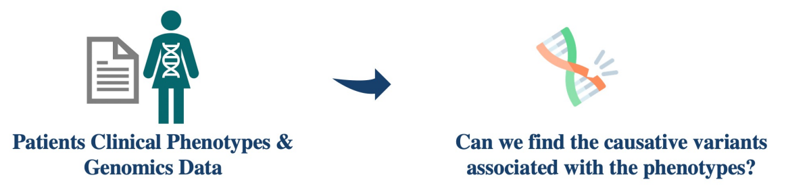
Use Cases – Prediction the causative variants
Determine which variants identified using Whole-exome Sequencing (WES) or Whole-genome sequencing (WGS) are most likely to:
damage gene function and
underlie the disease phenotype
Notes:
Calculating Phenotypic Similarity Approaches
Prioritizing the causative variants. ØDetermining which variants identified using Whole-exome Sequencing (WES) or Whole-genome sequencing (WGS) are most likely to damage gene function and underlie the disease phenotype

Slide 84
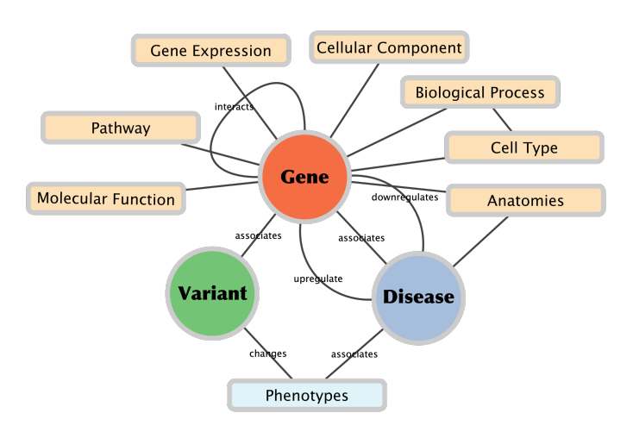
Use Cases – Prediction the causative variants
Annotations for Prioritization:
Gene-Phenotype Annotations
Gene-Function Annotations
Gene-Celltype Annotations
Gene-Anatomical Site of Gene Expression Annotations
Disease-Phenotype Annotations
Objective:
Utilize annotations to prioritize candidate genes/variants.
Notes:
This slide outlines the various types of annotations used for prioritizing genes and variants in the context of gene-disease associations. It emphasizes the importance of leveraging diverse annotations to identify relevant genes and variants for further investigation.

Slide 85
Use Cases – PPI
Task Overview:
Protein-Protein Interaction (PPI) Prediction Task.
Utilizing Methods from mOWL or Interfacing with Other Libraries (e.g., PyKEEN).
Dataset:
Yeast Species Dataset (PPIYeastDataset):
Built-in dataset in mOWL.
Contains Training, Validation, and Testing Ontologies.
Protein Interaction Data Randomly Split: 90% Training, 5% Validation, 5% Testing.
Gene Ontology Functional Annotations Included in Training Ontology.
Notes:
protein–protein interaction prediction task using methods found in mOWL either by direct implementation or interfacing with other libraries (such as PyKEEN).
yeast species. In mOWL, it is available as a built-in dataset called PPIYeastDataset that consists of three ontologies: training, validation and testing. Protein interaction data was randomly split 90:5:5 across training, validation and testing ontologies and Gene Ontology functional annotations of proteins is part of the training ontology only.

Slide 86

EL BOX Embeddings

Slide 87
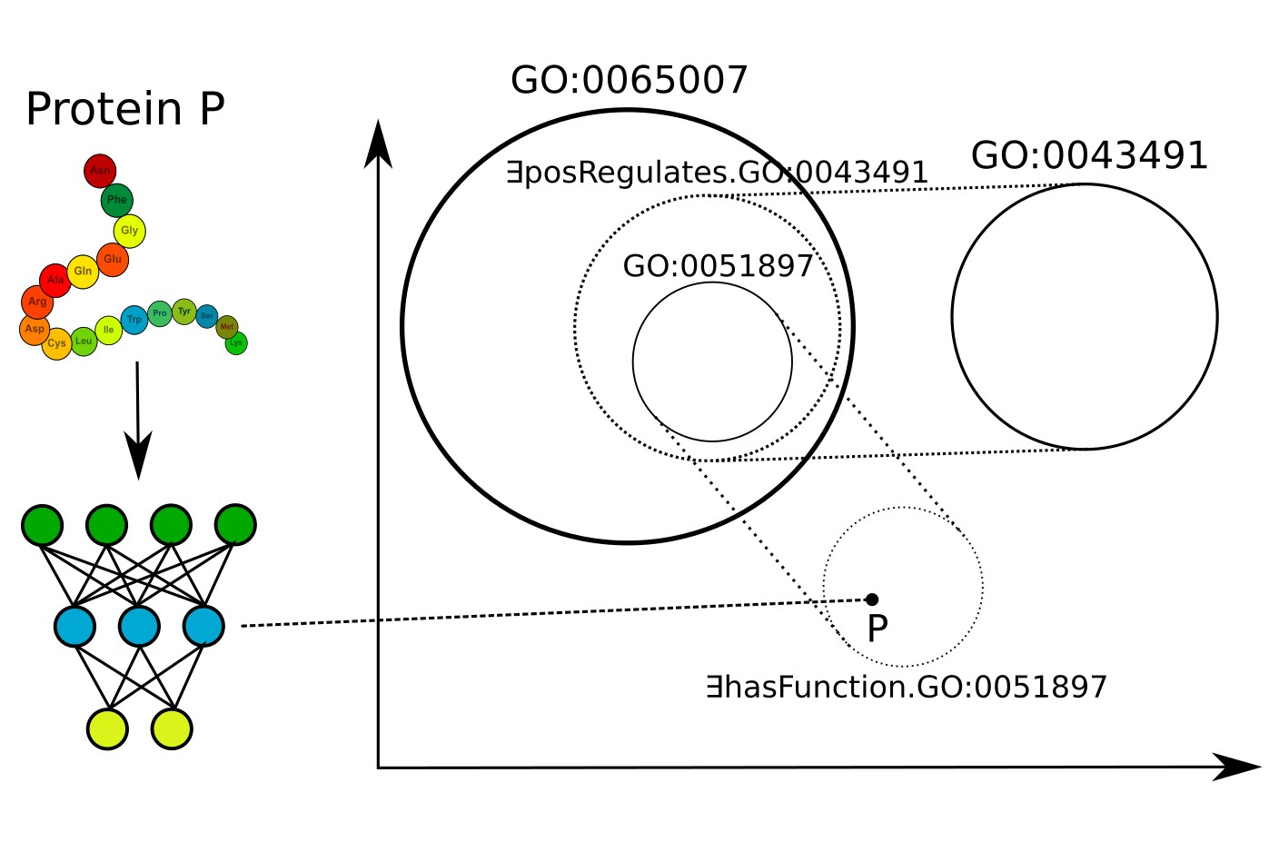
DeepGOZero – function prediction

Slide 88
Gene-disease association prediction: Mouse and Human
Experiment Overview:
Prediction of Gene-Disease Association.
Target Species: Mouse and Human.
Methodology:
Utilizing Phenotypic Annotations of Genes and Diseases.
Computing Associations Based on Phenotypic Similarity.
Dataset Preparation:
Gene-Disease Associations Obtained from Mouse Genes with DO Diseases File.
Associations Randomly Split: 80% Training, 10% Validation, 10% Testing.
Notes:
prediction of gene–disease association on two species: mouse and human. For this experiment, we used phenotypic annota2 tions of genes and diseases and computed associations based on phenotypic similarity.
Futhermore, gene-disease associations were obtained from the Associations of Mouse Genes with DO Diseases file downloaded from http://www.informatics. jax.org/downloads/reports/MGI_DO.rpt. From this file, associations for human and mouse were extracted and each of them were randomly split 80:10:10, added to the training ontology and created the validation and testing ontologies, respectively. In this way, we created the GDAHumanDataset and GDAMouseDataset built-in datasets. For the semantic models over the description language EL, it was necessary to remove complex axioms from the training ontology. This resulted in the GDAHumanELDataset and GDAMouseELDataset datasets

Slide 89
Gene-disease association prediction: Mouse and Human
Dataset Preparation:
Creation of Built-in Datasets: GDAHumanDataset, GDAMouseDataset.
Special Considerations:
Removal of Complex Axioms for Semantic Models over Description Language EL.
Resulting Datasets: GDAHumanELDataset, GDAMouseELDataset.
Notes:
prediction of gene–disease association on two species: mouse and human. For this experiment, we used phenotypic annota2 tions of genes and diseases and computed associations based on phenotypic similarity.
Futhermore, gene-disease associations were obtained from the Associations of Mouse Genes with DO Diseases file downloaded from http://www.informatics. jax.org/downloads/reports/MGI_DO.rpt. From this file, associations for human and mouse were extracted and each of them were randomly split 80:10:10, added to the training ontology and created the validation and testing ontologies, respectively. In this way, we created the GDAHumanDataset and GDAMouseDataset built-in datasets. For the semantic models over the description language EL, it was necessary to remove complex axioms from the training ontology. This resulted in the GDAHumanELDataset and GDAMouseELDataset datasets

Slide 90
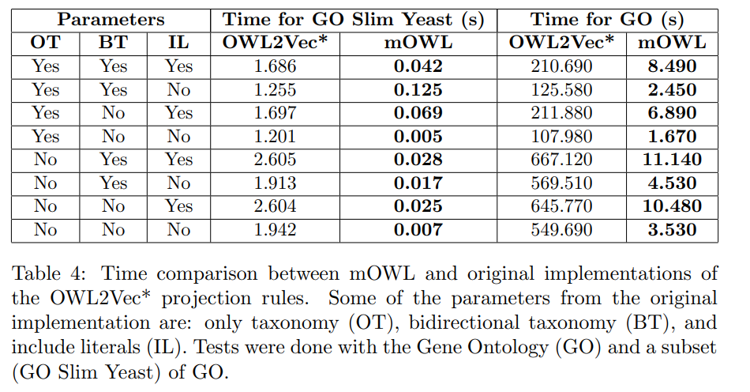
Time comparison
Notes:
Time comparison for OWL2Vec* projection method between original and mOWL implementation.

Slide 91
Conclusion

Slide 92
Conclusion
mOWL: library to generate ontology embeddings
Ontology embeddings applicable across diverse biological machine learning methods.
Leveraging numerous biomedical ontologies in bioinformatics.
Implementation of state-of-the-art methods.
Integration with OWL API.
Functionalities for ontology management.
Facilitating implementation of novel methods.
Notes:
mOWL is a library intended to generate ontology embeddings
Ontology embeddings are broadly applicable to incorporating background knowledge in biological machine learning methods due to the large number of biomedical ontologies used in bioinformatics.
mOWL provides implementation of state-of-the-art methods, datasets, OWL API integration and functionalities to manage ontologies.
mOWL also provides functionalities for the implementation of novel methods.

Slide 93
Conclusion
Importance of Ontology Background Knowledge:
Axioms and Natural Language: Definitions, Labels, Synonyms.
Deep Learning on Ontologies: Encoding Background Knowledge.
Feature Learning:
Utilizing Ontology Graphs, Axioms, or Model Structures.
Notes:
ontologies contain background knowledge that is useful as background knowledge: I axioms I natural language (definitions, labels, synonyms) feature learning (deep learning) on ontologies encodes this background knowledge I using ontology graphs, axioms, or model structures
This slide emphasizes the significance of ontology background knowledge, including axioms and natural language elements, in feature learning. It highlights how deep learning techniques can encode this knowledge using ontology graphs, axioms, or model structures to enhance learning outcomes.

Slide 94
References
https://github.com/bio-ontology-research-group/semrec2023
https://arxiv.org/pdf/2303.16519.pdf
https://mowl.readthedocs.io/en/latest/index.html
https://github.com/bio-ontology-research-group/mowl/tree/main
mOWL: Python library for machine learning with biomedical ontologies & supplementary
Singh-Blom, U. Martin, et al. "Prediction and validation of gene-disease associations using methods inspired by social network analyses." PloS one 8.5 (2013): e58977
Chen, Jun*, Azza Althagafi*, and Robert Hoehndorf. "Predicting candidate genes from phenotypes, functions and anatomical site of expression." Bioinformatics 37.6 (2021): 853-860.
Download dataset: https://bio2vec.cbrc.kaust.edu.sa/data/mowl/
Read the docs: https://mowl.readthedocs.io/en/latest/graphs/random_walks.html
Kulmanov, M., Liu-Wei, W., Yan, Y., & Hoehndorf, R. (2019). EL Embeddings: Geometric construction of models for the Description Logic EL ++. ArXiv, abs/1902.10499.

Slide 95
References
Jun Chen, Azza Althagafi, Robert Hoehndorf, Predicting candidate genes from phenotypes, functions and anatomical site of expression, Bioinformatics, Volume 37, Issue 6, March 2021, Pages 853–860
Chen, J., Hu, P., Jiménez-Ruiz, E., Holter, O., Antonyrajah, D., & Horrocks, I. (2020). OWL2Vec*: embedding of OWL ontologies. Machine Learning, 110, 1813 - 1845.
Zhapa-Camacho, F., & Hoehndorf, R. (2023). CatE: Graph-Based Embeddings of ALC Ontologies Using Category-Theoretical Diagrams. ArXiv, abs/2305.07163.
Perozzi, B., Al-Rfou, R., & Skiena, S.S. (2014). DeepWalk: online learning of social representations. Proceedings of the 20th ACM SIGKDD international conference on Knowledge discovery and data mining.
Grover, A., & Leskovec, J. (2016). node2vec: Scalable Feature Learning for Networks. Proceedings of the 22nd ACM SIGKDD International Conference on Knowledge Discovery and Data Mining.
Peng, X., Tang, Z., Kulmanov, M., Niu, K., & Hoehndorf, R. (2022). Description Logic EL++ Embeddings with Intersectional Closure. ArXiv, abs/2202.14018.
Jackermeier, M., Chen, J., & Horrocks, I. (2023). Box2EL: Concept and Role Box Embeddings for the Description Logic EL++. ArXiv, abs/2301.11118.

