Slide 1


XML and modular bioinformatics assessments
José María Fernández González
GN2, Instituto Nacional de Bioinformática
Biología Estructural y Biocomputación, CNIO

Slide 2
What is GOPHER
GOPHER is a continuous evaluation system (CES) initially designed for the evaluation of function prediction methods and servers.
Since its early development stages we saw the potential of generalizing it towards a modular, generic continuous evaluation system.

Slide 3
What should any CES do?
Periodically gather representative queries for the methods and servers to assess which are novel (not previously used in previous submissions to the participant methods and servers).
Management of participants and evaluators in the assessment: registration, updates, programmed shutdowns, results gathering, etc...
Filtering and tidying up of the representative query sets used to assess the participants, based on some criteria. And then, the queries are sent to the active participants.
Sending of an augmented version of the representative query sets to the evaluators (assessment methods and servers), so the complexity level of the assessment is measured.
Statistics generation.
Give end user access to the gathered information which is public.

Slide 4
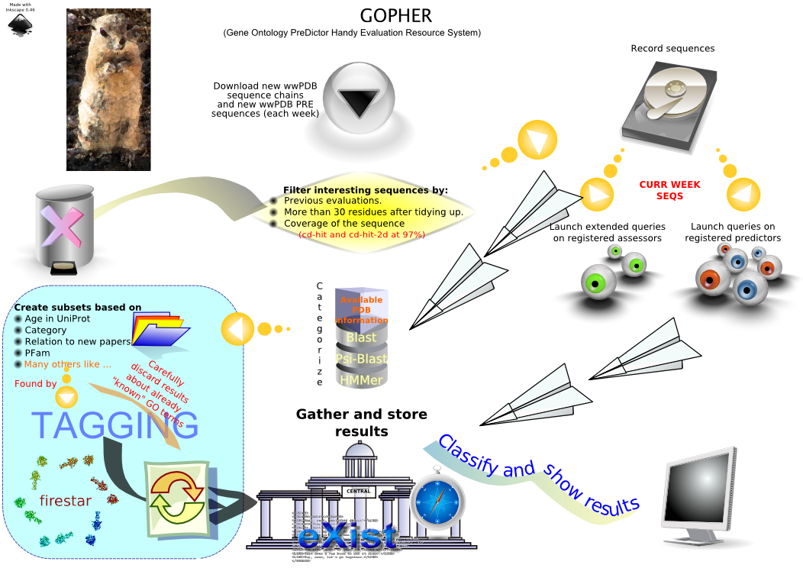

Slide 5


XCESC (XML Continuous Evaluation System Core)
XCESC is built around eXist XML database engine and extensions (HTTP server, Chiba, AtomicWiki, other).
It provides a standardize, reusable, XML protocol for evaluation and assessments.
Its design should be modular enough for most of the possible assessments.
All the server queries, gathered results, assessments, etc.. are stored in the database ASAP, so coherence it is kept as tight as possible.
This is a work still in progress

Slide 6
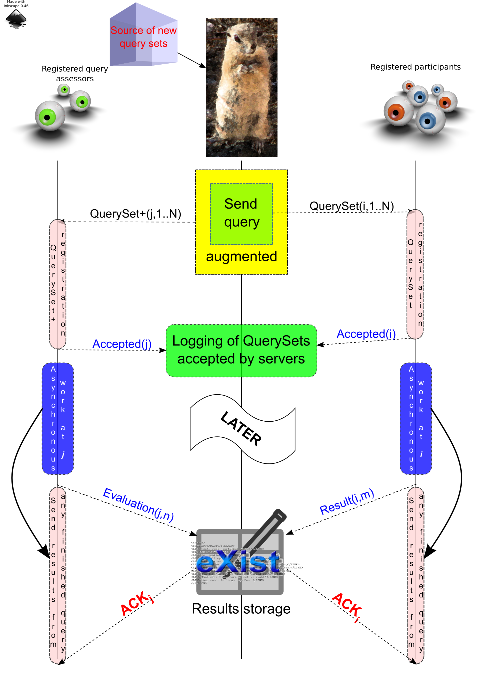

Slide 7
Future work
Finish most of core GUI interface.
Design an interface modular enough for results browsing, so common information, like scores, is handled by core and specific information, like the way to show the query, results mapping over the query and so on, is specific for each deployment.

