Slide 1
LUNG CANCER DETECTION - USING CNN AND XCEPTION TRANSFER LEARNING
TEAM MEMBERS:
160723748009 - MOHAMMED INABAH KHAN
160723748018 - BANNENOLA AKHIL
160723748041 – GUTTULA YESHWANTH

Slide 2
ABSTRACT
Lung cancer is one of the leading causes of cancer-related deaths worldwide. Early diagnosis is essential for improving survival rates. Manual analysis of CT scan images is time-consuming and prone to errors. This project proposes a Deep Learning-based Lung Cancer Detection System using CNN and Xception Transfer Learning.
The model classifies CT scan images into three categories: Benign, Malignant and Normal. Image preprocessing, data augmentation, and transfer learning techniques are used to improve classification accuracy and support intelligent medical diagnosis.

Slide 3
CONTENTS
INTRODUCTION
LITERATURE SURVEY
PROBLEM STATEMENT
PROPOSED SOLUTION
OBJECTIVES
FRAMEWORK (METHODOLOGY)
MODULES
TECH STACK
RESULTS

Slide 4
INTRODUCTION
Lung cancer is among the deadliest cancers globally.
Early detection significantly increases treatment success.
Manual CT scan examination requires expertise and time.
Deep Learning enables automated cancer detection.
CNN and Xception models provide accurate image classification.

Slide 5
LITERATURE SURVEY
S.No | Title | Authors | Year | Outcomes
1 | Deep Learning for Lung Cancer Detection Using CT Images | Setio et al. | 2017 | CNN models successfully detected lung nodules with high accuracy.
2 | Xception: Deep Learning with Depthwise Separable Convolutions | François Cholleto | 2017 | Introduced Xception architecture with improved feature extraction performance.
3 | Transfer Learning in Medical Image Analysis: A Survey | Cheplygina et al. | 2019 | Demonstrated effectiveness of transfer learning in medical imaging tasks.

Slide 6
PROBLEM STATEMENT
Manual CT scan analysis is time-consuming.
Diagnostic accuracy may vary among radiologists.
Early-stage lung cancer is difficult to identify.
Large amounts of imaging data increase workload.
Need for an automated and reliable detection system.

Slide 7
PROPOSED SOLUTION
Use CNN and Xception Transfer Learning.
Perform image preprocessing and augmentation.
Extract deep features from CT scans.
Classify scans into four categories:
Normal
Benign (non-cancerous)
Malignant (cancerous)
Provide accurate diagnostic support.

Slide 8
OBJECTIVES
Develop an automated lung cancer detection system.
Improve diagnostic accuracy using transfer learning.
Reduce radiologist workload.
Classify CT scans into four classes.
Assist in early disease diagnosis.

Slide 9
FRAMEWORK (METHODOLOGY)
Dataset Collection – Gather CT scan images.
Preprocessing – Resize and normalize images.
Data Augmentation – Rotate, flip, and zoom images.
Xception Model – Extract important features.
CNN Classifier – Classify lung cancer types.
Training & Validation – Train and evaluate model.
Prediction – Generate final classification result.

Slide 10
MODULES
Dataset Collection
Image Preprocessing
Data Augmentation
Xception Feature Extraction
CNN Classification
Model Training
Prediction Output

Slide 11
TECH STACK
Language: Python
Frameworks: TensorFlow, Keras
Model: CNN + Xception
Libraries: NumPy, OpenCV, Matplotlib, Scikit-learn
Tools: Google Colab, Jupyter Notebook, VS Code

Slide 12
RESULTS
Successful classification of lung CT scans.
Improved accuracy using transfer learning.
Better feature extraction through Xception.
Reduced chances of misclassification.
Supports intelligent medical diagnosis.
Includes
Accuracy graph
Loss graph
Confusion matrix
Sample prediction images

Slide 13
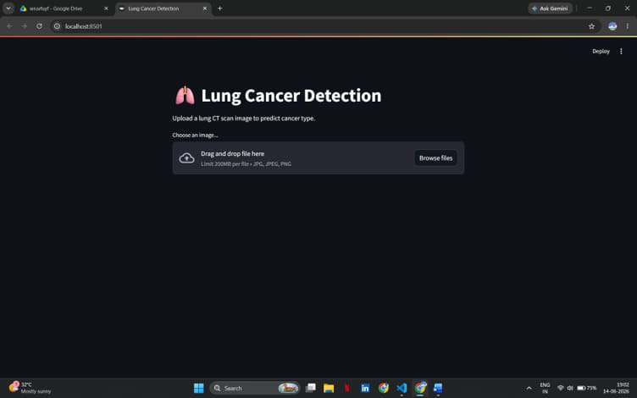
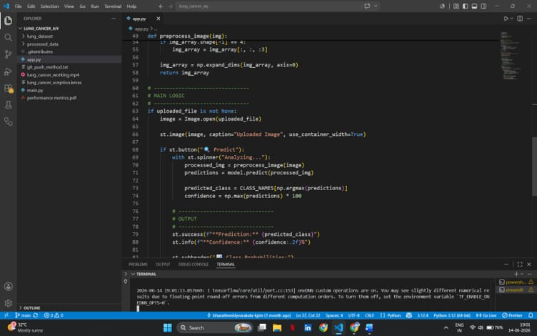
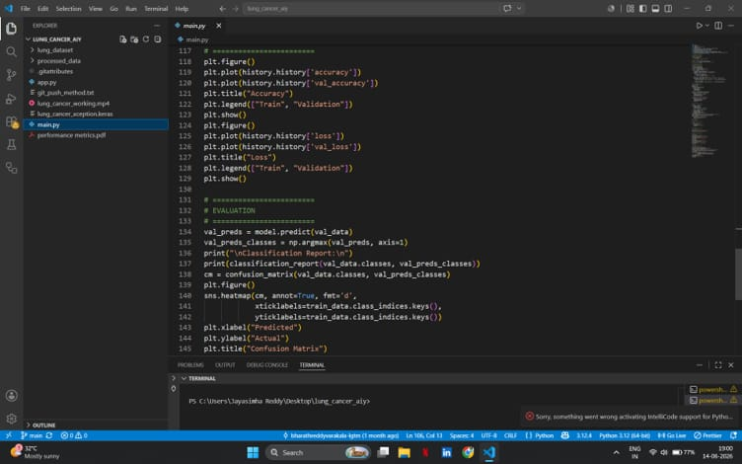

Slide 14
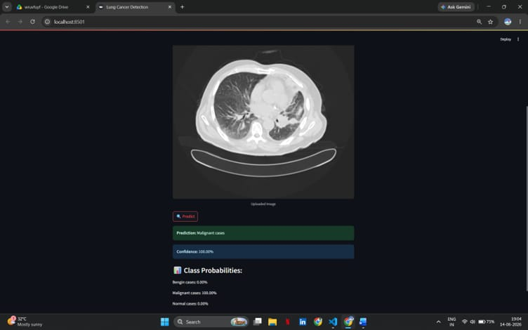
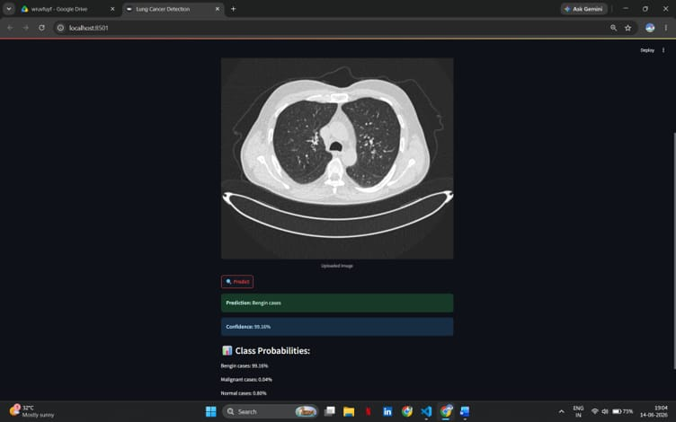
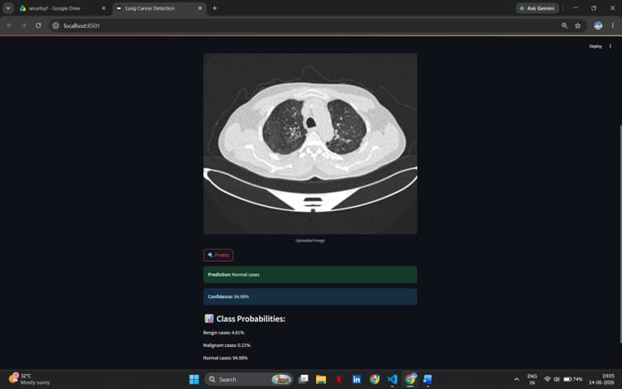

Slide 15
CONCLUSION
CNN and Xception provide effective lung cancer detection.
Transfer learning improves model performance.
AI can assist radiologists in diagnosis.
Early detection improves patient survival. Demonstrates the potential of AI in healthcare.

Slide 16
"Artificial Intelligence is transforming medical diagnosis by enabling faster, more accurate, and intelligent healthcare solutions."

