Slide 1
PLASTIC DETECTION USING YOLO
TEAM MEMBERS:
160723748001 – BHARATH SIMHA REDDY V
160723748030 – RAAVI INDU
160723748031 – KORIMI AKASH

Slide 2
ABSTRACT
Plastic pollution is a major environmental challenge that threatens marine ecosystems, biodiversity, and ecological balance. A key obstacle in addressing this issue is the absence of efficient automated systems capable of accurately detecting and locating plastic waste in complex underwater environments. To tackle this problem, the proposed system, “Plastic Detection using YOLO,” employs a deep learning-based object detection model to identify and localize marine plastic debris in images. Unlike traditional image classification methods, YOLO performs real-time object detection by generating bounding boxes around detected waste along with confidence scores.

Slide 3
The model is trained using the he TrashCan dataset, which contains annotated underwater images of marine debris. Through a Streamlit-based web interface, users can upload images that are processed by the trained YOLO network to detect and highlight plastic waste locations. By providing both detection and localization, the system improves automation in environmental monitoring and supports practical applications such as autonomous ocean-cleaning systems and robotic inspection platforms, contributing to scalable marine pollution management and ecosystem conservation.

Slide 4
CONTENTS
INTRODUCTION
LITERATURE SURVEY
PROBLEM STATEMENT
PROPOSED SOLUTION
OBJECTIVES
FRAMEWORK (METHODOLOGY)
MODULES
TECH STACK
RESULTS

Slide 5
INTRODUCTION
Plastic pollution is one of the most serious threats to marine ecosystems.
Manual detection of underwater waste is time-consuming and inefficient.
Computer Vision and Deep Learning enable automated debris detection.
YOLO (You Only Look Once) provides fast and accurate object detection.
This project focuses on detecting and localizing marine plastic waste in underwater images using a custom-trained YOLO model.

Slide 6
LITERATURE SURVEY
S.No | Title | Authors | Year | Outcomes
1 | TrashCan: A Semantically-Segmented Dataset towards Visual Detection of Marine Debris | Jungseok Hong, Michael Fulton, Junaed Sattar | 2020 | Introduced the TrashCan dataset with underwater trash annotations, providing a benchmark for marine debris detection.
2 | State of the Art Applications of Deep Learning within Tracking and Detecting Marine Debris: A Survey | Zoe Moorton, Zeyneb Kurt, Wai Lok Woo | 2024 | Reviewed recent deep learning methods and concluded that YOLO-based models show strong potential for marine debris detection.
3 | A Dataset for Detection and Segmentation of Underwater Marine Debris in Shallow Waters | Seaclear Research Team | 2024 | Presented a large annotated underwater debris dataset to improve object detection and segmentation performance.

Slide 7
PROBLEM STATEMENT
• Growing Marine Pollution: Plastic waste in oceans, rivers, and coastal regions continues to threaten marine ecosystems and biodiversity.
• Challenging Underwater Environments: Variations in lighting, water clarity, and background objects make debris detection difficult.
• Lack of Intelligent Perception Systems: Autonomous cleanup robots require reliable vision systems to identify and locate waste.
• Need for Precise Localization: Simply identifying debris is not enough; its exact location must be detected for effective collection.
• Limited Real-World Detection Solutions: Existing approaches often struggle to distinguish debris from surrounding underwater objects.

Slide 8
PROPOSED SOLUTION
• A YOLO-based object detection system that identifies and localizes marine plastic debris in underwater images.
• The model outputs bounding boxes with confidence scores instead of simple class labels.
• A Streamlit-based interface allows users to upload images and visualize detected waste in real time.
• Trained on the TrashCan dataset along with curated test images for robustness validation.

Slide 9
OBJECTIVES
• Develop a YOLO-based object detection system for identifying marine plastic waste in underwater images.
• Accurately localize detected debris using bounding boxes and confidence scores.
• Provide a user-friendly Streamlit interface for uploading images and visualizing detection results.
• Enable real-time and automated monitoring of marine pollution in complex underwater environments.
• Create a scalable solution that can be integrated with autonomous ocean-cleaning and monitoring systems.

Slide 10
FRAMEWORK (METHODOLOGY)
• Upload: User uploads an underwater or marine environment image via Streamlit app.
• Preprocessing: Image is resized and normalized for YOLO inference.
• Detection (YOLO): The trained YOLO model processes the image and detects marine objects.
• Bounding Box Output: Detected debris is highlighted using bounding boxes with confidence scores.
• Visualization: Output image is displayed with labeled detections in the UI.

Slide 11
MODULES
• Web-Based Interface: Streamlit app for uploading images and visualizing detection results.
• Object Detection (YOLO): Detects and localizes marine debris using bounding boxes.
• Confidence Scoring: Each detection includes a probability score.
• Marine Environment Adaptation: Handles complex underwater backgrounds like sand, rocks, and vegetation.
• Custom Test Dataset: Uses generated unseen images to validate real-world generalization.

Slide 12
TECH STACK
• Programming Language: Python
• Deep Learning Model: YOLO (custom trained, saved as best.pt)
• Framework:Ultralytics YOLO
• Dataset: TrashCan Dataset + custom generated test images
• Frontend: Streamlit Libraries: OpenCV, NumPy, Pillow, Matplotlib
• Environment: Google Colab(training), VS Code (deployment/testing)

Slide 13
RESULTS
• The proposed YOLO-based marine debris detection system demonstrates a shift from simple image classification to real-time object detection in complex underwater environments.
• By leveraging the TrashCan dataset and a custom-trained YOLO model (best.pt), the system can accurately detect and localize marine plastic waste using bounding boxes and confidence scores.
• The project serves as a foundational perception module for intelligent ocean-cleaning robots and automated marine monitoring systems.

Slide 14
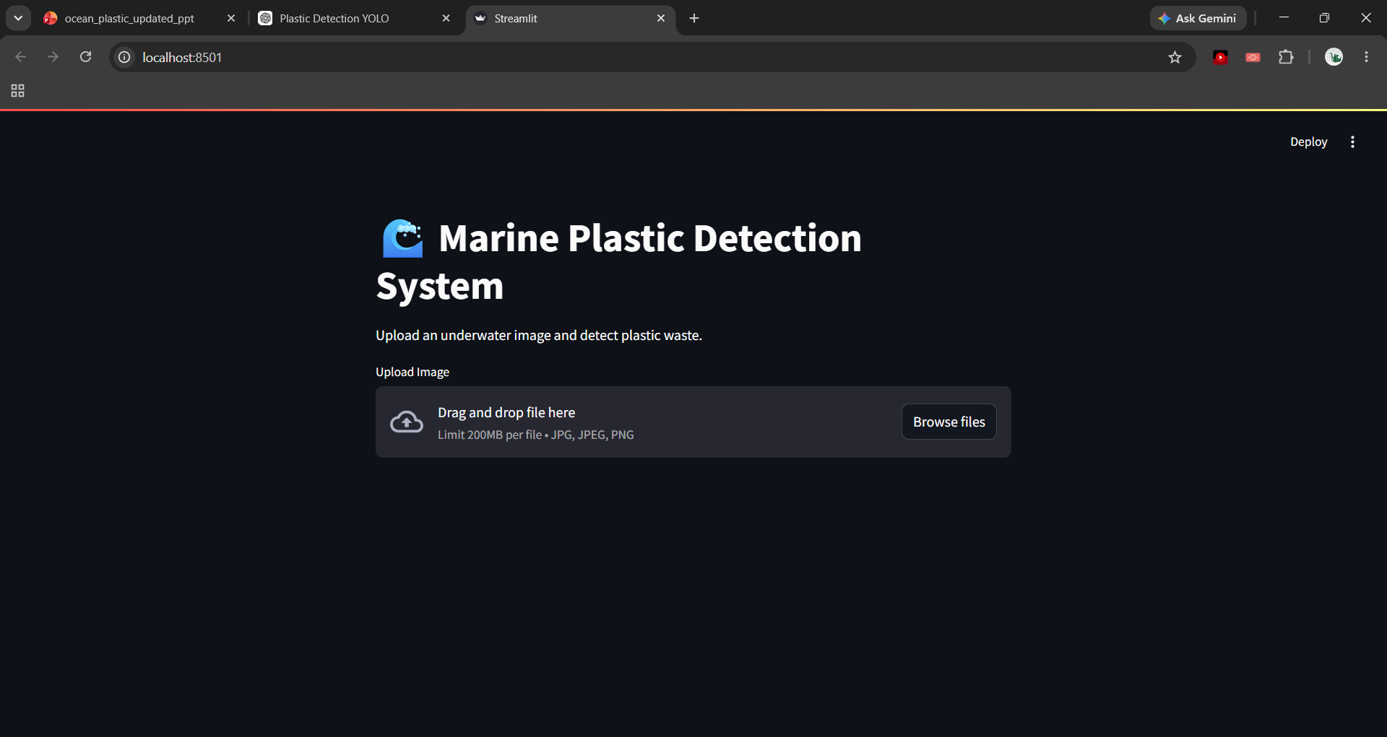
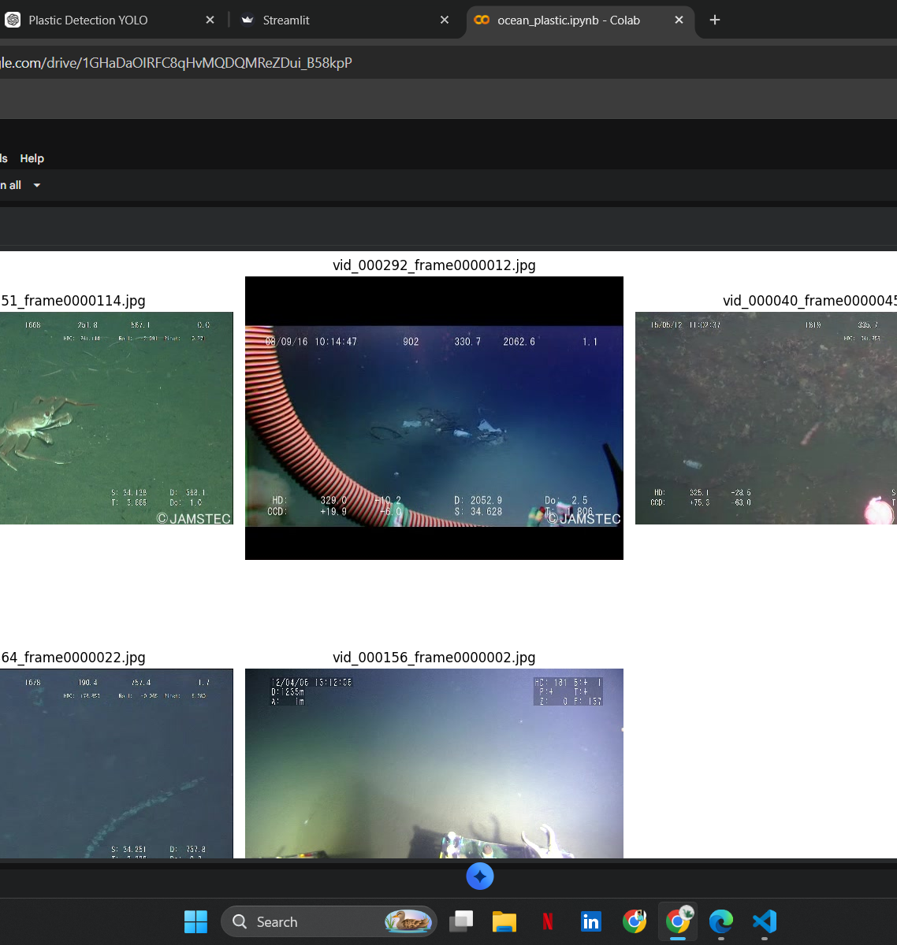
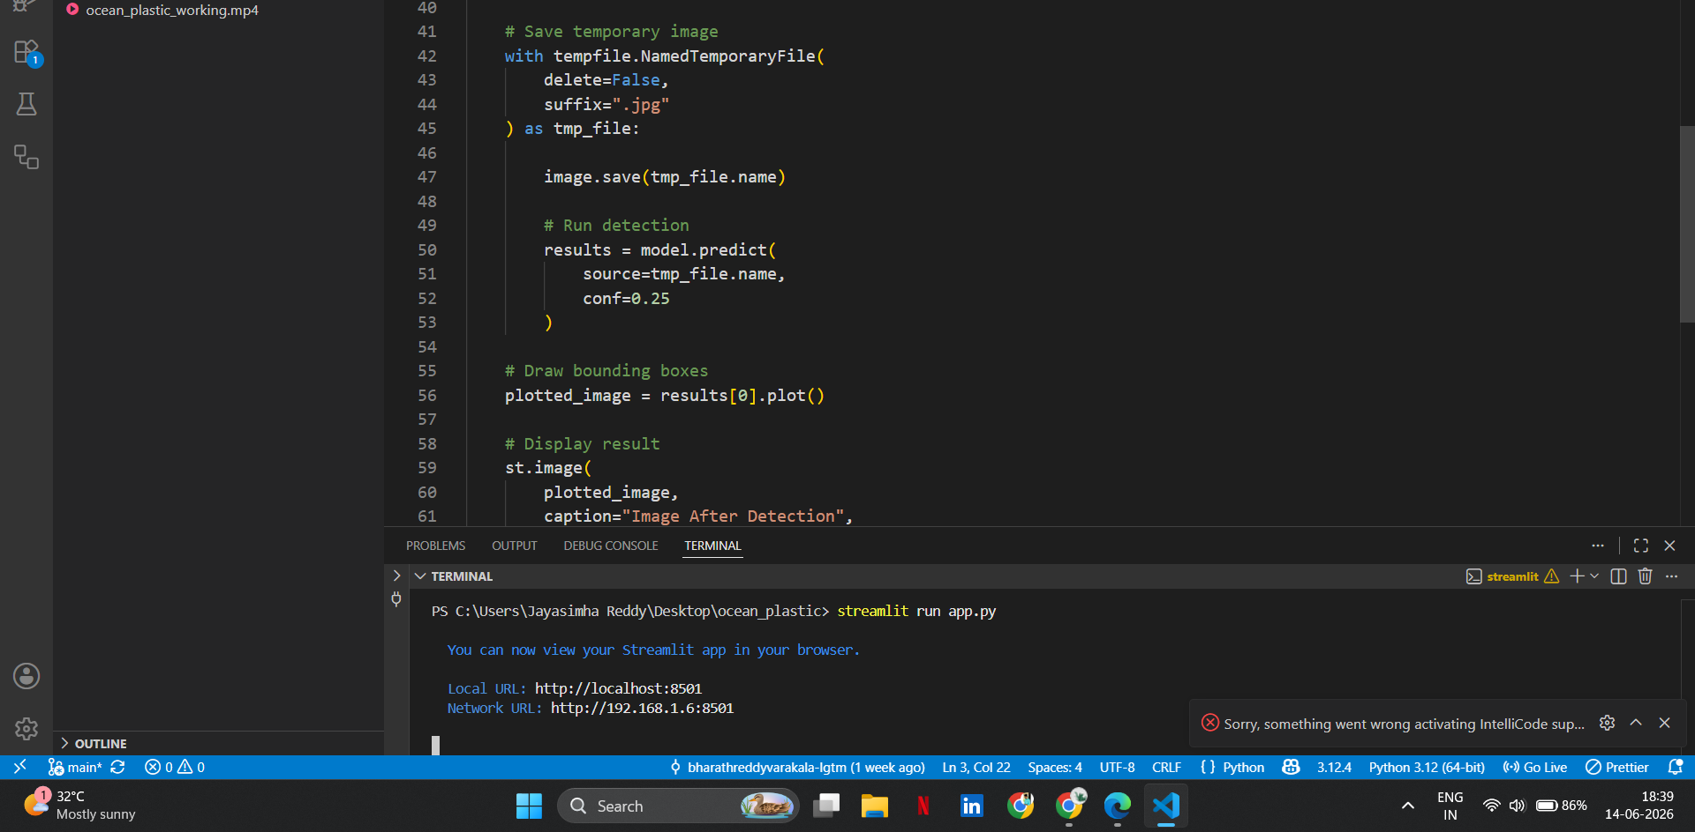

Slide 15
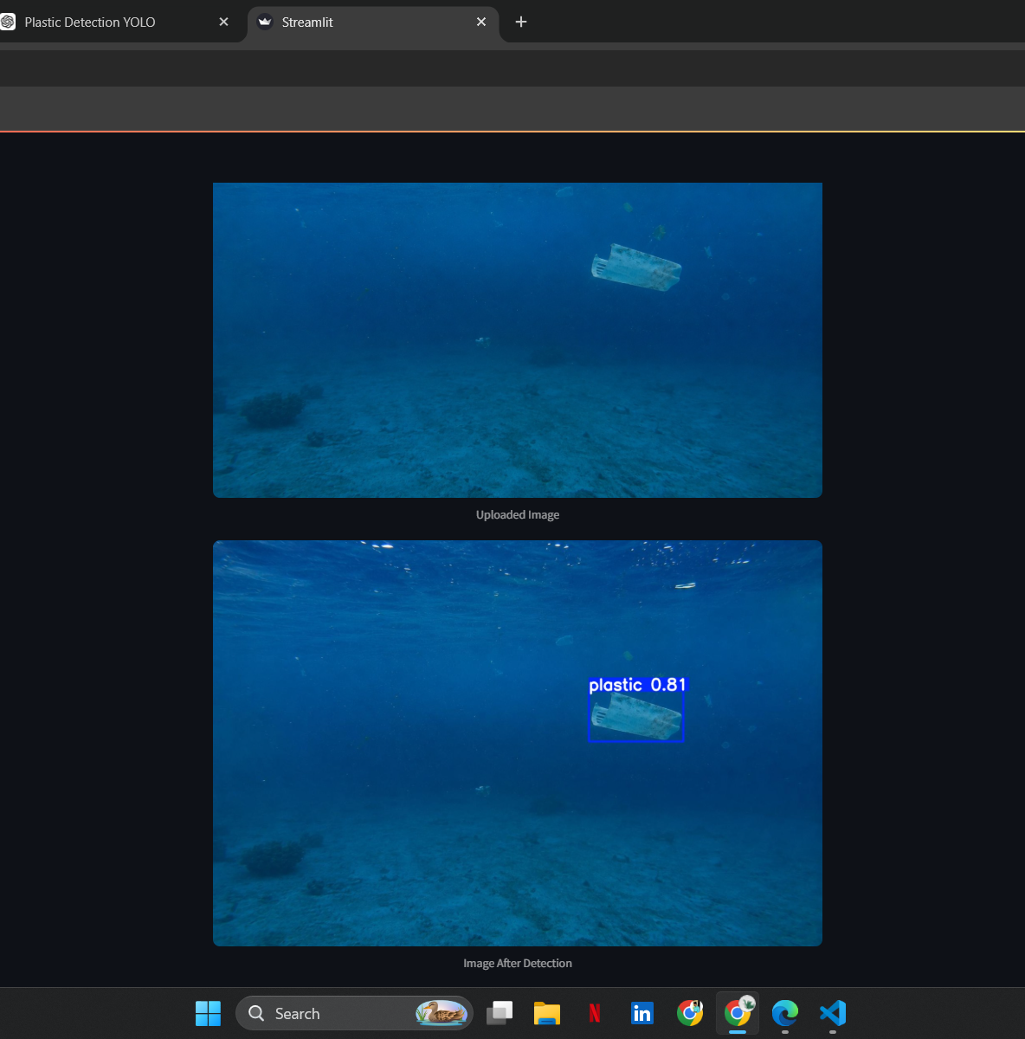
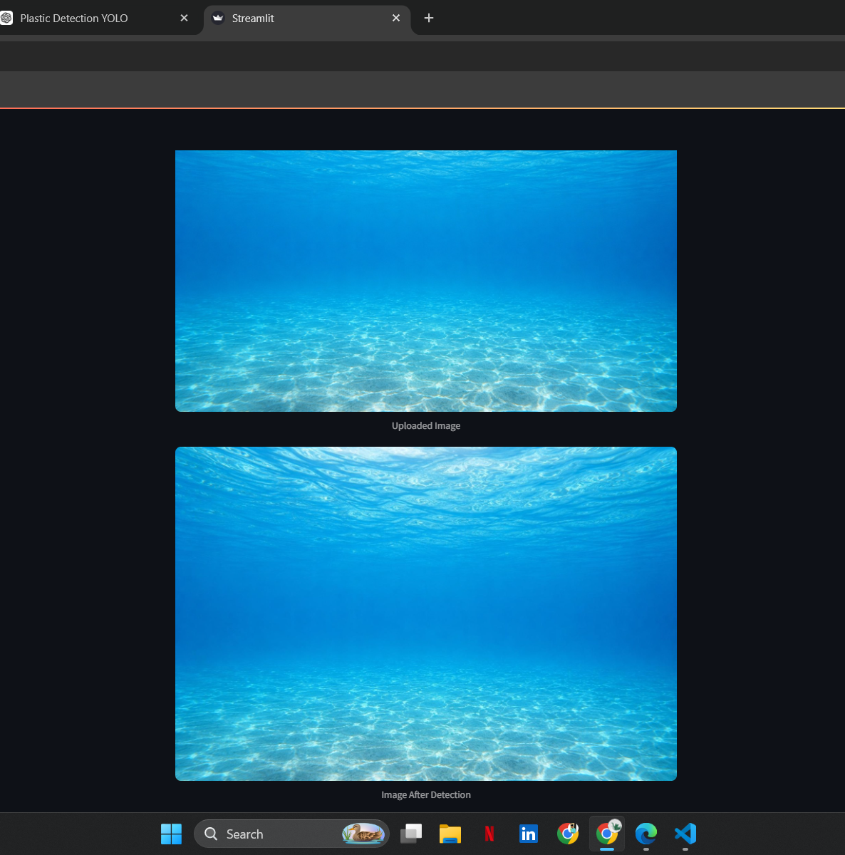

Slide 16
Advancing ocean conservation by bridging the gap between computer vision and autonomous marine cleanup systems.

