Slide 1

Beverage Industry Sales Performance Analysis
This presentation examines a detailed dataset of warehouse and retail sales across alcoholic and non-alcoholic beverages, including beer, wine, liquor, and related supplies.
Our analysis focuses on five key objectives: yearly and monthly sales performance, supplier contributions, product profitability, sales forecasting, and customer purchase patterns..
The dataset, sourced from the U.S. government's open data initiative, contains over 307,646 records with a total sales value of $9,942,655 split between retail ($2,160,899) and warehouse ($7,781,756) channels.
by Abhishek Kashyap
12311363

Slide 2




Dataset Preprocessing Methodology
Data Cleaning
Column Standardization
Identified and managed missing entries while retaining them for aggregate analysis. Checked for duplicates using countif formulas and removed them when detected.
Verified numerical consistency across "RETAIL SALES," "WAREHOUSE SALES," and "Total Sales" columns, converting text-based numbers to float values where necessary.
Aggregation
Summarized the dataset to calculate key metrics like total retail sales ($2,160,899.37) and warehouse sales ($7,781,756.28) using sum formulas.

Slide 3
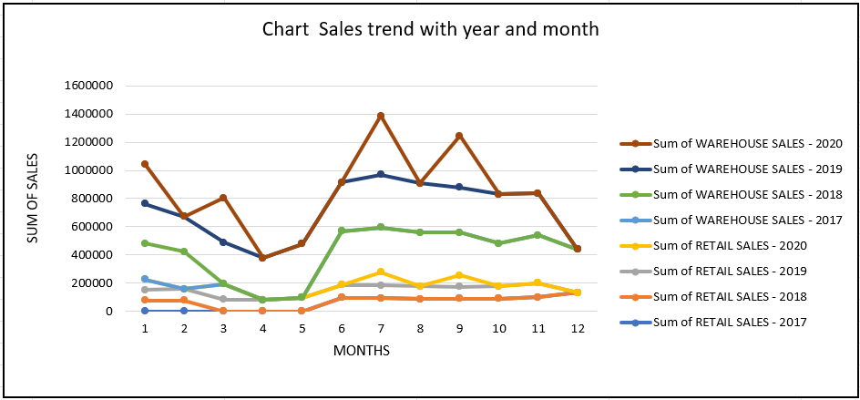
Yearly & Monthly Sales Performance
Our analysis reveals consistent growth in both retail and warehouse sales from 2017 to 2019, with 2019 recording the highest total revenue across both sectors. The data shows clear seasonal patterns, with July consistently demonstrating higher sales volumes across all years.
The multiline chart visualization allows for easy comparison of seasonal sales patterns across different years. Monthly and yearly filters enable targeted analysis while maintaining readability between retail and warehouse performance through dual-axis scaling.

Slide 4
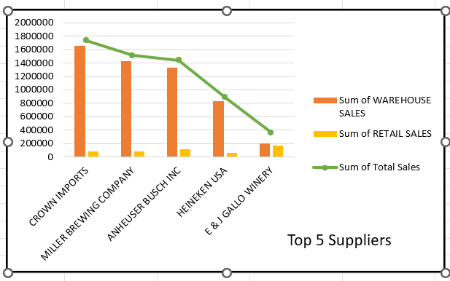
Top Supplier Performance Analysis
CROWN IMPORTS
Market leader in both warehouse and retail channels, contributing the
largest share to total sales.
MILLER BREWING COMPANY
Strong second-place performer with significant contributions across both sales
channels.
ANHEUSER BUSCH INC
Major contributor to total sales with balanced performance in retail and
warehouse segments.
Other Top Performers
HEINEKEN USA and E & J GALLO WINERY round out the top five suppliers, collectively representing a significant portion of total sales.

Slide 5
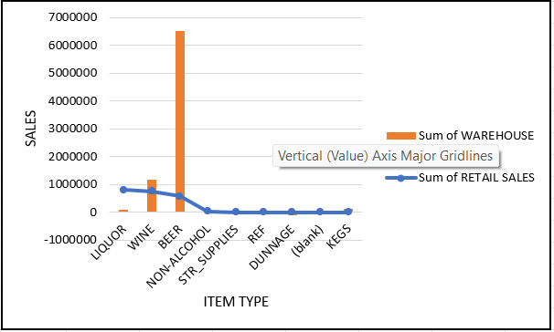






Product Sales Performance and profitability
Wine
Demonstrates balanced performance across both retail and warehouse channels with stable demand over time.
Liquor
Beer
Leads in retail sales with the highest profit margins in this channel, showing consistent growth over the analysis period.
Dominates warehouse sales (70.5% of total) but shows lower performance in retail channels.
Our analysis reveals distinct channel preferences for different product categories. Beer contributes most significantly to warehouse sales, while liquor leads in the retail segment. Wine shows the most consistent performance across both channels, suggesting a balanced distribution strategy.
The profit margin is highest for liquor in retail sales and beer in warehouse sales, indicating these as the most valuable product categories in their respective channels.

Slide 6
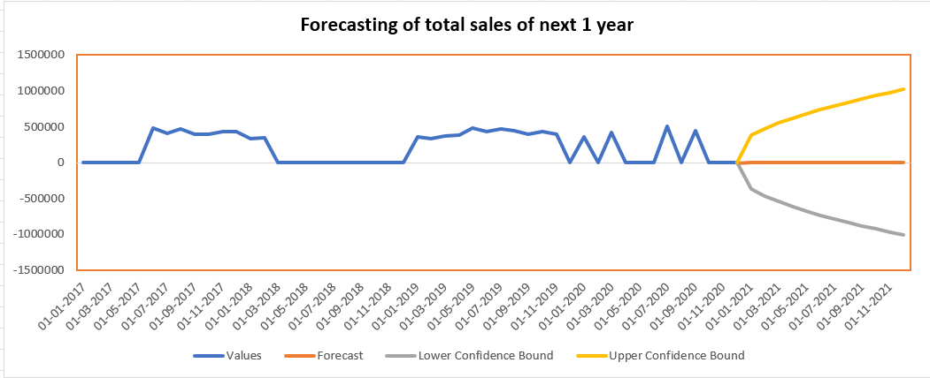
Sales Forecasting & Trend Projection
1
Historical Data (2017-2020)
Shows ascending sales trend with seasonal fluctuations and peak performance in 2019.
2
Current Trend
Indicates continued growth trajectory with predictable seasonal patterns.
3
Future Projection
Forecasts continued growth with highest increases expected in Q4, likely due to seasonal effects.
Our forecasting model includes confidence boundaries to provide expected ranges for future sales values. The analysis projects continued growth, with particularly strong performance expected in the fourth quarter of each year, consistent with observed seasonal patterns.
This forecast can help stakeholders with inventory planning, resource allocation, and financial projections, enabling more informed decision-making for future business cycles.

Slide 7

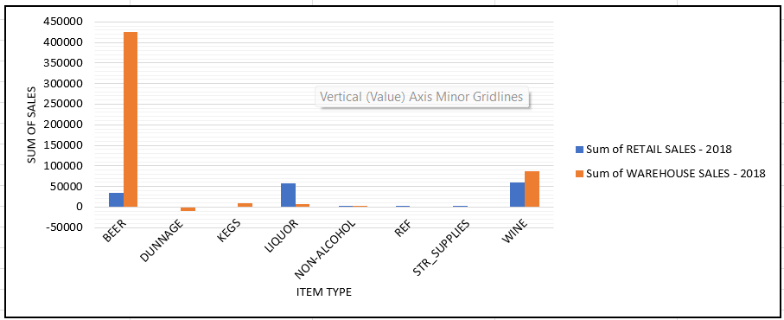



Customer Demand & Purchase Patterns
Beer Trends
Sharp increase in 2019 for warehouse sales, followed by a drop in 2020. Retail sales showed a decline in 2018.
Wine Patterns
Demonstrates overall stability across the analysis period in both retail and warehouse channels.
Liquor Growth
Shows consistent growth over the years, particularly in retail channels where it leads in sales performance.
Overall Trends
Reveals shifting customer preferences potentially influenced by marketing strategies or socioeconomic factors.
Our analysis of customer purchase patterns reveals interesting shifts in product preferences over time. The clustered area chart visualization illustrates these changing demands across product categories, with each layer representing a specific item type and the total area showing overall purchase volume.

Slide 8








Conclusions & Future Opportunities
Expanded Analytics
Integrate cost data and extend beyond 2025
Advanced Forecasting
Apply ARIMA models for better seasonal predictions
Consumer Insights
Add demographics and behavior data
Strategic Applications
Optimize inventory, negotiations, and marketing
Our analysis reveals a beverage distribution model heavily skewed toward warehouse sales (78.6% of total), with beer as the primary revenue driver. Top suppliers like CROWN IMPORTS and MILLER BREWING COMPANY dominate, contributing nearly 60% of total sales.
Future opportunities include inventory optimization based on seasonal insights, leveraging supplier relationships for better terms, targeted marketing strategies for high-value segments, and improved operational efficiency through better understanding of channel dynamics.

Slide 9
