Slide 2
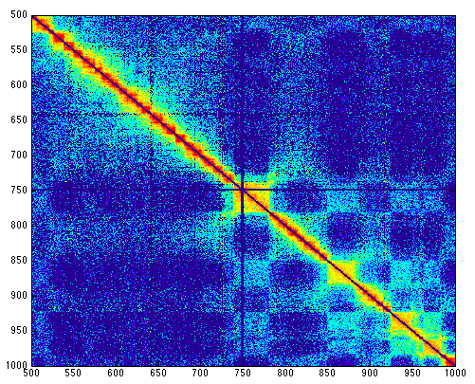
Looking for TADS
Boundaries
Another classification?

Slide 3
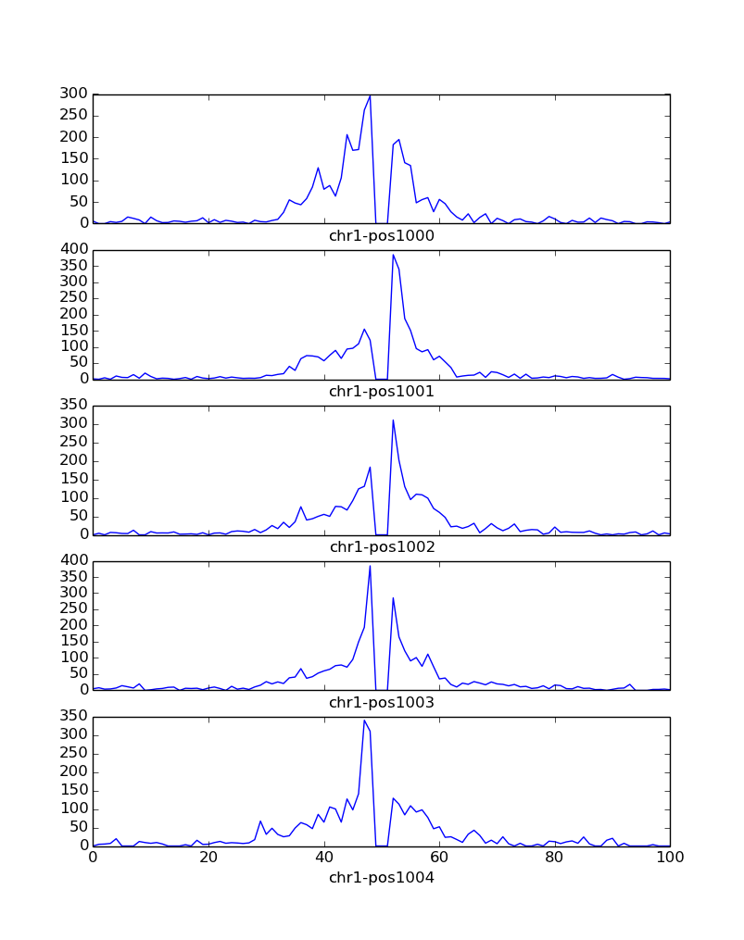
Method
Take windows (100 bin wide)
Take metrics of the profiles
Left area
Right area
Sum
Difference
Noisy profile

Slide 4
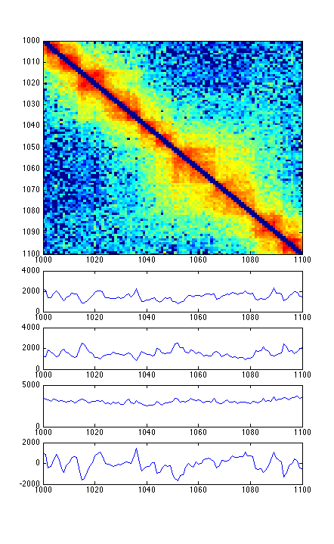
A Look at the Metrics
L
R
L + R
L - R

Slide 5
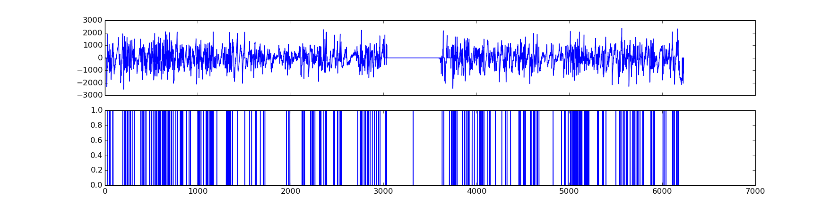
Removing the Noise
How far apart do we look for the shifts?
What should be the minimum difference between a max and min?
What counts as a shift?
Three parameters that can be varied and possibly learned

Slide 6
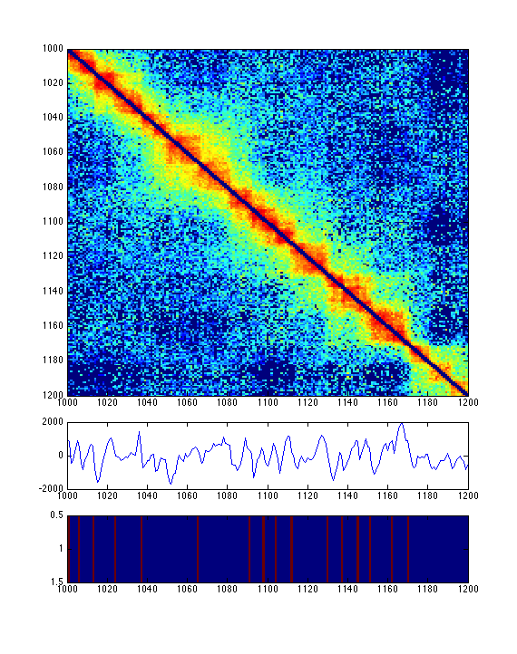
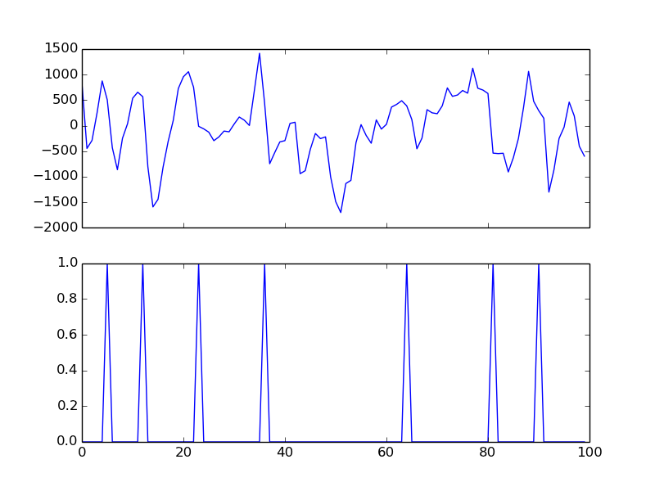

Slide 7
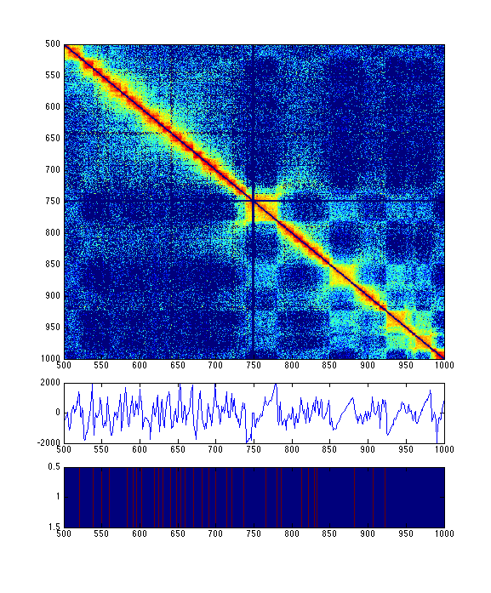

Slide 8
Improving TADS
Using learning
- Label some boundaries to train with
Other classifications

Slide 9
Next Steps
Combine with compartments
Look for genetic sequence enrichments in different classifications
Look for genetic sequences in combination with compartments

