Slide 1
Stock Market Sentiment in Times of Crisis
Seminar Social Sentiment in Times of Crisis

Slide 2
For individuals, we expect that the sentiment on current events, particularly those with implications on macroeconomic indices, as well as the grade of the individuals information to influence the opinion on investments.

Slide 3
Overview
Related Work
Methodology
Results
Discussion

Slide 4
Related Work

Slide 5
Methodology

Slide 6
Structural Equation Modelling - SEM
Goal: Find relationships between observed and latent variables
Simultaniously estimate latent variables and causal relationships between them
Step 1: Define how latent variables depend on observed variables
Step 2: Define causal relationships between latent variables
Step 3: Define additional connection links between observed variables
Limitations: in general used for linear dependencies

Slide 7
Feature Selection

Slide 8
Explorative Factor Analyse (EFA)

Slide 9
Cornbach Alpha

Slide 10
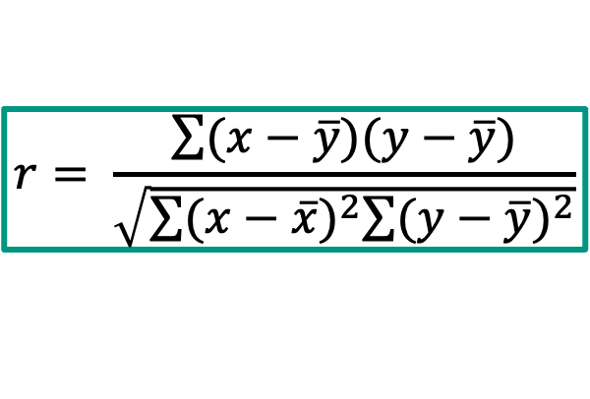

Connection Links Observed Variables
Calculate Pearson Correlation Coefficient between observed variables
Add found correlations to the model to be considered
Limitations: Only finds linear dependencies between variables
But SEM is also for linear dependencies, so no problem
$$r= \frac{\sum{(x−\overline{y})(y−\overline{y})}}{\sqrt{\sum{{(x−\overline{x})}^{2}\sum{{(y−\overline{y})}^{2}}}}}$$

Slide 11
Results

