Slide 1
Stock Market Sentiment in Times of Crisis
Seminar Social Sentiment in Times of Crisis

Slide 2
For individuals, we expect that the sentiment on current events, particularly those with implications on macroeconomic indices, as well as the grade of the individuals information to influence the opinion on investments.

Slide 3
Overview
Related Work
Methodology
Results
Discussion

Slide 4
Related Work

Slide 5
Methodology

Slide 6
Structural Equation Modelling - SEM
Goal: Find relationships between observed and latent variables
Simultaniously estimate latent variables and causal relationships between them
Step 1: Define how latent variables depend on observed variables
Step 2: Define causal relationships between latent variables
Step 3: Define additional connection links between observed variables
Limitations: in general used for linear dependencies

Slide 7
Feature Selection
 | Information Awareness
F5a | How often do you inform via public, private and alternative media channels?
F5b | Which channels are you using?
F5A10_1 – A14_1 | How much du you trust in different media?
 | Ukraine War Sentiment
F2A6 | I worry Germany will get involved in ukraine war deeper
F2A7 | I worry about Ukrainian refugee’s situation in Germany
F2A14 | I worry that russia will use atomic weapons
F3A14_1 | Germany should support Ukraine military as long as war is going on
F3A22_1 | Ukraine should admit lost of land to end war
 | Investment Sentiment
F71invest | Are you currently investing in the stock market?
F5A10_2 | How much do you trust in the stock market
F3A21_1 | It currently makes sense to invest in stocks
 | Energy Crisis Sentiment
F1A13_1 | The energy crisis is worsen my situation
F1A14_1 | I can handle the energy crisis better than past crises
F3A20_1 | I lower energy consumption due to financial reasons
 | Corona Sentiment
F3A15_1 | Current corona regulations in Germany are going to far
F3A16_1 | A mask obligation is currently necessary
F3A17_1 | Corona infected people should still isolate for 5 days
Eonomoic Indizes
Inflation Rate
Interest Rate
DAX
MSCI World

Slide 8
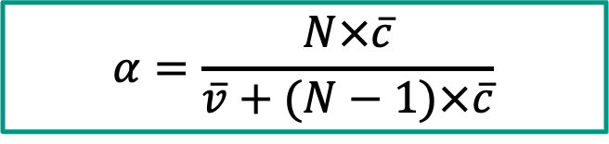
Cronbach Alpha
Calculate internal consistency of intended latend variables
Not content wise, but based on covariance
Commonly used interpretation:
$$α=\frac{N×\overline{c}}{\overline{v}+(N−1)×\overline{c}}$$
Economic Indices
Information Awareness, Ukraine War Sentiment, Energy Crisis Sentiment, Investment Behaviour
Corona Sentiment
> 0,9 | Excellent
> 0,8 | Good
> 0,7 | Acceptable
> 0,6 | Questionable
> 0,5 | Bad
< 0,5 | Inacceptable
Notes:
α=0.7 means 70% of the total variance is due to the shared covariance (inter-item relationships), while the remaining 30% is due to unique variance (item-specific variance or error)

Slide 9
Explorative Factor Analyse (EFA)

Slide 10
Final Feature Selection
 | Information Awareness
F5a | How often do you inform via public, private and alternative media channels?
F5b | Which channels are you using?
F5A10_1 – A14_1 | How much du you trust different media?
 | Ukraine War Sentiment
F2A6 | I worry Germany will get involved in ukraine war deeper
F2A7 | I worry about Ukrainian refugee’s situation in Germany
F2A14 | I worry that russia will use atomic weapons
F3A14_1 | Germany should support Ukraine military as long as war is going on
F3A22_1 | Ukraine should admit lost of land to end war
 | Investment Sentiment
F71invest | Are you currently investing in the stock market?
F5A10_2 | How much do you trust in the stock market
F3A21_1 | It currently makes sense to invest in stocks
 | Energy Crisis Sentiment
F1A13_1 | The energy crisis is worsen my situation
F1A14_1 | I can handle the energy crisis better than past crises
F3A20_1 | I lower energy consumption due to financial reasons
 | Corona Sentiment
F3A15_1 | Current corona regulations in Germany are going to far
F3A16_1 | A mask obligation is currently necessary
F3A17_1 | Corona infected people should still isolate for 5 days
Eonomoic Indizes
Inflation Rate
Interest Rate
DAX
MSCI World

Slide 11
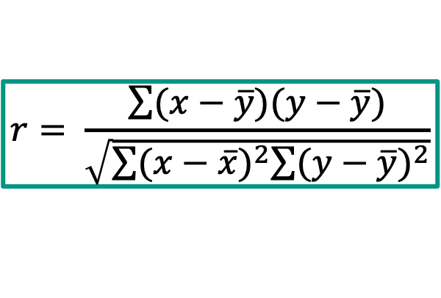

Connection Links Observed Variables
Calculate Pearson Correlation Coefficient between observed variables
Add found correlations to the model to be considered
Limitations: Only finds linear dependencies between variables
But SEM is also for linear dependencies, so no problem
$$r= \frac{\sum{(x−\overline{y})(y−\overline{y})}}{\sqrt{\sum{{(x−\overline{x})}^{2}\sum{{(y−\overline{y})}^{2}}}}}$$

Slide 12
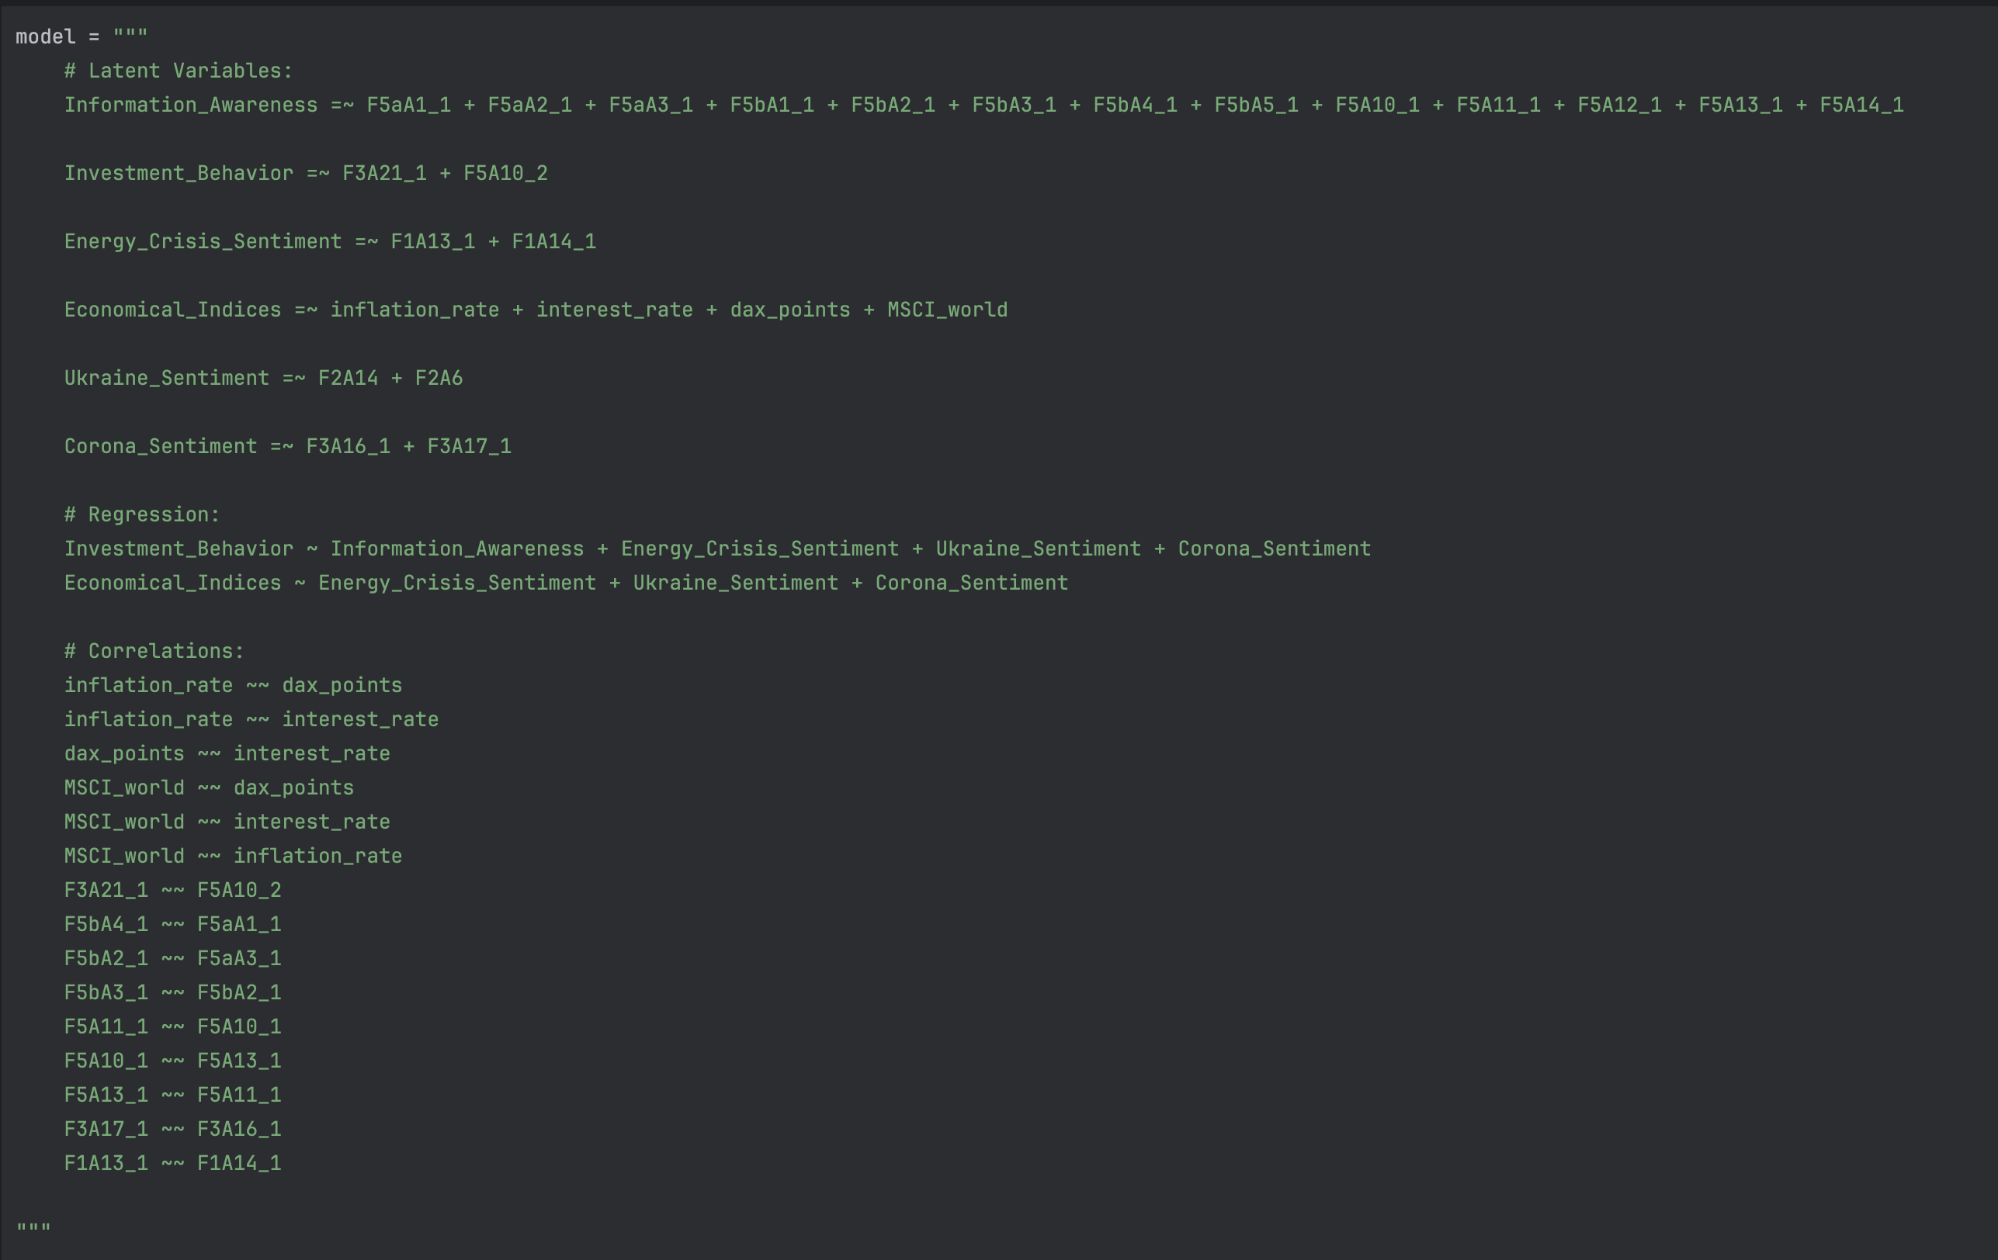

Slide 13
Results

Slide 14
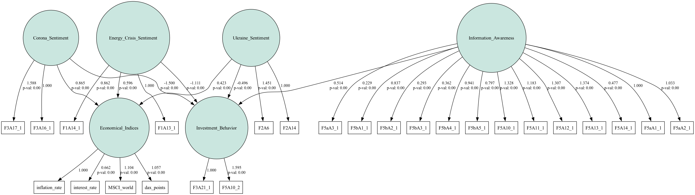
SEM - Stuctural Equation Model

Slide 15
Investment Behaviour |  | Estimator | P-Value
~ | Information Awareness | 0.514 | 0.002
~ | Energy Crisis Sentiment | -1.111 | 0.001
~ | Ukraine Sentiment | -0.496 | 0.000
~ | Corona Sentiment | -1.500 | 0.001
Economical Indices |  | Estimator | P-Value
~ | Energy Crisis Sentiment | 0.596 | 0.000
~ | Ukraine Sentiment | 0.423 | 0.000
~ | Corona Sentiment | 0.865 | 0.000

Slide 16
Subgroups of Interest
New vs. old states
New: 3227
Old: 21097
Age
Age <=39: 8282
39 > Age >= 60: 8298
Age > 60: 7744
School Education
Up to Middle School: 10786
High School Diploma or Similar: 13127
Income
Up to 2600€: 7544
Between 2600€ and 3560€: 8091
More than 3650€: 8689

Slide 17
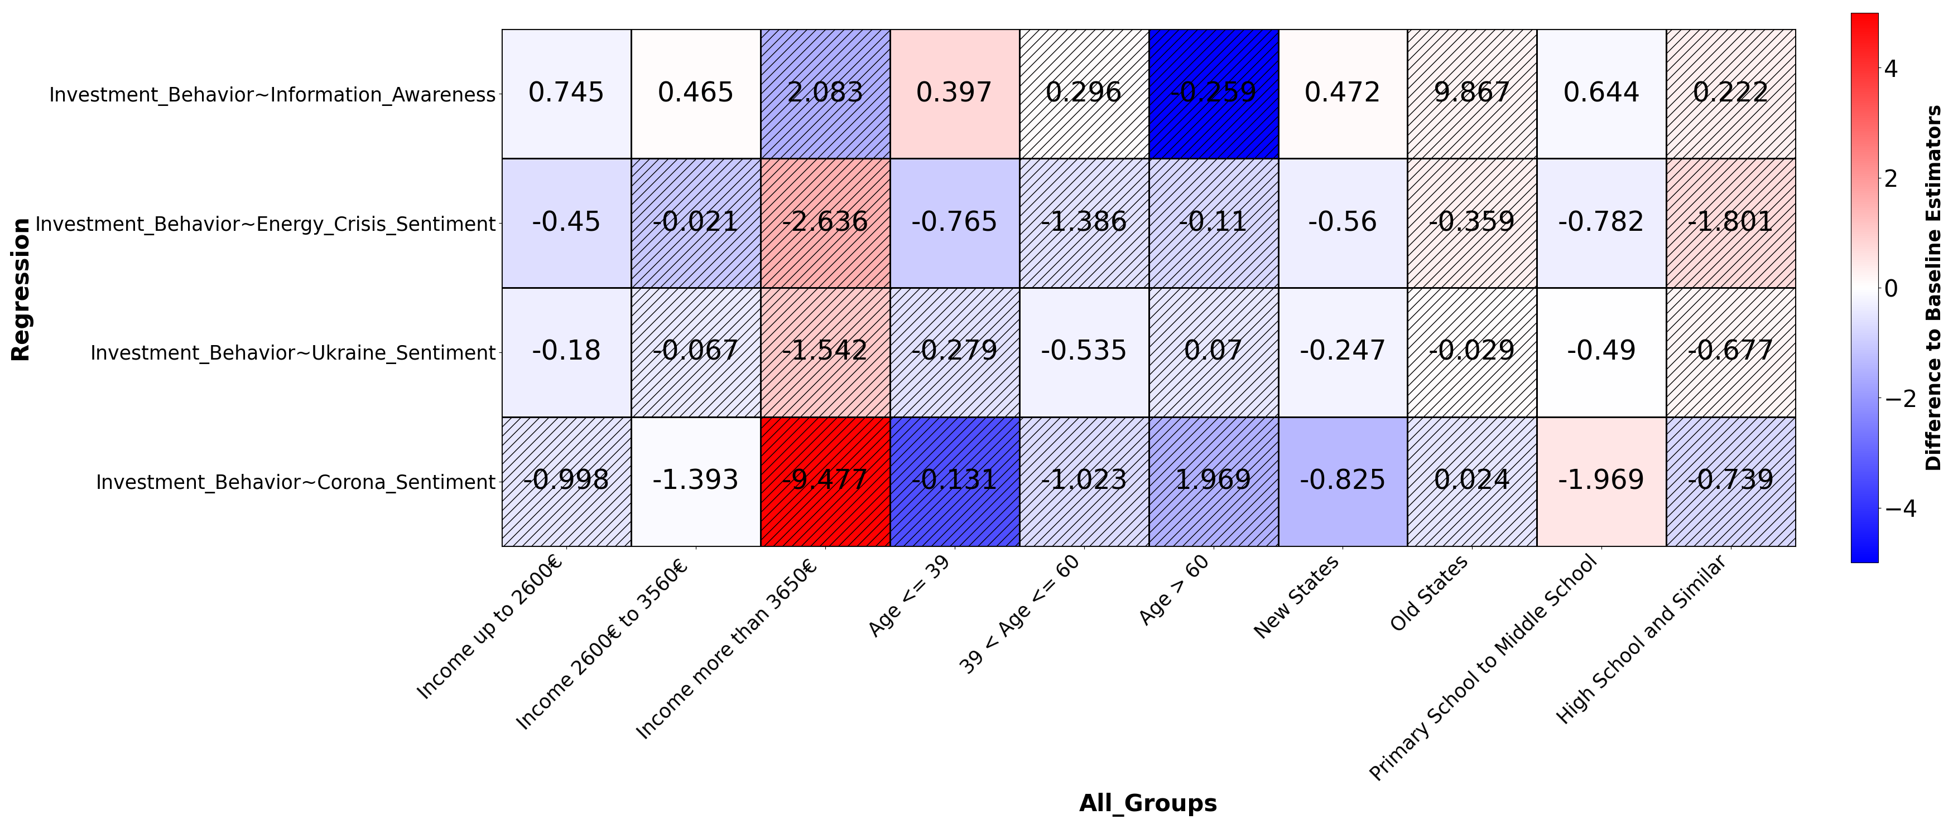
Subgroups Influence on Estimators
-0.259

Slide 18
Discussion

