Slide 1
Stock Market Sentiment in Times of Crisis
Seminar Social Sentiment in Times of Crisis

Slide 2
For informed individuals, we expect current events, particularly those with economic implications, as well as macroeconomic indices to influence their opinion on the timing of investments. Negative events, higher interest rates, and higher inflation lead to lower investment intention, while rising markets cause higher investment intention.

Slide 3
Data
SOSEC Data Set
Fearures especially in use:
F3A21_1: ”Aktuell ergibt es Sinn in Aktien zu investieren”
F71invest: “Investieren Sie momentan in den Aktienmarkt”
F5A10_2: “Wie viel Vertrauen haben Sie in den Aktienmarkt”
F5a: ”Wie häufig beziehen Sie Nachrichten aus den Quellen? … ”
F5b: “Auf welche Kanäle greifen Sie dabei zu? … ”
i_START / i_END
External Datasets from Yahoo Finance and Deutsche Bundesbank for
Interest rate, inflation rate, dax points, consumer price index

Slide 4
Structural Equation Modelling - SEM
Goal: Find relationships between observed and latent variables
Simultaniously estimate latent variables and causal relationships between them
Step 1: Define how latent variables depend on observed variables
Step 2: Define causal relationships between latent variables
Step 3: Define additional connection links between observed variables
Limitations: in general used for linear dependencies

Slide 6
SEM - Dependencies Observed and Latent Variables
Observed variables:
Latent variables
How often are specific news channels used
Which news channels are used mostly
Trust in stock market
Are people investing right now
Do people think investing is a good idea right now
Intrest rate, dax points, consumer price index, inflation rate
How informed individuals
Opinion on timing of investment
Macroeconomic indizes

Slide 7
SEM – Dependency Assumption
Channels of Information
How Informed are Individuals
Frequency of Informing
Trust in Stock Market
Interest Rate
Currently Investing
Opinion on Timing of Investment
Inflation Rate
Current Opinion of Investing
Dax Points
Macroeconomic Indices
Consumer Price Index

Slide 8
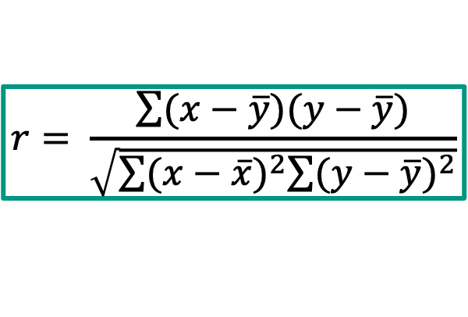

SEM – Connection Links Observed Variables
Calculate Pearson Correlation Coefficient between observed variables
Add found correlations to the model to be considered
Limitations: Only finds linear dependencies between variables
But SEM is also for linear dependencies, so no problem
$$r= \frac{\sum{(x−\overline{y})(y−\overline{y})}}{\sqrt{\sum{{(x−\overline{x})}^{2}\sum{{(y−\overline{y})}^{2}}}}}$$

Slide 9
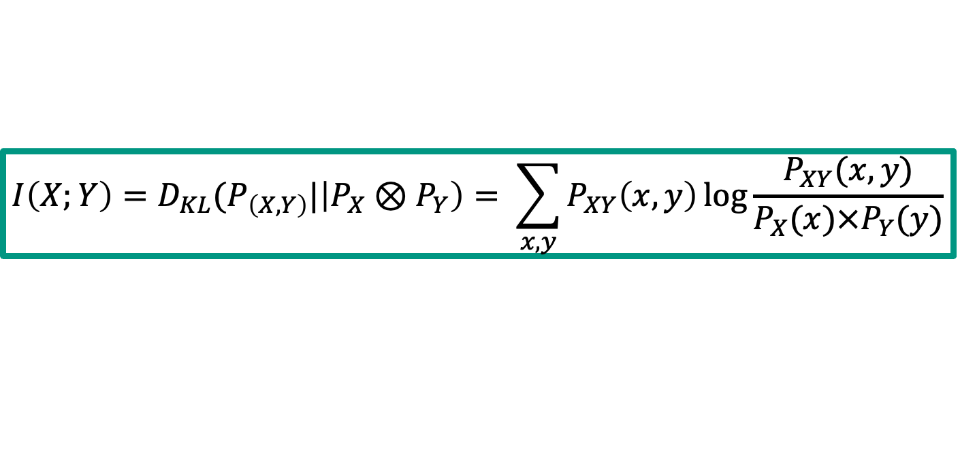
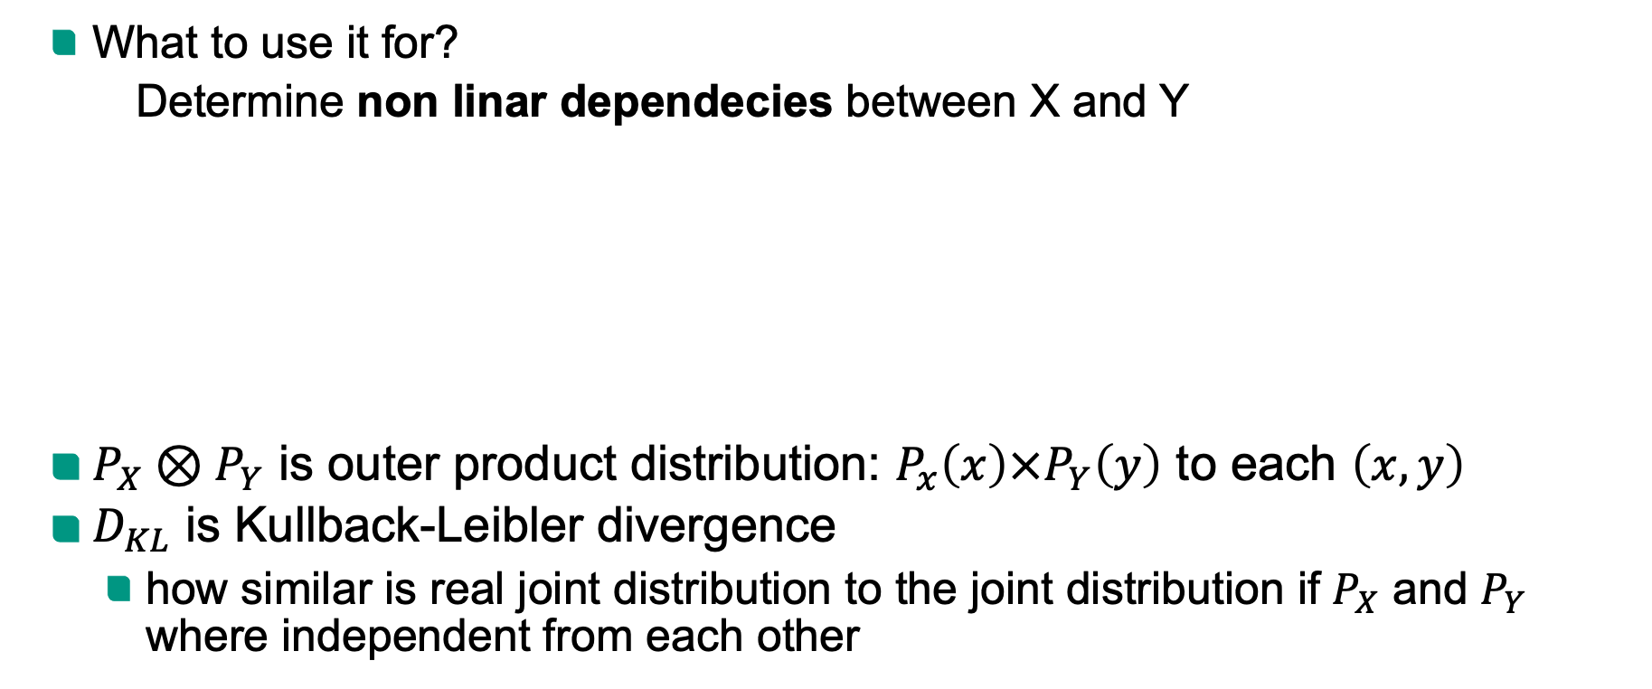
Mutual Information
What to use it for?
Determine non linar dependecies between X and Y
$P_{X}⊗P_{Y}$ is outer product distribution: $P_{x}\left(x\right)×P_{Y}\left(y\right)$ to each $\left(x, y\right)$
$D_{KL}$ is Kullback-Leibler divergence
how similar is real joint distribution to the joint distribution if $P_{X}$ and $P_{Y}$ where independent from each other
$$I\left(X;Y\right)=D_{KL}(P_{\left(X,Y\right)}|\left|P_{X}⊗P_{Y}\right)= \sum_{x, y}{P_{XY}\left(x, y\right)\log{\frac{P_{XY}(x,y)}{P_{X}(x)×P_{Y}(y)}}}$$

