Slide 1
Stock Market Sentiment in Times of Crisis
Seminar Social Sentiment in Times of Crisis

Slide 2
For informed individuals, we expect current events, particularly those with economic implications, as well as macroeconomic indices to influence their opinion on the timing of investments. Negative events, higher interest rates, and higher inflation lead to lower investment intention, while rising markets cause higher investment intention.

Slide 3
Data – General Analytics and Preprocessing
SOSEC Data Set
Data set starts in November 2022
Investment related data starts in January 2023
External Datasets from Yahoo Finance and Deutsche Bundesbank for
Interest rate, inflation rate, dax points, consumer price index

Slide 4
Structural Equation Modelling - SEM
Goal: Find relationships between observed and latent variables
Step 1: Define a model
What dependencies do we assume?
Step 2: Define those dependencies
Which observable variabels do we have?
How are latent variables connected to theese?
Step 3: Define additional connection links
Which connections do exist inbetween the observed variables?
Limitations: In general used for linear dependencies

Slide 5
SEM – Dependency Assumption
Opinion on Timing of investment = Economical Situation + Informed Individuals

Slide 6
SEM - Dependencies observed and latent variables
Observed variables:
Latent variables
How often are specific news channels used
Which news channels are used mostly
Trust in stock market
Are people investing right now
Do people think investing is a good idea right now
Intrest rate, dax points, consumer price index, inflation rate
How informed individuals
Opinion on timing of investment
Macroeconomic indizes

Slide 7
Screenshot of Model Definition

Slide 8
Correlation
Formular Explained

Slide 9
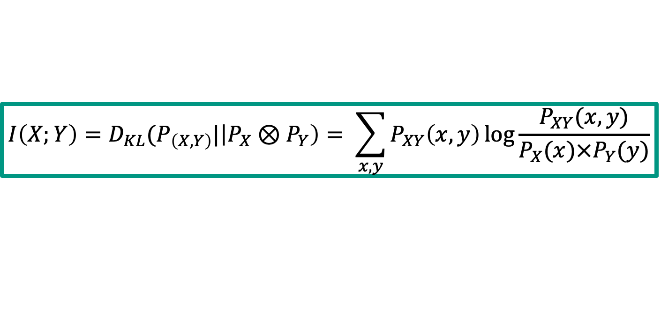
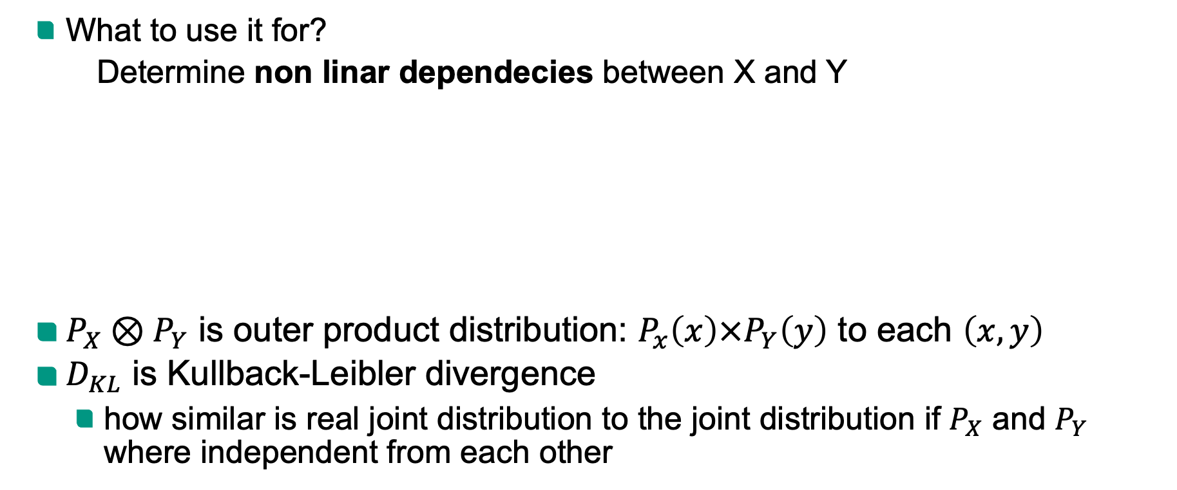
Mutual Information
What to use it for?
Determine non linar dependecies between X and Y
$P_{X}⊗P_{Y}$ is outer product distribution: $P_{x}\left(x\right)×P_{Y}\left(y\right)$ to each $\left(x, y\right)$
$D_{KL}$ is Kullback-Leibler divergence
how similar is real joint distribution to the joint distribution if $P_{X}$ and $P_{Y}$ where independent from each other
$$I\left(X;Y\right)=D_{KL}(P_{\left(X,Y\right)}|\left|P_{X}⊗P_{Y}\right)= \sum_{x, y}{P_{XY}\left(x, y\right)\log{\frac{P_{XY}(x,y)}{P_{X}(x)×P_{Y}(y)}}}$$

