Slide 1

UK Flight Forecast – Predicting Daily Arrivals at London Airports
Data Analysis and Time Series Forecasting with ARIMA
Daniel Hernandez | Milena Musiienko | Oscar Denche | Matthew Lester

Slide 2

01
Project overview
Introduction to project, Datasets and design choices.

Slide 3

Introduction
In this project we focused on analysing and forecasting daily flight arrivals into london using real world flight data. The data sets we used contained detailed records of flight and airport information for the month of september 2023.
Our goal for this project is to show how time series forecasting can be applied to real airline data to help with planning, management and operational decision making. To do this we decided to use an ARIMA model to generate a forecast showing the volume of flights arriving into london airports over the following 14 days.

Slide 4
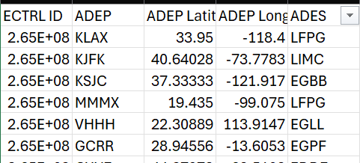
Datasets
We chose the dataset ‘Flights_20230901_20230930.csv’ because we could see the Airport of destination of each flight

Slide 5
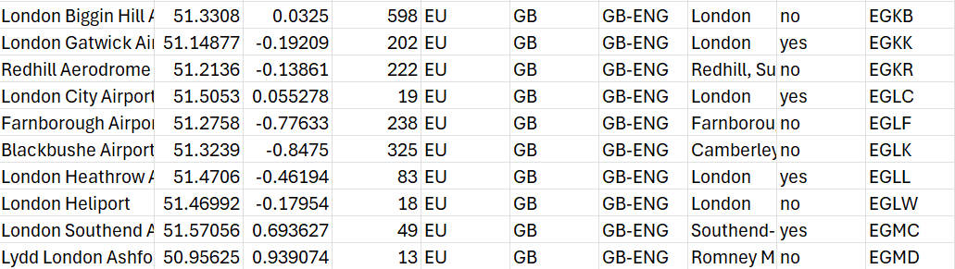

We also used the ‘airports.csv’ to filter the airports using their icao code

Slide 6
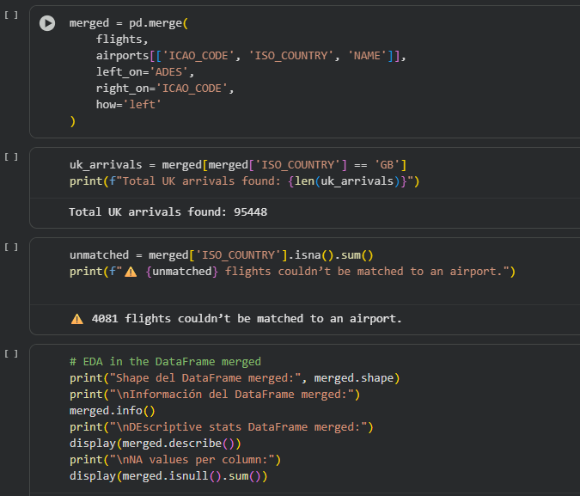
Merging the datasets
We needed to merge the datasets we had as the flight data only included airport codes (Eg, EGLL) and as a result we had to merge it with another data set containing airport names, countries they are located in and the codes.
We merged the datasets using Pandas’ merge() function, matching the destination airport codes in the flight data (ADES) with the ICAO codes in the airport data (ICAO_CODE) using a left join.
As a result, each flight record now includes the airport name and country, which allows us to filter for UK arrivals and prepare the data for daily aggregation and forecasting.

Slide 7
02
Dataset & Data Cleaning
Data Cleaning & Preparation

Slide 8

Data Set cleaning process
The raw dataset contained over 899,495 flight records with 21 variables.
To ensure reliability for time series modeling, several data cleaning steps were applied — including date formatting, duplicate removal, and outlier detection

Slide 9
Data Cleaning Steps
Handling Missing Values
Removing Duplicates
Detecting Outliers
Converting Data Types
All missing or empty entries were checked and removed where necessary.
(No significant missing data remained after cleaning.)
Verified that no duplicate flight records were present in the merged dataset.
(Ensured every flight entry was unique.)
Used the 1.5×IQR rule to identify extreme values in distance and flight-level variables.
(Most outliers were valid long-distance flights.)
Converted all time-related columns to date-time format for time series modeling.
(This enabled daily aggregation and forecasting.)

Slide 10

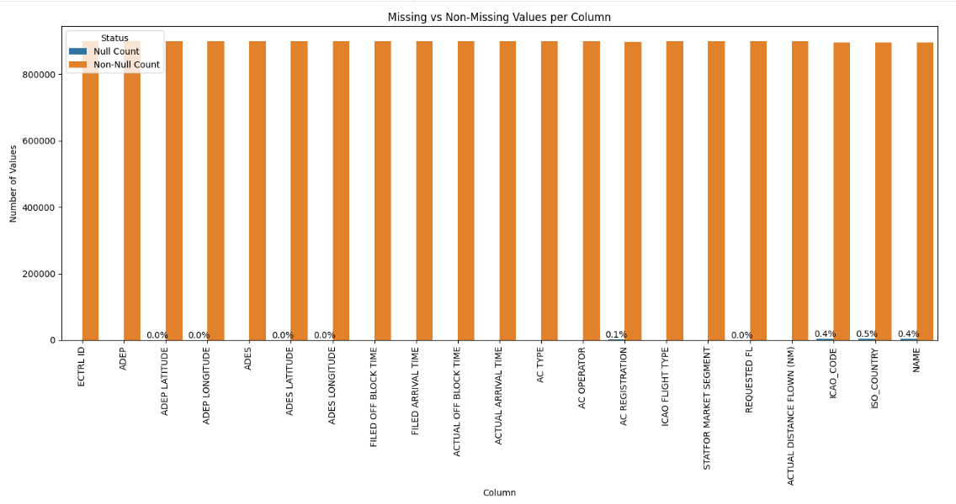
Missing Values Overview
1%
Missing values
860K
Clean records
Missing values were below 1% in all columns.
After cleaning, the dataset retained over 860,000 valid and consistent flight records ready for analysis.

Slide 11

03
Exploratory Data Analysis
The analysis focused on flight frequency, distance, and geographic distribution.

Slide 12
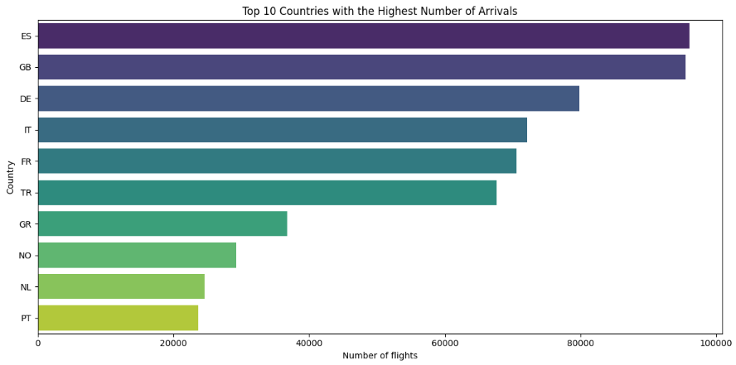
Top 10 Countries with the Highest arrivals
3
Main Origins
70%
of flights from Europe
Spain, UK, Germany.
Spain, the United Kingdom, and Germany accounted for the largest share of arrivals at London airports.Most inbound flights originated from European countries, confirming that short and medium-haul routes dominate the dataset.

Slide 13
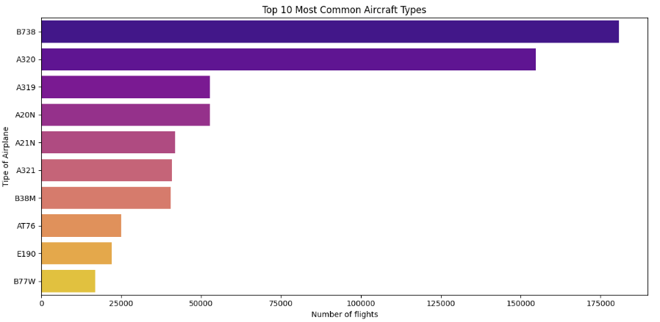
Top 10 Most Common Aircrafts Types
Main Models
B738 and A320 dominate
Flight range
Short/medium-haul routes
The most frequent aircraft in the dataset are the Boeing 737-800 and the Airbus A320, which together account for the majority of flights.This indicates that most routes are operated by short and medium-haul aircraft, consistent with the European flight patterns observed earlier.

Slide 14
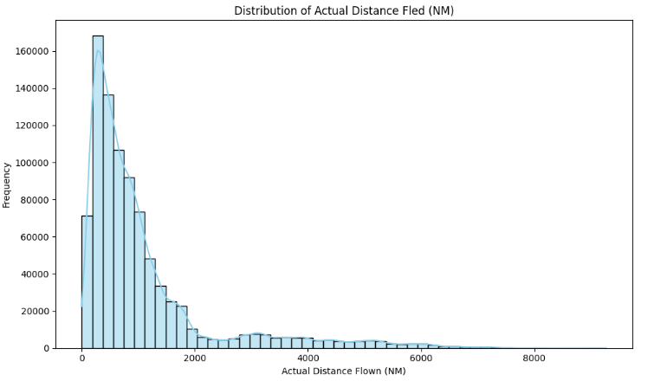
Distribution of Distance Fled
80%
Of flights under 2,000 NM
Few long-haul flights beyond 4,000 NM
Most flights cover short distances below 2,000 nautical miles, indicating that the majority are regional or intra-European routes.A smaller number of long-haul flights extend beyond 4,000 NM, representing intercontinental connections.

Slide 15

04
Prediction

Slide 16
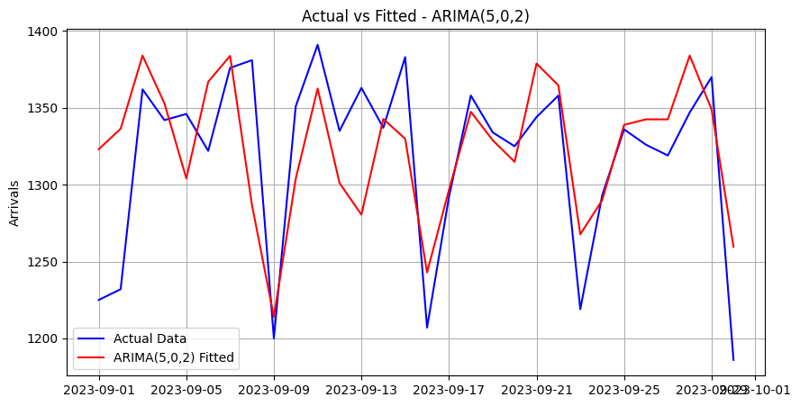
ARIMA for UK Arrivals Prediction
To forecast the number of daily flight arrivals, we selected the ARIMA model, as it is one of the most effective statistical methods for time series forecasting. ARIMA is specifically designed to capture how today’s values depend on previous days, making it ideal for predicting flight arrivals.
The parameters for ARIMA(5,0,2) closely follow the actual data, suggesting that this configuration captures short-term dynamics effectively.
p = 5: The model uses the last 5 days’ arrivals to predict the next day’s value.
d = 0: No differencing was required, as the daily arrivals series was already stationary after inspection.
q = 2: The forecast error depends on the previous 2 days’ forecast errors, helping smooth out random fluctuations in arrivals.

Slide 17
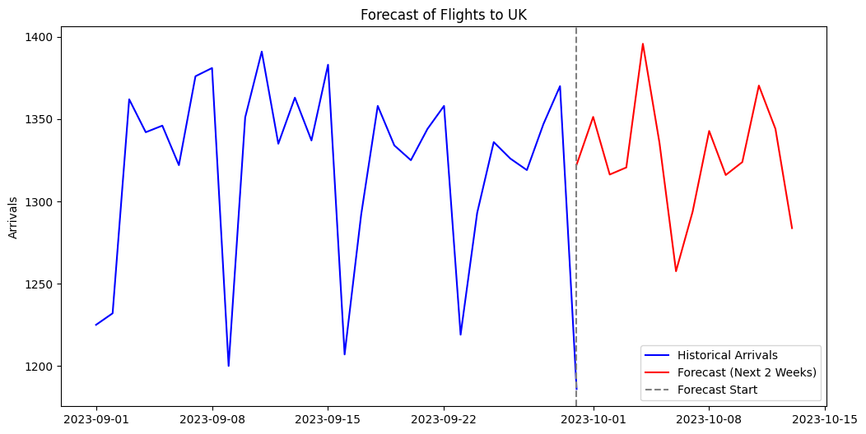
Actual vs Predicted Arrivals
Actual Data
Daily arrivals fluctuated between 1180-1390 flights per day.
Noticeable drops occurred on weekends, indicating lower traffic. Despite fluctuations, the overall pattern is stable, meaning consistent flights.
Predicted Data
Forecasted arrivals remain within the same range, showing that the model successfully captured the general trend, though the forecast predicts slightly higher averages in the first week.
No extreme deviations are observed, which indicates model stability and a well-fitted time series.
The model reproduces the weekly rhythm of flight activity. The small difference between actual and predicted values shows high accuracy of ARIMA.

Slide 18
05
Project Evaluation

Slide 19
Project limitations
The main limitation of our project was the restricted scope of the dataset. The data only covered flights for a single month (September 2023), and as a result, this limited our ability to identify long-term or seasonal trends in the data. With a larger dataset covering 6 months to a year, we could have applied more advanced models such as SARIMA (Seasonal ARIMA) to capture recurring seasonal patterns in flight arrivals, such as holiday peaks.
We also had a limited timeframe to complete this project, and we feel given more time we could create a more in-depth and polished product showing more insightful and accurate trends in the data.

