Slide 1

Simulations of qubit communication in prepare-and-measure and Bell scenarios
Prof: Gael Sentís Herrera (UAB)
Aido Cortés Alcaraz
Iñaki Ortiz de Landaluce Sáiz
Postgraduate Degree in Quantum Engineering

Slide 2
Postgraduate Degree in Quantum Engineering
OUTLINE:
INTRODUCTION
OBJECTIVES
CLASSICAL SIMULATIONS
QUANTUM SIMULATIONS WITH QUANTUM COMPUTERS
CONCLUSION AND FURTHER WORK

Slide 3
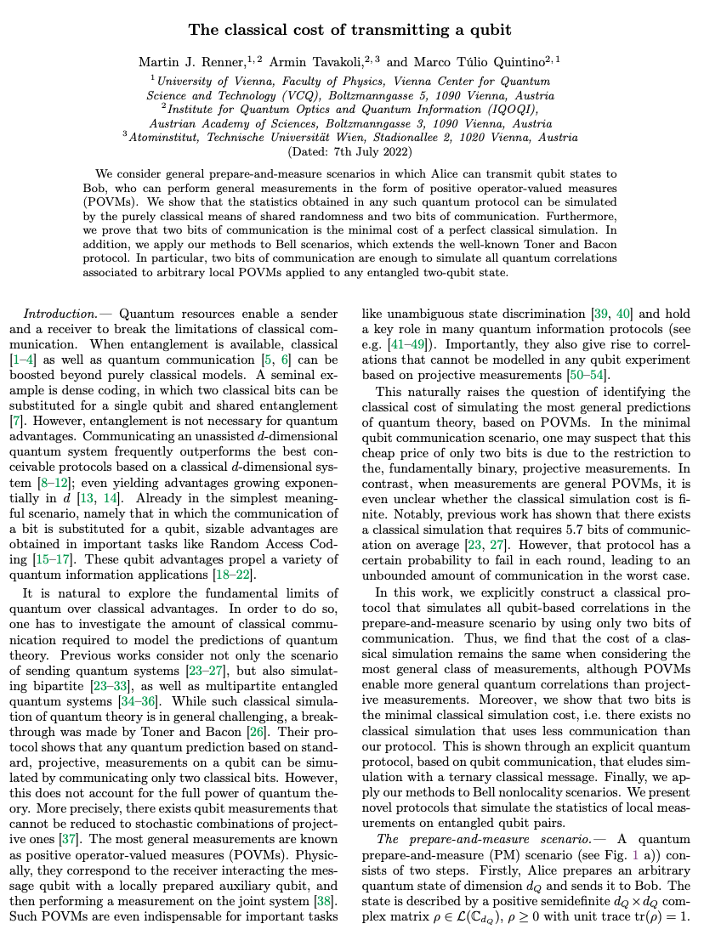

Postgraduate Degree in Quantum Engineering
1. INTRODUCTION
M. J. Renner, A. Tavakoli, M. T. Quintino, 2022,
The classical cost of transmitting a qubit
INTRODUCTION
OBJECTIVES
Considering a general prepare-and-measure scenario in which Alice can transmit qubit states to Bob, who can perform general measurements in the form of positive operator-valued measures…
… the statistics obtained in such scenario can be reproduced by purely classical means of shared randomness and two bits of communication.
Furthermore, it is proved that two bits of communication is the minimal cost of a perfect classical simulation.
In addition, the protocol can be adapted to Bell scenarios, extending Toner and Bacon results. In particular, one bit of communication is enough to reproduce all quantum correlations associated to arbitrary local measurements applied to a Bell singlet state.
CLASSICAL
SIMULATIONS
QUANTUM SIMULATION
WITH QC
CONCLUSIONS
AND FURTHER WORK
Can we simulate and verify this?
LET´S CHECK…

Slide 4
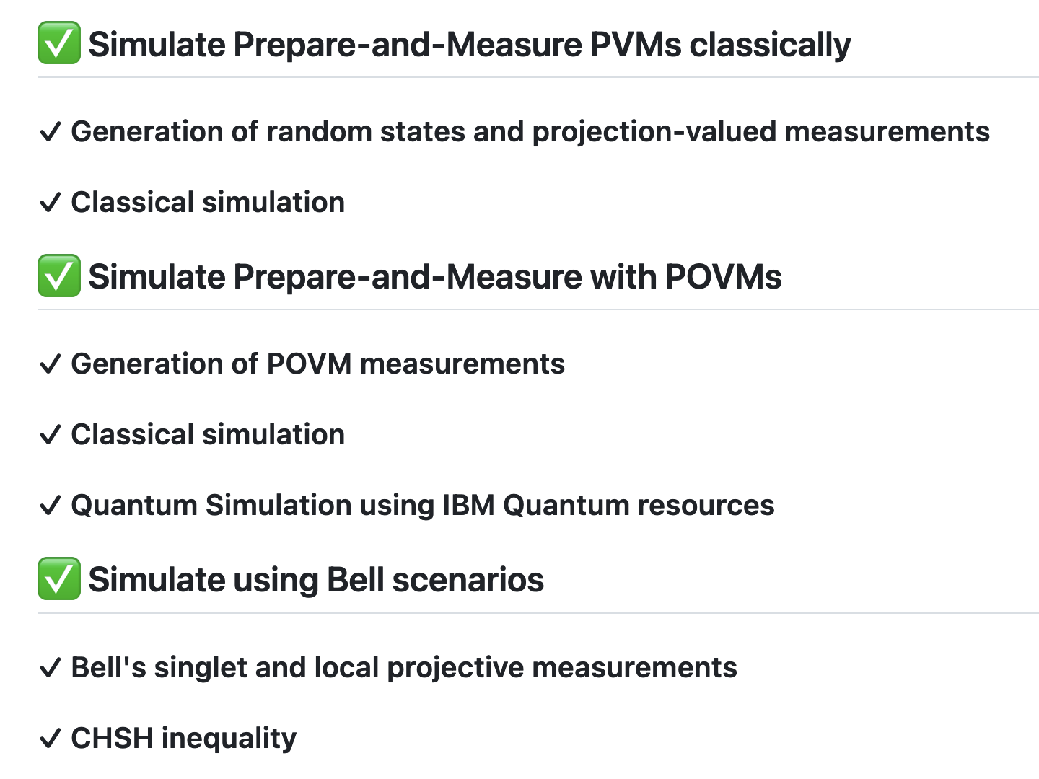

Postgraduate Degree in Quantum Engineering
2. OBJECTIVES
MAIN OBJECTIVE:
Prove by computer-based experiments that a qubit communication can be simulated classically with a total cost of 2 classical bits for any POVM in a prepare-and-measure scenario, or 1 classical bit for any arbitrary local measurement in a Bell scenario.
PROJECT STEPS TO ACHIEVE IT:
INTRODUCTION
OBJECTIVES
CLASSICAL
SIMULATIONS
QUANTUM SIMULATION
WITH QC
CONCLUSIONS
AND FURTHER WORK
https://github.com/inaki-ortizdelandaluce/qubit-communication-simulations

Slide 5



Postgraduate Degree in Quantum Engineering
3. CLASSICAL SIMULATIONS
INTRODUCTION
PREPARE-AND-MEASURE SCENARIO
OBJECTIVES
Alice prepares qubit state ⍴ and sends
CLASSICAL
SIMULATIONS
Bob receives state ⍴ and measures with POVM {Bk}
QUANTUM SIMULATION
WITH QC
Classical information
Qubit state
CONCLUSIONS
AND FURTHER WORK
Shared randomness
POVM measurement
Success criteria

Slide 6
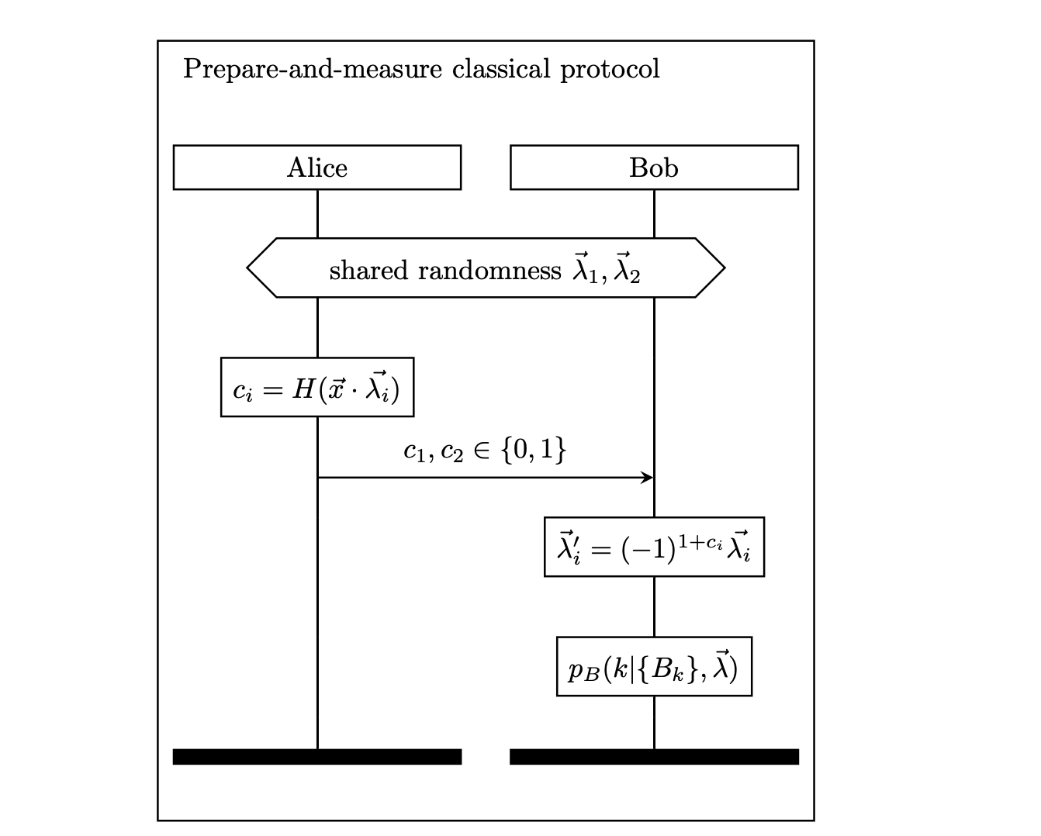
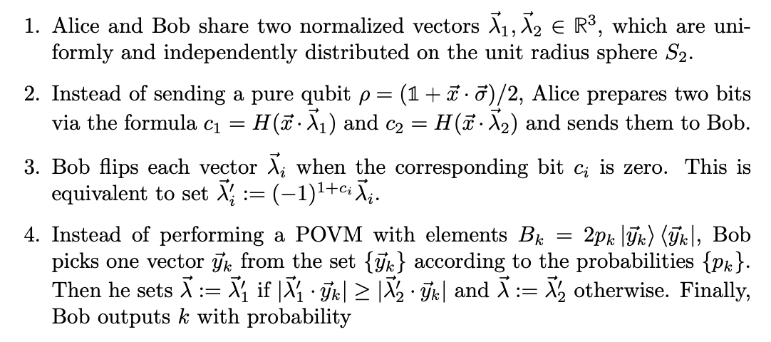
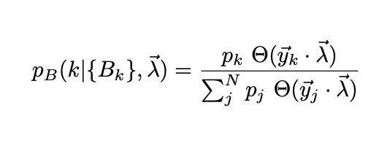
Postgraduate Degree in Quantum Engineering
3. CLASSICAL SIMULATIONS
INTRODUCTION
PREPARE-AND-MEASURE CLASSICAL PROTOCOL
OBJECTIVES
CLASSICAL
SIMULATIONS
QUANTUM SIMULATION
WITH QC
CONCLUSIONS
AND FURTHER WORK

Slide 7
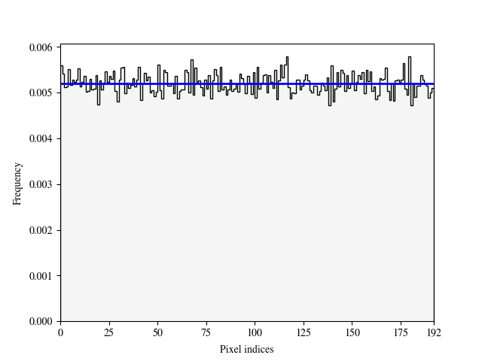
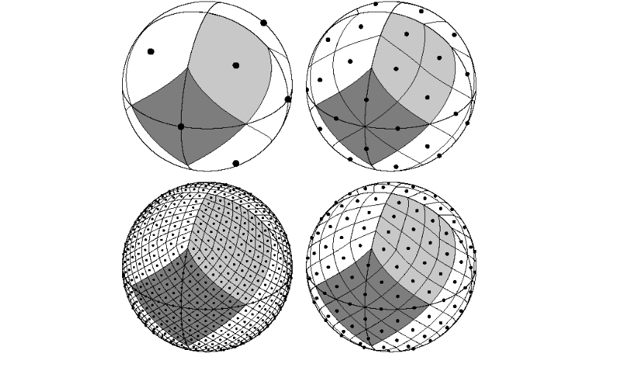
Postgraduate Degree in Quantum Engineering
3. CLASSICAL SIMULATIONS
INTRODUCTION
PREPARE-AND-MEASURE CLASSICAL PROTOCOL: STATE PREPARATION
OBJECTIVES
To produce a random qubit pure state, we should obtain a random unitary matrix and then apply the unitary transformation to the zero qubit state, resembling the time evolution of a qubit from a zero initial state.
The random unitary matrix can be generated by just building a matrix of normally distributed complex numbers, and then apply the Gram-Schmidt QR decomposition to orthogonalize the matrix.
HOW WE VALIDATE THE RANDOM QUBIT STATE DISTRIBUTION?
CLASSICAL
SIMULATIONS
QUANTUM SIMULATION
WITH QC
CONCLUSIONS
AND FURTHER WORK
Hierarchical Equal Area isoLatitude Pixelisation (HEALPix)
of the Bloch sphere

Slide 8
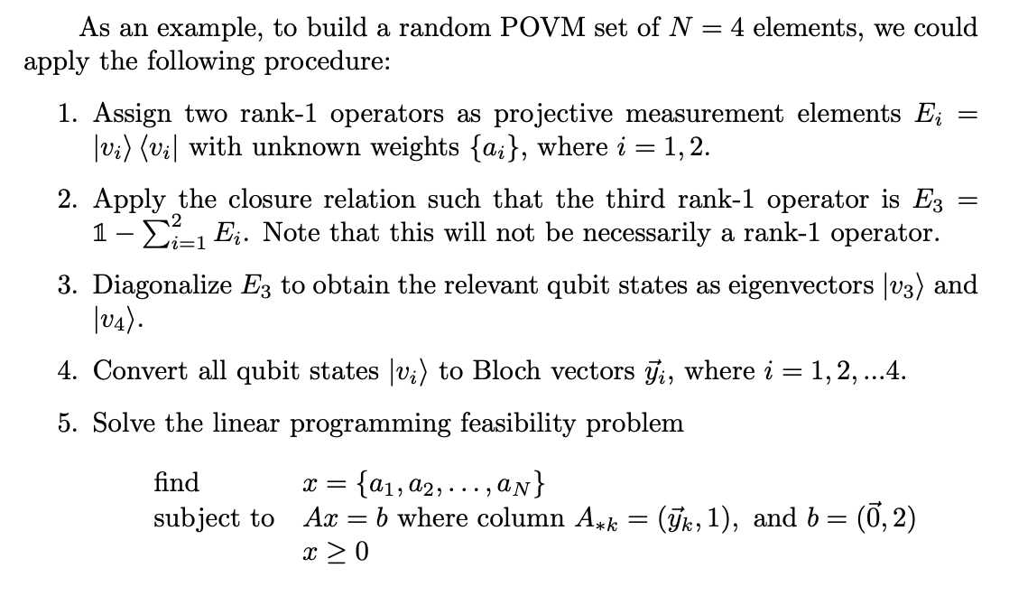
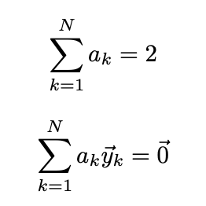
Postgraduate Degree in Quantum Engineering
3. CLASSICAL SIMULATIONS
PREPARE-AND-MEASURE CLASSICAL PROTOCOL: RANK-1 POVM GENERATION
INTRODUCTION
OBJECTIVES
Every POVM can be written as a coarse graining of rank 1 projectors, such that the protocol implementation can restrict without any loss in generality to POVMs proportional to rank-1 projectors.
As described by Sentís et al. the conditions under which a set of N arbitrary rank-1 operators {B_{k}} comprises a qubit POVM, can be equivalently written in a system of four linear equations. The existence of the set {ak } has a direct translation into a linear programming feasibility problem we would have to solve computationally.
CLASSICAL
SIMULATIONS
QUANTUM SIMULATION
WITH QC
CONCLUSIONS
AND FURTHER WORK

Slide 9

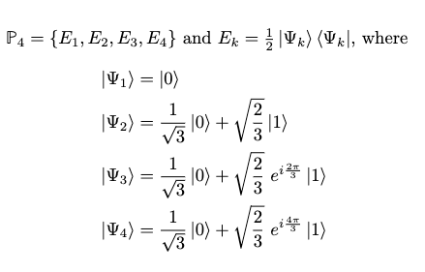
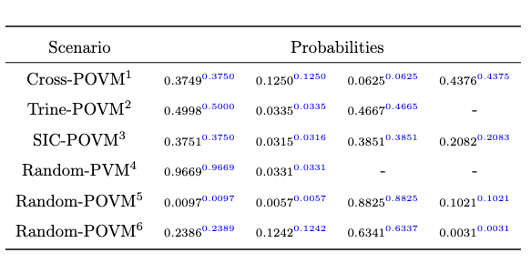
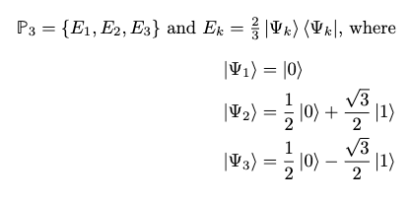
Postgraduate Degree in Quantum Engineering
3. CLASSICAL SIMULATIONS
INTRODUCTION
PREPARE-AND-MEASURE CLASSICAL PROTOCOL: SIMULATIONS
OBJECTIVES
Simulations run using random states and POVM measures, and also well-known POVMs (e.g. Cross, Trine, SIC-POVM), all reproducing the quantum probabilities with extraordinary accuracy.
CLASSICAL
SIMULATIONS
Cross-POVM
QUANTUM SIMULATION
WITH QC
SIC-POVM
CONCLUSIONS
AND FURTHER WORK
Trine-POVM

Slide 10
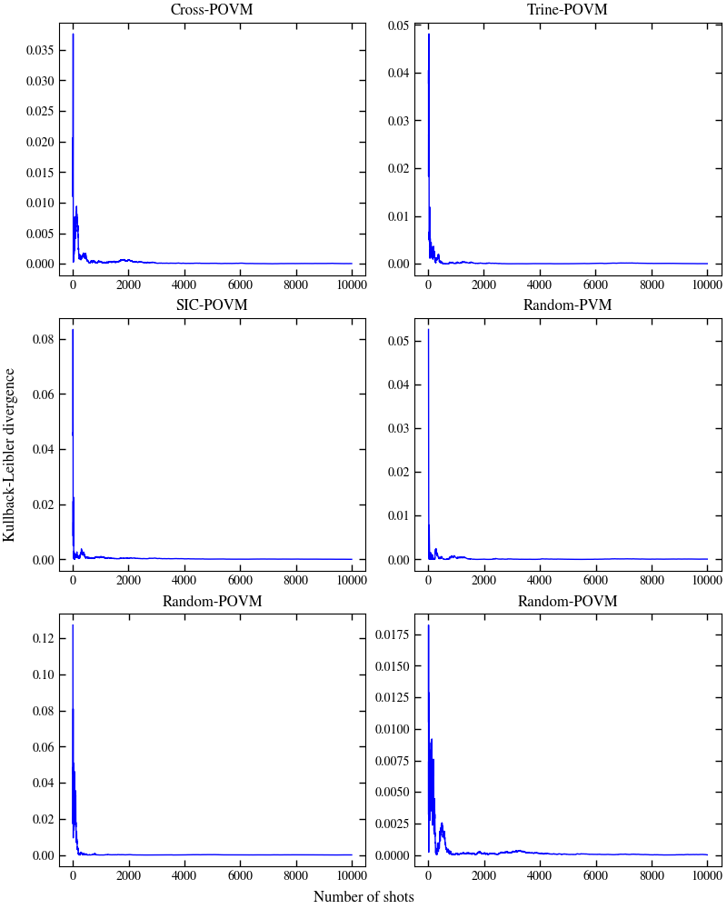

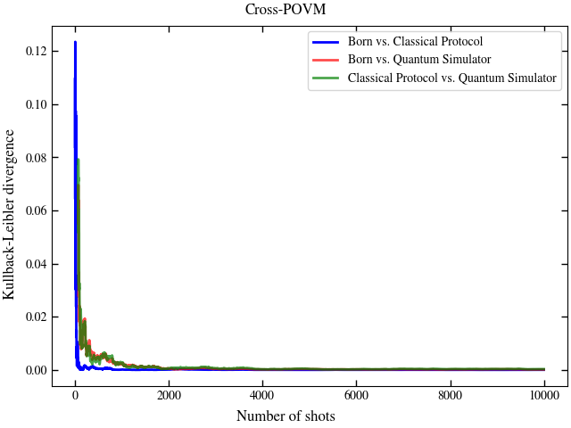
Postgraduate Degree in Quantum Engineering
3. CLASSICAL SIMULATIONS
INTRODUCTION
PREPARE-AND-MEASURE CLASSICAL PROTOCOL: SIMULATIONS
OBJECTIVES
The relative entropy distance, or Kullback-Leibler divergence, among the theoretical and classical simulation probability distributions:
CLASSICAL
SIMULATIONS
QUANTUM SIMULATION
WITH QC
CONCLUSIONS
AND FURTHER WORK

Slide 11



Postgraduate Degree in Quantum Engineering
3. CLASSICAL SIMULATIONS
INTRODUCTION
BELL SCENARIO
OBJECTIVES
Bipartite quantum system of two entangled and separated qubits:
CLASSICAL
SIMULATIONS
ALICE BOB
QUANTUM SIMULATION
WITH QC
Chooses a random local measurement A_{x} among two possible observables {A₀, A₁}
Chooses a random local measurement By among two possible observables {B₀, B₁}
CONCLUSIONS
AND FURTHER WORK
Output a_{x}
Output by
BELL CORRELATIONS
Shared randomness
Classical information
Success criteria

Slide 12
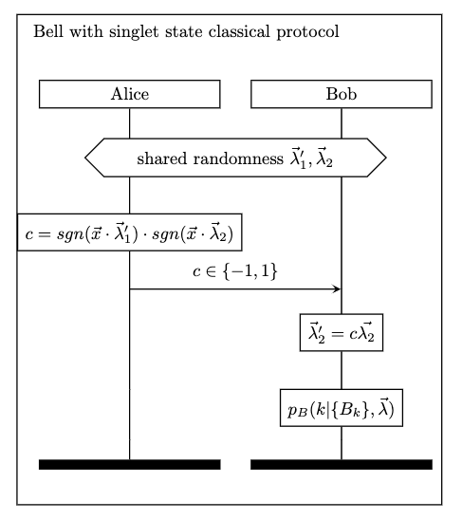
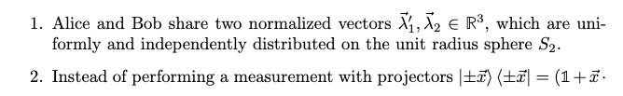
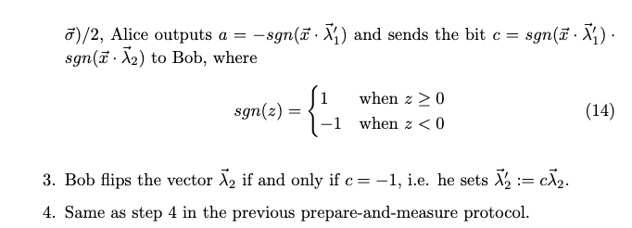
Postgraduate Degree in Quantum Engineering
3. CLASSICAL SIMULATIONS
INTRODUCTION
BELL CLASSICAL PROTOCOL
OBJECTIVES
CLASSICAL
SIMULATIONS
QUANTUM SIMULATION
WITH QC
CONCLUSIONS
AND FURTHER WORK

Slide 13
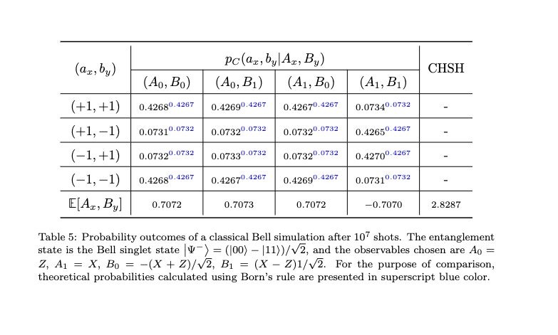
Postgraduate Degree in Quantum Engineering
3. CLASSICAL SIMULATIONS
INTRODUCTION
BELL CLASSICAL PROTOCOL: SIMULATIONS
OBJECTIVES
Simulations run using Bell singlet state and local projective measurements, reproducing joint probabilities with extraordinary accuracy.
CLASSICAL
SIMULATIONS
QUANTUM SIMULATION
WITH QC
CONCLUSIONS
AND FURTHER WORK

Slide 14
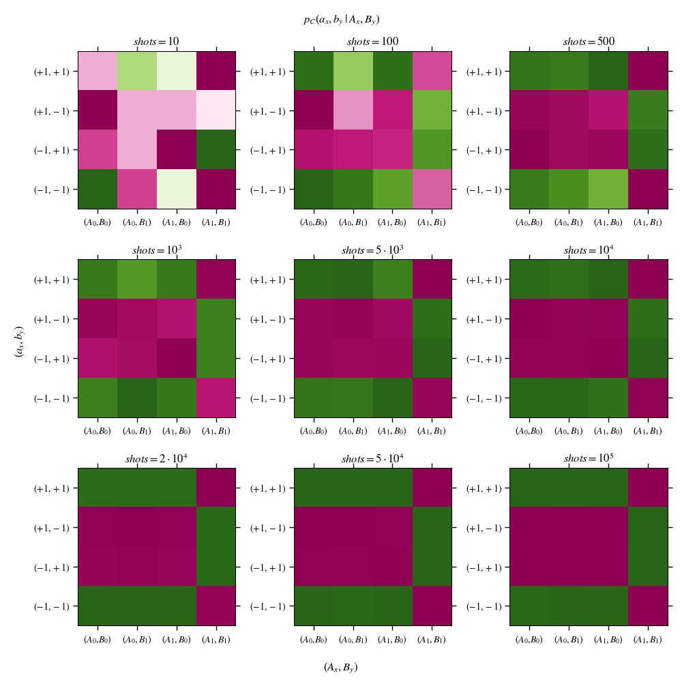
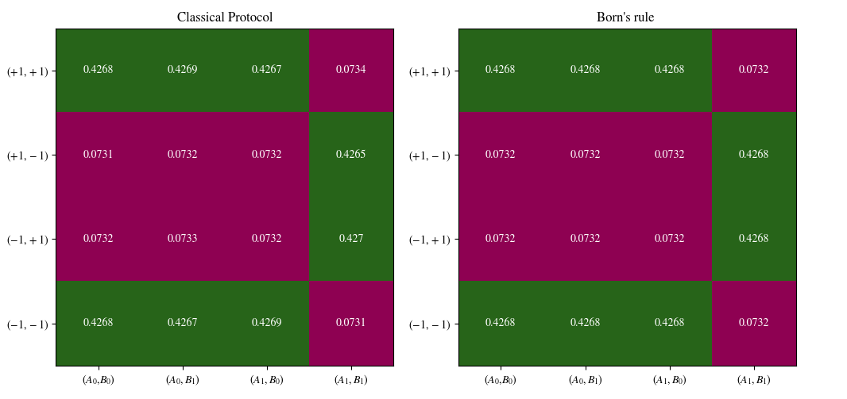
Postgraduate Degree in Quantum Engineering
3. CLASSICAL SIMULATIONS
INTRODUCTION
BELL CLASSICAL PROTOCOL: SIMULATIONS
OBJECTIVES
CLASSICAL
SIMULATIONS
QUANTUM SIMULATION
WITH QC
CONCLUSIONS
AND FURTHER WORK

Slide 15
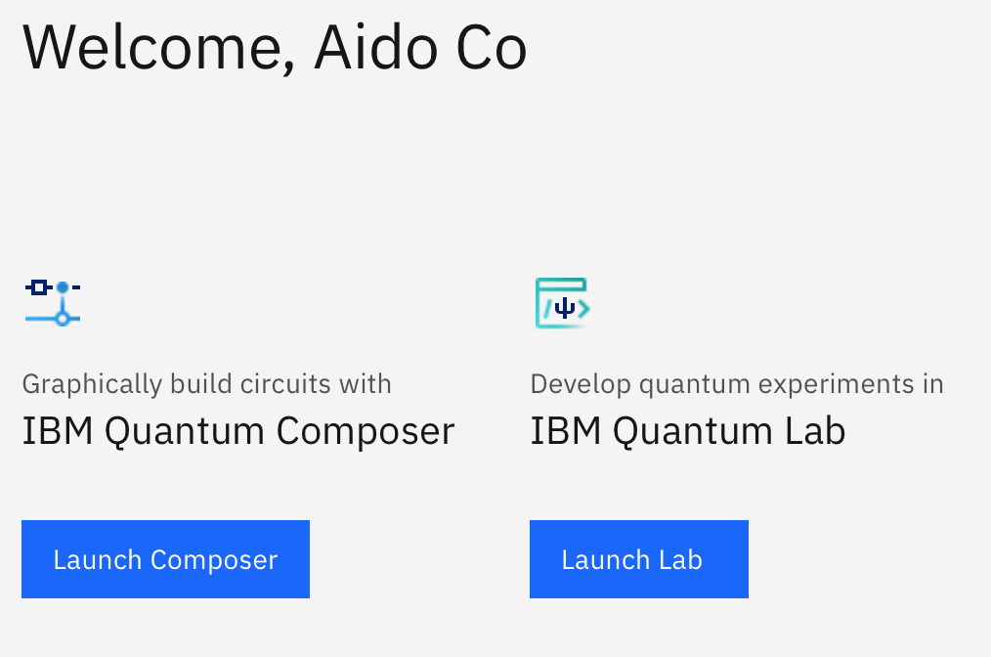
Postgraduate Degree in Quantum Engineering
4. QUANTUM SIMULATION WITH QUANTUM COMPUTERS
INTRODUCTION
We worked with QISKIT (IBM):
https://quantum-computing.ibm.com
OBJECTIVES
CLASSICAL
SIMULATIONS
QUANTUM SIMULATION
WITH QC
CONCLUSIONS
AND FURTHER WORK
2 PROGRAMING PATHS:
CIRCUIT OR CODE

Slide 16
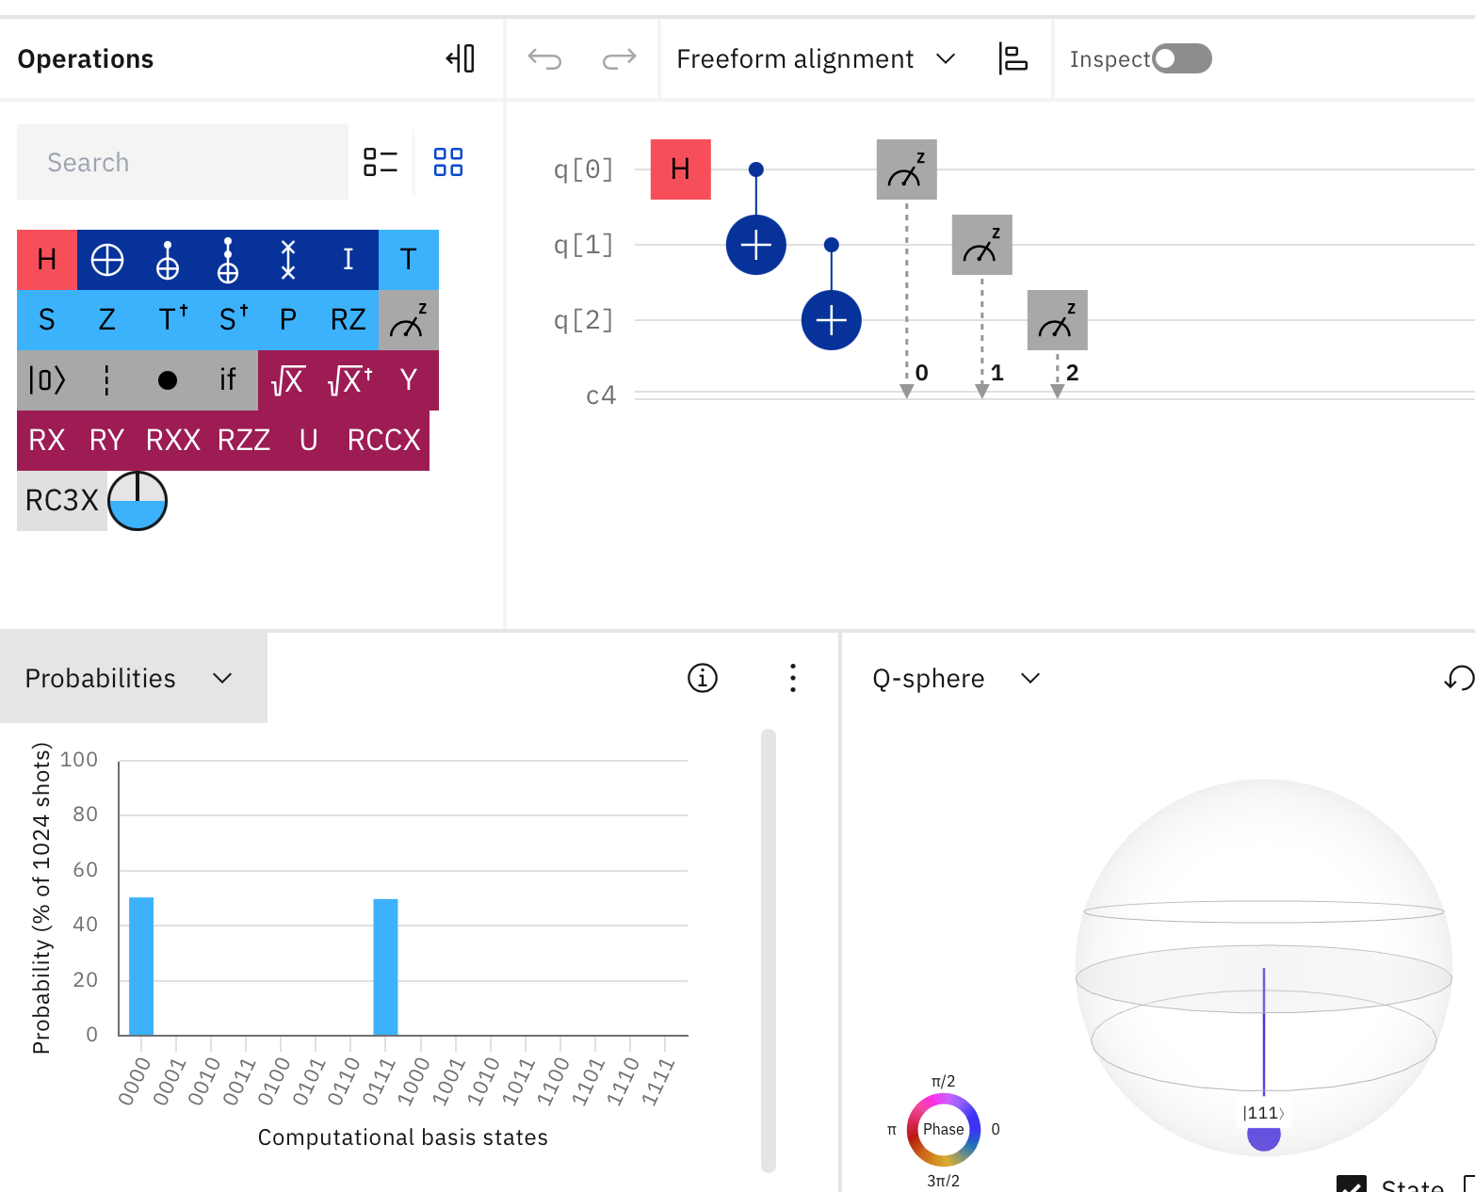
Postgraduate Degree in Quantum Engineering
4. QUANTUM SIMULATION WITH QUANTUM COMPUTERS
INTRODUCTION
Circuit example in IBM Quantum Composer (not project code):
OBJECTIVES
CLASSICAL
SIMULATIONS
EASY TO USE.
SIMPLE.
- VISUAL.
EASY SIMULATION IN LOCAL COMPUTER.
EASY EXECUTION IN QC.
QUANTUM SIMULATION
WITH QC
CONCLUSIONS
AND FURTHER WORK
LIMITED USES: IN OUR CASE CIRCUIT IS NOT PREPARED TO CREATE A UNITARY MATRIX OR POVM MEASUREMENTS.
ALL COMPLEX QUANTUM PROGRAMS DEVELOPED BY CODE.

Slide 17
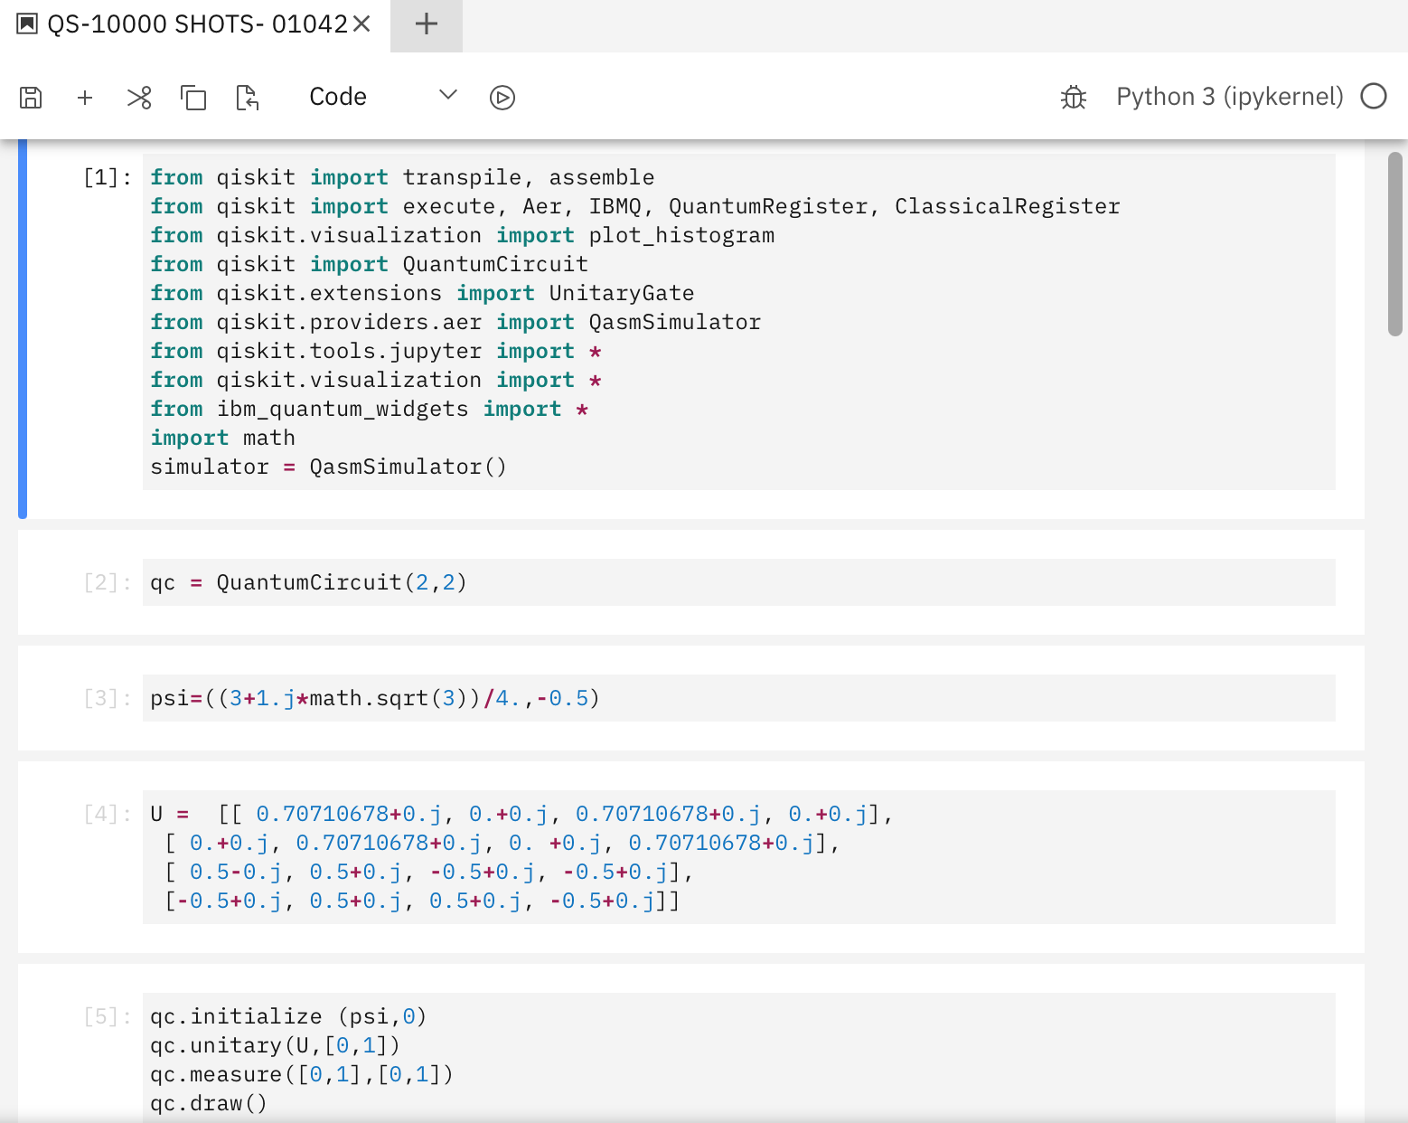
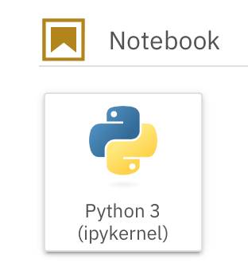
Postgraduate Degree in Quantum Engineering
4. QUANTUM SIMULATION WITH QUANTUM COMPUTERS
INTRODUCTION
Project program in IBM Quantum Lab:
OBJECTIVES
CLASSICAL
SIMULATIONS
PYTHON: high level programming language.
With the relevant packages the program can be simulated locally, or even launched on IBM quantum computers.
Programming option used in the project.
QUANTUM SIMULATION
WITH QC
CONCLUSIONS
AND FURTHER WORK
To simulate the quantum program locally we use
AER SIMULATION.

Slide 18
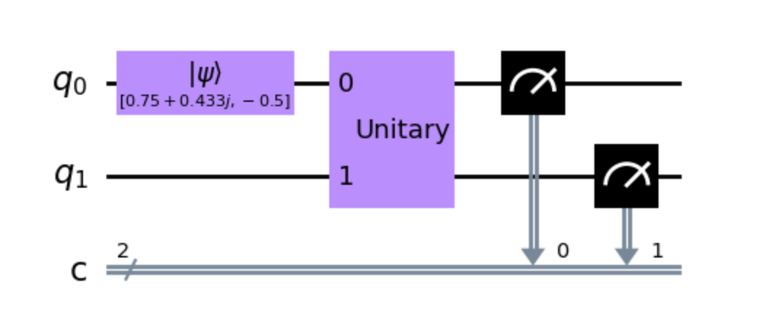
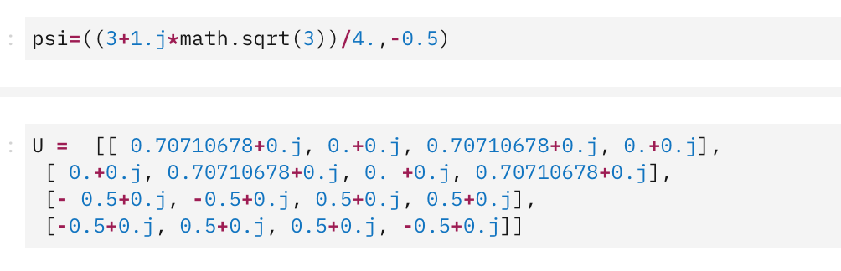
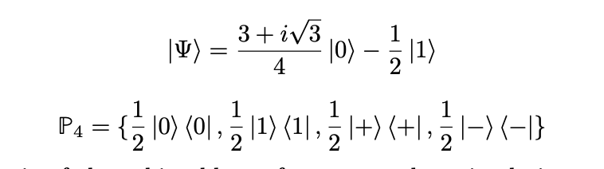
Postgraduate Degree in Quantum Engineering
4. QUANTUM SIMULATION WITH QUANTUM COMPUTERS
INTRODUCTION
Project program in IBM Quantum Lab ( QUANTUM SIMULATION):
OBJECTIVES
CLASSICAL
SIMULATIONS
In order to compare the quantum simulation program with the classical program. We must fix a state and unitary matrix with characterized POVM (Naimark extension).
QUANTUM SIMULATION
WITH QC
CONCLUSIONS
AND FURTHER WORK
Above: Quantum program drawing
QISKIT libraries are not prepared to POVMs, the only measurements allow are PVMs.

Slide 19
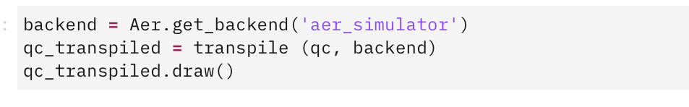
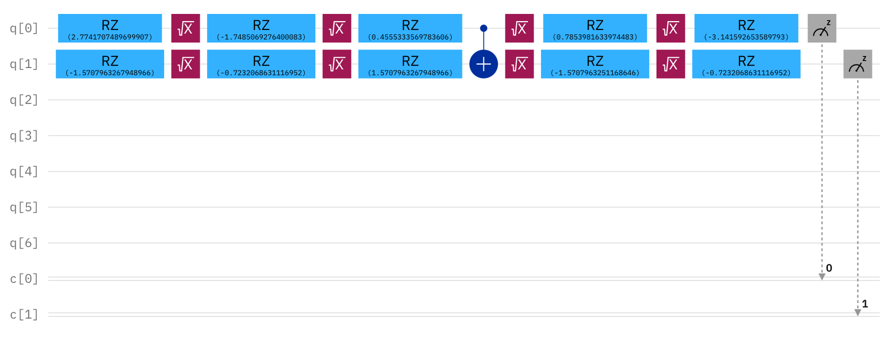
Postgraduate Degree in Quantum Engineering
4. QUANTUM SIMULATION WITH QUANTUM COMPUTERS
INTRODUCTION
Project program in IBM Quantum Lab ( QUANTUM SIMULATION):
OBJECTIVES
To decompose the unitary matrix in standard gates, we have the theoretical option in the book Quantum Information by Nielsen and Chuang, or Qiskit Transpile (Quantum process rewriting).
CLASSICAL
SIMULATIONS
QUANTUM SIMULATION
WITH QC
CONCLUSIONS
AND FURTHER WORK
To simulate the quantum program locally we use
AER SIMULATION.
Transpile is not efficient at 100%. For descomposing a toffoli gate uses 16cnot when theoretically the minimum would be 6.
But for our program is good enough. One CNOT in transpile and in Nielsen and Chuang unitary decomposition.
Above: Quantum circuit after transpile

Slide 20

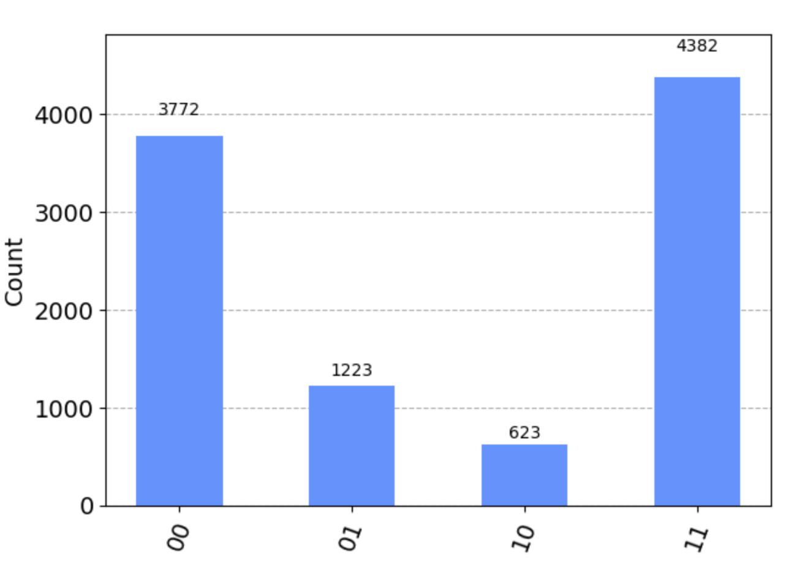
Postgraduate Degree in Quantum Engineering
4. QUANTUM SIMULATION WITH QUANTUM COMPUTERS
INTRODUCTION
Project program in IBM Quantum Lab ( QUANTUM SIMULATION):
OBJECTIVES
CLASSICAL
SIMULATIONS
SAME RESULTS IN QUANTUM AND CLASSICAL PROTOCOL:
LOVE IS IN THE “AER”
QUANTUM SIMULATION
WITH QC
CONCLUSIONS
AND FURTHER WORK
NEXT STEP: EXECUTE QUANTUM PROGRAM IN QC

Slide 21
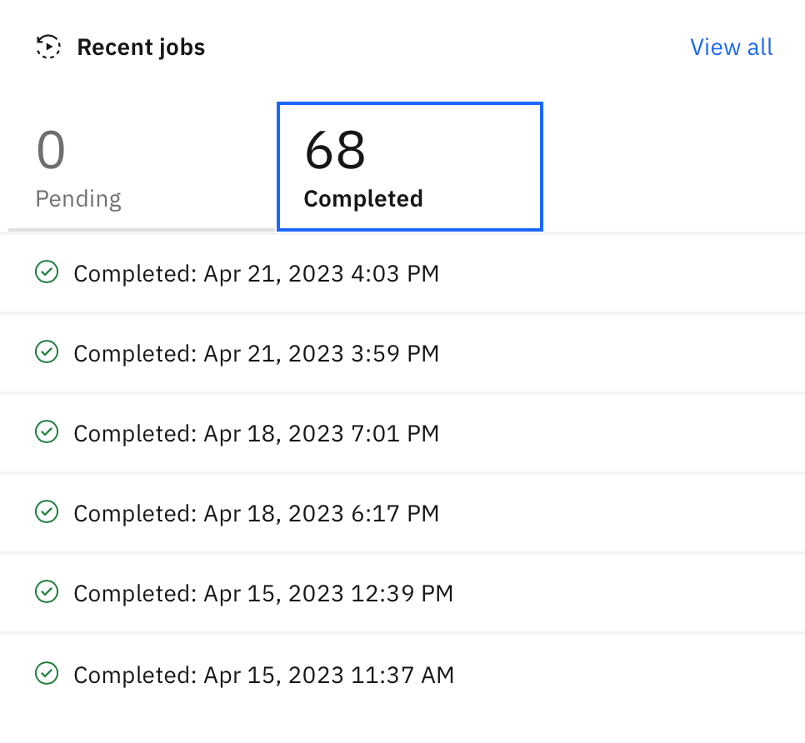
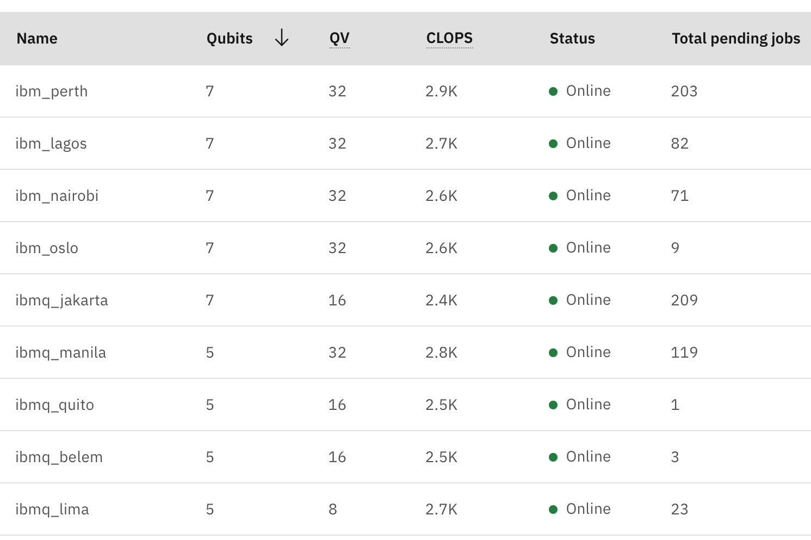
Postgraduate Degree in Quantum Engineering
4. QUANTUM SIMULATION WITH QUANTUM COMPUTERS
INTRODUCTION
Project program in IBM Quantum Lab ( QUANTUM COMPUTER ):
OBJECTIVES
CLASSICAL
SIMULATIONS
For understanding Real Quantum Computation, tools and error, we run 68 programs in 5 Quantum Computers.
QUANTUM SIMULATION
WITH QC
CONCLUSIONS
AND FURTHER WORK
We choose the 5 QC (free available) with best relation QV, CLOPS, median CNOT error and median Readout error.

Slide 22
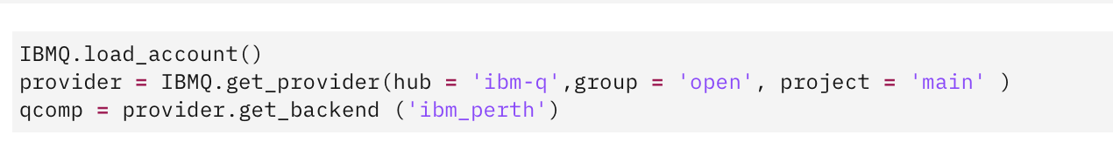
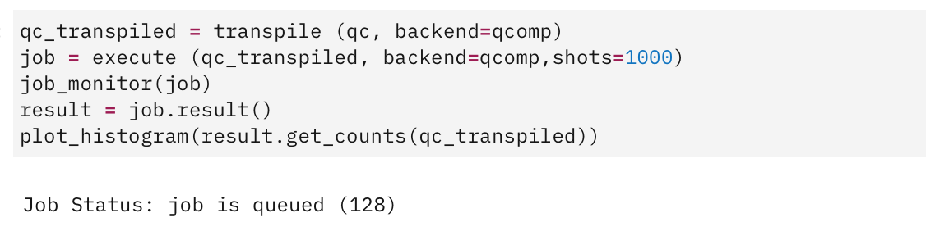
Postgraduate Degree in Quantum Engineering
4. QUANTUM SIMULATION WITH QUANTUM COMPUTERS
INTRODUCTION
Project program in IBM Quantum Lab ( QUANTUM COMPUTER ):
OBJECTIVES
CLASSICAL
SIMULATIONS
QUANTUM SIMULATION
WITH QC
CONCLUSIONS
AND FURTHER WORK
Above: Quantum program execution in QC perth with 1000 shots
 | QUBITS | QV | CIRCUIT LAYER | Median CNOT ERROR | Median ReadOut Error
NAIROBI | 7 | 32 | 2.6K | 0,01357 | 0,0227
PERTH | 7 | 32 | 2.9K | 0,01733 | 0,0188
OSLO | 7 | 32 | 2.6K | 0,01 | 0,01667
JAKARTA | 7 | 16 | 2.4K | 0,00773 | 0,0258
LAGOS | 7 | 32 | 2.7K | 0,007243 | 0,0145
In theory LAGOS is the best quantum computer, let’s check the results.

Slide 23
Postgraduate Degree in Quantum Engineering
4. QUANTUM SIMULATION WITH QUANTUM COMPUTERS
INTRODUCTION
Quantum compilation Results:
OBJECTIVES
CLASSICAL
SIMULATIONS
Why we run program in 5 QC?
Qiskit works automatically with 4000 shots.
Initially, We launched two QC programs in Nairobi, with 4000 shots and 10000 shots,
Contrary to what theory told us, the more shots we implement, the worse results we got ….
QUANTUM SIMULATION
WITH QC
CONCLUSIONS
AND FURTHER WORK
It was not logical at all, that's why:
We studied the behavior of 5QC with the same number of Qubits, for different number of shots: 100, 500, 1.000, 4.000, 10.000 and 20.000 (20.000 is the maximum that can be launched in a QC for free).

Slide 24
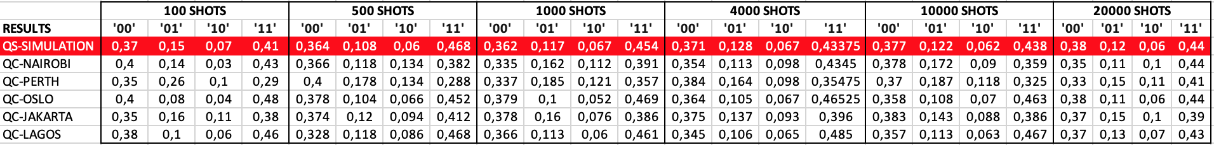
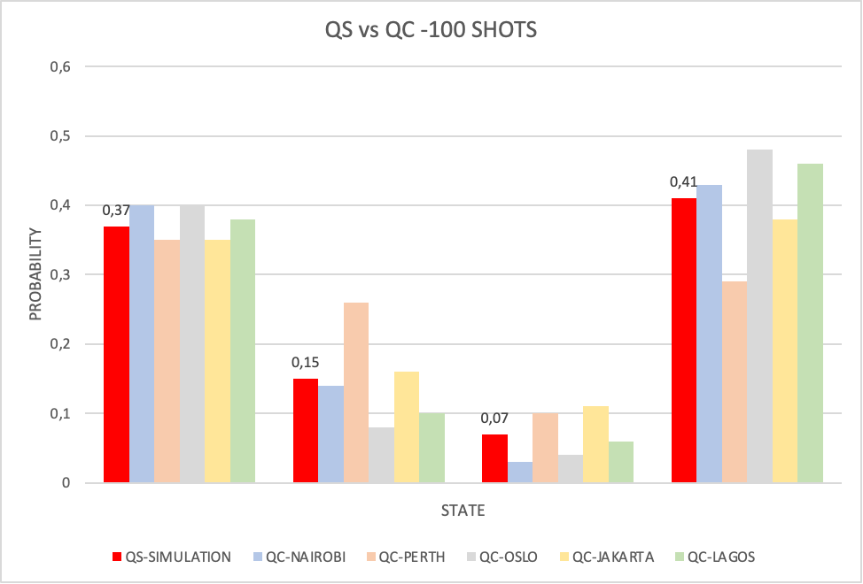
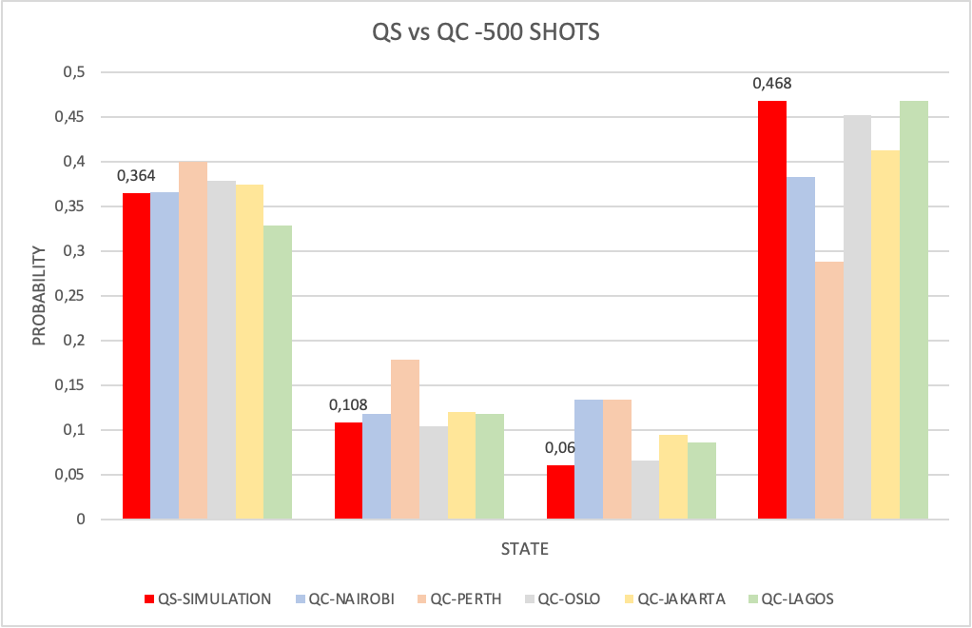
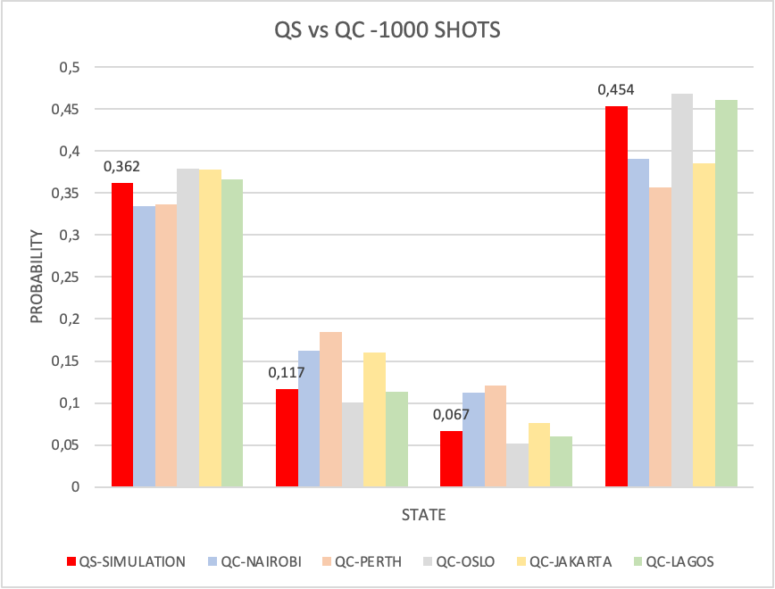
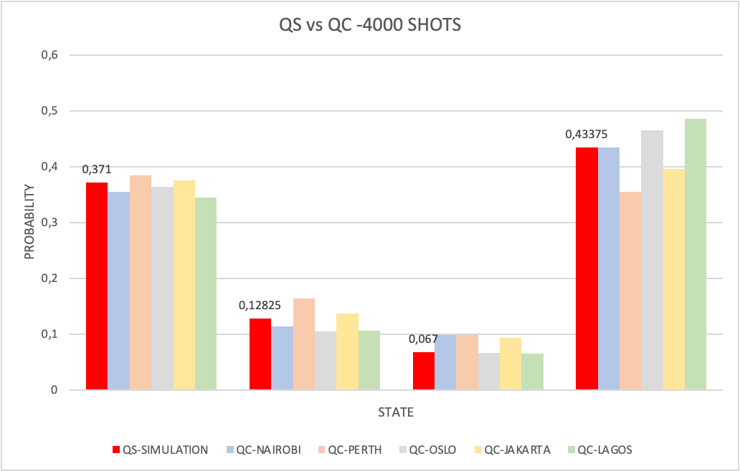
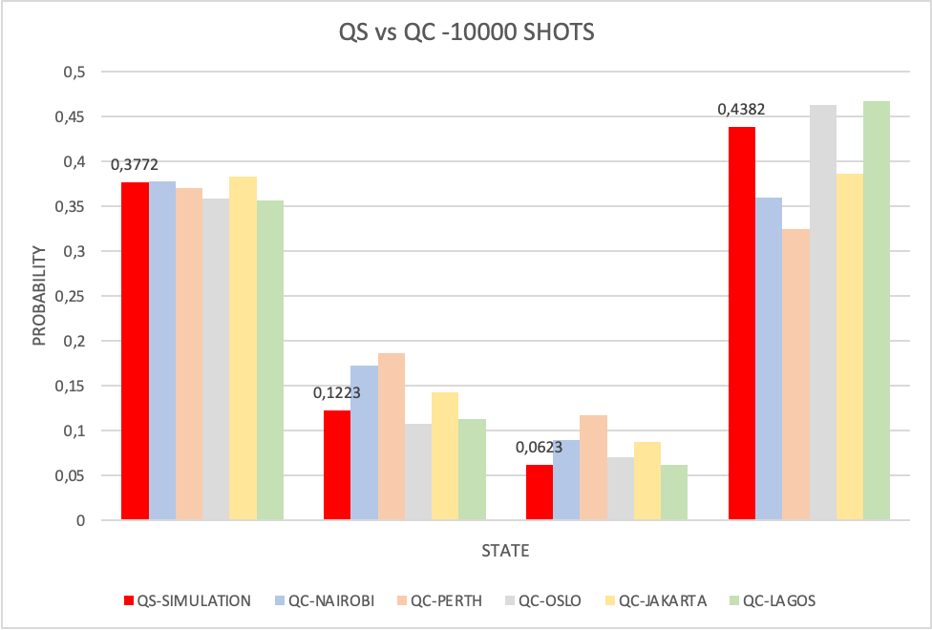
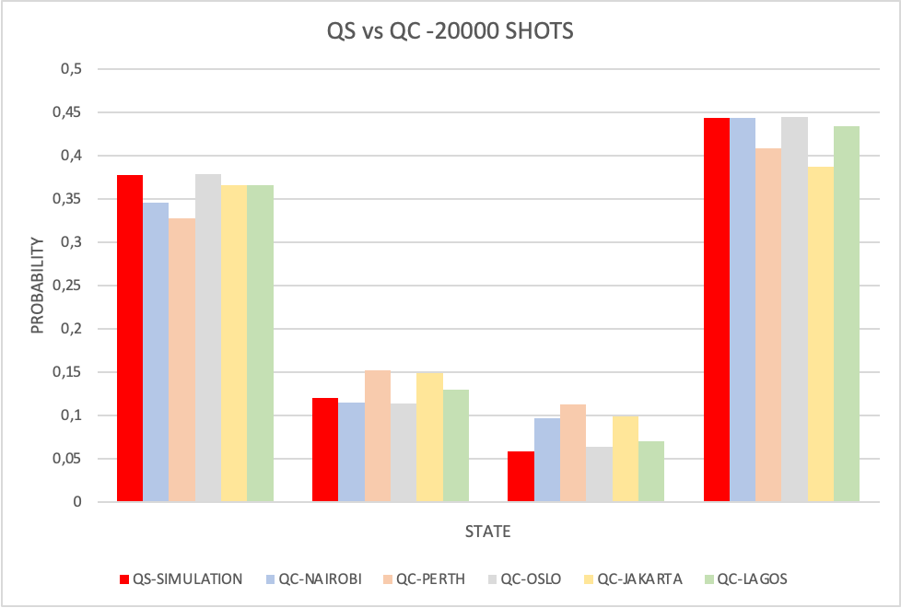
Postgraduate Degree in Quantum Engineering
4. QUANTUM SIMULATION WITH QUANTUM COMPUTERS
INTRODUCTION
Quantum compilation Results ( Quantum Simulation vs Quantum Computation ):
OBJECTIVES
CLASSICAL
SIMULATIONS
QUANTUM SIMULATION
WITH QC
CONCLUSIONS
AND FURTHER WORK
We can appreciate the GAP between QS and QC
We can NOT obtain any conclusion.

Slide 25
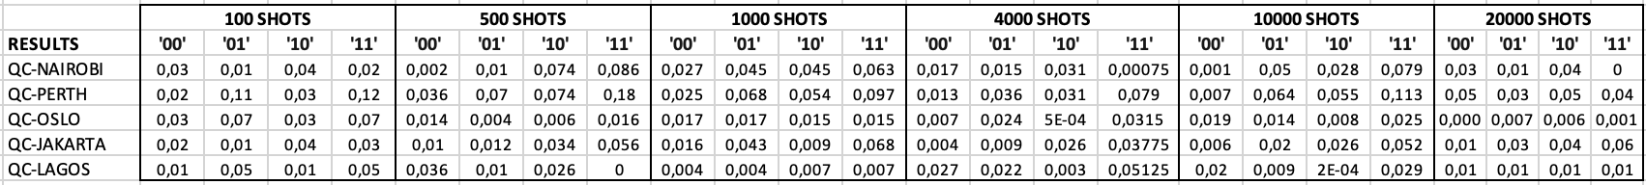
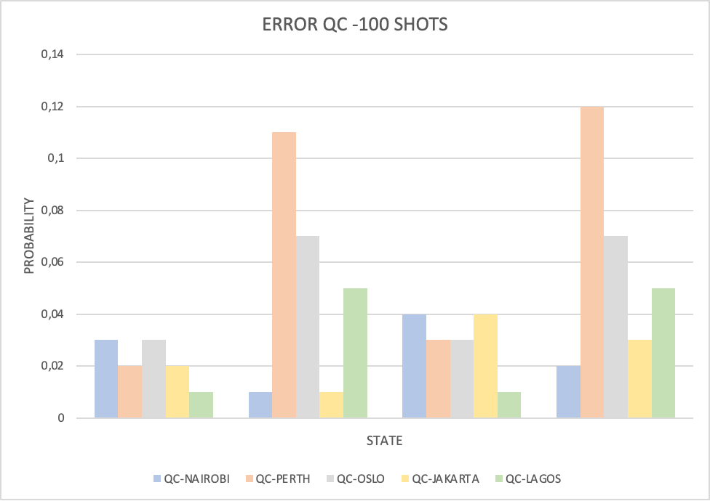
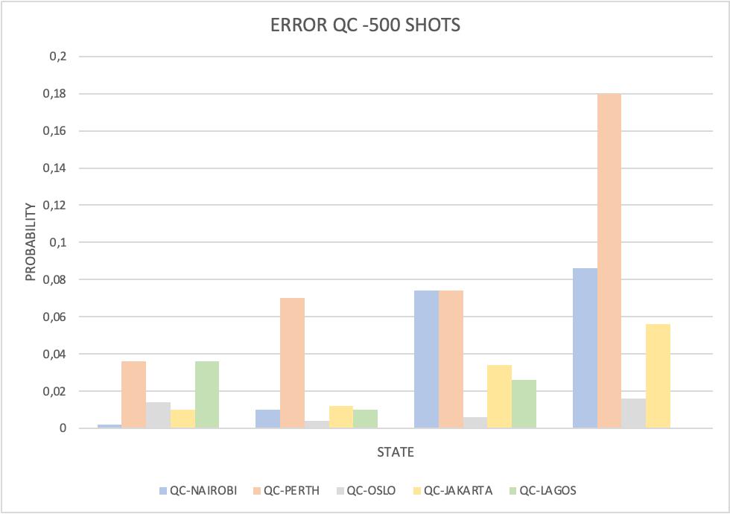
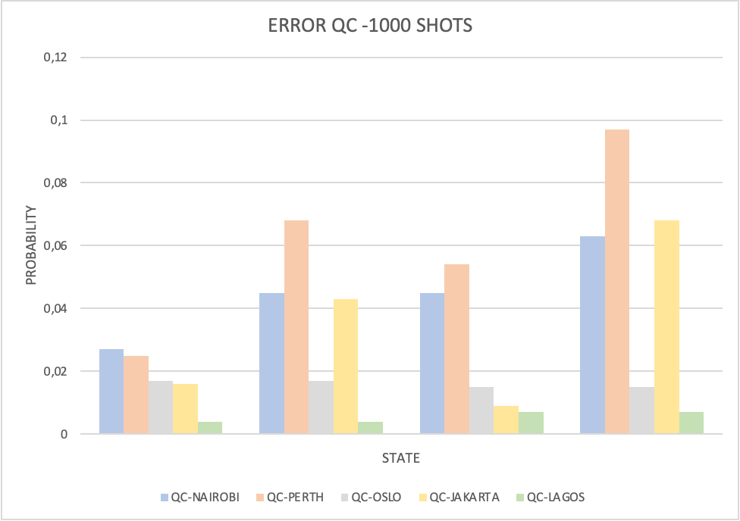
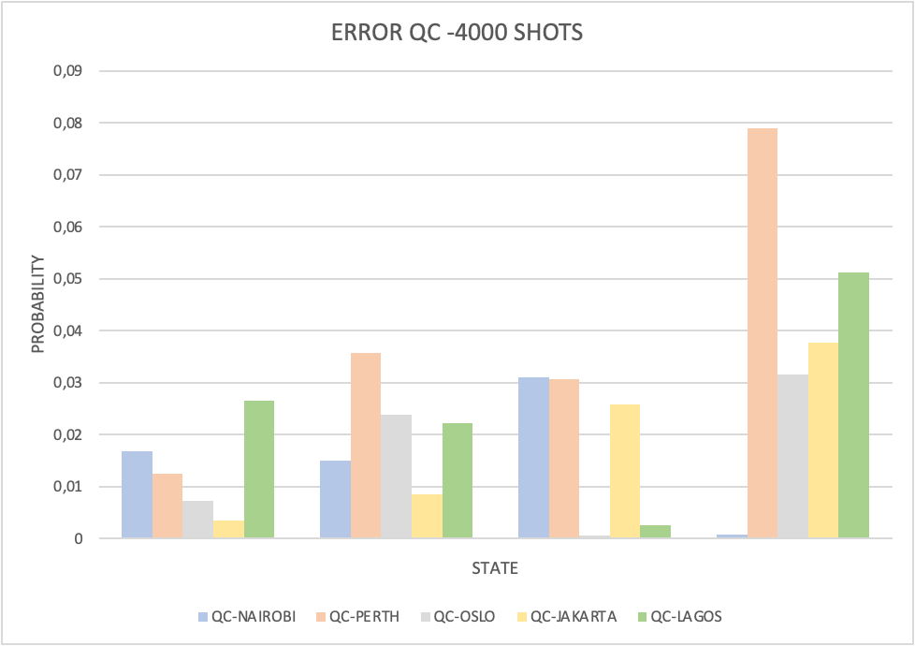
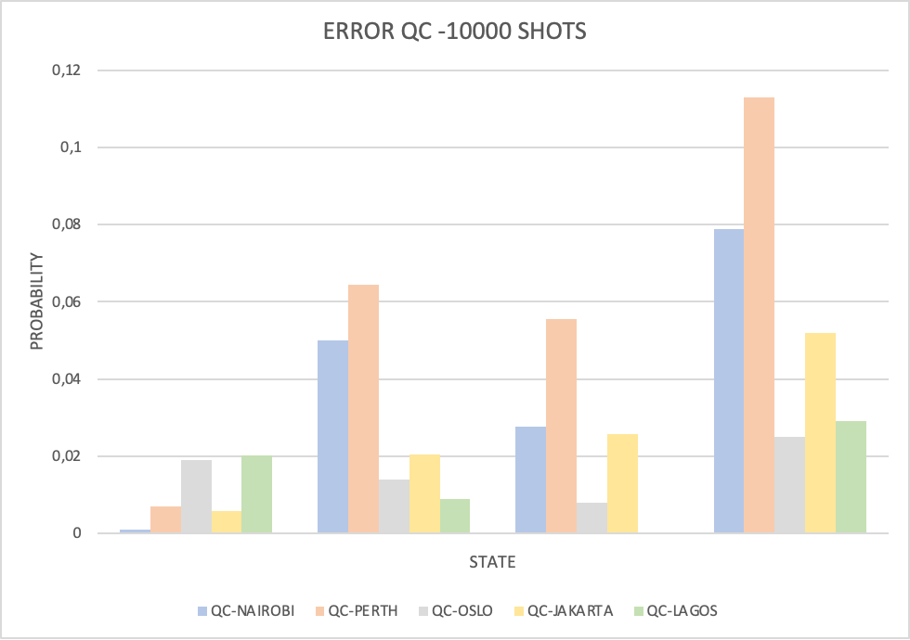
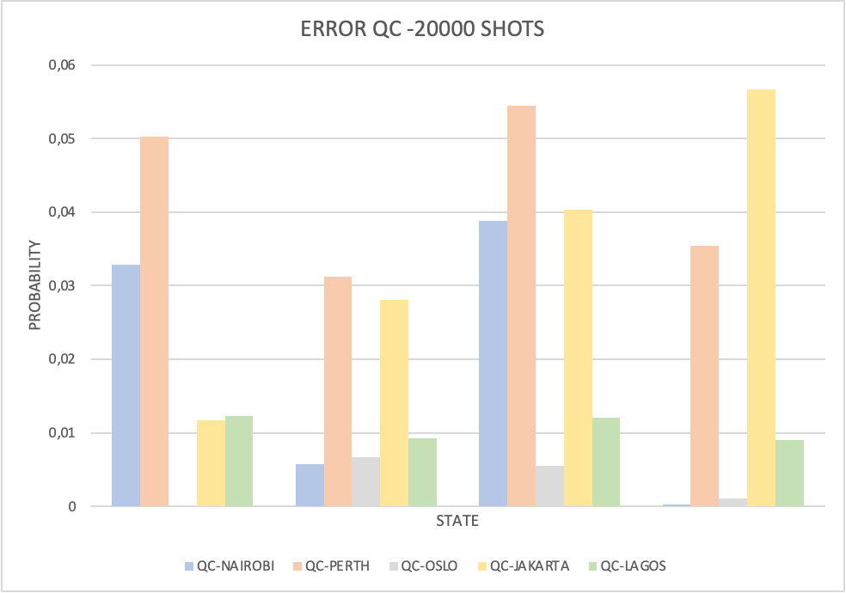
Postgraduate Degree in Quantum Engineering
4. QUANTUM SIMULATION WITH QUANTUM COMPUTERS
INTRODUCTION
Quantum compilation Results ( Error comparison ):
OBJECTIVES
CLASSICAL
SIMULATIONS
QUANTUM SIMULATION
WITH QC
CONCLUSIONS
AND FURTHER WORK
We can easily see that PERTH, has more error than the other QC options.
We still can NOT obtain any conclusion.

Slide 26
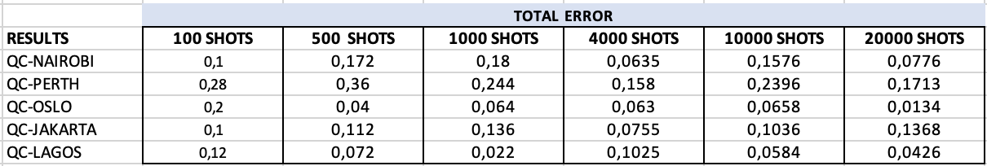
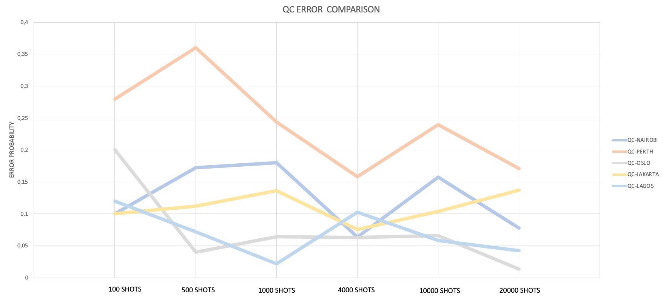
Postgraduate Degree in Quantum Engineering
4. QUANTUM SIMULATION WITH QUANTUM COMPUTERS
INTRODUCTION
Quantum compilation Results ( Error comparison ):
OBJECTIVES
CLASSICAL
SIMULATIONS
QUANTUM SIMULATION
WITH QC
CONCLUSIONS
AND FURTHER WORK

Slide 27

Postgraduate Degree in Quantum Engineering
4. QUANTUM SIMULATION WITH QUANTUM COMPUTERS
INTRODUCTION
Quantum compilation Results ( Best Option for prepare and measure scenario ):
OBJECTIVES
CLASSICAL
SIMULATIONS
QUANTUM SIMULATION
WITH QC
CONCLUSIONS
AND FURTHER WORK
We confirm that lagos is the best option, followed closely by Oslo.

Slide 28
Postgraduate Degree in Quantum Engineering
4. QUANTUM SIMULATION WITH QUANTUM COMPUTERS
INTRODUCTION
Quantum compilation Results:
OBJECTIVES
1) Quantum computer statistics are different from Quantum Simulation, it is noted that the less noise the QC has, the closer statistics are to Quantum Simulation.
2) All five QC have better performance from 1.000 shots.
3) Lagos is the best QC option for prepare and measurement scenario, is the QC with lowest median
CNOT error and median Readout error.
4) Perth is the worst QC option for prepare and measurement scenario by far.
5) Oslo has the closest approximation to Quantum Simulation (20.000 shots), for further work it will be
interesting increasing the number of shots and check if it matches completely to simulation.
6) Jakarta, with worst QUANTUM VOLUME values, has given optimal results.
7) Running with 20.000 shots, 4/5 worked with less noise than in previous programs. Those who have
given these values have the highest QUANTUM VOLUME (32).
CLASSICAL
SIMULATIONS
QUANTUM SIMULATION
WITH QC
CONCLUSIONS
AND FURTHER WORK

Slide 29
Postgraduate Degree in Quantum Engineering
5. CONCLUSIONS AND FURTHER WORK
INTRODUCTION
CONCLUSIONS:
OBJECTIVES
We have executed and confirmed the work of Martin J. Renner, Armin Tavakoli, Marco Túlio Quintino, 2022 , The classical cost of transmitting a qubit: two bits of communication are enough to classicaly simulate a qubit in a prepare-and-measure scenario.
We also executed and confirmed the work of B.F. Toner and D.Bacon, 2004, Communication Cost of Simulating Bell Scenarios.
We simulated and executed the prepare-and-measure protocol (POVM) in real quantum computers.
The running computing time has been the same for the classical and quantum prepare-and-measure protocol.
We have obtained very concrete data on the quantum computers performance: most relevant conclusion is: noise is actually being reduced in quantum computing by IBM.
We can easily identify quantum computers accuracy by the theoretical values of each Quantum Computer, we also confirm statistically that the manufacturer values links to the results in a correct way.
CLASSICAL
SIMULATIONS
QUANTUM SIMULATION
WITH QC
CONCLUSIONS
AND FURTHER WORK

Slide 30
Postgraduate Degree in Quantum Engineering
5. CONCLUSIONS AND FURTHER WORK
INTRODUCTION
FURTHER WORK:
OBJECTIVES
Study classical communication applied to higher dimensional scenarios (QUTRIT), giving special attention to the new block sphere shape.
Simulate and execute Bell scenarios protocol in quantum computers.
Implement again the quantum protocol when the transpile function is more accurate (It depends on IBM Software improvements).
Execute the quantum protocol over 20.000 shots in the future.
- It would be really interesting execute this protocols in quantum computers from other manufactures (Qilimanjaro, Cirq, Dwave…), conclusions can be reached as to which technology is closest to theoretical simulation.
CLASSICAL
SIMULATIONS
QUANTUM SIMULATION
WITH QC
CONCLUSIONS
AND FURTHER WORK

Slide 31
Postgraduate Degree in Quantum Engineering
5. CONCLUSIONS AND FURTHER WORK
INTRODUCTION
WHAT WE HAVE LEARNED AS STUDENTS?
Lose the fear with highly theoretical papers: We studied and understood more than five papers and two books in order to achieve the goals.
Perform a Study Case, covering different quantum theoretical topics: PREPARE- AND-MEASURE SCENARIOS with PVMs, POVMs and BELL SCENARIOS. When we achieved a goal, we always had the feeling that we were starting at point zero, in order to learn and solve the new scenario.
Implementation and simulation with a “classic” programming language (python)
Implementation and simulation in QISKIT.
Execute programs in real Quantum Computers.
Hours and Hours of learning, Hours and Hours if talks with colleagues and professors, Hours and hours of rethinking everything, starting over and moving forward. Hours and hours of fun !!!!
OBJECTIVES
CLASSICAL
SIMULATIONS
QUANTUM SIMULATION
WITH QC
CONCLUSIONS
AND FURTHER WORK

Slide 32

Postgraduate Degree in Quantum Engineering
INTRODUCTION
OBJECTIVES
THANK YOU FOR YOUR ATTENTION
QUESTIONS….
CLASSICAL
SIMULATIONS
QUANTUM SIMULATION
WITH QC
CONCLUSIONS
AND FURTHER WORK

