Slide 1

Claude Code
A Powerful Coding Assistant
Anthropic Guide 2026
Understanding the Foundations
Topics
Setup & Context Management
Tool Use & Architecture

Slide 2
Agenda
1 ― What is a Coding Assistant?
2 ― How Tool Use Works
Claude Code: A Powerful Coding Assistant.
3 ― Why Claude’s Tool Use Matters
4 ― Claude Code setup
5 ― Adding context with CLAUDE.md
6 ― Key takeaways
Claude Code: A Powerful Coding Assistant

Slide 3

What is a Coding Assistant?
01 ― 03
Claude Code: A Powerful Coding Assistant

Slide 4
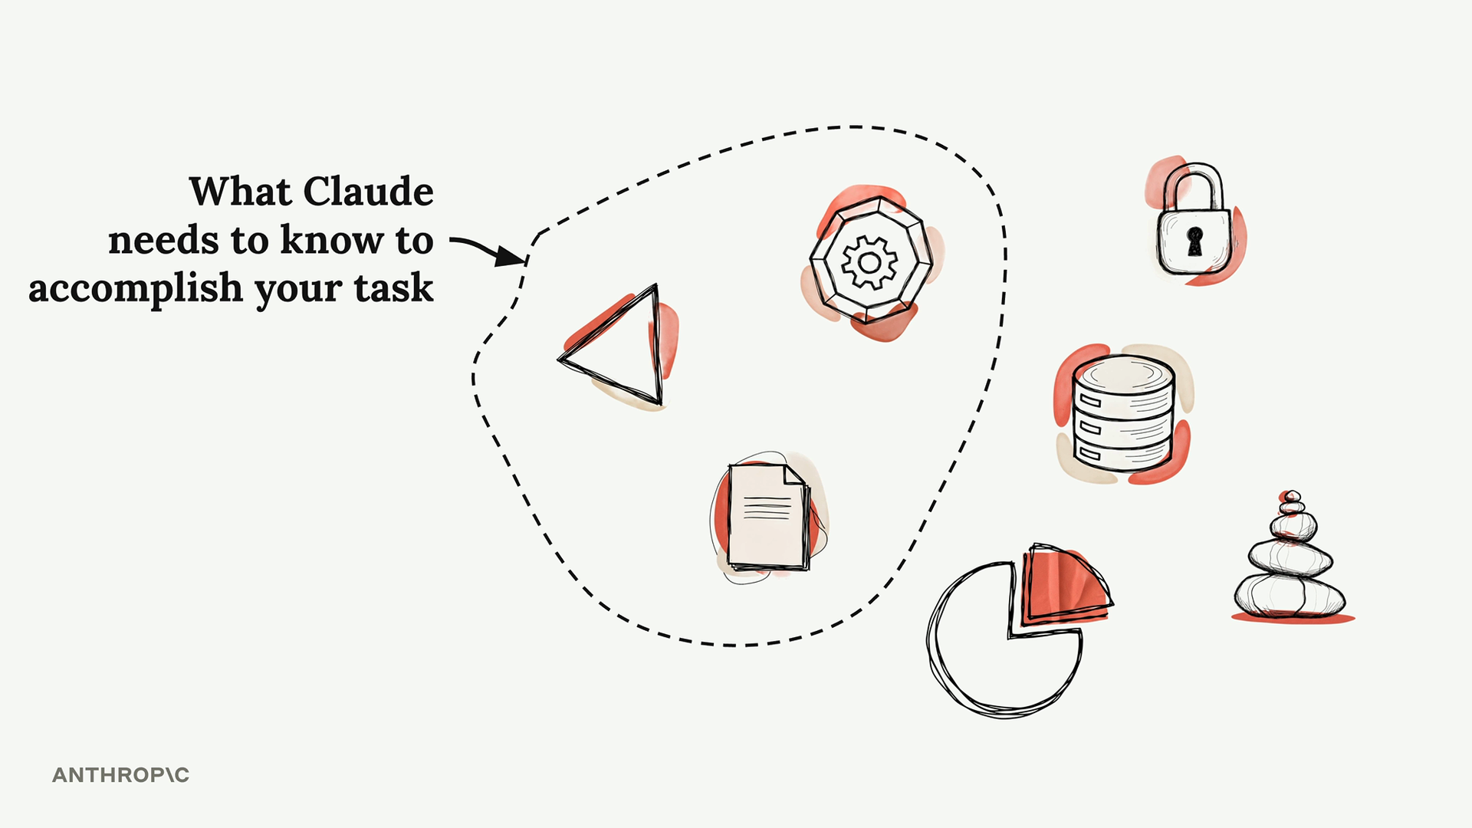
What is a Coding Assistant?
More Than a Tool That Writes Code
A coding assistant is a sophisticated system that uses language models to tackle complex programming tasks. Understanding how it works behind the scenes reveals what makes a truly powerful coding companion.
When you give it a task — like fixing a bug from an error message — it follows a process similar to how a human developer would: gather context, formulate a plan, then take action. The first and last steps require interacting with the outside world: reading files, fetching docs, running commands.
Claude Code: A Powerful Coding Assistant

Slide 5
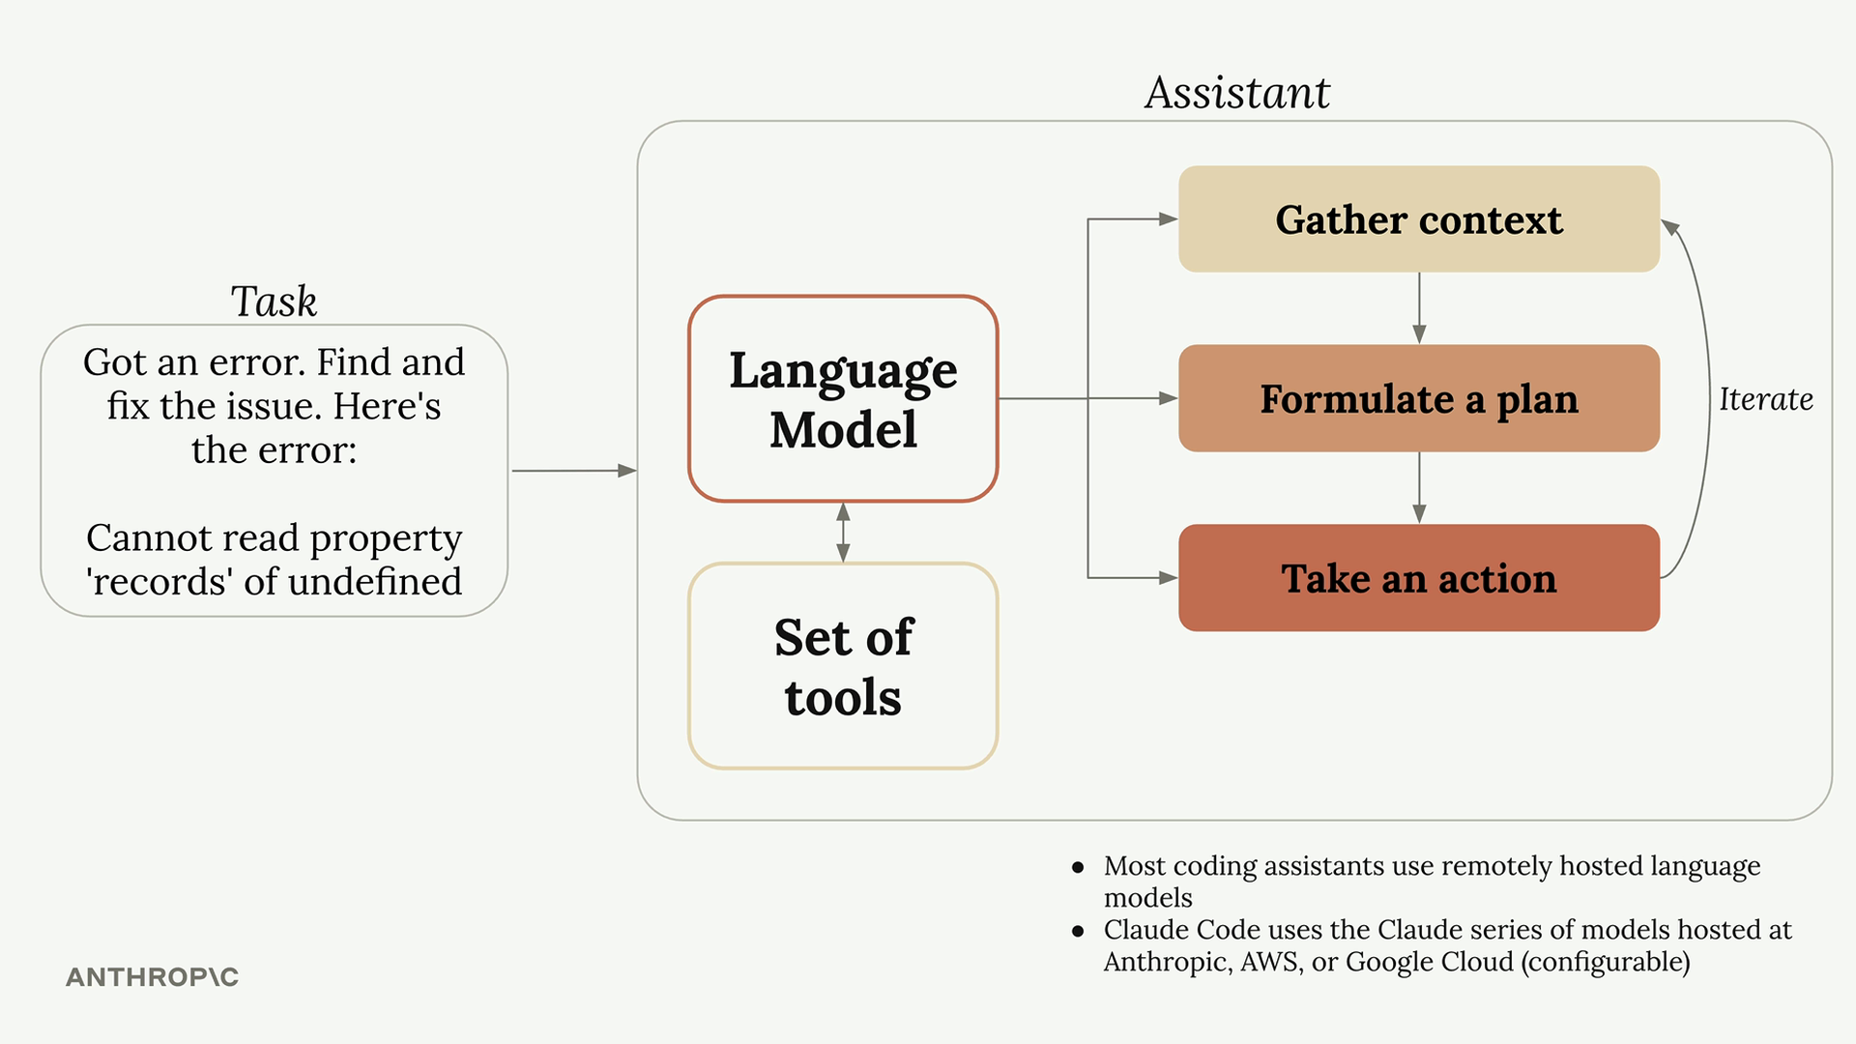
How Coding Assistants Work
A Three-Step Loop, Powered by Tools
Given a task, the assistant follows the same loop a human developer would: Gather context (which files matter, what the error refers to), Formulate a plan (decide how to fix it and how to verify), and Take action (edit files, run commands, iterate).
The first and last steps require interacting with the outside world. Most coding assistants use remotely hosted language models. Claude Code uses the Claude series of models hosted at Anthropic, AWS, or Google Cloud (configurable).
Claude Code: A Powerful Coding Assistant

Slide 6

Language models alone can’t read your files.
They only process text. Tool use is how Claude Code bridges that gap.

Slide 7
How Tool Use Works
How tool use bridges text-only models to real action.
The assistant adds tool instructions to every request, teaching the model how to ask for actions like reading files or running commands.
Step 1
You ask: “What code is in main.go?”
Step 2
The assistant attaches tool instructions to your request.
Step 3
The model replies: “ReadFile: main.go”.
Step 4: The coding assistant reads the actual file and sends its contents back to the model.
Step 5: The model uses the file contents to give its final answer. This loop is how text-only models can effectively read files, write code, and run commands.
Claude Code: A Powerful Coding Assistant

Slide 8
Why Claude’s Tool Use Matters
Tackles harder tasks
Claude can combine different tools to handle complex work — and will use tools it hasn’t seen before.
Strong tool use means the assistant adapts to new APIs, libraries, and frameworks without needing to be retrained on them.
Extensible platform
You can easily add new tools to Claude Code, and Claude will adapt to use them as your workflow evolves.
The same model handles file editing, web search, shell commands, and any custom MCP server you connect, all from the same interface.
Better security
Claude Code can navigate codebases without requiring indexing, which often means not sending your entire codebase to external servers.
Local-first tool use also gives you tighter control over which files and secrets ever leave your machine.
Claude Code: A Powerful Coding Assistant

Slide 9
Claude Code Setup
02 ― 02
Claude Code: A Powerful Coding Assistant

Slide 10

Claude Code Setup
macOS, Linux, WSL
curl -fsSL https://claude.ai/install.sh | bash
Windows PowerShell
irm https://claude.ai/install.ps1 | iex
macOS (Homebrew)
brew install --cask claude-code
Then launch it
claude
Install Locally in Under a Minute
Claude Code runs in your terminal. Pick the install command for your platform and run it. The first time you launch claude, you’ll pick a color theme and authenticate with your claude.ai credentials.
Full instructions: https://code.claude.com/docs/en/quickstart. Using Claude Code through Amazon Bedrock, Google Cloud Vertex AI, or Microsoft Foundry? See third-party provider setup for additional steps.
Claude Code: A Powerful Coding Assistant

Slide 11
Adding Context
03 ― 06
Claude Code: A Powerful Coding Assistant

Slide 12
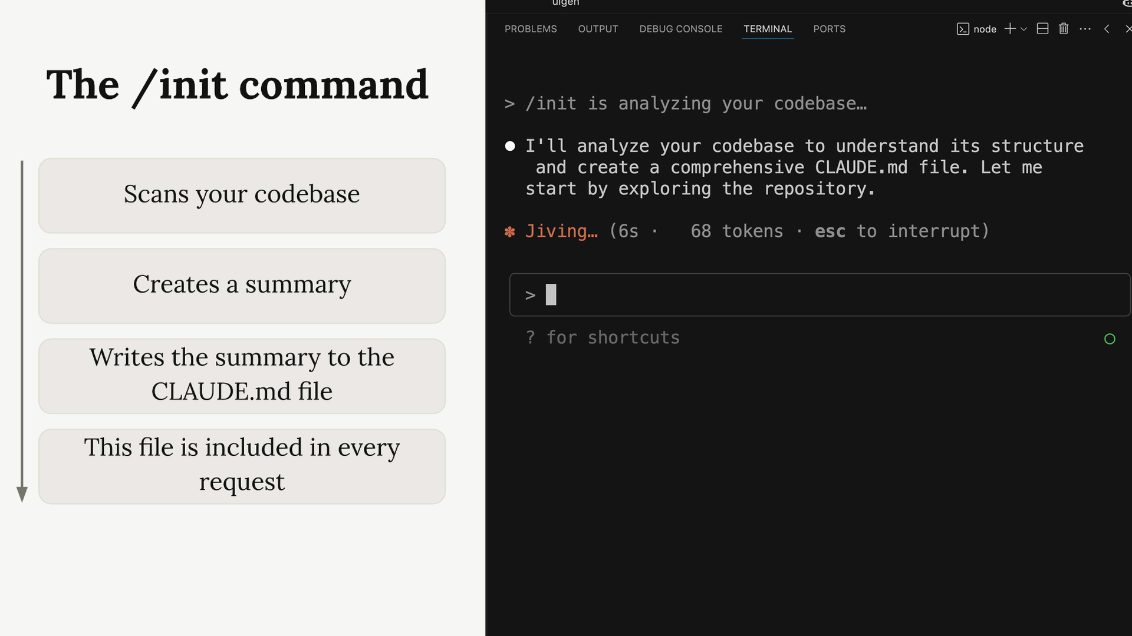
The /init Command
Teach Claude Your Codebase in One Command
When you first start Claude in a new project, run /init. Claude scans the entire codebase to understand its purpose and architecture, important commands and critical files, and the coding patterns and structure already in use.
It then writes a summary to a CLAUDE.md file. Hit Enter to approve each write, or press Shift+Tab to let Claude write files freely for the rest of the session.
Claude Code: A Powerful Coding Assistant

Slide 13
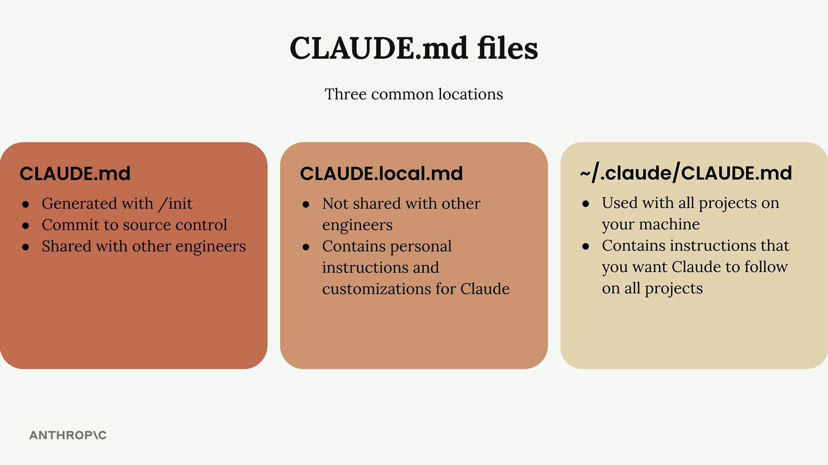
The CLAUDE.md File
A Persistent System Prompt for Your Project
CLAUDE.md guides Claude through your codebase and lets you give custom directions. It’s included in every request, so it acts like a persistent system prompt for your project.
Three common locations: CLAUDE.md committed to source control and shared with the team, CLAUDE.local.md for personal customizations, and ~/.claude/CLAUDE.md for instructions Claude should follow across every project on your machine.
Claude Code: A Powerful Coding Assistant

Slide 14

File Mentions with @
In a Claude Code prompt
How does the auth system work? @auth
Inside your CLAUDE.md
The database schema is defined in @prisma/schema.prisma. Reference it anytime you need to understand the structure of stored data.
When you need Claude to look at a specific file, type @ followed by the path. Claude shows you matching files and includes the one you pick in the conversation.
You can use the same @ syntax inside CLAUDE.md. Referenced files are pulled in automatically with every request, so Claude can answer questions about them without searching.
Claude Code: A Powerful Coding Assistant

Slide 15
Key Takeaways
Four ideas worth remembering about how Claude Code actually works.
The architecture is simple at heart: a model, a set of tools, and a loop that connects them to your codebase.
1. Coding assistants use language models to plan, decide, and act on programming tasks. The model is the brain; the assistant gives it hands.
2. Language models on their own can’t read files or run commands. Tool use is what lets them do real work on a real codebase.
3. Not all models use tools with the same skill. Strong tool use is what separates a useful assistant from an unreliable one.
4. Claude’s strong tool use is what gives Claude Code its security, extensibility, and ability to grow with your workflow.
Claude Code: A Powerful Coding Assistant

Slide 16
Thank You
For Watching
Anthropic Guide 2026
Get started:
code.claude.com/docs claude.ai/install.sh
Learn more:
Anthropic docs GitHub examples Community forum
Topics
Setup & Context Management
Tool Use & Architecture

