Slide 1

Introduction
to Subagents
Claude Code Guide
Specialized Helpers for Claude Code
Topics
Creating Custom Agents
Designing & Using Subagents

Slide 2
Agenda
1 ― What Are Subagents?
2 ― Creating a Subagent
Introduction to Subagents.
3 ― Designing Effective Subagents
4 ― Using Subagents Effectively
5 ― The Decision Rule
6 ― Key Takeaways
Introduction to Subagents

Slide 3

What Are Subagents?
01 ― 04
Introduction to Subagents

Slide 4

What Are Subagents?
Subagents are specialized assistants that Claude Code can delegate tasks to. Each one runs in its own conversation context, does its work, and returns a focused summary to the main thread.
The intermediate steps — file reads, searches, tool calls — stay isolated and never clutter your main conversation. You get the answer without the noise of the journey.
Introduction to Subagents

Slide 5
Why Subagents Matter
Context windows are finite — and they fill up fast.
Every tool call, file read, and search result is stored in your main context. Once it fills up, Claude starts losing track of earlier parts of the conversation.
Without subagents, even a simple question can fill your main context with the journey it took to find the answer — dozens of files read, searches run, function calls traced.
All of that exploration accumulates. You only needed one fact, but the noise has already crowded out room for the rest of your session.
A subagent spins up a separate context window. It receives a custom system prompt and a task description, then works on its own.
When it’s done, only a focused summary returns. The entire subagent conversation is then discarded — your main context stays clean.
Introduction to Subagents

Slide 6
Built-in Subagents
General purpose
For multi-step tasks that require both exploration and action. Use this when you need a subagent that can both research and execute.
The most flexible built-in option — pick it when the task isn’t purely exploratory and you also need changes made.
Explore
For fast searching and navigation of codebases. Ideal when you need to find something quickly without changing anything.
A read-focused worker. Great for “which file handles X?” or “where is Y configured?” type questions.
Plan
Used during plan mode for research and analysis of your codebase before presenting a plan to the user.
Specialized for planning: gathers context up front so the plan is grounded in what’s actually in the repo.
Introduction to Subagents

Slide 7
Creating a Subagent
02 ― 04
Introduction to Subagents

Slide 8
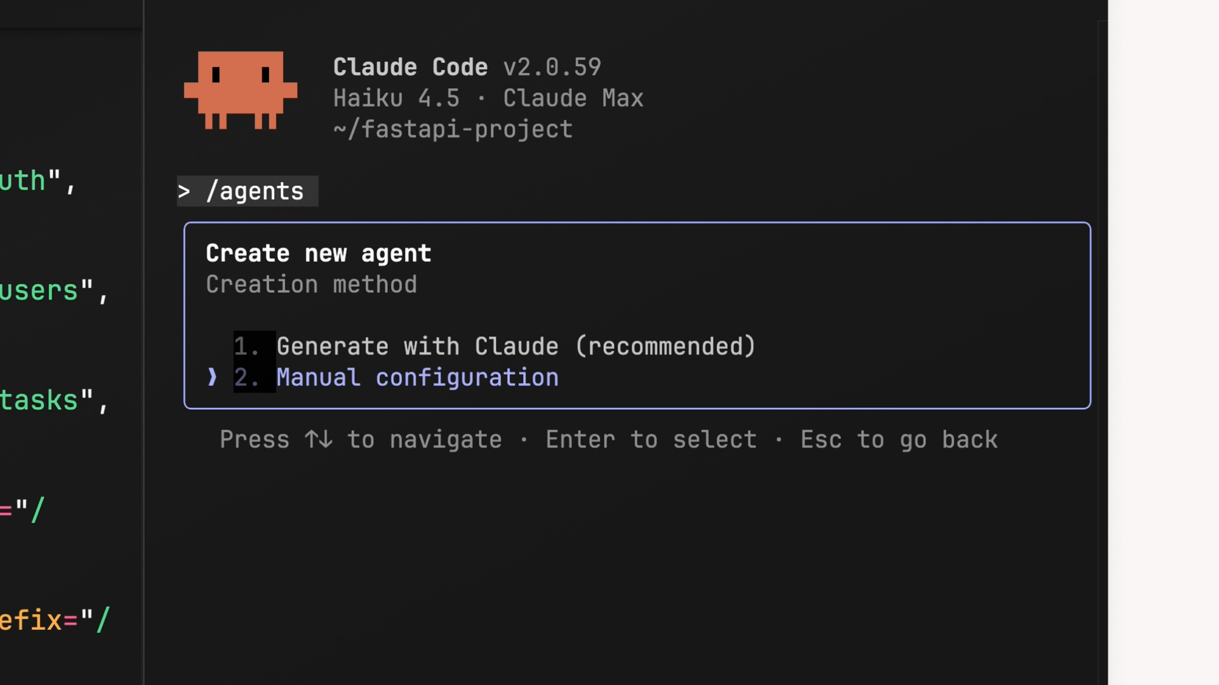
Creating a Subagent
Start with the /agents Command
The /agents slash command opens the main interface for managing your subagents. Pick “Create new agent” to start. You’ll first choose the scope: project-level (current project only) or user-level (shared across every project on your machine).
Then pick how to create it. You can write the config manually, but the recommended approach is to let Claude generate it — just describe what you want the subagent to do and Claude produces a name, description, and system prompt for you.
Introduction to Subagents

Slide 9
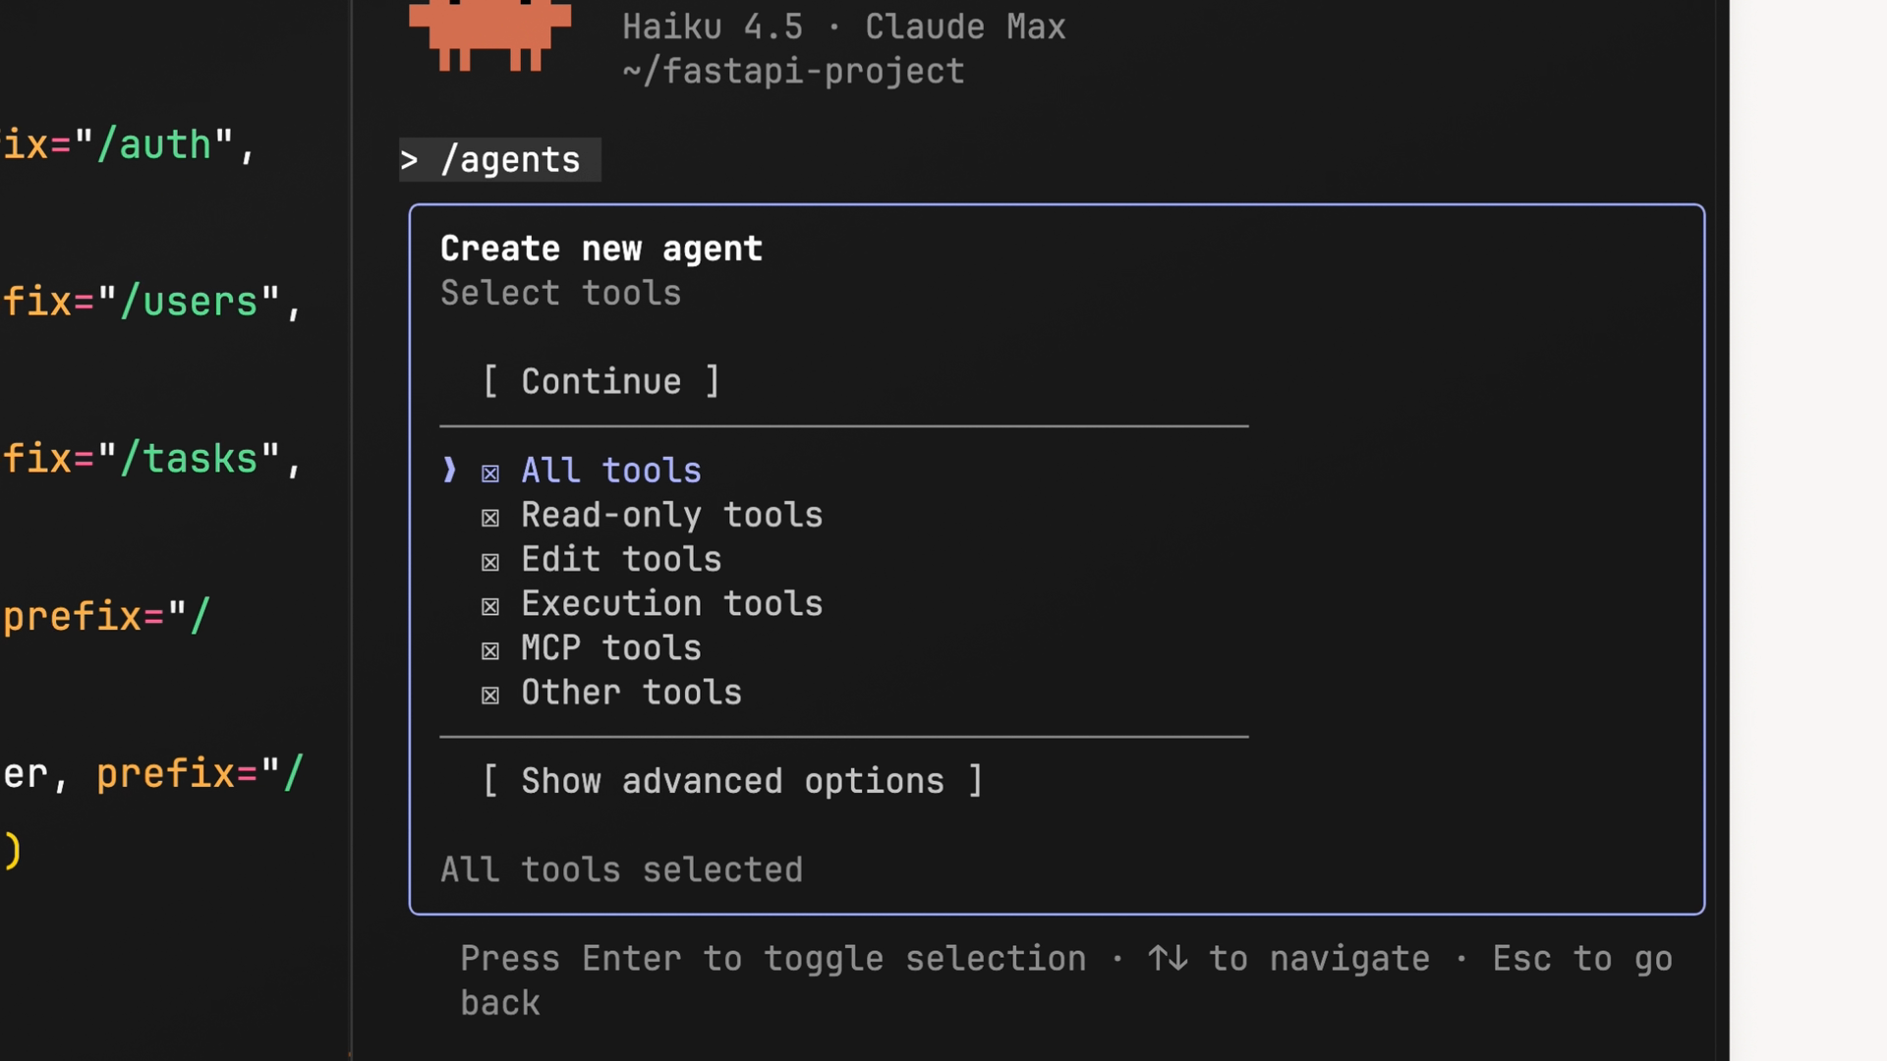
Customizing Tools
Give the Subagent Only What It Needs
During creation you choose which tool categories the subagent can access: Read-only, Edit, Execution, MCP, and Other. Think about what the subagent actually needs.
A code reviewer probably doesn’t need edit tools — it should read and analyze, not change. But execution tools can stay enabled so it can run git diff and identify pending changes.
Introduction to Subagents

Slide 10
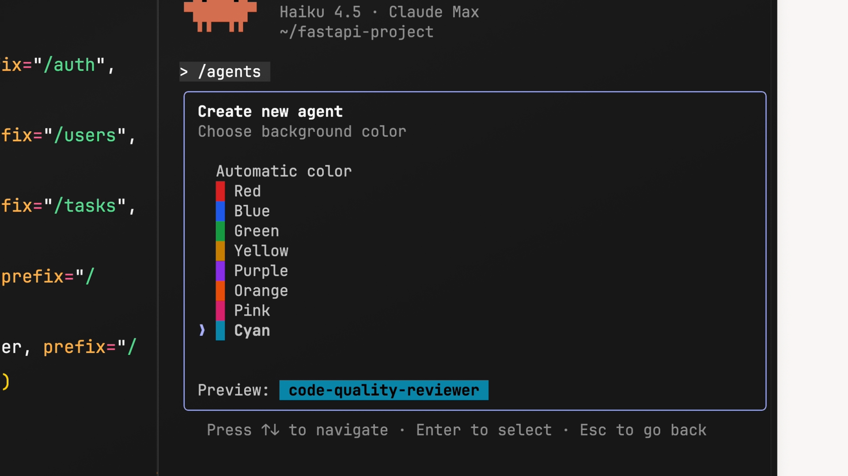
Choosing a Model & Color
Match the Model to the Workload
Pick the Claude model that powers the subagent: Haiku for fast, lightweight tasks; Sonnet for a good middle ground; Opus for complex analysis; or Inherit to use whatever your main conversation is running.
Then pick a color. It shows up in the UI so you can quickly see which subagent is active — a small touch that helps a lot when several are running at once.
Introduction to Subagents

Slide 11
The Config File
---
name: code-quality-reviewer
description: Use when you need
to review recently written or
modified code for quality,
security, best practices.
tools: Bash, Glob, Grep, Read,
WebFetch, WebSearch
model: sonnet
color: purple
---
You are an expert code reviewer
specializing in quality...
Once you finish creating a subagent, its config is saved to .claude/agents/<name>.md. The YAML frontmatter sets behavior; the markdown body below is the system prompt.
Five fields control everything: name (the identifier), description (when to use it), tools (what it can access), model (which Claude powers it), and color (UI tag).
Introduction to Subagents

Slide 12
Designing Effective Subagents
03 ― 04
Introduction to Subagents

Slide 13
Four Patterns That Make Subagents Effective
Specific descriptions
The description controls both when the subagent is launched and what instructions it receives. Write it to steer both.
Tip: add a sentence like “you must tell the agent precisely which files to review” to make the main agent write a more specific input prompt.
Structured output
Define an output format in the system prompt so the subagent knows when it’s done and returns information the main thread can use.
The single biggest improvement you can make. It creates natural stopping points and prevents subagents from running too long.
Obstacle reporting & tool access
Include a section for workarounds, quirks, and problems so the main thread doesn’t have to rediscover them.
Only give a subagent the tools it actually needs: read-only for research, Bash for reviewers, edit/write only for agents that should change code.
Introduction to Subagents

Slide 14
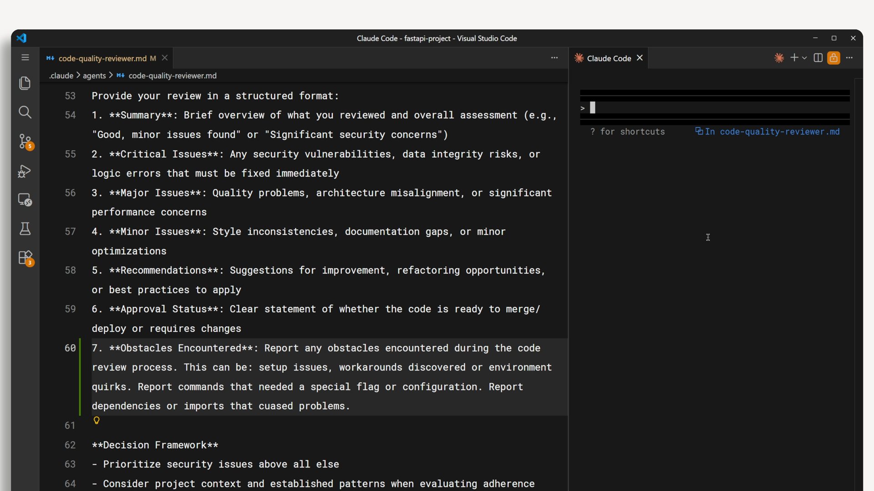
Define a Structured Output Format
The Single Biggest Improvement You Can Make
Without a defined output, subagents struggle to decide when enough research is done and tend to run far longer than necessary. A clear format gives them a checklist to work through.
For a code reviewer: Summary, Critical Issues, Major Issues, Minor Issues, Recommendations, Approval Status, and Obstacles Encountered. Once every section is filled, the subagent knows it can stop.
Introduction to Subagents

Slide 15
Limiting Tool Access
Only give a subagent the tools it actually needs.
This prevents unintended side effects and makes each subagent’s role clearer when you have several of them.
Research / read-only subagent: only needs Glob, Grep, and Read. Cannot accidentally modify files.
Code reviewer: needs Bash to run git diff and see what changed, but still doesn’t need Edit or Write.
Styling / code modification agent: this is where you grant Edit and Write access — the job is to actually change your code.
Rule of thumb: read for research, Bash for review, write only for agents whose explicit purpose is to modify code.
Introduction to Subagents

Slide 16
Using Subagents Effectively
04 ― 04
Introduction to Subagents

Slide 17
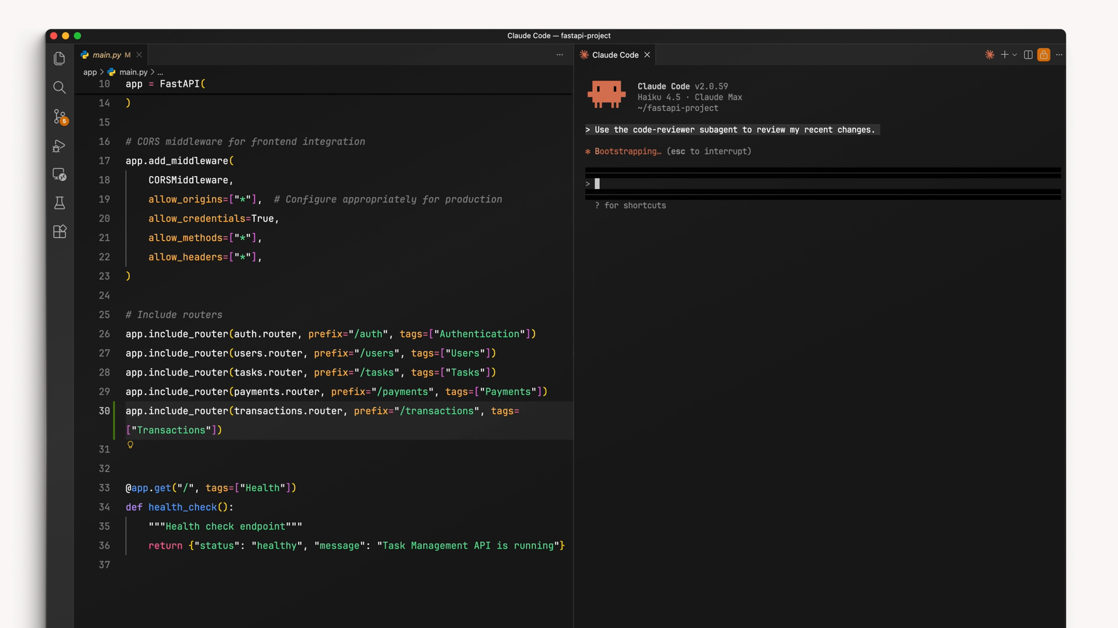
When Subagents Shine
Research, Reviews & Custom System Prompts
Subagents excel when exploration is separate from execution — when you need a result, not a play-by-play. Classic use cases include investigating an unfamiliar codebase and code reviews where a fresh perspective improves the feedback.
Custom system prompts are another sweet spot: a copywriting subagent can have completely different voice instructions, and a styling subagent can auto-load your design system files into its context.
Introduction to Subagents

Slide 18
When Subagents Hurt
Expert personas
Subagents that claim expertise rarely help. “You are a Python expert” adds no value — Claude already has that knowledge.
There is nothing a self-declared “expert” subagent can do that your main thread cannot do directly.
Sequential pipelines
Pipelines that hand off between agents fail when each step depends on the previous step’s discoveries. Information gets lost in compression.
Bug fixing is a classic example. The fix depends on what the debug step found — keep it in one context.
Test runners
Test runner subagents tend to hide the output you actually need. When tests fail, you want the full error, not “tests failed.”
Testing showed this pattern performed worst of all configurations. You end up writing debug scripts to recover information you should have seen directly.
Introduction to Subagents

Slide 19

Does the intermediate work matter?
YES — Keep it in your main thread
You need to see and react to what’s happening along the way. Each step depends on what the previous step discovered.
Example: bug fixing, where the fix depends on what the debug step found.
NO — Delegate to a subagent
You just need the final result. The exploratory work would only clutter your main thread’s context.
Example: investigating how authentication works in an unfamiliar codebase.

Slide 20
Key Takeaways
Three benefits, one decision rule.
The less noise in your main context, the longer and more effectively you can work.
1. Focused work. Each subagent concentrates on a specific task instead of mixing concerns in the main thread.
2. Clean context. The intermediate file reads, searches, and tool calls stay isolated in the subagent’s window.
3. Concise summaries. Only the information you need comes back to the main conversation, in a structured shape.
The decision rule: if the intermediate work matters, keep it in your main thread. If you just need the result, delegate it.
Introduction to Subagents

Slide 21
Thank You
For Watching
Claude Code Guide
Get started:
Run /agents in Claude Code .claude/agents/<name>.md
Learn more:
Subagent docs Output format guide Decision examples
Topics
Creating Custom Agents
Designing & Using Subagents

