Slide 1

Claude Code
Fundamentals
Claude Code Guide
Seven Fundamentals for Daily Use
Topics
Tool Use, Context, MCP & Custom Commands
From First Install to GitHub Integration

Slide 2
Agenda
1 ― What Is a Coding Assistant?
2 ― Claude Code Setup
Claude Code Fundamentals.
3 ― Adding Context
4 ― Controlling Context
5 ― Custom Commands & MCP Servers
6 ― GitHub Integration
Claude Code Fundamentals

Slide 3

What Is a Coding Assistant?
01 ― 07
Claude Code Fundamentals

Slide 4
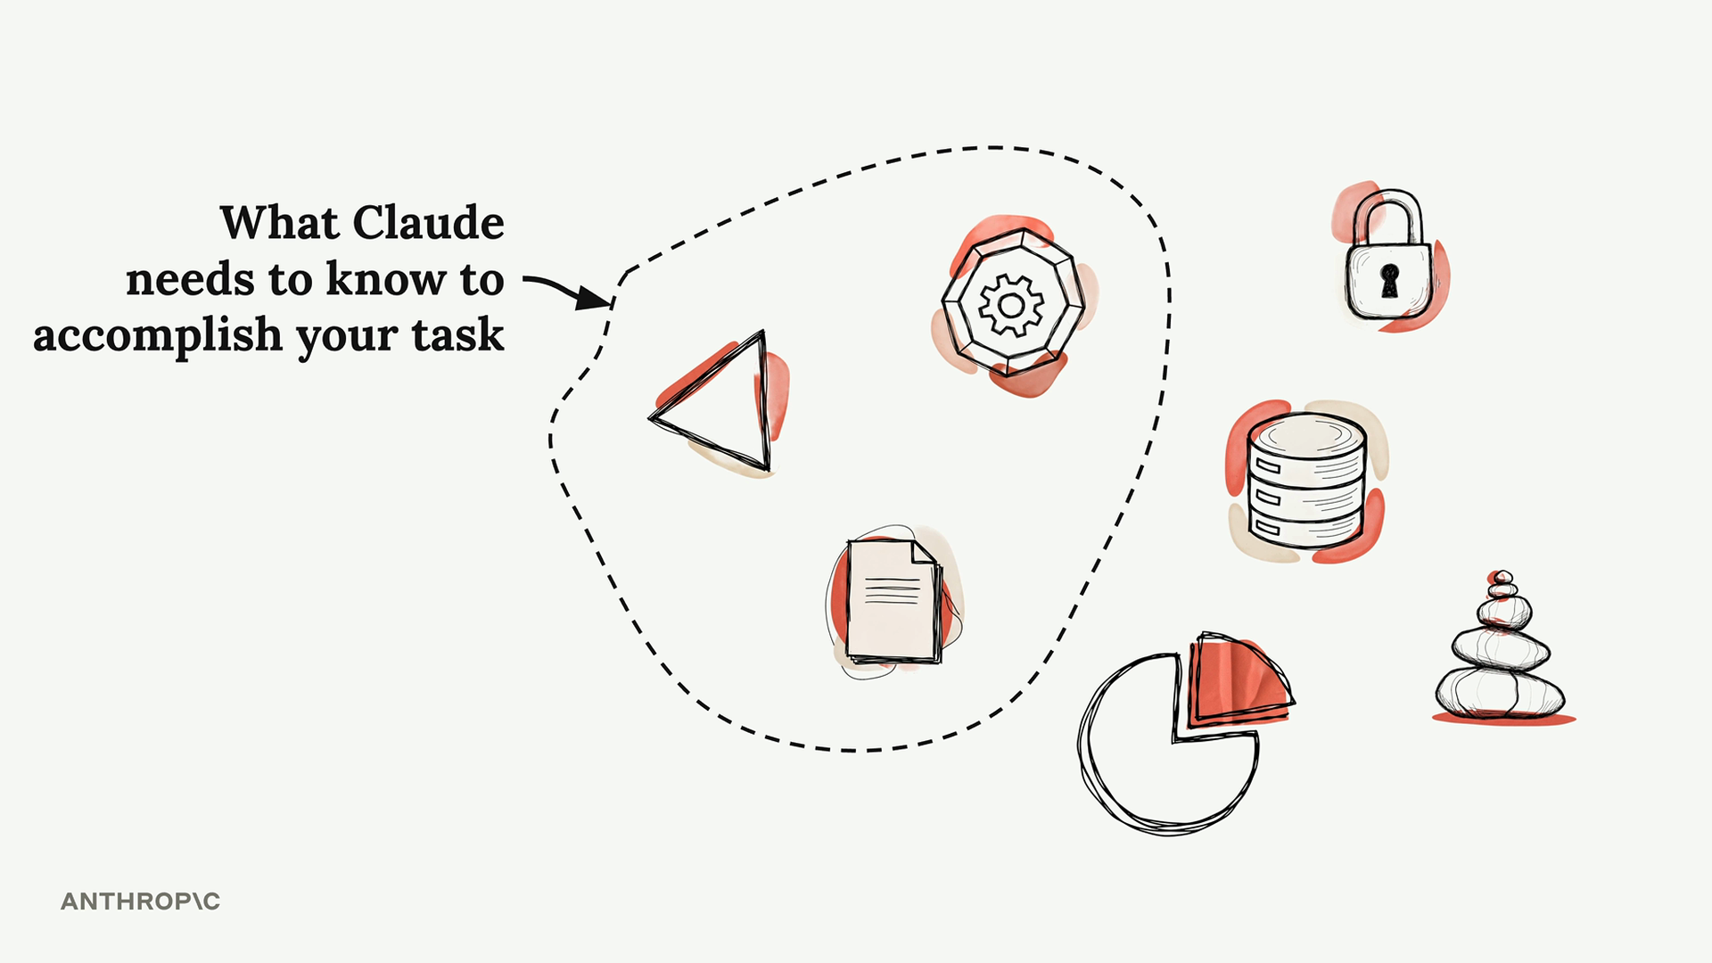
What Is a Coding Assistant?
More Than a Tool That Writes Code
A coding assistant is a sophisticated system that uses language models to tackle complex programming tasks. Understanding how it works behind the scenes reveals what makes a truly powerful coding companion.
When you give it a task — like fixing a bug from an error message — it follows a process similar to how a human developer would: gather context, formulate a plan, then take action.
Claude Code Fundamentals

Slide 5
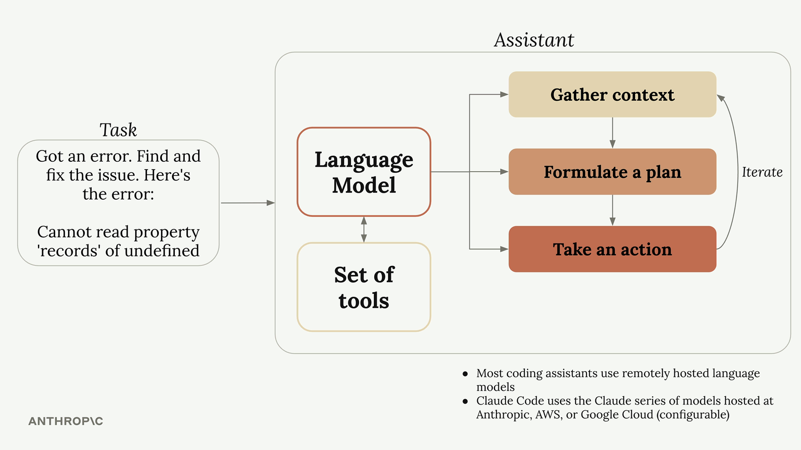
How Coding Assistants Work
A Three-Step Loop, Powered by Tools
The assistant follows the same loop a human developer would: Gather context (which files matter, what the error refers to), Formulate a plan (decide how to fix it and how to verify), and Take action (edit files, run commands, iterate).
The first and last steps require interacting with the outside world. Most coding assistants use remotely hosted language models. Claude Code uses the Claude series of models hosted at Anthropic, AWS, or Google Cloud.
Claude Code Fundamentals

Slide 6

Language models alone can’t read your files.
The Problem
Language models only process text and return text. Ask one to read a file directly and it’ll tell you it can’t.
So how does the assistant actually open your code?
The Solution: Tool Use
The assistant adds tool instructions to every request. The model emits a structured request like “ReadFile: main.go”.
The assistant runs the action, returns the result, and the loop continues.

Slide 7
Why Claude’s Tool Use Matters
Tackles harder tasks
Claude can combine different tools to handle complex work — and will use tools it hasn’t seen before.
Strong tool use means the assistant adapts to new APIs, libraries, and frameworks without needing to be retrained on them.
Extensible platform
You can easily add new tools to Claude Code, and Claude will adapt to use them as your workflow evolves.
The same model handles file editing, web search, shell commands, and any custom MCP server you connect, all from the same interface.
Better security
Claude Code can navigate codebases without requiring indexing, which often means not sending your entire codebase to external servers.
Local-first tool use also gives you tighter control over which files and secrets ever leave your machine.
Claude Code Fundamentals

Slide 8
Claude Code Setup
02 ― 07
Claude Code Fundamentals

Slide 9

Claude Code Setup
macOS, Linux, WSL
curl -fsSL https://claude.ai
/install.sh | bash
Windows PowerShell
irm https://claude.ai/install
.ps1 | iex
macOS (Homebrew)
brew install --cask claude-code
Then launch:
claude
Install Locally in Under a Minute
Claude Code runs in your terminal. Pick the install command for your platform and run it. The first time you launch claude, you’ll pick a color theme and authenticate with your claude.ai credentials.
Full instructions: https://code.claude.com/docs/en/quickstart. Using Claude Code through Amazon Bedrock, Google Cloud Vertex AI, or Microsoft Foundry? See third-party provider setup for additional steps.
Claude Code Fundamentals

Slide 10
Adding Context
03 ― 07
Claude Code Fundamentals

Slide 11
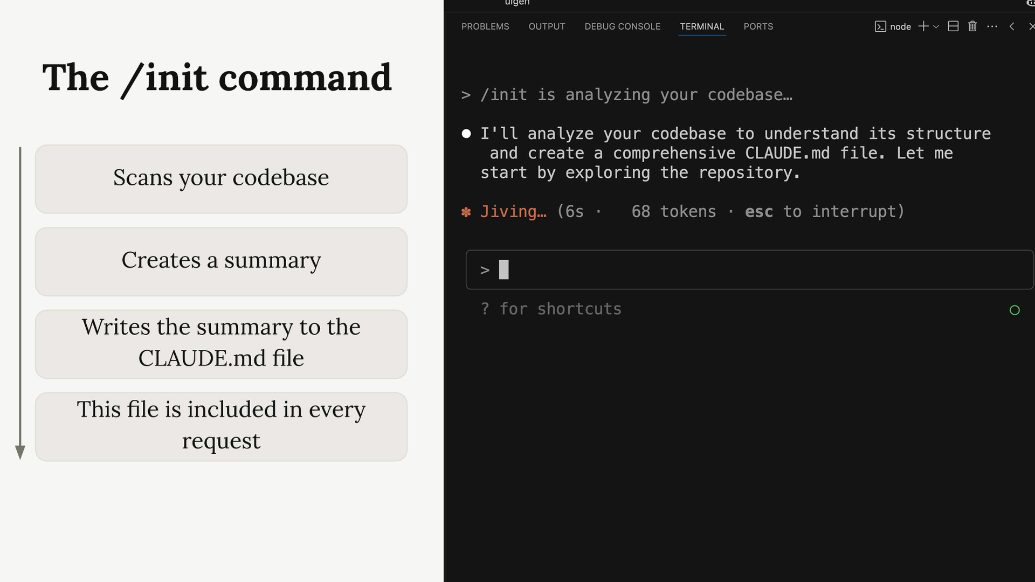
The /init Command
Teach Claude Your Codebase in One Command
When you first start Claude in a new project, run /init. Claude scans the entire codebase to understand its purpose and architecture, important commands and critical files, and the coding patterns already in use.
It then writes a summary to a CLAUDE.md file. Hit Enter to approve each write, or press Shift+Tab to let Claude write files freely for the rest of the session.
Claude Code Fundamentals

Slide 12
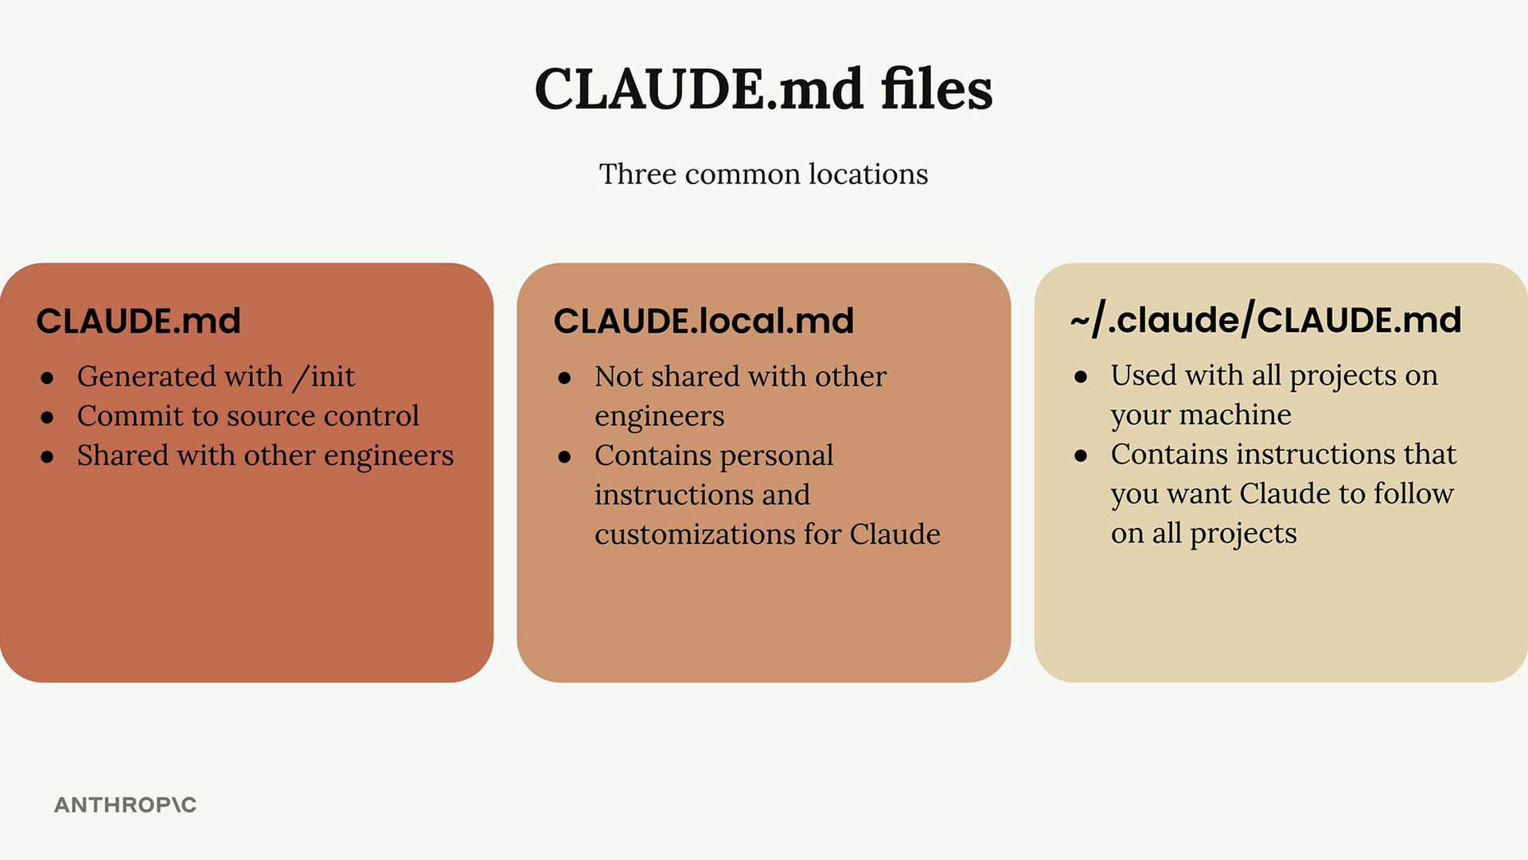
The CLAUDE.md File
A Persistent System Prompt for Your Project
CLAUDE.md guides Claude through your codebase and lets you give custom directions. It’s included in every request, so it acts like a persistent system prompt for your project.
Three common locations: CLAUDE.md committed to source control, CLAUDE.local.md for personal customizations, and ~/.claude/CLAUDE.md for instructions Claude should follow across every project.
Claude Code Fundamentals

Slide 13

File Mentions with @
In a Claude Code prompt
How does the auth system
work? @auth
Inside your CLAUDE.md
The database schema is
defined in
@prisma/schema.prisma.
Reference it anytime you
need to understand the
structure of stored data.
When you need Claude to look at a specific file, type @ followed by the path. Claude shows you matching files and includes the one you pick in the conversation.
You can use the same @ syntax inside CLAUDE.md. Referenced files are pulled in automatically with every request, so Claude can answer questions about them without searching.
Claude Code Fundamentals

Slide 14
Controlling Context
04 ― 07
Claude Code Fundamentals

Slide 15
Controlling Your Conversation
Escape & double-tap
Press Escape to stop Claude mid-response and redirect. Press Escape twice (or type /rewind) to jump back to an earlier message.
Especially useful for fixing repetitive errors: stop Claude, run /memory to update CLAUDE.md, then continue. Future conversations won’t repeat the mistake.
/compact
/compact summarizes your entire conversation while preserving the key things Claude has learned. Best when Claude has gained valuable project knowledge and you want to keep it.
Use when the conversation has become long but contains important context you want to carry into the next related task.
/clear
/clear starts a fresh conversation with no context. Best when switching to a completely unrelated task and the current context might confuse Claude.
The cleared conversation isn’t lost — /resume lets you return to it. /clear doesn’t remove it from your session history.
Claude Code Fundamentals

Slide 16
Custom Commands
05 ― 07
Claude Code Fundamentals

Slide 17
Creating Custom Commands
.claude/commands/audit.md
Run npm audit to find
vulnerable installed packages.
Run npm audit fix to apply
updates.
Run the test suite to verify
nothing broke.
Trigger it with:
/audit
Turn Repetitive Workflows Into One Slash Command
Create a .claude/commands/ directory in your project, then add a markdown file. The filename becomes the command name: audit.md creates /audit. Claude Code picks it up automatically — no restart needed.
Inside the file, describe the steps Claude should run. The example /audit command runs npm audit, applies fixes, and then runs tests to verify nothing broke.
Claude Code Fundamentals

Slide 18
Commands with Arguments
write_tests.md
Write comprehensive tests
for: $ARGUMENTS
Conventions:
- Use Vitest with React
Testing Library
- Use @/ prefix for imports
Coverage:
- Happy paths
- Edge cases
- Error states
Then run it:
/write_tests use-auth.ts
Custom commands can accept arguments via the $ARGUMENTS placeholder. This makes them reusable across files, modules, and tasks — not locked to a single scenario.
Arguments don’t have to be file paths — any string works. Pair $ARGUMENTS with conventions and coverage rules to bake your team’s standards into every test you generate.
Claude Code Fundamentals

Slide 19
MCP Servers
06 ― 07
Claude Code Fundamentals

Slide 20
Adding MCP Servers
Install Playwright MCP
claude mcp add playwright
npx @playwright/mcp@latest
.claude/settings.local.json
{
"permissions": {
"allow": [
"mcp__playwright"
],
"deny": []
}
}
Extend Claude with New Tools
MCP (Model Context Protocol) servers run locally or remotely and give Claude new tools — database access, browser control, API testing, cloud integrations. Run claude mcp add in your terminal to register one.
To skip permission prompts every time, pre-approve the server in .claude/settings.local.json. Note the double underscore in mcp__playwright. Playwright is one of the most popular MCP servers — it gives Claude a real browser to drive.
Claude Code Fundamentals

Slide 21
MCP in Practice
With Playwright MCP, you can ask Claude to open a browser, generate a component, look at the rendered output, and update its own generation prompt based on what it sees. The loop closes between code and visual result.
In practice, this means Claude can move past generic purple-to-blue gradients toward warm sunset palettes, ocean-depth themes, asymmetric layouts — because it sees the actual visual output, not just the code, and adapts accordingly.
Claude Code Fundamentals

Slide 22
GitHub Integration
07 ― 07
Claude Code Fundamentals

Slide 23
GitHub Integration
Setup
Run /install-github-app inside Claude to start. It installs the Claude Code app on GitHub, adds your API key, and generates a PR that adds workflow files to .github/workflows.
Once you merge the generated PR, both workflows are active. You can customize them later to fit your project’s setup steps and tooling.
Mention Action
Mention Claude in any issue or pull request with @claude. Claude analyzes the request, creates a task plan, executes with full repo access, and responds directly in the issue or PR.
Works inside the conversation thread, so you stay in GitHub. Claude has access to your codebase via the workflow runner.
Pull Request Action
Whenever a PR is created, Claude automatically reviews the proposed changes, analyzes the impact, and posts a detailed report on the pull request — no manual trigger required.
Catches issues automatically before review. You can disable or scope it down later if it’s too chatty on certain repos.
Claude Code Fundamentals

Slide 24
Customizing GitHub Workflows
Project setup step
- name: Project Setup
run: |
npm run setup
npm run dev:daemon
Custom instructions
custom_instructions: |
Server is running at
localhost:3000. Logs go
to logs.txt.
Allowed tools (explicit)
allowed_tools: "Bash(npm:*),
mcp__playwright__..."
Add a Project Setup step before Claude runs, custom_instructions to share project context (running server, log file location, available CLIs), and an mcp_config block to attach MCP servers like Playwright to the workflow.
Unlike local development, GitHub Actions requires you to list every allowed tool explicitly — there’s no shortcut. Each tool from each MCP server must be enumerated in allowed_tools.
Claude Code Fundamentals

Slide 25
Thank You
For Watching
Claude Code Guide
Get started:
code.claude.com/docs claude.ai/install.sh
Learn more:
MCP server registry Custom commands guide GitHub integration
Topics
Tool Use, Context, MCP & Commands
From First Install to GitHub

