Slide 1
Variant Annotation M7 Bioinformatics MSc Genomic Medicine Tues 16th Feb 2016
Simon Topp
simon.topp@kcl.ac.uk
Basic & Clinical Neuroscience
Institute of Psychiatry, Psychology & Neuroscience

Slide 2
Overview
Annotation Tools
Transcript choice
Variant Nomenclature
Left vs Right alignment issues
Population Databases
Pathogenicity Predictors
Non-coding Variants

Slide 3
Annotation Tools
http://omictools.com/variant-annotation-category
START
Does it take VCF input?
Probably not the right tool
NO
YES
Upload VCF

Slide 4


Annotation Tools
3 most popular tools:
wANNOVAR
http://wannovar.usc.edu/
SNPeff
http://snpeff.sourceforge.net/
Variant Effect Predictor
http://www.ensembl.org/Tools/VEP

Slide 5
Also recommended... (command line only)
VAT – Variant Annotation Tool
http://vat.gersteinlab.org/index.php
VAAST - Variant Annotation, Analysis and Search Tool
http://www.yandell-lab.org/software/vaast.html
SNPAAMapper - A SNP Amino Acid Mapping tool
http://www.ccmb.med.umich.edu/ccdu/SNPAAMapper

Slide 6
Genome Version
hg18 (NCBI36) Mar 2006
Deprecated, but used in many older publications and resources
If you can’t find the variant they refer to, check the small print in the methods and the publication date!
hg19 (GRCh37) Feb 2009
Most commonly used (still)
hg38 (GRCh38) Dec 2013
Better for HLA and repeat-rich regions
Very little uptake by scientific community
Fewer annotations available mapped to it

Slide 7
Transcripts - Refseq
Curated by the NCBI
http://ncbi.nlm.nih.gov/gene
NM_nnnnn.n mRNA
NR_nnnnn.n non-coding
NP_nnnnn.n protein
XM_/XR_/XP_ predicted
Manually curated, high quality, not comprehensive. Some issues in genome mapping have been reported (incorrect location of splice sites in 3% of transcripts)

Slide 8
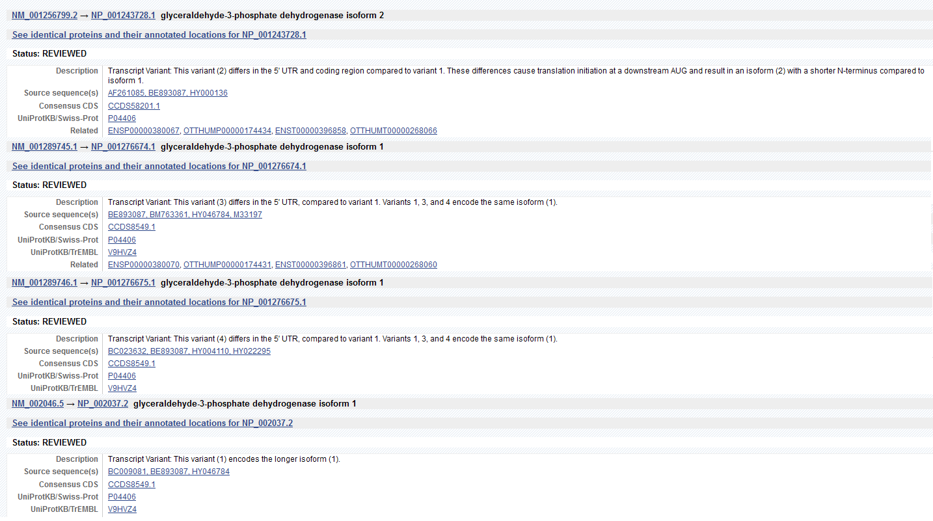
GAPDH in Refseq
4 Alternately spliced isoforms
3 of them encode the same protein (splicing only affects the UTR)

Slide 9
Transcripts - Ensembl
Curated by the EBI (www.ensembl.org)
ENSTnnnnnnnnnnnn – mRNA
ENSPnnnnnnnnnnnn – protein
Not manually curated. Usually one Ensembl transcript for every uniquely observed splicing pattern. Many are partial fragments of full length transcripts or pre-mRNA with unspliced introns (junk).
Can result in annotation-overload.

Slide 10
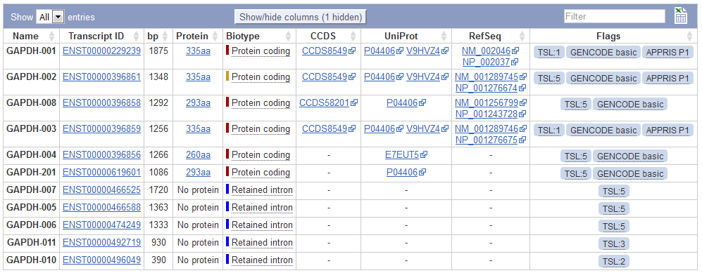
GAPDH in Ensembl
11 Transcripts
4 overlap with Refseq
5 have retained introns – probably unspliced pre-mRNA

Slide 11
LRG – Locus Reference Genomic
“LRG sequences provide a stable genomic DNA framework for reporting mutations with a permanent ID and core content that never changes.”
“Only transcripts with good biological understanding and essential for reporting variants will be included.”
not in widespread use (yet). Not available for every gene (yet) - 1070 to date.
http://www.lrg-sequence.org/

Slide 12
Canonical Transcripts
Usually defined as the splice isoform with the longest Open Reading Frame (translated protein)
Not always clear which isoform is canonical
NOT necessarily the most abundant isoform
NOR the one first discovered / most cited in the literature
NOR the primary sequence in UniProt.
May not be present in your tissue of interest or relevant to your disease
Therefore variants must be mapped to all isoforms.

Slide 13
Popular Terminology
SNP – Single Nucleotide Polymorphism
SNV – Single Nucleotide Variant (preferred)
CNV – Copy Number Variant
Mutation – a variant likely to contribute to disease
SNP – A (usually common) benign variant
Missense – a single amino acid change
Nonsense – A truncated (or extended) protein sequence

Slide 14
HGVS Nomenclature
Human Genome Variation Society (hgvs.org)
Standardised naming system for genomic / transcript / protein variants
Always cite the genome / transcript / protein unique identifier it refers to (with version numbers).
g.nnnnnnn co-ordinate on chromosome
hg19:chr1:g.1234567
c.nnnn position in cDNA (A of ATG start codon = c.1)
NM_012345.1:c.128A>T / ENST00000012345:c.128A>T
p.nnn position in amino acid sequence
NP_012534.2:p.P20L / ENSP000000012354:p.P20L

Slide 15
HGVS cDNA variants
Substitution (SNV only!)
c.123A>G
deletion
c.123del
c.123delA
c.586_591del
c.586_591delTGGTCA
duplication
c.123dup
c.123dupA
c.586_591dup
c.586_591dupTGGTCA
insertion
c.123_124insC
!NOT! c.123insC
c.1086_1087insGCGTGA
complex indel
c.123_136delinsAGT
c.123_125delTGAinsACC
protein coding region
c.1637A>G
in intron (5' half)
c.859+12T>C
in intron (3' half)
c.2396-6G>A
5' of protein coding region (5' UTR)
c.-23C>G
3' of protein coding region (3' UTR)
c.*143A>T
intron in 5' UTR (5' of ATG)
c.-89-12T>G
intron in 3' UTR (3' of stop)
c.-649+79G>C

Slide 16
HGVS Amino Acid Variants
substitution
p.Ala23Thr
p.A23T
stop-gain
p.Arg105*
p.R105X * is preferred to X for stop codons
stop-lost
p.*673R
p.X673R
frameshift
p.Arg83fs
p.Arg83Serfs*15 frameshift changes Pro to Ser, and new stop codon introduced 15
residues downstream.
indel
p.R123delinsKKK
p.R123_K136delinsGGQQQQGG

Slide 17
Left vs Right Alignment
HGVS standard is to report variant at most 3’ position, relative to transcript.
For forward strand genes:
M K K K *
REF: CCCATGAAAAAAAAA-TGACCC g.15dupA g.15_16insA
VAR: CCCATGAAAAAAAAAATGACCC c.12dupA c.12_13insA
M K K K M T p.*5Mfs*?
But for most read aligners/variant callers (not all) the standard is to left-shift variants, relative to the genome reference forward strand.
M K K K *
REF: CCCATG-AAAAAAAAATGACCC g.6_7insA
VAR: CCCATGAAAAAAAAAATGACCC c.3_4insA
M K K K M T p.*5Mfs*?
Some annotation pipelines correct for this, some don’t.
For reverse strand genes, This issue should cancel out
FORWARD VAR: 5’ CCCTCATTTTTTTTTTTGAGGG 3’ g.6_7insT
FORWARD REF: 5’ CCCTCA-TTTTTTTTTTGAGGG 3’
|||||| |||||||||||||||
REVERSE REF: 3’ GGGAGT-AAAAAAAAAGTACCC 5’
REVERSE VAR: 3’ GGGAGTAAAAAAAAAAGTACCC 5’ c.12_13insA
T M K K K M p.*5Mfs*?

Slide 18
VCF Normalisation Examples
Right-Aligned Left-Aligned
REF:ATCTTTTTCTA ATCTTTTTCTA
||||||| ||| ||| |||||||
VAR:ATCTTTT-CTA ATC-TTTTCTA
VCF: 7 TT/T 3 CT/C
ANNOVAR: 8 T/- 4 T/-
HGVS: c.8del c.4del
REF:ACTCTCTC--CA A--CTCTCTCCA
|||||||| || | |||||||||
VAR:ACTCTCTCTCCA ACTCTCTCTCCA
VCF: 8 C/CTC 1 A/ACT
ANNOVAR: 9 -/TC 1 -/CT
HGVS: c.8_9insTC c.1_2insCT

Slide 19
Multi-allelic Loci
VCFs have one row per locus
Annotation output has one row per variant
eg
VCF: A/G,ATC,ATCTC ATCTC/A,ATC,G
ANNOVAR1: A/G A/G
ANNOVAR2: -/TCTC TCTC/-
ANNOVAR3: -/TC TC/-
Can’t find your annotated variant in the original VCF? This is probably why.

Slide 20
Detecting False Positives
Low Read depth (DP)
Low GQ value (Genotype Quality)
Misaligned reads
Homopolymer runs (sequencing errors)
Left/right alignment
Polymorphic InDels – microsatellites or longer repeats
Close paralogues – wrong gene
Contamination – wrong species

Slide 21
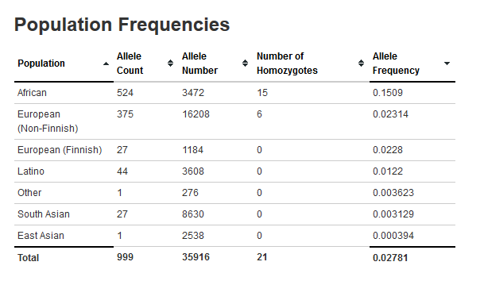
A real-world False Positive
From our exome capture cohort – after annotation and filtering I had the following NOVEL coding variants, giving a highly significant result to the gene in burden tests.
2x chr10:3208567 T / TGCACGCTAGGGAAGAGAGAG
2x chr10:3208567 T / TGCACGCTAGGGAAGAGAGAGG
1x chr10:3208567 T / TGCACGCTAGGGAAGAGAGAGGA
4x chr10:3208567 T / TGCACGCTAGGGAAGAGAGAGGAA
However, in ExAC:
Variant: chr10:3208567 T / TGCACGCTAGGGAAGAGAGAGGAATG
Other alt alleles in ExAC:
chr10-3208567-T-TGCACACTAGGGAAGAGAGAGGAATG
chr10-3208567-T-TGCATGCTAGGGAAGAGAGAGGAATG
chr10-3208567-T-TAGGGAAGAGAGAGGAATG
chr10-3208567-T-TGCACGCTAAGGAAGAGAGAGGAATG
Common polymorphic insertion

Slide 22
Overlapping Genes
Most annotation tools have a heirarchy of significance
eg,
stop-lost > splicing > nonsynonymous > UTR > synonymous > intronic > intergenic
GENE A
GENE B
*
There isn’t always a clear ‘winner’ if two genes share exons
*
GENE A
GENE B
*

Slide 23
Population Databases
dbSNP
NCBI repository for all reported small variants.
87 million human variants in version 146
dbSNP ids: rsnnnnnn
One entry can encompass multiple variants
http://ncbi.nlm.nih.gov/snp
1000 genomes (1000g)
Entire genome sequence and variants from ~2,500 people across 25 selected population groups.
http://www.ncbi.nlm.nih.gov/variation/tools/1000genomes
ESP/EVS (Exome Sequencing Project / Exome Variant Server)
Exome variants from 6,300 people (4,300 European-American & 2,000 African-American)
http://evs.gs.washington.edu/EVS

Slide 24
Population Databases
ExAC (Exome Aggregation Consortium)
Exome variants from ~61,000 people. 50% Are Non-Finnish Europeans. Remainder divided between South Asian, East Asian, Finnish, African, Latino.
http://exac.broadinstitute.org
UK10K
Exome variants from 3,700 UK individuals
http://www.uk10k.org
Cosmic
Somatic variants from cancer studies
http://cancer.sanger.ac.uk
ClinVar
Variants believed to be pathogenic
http://www.ncbi.nlm.nih.gov/clinvar

Slide 25
MAF vs VAF
Minor Allele Frequency vs Variant Allele Frequency
The reference genome is not always the major allele.
Minor allele in population A could be major allele in population B.
1 heterozygote in 100 samples:
MAF = 0.005 (or 0.5%) - NOT 1%!
Population database annotations should give VAF.
Sometimes also give #homozygotes.
VAF = #hets + (2 x #homs)
sample size

Slide 26
dbNSFP
database for Nonsynonymous SNPs' Functional Predictions
Originally every competing annotation tool used its own derived databases for variant annotations.
Now most obtain them from a single 3rd party source – dbNSFP
http://sites.google.com/site/jpopgen/dbNSFP

Slide 27
Pathogenicity Predictors
 | ANNOVAR | VEP | SNPEff | Data
GERP++ | X | X | ? | DNA Conservation
LRT | X | X | ? | DNA Conservation
phastCons | X | X | ? | DNA Conservation
phyloP | X | X | ? | DNA Conservation
SIFT | X | X | ? | DNA Conservation
SiPhy | X | X | ? | DNA Conservation
BLOSUM |  | X | ? | AA Conservation
FATHMM | X | X | ? | AA Conservation
MutationAssessor | X | X | ? | AA Conservation
PolyPhen | X | X | ? | AA Conservation
Provean | X | X | ? | AA Conservation
CADD | X | X | ? | Meta
ConDel |  | X | ? | Meta
RadialSVM | X | X | ? | Meta
MetaLR | X | X | ? | Meta
VEST3 | X | X | ? | Meta
DANN | X | X | ? | Meta
MutationTaster | X | X | ? | AI classifier
MaxEnt |  | X | ? | Splicing
ADA | X | ? | ? | Splicing
RF | X | ? | ? | Splicing
LoFtool |  | X | ? | NMD
miRNA | X | X | ? | miRNA

Slide 28
Prediction Assessment
Independent benchmarking of 20 Annovar-derived prediction tools (Simon Topp, 2016).
Percentage of variants classed as “Damaging”, based on 950 validated pathogenic nonsynonymous mutations (True Damaging) vs ~40,000 private ExAC variants (Random).
FATHMM did best, followed by several meta-analysis methods.
PolyPhen and SIFT performed poorly.
 | FATHMM | SVM | LR | VEST3 | MutationAssessor | CADD | Provean | SIFT | MutationTaster | PP2_HDIV | LRT | PP2_HVAR | DANN | FATHMM_MKL | SIPHY | PHASTCONS7 | PHASTCONS20 | GERPrs | PHYLOP7 | PHYLOP20
Optimised Threshold | <= -1.21 | >= -0.12 | >= 0.43 | >= 0.73 | >= 2.39 | >= 24.8 | >= -2.9 | <= 0.014 | A or D | >= 0.99 | D | >= 0.78 | >= 0.99 | >= 0.84 | >= 12.23 | >= 0.83 | >= 0.93 | >= 3.84 | >= 0.77 | >= 0.84
True Damaging (%) | 87.1 | 75.8 | 78.6 | 77.5 | 52.5 | 66.1 | 64.5 | 64.6 | 92.4 | 61.4 | 76.7 | 65.5 | 77.2 | 79.5 | 69.9 | 87.1 | 77.5 | 76.3 | 81.5 | 81.1
Random (%) | 28.1 | 19.4 | 22.2 | 25.3 | 19.9 | 33.6 | 32.6 | 35.6 | 65.8 | 36.7 | 52.3 | 41.2 | 54.4 | 58.0 | 50.2 | 68.2 | 59.7 | 61.2 | 68.3 | 69.0
Difference (%) | 59.0 | 56.4 | 56.4 | 52.2 | 32.6 | 32.5 | 31.9 | 29.0 | 26.6 | 24.7 | 24.4 | 24.3 | 22.8 | 21.5 | 19.7 | 18.9 | 17.8 | 15.1 | 13.2 | 12.1
Other benchmarks have shown DANN > CADD > FATHMM
http://www.enlis.com/blog/2015/03/17/the-best-variant-prediction-method-that-no-one-is-using
Depends on your test set data!

Slide 29
Also need to consider…
Active Sites.
Post Translational Modification Sites.
Amyloidogenic / Aggregation-Prone Regions.
Secondary structure elements (creation and destruction).
Protease cleavage sites.
Transmembrane regions.
Subcellular targeting signals.
Etc...

Slide 30
Splice Sites
Forward Strand
donor acceptor
exon intron exon
GCCTGTAGCATCG|GTACATGACGATAATCGCATAAG|CTGGATTAAGCGCA
“essential” splice site locations
Reverse Strand
GTCACAAGCAGCA|GAACATGACGATAATCGCATATG|CAGCAAAAATGCGT
acceptor donor
exon intron exon
Many tools only annotate “essential splice” or “near splice”.
Some incorporate more sophisticated predictions.
Splicing can also be affected by Exonic Splicing Enhancer (ESE) motifs or Exonic Splicing Suppressor (ESS) motifs, .

Slide 31
Splice Site Predictors
dbscSNV
assesses variants:
11-base region near the 5’ (“donor”) end of each intron
14-base region near the 3’ (“acceptor”) end of each intron
“Essential” splice sites excluded
AI consensus of 6 splice site prediction tools (including MaxEnt) comparing reference vs variant derives 2 output scores:
RF (Random Forest AI)
ADA (AdaBoost AI)
Score > 0.6 implies probable alteration of a splice site
Forward Strand
TAGGTTCG|GTACATGACGAATG...GGAATTTAATCGCATAAG|CTGGATTCGCA

Slide 32
Splice Site variants
Exon 1 Exon 2 Exon 3
Normal splicing
*
Skipped exon
Cryptic intronic splice acceptor
*
Cryptic exonic splice acceptor
*
*
Retained intron
Cryptic intronic splice donor
*
Impact depends heavily on reading frame (insertion/deletion, frameshift?)

Slide 33
Nonsense Mediated Decay
Premature Termination Codons (PTC) are normally degraded by the NMD pathway.
Complete knock-out of the gene from one allele.
Cells can compensate via feedback loops, and increase expression of remaining allele.
Hence Nonsense mutations are more likely to cause recessive rather than dominant disorders.
Can bypass NMD if the PTC is in the last exon, possibly producing a misfolded or non functional protein.

Slide 34
Promoters
Region upstream of (and often overlapping) the 5’ exon of the gene.
Binding sites for transcription factors, that control the expression of the gene.
Some annotation tools attempt to map to these
Predicted, conserved across species.
Validated, ENCODE experimental results.
Impact of a variant often uncertain and difficult to validate experimentally

Slide 35
3’UTR
Most common variant of interest in 3’ UTRs are those impacting micro RNA (miRNA) binding sites.
miRNAs target transcript for degradation, lowering absolute expression levels.
Some annotation tools attempt to map to these binding sites, but most are only predicted, and the impact of a variant uncertain.

Slide 36
Non-coding RNAs
Many thousands discovered to date.
Often within introns of coding genes.
Very poorly understood.
Can be spliced.
Opposite strand to ‘host’ gene could have a regulatory function
Very few have had pathogenic variants identified within them.

