Slide 1
Phenotypic data and Acute records
Clive Stringer- who am I ?
Degree in Biology
Post Grad qualification in Medical Bacteriology
10 Years at the bench
Developed literature search on Mainframe

Slide 2
Phenotypic data and Acute records
What have I done ?
3 years Prduct specialist at Wellcome Diagnostics
10 years developing and supporting Pathology systems at King’
Worked at NHSIA on strucutred Pathology messaging to GP’s
12 years in charge of EPR at King;’s
Last few years concentrating on Genomics and Interoperability

Slide 3
Phenotypic data and Acute records
My role in 100K Genome
King’s part of GMC (Gstt/Slam/St Georges/King’s)
It enablement bid put in by GSTT
Provide legacy which will propel Genomics into the mainstream
Setting up systems to track patients and find phenotypic data.

Slide 4
Phenotypic data and Acute records
Why am I interested
Huge amount of data within EPR at King’s which is not utilised
Lot’s of genetic interest in bacteria
Brother has CF
? Heterozygous adavantage

Slide 5
Phenotypic data and Acute records
CF Background and treatment
Multi-organ involvement
Lung’s most acutely affected
Colonisation with certain types of bacteria (mucoid Psuedomonas aueriginosa)
Treatment -long term antibiotics and Physiotherapy

Slide 6
Phenotypic data and Acute records
CF Genetic basis and mutations
Gene discovered in 1989
Located on Chromosone 7
CFTR(cystic fibrosis transmembrane conductance regulator )
The most common mutation, called delta F508, is a deletion of one amino acid at position 508 in the CFTR protein

Slide 7
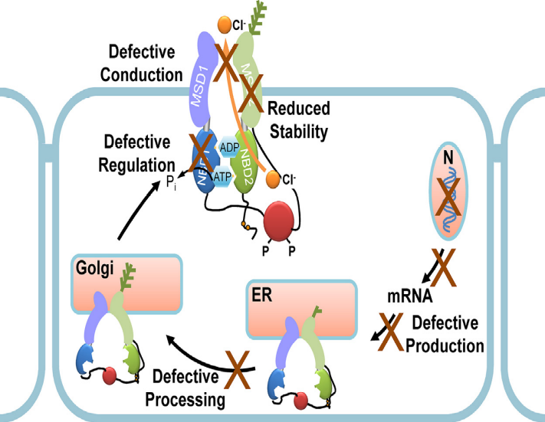
Phenotypic data and Acute records
CF Molecular basis and treatments
delta F508 The resulting abnormal channel protein breaks down shortly after it is made, so it never reaches the cell membrane to transport chloride ions.
Other mutations affect the gating of the channel once it is in situ

Slide 8
Phenotypic data and Acute records
? The future
Whole genome sequencing
Understanding implications for variants
Understanding treatment options

Slide 9
Phenotypic data and Acute records
Next-generation sequencing demands next-generation phenotyping.
Hum Mutat. 2012 May;33(5):884-6. doi: 10.1002/humu.22048. Epub 2012 Mar 27.
Hennekam RC1, Biesecker LG.
We predict that NGS performed for diagnostic purposes will yield variants in several genes, and consequences of these variants will need to be analyzed and integrated with clinical findings to make a diagnosis. Diagnostic skills of medical specialists will shift from a pre-NGS-test differential diagnostic mode to a post-NGS-test diagnostic assessment mode. In research phenotyping and medical genetic assessments will remain essential as well

Slide 10
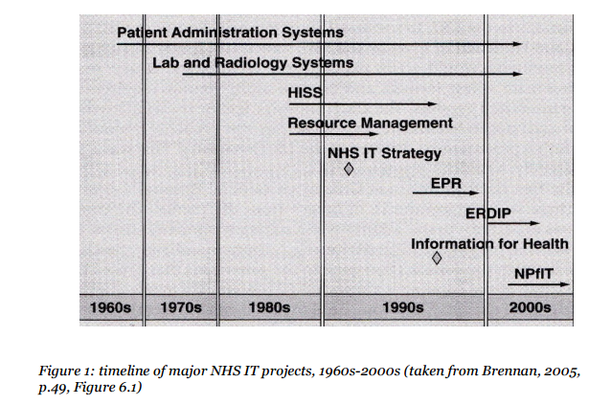
Phenotypic data and Acute records
History of Patient Records in the NHS
The National. Programme for IT in the NHS. A Case History. Oliver Campion-Awwad, Alexander Hayton, Leila. Smith and Mark Vuaran.

Slide 11
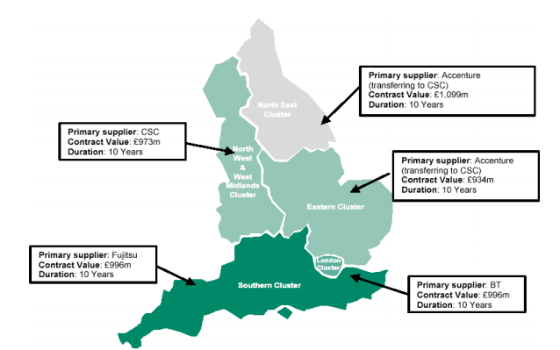
Phenotypic data and Acute records
National Program for IT

Slide 12
Phenotypic data and Acute records
Post National Program
Emergence of SME’s
Open Source discussions
Inter-operability (not rip and replace)
Talk of standards
ITK (Interoperability Toolkit)
ITK Challenge fund and Technology funds

Slide 13
Phenotypic data and Acute records
Structured data, terminologies /ontologies and OpenEHR
What have we got ;
OPCS / ICD 10
Snomed CT
Read

Slide 14
Phenotypic data and Acute records
What have we got at King’s
17 years EPR (iSoft Clinical Manager- iCM)
Diagnostic interfaces
Documents interface
Direct clinical noting
Forms based data capture
9 Million documents
>100 million diagnostic results

Slide 15
Phenotypic data and Acute records
What have we done so far ?
Used SQL server
Direct queries
Full text searching
Ad hoc queries
Data mining for Cardiac data sets
Using reporting database

Slide 16
Phenotypic data and Acute records
Epilepsy story
Clinicians wanted to extract data from EPR and put it in CRIS database
Ethics approval needed
Data needed extracting and shipping
Used 100K money to engage with Bioinfofmatics unit
Docker containersisation bought tools to the data
Cogstack pipeline on 36000 documents
Elastic index
Kibana visulation
Much easier to search data

Slide 17
Phenotypic data and Acute records
Parkinsons Story
Have now indexed 9 Million documents
Want to find all Patients with early onset Parkinsons
Can tailor queires and refine for search terms
Will use for other candidate recruitment

Slide 18
Phenotypic data and Acute records
What do we want to do next ?
Infer terms from free Text using Natural Language processing tools
Should allow us to describe phenotypic data in terms which are transferable and computable

Slide 19
Phenotypic data and Acute records
What’s the future ?
“Dissecting all influences necessitates ongoing and detailed phenotyping, refinement of clinical diagnostic assignments, and iterative analyses of NGS data.”
Hennekam RC1, Biesecker LG.
Fhir ?
Fast Healthcare Interoperability Resources
https://www.hl7.org/fhir/summary.html

Slide 20
Reading
The National. Programme for IT in the NHS. A Case History. Oliver Campion-Awwad, Alexander Hayton, Leila. Smith and Mark Vuaran. https://www.cl.cam.ac.uk/~rja14/Papers/npfit-mpp-2014-case-history.pdf
Understanding how cystic fibrosis mutations disrupt CFTR function: From single molecules to animal models Yiting Wang, Joe A. Wrennall, Zhiwei Cai, Hongyu Li, David N. Sheppard∗
The International Journal of Biochemistry & Cell Biology 52 (2014) 47–57
Hum Mutat. 2012 May;33(5):884-6. doi: 10.1002/humu.22048. Epub 2012 Mar 27.
Next-generation sequencing demands next-generation phenotyping.
Hennekam RC1, Biesecker LG.
OpenEHR
http://www.openehr.org/news_events/community_news.php?id=136

