Slide 1
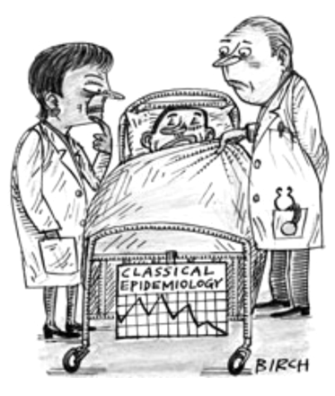
Mendelian Randomization
Dr Petra Proitsi
Department of Basic and Clinical Neuroscience
King’s College London
Institute of Psychiatry, Psychology & Neuroscience
February 2016

Slide 2
Lecture overview
Conventional epidemiology
What is causality
Mendelian Randomization (MR) and instrumental variable (IV) analysis
Polygenic Risk Scores (PRS) in relation to MR

Slide 3
Conventional epidemiology
Epidemiology is interested in the effect of interventions
  -What is the effect of alcohol
  -What will happen if we have a specific diet i.e. folic acid
  -What is the effect of a drug used e.g. to treat cholesterol, on Alzheimer’s disease
Observational studies assess these effects in the general population and provide preliminary research
Can you see any problems with this?

Slide 4
Conventional epidemiology
Example 1: Prospective study of 42,000 men in Sweeden, aged 45-79 with 12 years follow-up (Rahman et al., Heart 2015)
Study Design: Sweetened drinks consumption assessed by food frequency questionnaire; 4113 cases of incident heart failure (HF) identified through hospital/death registers
Results: Positive association between sweetened drinks consumption and risk of HF after adjustment for other risk factors; consuming more than 2 such drinks per day associated with relative risk of HF of 1.23 (95% CI 1.12 – 1.35)
Author’s conclusions: This association could have implications for HF prevention strategies

Slide 5
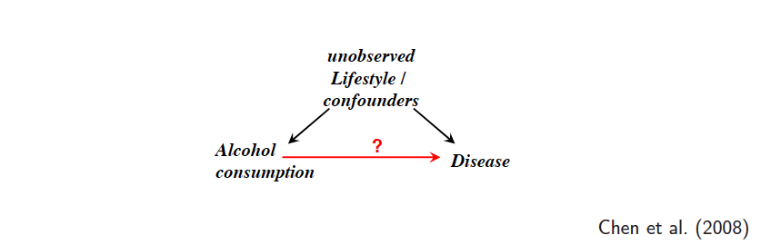
Conventional epidemiology
Epidemiological studies have shown that alcohol has both “positive” effects (e.g. decreased risk for coronary heart disease”) and “negative” effects ( e.g. increased risk for some cancers, liver cirrhosis, mental health problems)
However, alcohol may be also associated with other “confounders” such as lifestyle factors (e.g. smoking, specific diet/lifestyle) and “self-reporting” bias.
So, can we conclude that alcohol causes disease? Or protects from disease?

Slide 6
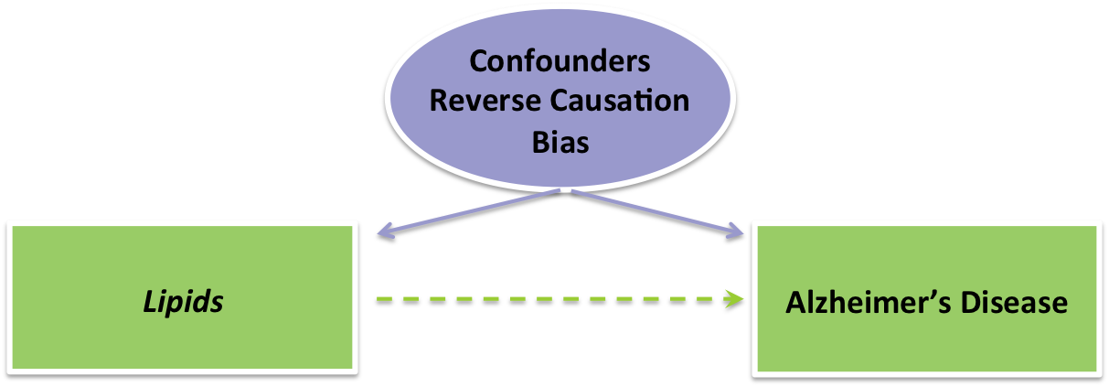
Conventional epidemiology
?
Epidemiological studies implicate high cholesterol levels with (for example people with hypercholesterolemia have twice the risk of having AD)
However, high cholesterol levels may be also associated with other “confounders” such as lifestyle factors (e.g. smoking, specific diet/lifestyle)
Also: changes in AD start many years before the onset of the clinical symptoms
So can we we say that high cholesterol “causes” AD?

Slide 7
Conventional epidemiology
Confounding: effects of interest are entangled with many other effects — this can never be fully excluded
for example alcohol and diet/lifestyle
We may have missing confounders/ or measure them with error
Reverse causation: what is the cause and what is the result
for example do changes in specific lipids “cause” AD or are the a result of AD?
Small studies, other bias?

Slide 8
What is causality
“Association is not causation”
“Correlation does not imply causation”
Causal effect: change in the outcome given change in risk factor
≠
Difference in outcome when risk factor is observed at different levels.

Slide 9
What is causality
How can we ascertain whether these relationships are causal?
Randomised trials:
Randomisation to an intervention (allocation by chance alone)
  Receiving the intervention (or not) is independent of all confounders (measured and unmeasured)
An average difference in outcome between the randomized groups is due to (allocation to) the intervention
“The intervention causes the difference in outcome”
Causality refers to the average effect on a group – not the effect on an individual

Slide 10
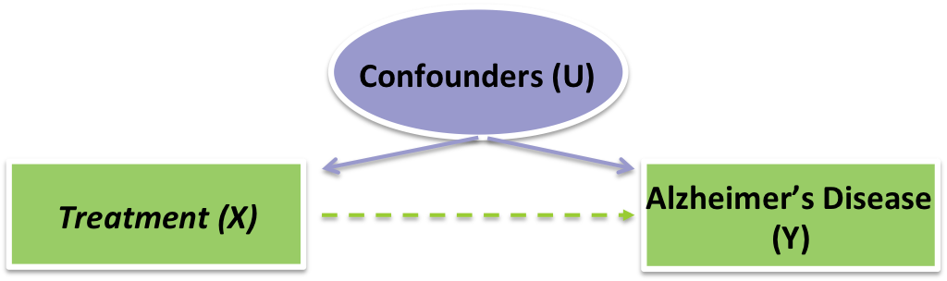
What is causality
Instrumental
Variable (IV)
Randomized
allocation (R)
Randomization as an instrumental variable for the effect of treatment received
Three crucial assumptions
R affects X
R is not related to U
Y is conditionally independent of R given X and U

Slide 11
Mendelian Randomization (MR) & instrumental variable (IV) analysis
Problems with randomized trials?
  Expensive, difficult to design, risky?
If we cannot randomize we can look into instances where “nature” has randomized for example through genetic variation
Mendelian randomization is analogous to a randomized trial
An association between a genetic variant and an outcome is indicative of a causal effect of the risk factor on the outcome

Slide 12

Mendelian Randomization (MR) & instrumental variable (IV) analysis
Instrumental
Variable (IV)
Genetic Variant (G)
Mendelian Randomization:
using genetic variants as instrumental variables (IV)

Slide 13

Mendelian Randomization (MR) & instrumental variable (IV) analysis
Instrumental
Variable (IV)
Genetic Variant (G)
Three crucial assumptions
G affects X : the IV is associated with the risk factor of interest (strong association)
G is not related to U: the IV is not associated with any potentially confounding variable
Y is conditionally independent of G given X and U: the IV is only associated with the outcome (Y) via the risk factor (X)

Slide 14
Mendelian Randomization
Mendelian Randomization: is the use of genetic variants
as instrumental variables (IV) to identify and estimate causal relationships between an exposure and an outcome
Identifies risk factor / biological pathway
Suggests potential targets for intervention
Causality refers to the effect on a group, not the effect on an individual
MR is based on observational data, but provide inferences about causal effects
MR is crucially based on 3 assumptions

Slide 15
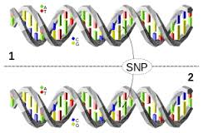
Mendelian Randomization:
Genetic variants
Genetic variants are particularly suitable candidate instrumental variables
  Scientific knowledge about genetic function
  Specific strong associations with traits
  Genetic sequence is determined at conception
A genetic variant is a naturally occurring mutation that appears in some subset of the population
Usually it is a Single Nucleotide Polymorphisms (SNP)
Most SNPs are diallelic i.e. there are two possible versions of the allele at a locus
The less common allele is the minor allele and as we have two chromosomes each individual has 0,1,2 copies
Due to the strong
association of genetic variation with outcomes the are good proxies

Slide 16
Mendelian Randomization:
Mendels’ Laws
Law of segregation
  During gamete formation, the alleles for each gene segregate from each other so that each gamete carries only one allele for each gene
Law of independent assortment
  Genes for different traits segregate independently during the formation of gamets
Under Mendel’s laws, the number of variant alleles at a particular genetic locus (conditional on your parent’s genotypes) is in some way random
It is also independent of number of variants alleles at other loci (this is not fully true due to LD)
Mendel’s laws + random mating should lead to random distribution of genetic variants

Slide 17
Mendelian Randomization:
Distribution of genetic variants
Key assumption: Genetic variants are distributed independently of confounders
This is something we can test:
  Test associations with covariates
  Test for HWE do genetic variants have expected numbers of homozygotes and heterozygotes?
As genetic variants are fixed at conception, they are unlikely to associate with environmental /social factors
  Note: take population into consideration

Slide 18

Mendelian Randomization: outcomes
We can investigate changes in disease outcomes or continuous outcomes
Instrumental
Variable (IV)
Genetic Variant (G)
Lipid levels or another disorder
OR e.g. blood pressure

Slide 19
Mendelian Randomization: objectives
Mendelian randomization has two objectives
To assess whether the causal null hypothesis is true
  Does the risk factor have a causal effect on the outcome ?
  Does the expected value of the outcome change when the risk factor is manipulated to take different values?
To estimated the magnitude of causal effect of the risk factor on the outcome
  What is the expected value of the outcome when the risk factor is set to 1 minus the expected value when the risk factor is set to 0?
  What is the expected change in the outcome when the risk factor is increased by 1 unit?

Slide 20
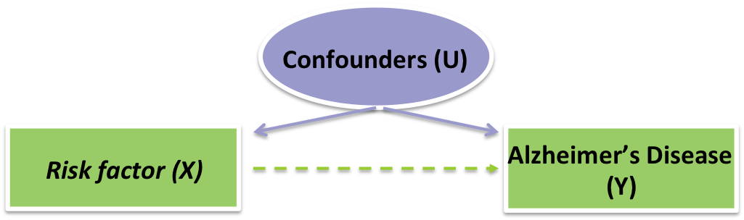
Mendelian Randomization: methodology
The ratio or Wald Method (Wald, 1940) is the simplest approach to estimated the causal effect of an exposure X on an outcome Y
It uses a single IV
Instrumental
Variable (IV)
Genetic Variant (G)
β
Lipid levels or another disorder
OR e.g. blood pressure
Ratio estimate for causal effect is ⌃= GY association / GX association
^{β}

Slide 21

Mendelian Randomization: methodology
But what if we have multiple variants available
Multiple Ivs (1..k)
Genetic Variant (G1)
Genetic Variant (G2)
Genetic Variant (G3)
β
Genetic Variant (Gk)
Lipid levels or another disorder
OR e.g. blood pressure
All variants must satisfy the assumptions
Various two-stage approaches can be used

Slide 22
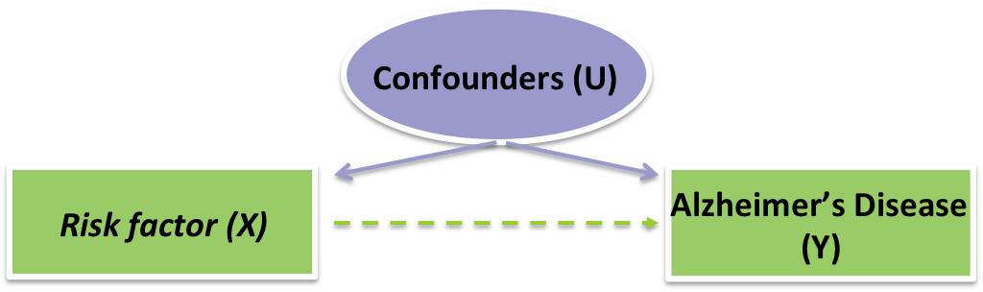
Mendelian Randomization: methodology
Genetic Variant (G1)
Genetic Variant (G2)
Genetic Variant (G3)
β
Genetic Variant (Gk)
Lipid levels or another disorder
OR e.g. blood pressure
2 stage approaches comprises of two regression stages
1st stage is regression of X on the Gs
  We save the predicted exposure on the Gs
2nd stage regression of Y on the “predicted” exposure

Slide 23

Mendelian Randomization: methodology
Genetic Variant (G1)
Genetic Variant (G2)
Genetic Variant (G3)
β
Genetic Variant (Gk)
Lipid levels or another disorder
OR e.g. blood pressure
Allele scores= gene score= genotype score
Gik= number of exposure-increasing alleles for individual I and genetic variant k=1..k
Unweighted score= ΣkGik
Weighted score = ΣkwkGik, where wk is the effect of G on X

Slide 24
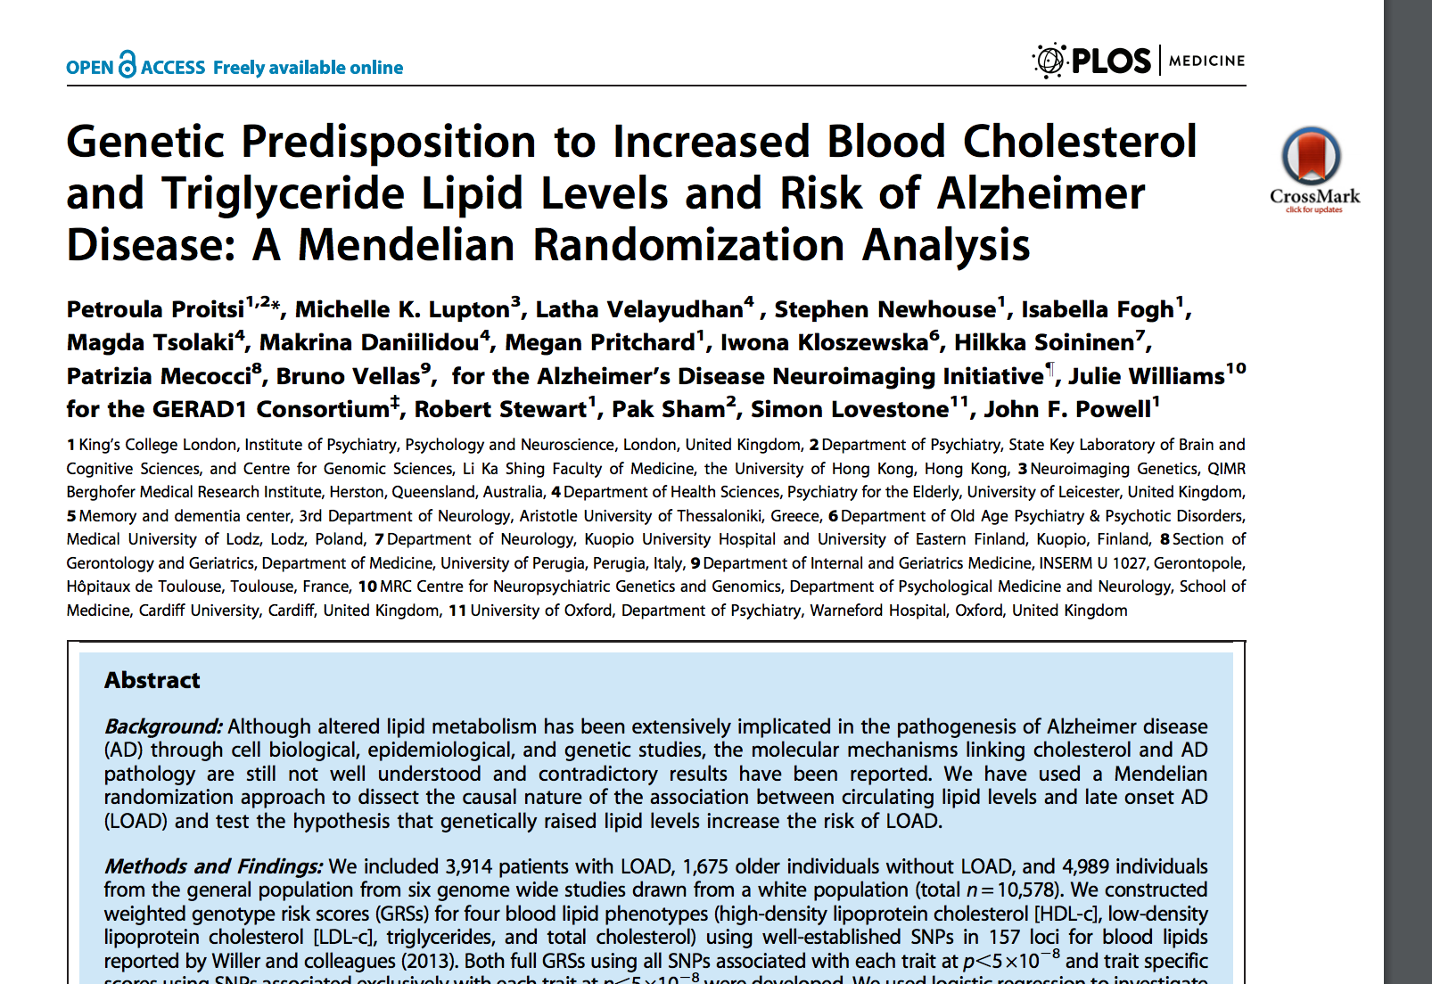
Mendelian Randomization: example (allele score)
Are increased blood cholesterol and triglyceride levels causally related to AD?
Constructed allele scores for each each phenotype based on published studies
No evidence of association

Slide 25
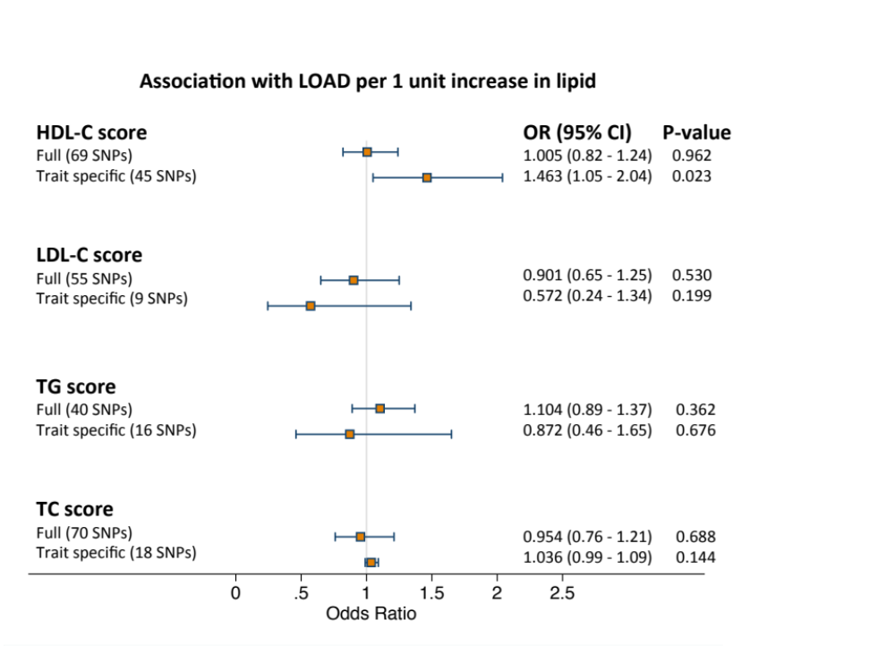
Mendelian Randomization: example (allele score)
Are increased blood cholesterol and triglyceride levels causally related to AD?

Slide 26
Issues to take into consideration
Satisfy all assumptions
  Difficult to distinguish mediators from confounders (assumption 2)
  Pleiotropy (assumptions 2 &3)
  Genetic heterogeneity
LD
Power
Weak instruments- role of thumb F>10
  For the association of the IV with the exposure

Slide 27
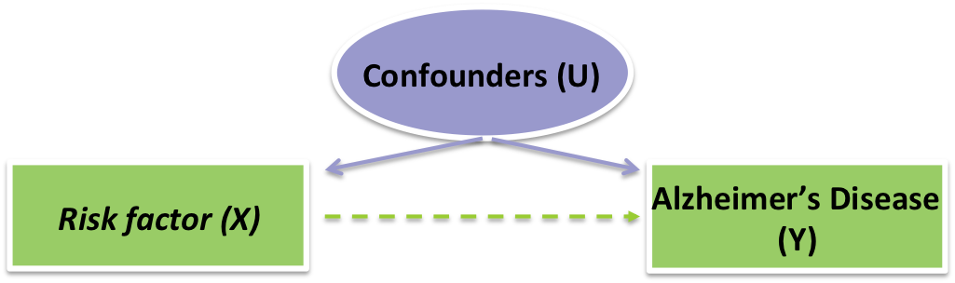
Polygenic Risk Scores (PRS)
Similar to allele scores
Multiple variants used to achieve more power
However in PRS a large number of genes are used (weighted) hence some of the assumptions of MR may be violated
Genetic Variant (G1)
Genetic Variant (G2)
Genetic Variant (G3)
β
Genetic Variant (Gk)
Lipid levels or another disorder
OR e.g. blood pressure

Slide 28
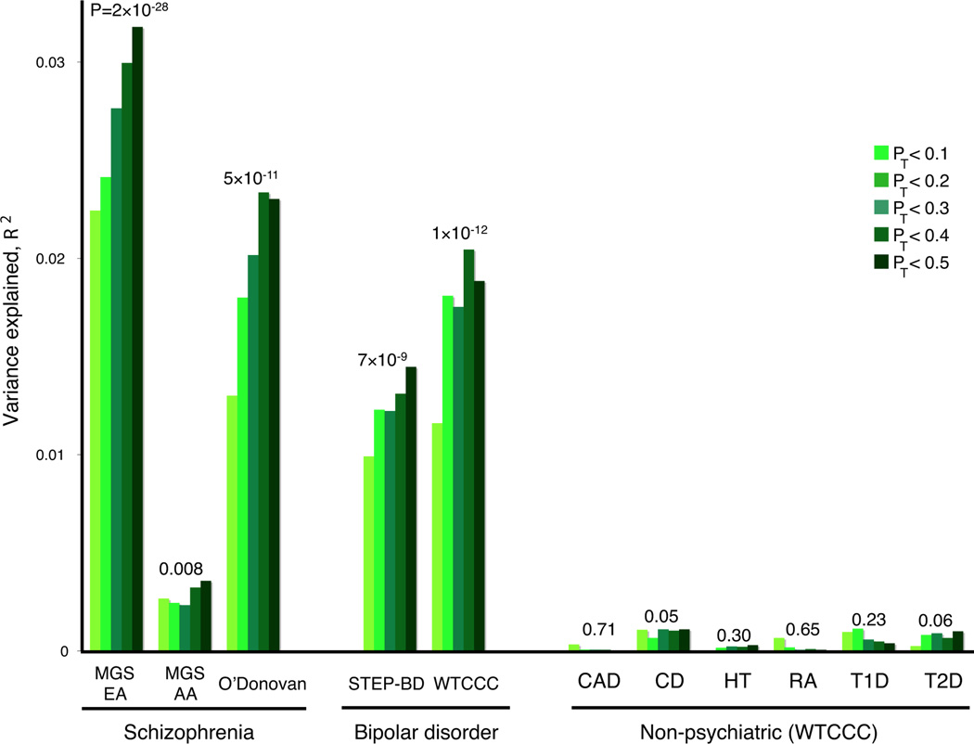
Polygenic Risk Scores (PRS)
Nature. 2009;
460(7256):748-52.

Slide 29
Summary
Mendelian Randomization is a powerful method to test causal relationships between exposures and outcomes
They resemble randomized clinical trials
If the assumptions are not violated it has more power than conventional epidemiology
Can be performing using single variants or multiple variants (two-stage approaches or risk scores)
Polygenic risk scores are calculated as in MR but due to the large number of variants included some assumptions of MR may be violated
Polygenic risk scores are used to increase power to identify associations, especially when there are many genetic variants of small effect size

Slide 30
Questions?
1: Davey Smith G, Hemani G. Mendelian randomization: genetic anchors for causal inference in epidemiological studies. Hum Mol Genet. 2014 Sep 15;23(R1):R89-98. doi: 10.1093/hmg/ddu328. Epub 2014 Jul 4. Review. PubMed PMID: 25064373; PubMed Central PMCID: PMC4170722.
2: Thanassoulis G. Mendelian randomization: how genetics is pushing the boundaries of epidemiology to identify new causes of heart disease. Can J Cardiol. 2013 Jan;29(1):30-6. doi: 10.1016/j.cjca.2012.09.014. Epub 2012 Nov 29.
Review. PubMed PMID: 23199790.
3: Burgess S, Thompson SG; CRP CHD Genetics Collaboration. Avoiding bias from weak instruments in Mendelian randomization studies. Int J Epidemiol. 2011 Jun;40(3):755-64. doi: 10.1093/ije/dyr036. Epub 2011 Mar 16. Review. PubMed PMID: 21414999.
4: Østergaard SD, Mukherjee S, Sharp SJ, Proitsi P, Lotta LA, Day F, Perry JR, Boehme KL, Walter S, Kauwe JS, Gibbons LE; Alzheimer’s Disease Genetics Consortium; GERAD1 Consortium; EPIC-InterAct Consortium, Larson EB, Powell JF,
Langenberg C, Crane PK, Wareham NJ, Scott RA. Associations between Potentially Modifiable Risk Factors and Alzheimer Disease: A Mendelian Randomization Study. PLoS Med. 2015 Jun 16;12(6):e1001841; discussion e1001841. doi: 10.1371/journal.pmed.1001841. eCollection 2015 Jun. PubMed PMID: 26079503; PubMed Central PMCID: PMC4469461.
5: Proitsi P, Lupton MK, Velayudhan L, Newhouse S, Fogh I, Tsolaki M, Daniilidou M, Pritchard M, Kloszewska I, Soininen H, Mecocci P, Vellas B; Alzheimer’s Disease Neuroimaging Initiative, Williams J; GERAD1 Consortium, Stewart R, Sham
P, Lovestone S, Powell JF. Genetic predisposition to increased blood cholesterol and triglyceride lipid levels and risk of Alzheimer disease: a Mendelian randomization analysis. PLoS Med. 2014 Sep 16;11(9):e1001713. doi: 10.1371/journal.pmed.1001713. eCollection 2014 Sep. PubMed PMID: 25226301; PubMed Central PMCID: PMC4165594.
6: Pan W(1), Chen YM, Wei P.Testing for polygenic effects in genome-wide association studies. Genet Epidemiol. 2015 May;39(4):306-16. doi: 10.1002/gepi.21899. Epub 2015 Apr 6.

