Slide 1
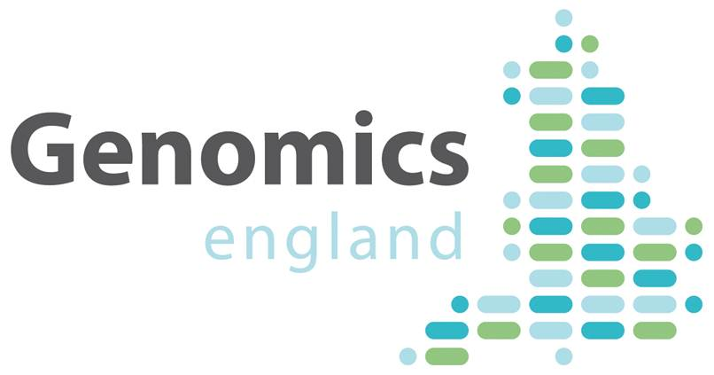
An introduction to rare disease data models
Andrew Devereau, Dr Mina Ryten
www.genomicsengland.co.uk

Slide 2
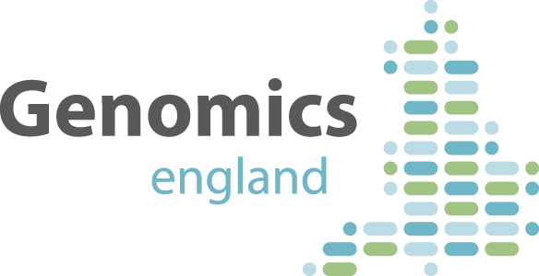
Genomics England
The project will sequence 100,000 genomes from around 70,000 people with a rare disease or cancer.
The aim is to offer a diagnosis and in time there is the potential of new and more effective treatments.
The project will also enable new medical research. Combining genomic sequence data with medical records is a ground-breaking resource for researchers and the developing genomics industry.

Slide 3
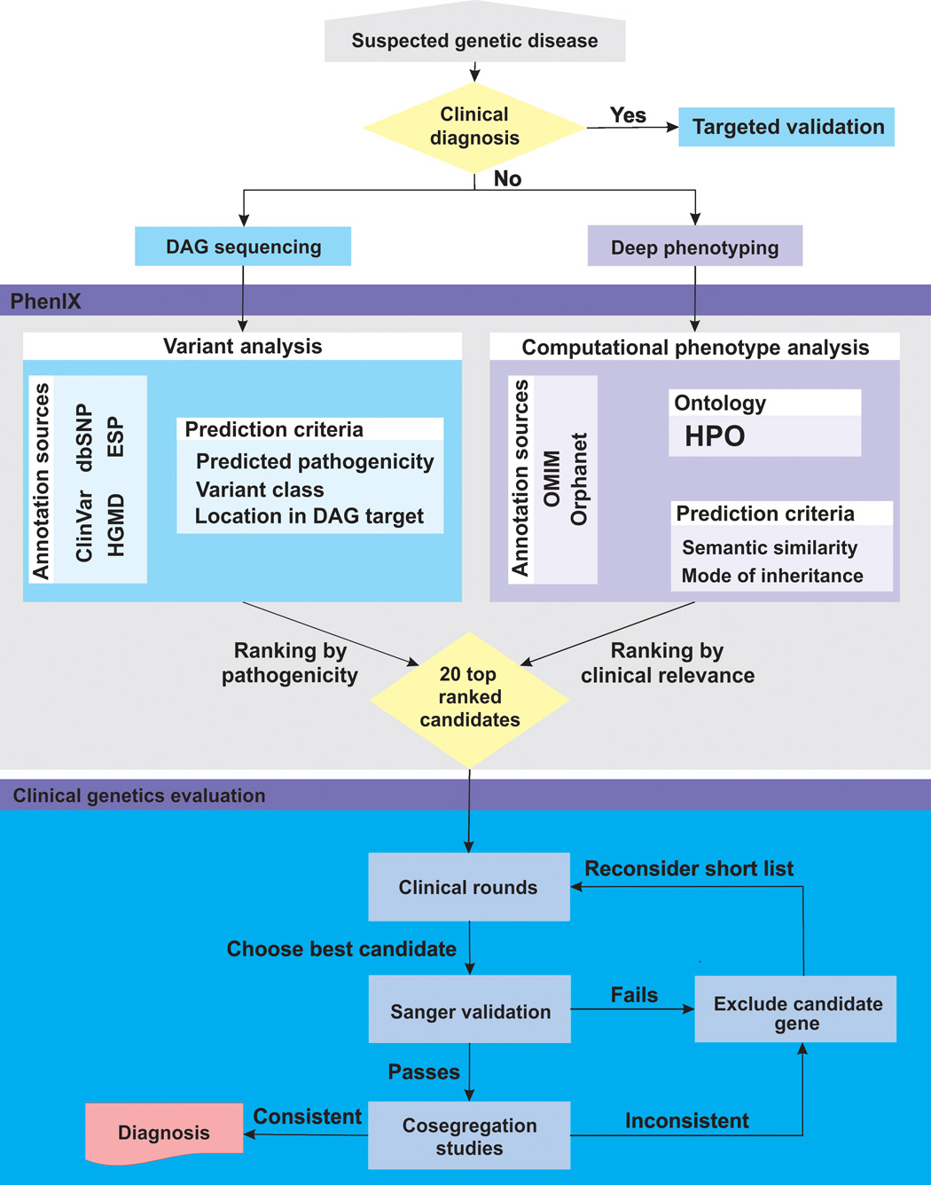
Phenotypic data is required for the interpretation of genetic data
Ranking by pathogenicity
Ranking by clinical relevance
Prioritise variants
Adapted from Tomasz Zemojtel et al., Sci Transl Med 2014;6:252ra123

Slide 4
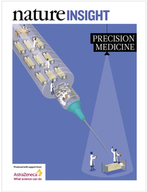
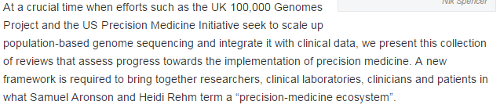
Precision medicine is on the agenda

Slide 5
Capturing, analysing and sharing phenotypic information is hard
Multiple data types required
Family structures
Phenotypic data: evaluations, investigations, treatments
No “routine” clinical data collection models
Data collection model is almost unique to each rare disease
Often multisystem disorder -> many terms required
Many clinicians involved in patient care
Implementation within routine health care setting
Time
IT structures

Slide 6
What is a rare disease data model?
The set of clinical features & test results required to interpret WGS data given recruitment to a specific disorder.
Define what data we want to collect
By “interpret” we mean more than sufficient for a diagnosis
Aim to ensure data is deep, relevant and consistent

Slide 7
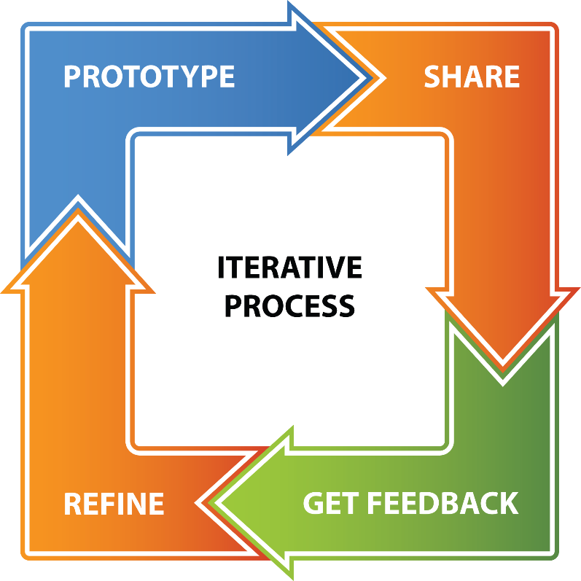
Data model development requires clinical engagement
1000s of emails – many out of hours
100s of clinicians, many senior consultants
Reviewed by as wide a group as possible
More feedback when recruitment begins

Slide 8

Guiding principles in RD model development
Clinical data collection should be performed with collaboration in mind
There are many projects and initiatives in the NHS, UK and worldwide that are using or developing standards for relevant data
Notes:
ADD MODIFIERS

Slide 9

Guiding principles in RD model development
Data models should be aligned to existing UK-based initiatives if possible (clinical & research)
Use existing CRFs, database headings, publications, informatics/clinical projects, etc.
This makes model development and data collection easier
Notes:
ADD MODIFIERS

Slide 10
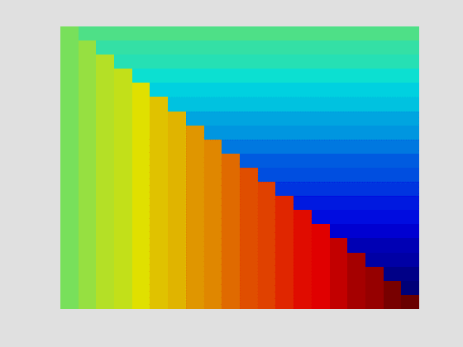
Guiding principles in RD model development
Clinical detail must be preserved if models are going to be useful
Clinical terms need to be described in more detail, for example age of onset, severity, rate and pattern of progression, laterality and spatial pattern
Notes:
ADD MODIFIERS

Slide 11

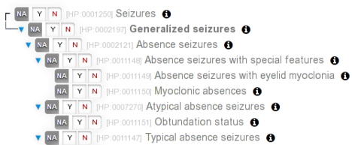
Guiding principles in RD model development
The capture of negative information is as important as positive information
Disease-specific models used in order to limiting the “phenotypic space” and make the acquisition of negative information meaningful.
Notes:
ADD MODIFIERS

Slide 12
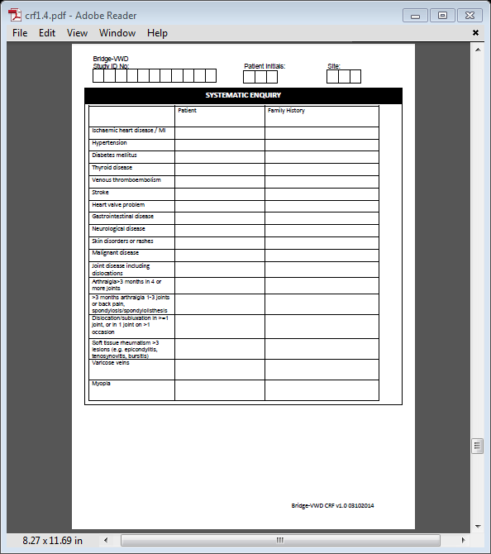
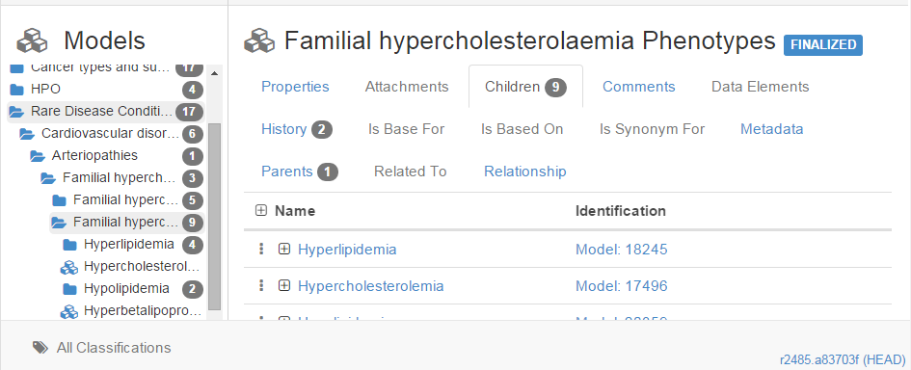
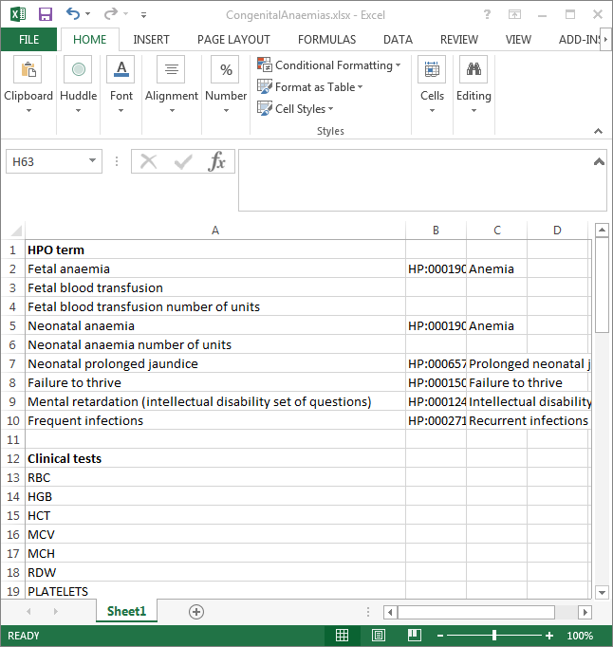
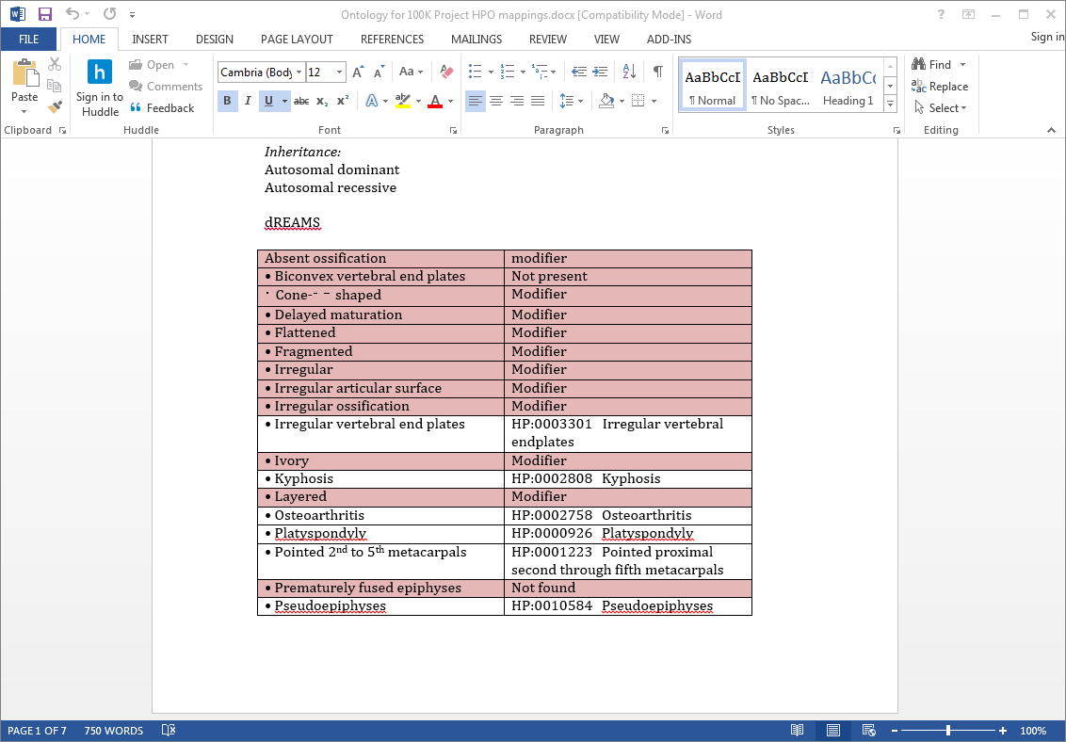
Provenance must be recorded
Origin of model
Transcription who/when
Revision who/when
Changes/corrections

Slide 13
Two aspects of the models
Qualitative phenotypes – descriptions of observed abnormalities. We have used HPO to represent this
Quantitative data – clinical tests and observations which lead to a quantified results. These are not in HPO and we did not find a comprehensive standard data set
For both we collected clinical requirements first, then identified HPO terms and aggregated clinical tests into our own catalogue

Slide 14
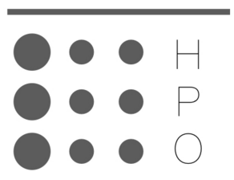
HPO Phenotype models
Aim to capture detailed phenotype data, also to be practical
The models will allow OpenClinica to produce specific data capture screens
Our approach allows:
A fixed set of HPO terms to be presented for each disease
Yes/no/unknown to be indicated for each phenotype
Modifiers to be added to each term
Drill down to lower HPO terms
Any other HPO term to be added

Slide 15
Why HPO?
The Human Phenotype Ontology – adopted by many projects worldwide
Specifically designed for clinical abnormalities in humans
Contains over 10,000 terms in directed acyclic graph
Main content is phenotypic abnormalities, arranged under 23 high level categories
There are also modifiers which can be appended to each term – e.g. onset, pace of progression, severity – and modes or inheritance
Can only represent qualitative data
Can be negated to indicate that a phenotype is NOT present

Slide 16
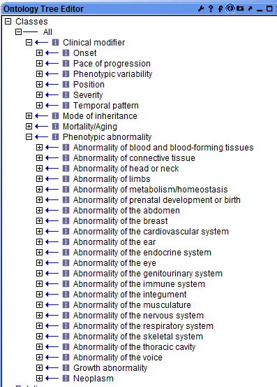
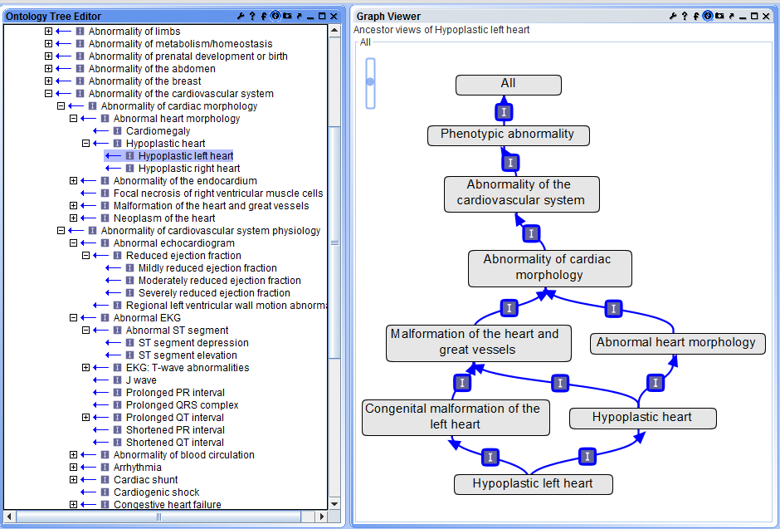
HPO example

Slide 17
Clinical test models
Test types were indicated by clinicians
Some tests have established representation in NHS data sets such as COSD, e.g. weights, heights, blood pressure
We assumed that panels of tests are collected, rather than specific items. E.g. whole blood counts
Where possible we replaced test results with HPO terms, or we limited results to normal/abnormal with an attached report
This allowed a generalised catalogue of tests to be developed, with ‘general’ items and more specialised items where necessary

Slide 18
Clinical tests
>1500 tests requested including:
Laboratory tests (standard & specialised)
Imaging diagnostics
Non-imaging diagnostics
Vital signs & other body measurements
Performance measures
Metadata requirements to meaningfully interpret the information can be very large
Cross-referencing to NHIC/other disease-specific initiatives as far as possible
Develop HPO terms to represent abnormal findings or directly capture the findings?

Slide 19
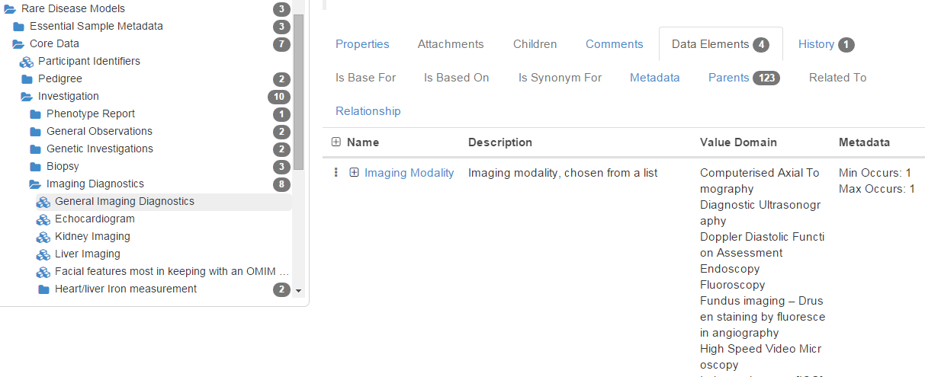
Clinical test example

Slide 20
Development of models
Contact proposer – get an existing model
Convert to HPO
Revision by proposer
Review by GMC/GeCIP
Implement in Data Model Catalogue
Review and revise

Slide 21
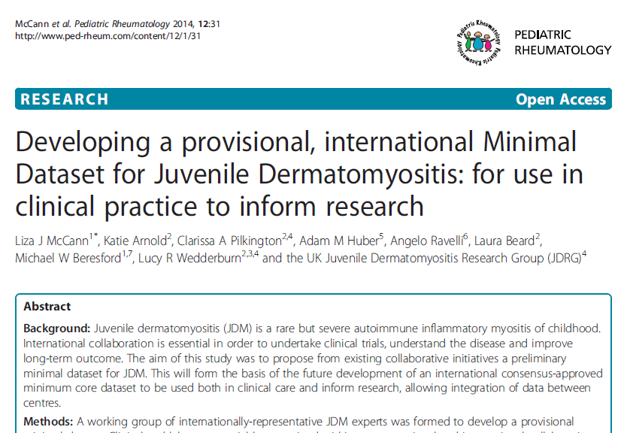
Get an existing model
Could also be:
A project case report form
Database schema
A published disease description
An OMIM model
A list developed by the clinical expert, possibly using Phenomizer or Phenotips

Slide 22
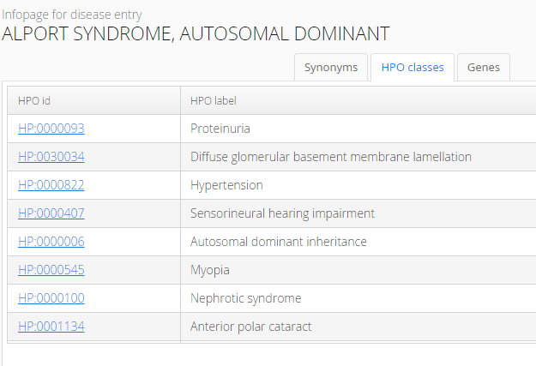
Using OMIM
Use OMIM mappings given in HPO
There may be a large Phenotypic series in OMIM – this needs scripting
Our experience was that such models are too large, with too many irrelevant terms
Can be a good starting point if nothing else exists

Slide 23
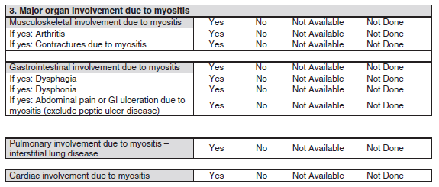
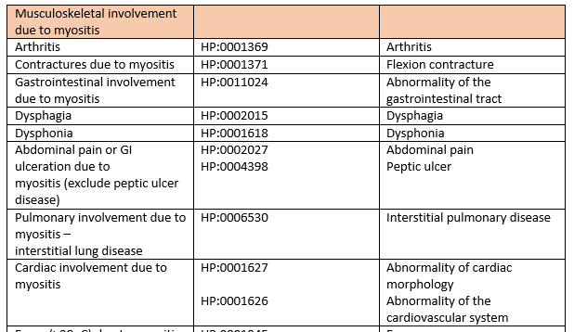
Convert existing model to HPO
Transcribe
Find nearest HPO codes

Slide 24
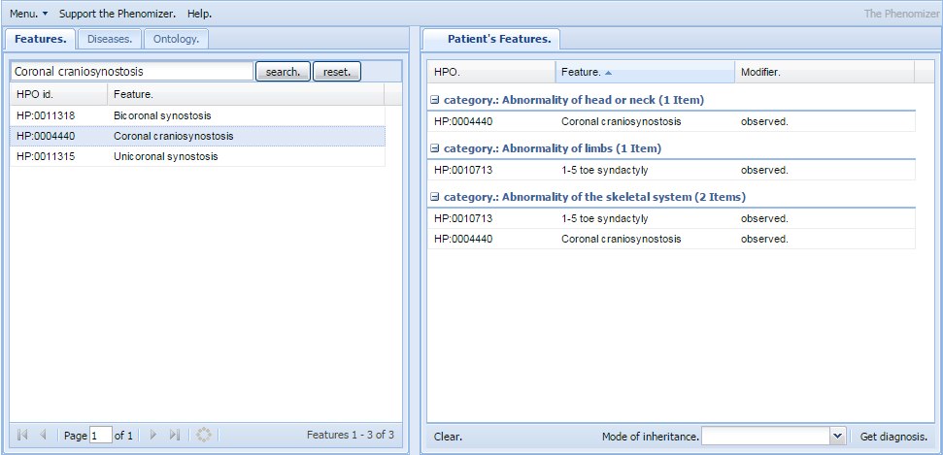
Mapping to HPO
Smaller models can be mapped manually using Phenomizer, HPO Browser or Phenotips
Bio-LarK provides a Concept recogniser tool as a REST API
Some manual revision is always necessary

Slide 25
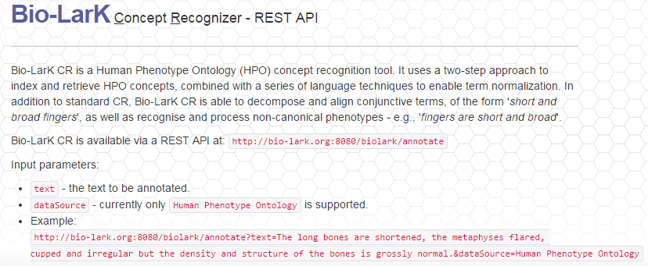
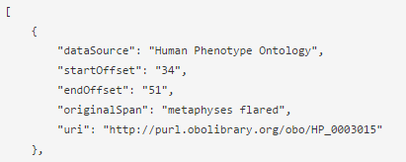
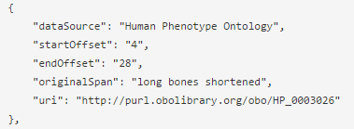
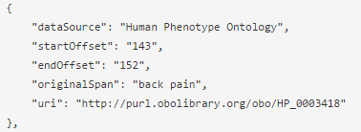

Slide 26
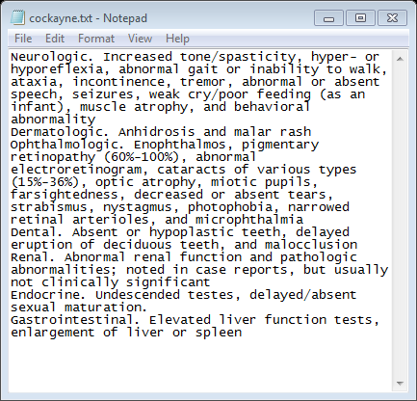
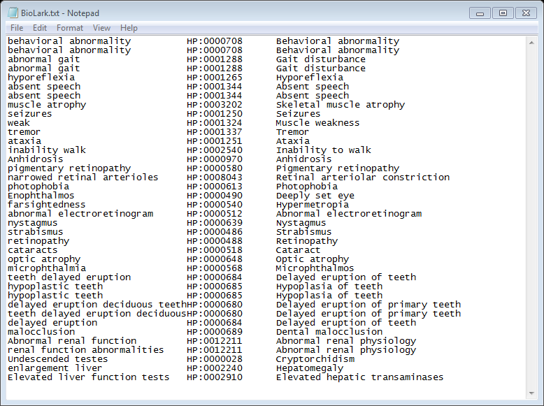
A more realistic BioLarK example

Slide 27
Revision
Clinical revision is vital
We are aiming to keep models below around 40 terms
We wish to present terms in a clinically logical order, reduce redundancy, too general or rare, and irrelevant
One method of keeping models shorter is replace terms in a sibling relationship with a common parent, or reduce terms in parent/child relationships to one term
Parent term
Child term A
Child term B
Child term C
Term
Sub-sub-term
Sub-term

Slide 28
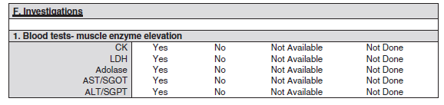
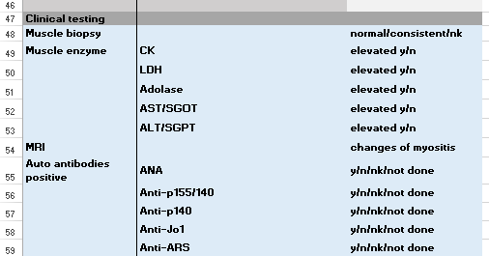
Clinical test data
Collected as HPO terms, but against our own catalogue, adding new terms if necessary

Slide 29
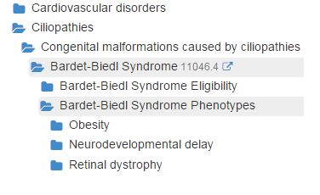
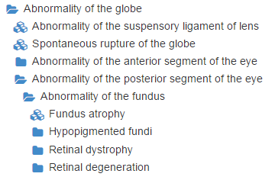
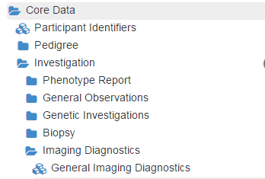

Implement in the Data Model Catalogue
This is a semantically enabled on-line catalogue which allows hierarchical models to be built, cross-linked and maintained
This ensures that classes and value domains remain independent
Disease tree
HPO tree
Clinical test tree

Slide 30
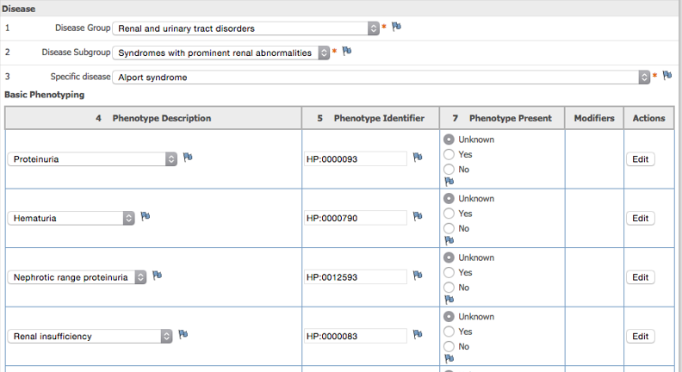
Implementation in OpenClinica

Slide 31
Measuring quality
Much of development to date has aimed to capture clinical knowledge
However feedback has required us to start looking at optimising the models
We also need to assess the quality of submitted data

Slide 32
Quality metrics
Simple metrics:
number of HPO terms
redundancy
too general/too rare
For submitted participants’ records we can assess:
number of entered items within the data model
the number of terms outside the model
Extent of modifiers
contradictions in entered data, e.g. Pterygium is present but there are no abnormalities of the skeletal system (they are both skin and skeletal abnormalities)

Slide 33
Sufficiency
Washington et al. () describe a quality metric in their paper – a scaled score – which aims to “assess the sufficiency of a phenotype profile, by investigating the necessary and sufficient information characteristics required to identify disease similarity based on phenotypes alone”
This is calculated using the Information Content of the phenotype terms chosen – this measures how informative a term is
This metric is built into Phenotips to guide a clinician in phenotyping a patient
Also available from the Monarch services website: http://monarchinitiative.org/page/services
We can use this is refine the data models and to assess the data collected for each participant

Slide 34
Conclusions from model development
Revision has been extensive…the models are evolving
HPO has proved comprehensive but some revision is needed
There is a need to choose between qualitative and quantitative representation of data – this seems to be a case-by-case decision
Some models cover more than one disease or set of features, and common observations can be separated out, but many diseases have required their own specific model
Clinical test data is often used by more than one model, and can be cross mapped to existing standards in some cases
Measurement of quality can now be introduced to data models and to collected data

Slide 35
Acknowledgements
Genomics England:
Mina Ryten
Richard Scott
Damian Smedley
Tim Hubbard
Ellen Thomas
Adam Milward
Ellen McDonagh
Katherine Smith
Tom Fowler
GMCs and GeCIP partners
NHSE, HSCIC
HPO

