Slide 1
Variant Filtering and Prioritisation
(VAAST and PHEVOR)
Dr Petra Proitsi
King’s College London
Institute of Psychiatry, Psychology & Neuroscience
February 2016

Slide 2
Lecture overview
Variant Filtering / Prioritisation challenges
VAAST
  Overview
  Pipeline example
PHEVOR
  Overview
  Pipeline example

Slide 3
NGS challenges
High-throughput next-generation sequencing (NGS) technology produces a tremendous amount of raw sequence data
Challenges
  process the raw data
  map the sequences to genome
  discover variants that are different from the reference genome
  prioritize/rank the variants for the question of interest
Number of tools are available
Still not trivial
Steps have assumptions which may influence results

Slide 4
NGS challenges
Usual workflow for disease gene filtering /prioritisation
  Raw sequence processing and mapping
  Variant discovery
  Disease filtering and/or prioritisation

Slide 5
NGS workflow tools
Usual workflow for disease gene filtering /prioritisation
  Raw sequence processing and mapping
      Preprocess FASTQ file: FASTQC, FASTX-Toolkit, Cutadapt
      Mapping: Bowtie2, BWA, Mosaik, MAQ, mrFAST, SOAP2 , Subread
      Recalibration: IndelRealigner in GATK toolkit, Picard, Samtools
  Variant discovery
    Variant discovery and genotyping: SAMtools, SNPTools, GATK UnifiedGenotyped and GATK HaplotypeCaller
    Genotype phasing and refinement: GATK PhaseByTransmission, GATK Read-BackedPhasing
  Disease filtering and/or prioritisation
    Annotation: VAAST, ANNOVAR (Open source) & Ingenenuity, Golden Helix etc (commercial)
    Severity prediction: SHIFT, BLOSOM62, Polyphen2, SNPA
    Filtering: ANNOVAR
    Ranking: VAAST
    Pathway analysis: KEGG, ADAVID, PANTHER
Notes:
The raw FASTQ file contains all of the raw sequences, some of which are of low quality. The overall quality should be evaluated, and the lower-quality reads should be removed before mapping to the reference genome to improve mapping efficiency.
Several recent studies provided a detailed description and comparison of the alignment programs [5, 13], although it could be difficult to choose among aligners, because benchmark results vary across studies
Unlike Phase 1 and Phase 2, which have largely converged to well-formed computation workflows and platform-free file formats (e.g., FASTQ, BAM, and VCF formats), Phase 3 has more variations in the tools and workflows to suit the different needs of various research or clinical projects.
Bowtie2 is often used for mapping ChIP-seq and RNA-seq data, and BWA is often used for mapping whole-genome/exome data.

Slide 6
VAAST (Variant Annotation Analysis and Search Tool)
Software suite for disease gene discovery from NGS data
Probabilistic disease-gene finder that combines amino acid substitution (AAS) and allele-frequency information to search for and prioritize genes harboring damaging alleles (Yandell et al., 2011)
Great accuracy, easy to use
Scores both coding and non-coding variants evaluating the cumulative impact of both types simultaneously
Incorporates robust models of cross-species sequence conservation (Hu et al., 2013)
Notes:
VAAST2.0, incorporates robust models of cross-species sequence conservation, which further improve the accuracy in differentiating between benign and disease-causing variation

Slide 7
VAAST
Package containing four primary tools
VAT (Variant Annotation Tool): calculates a rich set of annotations on the effects of variants have on genomic features based on terms described and constrained by the Sequence Ontology
  VST (Variant Selection Tool): filters combines and manipulates datasets
VAAST 2: A probabilistic search tool that uses the outputs of VAT and VST to identify damaged genes and their disease-causing variants in sets of unrelated personal genome sequences
pVAAST: Built on the VAAST 2 framework for pedigrees

Slide 8
VAAST
Small studies (publicly available controls and few cases)
  highly sensitive variant classifier and gene-prioritization tool
Rare Mendelian diseases segregating in small pedigrees
  identification of variants likely to be damaging and consistent with the expected inheritance pattern
Large studies with matched cases and controls
  robust, genome-wide rare variant association analysis that directly incorporates calibrated variant classification scores
pVAAST (pedigrees)
  highly flexible approach for pedigree analysis that supports a broad range of study designs (monogenic Mendelian diseases in a single family to polygenic, common diseases involving hundreds of families)
Implementation within OPAL

Slide 9
VAAST Workflow 1
Variant Calling
Prior to running VAAST
  Alignment
  Variant-calling (cases and controls should be called in the the same tool)
  Joint calling and missing genotypes
  Variant filtering and quality score recalibration
GVF (Genome Variation Format) conversion

Slide 10
VAAST Workflow 1
Variant Calling
Variant annotation (VAT)
Annotates the impact of variants on genomic variants based on terms and relationships described in the Sequence Ontology (SO) (Eilbeck et al., 2015)
It outputs its annotations in GVF format
VAT requires three files as inputs:
    a GFF3 file that contains sequence features;
    a FASTA file containing the genome’s sequence
    a GVF file containing the sequence alterations that will be annotated
VAT annotates the function of each variant in the GVF file when it overlaps a sequence feature in the provided GFF3 file

Slide 11
VAAST Workflow 1
Variant Calling
Variant_effect attribute is added to the the final column of the GVG file
The annotated GVF file with the added Variant_effect attribute provides impact on the alteration on sequnce features in 3 parts:
      Sequence_alterations
      Sequence_feature
      Sequence_variant
Additional information to many Variant_effect attributes available ththat provide more detail about a particular sequence_variant
Description of the SO terms and GVF format:http://www.sequenceontology.org
VAAST includes all files necessary to annotate variants in the human genome in NCBI builds 36 (hg18) and 37 (hg19)
Notes:
VAAST2.0, incorporates robust models of cross-species sequence conservation, which further improve the accuracy in differentiating between benign and disease-causing variation
All variant callers make both false-positive and false-negative errors in variant-calling.
However, the error profile produced by different variant callers (or even the same variant
caller with different parameters or different versions) can be quite different. If cases and
controls are not called with exactly the same variant-calling tool (including software version
and run-time parameters), these differences in systematic error can manifest as false-positive
results in VAAST.
VAAST is
specifically designed to make use of missing genotype information, which substantially
improves the signal-to-noise ratio in disease-gene searches (see Fig. 6.14.1). A
GVF is a file format developed by the Sequence Ontology group for use in
describing sequence variants that provides a computationally robust ontology-controlled
format for deeply annotating the effect of those variants on sequence features.

Slide 12
VAAST Workflow 1
Variant Calling
Variant selection (VST)
VST condenses variant files from multiple individuals into a single condenser file (CDR)
  A number of operations available (intersection, union etc)
  You can also set a cut-off for exclude or include variants based on how many people have them
Strict assumptions about the presence or absence of variants
  Special care should be taken to avoid errors introduced by missing data
  VST will filter missing genotypes
You can end up with a file that includes variants common to a number of individuals
A wrapper available to convert from VCF format

Slide 13
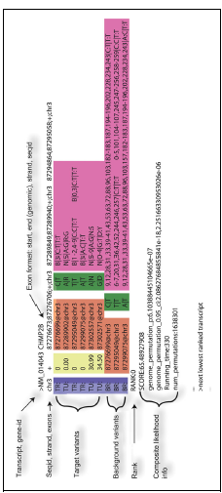
VAAST gene report

Slide 14
VAAST
Case-control example
266 Northern European Individuals
    256 controls
    10 cases with frontotemporal lobar degeneration
Two known disease-causing variants “doped” in cases as heterozygotes
Each of 10 individuals has 1 or 2 damaing variants
Both are missense variants in CHMP2B gene

Slide 15
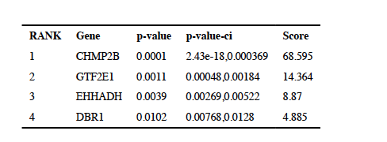
VAAST
Case-control example
Variant annotation of the GVF dataset (GFF3 and reference FASTA files required) (using VAT)
GVF files condensed to CDR file (using VST)
  Union of 10 affected individuals is taken
Scoring takes place (permutation)
Output file.simple file
Confidence interval for CHMP2B ranges from 2.4 × 10−18 to 0.000369 indicating that further permutation is necessary to accurately estimate the p-value.
The confidence intervals do not overlap between the first and second ranking gene, indicating
that the rank order is stable and is not likely to change with additional permutation
Notes:
VAAST2.0, incorporates robust models of cross-species sequence conservation, which further improve the accuracy in differentiating between benign and disease-causing variation
All variant callers make both false-positive and false-negative errors in variant-calling.
However, the error profile produced by different variant callers (or even the same variant
caller with different parameters or different versions) can be quite different. If cases and
controls are not called with exactly the same variant-calling tool (including software version
and run-time parameters), these differences in systematic error can manifest as false-positive
results in VAAST.
VAAST is
specifically designed to make use of missing genotype information, which substantially
improves the signal-to-noise ratio in disease-gene searches (see Fig. 6.14.1). A
GVF is a file format developed by the Sequence Ontology group for use in
describing sequence variants that provides a computationally robust ontology-controlled
format for deeply annotating the effect of those variants on sequence features.

Slide 16
VAAST
Case-control example
Interpretation
Rank: genes sorted by p-value
Score: VAAST score combines variant frequency data with AAS and phylogenetic conservation using a composite LRT. The higher the score the more likely the gene contains disease variants under the VAAST model. The VAAST score for each variant is reported
P-value: estimated using permutation test, comparing the VAAST score to the permuted score (VAAST2: 1+ number of successes to total number of permutations)
Confidence interval: Really important! IT is the 95% CI from the permutations assuming Poison distribution- it underlines uncertainty. The more permutations run the tighter the CI (trade off between accuracy and time)
Variant field: Lists the most likely disease-causing variants together with their VAAST score
Notes:
VAAST2.0, incorporates robust models of cross-species sequence conservation, which further improve the accuracy in differentiating between benign and disease-causing variation
All variant callers make both false-positive and false-negative errors in variant-calling.
However, the error profile produced by different variant callers (or even the same variant
caller with different parameters or different versions) can be quite different. If cases and
controls are not called with exactly the same variant-calling tool (including software version
and run-time parameters), these differences in systematic error can manifest as false-positive
results in VAAST.
VAAST is
specifically designed to make use of missing genotype information, which substantially
improves the signal-to-noise ratio in disease-gene searches (see Fig. 6.14.1). A
GVF is a file format developed by the Sequence Ontology group for use in
describing sequence variants that provides a computationally robust ontology-controlled
format for deeply annotating the effect of those variants on sequence features.

Slide 17
pVAAST
Pedigree example
Trio dataset consisting on 3 individuals from 1000 GP (two parents and their daughter) with mutations on CHMPB2 gene
We can use dominant or recessive inheritance and de novo models
VST or the VAAST – trio option very useful when family size is small and for recessive inheritance. It filters out variants found in the offsprings genome but not the parents
Mind! De novo mutations: about 70 true positive new mutations in each generation but Mendelian Inheritance Errors from NGS data X3fold
Also useful to identify de novo mutations
Notes:
VAAST2.0, incorporates robust models of cross-species sequence conservation, which further improve the accuracy in differentiating between benign and disease-causing variation
All variant callers make both false-positive and false-negative errors in variant-calling.
However, the error profile produced by different variant callers (or even the same variant
caller with different parameters or different versions) can be quite different. If cases and
controls are not called with exactly the same variant-calling tool (including software version
and run-time parameters), these differences in systematic error can manifest as false-positive
results in VAAST.
VAAST is
specifically designed to make use of missing genotype information, which substantially
improves the signal-to-noise ratio in disease-gene searches (see Fig. 6.14.1). A
GVF is a file format developed by the Sequence Ontology group for use in
describing sequence variants that provides a computationally robust ontology-controlled
format for deeply annotating the effect of those variants on sequence features.

Slide 18
VAAST summary
VAAST 2 thus has a much greater scope of use than any existing methodology to prioritize candidate disease genes in sets of unrelated affected genome sequences
Improvement to VAAST (using phylogenetic conservation data)
Can identify rare variants causing rare genetic diseases and both rare and common variants to identify genes causing common diseases
VAAST 2 shown to outperform other variant prioritization tools (KBAC, WSS, SKAT, and variable threshold (VT))
Notes:
VAAST2.0, incorporates robust models of cross-species sequence conservation, which further improve the accuracy in differentiating between benign and disease-causing variation
All variant callers make both false-positive and false-negative errors in variant-calling.
However, the error profile produced by different variant callers (or even the same variant
caller with different parameters or different versions) can be quite different. If cases and
controls are not called with exactly the same variant-calling tool (including software version
and run-time parameters), these differences in systematic error can manifest as false-positive
results in VAAST.
VAAST is
specifically designed to make use of missing genotype information, which substantially
improves the signal-to-noise ratio in disease-gene searches (see Fig. 6.14.1). A
GVF is a file format developed by the Sequence Ontology group for use in
describing sequence variants that provides a computationally robust ontology-controlled
format for deeply annotating the effect of those variants on sequence features.

Slide 19
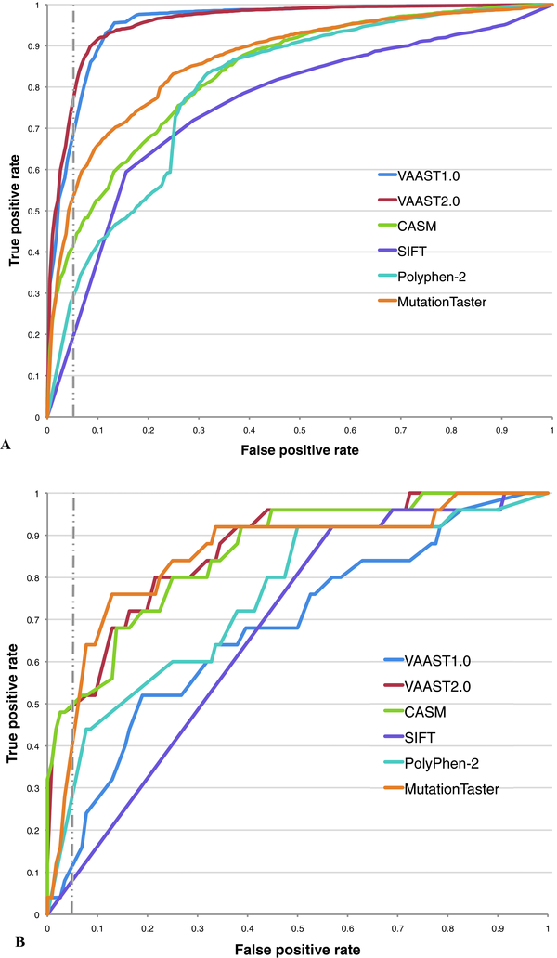
VAAST summary
ROC for the variant prioritization tools using two benchmark datasets:
(A) common and rare variants from HGMD and 1000 Genomes Project
(B) BRCA1 and BRCA2 rare variant set
Notes:
VAAST2.0, incorporates robust models of cross-species sequence conservation, which further improve the accuracy in differentiating between benign and disease-causing variation
All variant callers make both false-positive and false-negative errors in variant-calling.
However, the error profile produced by different variant callers (or even the same variant
caller with different parameters or different versions) can be quite different. If cases and
controls are not called with exactly the same variant-calling tool (including software version
and run-time parameters), these differences in systematic error can manifest as false-positive
results in VAAST.
VAAST is
specifically designed to make use of missing genotype information, which substantially
improves the signal-to-noise ratio in disease-gene searches (see Fig. 6.14.1). A
GVF is a file format developed by the Sequence Ontology group for use in
describing sequence variants that provides a computationally robust ontology-controlled
format for deeply annotating the effect of those variants on sequence features.

Slide 20
Phevor (Phenotype Driven Variant Ontological Re-ranking Tool)
NGS: thousands of variants, any one of which might be responsible for the person’s illness
Whole-genome and whole-exome tools such as VAAST great for identifying disease causing variants for case-control and family studies
Underpowered though for single affected individuals and small nuclear families
One solution is to narrow search of candidate genes in light of individuals phenotype
Notes:
VAAST2.0, incorporates robust models of cross-species sequence conservation, which further improve the accuracy in differentiating between benign and disease-causing variation
All variant callers make both false-positive and false-negative errors in variant-calling.
However, the error profile produced by different variant callers (or even the same variant
caller with different parameters or different versions) can be quite different. If cases and
controls are not called with exactly the same variant-calling tool (including software version
and run-time parameters), these differences in systematic error can manifest as false-positive
results in VAAST.
VAAST is
specifically designed to make use of missing genotype information, which substantially
improves the signal-to-noise ratio in disease-gene searches (see Fig. 6.14.1). A
GVF is a file format developed by the Sequence Ontology group for use in
describing sequence variants that provides a computationally robust ontology-controlled
format for deeply annotating the effect of those variants on sequence features.

Slide 21
Why Phevor?
More methods usually gather information ad-hoc
No general standards, procedures, or validated best practices
Genes not previously associated with the phenotype are not considered
Phevor: Integrates phenotype, gene function, and disease information with personal genomic data for improved power to identify disease-causing alleles
Combines outputs of widely used variant-prioritization tools: Human Phenotype Ontology (HPO), the Mammalian Phenotype Ontology (MPO), the Disease Ontology (DO) and the Gene Ontology (GO)
*Ontologies: graphical representations of knowledge, such as gene functions or human phenotypes
Notes:
VAAST2.0, incorporates robust models of cross-species sequence conservation, which further improve the accuracy in differentiating between benign and disease-causing variation
All variant callers make both false-positive and false-negative errors in variant-calling.
However, the error profile produced by different variant callers (or even the same variant
caller with different parameters or different versions) can be quite different. If cases and
controls are not called with exactly the same variant-calling tool (including software version
and run-time parameters), these differences in systematic error can manifest as false-positive
results in VAAST.
VAAST is
specifically designed to make use of missing genotype information, which substantially
improves the signal-to-noise ratio in disease-gene searches (see Fig. 6.14.1). A
GVF is a file format developed by the Sequence Ontology group for use in
describing sequence variants that provides a computationally robust ontology-controlled
format for deeply annotating the effect of those variants on sequence features.

Slide 22
Phevor
It propagates an individual’s phenotype information across and between biomedical ontologies
Accurately reprioritizes candidates identified by variant-prioritization tools in light of knowledge contained in the ontologies
Can discover emergent gene properties and latent phenotype information by combining ontologies, further improving its accuracy
Provides a general means of improving every tool’s performance
  variant-prioritization tools (SIFT)
  conservation-based tools (PhastCons)
  genome-wide search tools (VAAST2 and ANNOVAR)
It dynamically integrates knowledge from different databases to prioritize variants
Notes:
VAAST2.0, incorporates robust models of cross-species sequence conservation, which further improve the accuracy in differentiating between benign and disease-causing variation
All variant callers make both false-positive and false-negative errors in variant-calling.
However, the error profile produced by different variant callers (or even the same variant
caller with different parameters or different versions) can be quite different. If cases and
controls are not called with exactly the same variant-calling tool (including software version
and run-time parameters), these differences in systematic error can manifest as false-positive
results in VAAST.
VAAST is
specifically designed to make use of missing genotype information, which substantially
improves the signal-to-noise ratio in disease-gene searches (see Fig. 6.14.1). A
GVF is a file format developed by the Sequence Ontology group for use in
describing sequence variants that provides a computationally robust ontology-controlled
format for deeply annotating the effect of those variants on sequence features.

Slide 23
Phevor
It integrates ontologies that contain knowledge not explicitly linked to phenotype into the variant-prioritization process
It can discover disease-causing alleles in genes not previously associated with disease
Useful for single-exome and small, family-based analyses
These are the most commonly occurring clinical scenarios and ones for which variant-prioritization tools are most inaccurate/underpowered
Notes:
VAAST2.0, incorporates robust models of cross-species sequence conservation, which further improve the accuracy in differentiating between benign and disease-causing variation
All variant callers make both false-positive and false-negative errors in variant-calling.
However, the error profile produced by different variant callers (or even the same variant
caller with different parameters or different versions) can be quite different. If cases and
controls are not called with exactly the same variant-calling tool (including software version
and run-time parameters), these differences in systematic error can manifest as false-positive
results in VAAST.
VAAST is
specifically designed to make use of missing genotype information, which substantially
improves the signal-to-noise ratio in disease-gene searches (see Fig. 6.14.1). A
GVF is a file format developed by the Sequence Ontology group for use in
describing sequence variants that provides a computationally robust ontology-controlled
format for deeply annotating the effect of those variants on sequence features.

Slide 24
Phevor pipeline
Phenotype and Candidate-Gene Information
  Phenotypes drawn from HPO, or DO, MPO, GO and OMIM terms
  Phenomizer data also can be used for phenotype and gene list
Gene List assemply
  E.g. GO terms annotation
  HPO annotations
Ontology propagation
Notes:
All variant callers make both false-positive and false-negative errors in variant-calling.
However, the error profile produced by different variant callers (or even the same variant
caller with different parameters or different versions) can be quite different. If cases and
controls are not called with exactly the same variant-calling tool (including software version
and run-time parameters), these differences in systematic error can manifest as false-positive
results in VAAST.
VAAST is
specifically designed to make use of missing genotype information, which substantially
improves the signal-to-noise ratio in disease-gene searches (see Fig. 6.14.1). A
GVF is a file format developed by the Sequence Ontology group for use in
describing sequence variants that provides a computationally robust ontology-controlled
format for deeply annotating the effect of those variants on sequence features.

Slide 25
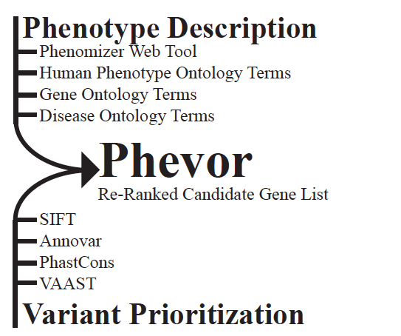
Phevor
1. Phenotype and Candidate-Gene Information
Notes:
All variant callers make both false-positive and false-negative errors in variant-calling.
However, the error profile produced by different variant callers (or even the same variant
caller with different parameters or different versions) can be quite different. If cases and
controls are not called with exactly the same variant-calling tool (including software version
and run-time parameters), these differences in systematic error can manifest as false-positive
results in VAAST.
VAAST is
specifically designed to make use of missing genotype information, which substantially
improves the signal-to-noise ratio in disease-gene searches (see Fig. 6.14.1). A
GVF is a file format developed by the Sequence Ontology group for use in
describing sequence variants that provides a computationally robust ontology-controlled
format for deeply annotating the effect of those variants on sequence features.

Slide 26
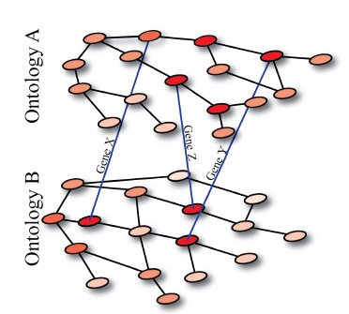
Phevor
2. Gene List Assembly
Notes:
All variant callers make both false-positive and false-negative errors in variant-calling.
However, the error profile produced by different variant callers (or even the same variant
caller with different parameters or different versions) can be quite different. If cases and
controls are not called with exactly the same variant-calling tool (including software version
and run-time parameters), these differences in systematic error can manifest as false-positive
results in VAAST.
VAAST is
specifically designed to make use of missing genotype information, which substantially
improves the signal-to-noise ratio in disease-gene searches (see Fig. 6.14.1). A
GVF is a file format developed by the Sequence Ontology group for use in
describing sequence variants that provides a computationally robust ontology-controlled
format for deeply annotating the effect of those variants on sequence features.

Slide 27
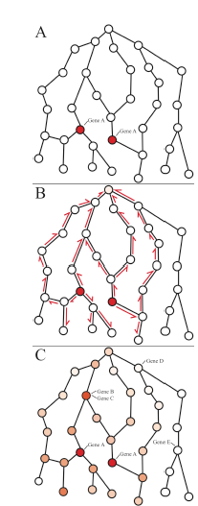
Phevor
3. Ontology propagation
Starting from a user-provided set of terms (nodes), supplemented by the cross-ontology linking procedure (2) Phevor propagates this across each ontology.
A) Hypothetical ontology, with two user provided
terms (nodes) shown in red. Gene A has been
annotated to both of these terms.
B)This information is propagated across the
ontology as illustrated in Panel B.
C) End result of the propagation process, with node colors corresponding to the magnitudes of their propagation scores, with red representing nodes with the greatest scores, white nodes with scores near zero.
Notes:
All variant callers make both false-positive and false-negative errors in variant-calling.
However, the error profile produced by different variant callers (or even the same variant
caller with different parameters or different versions) can be quite different. If cases and
controls are not called with exactly the same variant-calling tool (including software version
and run-time parameters), these differences in systematic error can manifest as false-positive
results in VAAST.
VAAST is
specifically designed to make use of missing genotype information, which substantially
improves the signal-to-noise ratio in disease-gene searches (see Fig. 6.14.1). A
GVF is a file format developed by the Sequence Ontology group for use in
describing sequence variants that provides a computationally robust ontology-controlled
format for deeply annotating the effect of those variants on sequence features.

Slide 28
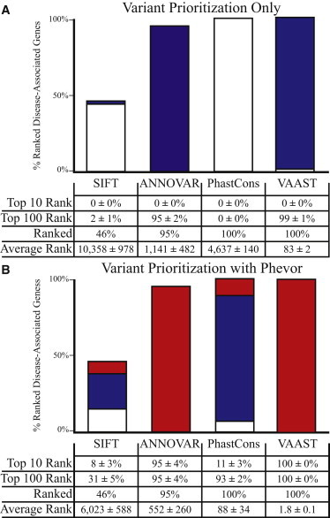
Phevor
Performance comparisons of four different variant-prioritization tools before (A) and after (B) postprocessing them with Phevor
Phevor dramatically improveds the performance of every tool benchmarked in Figure 1A.
Notes:
All variant callers make both false-positive and false-negative errors in variant-calling.
However, the error profile produced by different variant callers (or even the same variant
caller with different parameters or different versions) can be quite different. If cases and
controls are not called with exactly the same variant-calling tool (including software version
and run-time parameters), these differences in systematic error can manifest as false-positive
results in VAAST.
VAAST is
specifically designed to make use of missing genotype information, which substantially
improves the signal-to-noise ratio in disease-gene searches (see Fig. 6.14.1). A
GVF is a file format developed by the Sequence Ontology group for use in
describing sequence variants that provides a computationally robust ontology-controlled
format for deeply annotating the effect of those variants on sequence features.

Slide 29
Phevor example 1
These are based on recent Utah Genome Project cases
Proband is a 6-month-old infant with an undiagnosed liver disease phenotypically similar to progressive familial intrahepatic cholestasis
Exome sequencing was performed on the affected individual and both parents
For Phevor analyses, a single HPO phenotype term was used: “intrahepatic cholestasis” (HP:0001406).
Phevor analysis identified a single candidate gene (ABCB11) in the proband’s exome sequence.

Slide 30
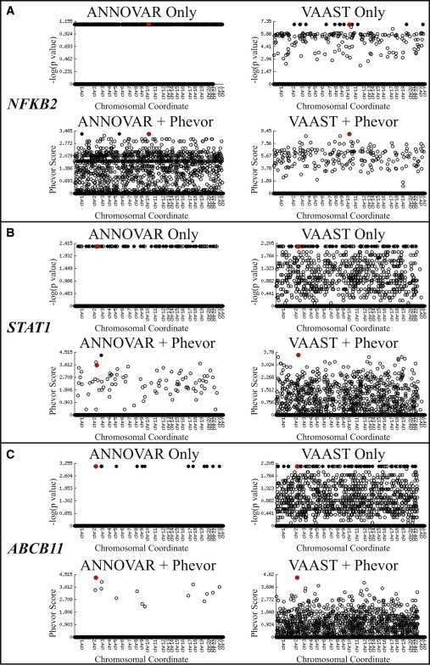
Phevor example 1
Phevor identified a mutation in ABCB11, a known disease-associated gene

Slide 31
Phevor example 2
Family affected by autosomal-dominant, early-onset hypogammaglobulinemia with variable autoimmune features and adrenal insufficiency
Blood samples were obtained from the affected mother, the unaffected father, their two affected children (family A), and a fourth, unrelated affected individual with the same phenotype (family B)
Exome data were analyzed with VAAST
Analysis with VAAST and ANNOVAR identified a number of genes
Amongst them was NFKB2

Slide 32
Phevor example 2
Phevor identified a single best candidate, NFKB2, by using the VAAST output
NFKB2 ranked 2nd with the ANNOVAR output
Functional follow-up studies established NFKB2—hence the noncanonical NF-κB signaling pathway—as a genetic etiology for this primary immunodeficiency syndrome

Slide 33
Phevor summary
Integrates phenotype, gene function, and disease information with personal genomic data for improved power to identify disease-causing alleles
Works by combining knowledge resident in multiple biomedical ontologies with the outputs of variant-prioritization tools
It uses an algorithm that propagates information across and between ontologies
Accurately reprioritizes potentially damaging alleles identified by variant-prioritization tools in light of gene function, disease, and phenotype knowledge
Phevor2 is now used

Slide 34
References
http://www.yandell-lab.org/software/index.html
Kennedy B, Kronenberg Z, Hu H, Moore B, Flygare S, Reese MG, Jorde LB, Yandell M, Huff C. Using VAAST to Identify Disease-Associated Variants in Next-Generation Sequencing Data. Curr Protoc Hum Genet. 2014 Apr 24;81:6.14.1-6.14.25. doi: 10.1002/0471142905.hg0614s81. PubMed PMID: 24763993.
Hu H, Roach JC, Coon H, Guthery SL, Voelkerding KV, Margraf RL, Durtschi JD, Tavtigian SV, Shankaracharya, Wu W, Scheet P, Wang S, Xing J, Glusman G, Hubley R, Li H, Garg V, Moore B, Hood L, Galas DJ, Srivastava D, Reese MG, Jorde LB, Yandell M, Huff CD. A unified test of linkage analysis and rare-variant association for analysis of pedigree sequence data. Nat Biotechnol. 2014 Jul;32(7):663-9. doi: 10.1038/nbt.2895. Epub 2014 May 18. PubMed PMID: 24837662
Hu H, Huff CD, Moore B, Flygare S, Reese MG, Yandell M. VAAST 2.0: improved variant classification and disease-gene identification using a conservation-controlled amino acid substitution matrix. Genet Epidemiol. 2013 Sep;37(6):622-34. doi: 10.1002/gepi.21743. Epub 2013 Jul 8. PubMed PMID: 23836555.
Singleton MV, Guthery SL, Voelkerding KV, Chen K, Kennedy B, Margraf RL, Durtschi J, Eilbeck K, Reese MG, Jorde LB, Huff CD, Yandell M. Phevor combines multiple biomedical ontologies for accurate identification of disease-causing alleles in single individuals and small nuclear families. Am J Hum Genet. 2014 Apr 3;94(4):599-610. doi: 10.1016/j.ajhg.2014.03.010. PubMed PMID: 24702956.

